Slide 1
WebVR - Bringing Virtual Reality to the Web
2017. 04. 26
2017.4.26
CHHEANG VUTHEA and Kwan-Hee Yoo
Chungbuk National University

Slide 2
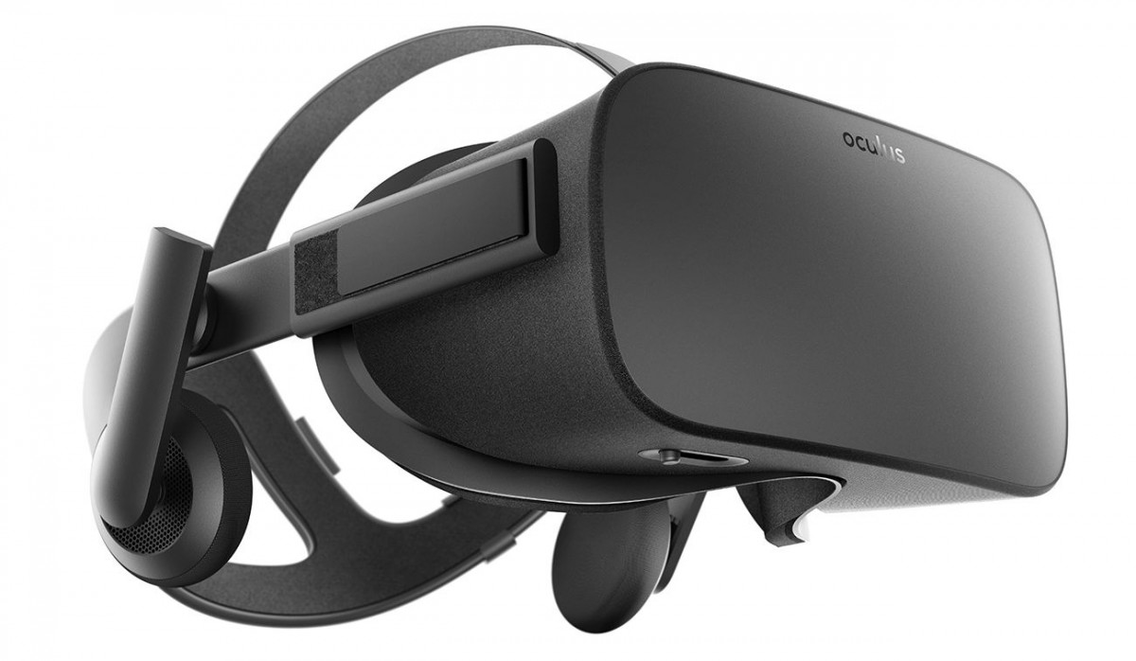
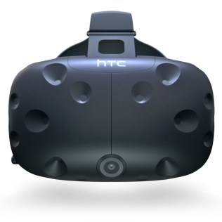
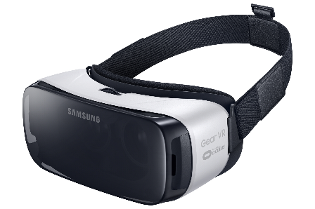
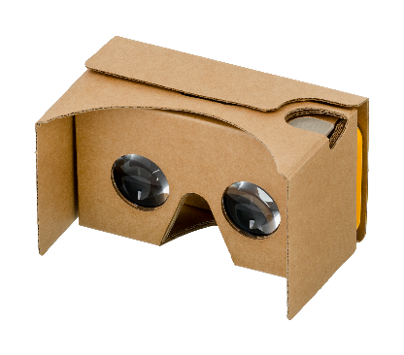
Introduction
WebVR is an experimental JavaScript API that provides access to Virtual Reality devices, such as the Oculus Rift, HTC Vive, Samsung Gear VR, or Google Cardboard, in your browser.
Oculus Rift
HTC Vive
Samsung Gear VR
Google Cardboard

Slide 3
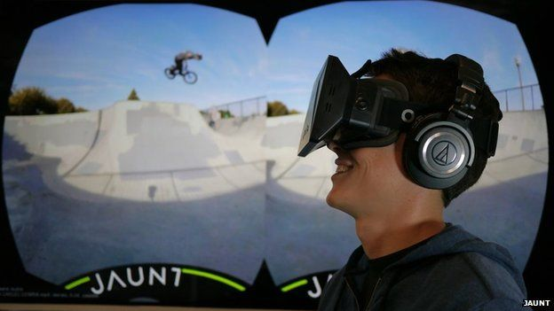
WHAT IS VIRTUAL REALITY?
Virtual Reality refers to a high-end user interface that involves real-time simulation and interactions through multiple sensorial channels.
Virtual Reality means feeling an imaginary (virtual) world, rather than the real one. The imaginary world is a simulation running in a computer.
Virtual Reality allows a user to interact with a computer-simulated environment, be it a real or imagined one.

Slide 4
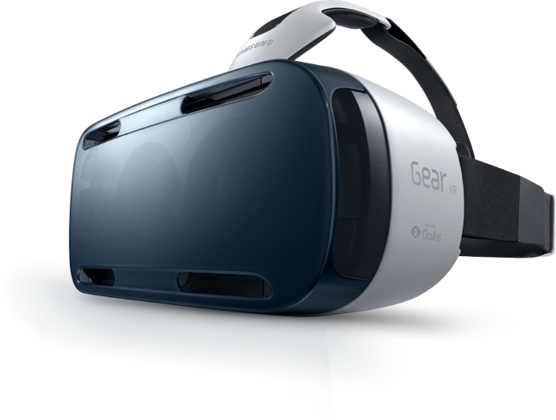
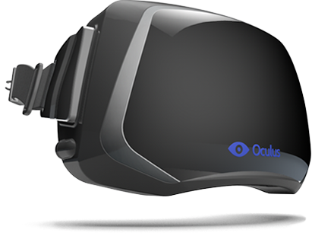
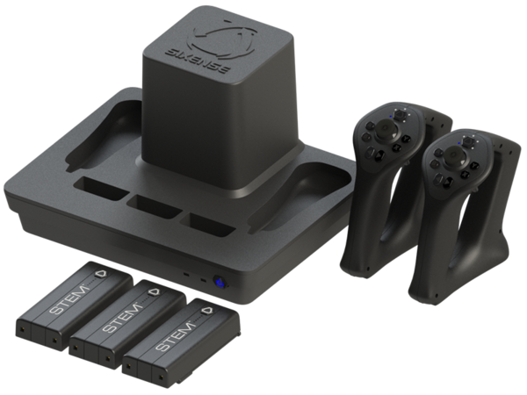
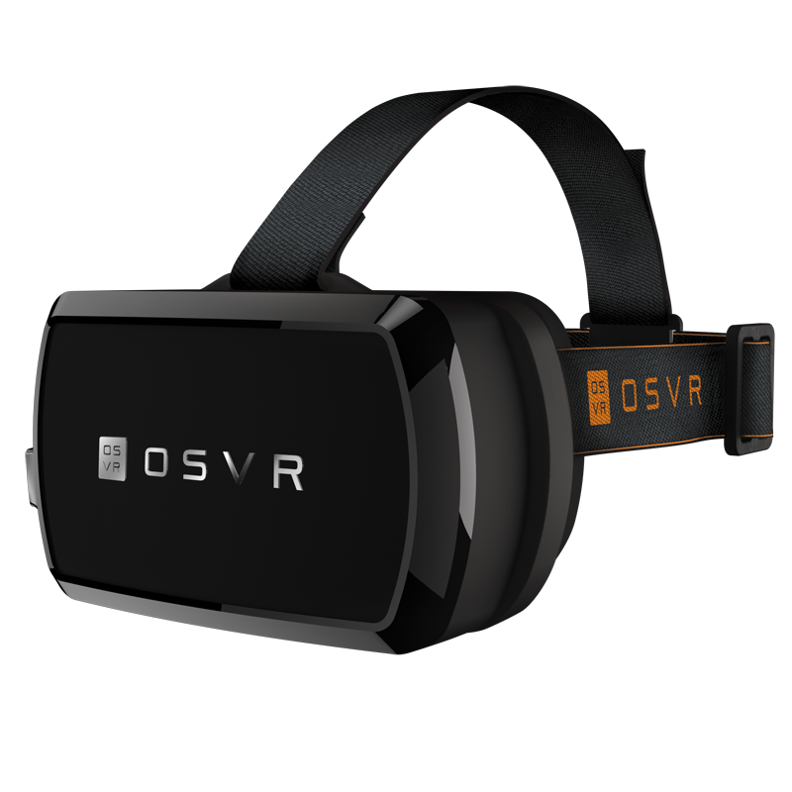
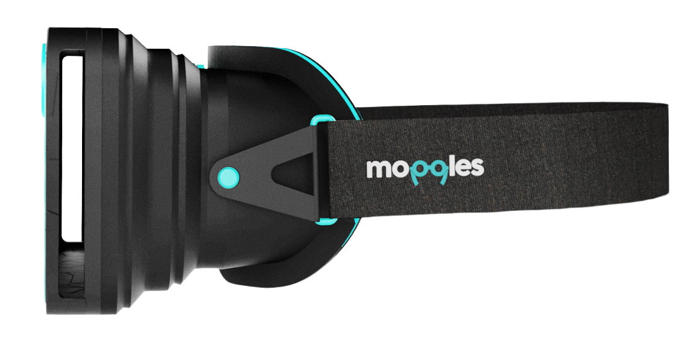
VR hardware explosion
Increasing of Virtual reality hardware
Affordable stereoscopic displays
Head Mounted Display
Motion tracking
Head tracking
VR input devices
VR HMD devices

Slide 5
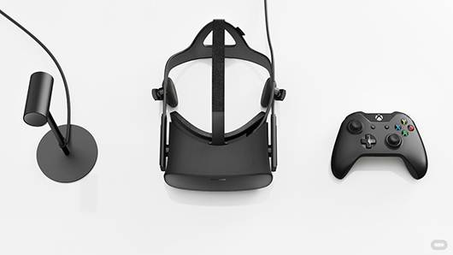
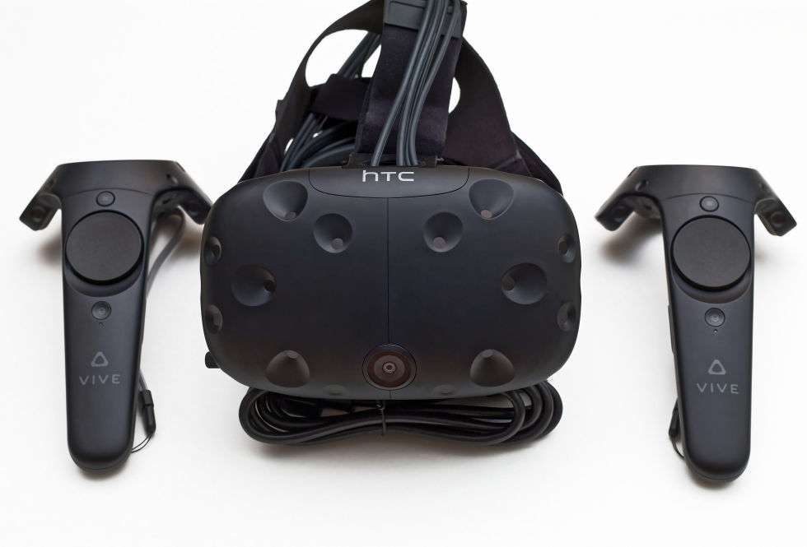
PC HMDs
PC HMDs refer to Desktop peripheral acts as external monitor
Provide deepest, most immersive VR
Position and orientation tracking
Tethered – one or more cables connect to computer such as camera for position tracking
Oculus Rift
HTC VIVE

Slide 6
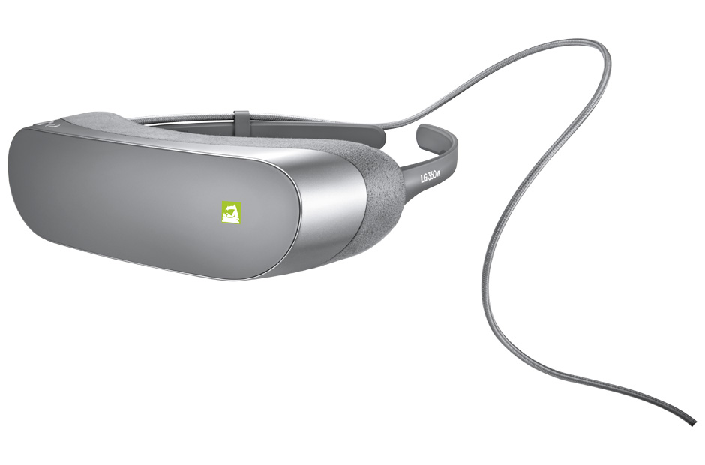
Mobile HMDs
Custom Android build/ Oculus mobile SDK
Orientation tracking only
Support for S6 coming – Samsung Gear VR
Support for LG G5 – LG VR
110 diagonal FOV – Gear VR
1000hz refresh rate – Gear VR
Samsung Gear VR
LG VR

Slide 7
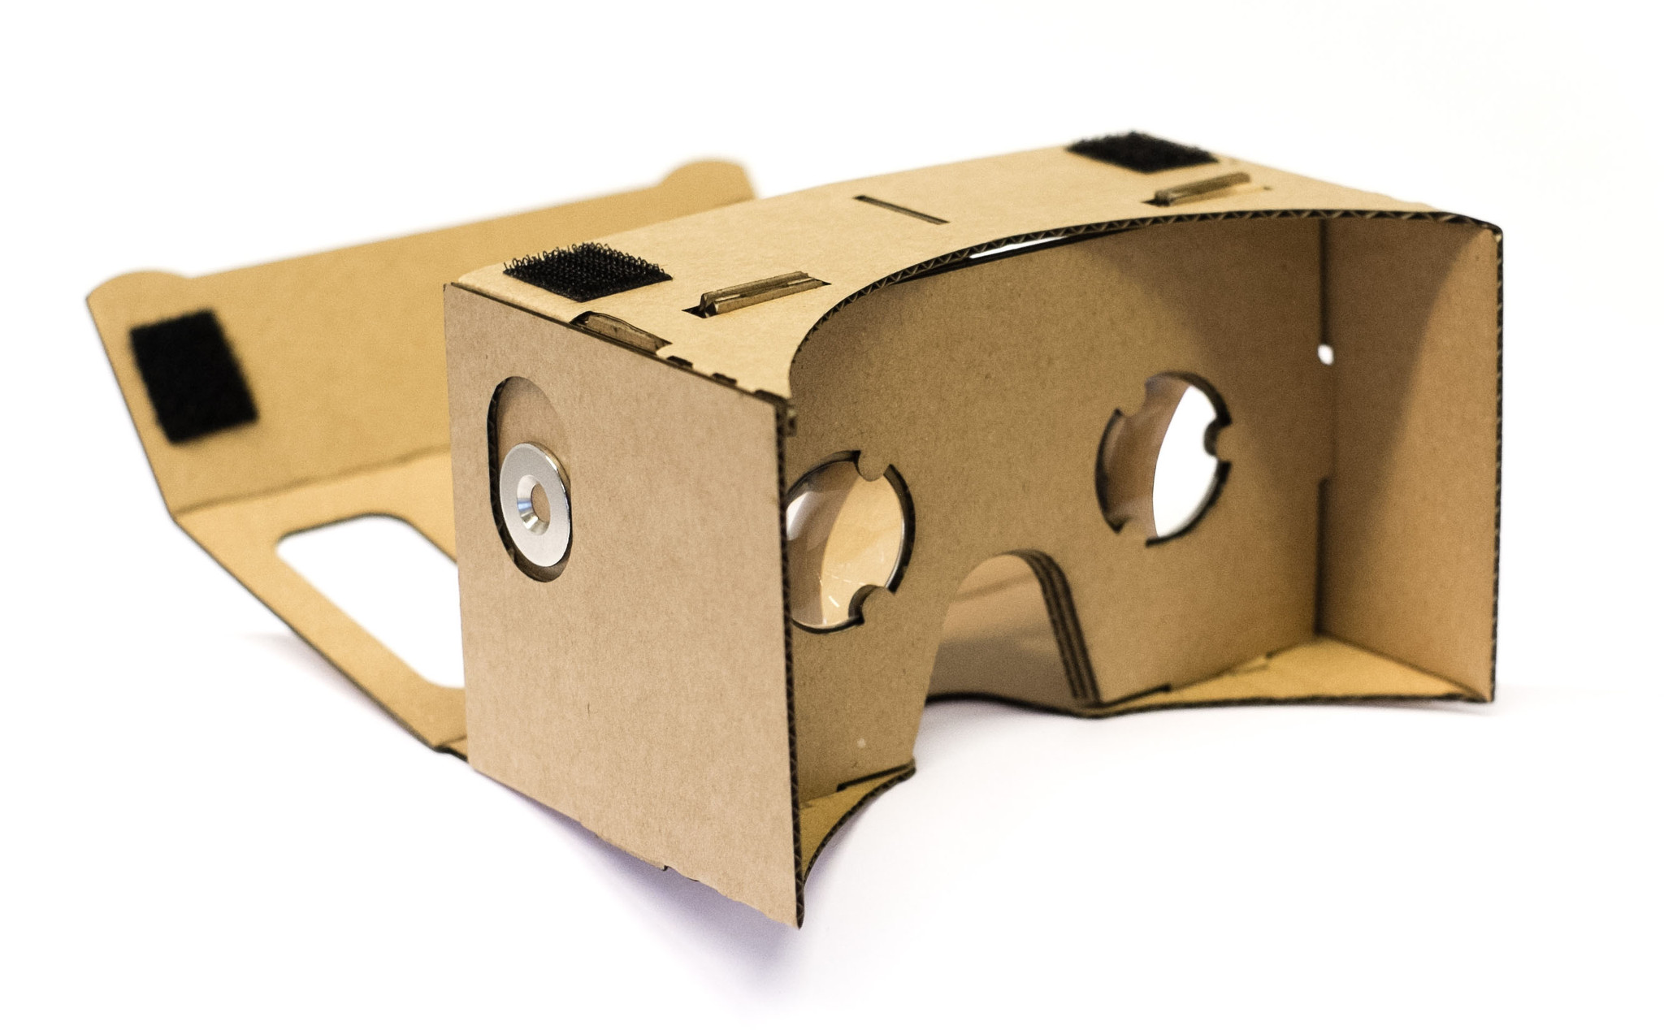
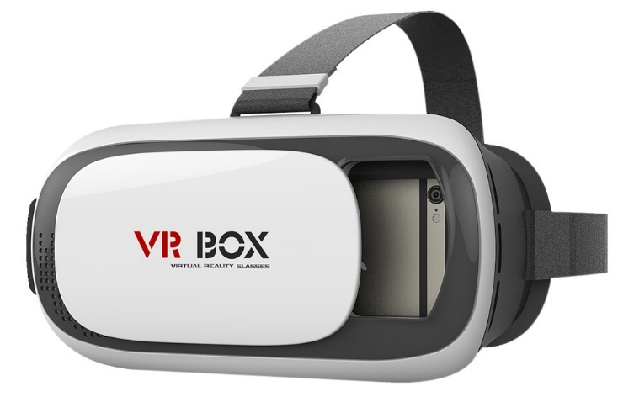
Drop-in phone viewers
Open specification for mobile VR
Orientation tracking only
Standard Android, iOS support, using simple stereo rendering and accelerometer tracking
Just add SmartPhone
90 degree FOV – Cardboard
200hz refresh rate
Google Cardboard
VR BOX

Slide 8
Specification of HMD Devices
Category | Gear VR | Oculus Rift | LG 360 VR | HTC VIVE | Sony PS VR
Display | 2560x1440 1280 x 1440 per eye Super AMOLED | 2160 x 1200 1080 x 1200 per eye OLED | 1.88" IPS LCD x 2 EA, 920 x 720 per Eye, 639 ppi Real RGB | 2560x1200 1080 x 1200 per eye OLED | 1920 x 1080 960x1080 per eye OLED
Refresh rate | 60 Hz | 90 Hz | 60 Hz | 90 Hz | 120 Hz, 90 Hz
Sensors | Accelerator,​ gyrometer, geomagnetic, proximity | Accelerometer, gyroscope, magnetometer, 360-degree positional tracking | 6-axis (Gyro & Accelerometer) Proximity Sensor | Accelerometer, gyroscope, laser position sensor, front-facing camera | 360 degree tracking, 9 LEDs
Field of view | 96 degrees | 110 degrees | Horizontal FOV (field-of-view) 80° lens | 110 degrees | 100 degrees
Controller | Bluetooth controller | Oculus Touch, Xbox One controller | G5 as handheld remote control | Vive Controllers, SteamVR controller, any PC-compatible gamepad | Sony DUALSHOCK 4 controller or PlayStation Move
Tracking area | Fixed position | 5 x 11 feet | Fixed position | 15 x 15 feet | 10 x 10 feet
Minimum hardware requirements | Samsung Galaxy Note 5, Galaxy S6 series, or Galaxy S7 series | NVIDIA GeForce GTX 970 or AMD Radeon R9 290 GPU, Intel Core i5-4590 CPU, 8GB RAM, HDMI 1.3, 2x USB 3.0 | LG G5 | NVIDIA GeForce GTX 970 or AMD Radeon R9 290 GPU, Intel Core i5-4590 CPU, 4GB RAM, HDMI 1.3, USB 2.0 | Sony Playstation 4

Slide 9

Web Today
Instant access
Instant publishing
No barriers to entry
Access any where any time
Easy for development (HTML, CSS, JavaScript)
Source code

Slide 10
WebVR
WebVR is an open standard that makes it possible to experience VR in browser. The goal is to make it easier for everyone to get into VR experiences, no matter what device is.
The WebVR API provides purpose-built interfaces to VR hardware to allow developers to build compelling, comfortable VR experiences.
Hardware that enables Virtual Reality applications requires high-precision, low-latency interfaces to deliver an acceptable experience.

Slide 11
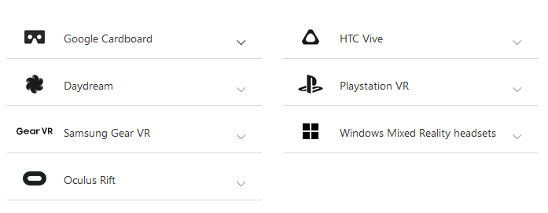
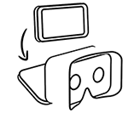
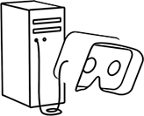

WebVR Support
The easiest way to get started is with a basic headset like Google Cardboard. Just drop your phone in and you’re ready to go. You can also use your phone with more advanced headsets like Samsung Gear VR and Google Daydream.
For the best performance and most features, you can use a VR headset connected to a computer, like Oculus Rift or HTC VIVE. Those will allow for higher framerates, higher resolutions, and even let you walk around in VR.
Or, on some sites, you can just use your computer or phone without a headset. You won’t be able to see in 3D or interact as fully in most VR worlds, but you can still look around in 360 degrees.

Slide 12
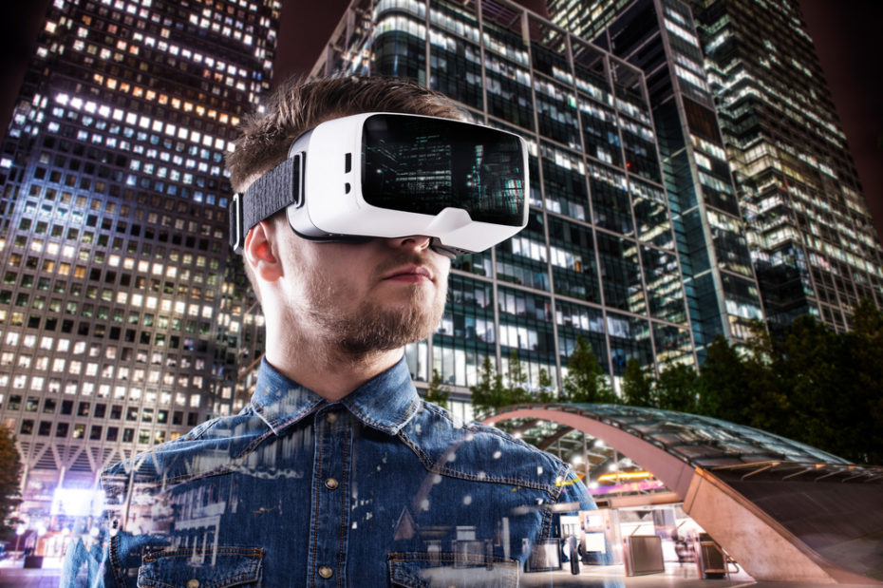

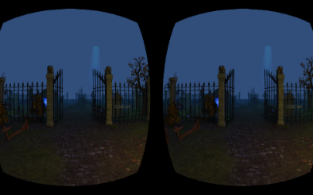
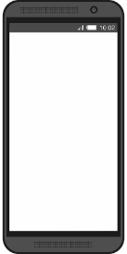
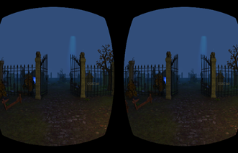
WebVR = Web + VR
Oculus VR
  Build Oculus VR apps in JavaScript
  All in browser – Chrome, Firefox or Samsung Internet
  Browser for GearVR
  Rendered in WebGL
  Head-tracking and full screen VR support in browser dev builds
Google cardboard
  Run on mobile browser
  Stereo rendering with Google cardboard VR
  Head tracking with phone’s accelerometer

Slide 13
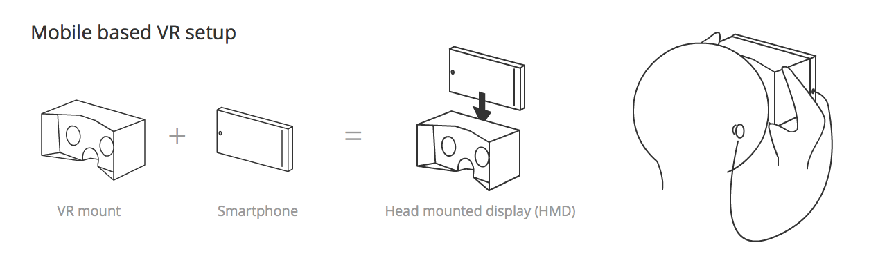
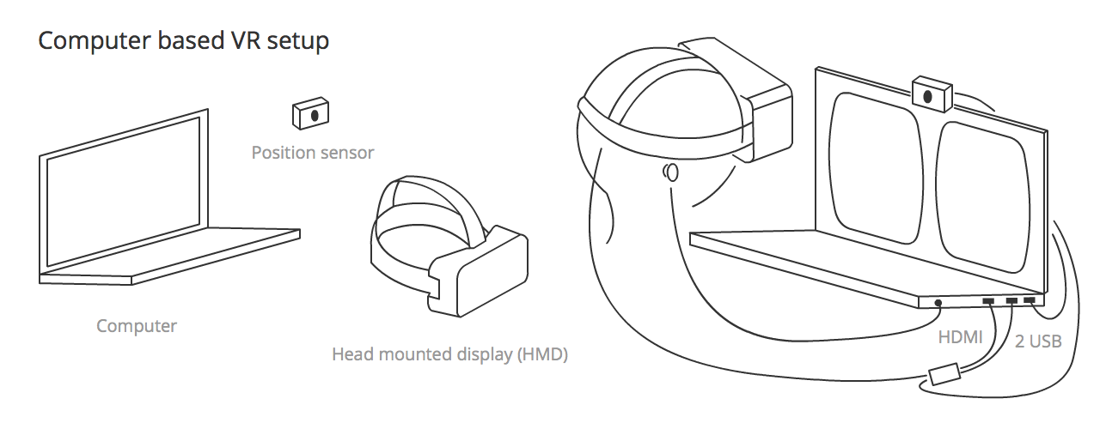
WebVR Concept

Slide 14
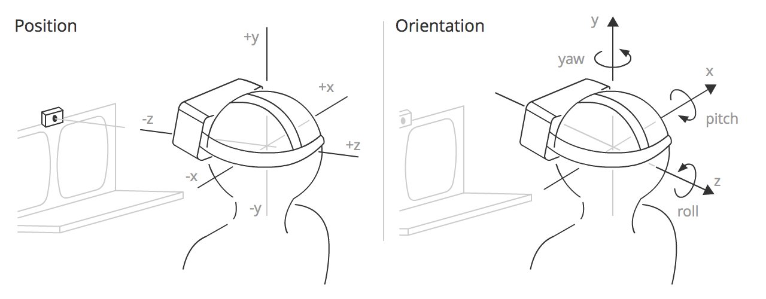
WebVR Concept
- Position — The position of the HMD along three axes in a 3D coordinate space. x is to the left and right, y is up and down, and z is towards and away from the position sensor.
- Orientation — The rotation of the HMD around three axes in a 3D coordinate space. Pitch is rotation around the x axis, yaw is rotation around the y axis, and roll is rotation around the z axis.

Slide 15
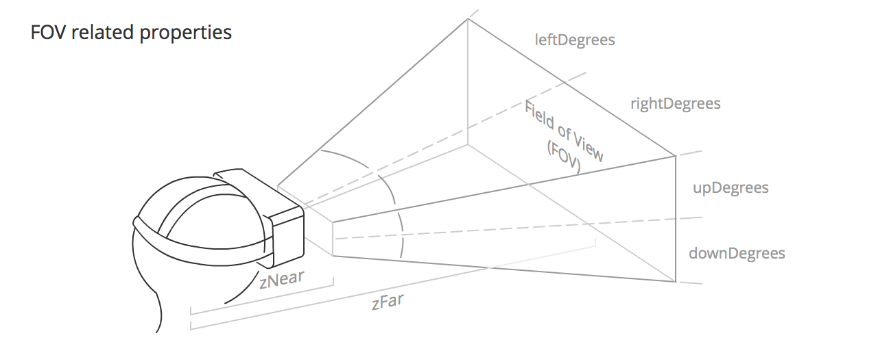
WebVR Concept
- The field of view (FOV) is the area that each of the user's eyes can reasonably be expected to see. It roughly takes the form of a pyramid shape, laid down on one side, with the apex inside the user's head, and the rest of the pyramid eminating from the user's eye. Each eye has it's own FOV, one slightly overlapping the other.

Slide 16
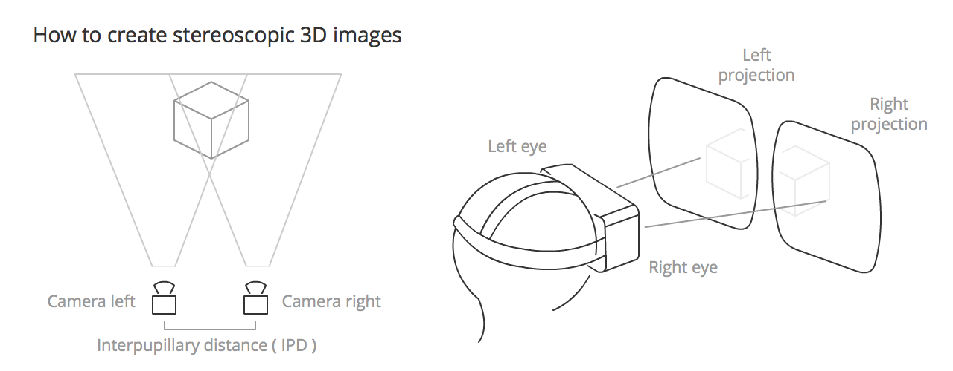
WebVR Concept
Stereoscopic vision is the normal vision humans and (most) animal have. The perception of two slightly differing images (one from each eye) as a single image. This results in depth perception, helping us to see the world in glorious 3D. To recreate this in VR apps, we need to render two very slightly different views side by side, which will be taken in by the left and right eyes when the user is using the HMD.

Slide 17
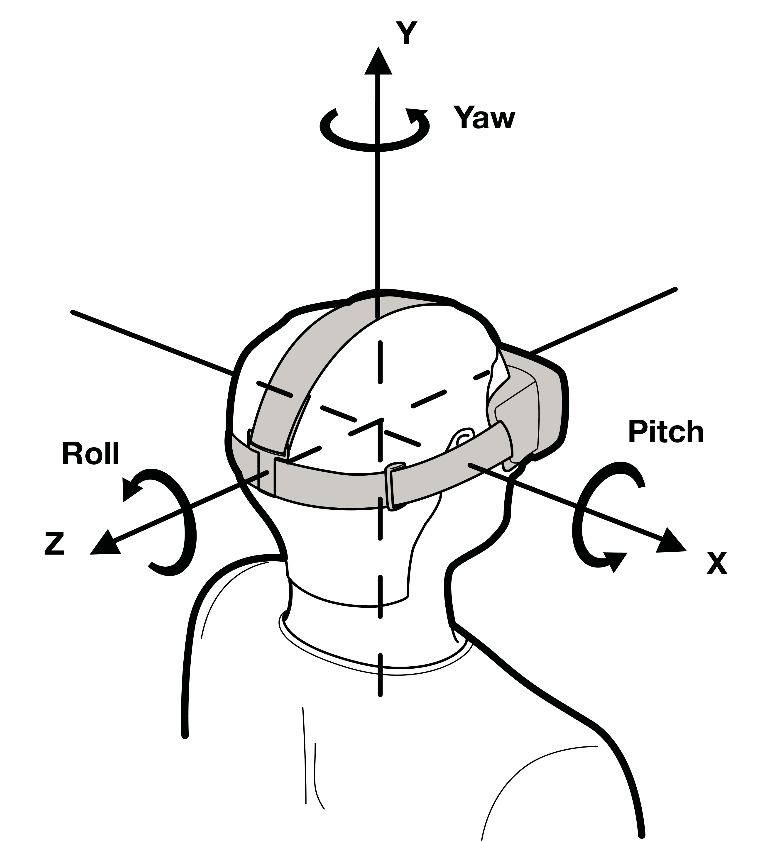
WebVR Concept
Head Tracking
- The primary technology used to make you feel present in a 360º scene, thanks to the gyroscope, accelerometer, and magnetometer (compass) included in the HMD.
- It has primary relevance because it makes our eyes believe we are in front of a spherical screen, giving users realistic immersion inside the app canvas.

Slide 18
WebVR Concept
Latency
Latency is the time between the physical head movement and the visual display reaching the user's eyes from the screen of an HMD being updated. This is one of the most critical factors in providing a realistic experience. Humans can detect very small delays — we need to keep the latency below 20 milliseconds if they are to be imperceptible (for example a 60Hz monitor has a 16 ms response.)
The Oculus Rift headset has a latency of 20 ms or less, but with mobile device-based setups it will depend heavily on the smartphone CPU power and other capabilities.

Slide 19
WebVR Concept
Framerate ( Frames per second / FPS )
Framerate is the frequency at which an imaging device produces unique consecutive images, called frames. A rate of 60fps is an acceptable rate for a smooth user experience, but depending on the performance of the machine the app is running on, or the complexity of the content you want to show, it can drastically lower. Less than 30fps is generally considered jittery, and annoying to the user.

Slide 20
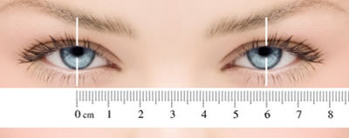
WebVR Concept
Interpupillary distance ( IPD )
IPD is the distance between the centers of the pupils of the two eyes. IPD is critical for the design of binocular viewing systems, where both eye pupils need to be positioned within the exit pupils of the viewing system.
Interpupillary distace ( IPD ) is represented by VREyeParameters.eyeTranslation in WebVR.

Slide 21
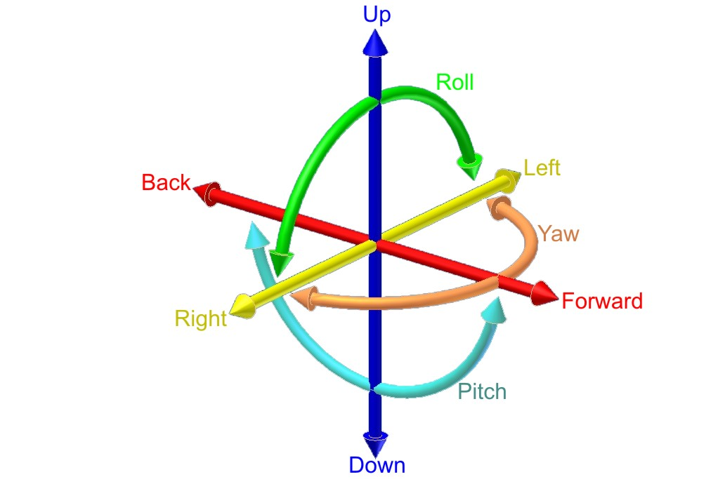
WebVR Concept
Degrees of Freedom ( DoF )
DoF refers to the movement of a rigid body inside space. There is no uniformity in creating acronyms for this term — we can find references to 3DoF in the context of sensors that detect only rotational head tracking, and 6DoF when an input allows us to control position and orientation simultaneously.
DoF is directly related to the tracking of the user's head movement.

Slide 22


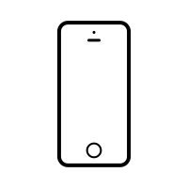





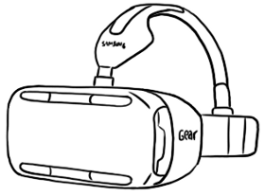


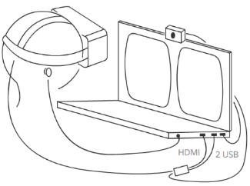
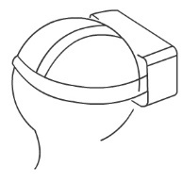
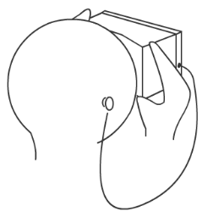
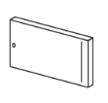


Global Scheme of WebVR
WebVR
Computer
Smartphone
Mouse
Oculus Rift
Gear VR
Cardboard
Gyroscope
Touch
VRDisplay
VRLayerInit
VRDisplayCapabilities
VREye
VRFieldOfView
VRPose
VRFrameData
VREyeParameter
VRStageParameter
Navigator Interface
Window Interface
Gamepad Interface
VRDisplayEventReason
VRDisplayDisplayEvent

Slide 23
Global functions in WebVR
VRDisplay : forms the base of all VR devices supported by this API. It includes generic information such as device IDs and descriptions.
VRLayerInit : interface is provided layer to a VRDisplay and presented in the HMD.
VRDisplayCapabilities : describes the capabilities of a VRDisplay. These are expected to be static per-device/per-user.
VREye : Provides enumeration of eye left and right.
VREyeParameters : represents all the information required to correctly render a scene for a given eye.
VRFieldOfView : represents a field of view, as given by 4 degrees describing the view from a center point.
VRPose : represents a sensor’s state at a given timestamp.
VRStageParameters : represents the values describing the stage/play area for devices that support room-scale experiences.

Slide 24
Global functions in WebVR
VRFrameData : The VRFrameData interface represents all the information needed to render a single frame of a VR scene..
Navigator Interface extension : Return a Promise which resolves to a list of available VRDisplays.
VRDisplayEventReason : Contains the enum value of mounted, navigation, requested, and unmounted.
VRDisplayEvent : The VRDisplay associated with this event.
Window Interface extension : User agents implementing this specification MUST provide the following new DOM events. The corresponding events must be of type VRDisplayEvent and must fire on the window object.
Gamepad Interface extension: Return the displayId of the VRDisplay this Gamepad is associated with.

Slide 25
VRDisplay
The VRDisplay interface forms the base of all VR devices supported by this API. It includes generic information such as device IDs and descriptions.
isConnected The isConnected attribute MUST return the VRDisplay's connected state.
isPresenting The isPresenting attribute MUST return the VRDisplay's presentation state.
Capabilities The capabilities attribute MUST return the VRDisplay's VRDisplayCapabilities object, a dictionary of capabilities describing the VRDisplay.
getEyeParameters() Returns the current VREyeParameters for the given eye.
getFrameData() Populates the provided VRFrameData object with the VRPose and view and projection matricies for the current frame.
getPose() Returns a VRPose describing the position, orientation, acceleration, and velocity of the VRDisplay.

Slide 26
VRDisplay
resetPose() Reset the pose for the VRDisplay, treating its current position and orientation as the "origin/zero" values.
requestAnimationFrame() Functionally equivalent to window.requestAnimationFrame when the VRDisplay is not presenting.
cancelAnimationFrame() Passing the value returned by requestAnimationFrame() to will unregister the callback.
requestPresent() Begins presenting the contents of the specified VRLayerInit array on the VRDisplay and fulfills the returned promise when presentation has begun.
exitPresent() Ends presentation to the VRDisplay and fulfills the returned promise when fully exited. If the VRDisplay is not presenting the promise MUST be rejected.
getLayers() Returns an array with the VRLayerInit currently being presented.
submitFrame() Captures the current state of the VRLayerInit currently being presented and displays it on the VRDisplay.

Slide 27
VRLayerInit
The VRLayerInit interface is provided to a VRDisplay and presented in the HMD.
source The source attribute defines the canvas whose contents will be presented by the VRDisplay when VRDisplay.submitFrame() is called.
leftBounds The leftBounds attribute contains four values defining the texture bounds within the source canvas to present to the eye in UV space: [0] left offset of the bounds (0.0 - 1.0); [1] top offset of the bounds (0.0 - 1.0); [2] width of the bounds (0.0 - 1.0); [3] height of the bounds (0.0 - 1.0). The leftBounds MUST default to [0.0, 0.0, 0.5, 1.0].
rightBounds The rightBounds attribute contains four values defining the texture bounds rectangle within the source canvas to present to the eye in UV space: [0] left offset of the bounds (0.0 - 1.0); [1] top offset of the bounds (0.0 - 1.0); [2] width of the bounds (0.0 - 1.0); [3] height of the bounds (0.0 - 1.0). The rightBounds MUST default to [0.5, 0.0, 0.5, 1.0].

Slide 28
VRDisplayCapabilities
The VRDisplayCapabilities interface describes the capabilities of a VRDisplay. These are expected to be static per-device/per-user.
hasPosition The hasPosition attribute MUST return whether the VRDisplay is capable of tracking its position.
hasOrientation The hasOrientation attribute MUST return whether the VRDisplay is capable of tracking its orientation.
hasExternalDisplay The hasExternalDisplay attribute MUST return whether the VRDisplay is separate from the device’s primary display.
canPresent The canPresent attribute MUST return whether the VRDisplay is capable of presenting content to an HMD or similar device.
maxLayers Indicates the maximum length of the array that requestPresent() will accept. MUST be 1 if canPresent is true, 0 otherwise.

Slide 29
VRPose
The VRPose interface represents a sensor’s state at a given timestamp.
position Position of the VRDisplay as a 3D vector.
linearVelocity Linear velocity of the sensor given in meters per second in sitting space. MAY be null if the sensor is incapable of providing linear velocity. When not null MUST be a three-element array.
linearAcceleration Linear acceleration of the sensor given in meters per second squared in sitting space. orientation Orientation of the sensor as a quaternion.
angularVelocity Angular velocity of the sensor given in radians per second in sitting space.
angularAcceleration Angular acceleration of the sensor given in radians per second squared in sitting space.

Slide 30
VRFrameData
VRFrameData interface represents all the information needed to render a single frame of a VR scene.
timestamp Monotonically increasing value that allows the author to determine if position state data been updated from the hardware.
leftProjectionMatrix A 4x4 matrix describing the projection to be used for the left eye’s rendering, given as a 16 element array in column major order.
leftViewMatrix A 4x4 matrix describing the view transform to be used for the left eye’s rendering, given as a 16 element array in column major order.
rightProjectionMatrix A 4x4 matrix describing the projection to be used for the right eye’s rendering, given as a 16 element array in column major order.
rightViewMatrix A 4x4 matrix describing the view transform to be used for the right eye’s rendering, given as a 16 element array in column major order.
pose The VRPose of the VRDisplay at timestamp.

Slide 31
VRFieldOfView
  VRFieldOfViewReadOnly.upDegrees: The number of degrees upwards that the field of view extends in.
  VRFieldOfViewReadOnly.rightDegrees: The number of degrees to the right that the field of view extends in.
  VRFieldOfViewReadOnly.downDegrees: The number of degrees downwards that the field of view extends in.
  VRFieldOfViewReadOnly.leftDegrees: The number of degrees to the left that the field of view extends in.

Slide 32
VREyeParameters
VREyeParameters.offset Read only Represents the offset from the center point between the user's eyes to the center of the eye, measured in meters.
VREyeParameters.fieldOfView Read only Describes the current field of view for the eye, which can vary as the user adjusts their interpupillary distance (IPD).
VREyeParameters.renderWidth Read only Describes the recommended render target width of each eye viewport, in pixels.
VREyeParameters.renderHeight Read only Describes the recommended render target height of each eye viewport, in pixels.
The VREyeParameters interface represents all the information required to correctly render a scene for a given eye.

Slide 33
VREyeParameters
sittingToStandingTransform The sittingToStandingTransform attribute is a 16-element array containing the components of a 4x4 affine transformation matrix in column-major order.
sizeX Width of the play-area bounds in meters. The bounds are defined as an axis-aligned rectangle on the floor. The center of the rectangle is at (0,0,0) in standing-space coordinates.
sizeZ Depth of the play-area bounds in meters. The bounds are defined as an axis-aligned rectangle on the floor. The center of the rectangle is at (0,0,0) in standing-space coordinates.
The VRStageParameters interface represents the values describing the the stage/play area for devices that support room-scale experiences.

Slide 34
Navigator Interface extension
getVRDisplays() Return a Promise which resolves to a list of available VRDisplays.
activeVRDisplays activeVRDisplays includes every VRDisplay that is currently presenting.

Slide 35
VRDisplayEventReason
mounted The VRDisplay has detected that the user has put it on.
navigation The page has been navigated to from a context that allows this page to begin presenting immediately, such as from another site that was already in VR presentation mode.
requested The user agent MAY request start VR presentation mode. This allows user agents to include a consistent UI to enter VR across diferent sites.
unmounted The VRDisplay has detected that the user has taken it off.

Slide 36
Window Interface extension
onvrdisplayconnect A user agent MAY dispatch this event type to indicate that a VRDisplay has been connected.
onvrdisplaydisconnect A user agent MAY dispatch this event type to indicate that a VRDisplay has been disconnected.
onvrdisplayactivate A user agent MAY dispatch this event type to indicate that something has occured which suggests the VRDisplay should be presented to.
onvrdisplaydeactivate A user agent MAY dispatch this event type to indicate that something has occured which suggests the VRDisplay should exit presentation.
onvrdisplayblur A user agent MAY dispatch this event type to indicate that presentation to the display by the page is paused by the user agent, OS, or VR hardware.

Slide 37
Window Interface extension
onvrdisplayfocus A user agent MAY dispatch this event type to indicate that presentation to the display by the page has resumed after being blurred.
onvrdisplaypointerrestricted A user agent MAY dispatch this event type to indicate that pointer input is restricted to consumption via a pointerlocked element.
onvrdisplaypresentchange A user agent MUST dispatch this event type to indicate that a VRDisplay has begun or ended VR presentation. This event should not fire on subsequent calls to requestPresent() after the VRDisplay has already begun VR presentation.

Slide 38
HMD Representation in WebVR
POS (VRPos)
Position — The position of the HMD along three axes in a 3D coordinate space. x is to the left and right, y is up and down, and z is towards and away from the position sensor. In WebVR:
  x position is represented by VRPositionState.position.x.
  y position is represented by VRPositionState.position.y.
  z position is represented by VRPositionState.position.z.
Orientation — The rotation of the HMD around three axes in a 3D coordinate space. Pitch is rotation around the x axis, yaw is rotation around the y axis, and roll is rotation around the z axis. In WebVR:
  Pitch is represented by VRPositionState.orientation.x.
  Yaw is represented by VRPositionState.orientation.y.
  Roll is represented by VRPositionState.orientation.z.
Velocity — There are two types of velocity to consider in VR:
  Linear — The speed along any one of the axes that the HMD is traveling. This information can be accessed using VRPositionState.linearVelocity (x, y, and z.)
  Angular — The speed at which the HMD is rotating around any one of the axes. This information can be accessed using VRPositionState.angularVelocity (x, y, and z.)
Acceleration — There are two types of acceleration to consider in VR:
  Linear — The acceleration of travel along any one of the axes that the HMD is traveling. This information can be accessed using VRPositionState.linearAcceleration (x, y, and z.)
  Angular — The acceleration of rotation of the HMD around any one of the axes. This information can be accessed using VRPositionState.angularAcceleration (x, y, and z.)

Slide 39
WebVR API
Run in DEV builds of Firefox and Chrome
Query the browser for VR devices
Use VR device, if found – set to Fullscreen mode, it will do the Oculus Rift rendering
During requestAnimationFrame, query position and orientation tracking devices will be changed the current values
Three.js supports

Slide 40
WebVR and WebGL
VRDisplay
navigator.getVRDisplay
Checking VRDisplays support
No
Yes
Browser not support WebVR
Browser support but not latest version
VRDisplayCapabilities
vrDisplay.capabilities.canPresent
Checking vrDisplayCapablities can be presented
WebVR support, but no VRDisplay found
-onVRRequestPresent
onVRPresentChange
onVRRequestPresent
onVRExitPresent
onResize
-leftEye = vrDisplay.getEyeParameter(“left”)
-rightEye = vrDisplay.getEyeParameter(“right”)
Set webGL canvas width and height

Slide 41
WebVR and WebGL
onAnimationFrame
WGLUstats
Stats.begin
Request AnimationFrame from VRDisplay interface
vrDisplay.requestAnimationFrame(onAnimationFrame)
Get the position, orientation from VRDisplay
pose = vrDisplay.getPose();
Set normal width and height
No Display found!
stats.renderOrtho();
renderScaleview Left
renderScaleview Right
orientation = pose.orientation;
position = pose.position;
Checking eye is parsing well
mat4.perpectiveFromFieldOfView of eye.fieldofview
mat4.fromRotationTranslation of orientation, position
vrDisplay.submitFrame(pose)
WebGL render

Slide 42
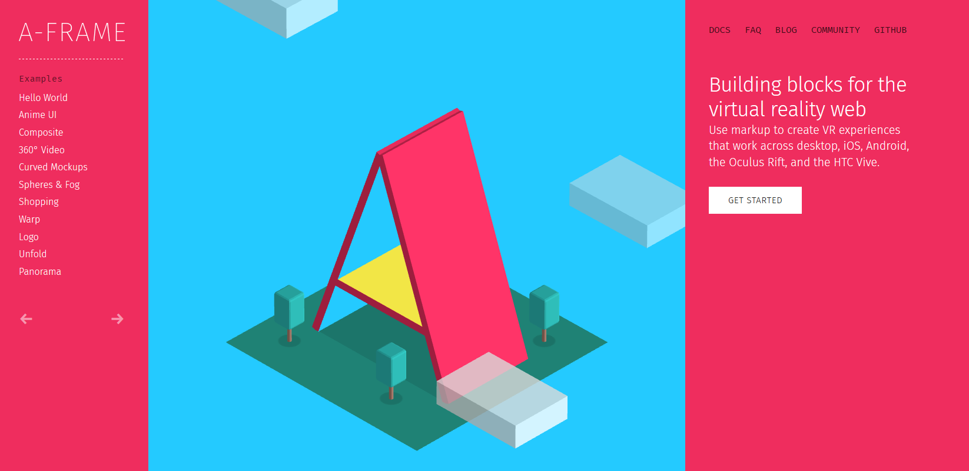
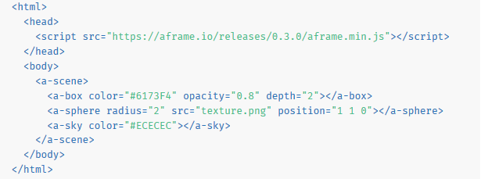
Resources
A-Frame is a MozVR’s open-source framework for creating WebVR worlds with markup.

Slide 43
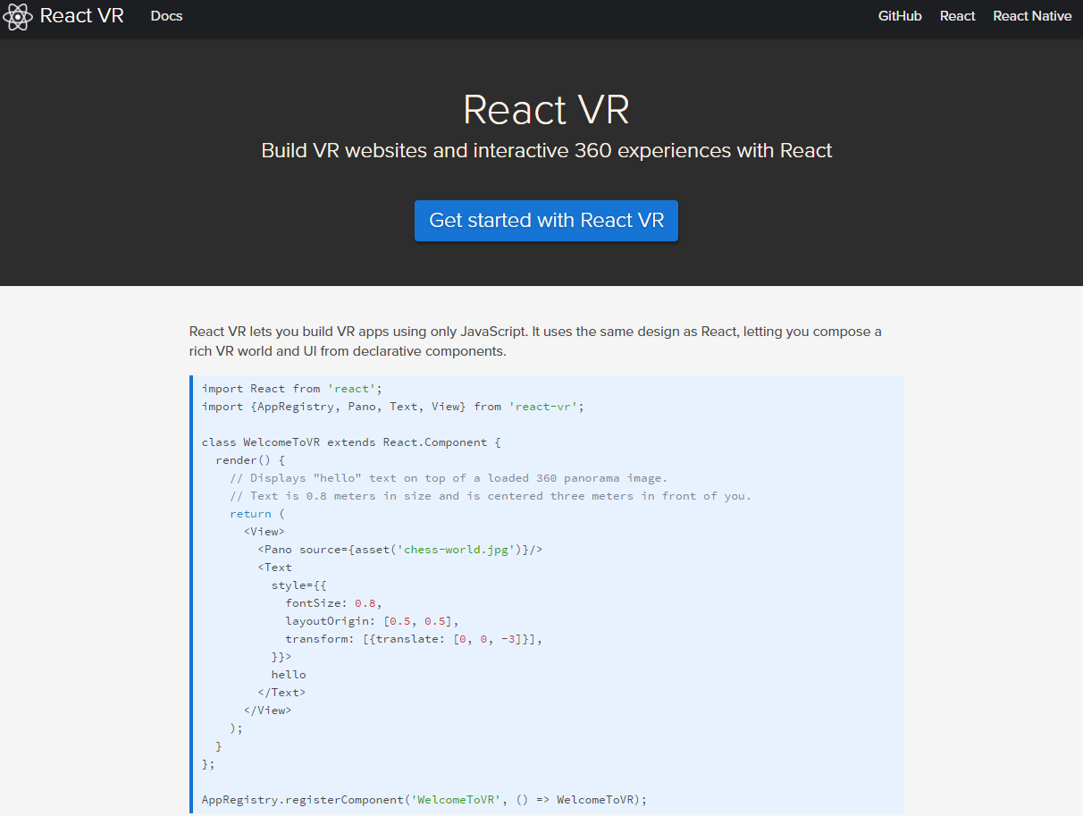
Resources
React VR lets you build VR apps using only JavaScript.
- is an open-source JavaScript library from Facebook that makes it easy to create interactive User Interfaces. React VR takes it to the next level, creating UIs and 3D scenes in virtual reality.
- It uses the same design as React, letting you compose a rich VR world and UI from declarative components.

Slide 44
Demo of Visualization based on WebVR
Sample Web VR
https://webvr.info/samples/
Mozilla VR Showcase
http://mozvr.com/
Cardboard VR Showcase
http://vr.chromeexperiments.com/
A-Frame
https://aframe.io/
React VR
https://facebook.github.io/react-vr/

Slide 45
CONCLUSION
Virtual Reality is a growing industry
PC and specialized hardware are getting better, faster and cheaper because of development in VR.
Maybe 3D user interfaces will replace the windows based ones?
Huge demand for VRML programmers in near future.
Revolution in gaming industries

Slide 46
Thank you.

