Slide 1

Cybersickness – Seeking Human Factors from Causes to Cures
Hyun Taek Kim Ph.D.
Department of Psychology, Korea University
www.brainbehavior.net

Slide 2
Compliance with IEEE Standards Policies and Procedures
Subclause 5.2.1 of the IEEE-SA Standards Board Bylaws states, "While participating in IEEE standards development activities, all participants...shall act in accordance with all applicable laws (nation-based and international), the IEEE Code of Ethics, and with IEEE Standards policies and procedures."
The contributor acknowledges and accepts that this contribution is subject to:
The IEEE Standards copyright policy as stated in the IEEE-SA Standards Board Bylaws, section 7, http://standards.ieee.org/develop/policies/bylaws/sect6-7.html#7, and the IEEE-SA Standards Board Operations Manual, section 6.1, http://standards.ieee.org/develop/policies/opman/sect6.html
The IEEE Standards patent policy as stated in the IEEE-SA Standards Board Bylaws, section 6, http://standards.ieee.org/guides/bylaws/sect6-7.html#6, and the IEEE-SA Standards Board Operations Manual, section 6.3, http://standards.ieee.org/develop/policies/opman/sect6.html

Slide 3
IEEE [WG Project #]
[WG Name]
[WG Chair Name and Email]
Cybersickness – Seeking Human Factors from Causes to Cures
Date: 2017-07-25
Author(s): Hyun Taek Kim
Name | Affiliation | Phone [optional] | Email [optional]
Hyun Taek Kim | Korea University | +(82) 2-3290-2065 | neurolab@korea.ac.kr

Slide 4
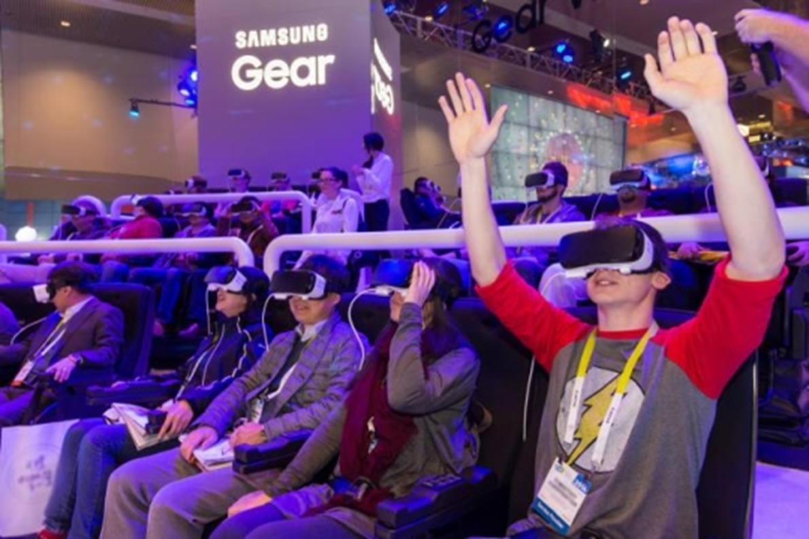
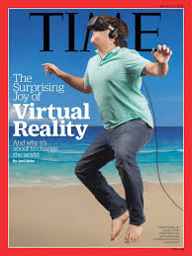
Virtual Reality
Notes:
ARE all these HMD users enjoying the virtual experience with a positive emotion by a perfect sensory coordination between different sensory modalities?

Slide 5
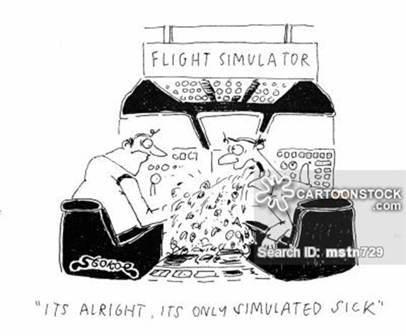

Cybersickness
VR Dystopia?
Notes:
Let’s consider the other side of the same coin.
As you see in this slide, one man in the right cartoon (may a trainee for pilot) has cybersickness when he is trained in a flight simulator.
Why is this man suffering from many uncomfortable emotional and behavioral symptoms such as negative emotions like anxiety, bodily disorientation, nausea, and vomiting?
What causes these symptoms and what are happening in this man’s body especially in his nervous system and physiological processes?

Slide 6
Discussion Points
Cybersickness theories and proposed causes
Behavioral correlates of cybersickness
Physiological correlates of cybersickness
Identifying human factors
Examining validity of questionnaires (eg. SSQ, MSSQ → CSQ)
Standardization of terms
Scientific criteria for preventing hazardous symptoms
Establishing standard & users’ guide

Slide 7
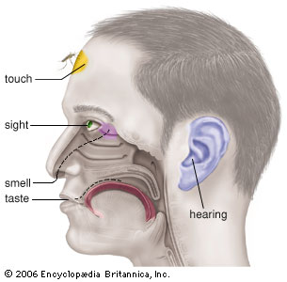
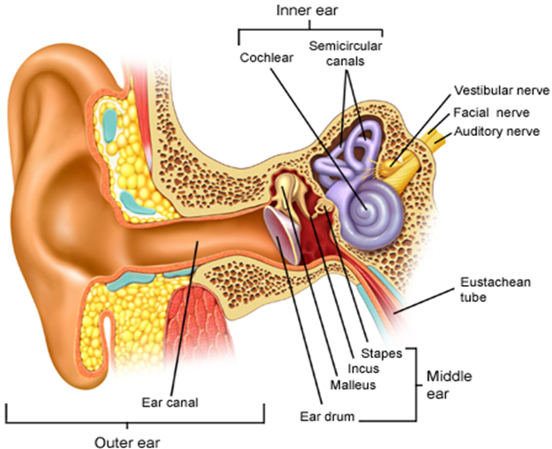
Sensory Conflict Theory of Cybersickness
Six Senses
balance (vestibular organ)
Notes:
In terms of gross and neuro anatomy, we have six senses as you see on this slide.
3 semicircular canals and utricles and saccules….

Slide 8
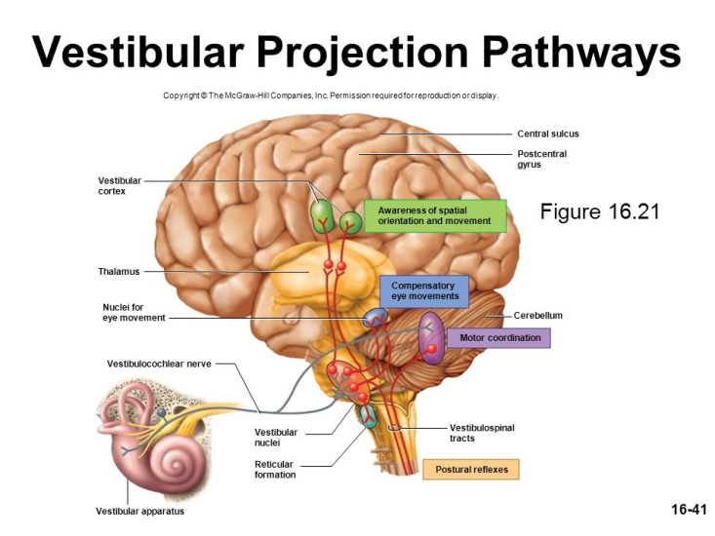
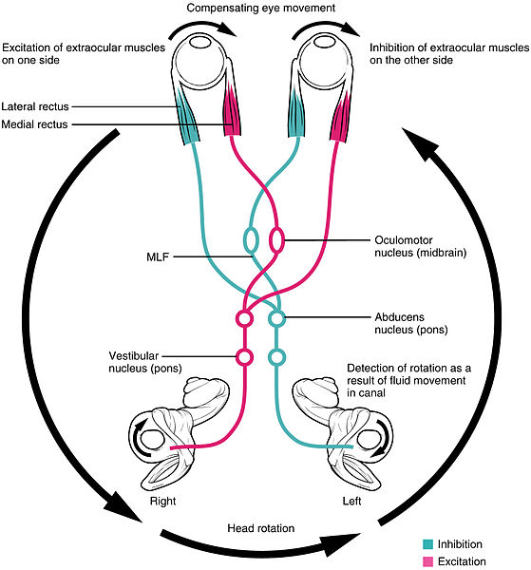
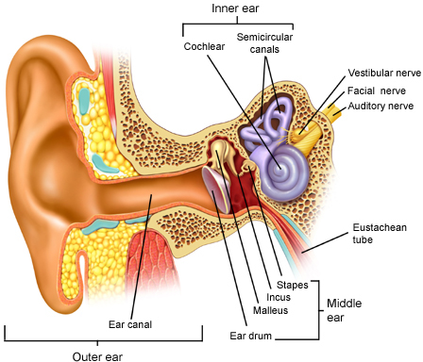
Sensory Conflict Theory of Cybersickness
Vestibular Ocular Reflex (VOR)
to Stabilize Visual Images
A top-down process from
the vestibular cortex to
the brainstem and the cerebellum
to modulate sensory mismatches?
Notes:
In this slide, you can find a physiological functions of inner ear (color blue), the function of semicircular canals is to stabilize or balance our body when we are turning our bodies or heads coordinating with eyes. Namely VOR
This vestibular organ is neurally connected to muscles attached to our eyeballs as you see on the right side of this slide.
When you turn your body to the left direction, the vestibular organ sends the information to the muscles on the eyeballs to go to the right direction to compensate the movements to ensue stabilizing visual scenes.
In engineering, it functions as a negative feedback to stabilize system parameters.
Physiologist found the same system between the eye and the vestibular organ, and called the system “vestibular – ocular reflex: VOR”.
If you wear a goggle with which you see everything upside down, the first day of using the goggle, you cannot even walk one step…and fall down but in several days eventually you can adapt to the new visual information and can walk and stroll here and there easily… a part of the behavioral adaptation is associated with VOR gain control function…mostly resides in the brain stem…
Here, we can track the vestibular projection pathways from the vestibular nucleus in the brain stem to the vestibular cortex via the thalamus…
The vestibular cortex has a broad range from Brodmann Area 43 , 5…the function of the vestibular cortex was suggested by many researchers…integration of visual, vestibular, proprioceptive singnals to produce the reference of the outer 3D world…some researchers proposed the function of this cortex as the modulation of visual working memory..

Slide 9

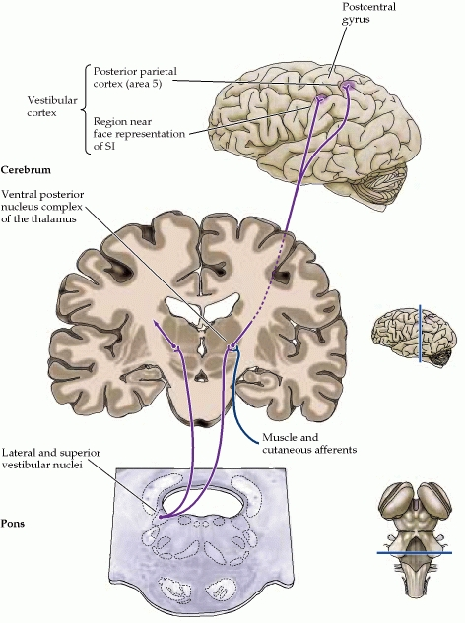
“The vestibular cortex function is…integrated in a larger network for spatial attention and
sensorimotor control of eye and body motion
in space.” Vertigo (1999)
Notes:
After measuring the activity changes in the central nervous system during the experience of cybersickness, we speculated that what would be an effect of direct electrical stimulation to a specific area of vestibular pathways in the brain.
We tried to apply tDCS (transcranial Direct Current Stimulation) at the site of scalp under which resides the vestibular cortex before and after the subjects were exposed to a virtual navigation.
In this slide, you can find where the vestibular cortex is and its connection to the subcortical structures which are responsible for the vestibular ocular reflex (VOR) and bodily stability.
Brodmann area 5 4 3…have not been well-defined

Slide 10
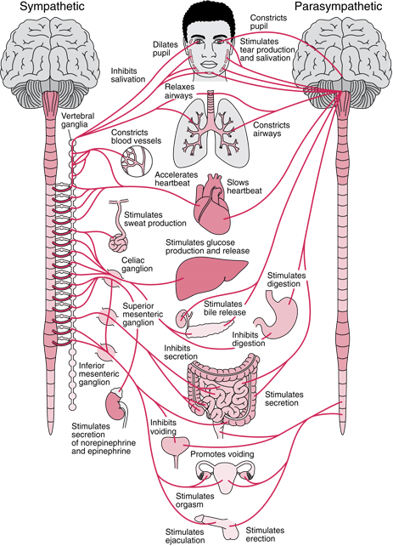
Hypothalamus and amygdala activity increase might be involved
Notes:
After measuring the activity changes in the central nervous system during the experience of cybersickness, we speculated that what would be an effect of direct electrical stimulation to a specific area of vestibular pathways in the brain.
We tried to apply tDCS (transcranial Direct Current Stimulation) at the site of scalp under which resides the vestibular cortex before and after the subjects were exposed to a virtual navigation.
In this slide, you can find where the vestibular cortex is and its connection to the subcortical structures which are responsible for the vestibular ocular reflex (VOR) and bodily stability.
Brodmann area 5 4 3…have not been well-defined

Slide 11
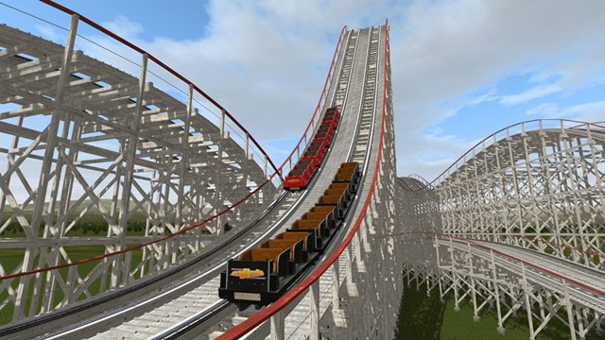

Theory of Motion Sickness / Cybersickness: Sensory Conflict
Symptoms of Cybersickness: Nausea, Dizziness, Eye Strain, etc.
Cybersickness refers to an uncomfortable state in virtual reality, which is similar to motion sickness.
Vestibular Input
(Stationary)
Visual Input
(Moving)
Sensory Conflict
CYBERSICKNESS
Notes:
Let me show you in a certain condition…how this VOR does not work properly.
When we are in a VR of roller coaster, our visual system has to process the visual inputs from the roller coaster up and down, but our vestibular organ does not process any bodily movement because we sit on the chair without any movement.
This condition causes a sensory conflict because of the discrepancy of moving visual inputs and stationary vestibular inputs.
Previous studies have suggested that the sensory conflict can be associated with symptoms of cybersickness, such as nausea, dizziness, eye strain, and uncomfortable feelings etc.
Next slide will show it,

Slide 12
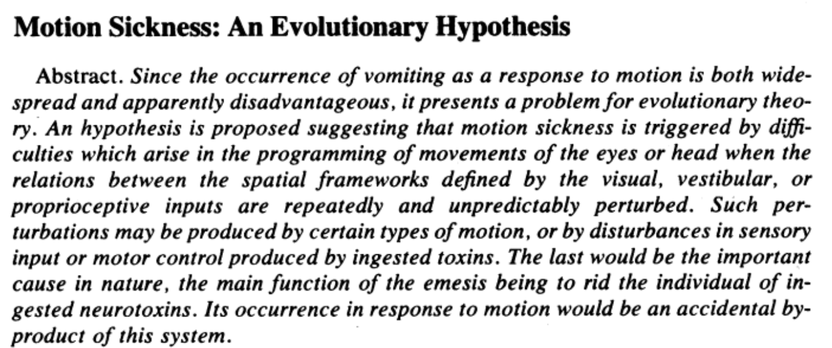

A Hypothesis: Poison Theory
The theory suggests that the ingestion of poison causes physiological effects involving the disturbances of
coordination between the visual, vestibular, and other sensory input systems.
These physiological effects act as an early warning system which enhances survival by removing the poiso-nous content from the stomach.
The adverse stimulation found in some virtual environments can effect the visual and vestibular system in
such a way that the body misreads the information and reacts it has ingested some type of toxic
substance, thus causing disturbing symptoms which lead to an emetic response.
LaViola Jr, J. J. (2000). A discussion of cybersickness in virtual environments. ACM SIGCHI Bulletin, 32(1), 47-56.
Treisman, M. (1977). Motion sickness: an evolutionary hypothesis. Science, 197(4302), 493-495.
Notes:
Triesman’s hypothesis(1977) of symptoms of motion sickness including vomitting.
Plants growing in the wild could contain a variety of chemicals some of which must be toxic which can cause disturbances of sensory and motor coordinations.
Our ancestors could survive from the toxin by throwing up the ingested toxin. Emesis out of the stomach.

Slide 13
Proposed Causes of Cybersickness
Human Factors | Hardware | Content
Age | Binocular view | Altitude above terrain
Concentration level | Calibration | Degree of control
Ethnicity | Time lag | Duration
Experience with real-world task | Update rate | Global visual flow
Experience with simulator (habituation) | Field of View | Head movements
Flicker fusion frequency threshold | Flicker | Color
Gender | Ambient brightness | Method of movement
Illness and personal characteristics | Motion platform | Rate of linear or rotational acceleration
Mental rotation ability | Phosphor lag | Scene-movement speed
Perceptual style | Position tracking error | Contrast
Eye dominace | Refresh rate | Type of application
Postural instability | Resolution | Unusual maneuvers
Revised from the Rebenitsch-2015
Ph.D. thesis Michigan State University
Measurement
Behavioral / physiological correlates of cybersickness
Notes:
Individual -> human factors
Herman witkin: field independent / field dependent to judge an absolutely vertical axis based on the context of surrounding objects or sense of himself as the vertical axis.
Simulator -> hardware
Task-> content

Slide 14
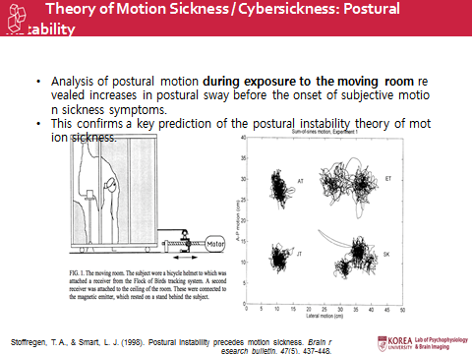
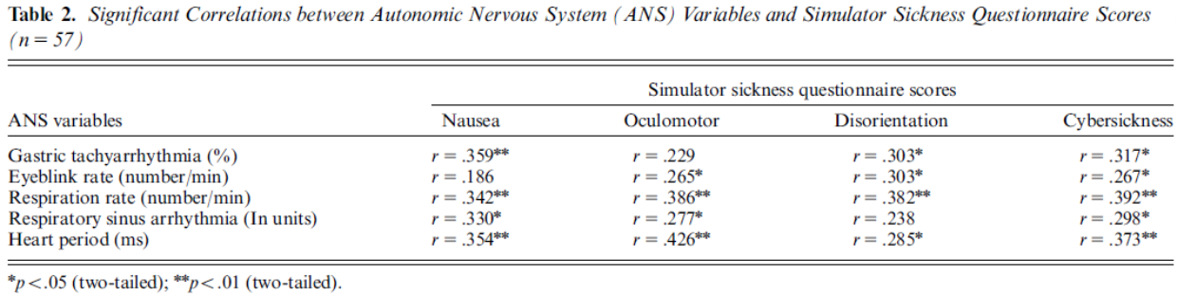
Behavioral Correlates of Cybersickness
Kim et al. (2005, 2008)

Slide 15
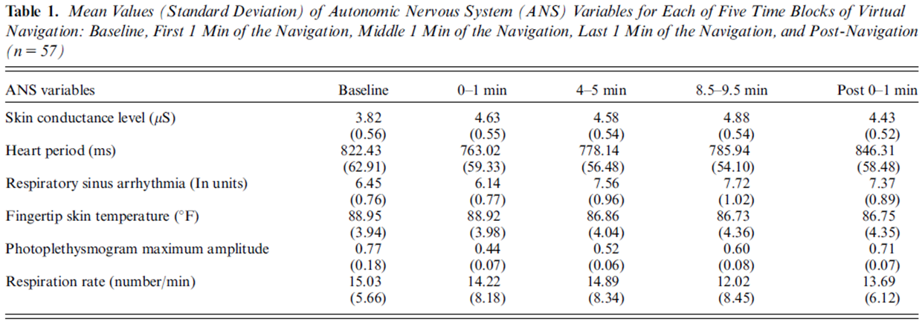
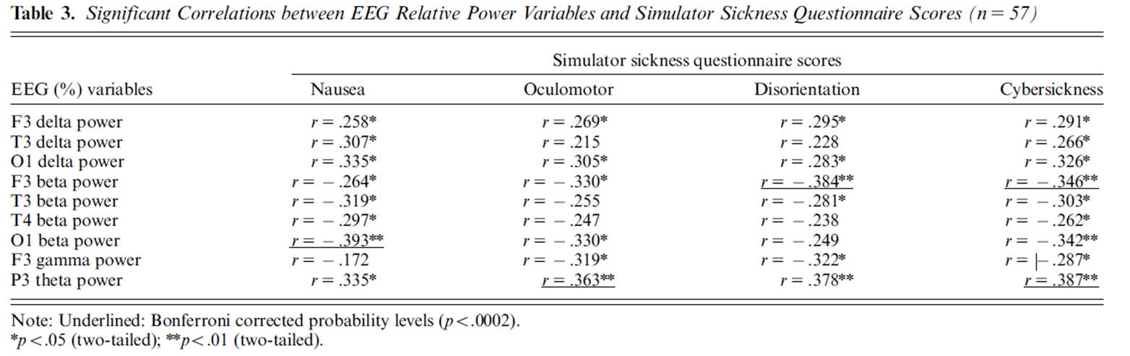
Physiological Correlates of Cybersickness
Kim et al. (2005, 2008)

Slide 16
Identifying Human Factors
Experience with HMD (habituation) | Experience with real-world task | Postural instability | Flicker fusion frequency threshold | Duration use time
Specific mental illness (Based on DSM) | Specific physical Illness (visual, vestibular, Proprioceptive etc.)
Perceptual style | Concentration level | Mental rotation ability | Personal characteristics (addiction, sensation seeking etc.)
Age | Ethnicity | Gender | Eye dominance
Based on Behavioral / Physiological Correlates of Cybersickness

Slide 17
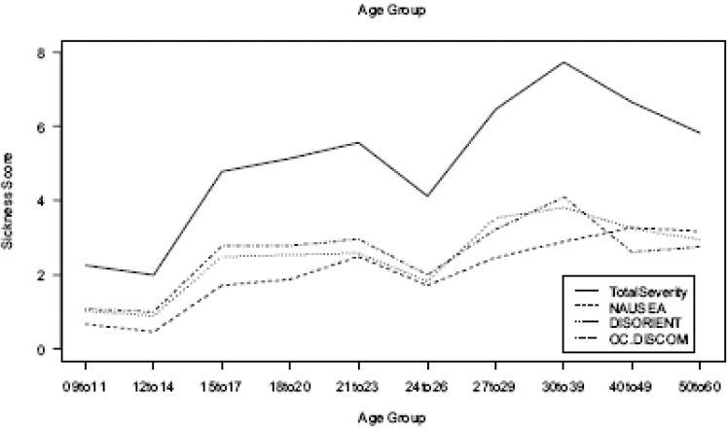
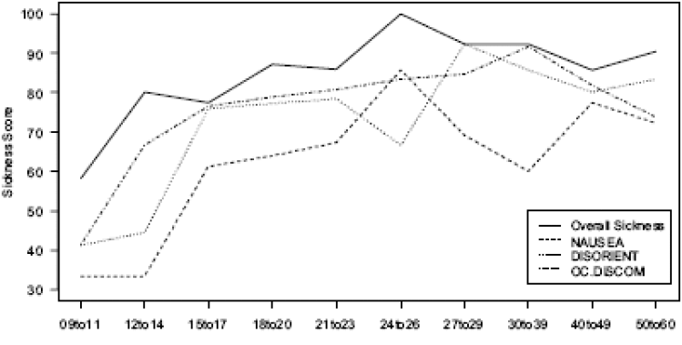
Human Factors Matter •
Younger age (2-12 range) showed the greatest increase of susceptibility to cybersickness and this acceleration rapidly decreases in 12 to 21
Kolasinski, E. M. 1995. Simulator sickness in virtual environments. United States Army Research Institute for Behavioral and Social Sciences
In contrast, older adults often appeared to suffer more severe cybersickness than younger adults
Arns, L. L., & Cerney, M. M. (2005, March). The relationship between age and incidence of cybersickness among immersive environment users. In Virtual Reality, 2005. Proceedings. VR 2005. IEEE (pp. 267-268). IEEE.
Notes:
슬라이드 3장 정도 할애해서 15가지 human factor들 (슬라이드 당 5가지 human factor 할당)이 각각 사용자들의 cybersickness에 어떻게 영향을 미치는지를 1~2줄로 요약하고 관련된 논문 reference를 한 개 씩만 달아줄 것.

Slide 18
Human Factors Matter • • (Figures)
The MSSQ score was significantly lower in Caucasians than Chinese volunteers.
Rotation tolerance time was significantly higher in Caucasian than Chinese subjects
Klosterhalfen, S., Kellermann, S., Pan, F., STOcKHORST, U., Hall, G., & ENcK, P. (2005). Effects of ethnicity and gender on motion sickness susceptibility. Aviation, space, and environmental medicine, 76(11), 1051-1057.
Women have a wider FOV, higher flicker perception. And this in turn increases susceptibility to cybersickness
LaViola Jr, J. 2000. A discussion of cybersickness in virtual
environments. ACM SIGCHI Bulletin, 32(1):47-56.
No correlation between cybersickness and eye dominance
Ling, Y., Nefs, H. T., Brinkman, W. P., Qu, C., & Heynderickx, I. (2013). The relationship between individual characteristics and experienced presence. Computers in Human Behavior, 29(4), 1519-1530.
Nichols et al. found a negative correlation between ‘interface (concentration level)’ and cybersickness.
Nichols S, Haldane C, Wilson JR. Measurement of presence and its consequences in virtual environments. International Journal of Human-Computer Studies. 2000 March;52(3):471-491.
Sense of being in a virtual world
Notes:
슬라이드 3장 정도 할애해서 15가지 human factor들 (슬라이드 당 5가지 human factor 할당)이 각각 사용자들의 cybersickness에 어떻게 영향을 미치는지를 1~2줄로 요약하고 관련된 논문 reference를 한 개 씩만 달아줄 것.

Slide 19
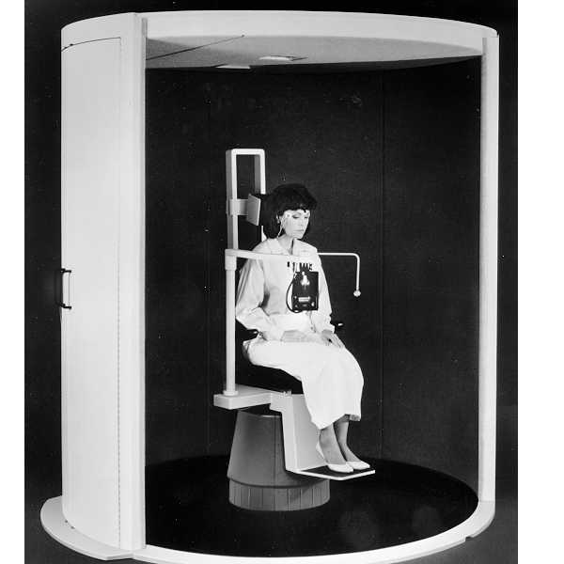
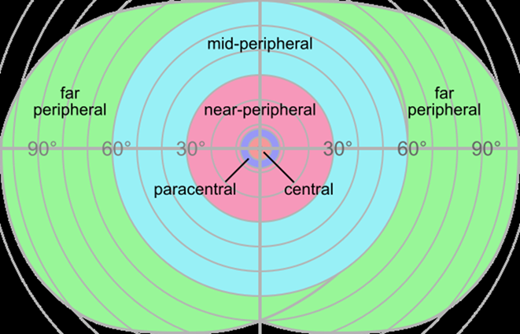
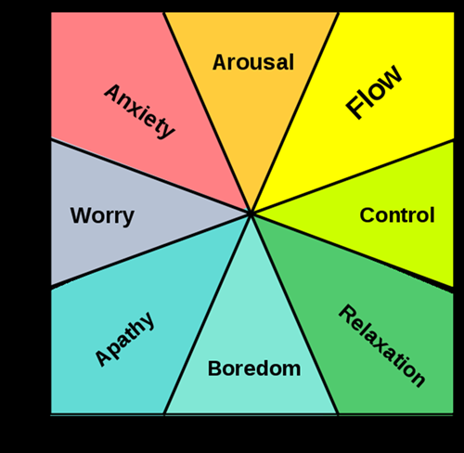
Flow: Mental state in terms of challenge level and skill level. - Csikszentmihalyi'

Slide 20
Human Factors Matter • • • (Figures)
The visual system of field-dependent subjects may be peripheral-dominant whereas the visual system of field-independent subjects may be foveal-domiant. In other words, field-dependent individuals should be more susceptible to simulator sickenss.
Ebenholtz, S. M., & Benzschawel, T. L. (1977). The rod and frame effect and induced head tilt as a function of observation distance. Perception & Psychophysics, 22(5), 491-496.
Improved mental rotation ability increased cybersickness in female, but it was reversed in male. But this effect is uncertain.
Kolasinski, E. M. 1995. Simulator sickness in virtual environments. United States Army Research Institute for Behavioral and Social Sciences
Biocca suggested that personal characteristics like neuroticism, anxiety and introversion may be related to sickness susceptibility. But the effect requires further research.
Biocca, F. (1992). Virtual reality technology: A tutorial. Journal of Communication, 42(4), 23-72.
Notes:
In the field-dependent/independent model of cognitive or learning style, a field-independent learning style is defined by a tendency to separate details from the surrounding context. It can be compared to a field-dependent learning style, which is defined by a relative inability to distinguish detail from other information around it. Theorists define these two cognitive styles in terms of how they are psychologically different - which makes this a useful model for teachers trying to understand their learners.

Slide 21
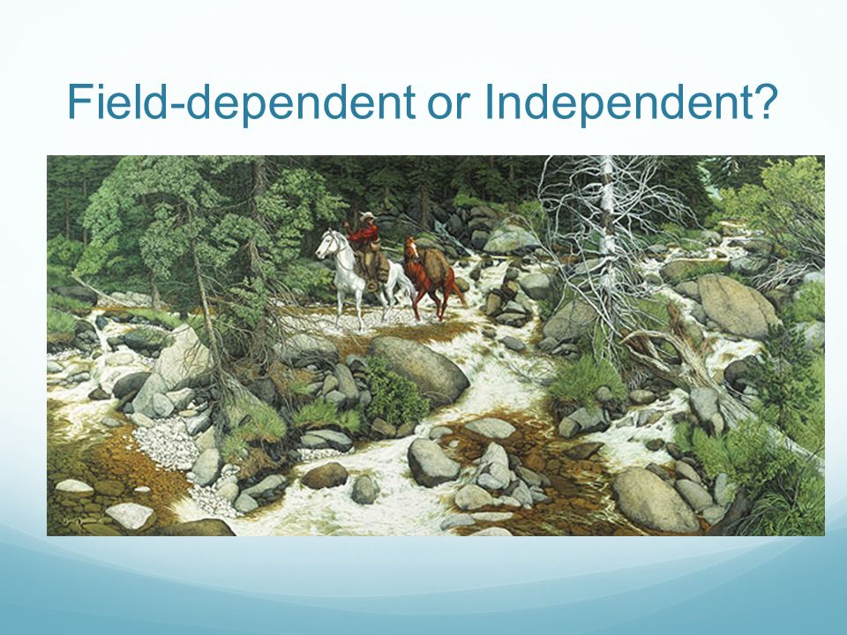
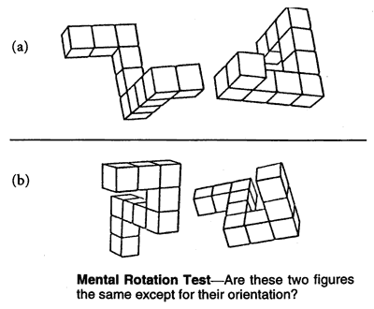
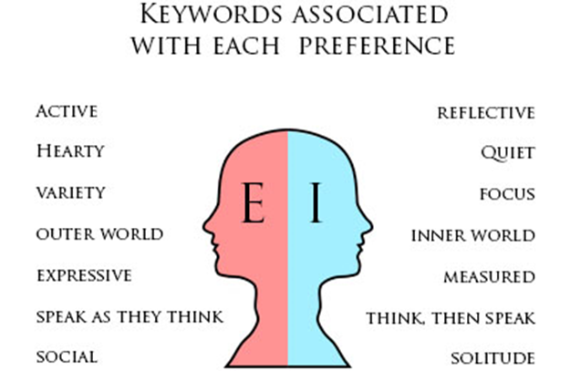
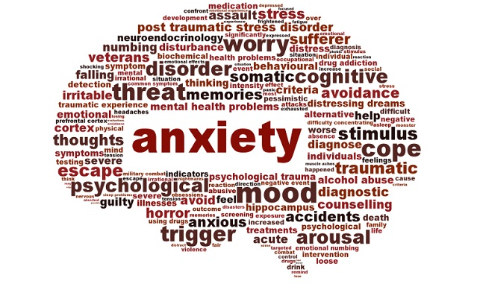

Slide 22
Human Factors Matter • • • •
People who are not at usual health level, cybersickness susceptibility appears to increase.
Kennedy, R. S., Berbaum, K. S., Lilienthal, M. G., Dunlap, W. P., & Mulligan, B. E. (1987). Guidelines for alleviation of simulator sickness symptomatology (No. NAVTRASYSCEN-TR-87-007). NAVAL TRAINING SYSTEMS CENTER ORLANDO FL.
Exposure duration is critical factors in simulator-sickness outcome. Longer exposure produce more symptoms and total sickness score.
Kennedy, R. S., Stanney, K. M., & Dunlap, W. P. (2000). Duration and exposure to virtual environments: sickness curves during and across sessions. Presence: Teleoperators and virtual environments, 9(5), 463-472.
Habituation to the side effects of immersion in a virtual reality was studied in some research groups (Hill & Howarth, 2000; Stanney, Kennedy, Drexler, & Harm, 1999).
We reported that habituation did occur when virtual reality was repeatedly presented.
Kim, Y. Y., Kim, H. J., Kim, E. N., Ko, H. D., & Kim, H. T. (2005). Characteristic changes in the physiological components of cybersickness. Psychophysiology, 42(5), 616-625.
Notes:
슬라이드 3장 정도 할애해서 15가지 human factor들 (슬라이드 당 5가지 human factor 할당)이 각각 사용자들의 cybersickness에 어떻게 영향을 미치는지를 1~2줄로 요약하고 관련된 논문 reference를 한 개 씩만 달아줄 것.

Slide 23
Human Factors Matter • • • • •
Past history of motion sickness and video game (real-world task) have the best predictive power of cybersickness
Rebenitsch, L., & Owen, C. (2014, October). Individual variation in susceptibility to cybersickness. In Proceedings of the 27th annual ACM symposium on User interface software and technology (pp. 309-317). ACM.
“The postural instability theory states that the cause of motion sickness and cybersickness is prolonged postural instability.” In numerous studies, postural instability is correlated with cybersickness
LaViola Jr, J. J. (2000). A discussion of cybersickness in virtual environments. ACM SIGCHI Bulletin, 32(1), 47-56.
Flicker can cause eye fatigue, and it is related to cybersickness in FOV aspects.
K. Harwood and P. Foley. Temporal Resolution: An Insight into the Video Display Terminal (VDT) "Problem".Human Factors, 29(4):447-452, 1987
.
And more human factors… such as VOR gain change etc.
Notes:
슬라이드 3장 정도 할애해서 15가지 human factor들 (슬라이드 당 5가지 human factor 할당)이 각각 사용자들의 cybersickness에 어떻게 영향을 미치는지를 1~2줄로 요약하고 관련된 논문 reference를 한 개 씩만 달아줄 것.

Slide 24
Examining Validity of Questionnaires
(SSQ, MSSQ etc.)
Minimizing cyber sickness in head mounted display systems: design guidelines and applications (2016). Thiago M. Porcino etc.
Notes:
SSQ consists of 16 symtoms for simulator sickness…
Basically, SSQ (simulator sickness questiomaire) is for measuring memory of unpleasant sensations and physical responses in simulators.
The SSQ might not be a sensitive and valid questionnaire for cybersickness…we need to develop a quesitonnaire for cybersickness exclusively,

Slide 25
Standardization of Terms
VR motion sickness
Simulation sickness
Stimulator sickness
Cybersickness
Visually induced motion sickness (VIMS)
Motion sickness has been shown to be different from cybersickness or simulator sickness as regards symptoms, both behaviorally and physiologically.
Notes:
Many VR experts who work in academy and industry have used different terms to decribe the same concept. For example, in their presentations or papers, they have used different terms for the uncomfortable senseations and behavioral responsed in VR. In some case, the terms have slight different meanings.

Slide 26

Scientific Criteria for Preventing
Hazardous Symptoms
Reducing cybersickness is feasible, however eradicating all symptoms seems improbable.
Not all cybersickness is harmful,
such as motion sickness from rides
at amusement parks.
How can we establish scientific criteria for hazardous symptoms of cybersickness which are harmful for users’ health based on different human factors?
Notes:
Some developers of VR content in industry have talked to me that they want to find a proper level of cybersickness which can provide users with exciting experience of rollercoaster after being exposed to virtual content.

Slide 27
Establishing Standards & Users’ Guide
Connecting dots of human factors with various hardware and content factors to establish a standard to reduce cybersickness based on understand of physiological mechanisms of cybersickness.
Referring to existing user’s guides (for example, Oculus VR Best Practices Guide) to issue better standards and users’ guide.
Cooperation with other working groups regarding the timetable,
work schedules with discussion based on scientific findings in papers.

Slide 28
Q & A
Thank You

