Slide 1
Considerations for Standardization of VR Display
Suk-Ju Kang, Sogang University

Slide 2
Compliance with IEEE Standards Policies and Procedures
Subclause 5.2.1 of the IEEE-SA Standards Board Bylaws states, "While participating in IEEE standards development activities, all participants...shall act in accordance with all applicable laws (nation-based and international), the IEEE Code of Ethics, and with IEEE Standards policies and procedures."
The contributor acknowledges and accepts that this contribution is subject to
The IEEE Standards copyright policy as stated in the IEEE-SA Standards Board Bylaws, section 7, http://standards.ieee.org/develop/policies/bylaws/sect6-7.html#7, and the IEEE-SA Standards Board Operations Manual, section 6.1, http://standards.ieee.org/develop/policies/opman/sect6.html
The IEEE Standards patent policy as stated in the IEEE-SA Standards Board Bylaws, section 6, http://standards.ieee.org/guides/bylaws/sect6-7.html#6, and the IEEE-SA Standards Board Operations Manual, section 6.3, http://standards.ieee.org/develop/policies/opman/sect6.html

Slide 3
IEEE P3333.3 HMD Based 3D Content Motion Sickness Reducing Technology
[Dong Il Seo and dillon@volercreative.com]
Considerations for Standardization of VR Display
Date: 2017-07-10
Author(s): Suk-Ju Kang
Name | Affiliation | Phone [optional] | Email [optional]
Suk-Ju Kang | Sogang University | +82-10-7103-6520 | sjkang@sogang.ac.kr

Slide 4
Outline
Introduction
Considerations in VR Displays
Part I: Display Resolution
Part II: Chromatic Aberration and Correction
Part III: Display Technology Trend in VR
Conclusion

Slide 5
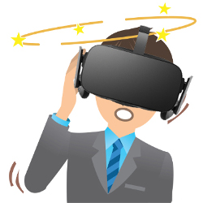
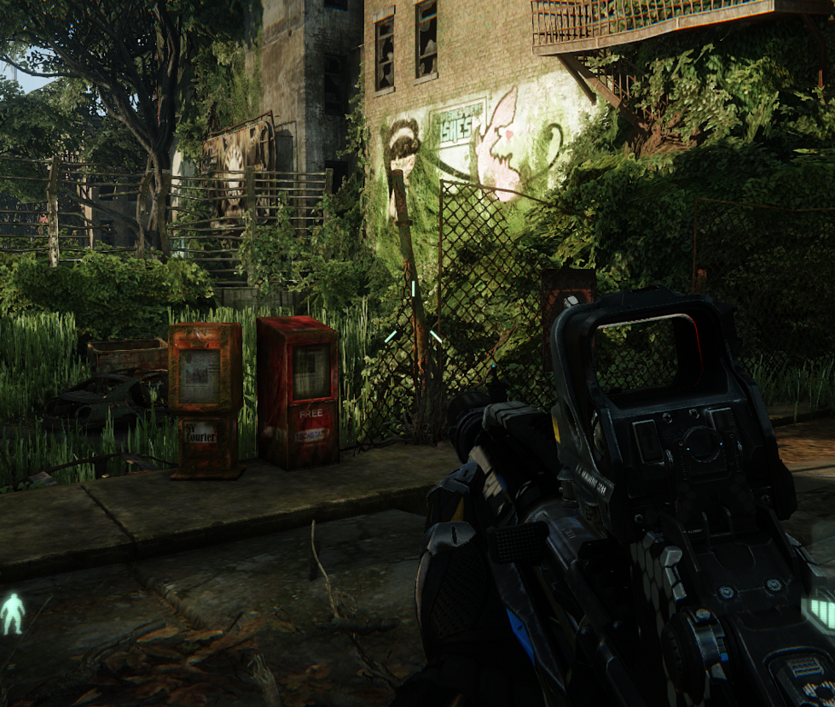
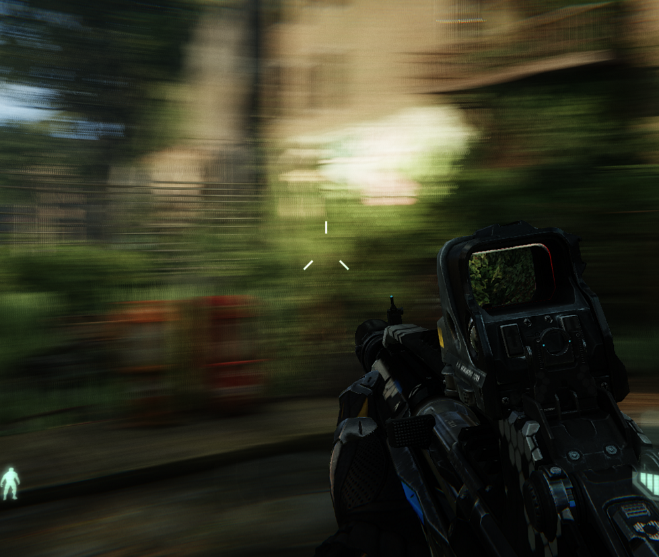
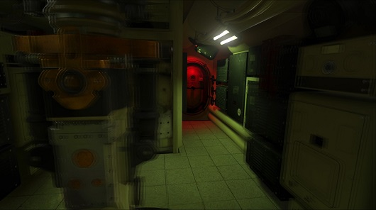
Introduction
Challenge of Virtual Reality
Users feel gaps on their sense between the reality and virtual reality because of a motion-to-photon latency
This causes dizziness and motion sickness to user
Motion-to-photon latency must be measured and compensated!
Human perception
Problems from latency of HMD
Motion sickness
Blurring
Image judder
Dizziness

Slide 6
Introduction
Motion-to-Photon Latency
Motion-to-Photon latency is the time needed for a user movement to be fully reflected on a display screen
Low motion-to-photon (< 20 ms) latency is a prerequisite to convince user’s mind that user is in another place
A high motion-to-photon latency makes a poor virtual reality experience
Tracker
CPU
GPU
Display
Photons
Optics
Head motion
Under 20 milliseconds of latency for comfortability
User’s retina

Slide 7
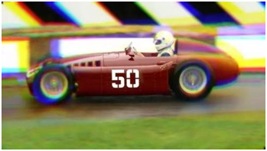
Introduction
We have to consider several factors in VR displays
Display Resolution
Chromatic Aberration and Correction

Slide 8
Part i: Display Resolution
Considerations In VR Displays

Slide 9
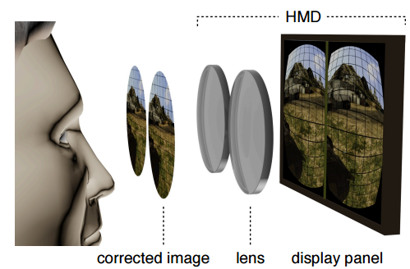
Display Resolution
Chromatic Aberration
General HW structure in HMDs
Display panel
Fisheye lens
Perceptional image
Fisheye lens

Slide 10
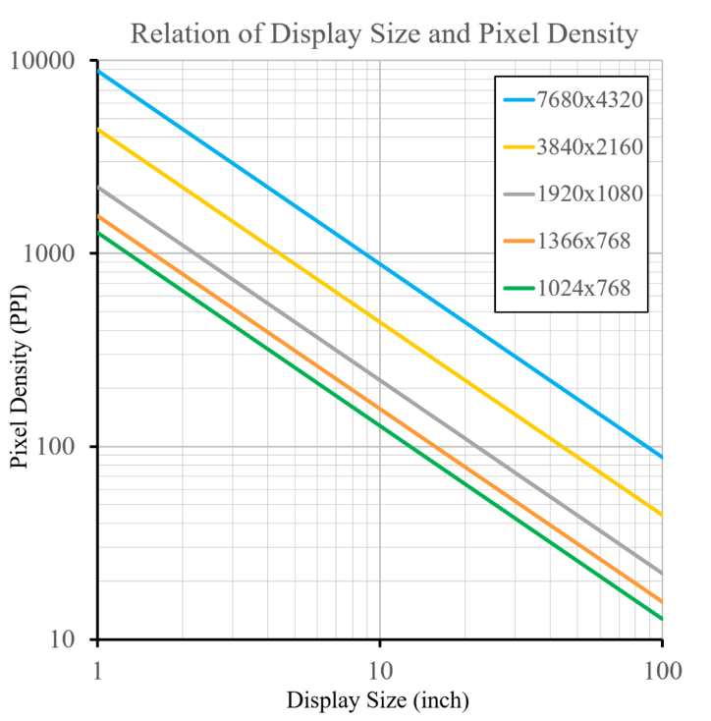
Display Resolution
Pixels per inch (PPI)
Measurement of the pixel density (resolution) of an electronic image device such as a monitor or television display
A 100×100 pixel image printed in a 1 inch square has a resolution of 100 pixels per inch

Slide 11
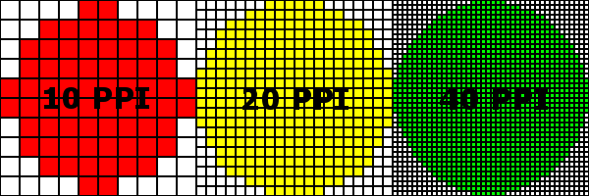
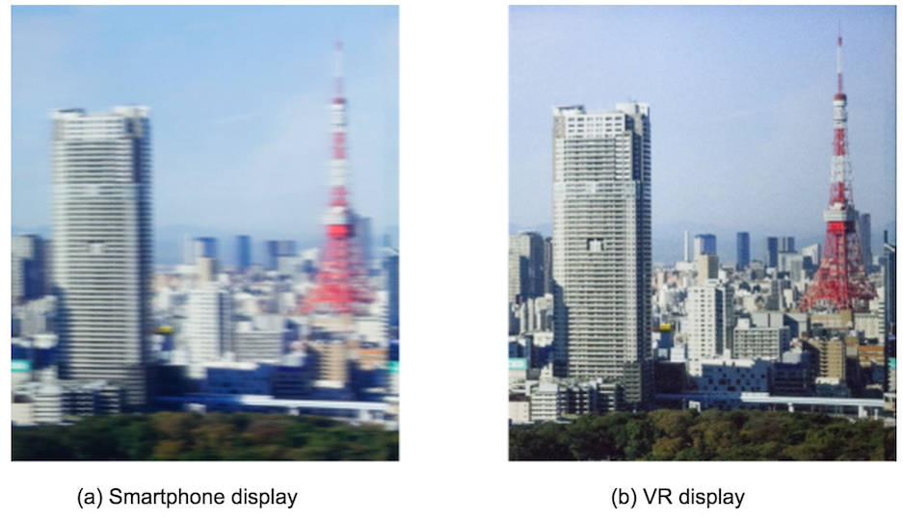
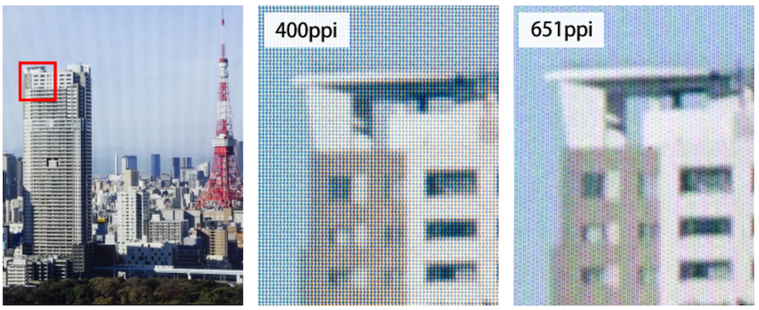
Display Resolution
JDI
New displays will be 3.42-inch low temperature polysilicon (LTPS) TFT LCD specifically designed for virtual reality (VR) head mount displays

Slide 12
Display Resolution

Slide 13
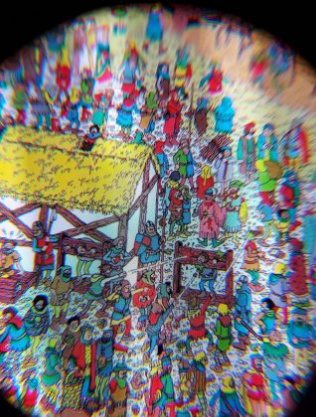
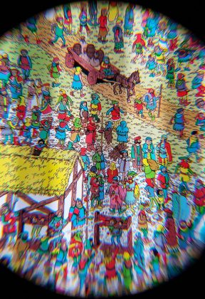
Display Resolution
Samsung
A new display targeting use in VR headsets packs 2,024 x 2,200 pixels into a 3.5″ form-factor, delivering an impressive 858 PPI (Nearly twice the 460 PPI of the Rift and the Vive)
The display is also capable of a 90Hz refresh rate and 100 nits brightness
Previous VR display
New VR display

Slide 14
Part iI: Chromatic Aberration and Correction
Considerations In VR Displays

Slide 15
Chromatic Aberration and Correction
Chromatic Aberration
Fisheye lens
The Fisheye lens gives users a wide viewing angle
Normal HMDs provide a FOV(Field Of View) of over 110°
Lens has a large refractive index

Slide 16
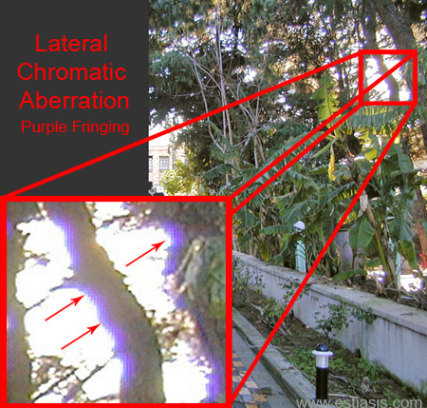
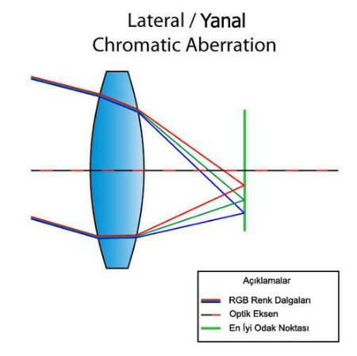
Chromatic Aberration and Correction
Chromatic Aberration
Reason for chromatic aberration
The separation of light is called chromatic aberration because of different refractive indexes depending on the wavelength of light

Slide 17
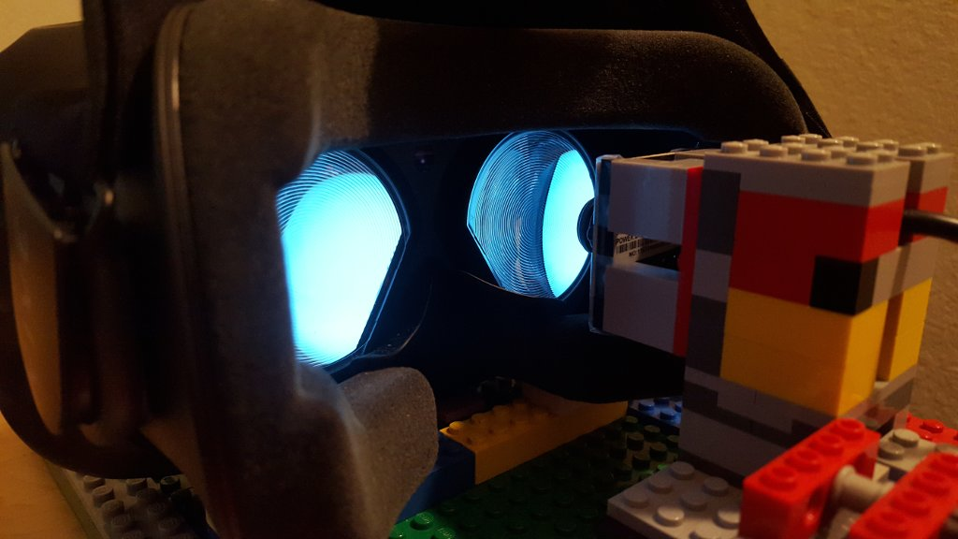
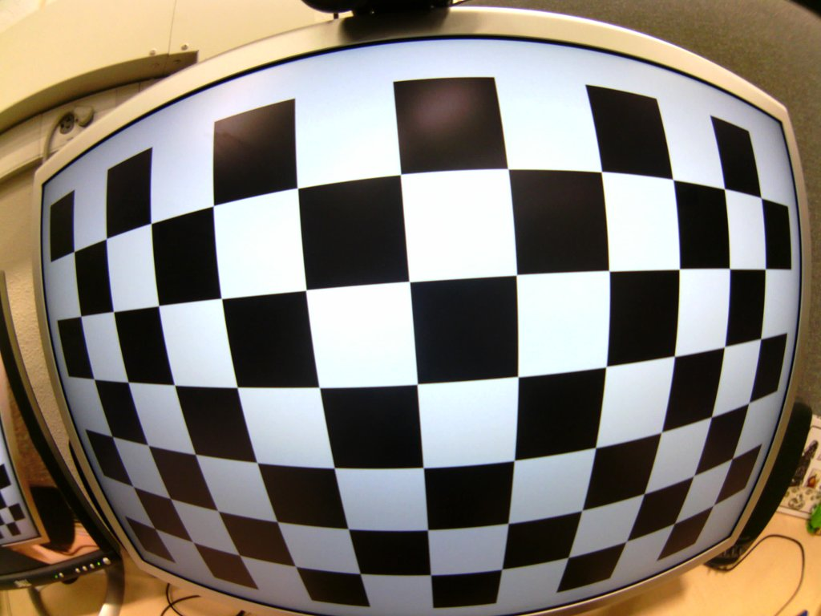
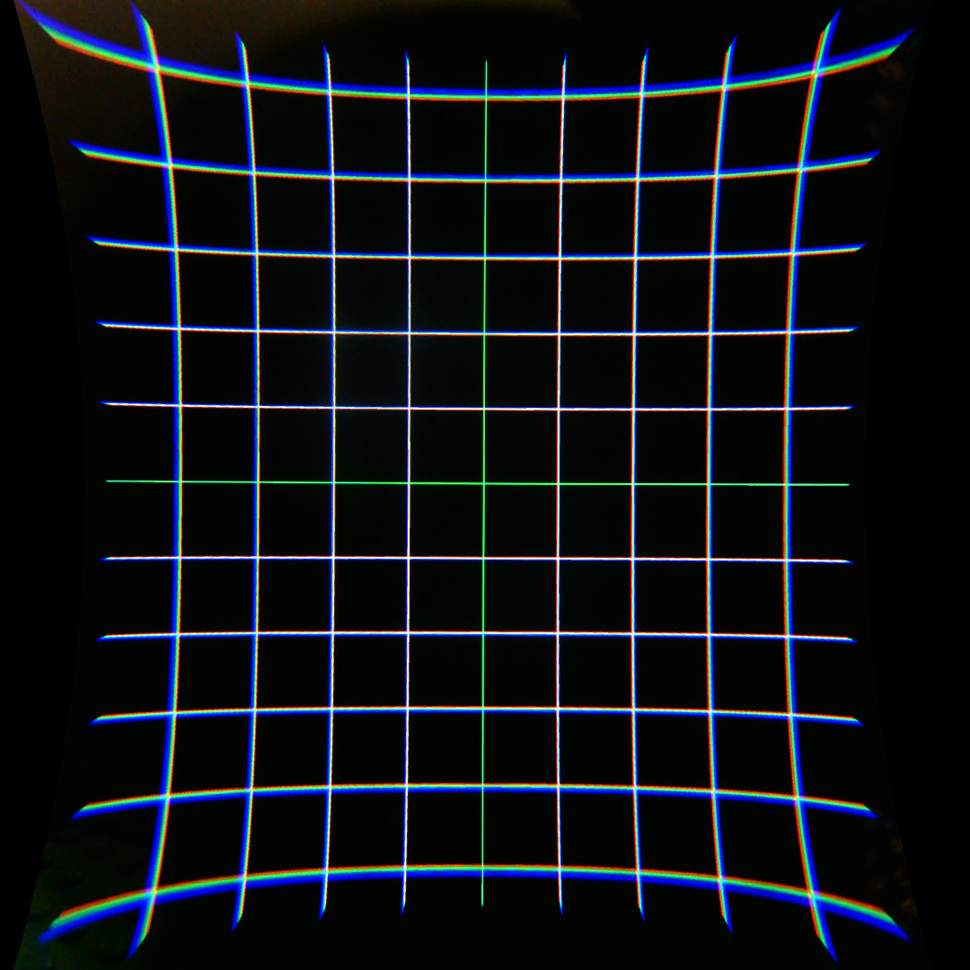
Chromatic Aberration and Correction
Correction
Fisheye lens modeling
Modeling is required for the precise pre-distortion
Measurement method
(a): Measuring HMD images with wide angle lens camera
(b): Camera calibration with the chess board
(c): Photographed VR images
(a)
(b)
(c)

Slide 18
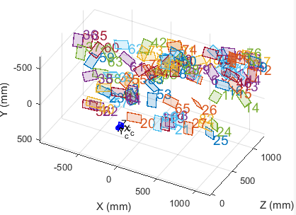
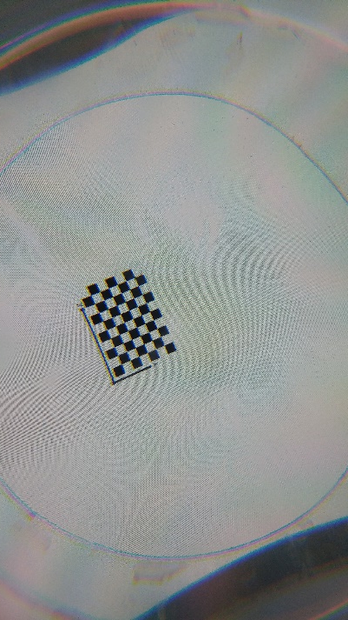
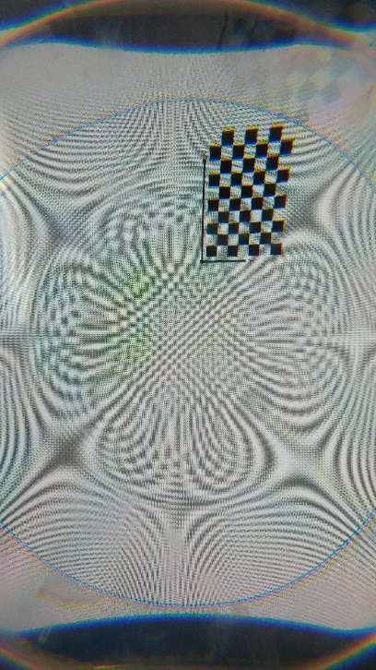
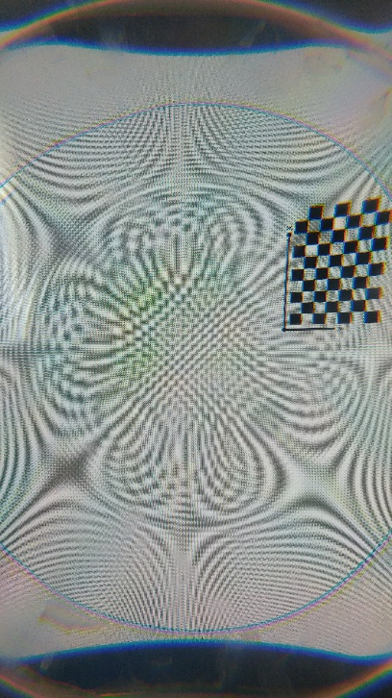
Chromatic Aberration and Correction
Correction
Measurement method
Parameter extraction through camera calibration
(a):Photos taken by using the chess board in virtual space
(b):Optimal parameter extraction using multiple photographs
(a)
(b)

Slide 19
Chromatic Aberration and Correction
Correction
Calibration result
(a): Original image
(b): Image with the pre-distortion
(c): User's perceptional image
(a)
(b)
(c)

Slide 20
Part iII: Display Technology Trend in VR
Considerations In VR Displays

Slide 21
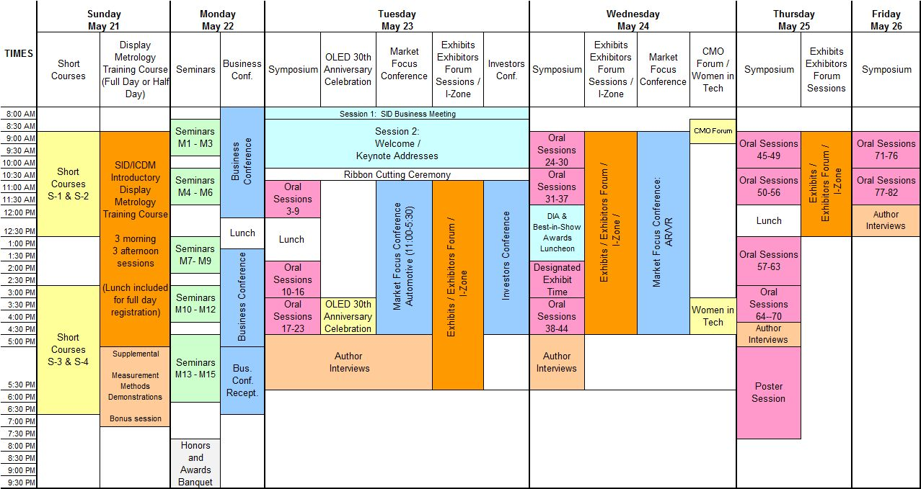
Display Technology Trend in VR
2017 Display Week

Slide 22
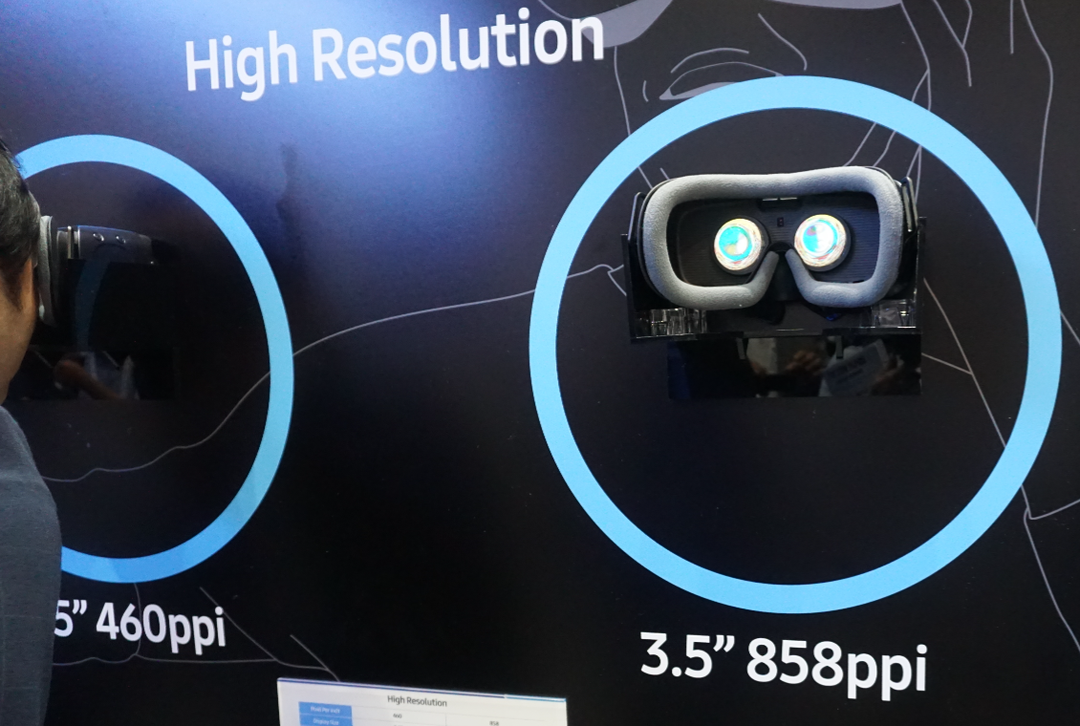
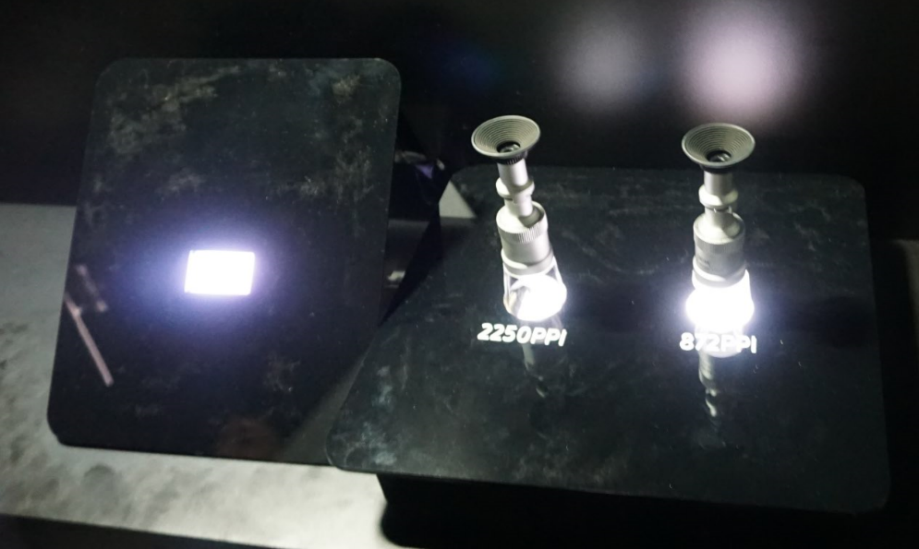
Display Technology Trend in VR
Samsung
HMD panel
High PPI panel

Slide 23
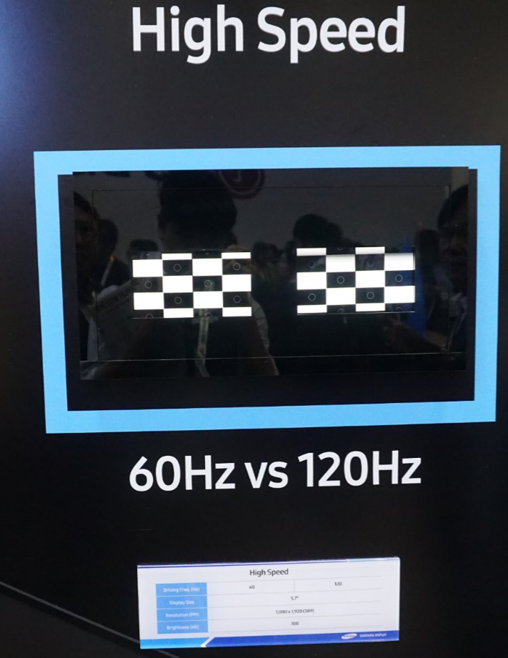
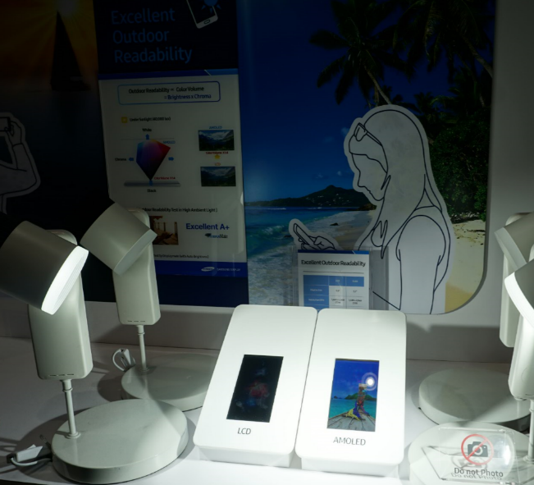
Display Technology Trend in VR
Samsung
High speed
HDR panel (Peak Brightness = 1000 nit)

Slide 24
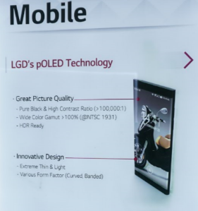
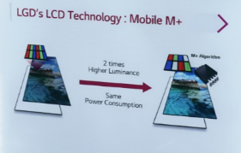
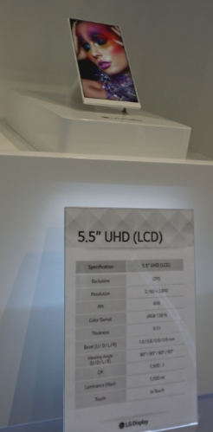
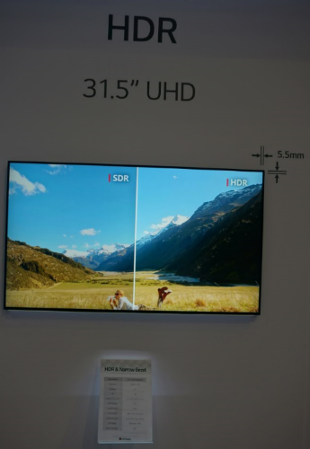
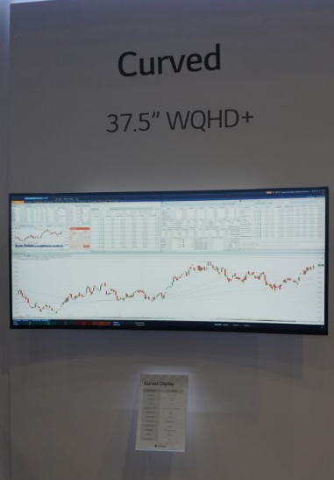
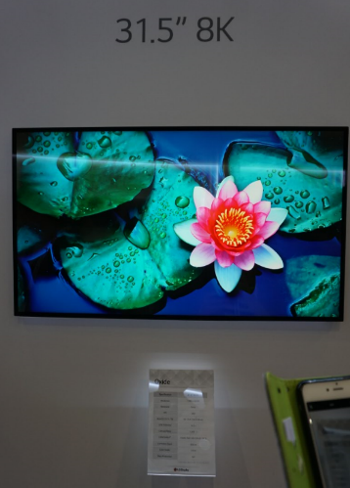
Display Technology Trend in VR
LG
HDR
Curved
8K / UHD

Slide 25
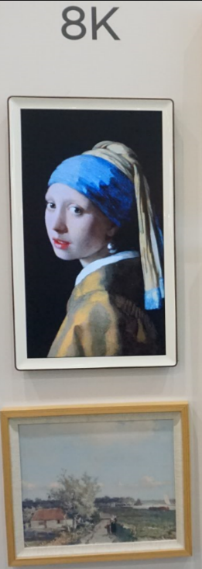
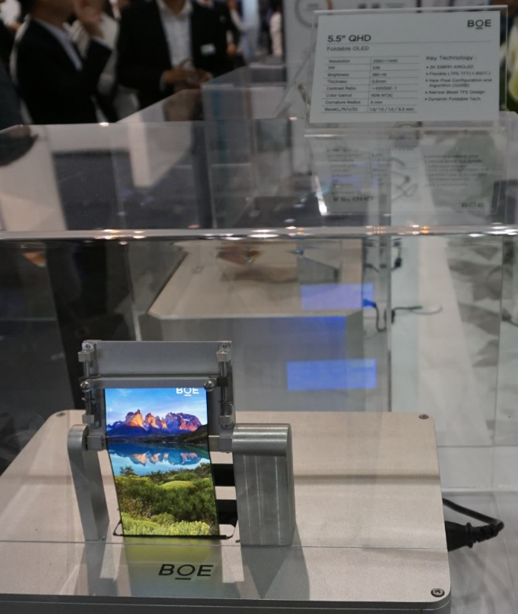
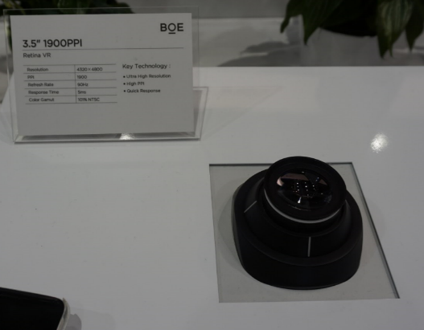
Display Technology Trend in VR
BOE
1900 PPI panel
8K Picture
Foldable

Slide 26
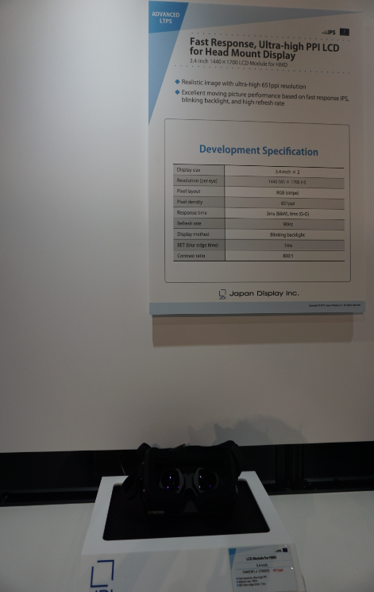
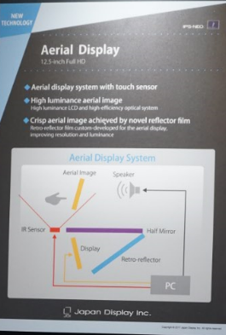
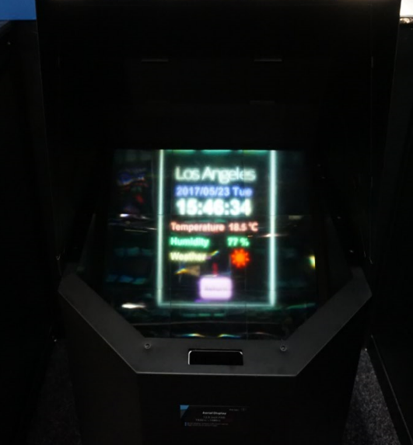
Display Technology Trend in VR
Japan display
Aerial display
Fast response panel

Slide 27
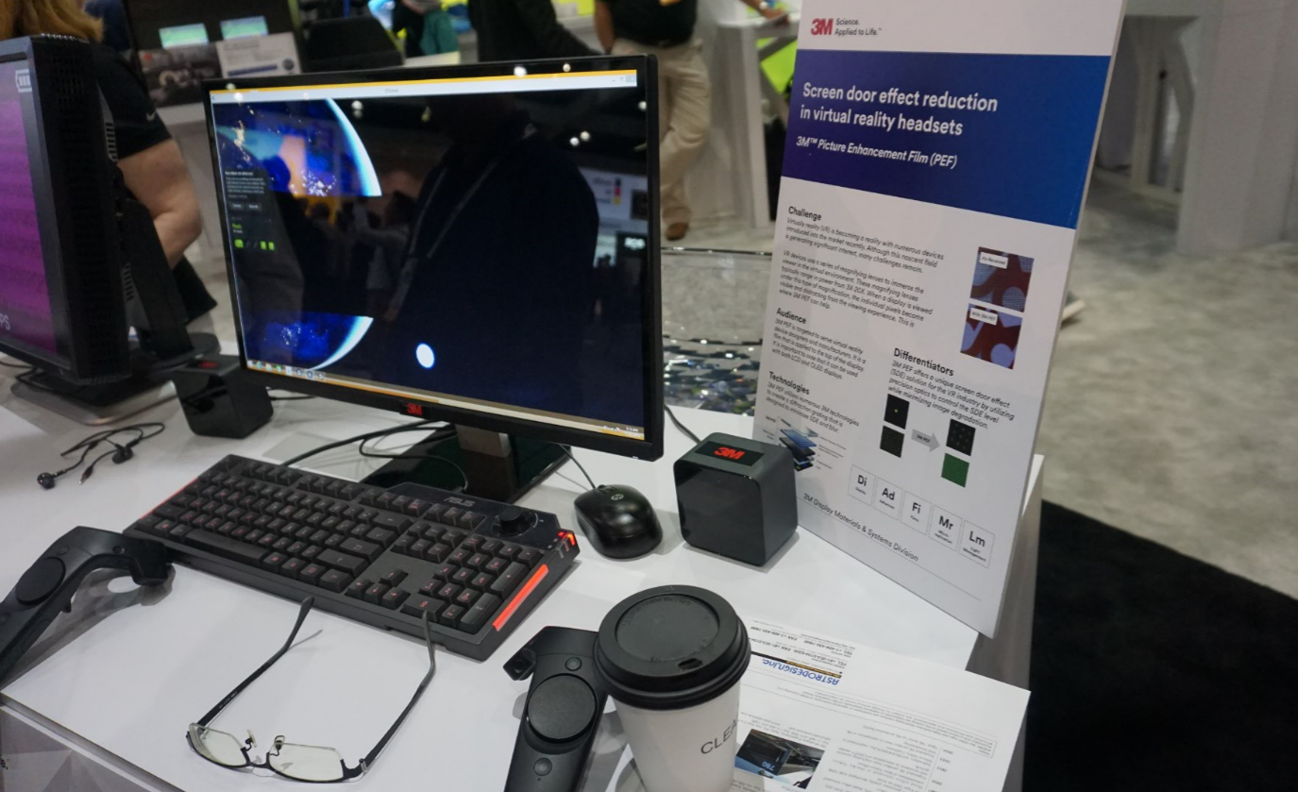
Display Technology Trend in VR
3M
Screen-door-effect reduction in virtual reality headsets

Slide 28
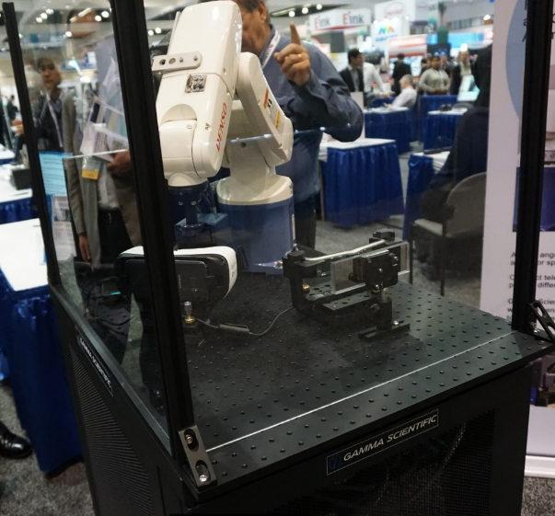
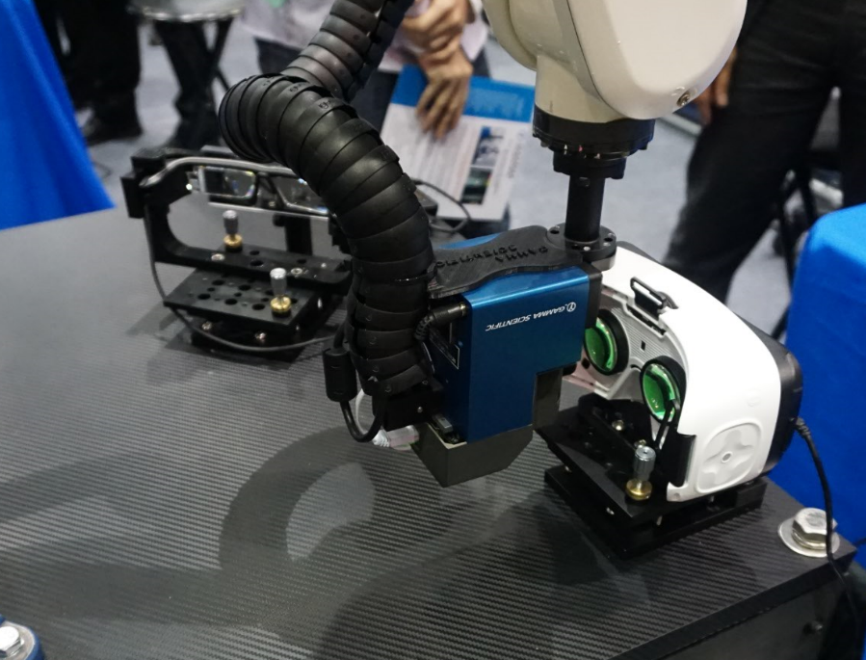
Display Technology Trend in VR
Display measurement system
Near-eye display measurement

Slide 29
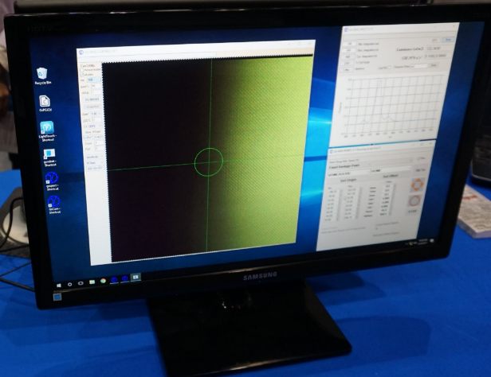
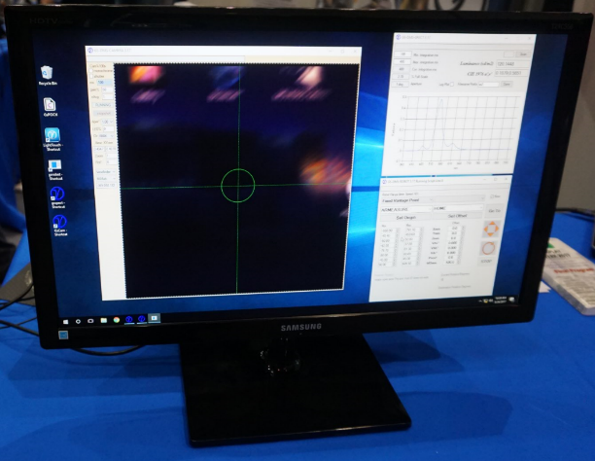
Display Technology Trend in VR
Display measurement system
Near-eye display measurement

Slide 30
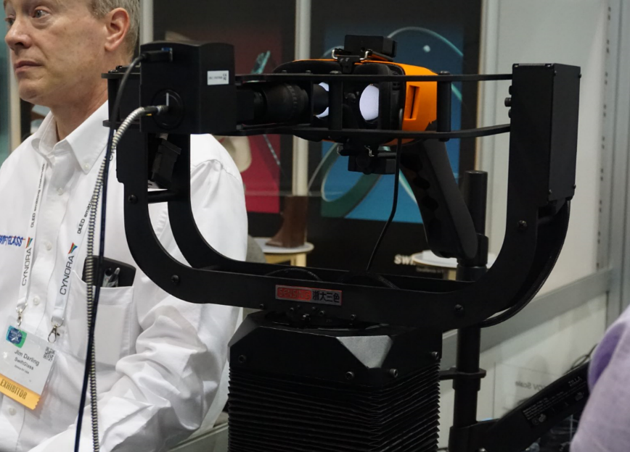
Display Technology Trend in VR
Display measurement system
Perceptual resolution measurement

Slide 31
Conclusion
We have to measure and reduce the motion-to-photon latency
The latency measurement system is required for quantitative numerical calculations
Finally, the latency compensation technique is required to reduce the motion sickness
Considerations in Displays
We have to use the high PPI display, but consider HW resources to render the output image
In order to reduce the chromatic aberration, we have to use the pre-correction technique

