Slide 1
Best Practices for VR Applications
July 25th, 2017
Wookho Son
SW·Content Research Laboratory
Electronics&Telecommunications Research Institute

Slide 2
Compliance with IEEE Standards Policies and Procedures
Subclause 5.2.1 of the IEEE-SA Standards Board Bylaws states, "While participating in IEEE standards development activities, all participants...shall act in accordance with all applicable laws (nation-based and international), the IEEE Code of Ethics, and with IEEE Standards policies and procedures."
The contributor acknowledges and accepts that this contribution is subject to
The IEEE Standards copyright policy as stated in the IEEE-SA Standards Board Bylaws, section 7, http://standards.ieee.org/develop/policies/bylaws/sect6-7.html#7, and the IEEE-SA Standards Board Operations Manual, section 6.1, http://standards.ieee.org/develop/policies/opman/sect6.html
The IEEE Standards patent policy as stated in the IEEE-SA Standards Board Bylaws, section 6, http://standards.ieee.org/guides/bylaws/sect6-7.html#6, and the IEEE-SA Standards Board Operations Manual, section 6.3, http://standards.ieee.org/develop/policies/opman/sect6.html

Slide 3
IEEE P3333.3
HMD Based 3D Content Motion Sickness Reducing Technology
[Dongil Seo, Dillon@volercreative.com]
Best Practices for VR Applications
Date: 2017-07-25
Author(s):
Name | Affiliation | Phone [optional] | Email [optional]
Wookho Son | ETRI | +82-10-8759-3602 | whson@etri.re.kr

Slide 4
Table of Content
1
Background
2
Best Practices for VR Applications
(in preparation)
3
Discussion

Slide 5

1. Background
Strong needs from Industry for developing sickness-relieved VR applications
- especially for VR computer games
- and for various types of training simulators
Each VR application company relies on its own ad-hoc methods to
reduce VR sickness/fatigue
- own ad-hoc methods acquired through experiences
Increased investment by global leading companies to resolve VR sickness in terms of improving VR headset device
- low-latency headset(head tracking, foveated rendering, etc)
- high-end headset: High resolution, Wide FoV(closed to 200°), HDR for colors
- Increased wearability
Best Practices by Oculus, the best one available to date
- what others are available?
Foundation of global association, GVRA(Global Virtual Reality Association) for developing and deploying best practices for VR
- supported by Acer, Google, HTC, Samsung, SONY, etc.
Notes:
GSR 센서: 피부의 습기에 의한 전류 변화를 감지하는 센서 (각성, 흥분과 같은 감정의 변화를 읽을 수 있는 센서)
- 피부의 습기변화는 교감신경계에 의해 제어
- 강한 감정이 발생하면 교감신경계에 의해 피부 습도가 변하게 되고, 이걸 전기적인 저항의 변화로 일어낼 수 있음

Slide 6
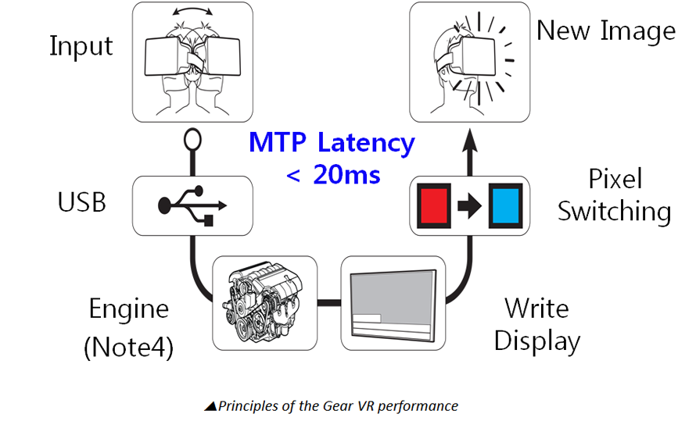
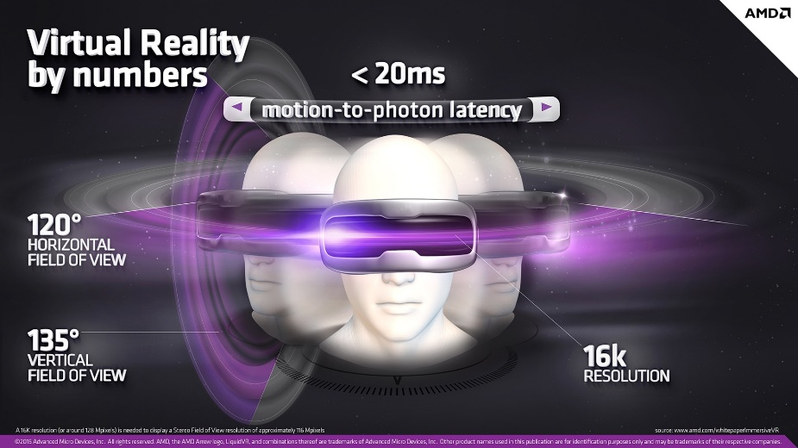
2. Best Practices for VR (1)
Latency Minimization
VR latency should not exceed 20 ms
<2015, Kostov G.>
<Graphics processing requirement for immersive VR(2015, AMD)>
VR Latency(Motion-to-Photon Latency)
- Mobile VR latency= Display Response + Head Tracking + Network Transmission + VR Rendering
- PC based VR latency= Display Response + Head Tracking + VR Rendering
Head-tracking performance varies among VR HMDs
Device | Samsung GearVR | HTC Vive VR | Oculus Rift CV | PlayStation VR
Head tracking | > 20ms | 13ms | 18ms | 18ms

Slide 7

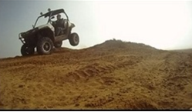
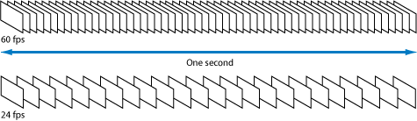
2. Best Practices for VR (2)
Frame Rate Optimization
Frame rate of VR content should be synchronized with the refresh rate of VR HMD, maintaining above 90 FPS for interactive VR applications
<30 FPS>
<60 FPS>
Low frame rate generates flickering/motion blurring/juddering in the VR image, causing headache, eye strain and seizure(ala Nintendo epileptic)
Normal video and interactive video should have frame rate of at least 30 fps and 90 fps, respectively
Most off-the-shelf VR HMDs have refresh rate of above 90 Hz
Oculus best practice is above 75 fps
High-contrast or high-sharpness VR content may have flickering even for high frame rates

Slide 8
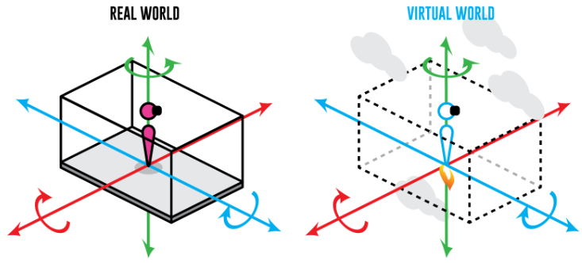
2. Best Practices for VR (3)
Camera Motion
Frequency and magnitude of the accelerated camera motion(back/forth, left/right, rotation, zoom) should be minimized, and should move at constant speed if possible
Abrupt camera movement causes VR sickness for the users, since it changes the cFoV(camera Field of View)
- The huge amount of pixel information change at an instant causes discomfort to users
Human vestibular system is very sensitive to the change of speed of visual objects, either being a camera and an object

Slide 9
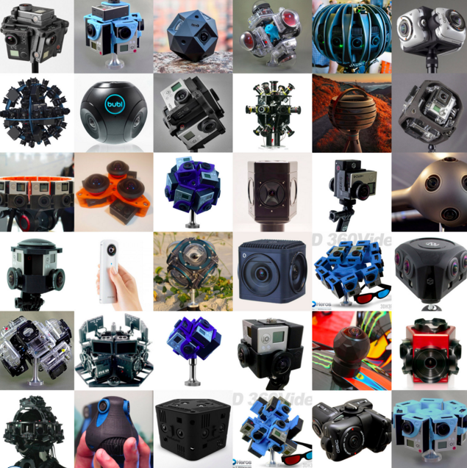
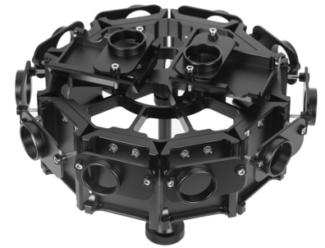
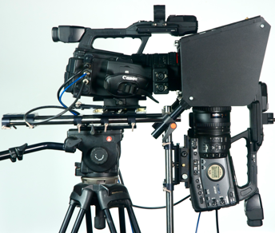
2. Best Practices for VR (4)
Rig Construction
For 360° VR, rig system should be manufactured in a way that cameras are aligned with the nodal point (a.k.a. no parallax point)
<360° Camera Rig>
<Vertical Camera Rig>
<Various 360° VR Camera Rig>
There exists some gaps between cameras for 360° VR due to its physical bulkiness
Proper design of camera-rig system is needed to overcome the problems due to inherent defection caused by the camera-rig structure
Deviations from the nodal point causes a uncomfortable parallax, which in turn aggravates the stitching errors

Slide 10
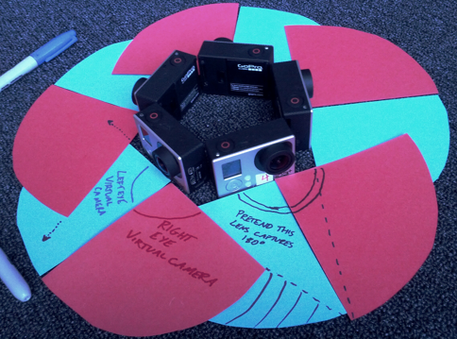
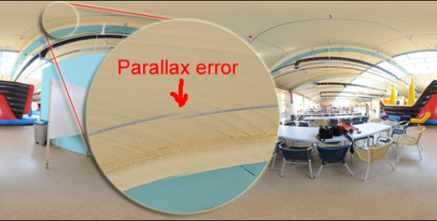
2. Best Practices for VR (5)
Stitching Optimization
Adjustments need to be done for camera placement, lens distortion, camera sync, and stitching algorithm in order to reduce the errors for 360° VR capturing and post processing
<Stitching errors (e.g.)>
Image distortion due to stitching errors prevents user’s immersion, eventually leading to VR sickness
Stitching errors occur due to camera differences in optical focal length, horizontal disparity, lens curvature, etc.
Specific guidelines needed for corrections:
- camera placement to handle disparity
- distortion due to lens curvature
- proper use of stitching SW

Slide 11
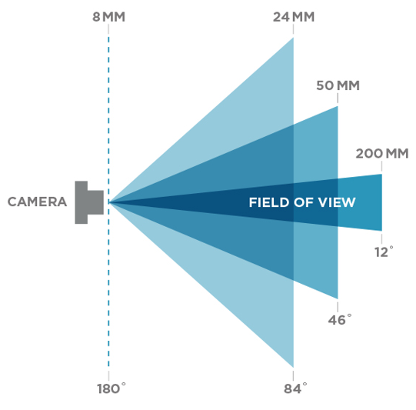
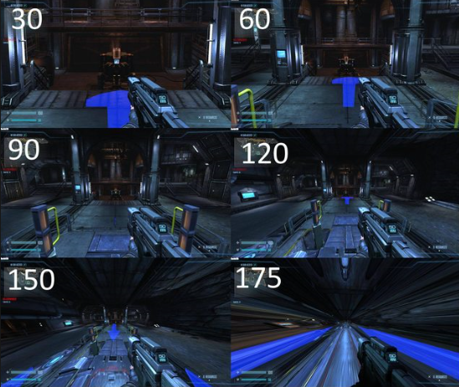
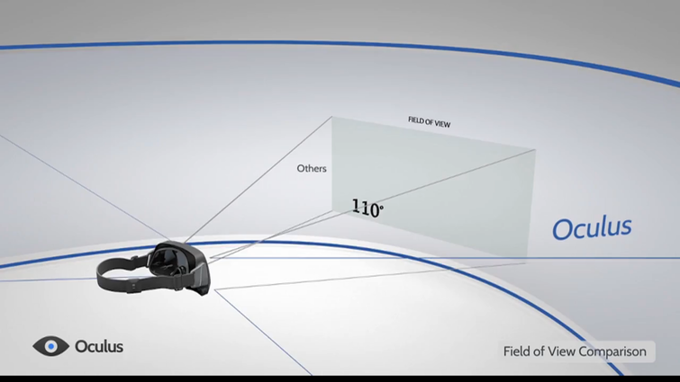
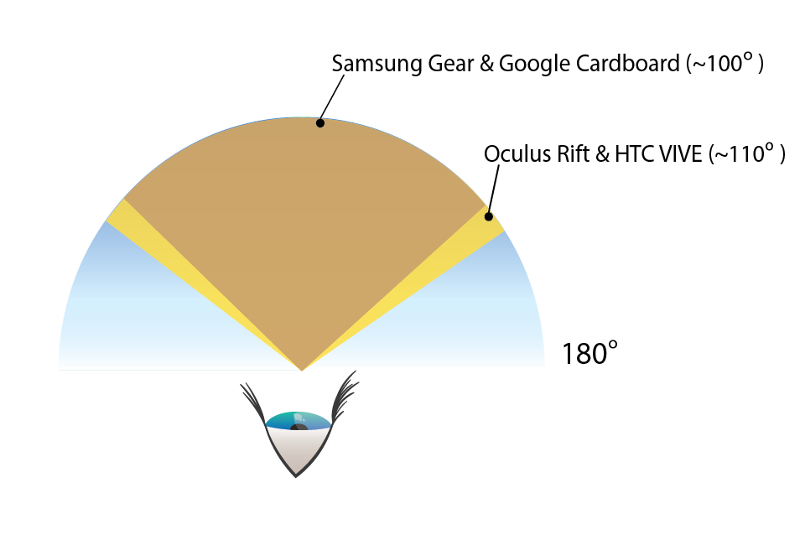
2. Best Practices for VR (6)
FoV Adjustment
cFoV (Camera’s FoV) must match the fixed dFoV (display FoV)
A discrepancy between cFoV and dFoV causes a discomfort due to distortion on displayed image and degraded resolution
* Human FoV: 210°, Military HMD’s FoV: 180°~210°
Some tradeoff between the immersion and VR fatigue w.r.t. large dFoV

Slide 12
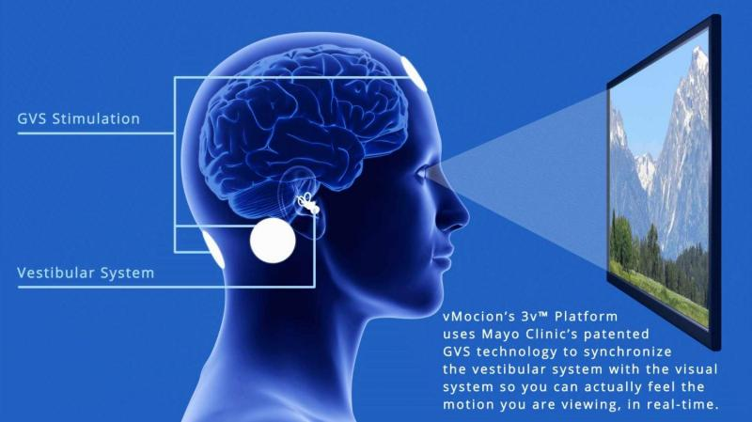
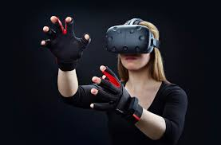
2. Best Practices for VR (7)
Synchronization of Sensory Conflicts
Synchronize the user’s visual experience with the bodily sensation in order to reduce the VR sickness
Synchronization of vestibular system via GVS (Mayo Clinic, 2016)
<Synchronization of proprioceptive sense>
VR sickness occurs mainly by two reasons:
- User’s visual cues doesn’t match with that of the internal ear’s vestibular sense
- User’s visual cues doesn’t match with that of the proprioceptive sense
VR sickness could be partially handled by:
- having the user’s VR experience to be expected
- using an avatar reflecting exact behaviors of the users
- artificial stimulation of the human vestibular system

Slide 13
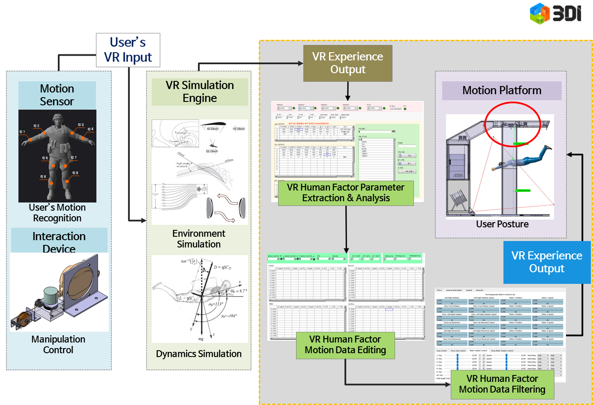
2. Best Practices for VR (8)
Synchronization of Motion Platform
To synchronize the user’s visual experience with the sensation of movement, the VR input-output latency should not exceed 150 ms
VR sickness due to riding simulators (motion sickness) is mainly caused by the desynchronization between the user’s visual cues and their sensation of movement
Currently-recommended VR input-output latencies:
- MLIT (Korea) : between 100ms~150ms(1st grade, 2nd grade, 3rd grade)
- FAA (U.S.A.) : under 100ms
Much more tricky to deal with the accuracy issues for riding simulators
Notes:
MILT(Ministry of Land, Infrastructure and Transport)
FAA(Federal Aviation Administration)

Slide 14
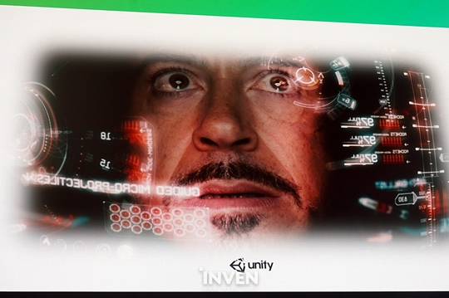
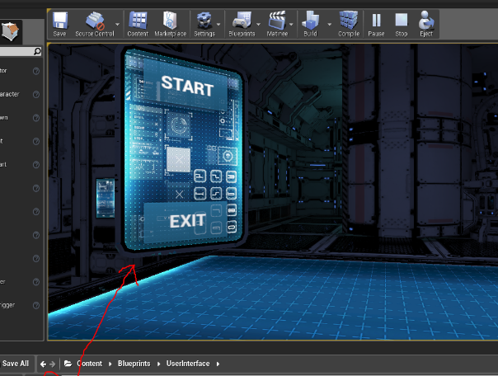
2. Best Practices for VR (9)
UI Placement
Place UI in the 3D space in VR by making it a 3D object
<UI in the form of a HUD>
<UI as an 3D object in VR space>
Avoid attaching UI to camera, so called HUD, so as to avoid undesirable movements due to its tight-coupling with the camera’s motion
- Embed or integrate the information into the environment, forgoing the HUD
Make UI visible whenever necessary or transparent using alpha value to avoid undesirable obtrusive view (occlusion)
Place UI within user’s effective Field of View
Use gaze crosshair or reticle

Slide 15
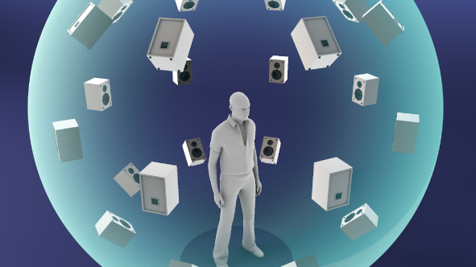
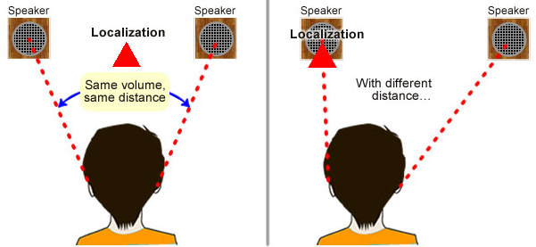
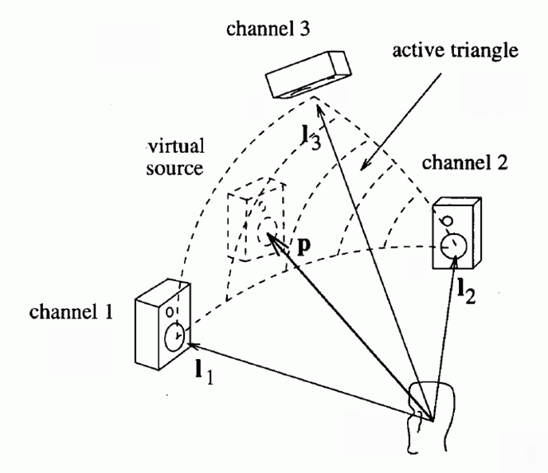
2. Best Practices for VR (10)
Sound
Adjust the incoming direction of the sound in synchronization with the head tracking of the users
<VR Sound>
<Binaural Effect>
Synchronizing the sound direction with the head tracking helps users to be situation-aware
Binaural rendering* can be used to create immersive sound
- Synthesize the 3D sound into two-channel output, which is rendered in a way that reflects
where the sound is coming from, taking into account the relative direction and distance
between the sound source and the listener(user)
* when two sound signals of two different frequencies are presented separately,
the user’s brain detects the phase variation and recognize it as a third sound signal

Slide 16
3. Discussion
Is there rigorous ways of validating the proposed best practices,
in terms of both by theory and practicality?
Best practices as an enforcement or just guidelines?
- best practices shouldn’t be used to regulate the commercial VR
application products
Do we need categorized best practices depending on application genre?
Too much factors to consider for the standardization proposals
Deal with the needs for quantifying the degree of VR sickness
- rate VR applications according to the severity of VR sickness induced by them
How to effectively develop globally-acceptable best practices for VR
- Find a way of participating in the effort by global association (e.g. GVRA)
- Contact global companies individually to find out the practices they are using
and/or preparing (other than Oculus)
Differentiate between real video and pure computer graphics data

