Slide 1
HMD 360º Images VR Service
2017. 07. 26
Kwan-Hee Yoo
Chungbuk National University

Slide 2
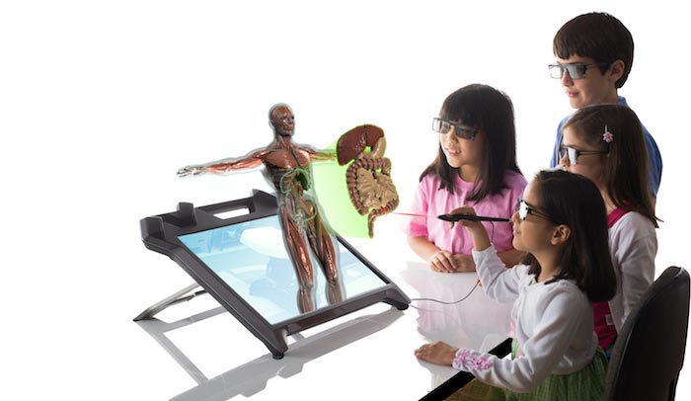
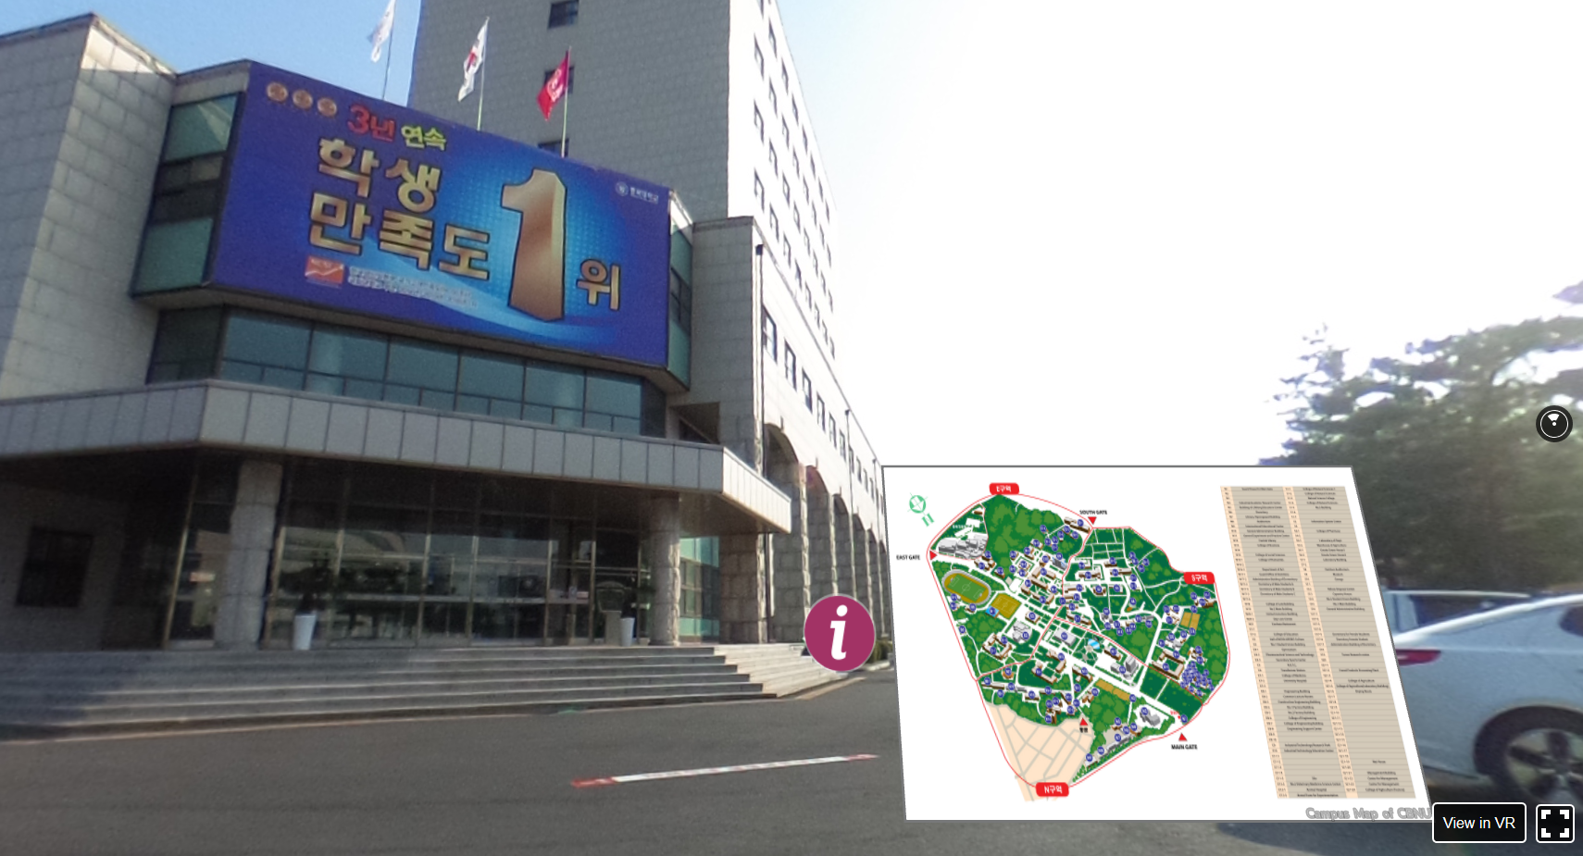
What is Virtual Reality?
Making an electronic world seem real and interactive
Not static 3D image
Not movies
Moving within the 3D world
Manipulating objects in the 3D world

Slide 3
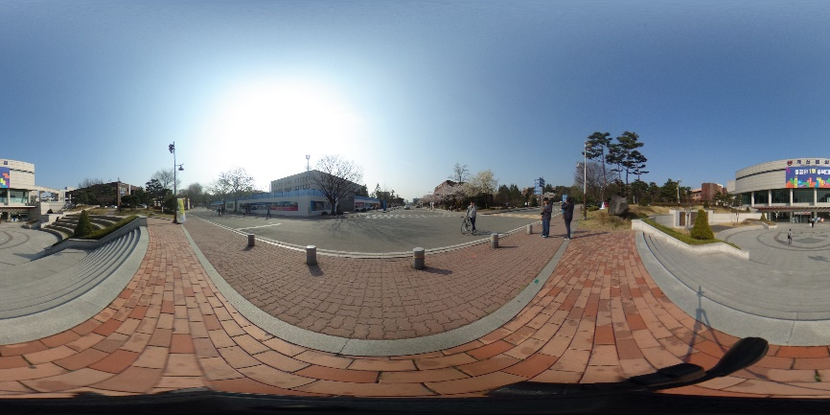
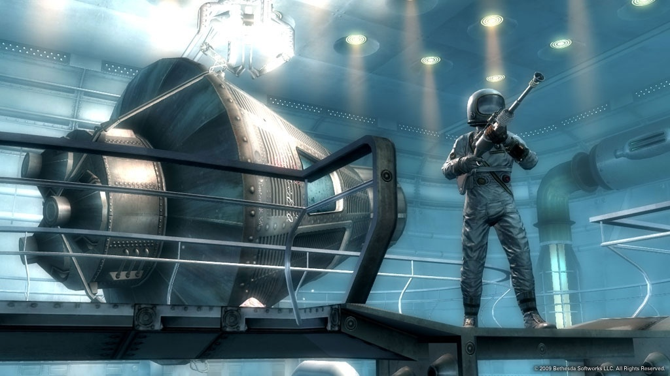
Type of VR Experiences
Immersive Spaces
- 360º Panorama image/Video
- High visual quality
- Limited interactivity
- Changing viewpoint orientation
-User can turn head to see different
views
- Fixed Position
Immersive Experiences
- 3D graphics
- Lower visual quality
- High interactivity
- Movement in space
- Interact with virtual objects

Slide 4
Where 360º VR Walking Tour can apply?
Virtual Map (University Campus, Hospital, Company, Factory…)
Visiting Place (Park, Resort, Mountain, Temple…)
Business Place (Hotel, Restaurant, bars,…)
More effective than Streetview
Add more information
Custom
Own system
Own website

Slide 5
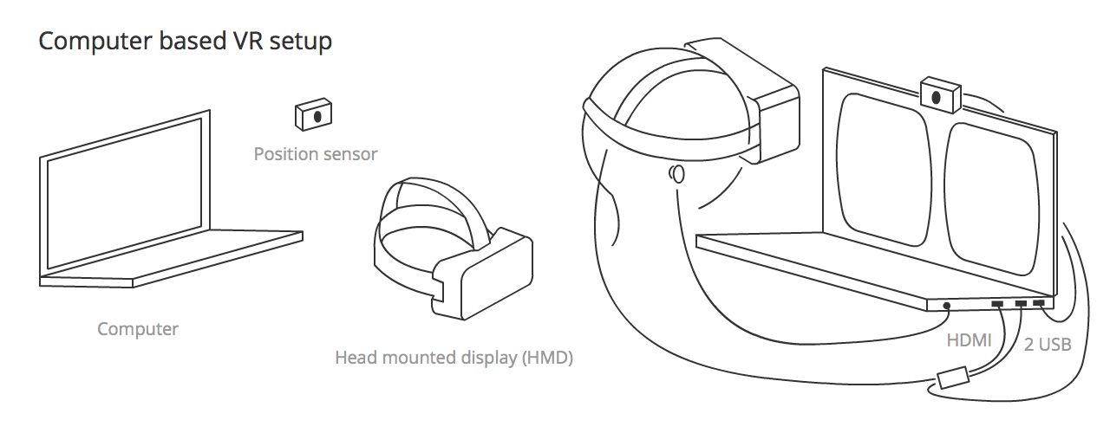
Computer based Vs. Mobile VR

Slide 6
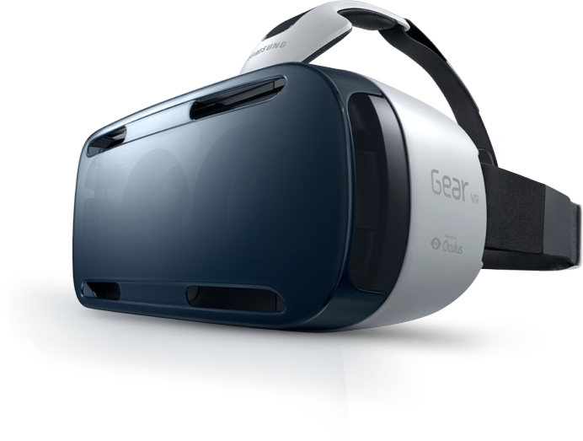
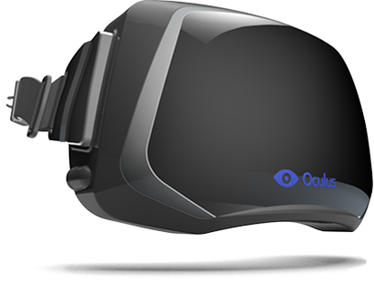
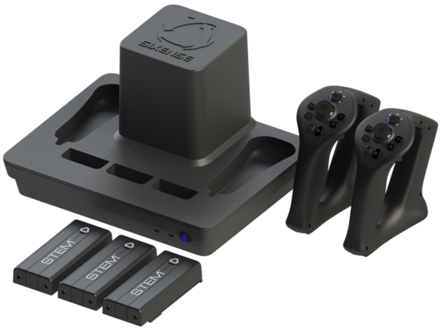
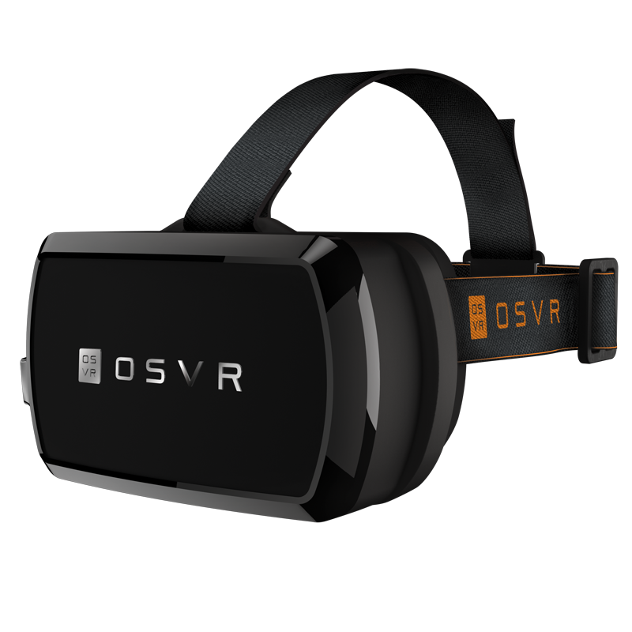
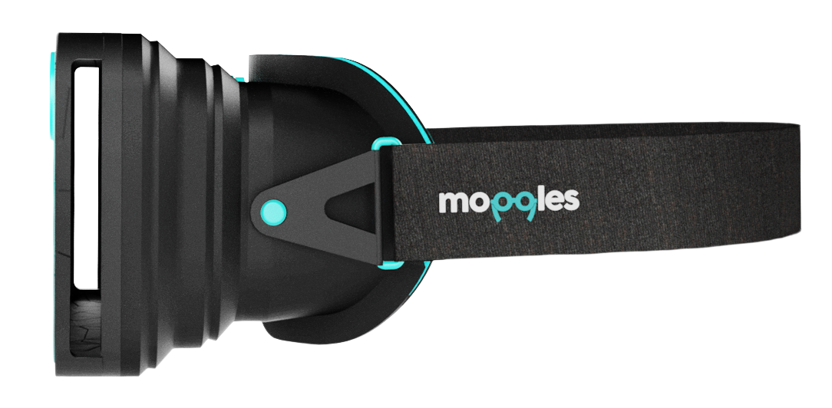
VR hardware explosion
Increasing of Virtual reality hardware
Affordable stereoscopic displays
Head Mounted Display
Motion tracking
Head tracking
VR input devices
VR HMD devices

Slide 7
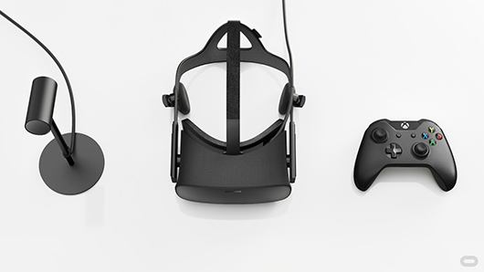
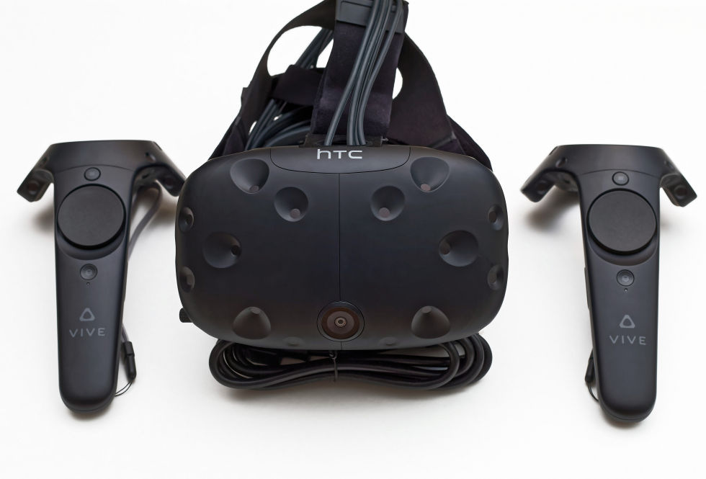
PC HMDs
PC HMDs refer to Desktop peripheral acts as external monitor
Provide deepest, most immersive VR
Position and orientation tracking
Tethered – one or more cables connect to computer such as camera for position tracking
Oculus Rift
HTC VIVE

Slide 8
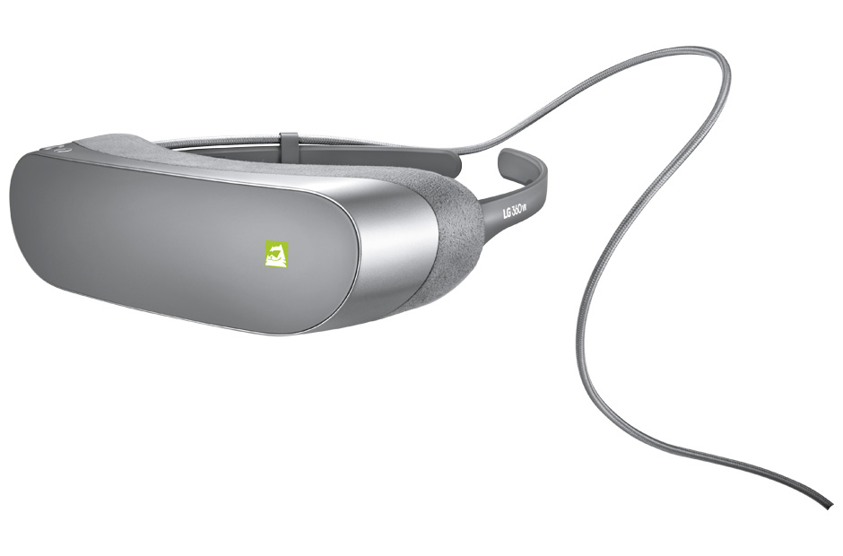
Mobile HMDs
Custom Android build/ Oculus mobile SDK
Orientation tracking only
Support for S6 coming – Samsung Gear VR
Support for LG G5 – LG VR
110 diagonal FOV – Gear VR
1000hz refresh rate – Gear VR
Samsung Gear VR
LG VR

Slide 9
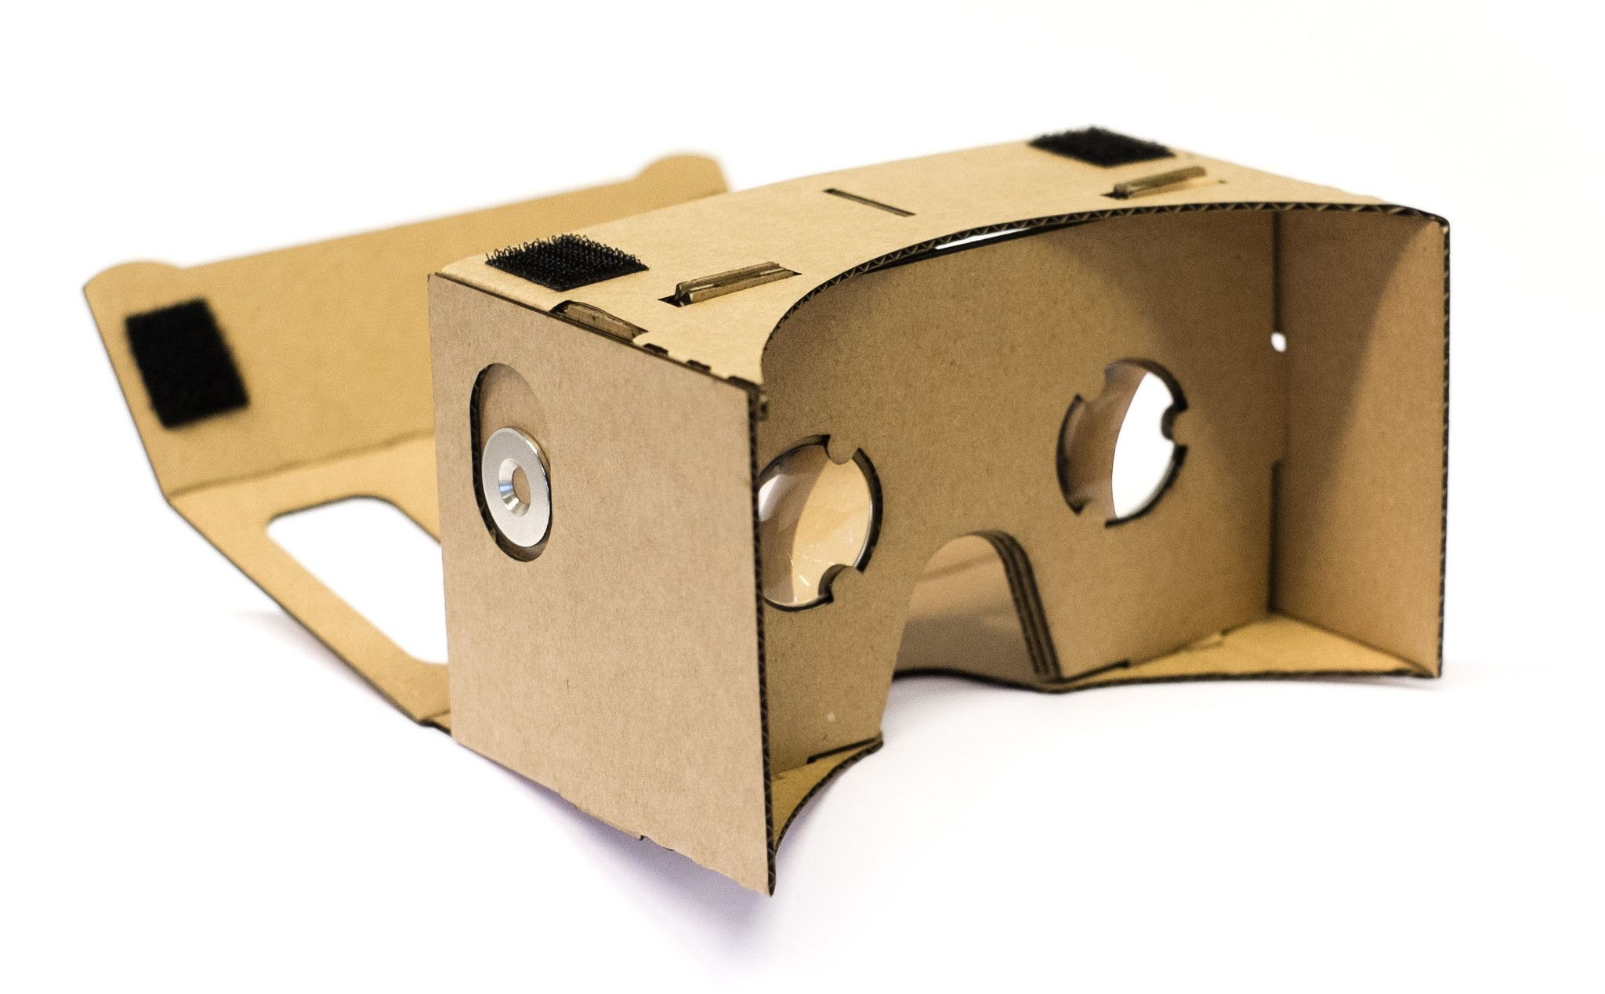
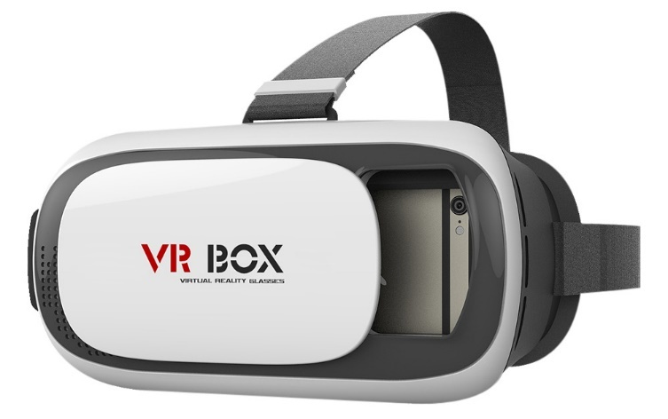
Drop-in phone viewers
Open specification for mobile VR
Orientation tracking only
Standard Android, iOS support, using simple stereo rendering and accelerometer tracking
Just add SmartPhone
90 degree FOV – Cardboard
200hz refresh rate
Google Cardboard
VR BOX

Slide 10
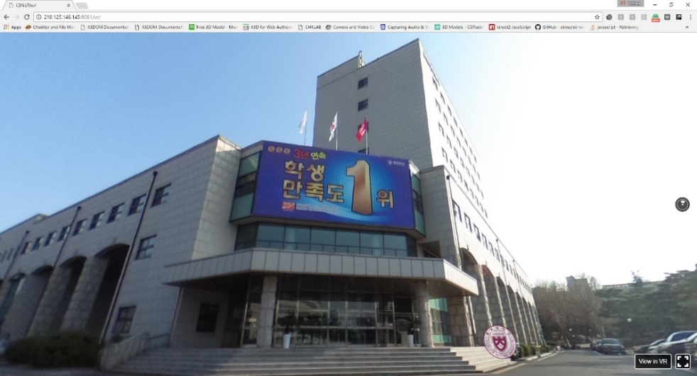
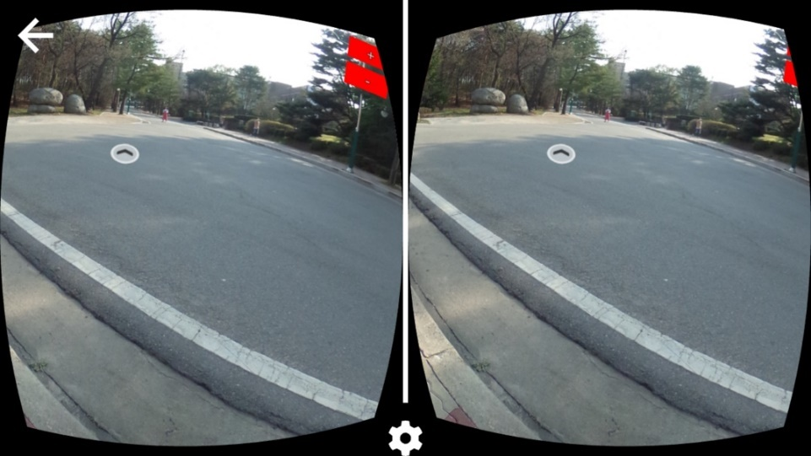
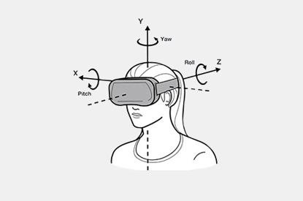
Image generating : One of the most time consuming task in Virtual Reality is generation of 360º images, 3D Objects and 3D world.
Stereo Vision: Accomplished by creating two different images of the world once for each eye.
Manipulation & Control Devices : One key element for interaction to the virtual world that is tracking the position of real world objects such as head tracking, side-by-side stereo rendering, spatial audio rendering, detecting user inputs such as the trigger.

Slide 11
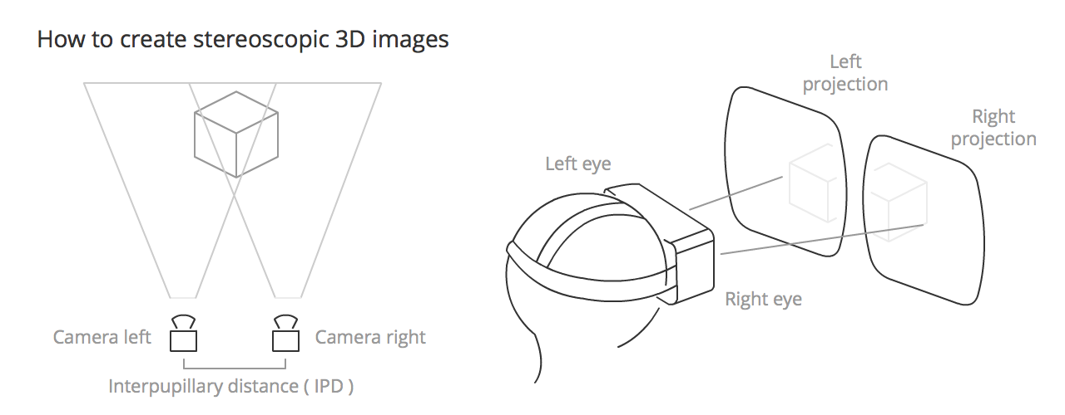
Stereoscopic Vision
Stereoscopic vision is the normal vision humans and (most) animals have — the perception of two slightly differing images (one from each eye) as a single image. This results in depth perception, helping us to see the world in glorious 3D.

Slide 12
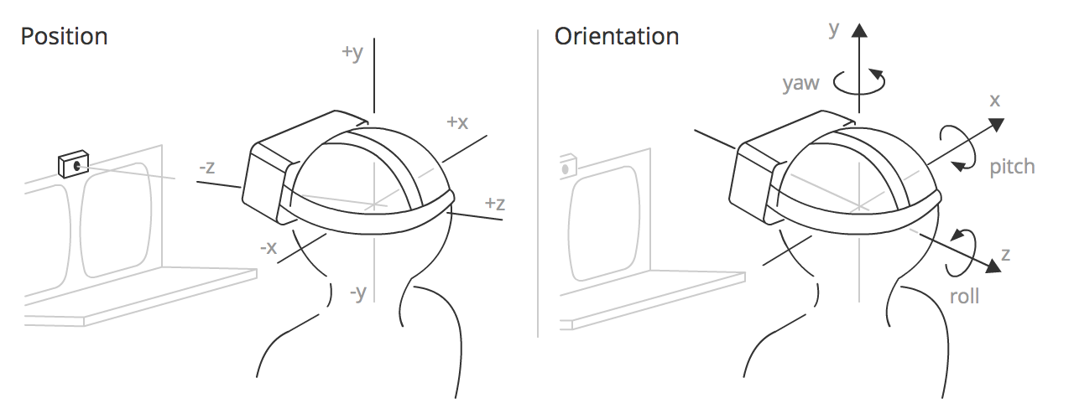
POSITION AND ORIENTATION
The position sensor detects information concerning the HMD and constantly outputs it.
Position :The position of the HMD along three axes in a 3D coordinate space. x is to the left and right, y is up and down, and z is towards and away from the position sensor.
Orientation :The rotation of the HMD around three axes in a 3D coordinate space. Pitch is rotation around the x axis, yaw is rotation around the y axis, and roll is rotation around the z axis.

Slide 13
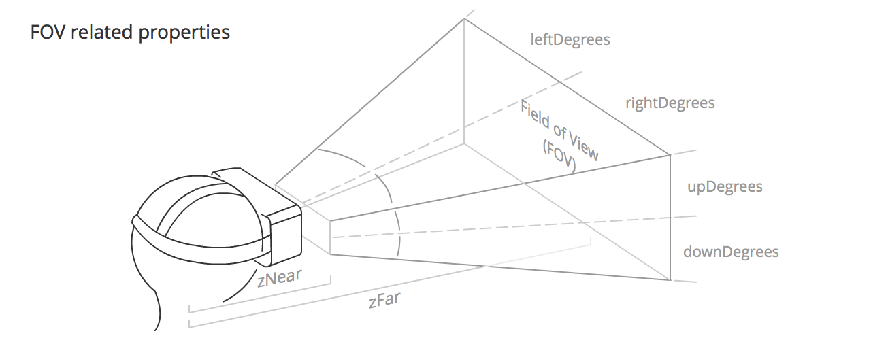
FIELD OF VIEW ( FOV )
The field of view (FOV) is the area that each of the user's eyes can reasonably be expected to see.
upDegrees: The number of degrees upwards that the field of view extends in.
rightDegrees: The number of degrees to the right that the field of view extends in.
downDegrees: The number of degrees downwards that the field of view extends in.
leftDegrees: The number of degrees to the left that the field of view extends in.
zNear: The distance from the middle of the user's head to the start of the visible FOV.
zFar: The distance from the middle of the user's head to the end of the visible FOV.

Slide 14
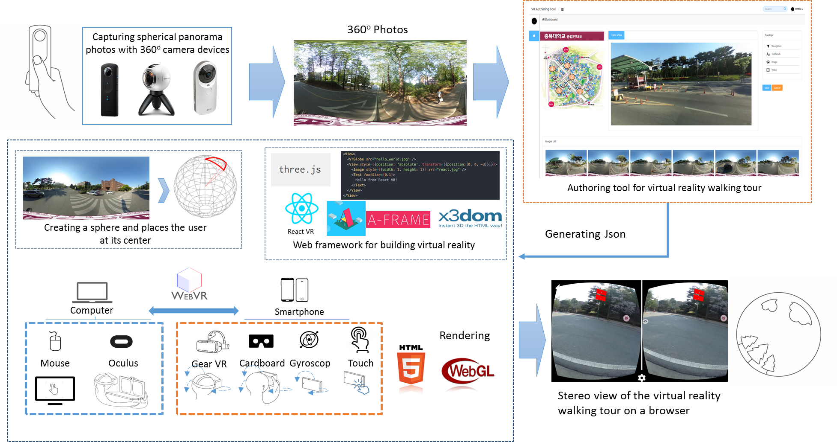
360º VR Tour Development

Slide 15
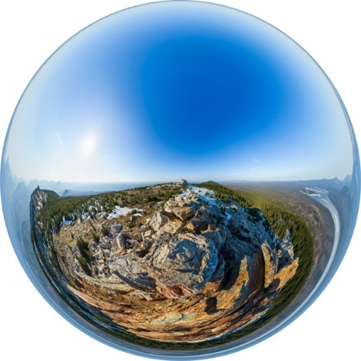
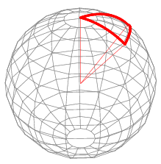
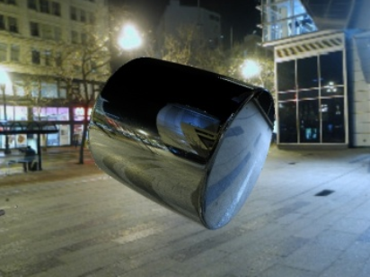
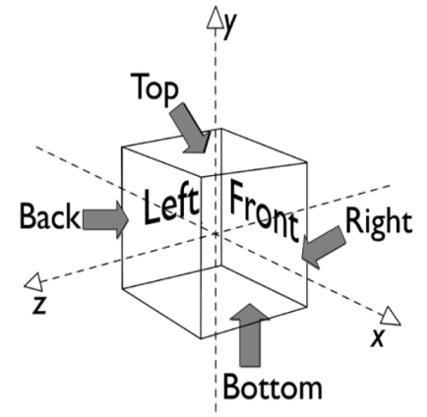
Panorama images for visualizing 360 scene
360º VR Tour app is composed by a panorama (pano) image, cubic and spherical
A panorama image allows you to see the image from every angle including above, below, behind and next to you, that's the reason they are also called 360 images or spherical panoramas.

Slide 16
X3D Panorama image
Cubic : Skybox mapping (Background) (6 images)
: 3D provides panoramic background node for Universal media
Equirectangular: Spherical mapping (360 image)
: Sphere and Image Texture

Slide 17
X3D Cubic panoramas
Cubemaps are the other format of 360 panoramas. This format uses six images for the six faces of a cube that will fill the sphere around us. It's also known as a skybox.

Slide 18
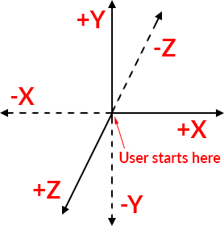
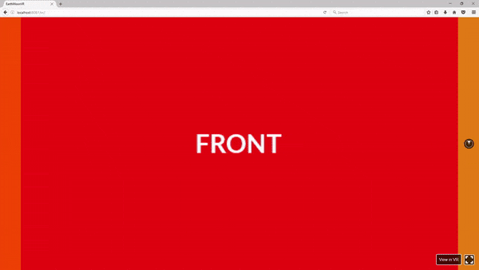
X3D Cubic panos
In 2D layouts, the X-axis points to the right and the Y-axis points down, which means that the top left is (0, 0) and the bottom right will be the width and the height of the element at (width, height).

Slide 19
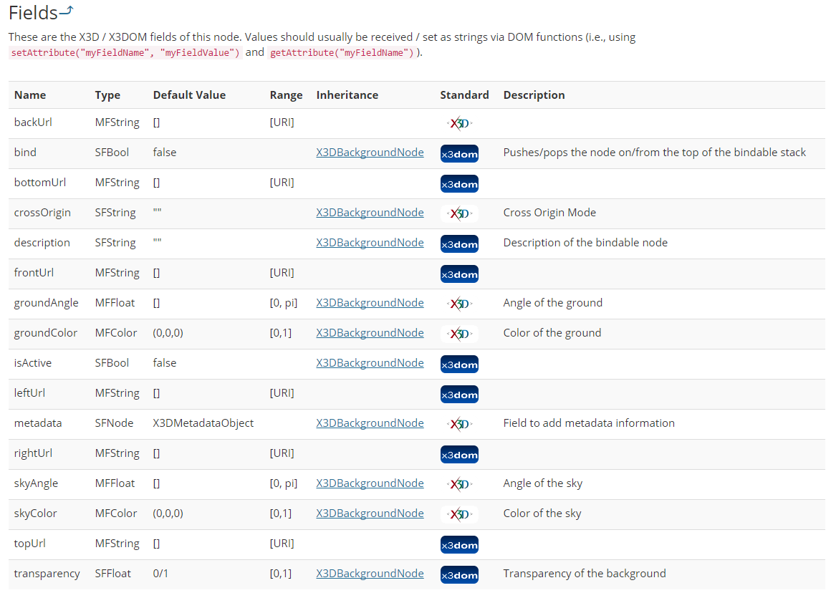
X3D 360º image - cubic
X3D provides panoramic background node for Universal media

Slide 20
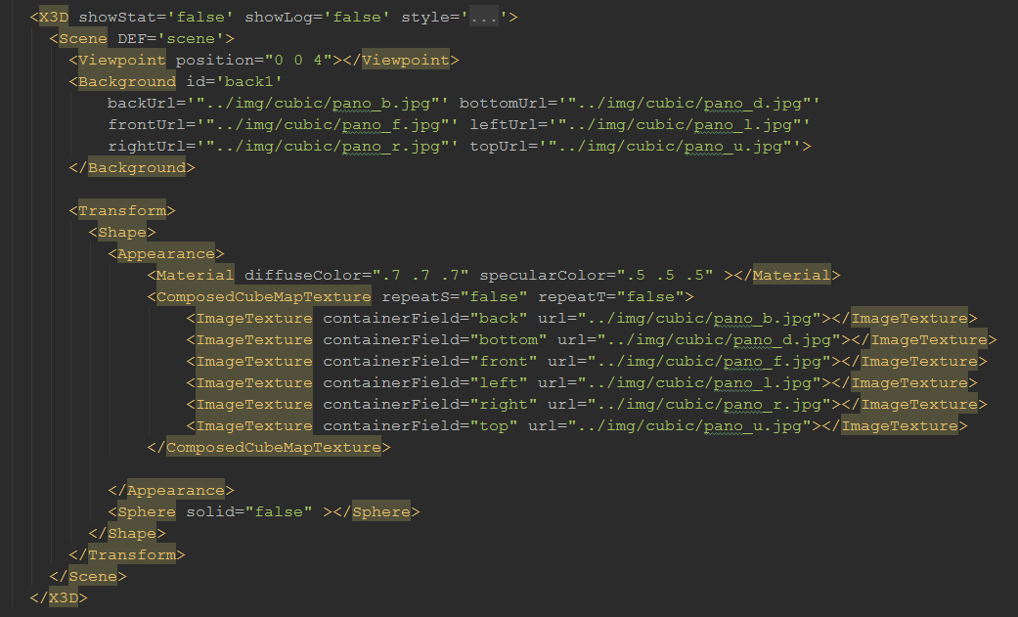
X3D 360º image - cubic

Slide 21
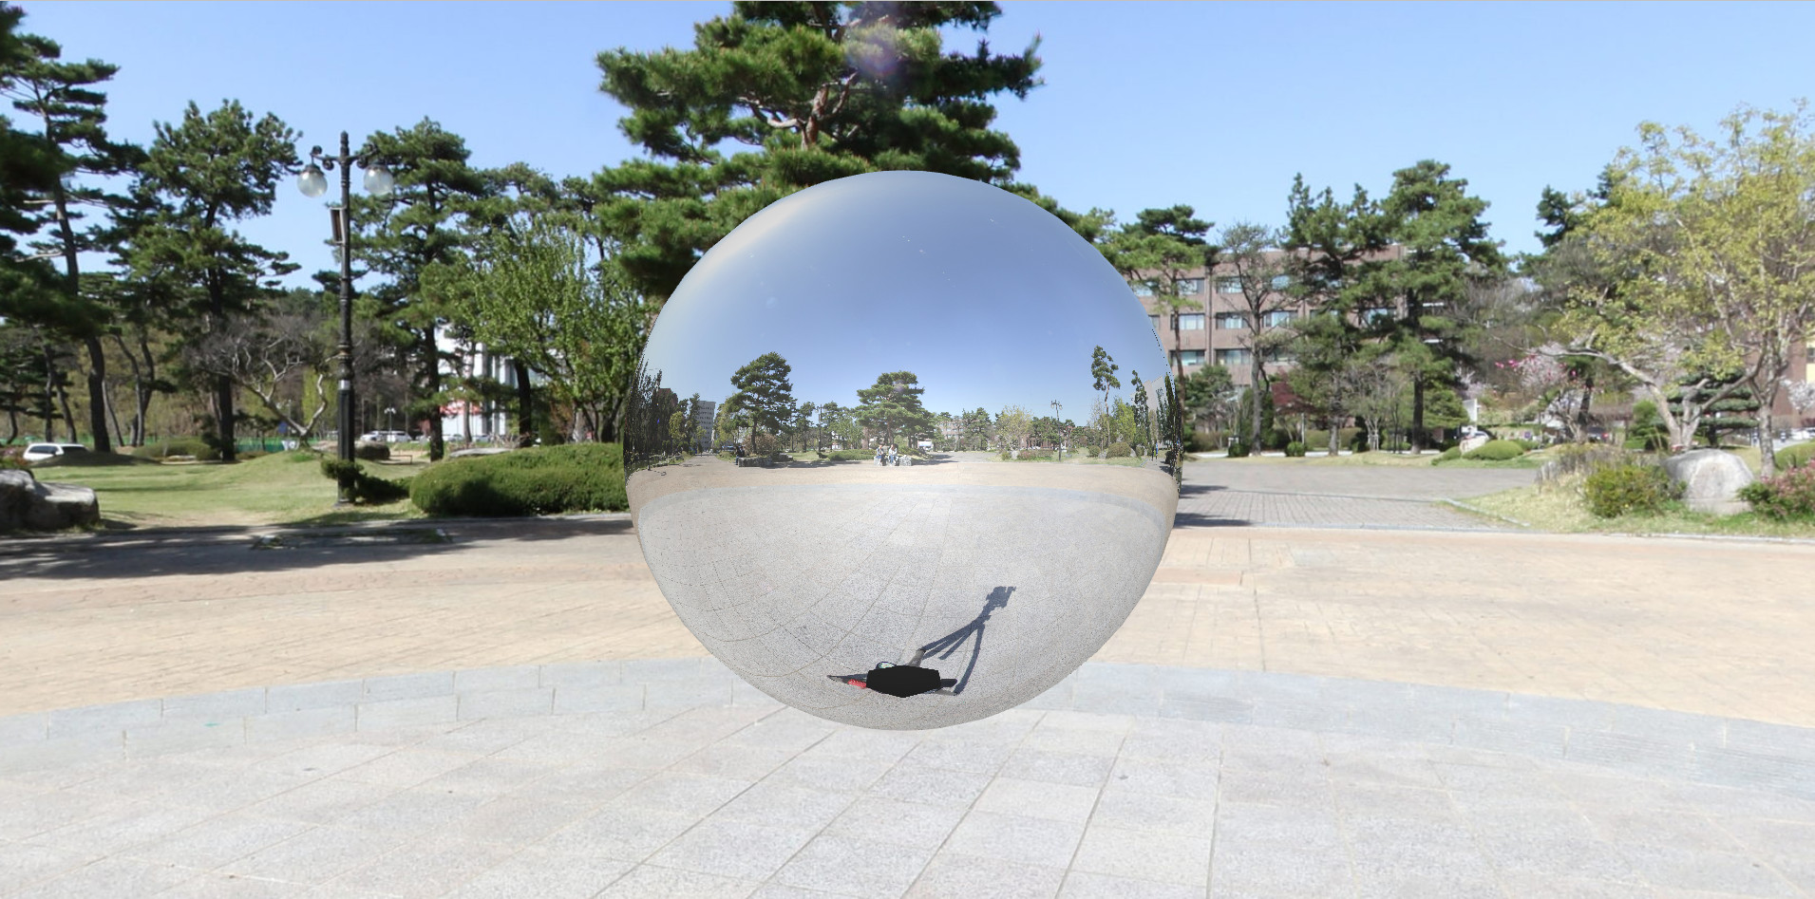
X3D 360º image - cubic
http://cgac.cbnu.ac.kr/vr/pano/cubemap.html

Slide 22
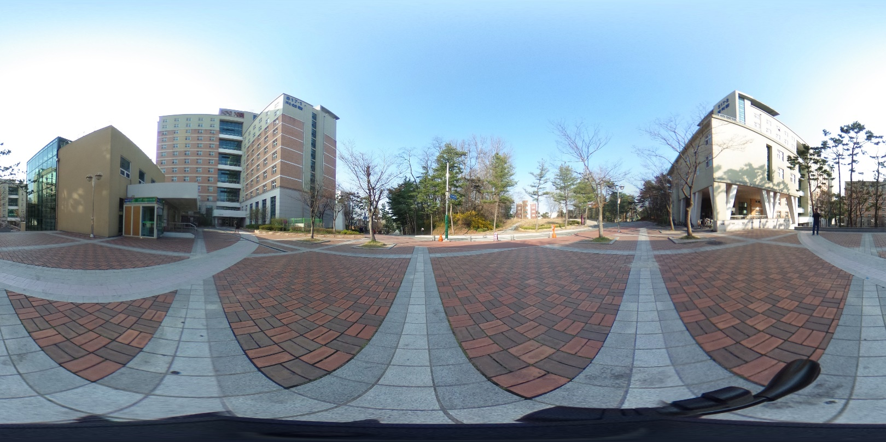
X3D Equirectangular panoramas
An equirectangular pano consists of a single image with an aspect ratio of 2:1, meaning that the width must be twice the height.

Slide 23
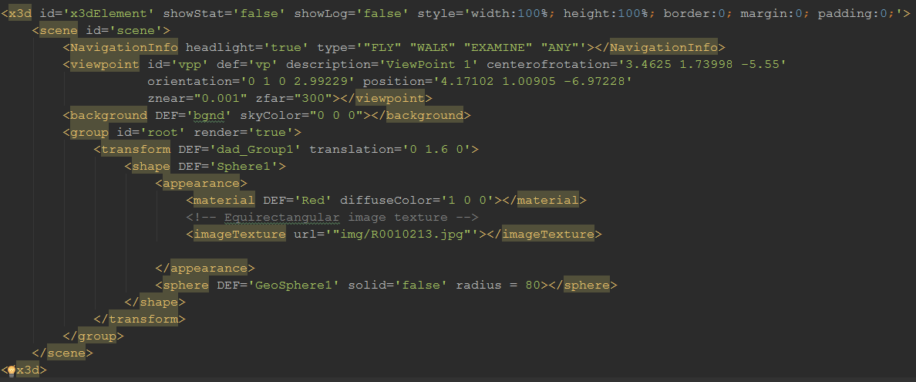
X3D 360º image - equirectangular
Creating a sphere and using imageTexture to texture equirectangular image

Slide 24
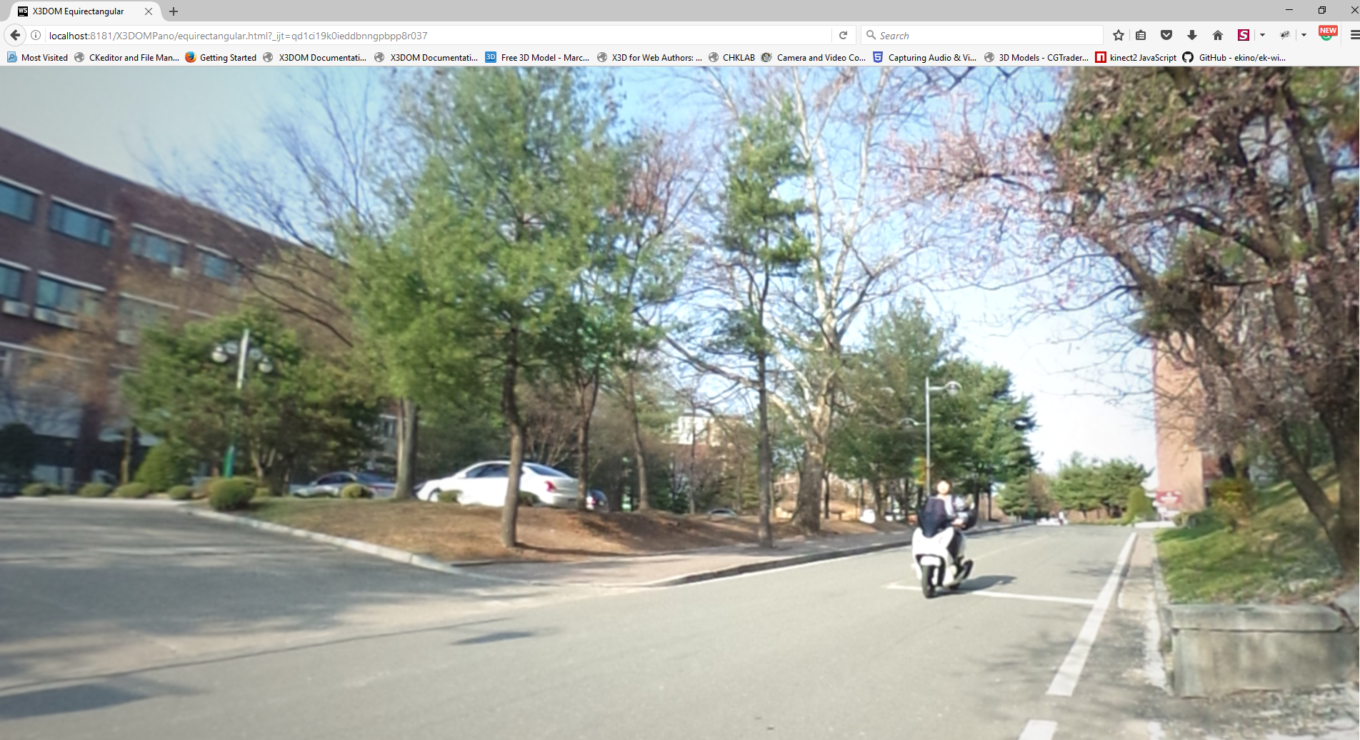
X3D 360º image - equirectangular
http://cgac.cbnu.ac.kr/vr/pano/equirectangular.html

Slide 25
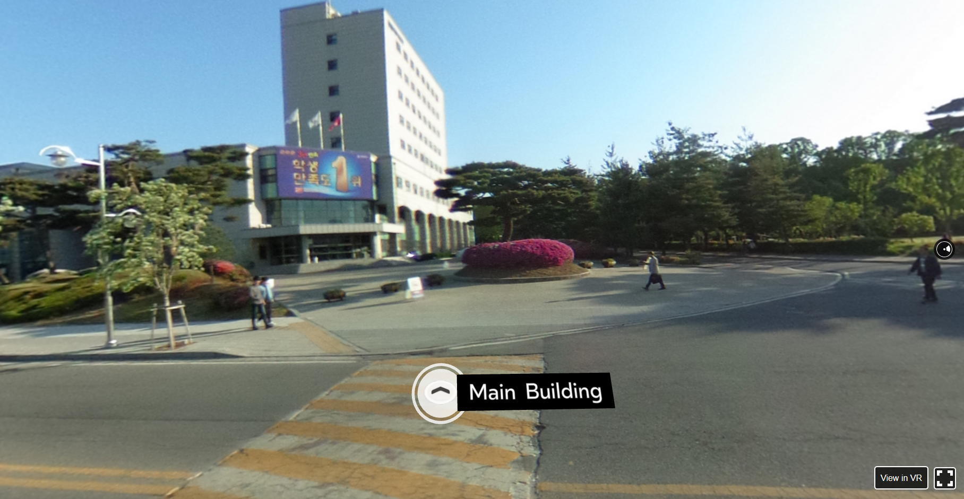
360 VR Tour - Navigation
Move to the next scene
Focus on the icon or click
Show the next place’s name

Slide 26
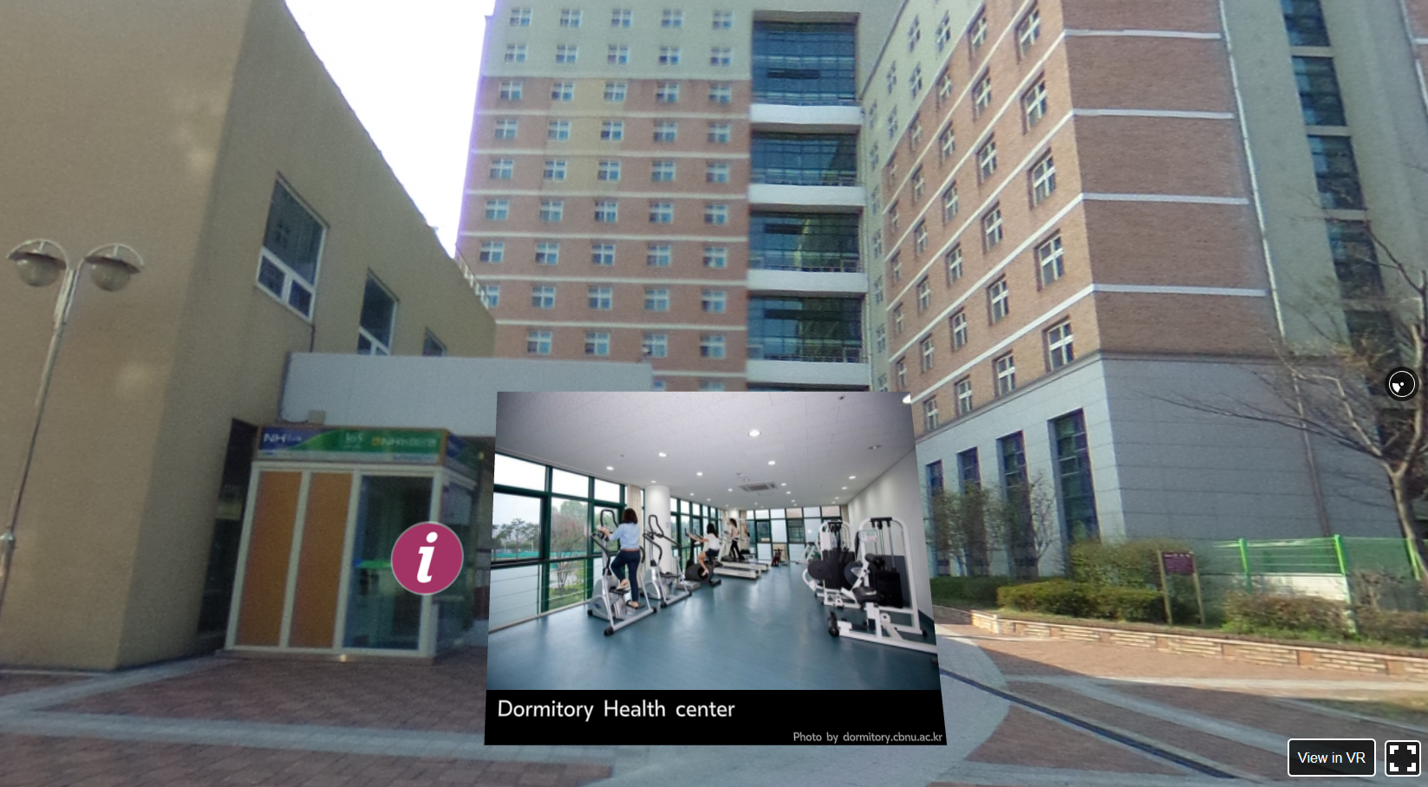
360 VR Tour - Tooltips
Information icon
Image tooltip type (attribution, attributionUri, width, height)
Image tooltip type

Slide 27
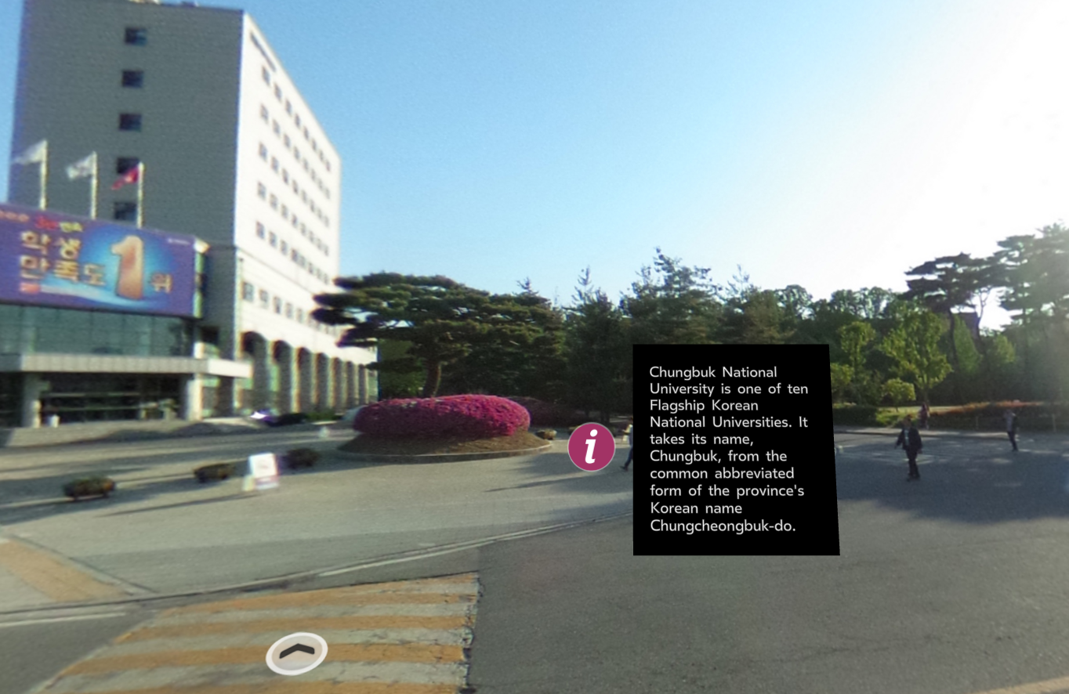
360 VR Tour - Tooltips
Textblock tooltip type (text, width, height)
Textblock tooltip type

Slide 28
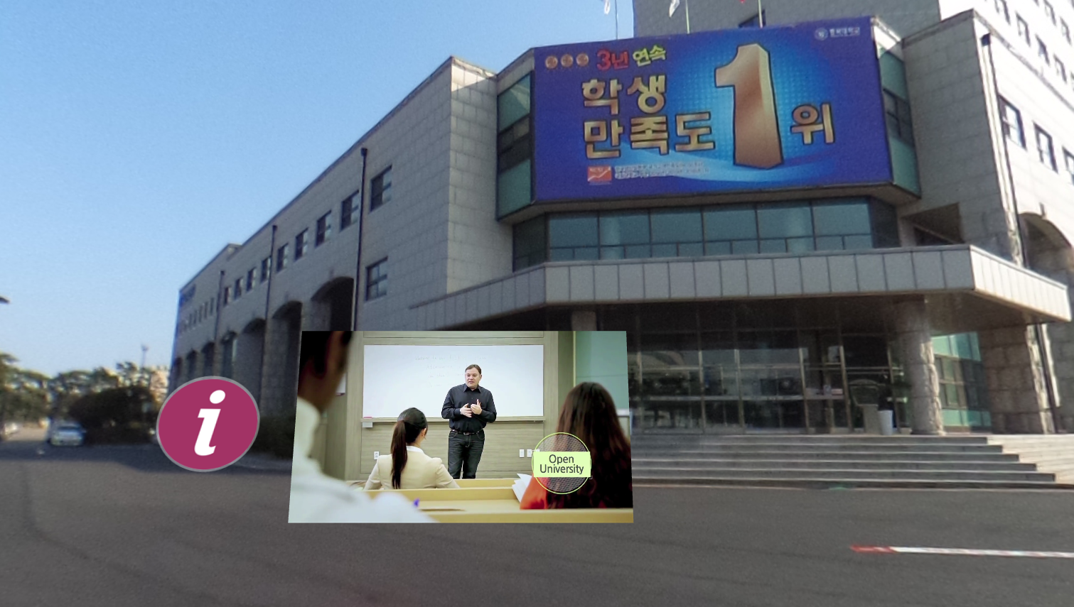
360 VR Tour - Tooltips
Video tooltip type (source, width, height)
video tooltip type

Slide 29
Issues in HMD 360 VR services
Attach AR Marker to 360º walking tour scene
How to attach 2D/3D model to 360º walking tour scene naturally
Use a captured video as a background video in order that users can avoid collision of real objects
HMD VR Service Framework
Send/Receive/See an message
Send/Receive/See a received video
Phone Call
Text Typing

Slide 30
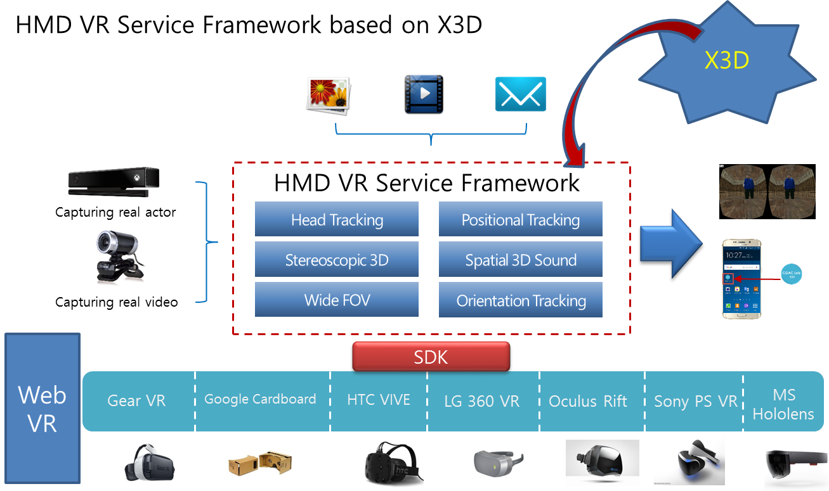
Issues in X3D VR walking tour

Slide 31
Many Areas for VR Research
Display
Wide field of view
New display technologies
Tracking
Precise tracking, wide area
Interaction
Natural gesture interaction, human factors
Applications
Collaboration, large scale VR

Slide 32
Conclusion
Virtual Reality is a growing industry
PC and specialized hardware are getting better, faster and cheaper because of development in VR.
Maybe 3D user interfaces will replace the windows based ones?
Huge demand for VRML programmers in near future.
Revolution in gaming industries

Slide 33
Thank you.

