Slide 1
[IEEE P3079 Session #4 WG Closing Plenary]
[Dillon Seo / VoleR Creative]

Slide 2
Compliance with
IEEE Standards Policies and Procedures
Subclause 5.2.1 of the IEEE-SA Standards Board Bylaws states, "While participating in IEEE standards development activities, all participants...shall act in accordance with all applicable laws (nation-based and international), the IEEE Code of Ethics, and with IEEE Standards policies and procedures."
The contributor acknowledges and accepts that this contribution is subject to
The IEEE Standards copyright policy as stated in the IEEE-SA Standards Board Bylaws, section 7, http://standards.ieee.org/develop/policies/bylaws/sect6-7.html#7, and the IEEE-SA Standards Board Operations Manual, section 6.1, http://standards.ieee.org/develop/policies/opman/sect6.html
The IEEE Standards patent policy as stated in the IEEE-SA Standards Board Bylaws, section 6, http://standards.ieee.org/guides/bylaws/sect6-7.html#6, and the IEEE-SA Standards Board Operations Manual, section 6.3, http://standards.ieee.org/develop/policies/opman/sect6.html

Slide 3
IEEE P3079
HMD Based 3D Content Motion Sickness Reducing Technology
Dongil Dillon Seo, dillon@volercreative
IEEE P3079 Session #4 WG Closing Plenary
Date: 2018-02-01
Author(s):
Name | Affiliation | Phone [optional] | Email [optional]
Dongil Seo | VoleR Creative | +82 10 3135 3194 | dillon@volercreative.com
Sangkwon Jeong | JoyFun | +82 10 8667 7329 | ceo@joyfun.kr

Slide 4
Session Time and Location
 | Monday (Jan. 29, 2018) | Tuesday (Jan. 30, 2018) | Wednesday (Jan. 31, 2018) | Thursday (Feb. 1, 2018)
AM-1 9:30-11:00a | Registration | WG Meeting | WG Meeting | WG Meeting
AM-2 11:30-1:00 | Open Plenary Roll Call Reviewing last meeting minutes (Introducing participants) | WG Meeting | WG Meeting | WG Meeting
PM-1 2:00 – 3:30p | WG Meeting | WG Meeting | WG Meeting | WG Closing Plenary
PM-2 4:00 – 5:30p | WG Meeting | WG Meeting | WG Meeting
※ Location
Default Meeting Room: A, 9th Floor, TTA Building

Slide 5
WG Motions

Slide 6
WG Motion
Move to approve the ‘DCN 3-18-0010-01-0000-Terms-and-Definition’ to the standard document after modifying this document.
Move: Jeong, Sangkwon Peter
Second: Lee, Beom-Ryeol
For Agree: 06
Against: 00
Abstain: 00
Motion Passes

Slide 7
WG Motion
Move to approve the ‘DCN 3-18-0001-01-0000-Cybersickness-Glossaries’ to the standard document after modifying this document.
Move: Kim, Hyun-Taek
Second: Seo, Dongil Dillon
For Agree: 06
Against: 00
Abstain: 00
Motion Passes

Slide 8
WG Motion
Move to approve the ‘DCN 3-18-0009-00-0000- Terminology-in-Network-Aspect’ to the standard document after modifying this document.
Move: Oh, Minseok
Second: Lee, Beom-Ryeol
For Agree: 06
Against: 00
Abstain: 00
Motion Passes

Slide 9
WG Motion
Move to approve the ‘To decide 2019 meeting locations’
Move: Seo, Dongil Dillon
Second: Jeong, Sangkwon Peter
For Agree: 05
Against: 00
Abstain: 00
Motion Passes

Slide 10
Changing of WG Title
Suggested WG Titles
VR Sickness Reducing Technology Standards Committee
  For agree: N/A
Cybersickness Reduction Standards Committee
  For agree: N/A
VR Sickness Reduction Working Group
  For agree: 1
Cybersickness Reduction Working Group
  For agree: 4

Slide 11
WG Motion
Move to approve the ‘Changing of WG Title’
‘Cybersickness Reduction Working Group’
Move: Seo, Dongil Dillon
Second: Jeong, Sangkwon Peter
For Agree: 05
Against: 00
Abstain: 01
Motion Passes

Slide 12
Changing of PAR Title
Suggested PAR Titles
HMD based 3D Content Cybersickness Reducing Technology
  For Agree 0/6
HMD based VR Sickness Reducing Technology
  For Agree 5/6
VR Sickness Reducing Technology
  For Agree 0/6

Slide 13
WG Motion
Move to approve the ‘Changing of PAR Title’
‘HMD based VR Sickness Reducing Technology’
Move: Seo, Dongil Dillon
Second: Jeong, Sangkwon Peter
For Agree: 05
Against: 00
Abstain: 01
Motion Passes

Slide 14
WG Motion
Move to approve the ‘DCN 3-18-0004-00-0001- Use Case Human Factor’ to the standard document after modifying this document.
Move: Kim, Hyun-Taek
Second: Kim, Nam-Gi
For Agree: 05
Against: 00
Abstain: 01
Motion Passes

Slide 15
WG Motion
Move to approve the ‘DCN 3-18-0003-00-0004- Measure the Motion to Photon Latency’ to the standard document after modifying this document.
Move: An, GwonHwan
Second: Jeong, Sangkwon Peter
For Agree: 05
Against: 00
Abstain: 01
Motion Passes

Slide 16
WG Motion
Move to approve the ‘DCN 3-18-0015-00-0002- Use Cases of VR Content Services for Evaluation of Cybersickness Levels’ to the standard document after modifying this document.
Move: Lee, Beom-Ryeol
Second: Seo, Dongil Dillon
For Agree: 05
Against: 00
Abstain: 01
Motion Passes

Slide 17
WG Motion
Move to approve the ‘DCN 3-18-0005-00-0003- Use cases and Network Requirements’ to the standard document after modifying this document.
Move: Jeong, Sangkwon Peter
Second: Oh, Minseok
For Agree: 05
Against: 00
Abstain: 01
Motion Passes

Slide 18
Attendees
Seo, Dongil Dillon | VoleRCreative
Jeong, Sangkwon Peter | JoyFun Inc.,
Lee, Beom Ryeol | ETRI
Kim, Hyun Taek | Korea University
Oh, Minseok | Kyonggi University
Kim, Namgi | Kyonggi University
Kim, Hyo-Jung | Seoul National University Bundang Hospital
Choi, Jeong-Yoon | Seoul National University Bundang Hospital
An, Gwon Hwan | Sogang University
Lee, Siyeong | Sogang University
Kim, Jungho | KoVRA

Slide 19
Future Sessions – 2018
April 23-26, 2018, E-1904 Aoyama-Twin Tower Bldg., (IEEE-SA Office) 1-1-1 Minami-aoyama, Minato-ku, Tokyo 107-0062, Japan Tokyo, Japan
July 16-19, 2018, 10662 Los Vaqueros Circle, Los Alamitos, California 90720 (​IEEE-SA Office), LA, USA
October 08-11, 2018, 1 Fusionopolis Walk #04-07 South Tower, Solaris, (IEEE-SA Office), Singapore, Singapore

Slide 20
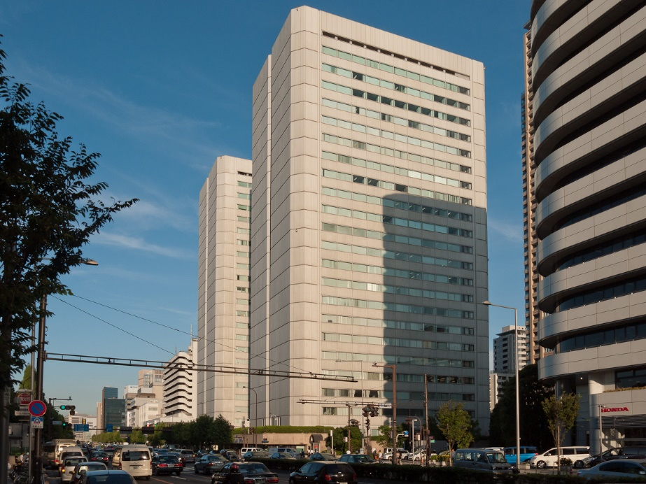
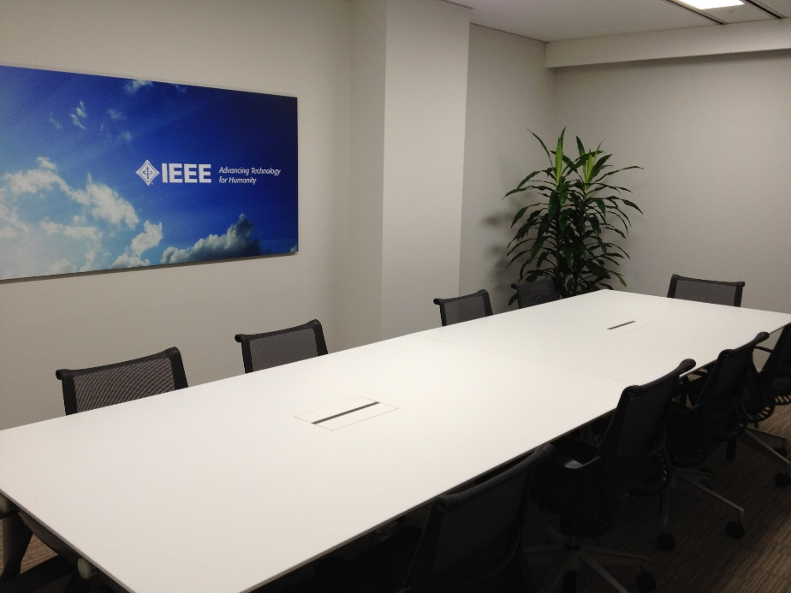
Meeting Location
WG Documents: https://mentor.ieee.org/3333.3/documents
Food and Beverages:
  Lunch Time: 12:30PM –1:30PM
  Afternoon Coffee break: 3:30PM-4:00PM

Slide 21
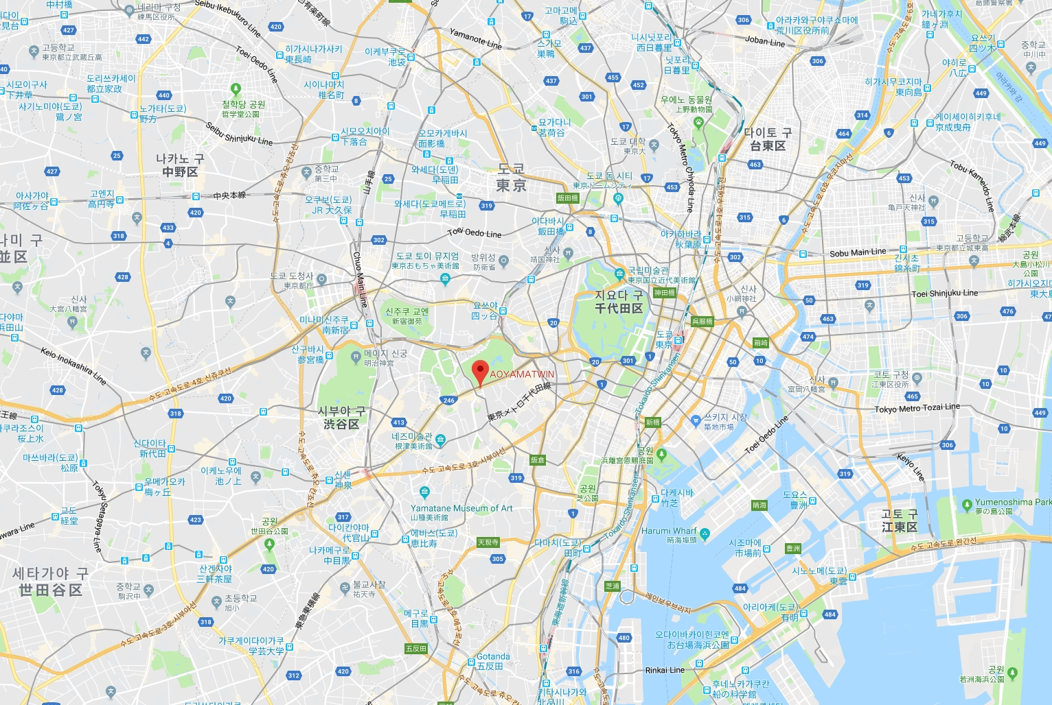
Meeting Location

Slide 22
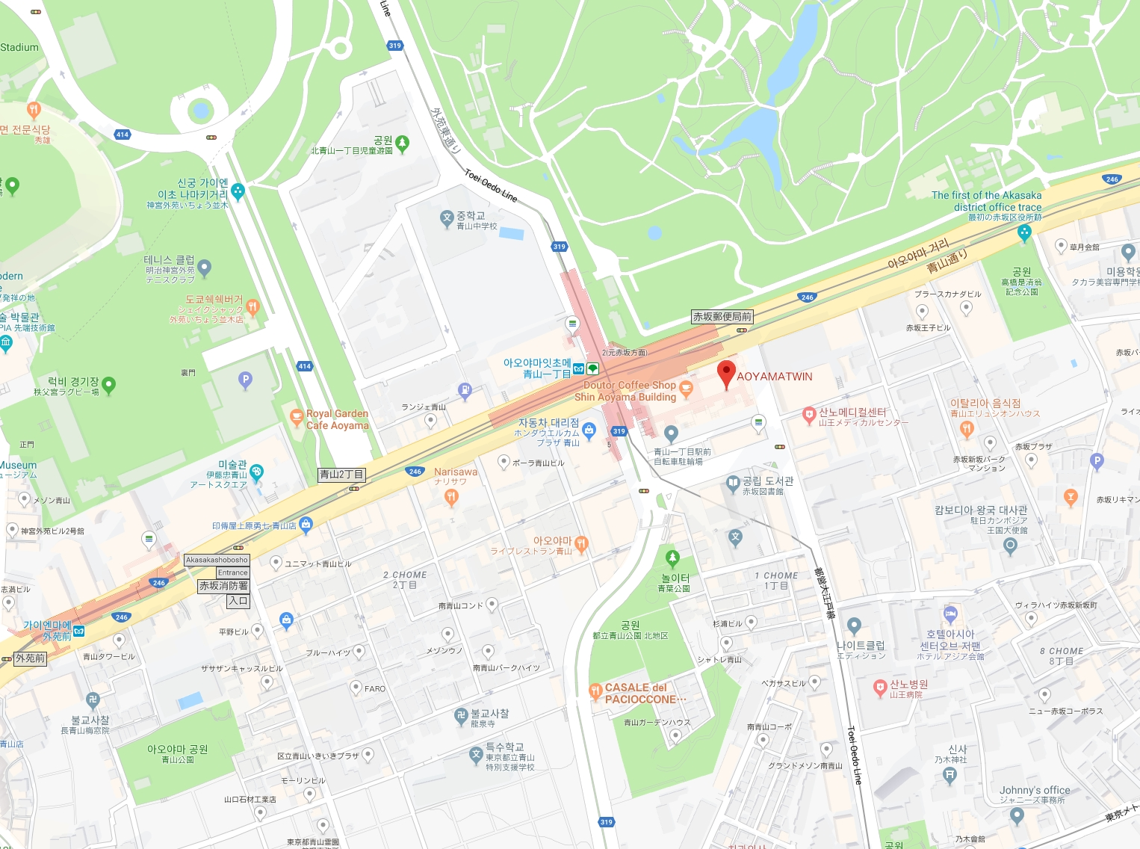
Meeting Location

Slide 23
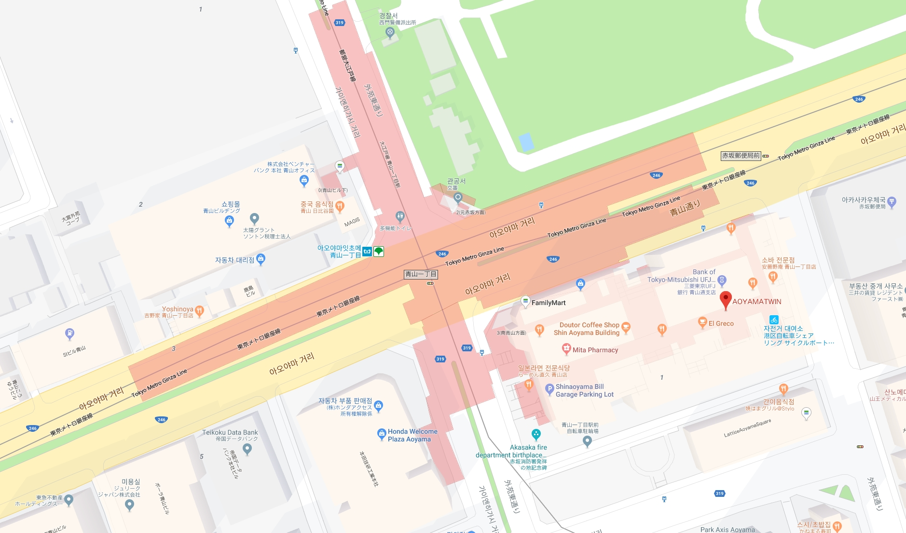
Meeting Location

Slide 24
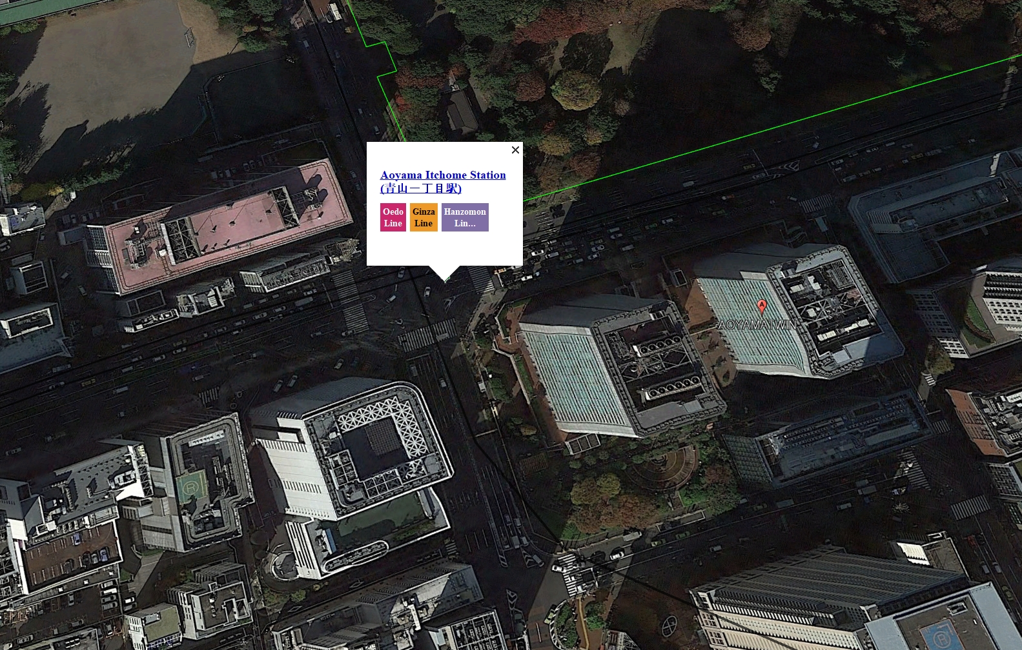
Meeting Location

Slide 25
Metro Info
Aoyama Ichome

Slide 26
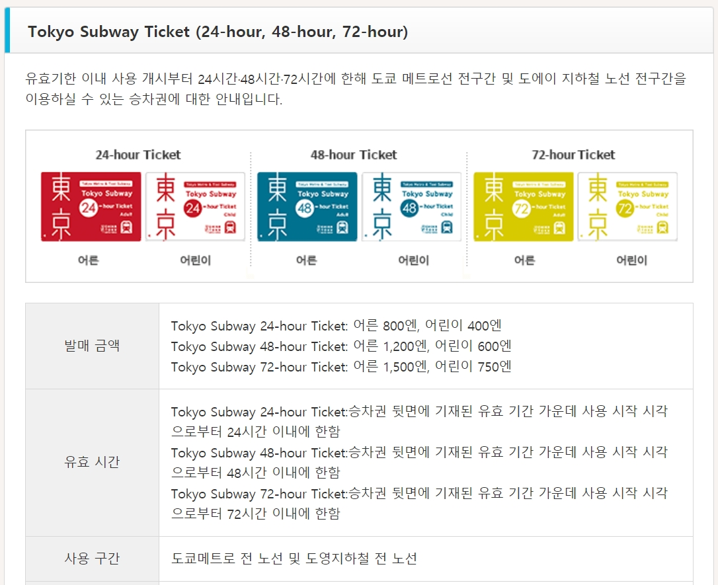
Metro Pass
【교통패스】 도쿄 메트로 무제한 이용패스 서브웨이 티켓 (24시간/48시간/72시간)
도쿄방면 여행상품 (교통기관, 숙박, 여행 패키지 상품 등) 과 동시에 구입하세요. 승차권만의 단독판매는 하지 않습니다.
여행회사에서 발행한 쿠폰권을 도쿄 메트로 각 역 및 도에이 지하철 주요 역사무실(도쿄역, 신주쿠역, 신바시역, 우에노역 등), 또는 하네다공항 국내선 제1여객터미널 및 제2여객터미널 지하 1층 안내소에서 교환

Slide 27
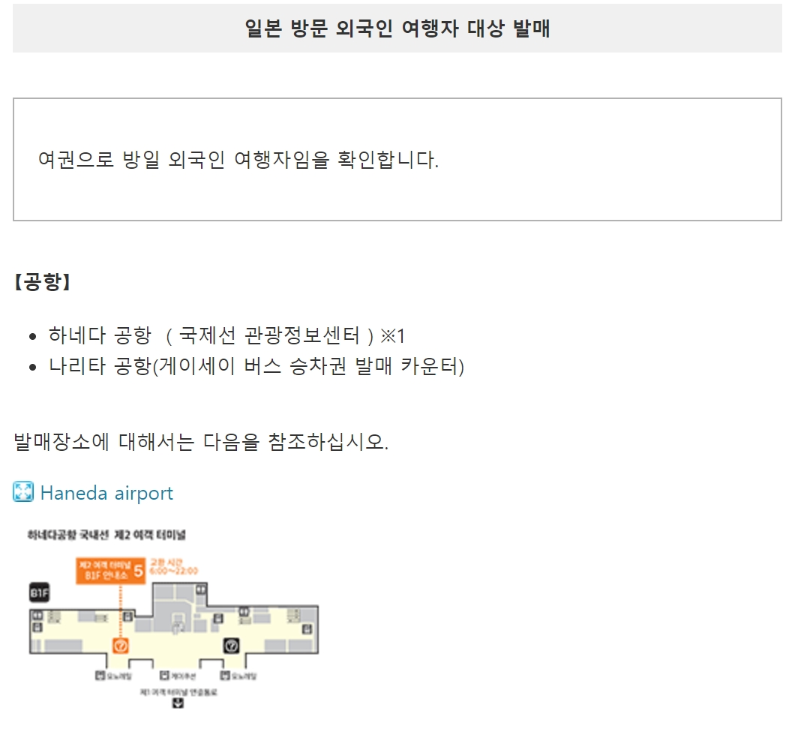
Metro Pass

Slide 28
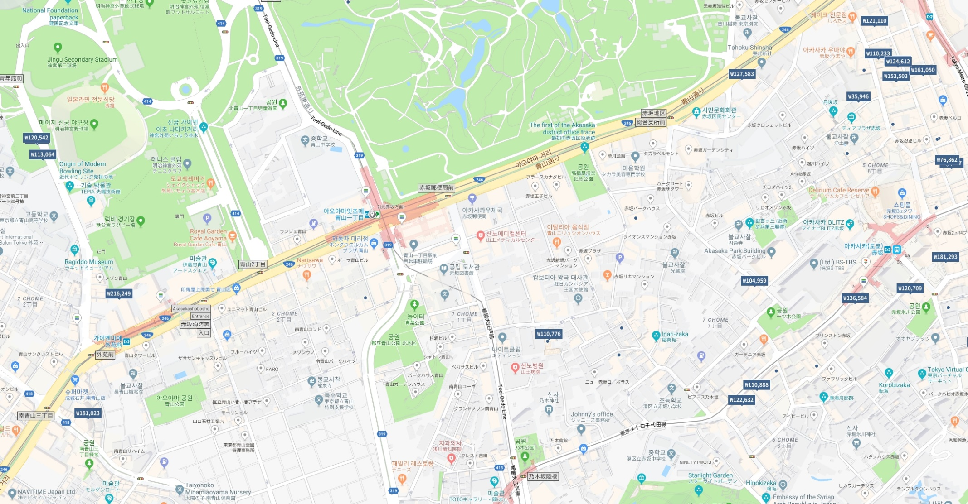
Hotel Info

Slide 29
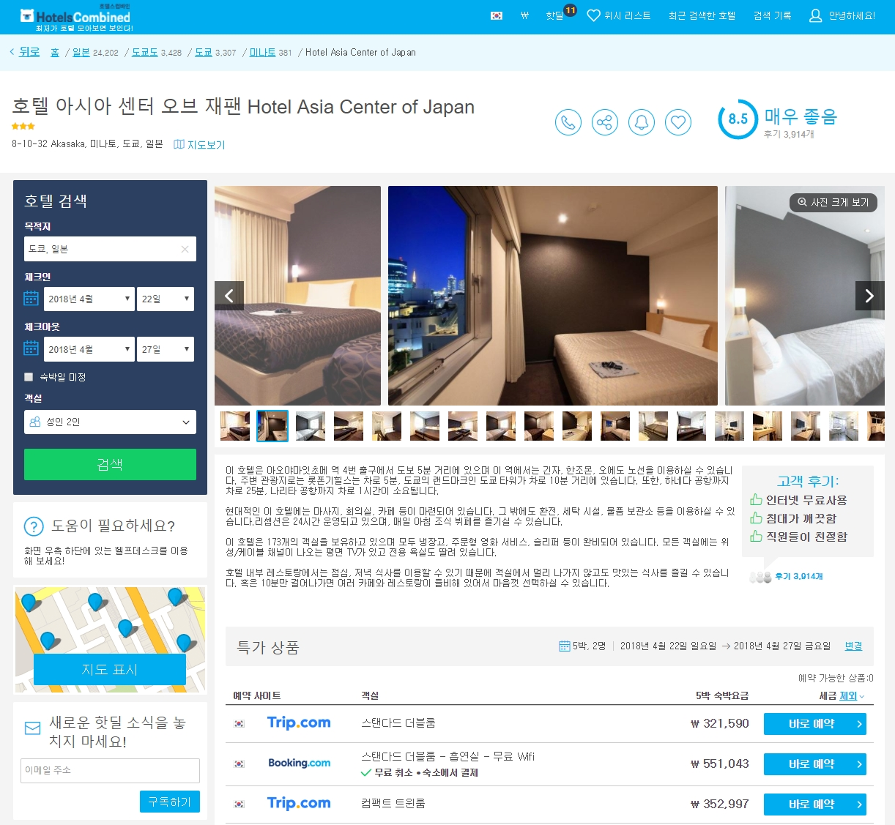
Hotel Info

Slide 30
Future Sessions – 2019
January 28- February 01, 2019, Jeju or Busan, Korea
April 22-26, 2019, 3 Park Avenue, (​IEEE-SA Office), New York City, New York 10016
July 8-12, 2019, IEEE Technology Centre GmbH, (​IEEE-SA Office), Heinestrabe 30, 1020 Vienna Austria
October 07-11, 2019, TBD, Southeast ASIA

Slide 31
Thank You

