Slide 1
[IEEE P3079 Session #5 WG Closing Plenary]
[Dillon Seo / VoleR Creative]

Slide 2
Compliance with IEEE Standards Policies and Procedures
Subclause 5.2.1 of the IEEE-SA Standards Board Bylaws states, "While participating in IEEE standards development activities, all participants...shall act in accordance with all applicable laws (nation-based and international), the IEEE Code of Ethics, and with IEEE Standards policies and procedures."
The contributor acknowledges and accepts that this contribution is subject to
The IEEE Standards copyright policy as stated in the IEEE-SA Standards Board Bylaws, section 7, http://standards.ieee.org/develop/policies/bylaws/sect6-7.html#7, and the IEEE-SA Standards Board Operations Manual, section 6.1, http://standards.ieee.org/develop/policies/opman/sect6.html
The IEEE Standards patent policy as stated in the IEEE-SA Standards Board Bylaws, section 6, http://standards.ieee.org/guides/bylaws/sect6-7.html#6, and the IEEE-SA Standards Board Operations Manual, section 6.3, http://standards.ieee.org/develop/policies/opman/sect6.html

Slide 3
IEEE P3079 HMD Based 3D Content Motion Sickness Reducing Technology Dongil Dillon Seo, dillon@volercreative
IEEE P3079 Session #5 WG Closing Plenary
Date: 2018-04-25
Author(s):
Name | Affiliation | Phone [optional] | Email [optional]
Dongil Seo | VoleR Creative | +82 10 3135 3194 | dillon@volercreative.com
Sangkwon Jeong | JoyFun | +82 10 8667 7329 | ceo@joyfun.kr

Slide 4
Session Time and Location
 | Monday (April 23, 2018) | Tuesday (April 24, 2018) | Wednesday (April 25, 2018) | Thursday (April 26, 2018)
AM-1 8:00-10:00a | Registration | WG Meeting | WG Meeting | WG Meeting
AM-2 10:30-12:30 | Open Plenary Roll Call Reviewing last meeting minutes (Introducing participants) | WG Meeting | WG Meeting | WG Closing Plenary
PM-1 1:30 – 3:30p | WG Meeting | WG Meeting | WG Meeting
PM-2 4:00 – 6:00p | WG Meeting | WG Meeting | WG Meeting
※ Location
Default Meeting Room: E-1904 Aoyama-Twin Tower Bldg.

Slide 5
WG Motions

Slide 6
WG Motion
Move to approve the ‘3079-18-0021-00-0000-Terms and Definition on Excel’ to the standard document after modifying this document.
Move: Jeong, Sangkwon Peter
Second: Lee, Beom-Ryeol
For Agree: 06
Against: 00
Abstain: 00
Motion Passes

Slide 7
WG Motion
Move to approve the ‘3079-18-0022-00-0004-terms-and-definition-on-excel’ to the standard document after modifying this document.
Move: Suk-Ju Kang
Second: Lee, GookHwan
For Agree: 06
Against: 00
Abstain: 00
Motion Passes

Slide 8
WG Motion
Move to approve the ‘3079-18-0019-00-0002-terms-and-definition-on-excel_UPDATE’ to the standard document after modifying this document.
Move: Lee, Beom-Ryeol
Second: Jeong, Sangkwon Peter
For Agree: 06
Against: 00
Abstain: 00
Motion Passes

Slide 9
WG Motion
Move to approve the ‘3079-18-0025-00-0000-terms-and-definitions-network’ to the standard document after modifying this document.
Move: Minseok OH
Second: Jeong, Sangkwon Peter
For Agree: 06
Against: 00
Abstain: 00
Motion Passes

Slide 10
WG Motion
Move to approve the ‘3079-18-0027-00-1000-Semi Final of Terms and Definition’ to the standard document after modifying this document.
Move: Dillon Seo
Second: Jeong, Sangkwon Peter
For Agree: 06
Against: 00
Abstain: 00
Motion Passes

Slide 11
WG Motion
Move to approve the ‘3079-18-0026-00-0000-Technical issues on 360o VR Scene on Web environment’ to the standard document after modifying this document.
Move: Kwan-Hee Yoo
Second: Lee, Beom-Ryeol
For Agree: 06
Against: 00
Abstain: 00
Motion Passes

Slide 12
WG Motion
Move to approve the ‘3079-18-0023-00-0004-use-cases-for-measuring-the-motion-to-photon-latency-in-the-display’ to the standard document after modifying this document.
Move: Suk-Ju Kang
Second: Lee, Beom-Ryeol
For Agree: 06
Against: 00
Abstain: 00
Motion Passes

Slide 13
WG Motion
Move to approve the ‘3079-18-0020-00-0002-use-cases-of-Content-&-SW-for-evaluation-of-CSL’ to the standard document after modifying this document.
Move: Lee, Beom-Ryeol
Second: Jeong, Sangkwon Peter
For Agree: 06
Against: 00
Abstain: 00
Motion Passes

Slide 14
WG Motion
Move to approve the ‘3079-18-0024-00-0003-Use cases and Network Requirements’ to the standard document after modifying this document.
Move: Jeong, Sangkwon Peter
Second: Lee, GookHwan
For Agree: 06
Against: 00
Abstain: 00
Motion Passes

Slide 15
Work Status
Working Group Status
Terms and Definition
Usecases and scenarios of each TGs.
Structure of the standard document

Slide 16
Objectives for the July Meeting
Work/discussion on
Elect an editor for the standard document
Decide on structure of the standard document
Review the Liaison request of the KoVRA
Develop requirements/specifications for each TG by studying usecases
Discuss details on next Singapore meeting

Slide 17
Attendees
Seo, Dongil Dillon | VoleRCreative
Jeong, Sangkwon Peter | JoyFun Inc.,
Lee, Beom Ryeol | ETRI
Lee, GookHwan | JoyFun Inc.,
Kang. Suk-Ju | Sogang University
Yoo, Kwan-Hee | Chungbook National University

Slide 18
Future Sessions – 2018
July 16-19, 2018, 10662 Los Vaqueros Circle, Los Alamitos, California 90720 (​IEEE-SA Office), LA, USA
October 08-11, 2018, 1 Fusionopolis Walk #04-07 South Tower, Solaris, (IEEE-SA Office), Singapore, Singapore

Slide 19
Meeting Location
Location:
10662 Los Vaqueros Circle, Los Alamitos, California 90720 (​IEEE-SA Office), USA
WG Documents: https://mentor.ieee.org/3079/documents
Food and Beverages:
Lunch Time: 12:30PM –1:30PM
Afternoon Coffee break: 3:30PM-4:00PM

Slide 20
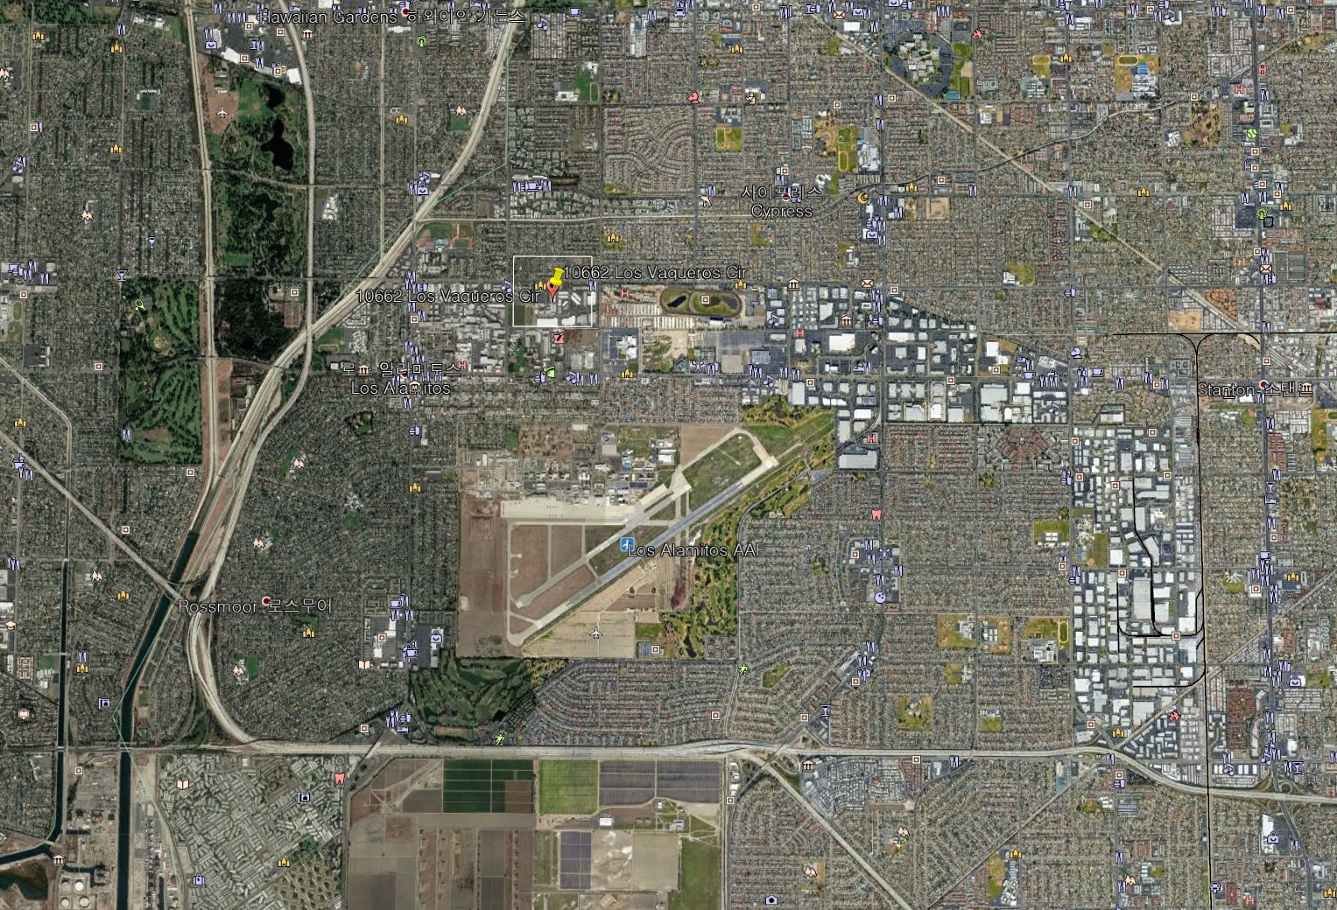
Information of Next Meeting Area

Slide 21
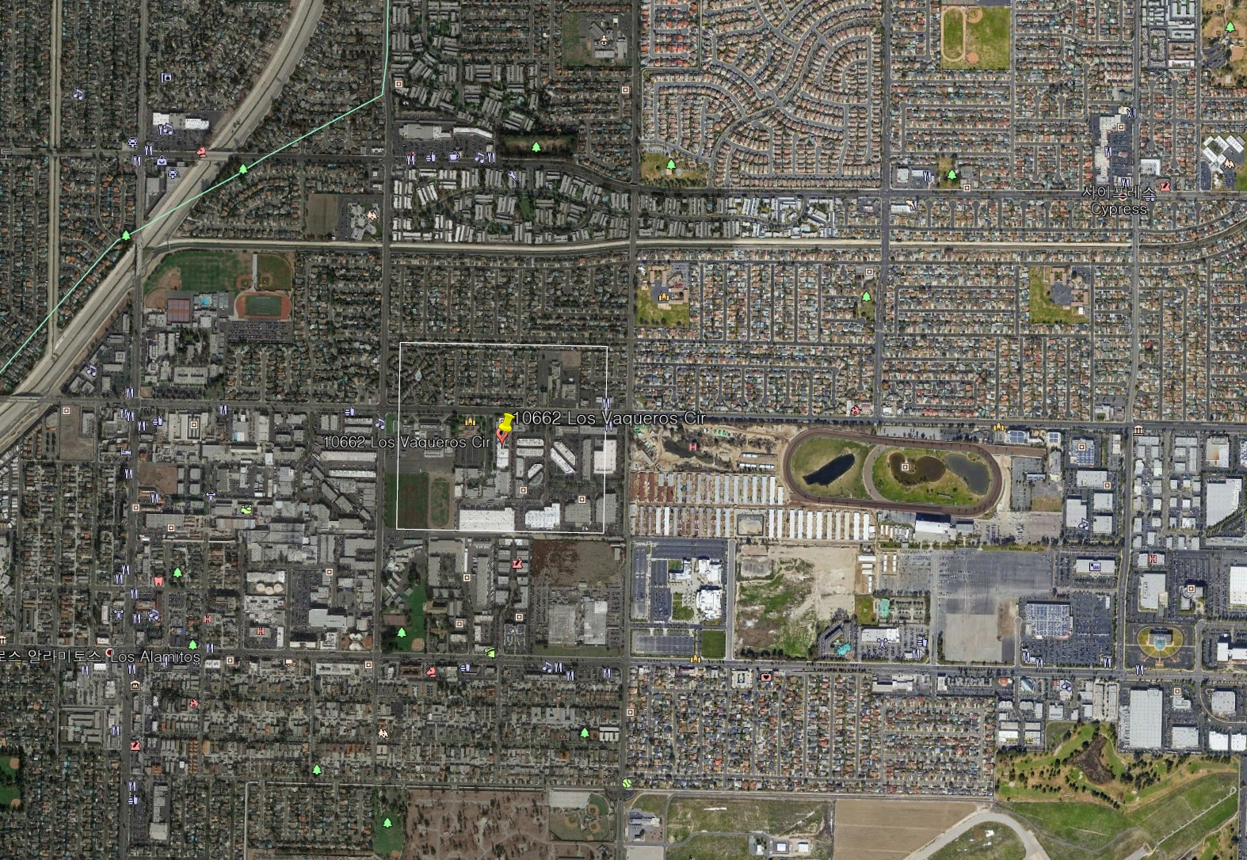
Information of Next Meeting Area

Slide 22
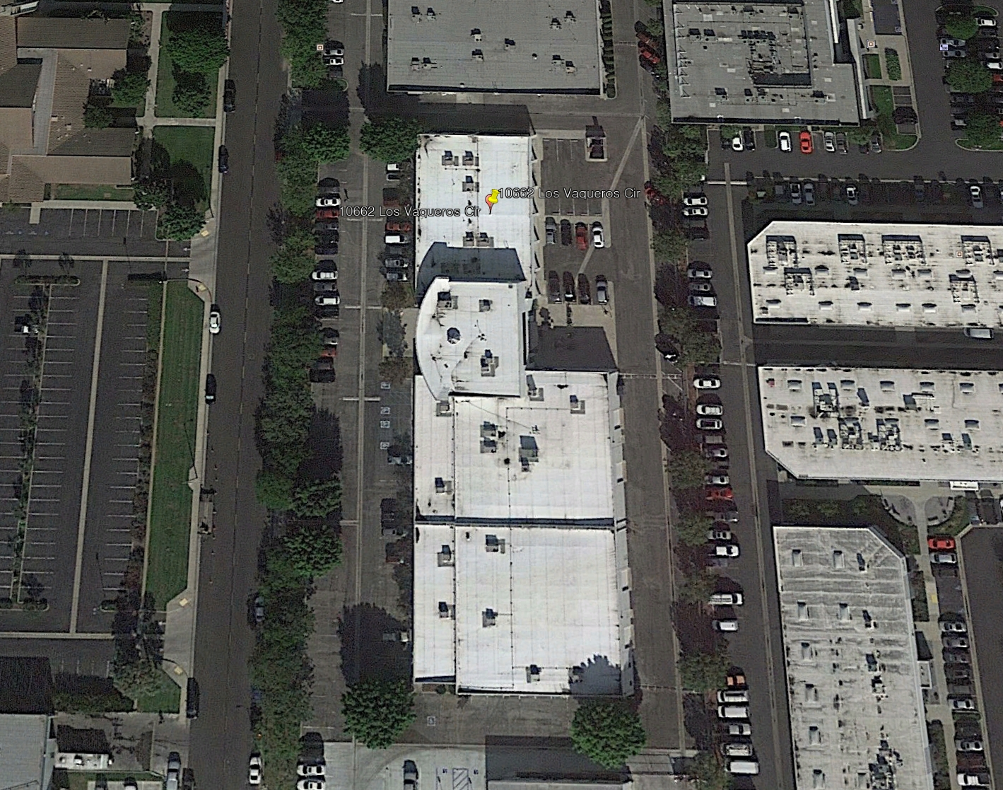
Information of Next Meeting Area

Slide 23
Information of Residences
HYATT HOUSE CYPRESS/ANAHEIM
5905 Corporate Ave. Cypress, California, USA, 90630
https://cypressanaheim.house.hyatt.com/en/hotel/home.html
They offer free;
airport pickup from LAX
shuttle service to places 5 miles in radius of the hotel - shuttle service to IEEE office
breakfast service
The lowest rate that they can office is $167 + tax.

Slide 24
Future Sessions – 2019
January 28- February 01, 2019, Jeju, Korea
April 22-26, 2019, 3 Park Avenue, (​IEEE-SA Office), New York City, New York 10016
July 8-12, 2019, IEEE Technology Centre GmbH, (​IEEE-SA Office), Heinestrabe 30, 1020 Vienna Austria
October 07-11, 2019, TBD, Southeast ASIA

Slide 25
Thank You

