Slide 1
Motion Blur Measurement System for VR Head Mounted Displays
Suk-Ju Kang, Sogang University

Slide 2
Compliance with IEEE Standards Policies and Procedures
Subclause 5.2.1 of the IEEE-SA Standards Board Bylaws states, "While participating in IEEE standards development activities, all participants...shall act in accordance with all applicable laws (nation-based and international), the IEEE Code of Ethics, and with IEEE Standards policies and procedures."
The contributor acknowledges and accepts that this contribution is subject to
The IEEE Standards copyright policy as stated in the IEEE-SA Standards Board Bylaws, section 7, http://standards.ieee.org/develop/policies/bylaws/sect6-7.html#7, and the IEEE-SA Standards Board Operations Manual, section 6.1, http://standards.ieee.org/develop/policies/opman/sect6.html
The IEEE Standards patent policy as stated in the IEEE-SA Standards Board Bylaws, section 6, http://standards.ieee.org/guides/bylaws/sect6-7.html#6, and the IEEE-SA Standards Board Operations Manual, section 6.3, http://standards.ieee.org/develop/policies/opman/sect6.html

Slide 3
IEEE 3079 Cybersickness Reduction Working Group
[Dong Il Seo and dillon@volercreative.com]
Motion Blur Measurement System for VR Head Mounted Displays
Date: 2018-07-09
Author(s): Suk-Ju Kang
Name | Affiliation | Phone [optional] | Email [optional]
Suk-Ju Kang | Sogang University | +82-10-7103-6520 | sjkang@sogang.ac.kr

Slide 4
Outline
Introduction
Moving Picture Response Time (MPRT)
Motivation
Proposed Measurement System
Experimental Results
Summary

Slide 5
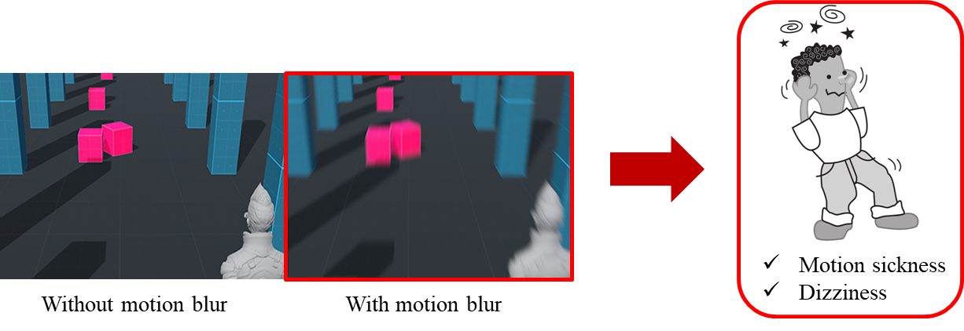
Introduction
Head Mounted Display (HMD)
HMD offers a high level of immersion, but several problems cause motion sickness
Main reasons of motion sickness
Motion-to-photon latency – Seo et al. (2017)
The time needed for a user movement to be fully reflected on a display screen
Motion blur
It greatly affects picture quality perceived by users
Quantitative measurement is necessary

Slide 6
Moving Picture Response Time (MPRT)
Perceptual characteristics of human
Perceived motion blur is different from motion blur which simply appears in a moving picture
A perceived image is a result from the temporally continuous image integration
It reflects the eye tracking synchronized with the moving picture
MPRT is measured by the perceived image
Edge which shows difference of luminance would be blurred
Measure blurred edge by number of pixel

Slide 7
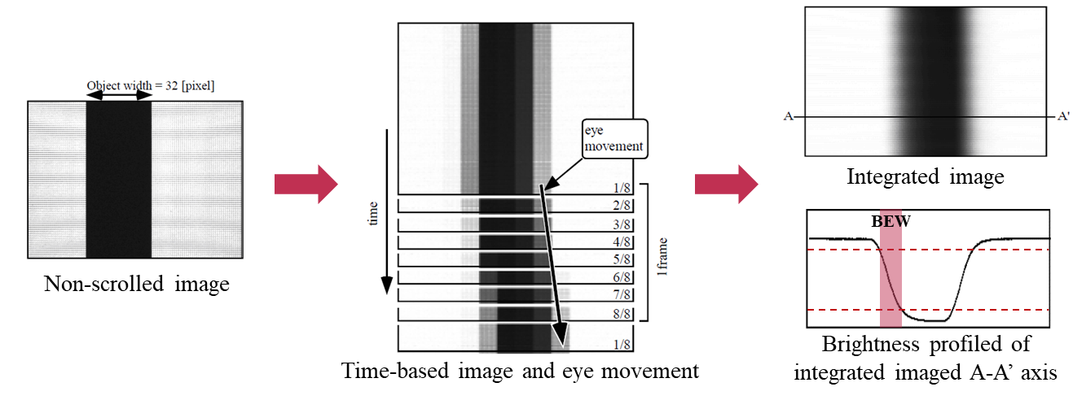
Moving Picture Response Time (MPRT)
MPRT calculations
$N_{BEW}=\frac{BEW}{Velocity(PPF)}$
$N_{BET}=\frac{N_{BEW}}{Frame rate}$
${\text{MPRT}\text{ = }\text{Averaged} \text{all} \text{of} N}_{BET}$
$BEW :Blurred edge width of moving picture$
$N_{BEW} :Normalized blurred edge width$
$N_{BET} :Normalized blurred edge time$
$PPF :Pixel per frame$

Slide 8
Motivation
Conventional methods of measuring MPRT
Tracking camera model : Camera($≈$Eye) follows the object
High-speed camera model : Camera is fixed to using eye trace integration
High-speed camera model (Target model)
Easy to synchronize between camera frame per second (fps) and display fps
Need additional eye trace integration process to measure BEW

Slide 9
Motivation
Example demo of high-speed camera model (Non head-movement environment )
Camera : Sony DSC-RX100 MK5 (960 fps high-speed camera)
Measurement object (Displayed on 60 fps mobile panel)
White box width: 100 pixels
Scroll speed: 30 PPF (constant)
Test pattern displayed on the mobile panel
Test pattern captured by high-speed camera

Slide 10
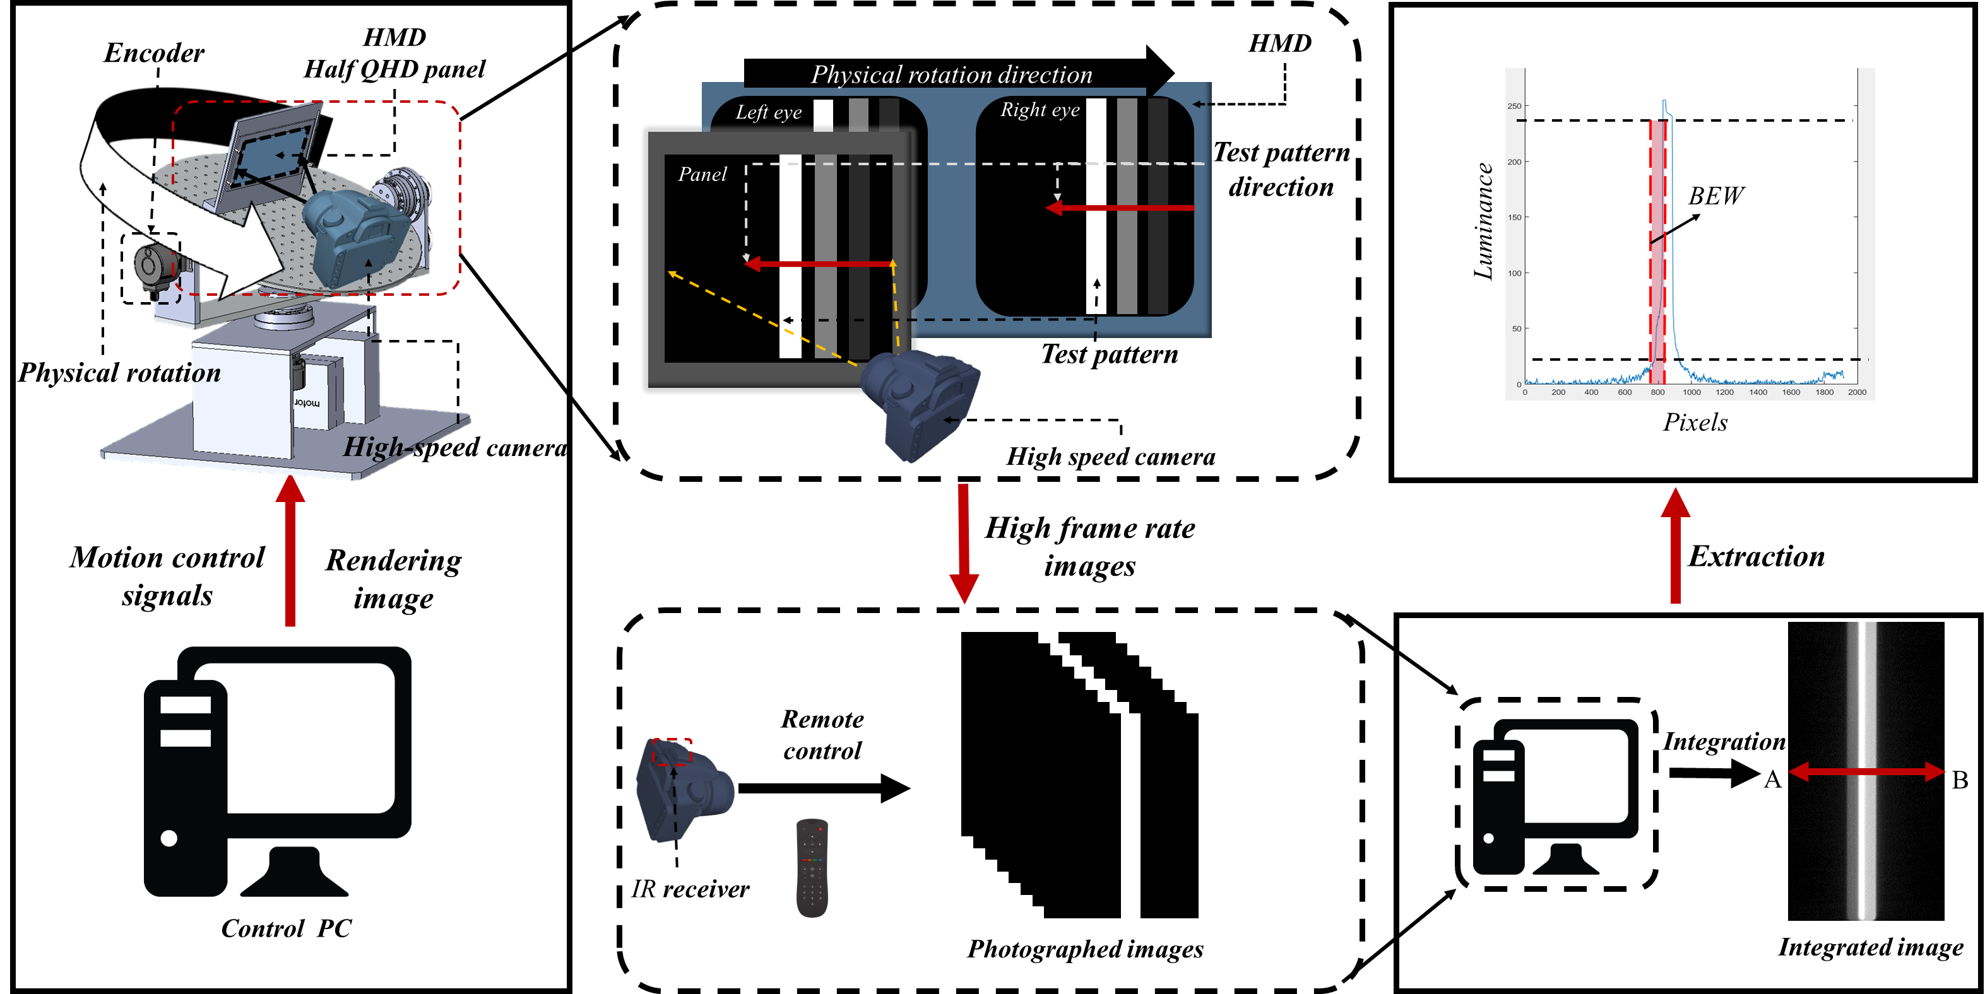
Proposed Measurement System
Head Movement-based Motion Blur Measurement System
Overall process of the proposed measurement system

Slide 11
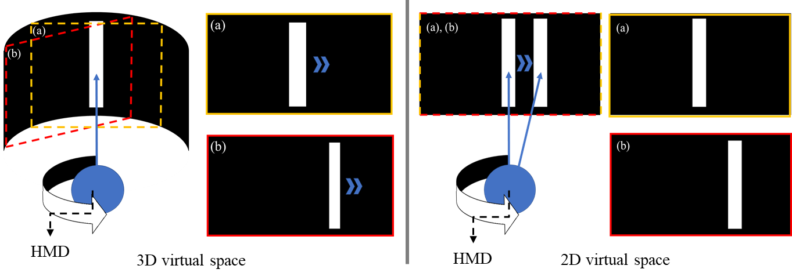
Proposed Measurement System
(1) Head movement simulation (rotary platform)
VR test pattern generation
Test pattern moves according to rotary platform movement with the rotation angle
3D virtual space (spherical space) → 2D virtual space (plane space) projection
To maintain width of the pattern(white object) constant respect to the view angle

Slide 12
Proposed Measurement System
(2) Image acquisition
During head movement simulation, test pattern on panel moves accordingly
Simultaneously, images are captured by high-speed camera
Remote controlling using IR receiver

Slide 13
Proposed Measurement System
(3) Scroll velocity calculation
Velocity of the test pattern has to be measured to calculate continuous $N_{BET}$
Rotation angle($θ$) is extracted by encoder
The angular velocity ($\frac{dθ}{dt}$) is a value obtained by differentiating the rotation angle
Angular velocity and scroll velocity are related
Relationship between scroll velocity and rotation angle

Slide 14
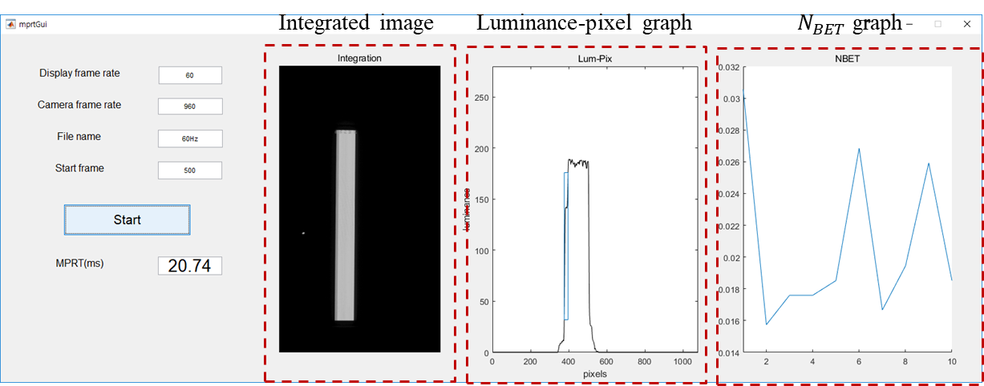
Proposed Measurement System
(4) MPRT calculation
Interface of MPRT calculation
Interface of MPRT calculation program

Slide 15
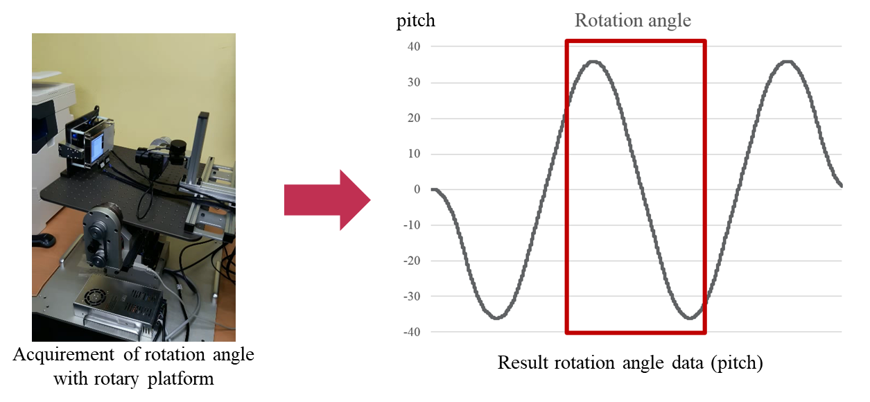
Experimental Results
Encoder data
Rotation angle data
Total 241,664 samples
Range of angle (pitch) : - 35.982 ~ 35.982

Slide 16
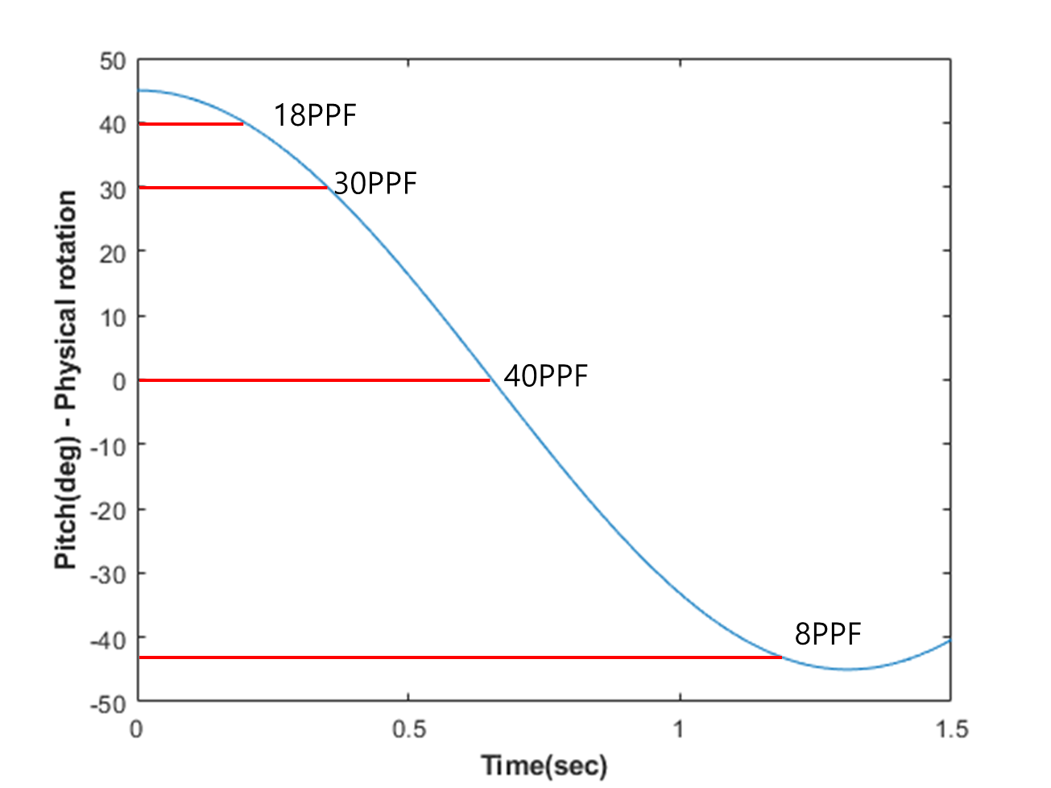
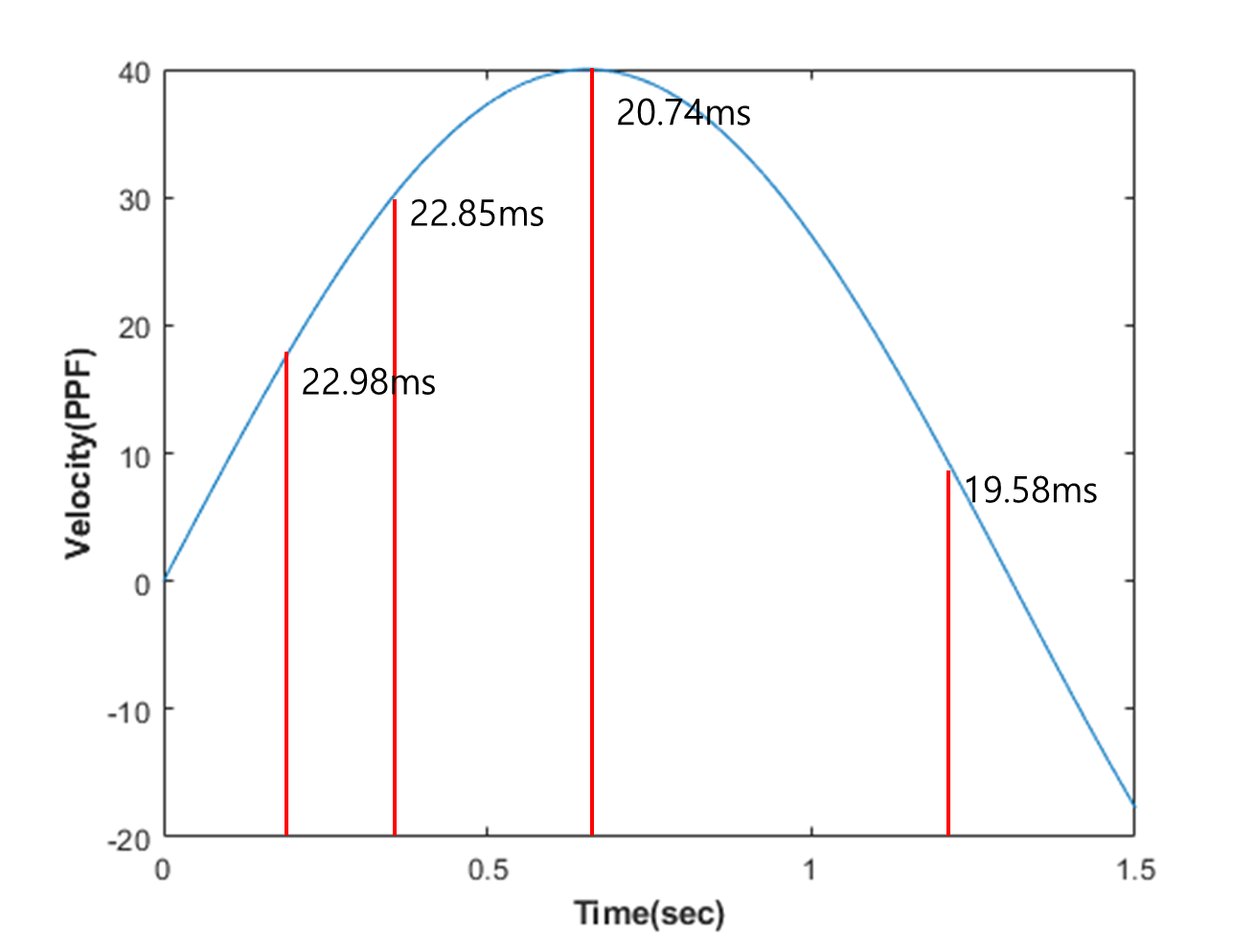
Experimental Results
Scroll velocity & MPRT
Angle (pitch) data – time
Velocity (PPF)
Scroll velocity is calculated by angle
Velocity – time
MPRT (ms)
Time – pitch graph
Time – velocity graph

Slide 17
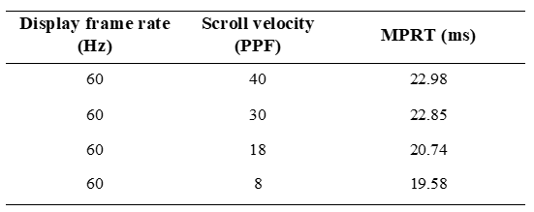
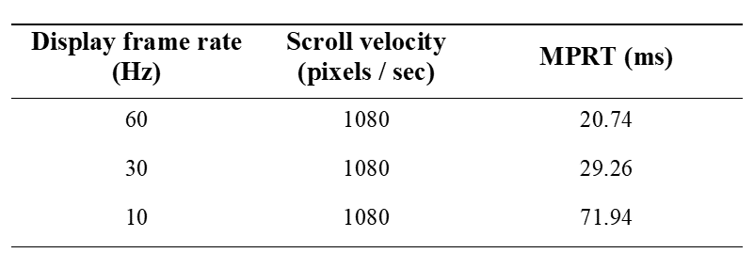
Experimental Results
MPRT results
MPRT had similar values when the scroll velocity were different
MPRT had smaller values when display frame rates were larger
MPRT according to scroll velocity
MPRT according to display frame rate

Slide 18
Summary
We proposed Head Movement-based Motion Blur Measurement System for HMD
MPRT metric is used to motion blur measurement and it is a conventional method
The rotary platform controlled orientations of an HMD device by a motion generator
The encoder collected angle data of physical rotation
The proposed system considered difference between HMD and existing display system
The correlation between actual physical rotation and VR space was considered
For HMD, scroll velocity of MPRT metric is not constant

