Slide 1
[IEEE P3079 Session #6 WG Closing Plenary]
[Peter Jeong / JoyFun]

Slide 2
Compliance with
IEEE Standards Policies and Procedures
Subclause 5.2.1 of the IEEE-SA Standards Board Bylaws states, "While participating in IEEE standards development activities, all participants...shall act in accordance with all applicable laws (nation-based and international), the IEEE Code of Ethics, and with IEEE Standards policies and procedures."
The contributor acknowledges and accepts that this contribution is subject to
The IEEE Standards copyright policy as stated in the IEEE-SA Standards Board Bylaws, section 7, http://standards.ieee.org/develop/policies/bylaws/sect6-7.html#7, and the IEEE-SA Standards Board Operations Manual, section 6.1, http://standards.ieee.org/develop/policies/opman/sect6.html
The IEEE Standards patent policy as stated in the IEEE-SA Standards Board Bylaws, section 6, http://standards.ieee.org/guides/bylaws/sect6-7.html#6, and the IEEE-SA Standards Board Operations Manual, section 6.3, http://standards.ieee.org/develop/policies/opman/sect6.html

Slide 3
IEEE 3079
HMD Based VR Sickness Reducing Technology
Dongil Dillon Seo, dillon@volercreative
IEEE 3079 Session #6 WG Closing Plenary
Date: 2018-07-19
Author(s):
Name | Affiliation | Phone [optional] | Email [optional]
Sangkwon Jeong | JoyFun | +82 10 8667 7329 | ceo@joyfun.kr

Slide 4
Session Time and Location
 | Monday (July 16, 2018) | Tuesday (July 17, 2018) | Wednesday (July 18, 2018) | Thursday (July 19, 2018)
AM-1 9:00-10:30a | Registration | WG Meeting | WG Meeting | WG Meeting
AM-2 11:00-12:30 | Open Plenary Roll Call Reviewing last meeting minutes (Introducing participants) | WG Meeting | WG Meeting | WG Closing Plenary
PM-1 1:30 – 3:00p | WG Meeting | WG Meeting | WG Meeting
PM-2 3:30 – 4:45p | WG Meeting | WG Meeting
※ Location
Default Meeting Room: Library Conference Room, 10662 Los Vaqueros Circle, Los Alamitos.

Slide 5
WG Motions

Slide 6
WG Motion
Move to approve the ‘3079-18-0034-00-0000-Session-06-Agenda.
Move: Seo, Dong-Il
Second: Jeong, Sangkwon
For Agree: 07
Against: 00
Abstain: 00
Motion Passes

Slide 7
WG Motion
Move to approve the Meeting minutes ‘3079-18-0029-00-0000-Session-05-WG-Meetingminutes.
Move: Seo, Dong-Il
Second: Jeong, Sangkwon
For Agree: 07
Against: 00
Abstain: 00
Motion Passes

Slide 8
WG Motion
Move to approve the election of an editor for the Standard Document
Electing Lee, Beom-Ryeol
For Agree: 06
Against: 00
Abstain: 00
Motion Passes

Slide 9
WG Motion
Move to approve the ‘3079-18-0031-00-0004-Motion Blur Measurement System for VR Head Mounted Displays.’
Move: Kang, Suk-Ju
Second: Son, Wookho
For Agree: 07
Against: 00
Abstain: 00
Motion Passes

Slide 10
WG Motion
Move to approve the ‘3079-18-0038-00-0001-Clinical measurement protocol for VR sickness prediction.
Move: Son, Wookho
Second: Yoo, Kwan-Hee
For Agree: 07
Against: 00
Abstain: 00
Motion Passes

Slide 11
WG Motion
Move to approve the meeting minutes ‘3079-18-0036-00-0002-Requirement specifications for design and implement VR content reducing VR sickness.’
Move: Lee, Beom-Ryeol
Second: Yoo, Kwan-Hee
For Agree: 06
Against: 00
Abstain: 00
Motion Passes

Slide 12
WG Motion
Move to approve the ‘3079-18-0037-00-0002-Technical issues of 360o VR Scene on Web environment.’
Move: Yoo, Kwan-Hee
Second: Lee, Beom-Ryeol
For Agree: 06
Against: 00
Abstain: 00
Motion Passes

Slide 13
WG Motion
Move to approve the meeting minutes ‘3079-18-0035-00-0003-Network Diagrams for HMD Based VR Service.’
Move: Jeong, SangKwon
Second: Son, Wookho
For Agree: 05
Against: 00
Abstain: 00
Motion Passes

Slide 14
Attendees
Seo, Dongil Dillon | VoleRCreative
Jeong, Sangkwon Peter | JoyFun Inc.,
Lee, Beom-Ryeol | ETRI
Kang, Hyun-Sam | JoyFun Inc.,
Kang. Suk-Ju | Sogang University
Yoo, Kwan-Hee | Chungbuk National University
Kim, Namgi | Kyonggi University
Son, Wookho | ETRI
Kim, Hak-Gu | KAIST
Kim, Soo | IEEE-SA

Slide 15
Future Sessions – 2018
October 08-11, 2018, 1 Fusionopolis Walk #04-07 South Tower, Solaris, (IEEE-SA Office), Singapore, Singapore

Slide 16
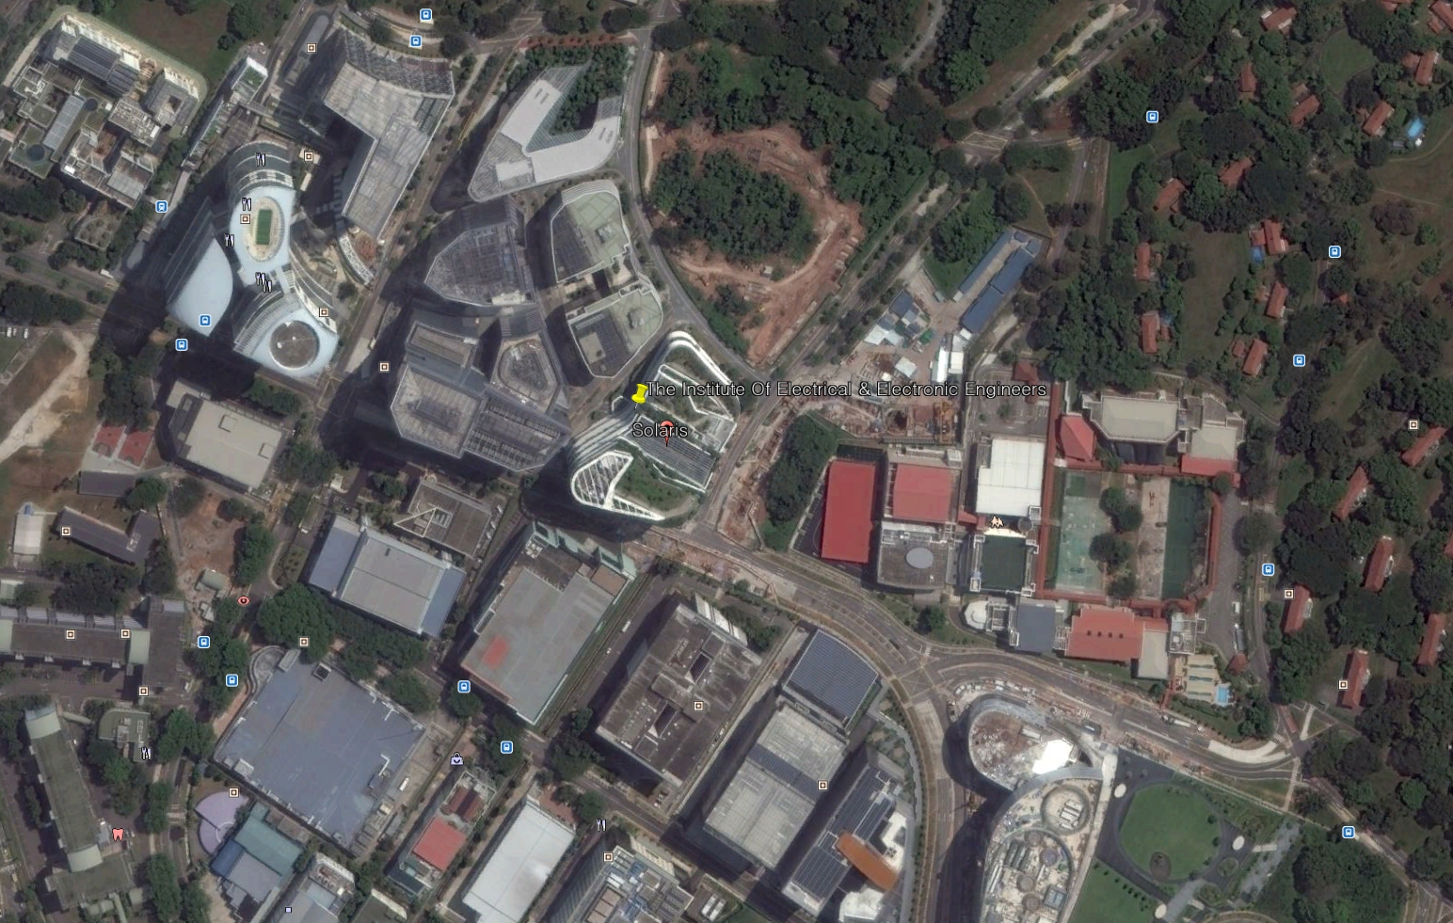
Information of Next Meeting Area

Slide 17
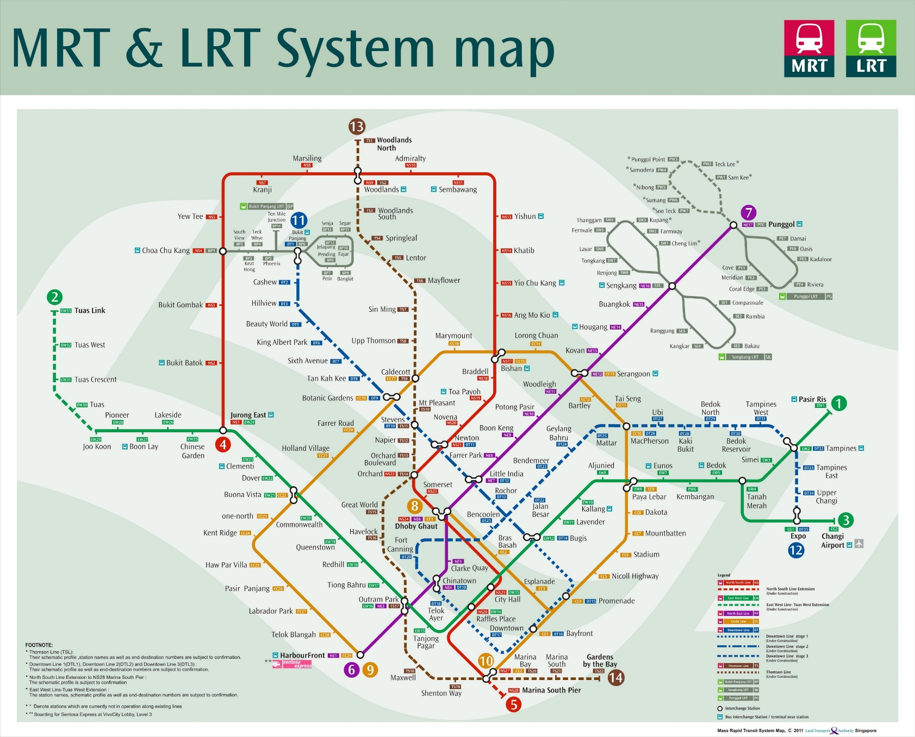
Information of Next Meeting Area
9호선 Circle Line
One-north 역
창이 공항

Slide 18
Meeting Location
Location:
1 Fusionopolis Walk #04-07 South Tower, Solaris, (IEEE-SA Office), Singapore, Singapore
WG Documents: https://mentor.ieee.org/3079/documents
Food and Beverages:
  Lunch Time: 12:30PM –1:30PM
  Afternoon Coffee break: 3:30PM-4:00PM

Slide 19
Information of Residences

Slide 20
Future Sessions – 2019
January 28- February 01, 2019, Busan, Korea
April 22-26, 2019, 3 Park Avenue, (​IEEE-SA Office), New York City, New York 10016
July 8-12, 2019, IEEE Technology Centre GmbH, (​IEEE-SA Office), Heinestrabe 30, 1020 Vienna Austria
October 07-11, 2019, Danang(TBC), Vietnam

Slide 21
Thank You

