Slide 1
Viewport-based 360 Video Streaming:
Motion-Constrained Tile and Viewport Extraction
Presenter: Eun-Seok Ryu (esryu@gachon.ac.kr)
Dongmin Jang, Jong-Beom Jeong, Eun-Seok Ryu
Multimedia Communications and Systems Lab. (MCSL)
http://mcsl.gachon.ac.kr
Department of Computer Engineering
Gachon University

Slide 2
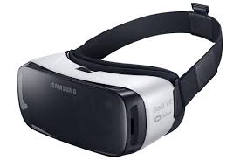
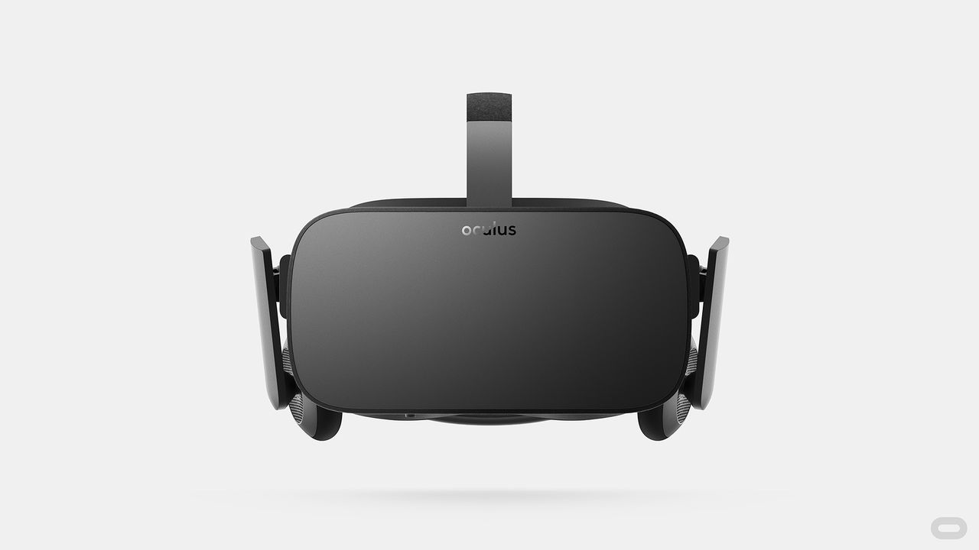
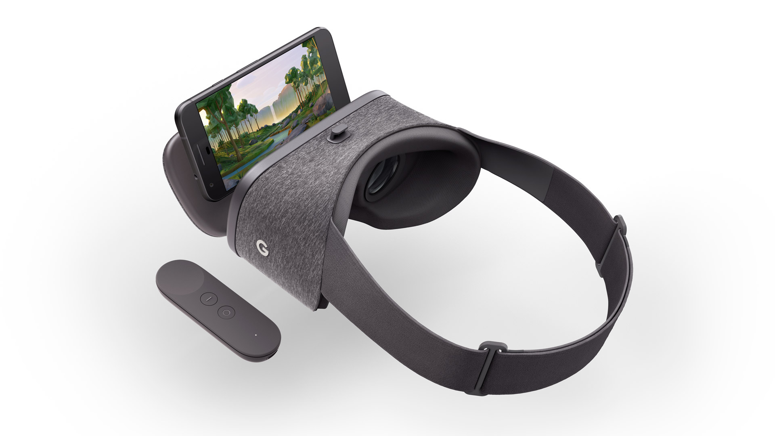
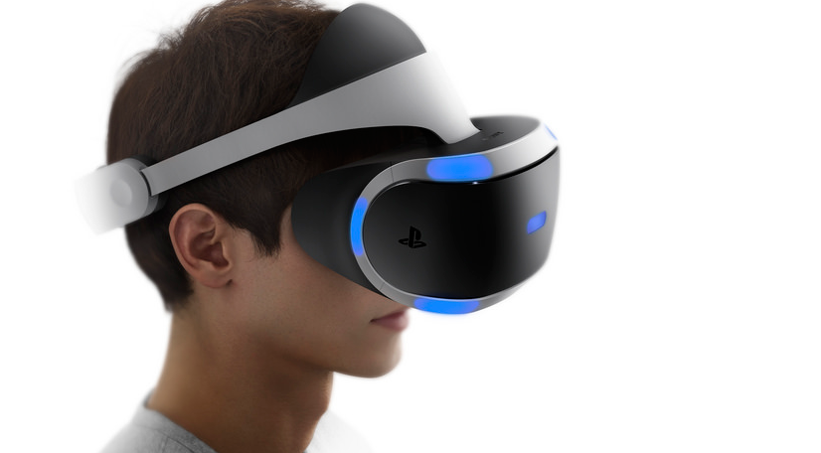
Introduction
High Bandwidth Requirement of VR
  Recently, various HMD devices are on the market
  Recommend 12K resolution for reducing nausea with high quality VR
  High Bandwidth and high computational complexity are huddle
Need to reduce the required bandwidth!
Requirement | details
pixels/degree | 40 pix/deg
video resolution | 11520x6480
framerate | 90 fps
The emergence of various HMD
(Gear VR, Oculus Rift, Daydream, PlayStation VR)
Requirements for high quality VR
Source:Technicolor, Oct. 2016 (m39532, MPEG 116th Meeting)

Slide 3
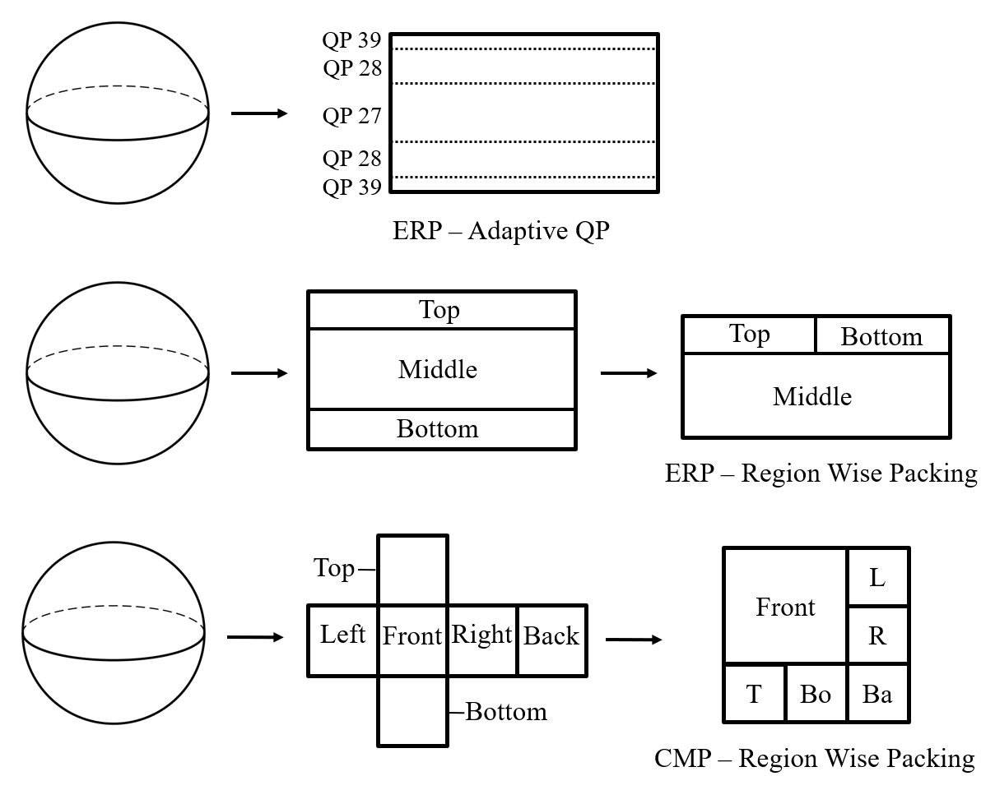
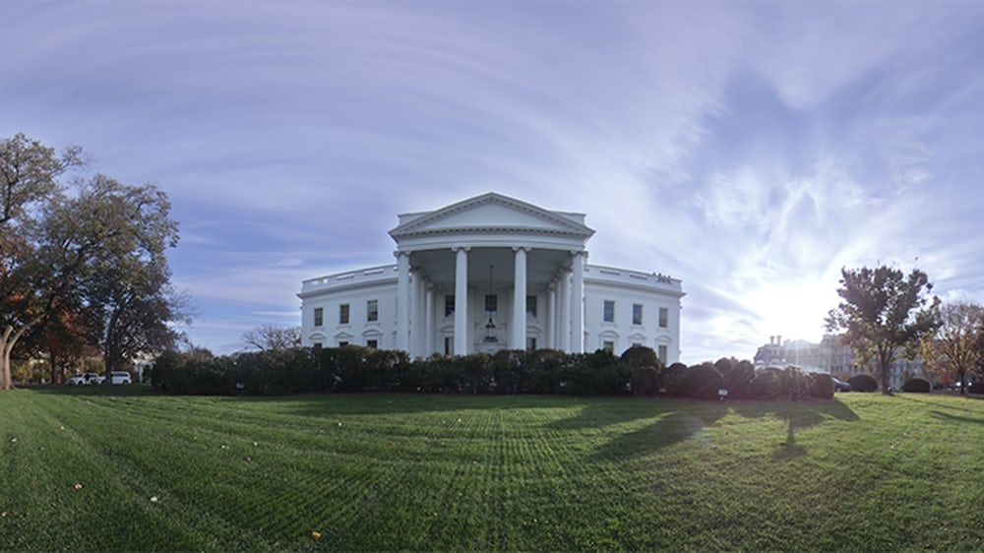


Viewport Independent vs Viewport Dependent
Viewport Dependent
(Proposed Method)
Viewport Independent
Transmit whole picture
Projection and packing
Downsampling / adjusting QP
Transmit viewport only
Bitrate saving
Ecoding complexity reducing
But, delay
viewport
Select the tiles corresponding to the viewport
Decoder
Viewpoint-based decoding

Slide 4
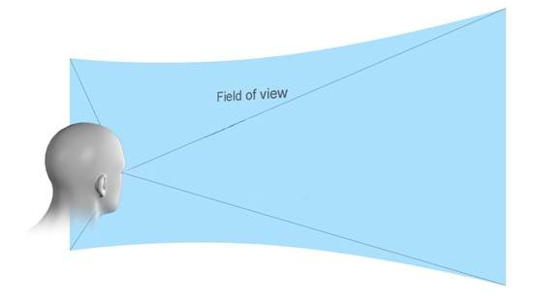
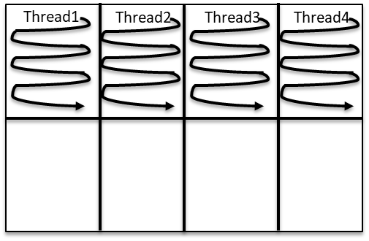
Keypoint for Viewport Dependent Streaming
  Field of View(FOV)
    The field of view (FOV) in the HMDs : 96° to 110°
    Part of the 360° picture
  Tiles
    Parallelization Tools
    Divided into rectangular regions
    Flexible horizontal and vertical boundaries
The user’s current viewport : high resolution
Remaining part : low resolution
Field of View (FOV)
Spatially refers to only its own tile, but temporally refers to other tiles
Decoding problems occurs when transmitting only some tiles
A frame divided into 8 Tiles

Slide 5
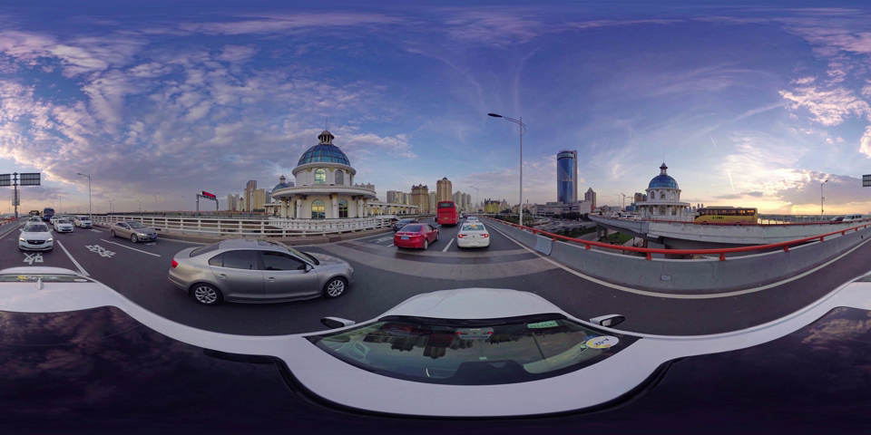
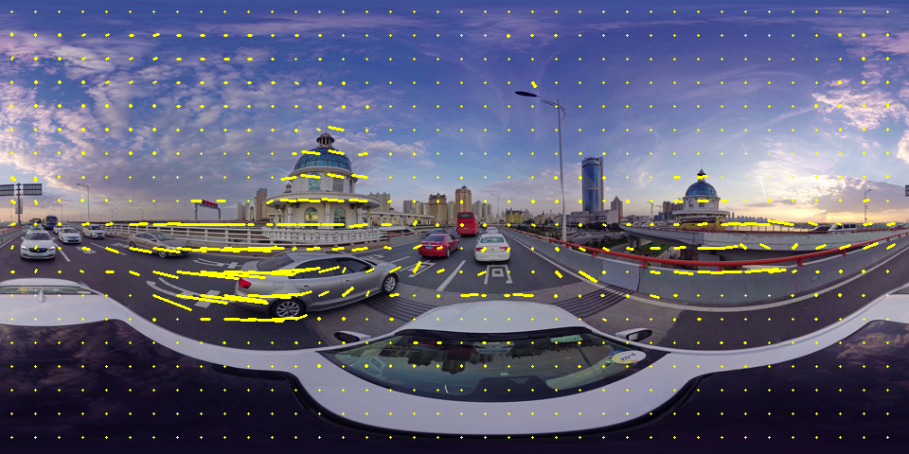



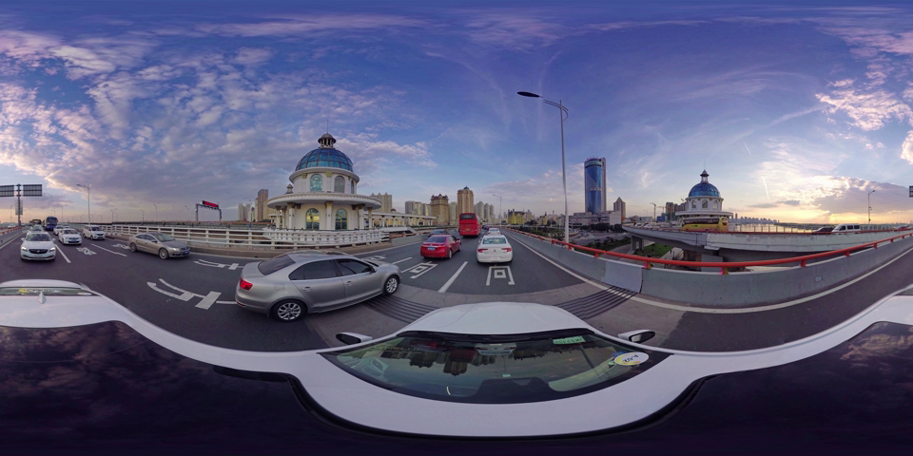

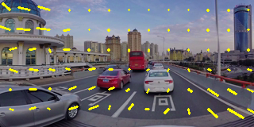
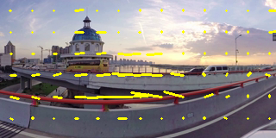
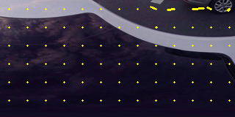
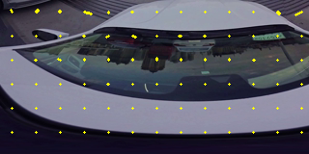
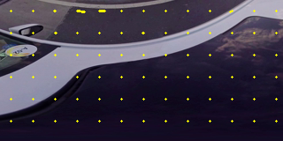
Proposed Motion Constraint Tile Sets
Reference Picture
Motion vectors can refer to anyware
Original Motion Estimation
before applying MCTS
Reference
Modify motion vector range
Motion Estimation
after applying MCTS
Current Picture
Motion vectors only refer the tile in same position
MPEG adopts Gachon Univ.’s MCTS codes in HM ver. 16.18

Slide 6
MCTS with HEVC and SHVC - Structure
SHM Encoder
HM Encoder
When referring to the same tile, TIP is performed
When referring to the same tile, TIP is performed
PicEL t-1
PicEL t
Pic t-1
Pic t
x
x
When referring to the other tiles, ILP is performed using Upsampled BL
When referring to the other tiles, Intra Prediction is performed
EL: Enhancement Layer
BL: Base Layer
TIP: Temporal Inter Prediction
ILP: Inter Layer Prediction
Upsampled PicBL t
*Filter interpolation, Temporal Candidate of AMVP and MERGE

Slide 7
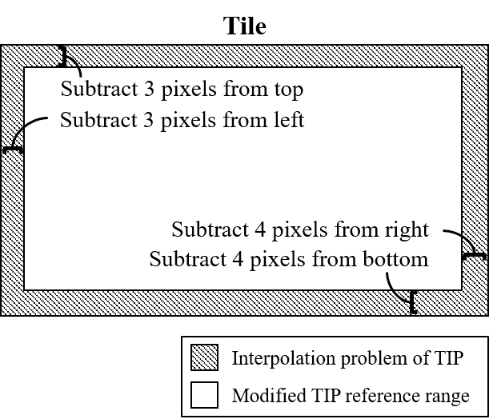
MCTS Considerations (1/2)
Interpolation
  Use an eight-tap filter to interpolate luma prediction
  Use 3 pixels of left and top, 4 pixels of right and bottom for Interpolation
Modify reference range of motion vectors
3 Pixels
4 Pixels
Current Pixel
Pixel used for interpolation
The current pixel and
the pixels used for interpolation
Interpolation problem of referring to a tile
at the same position in TIP

Slide 8
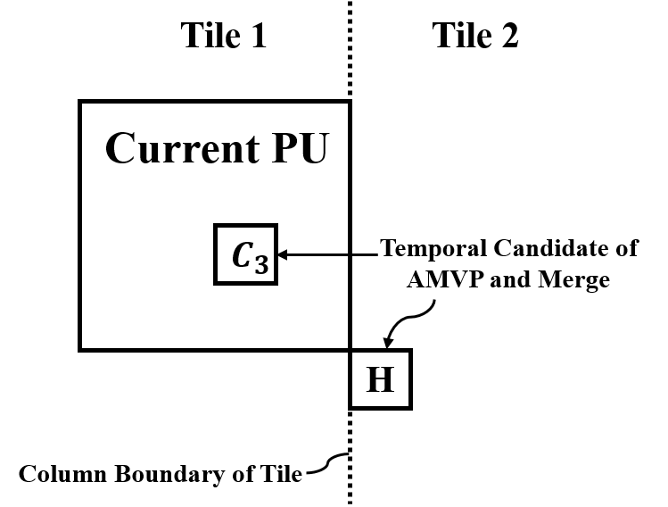

MCTS Considerations (2/2)
Temporal Candidate of AMVP and MERGE
  Temporal candidates : C3 and H block (right figure)
  Problem: cross the column boundary between tiles
Exclude H block at the column boundary between tiles
Tile 1
Tile 2
PU
H
Temporal candidate problem at column boundary between Tiles

Slide 9

Extraction Information Sets (EIS) SEI Message
Extraction Information Sets (EIS) SEI Message
  Contains replacement parameter set (max: around 2000 MCTS sets)
  MCTS set contains a set of tiles to be extracted
Extraction Information Set (1 ~ 2048)
Parameter set | Replacement Information
VPS | Level and Tier
SPS | Picture Resolution
PPS | Tile Partition
MCTS Set ( 1 ~ 2048)
Parameter Set (1)
Tile
MCTS index1
VPS, SPS, PPS
Tile
MCTS index2
Slice Reordering
( n $∝$ MCTS Set)
Replacement Information of Parameter Set
…
Slice address
…
Original VPS
Original SPS
Original PPS
EIS SEI
Slice / Tile
Slice / Tile
NAL Unit
NAL Unit
NAL Unit
NAL Unit
NAL Unit
NAL Unit
Bitstream before extraction

Slide 10
NAL Bitstream Extractor: Fucntional Flow
MCTS
Bitstream
Extractor
Extracted
Bitstream
Target EIS Id Target MCTS set Id Target Highest Temporal Id
Input Option
Replacement
VPS
Original VPS
Original SPS
Pharse Original PPS
Number of Original Tiles
Replacement
SPS
Number of EISs, MCTS sets, MCTSs MCTS Id Slice Reordering Info Replacement Parameter set (VPS, SPS, PPS)
Original PPS
Replacement
PPS
Pharse EIS SEI Message
EIS SEI
Target
Slice / Tile
Slice / Tile
Replace Original Parameter set With Replacement Parameter set
Target
Slice / Tile
Slice / Tile
Slice / Tile
Select Target Tile / Slice Corresponding to Input Option
Target
Slice / Tile
…
…
Adjust Slice Header
First Slice Segment in Pic Flag Slice Segment Address

Slide 11
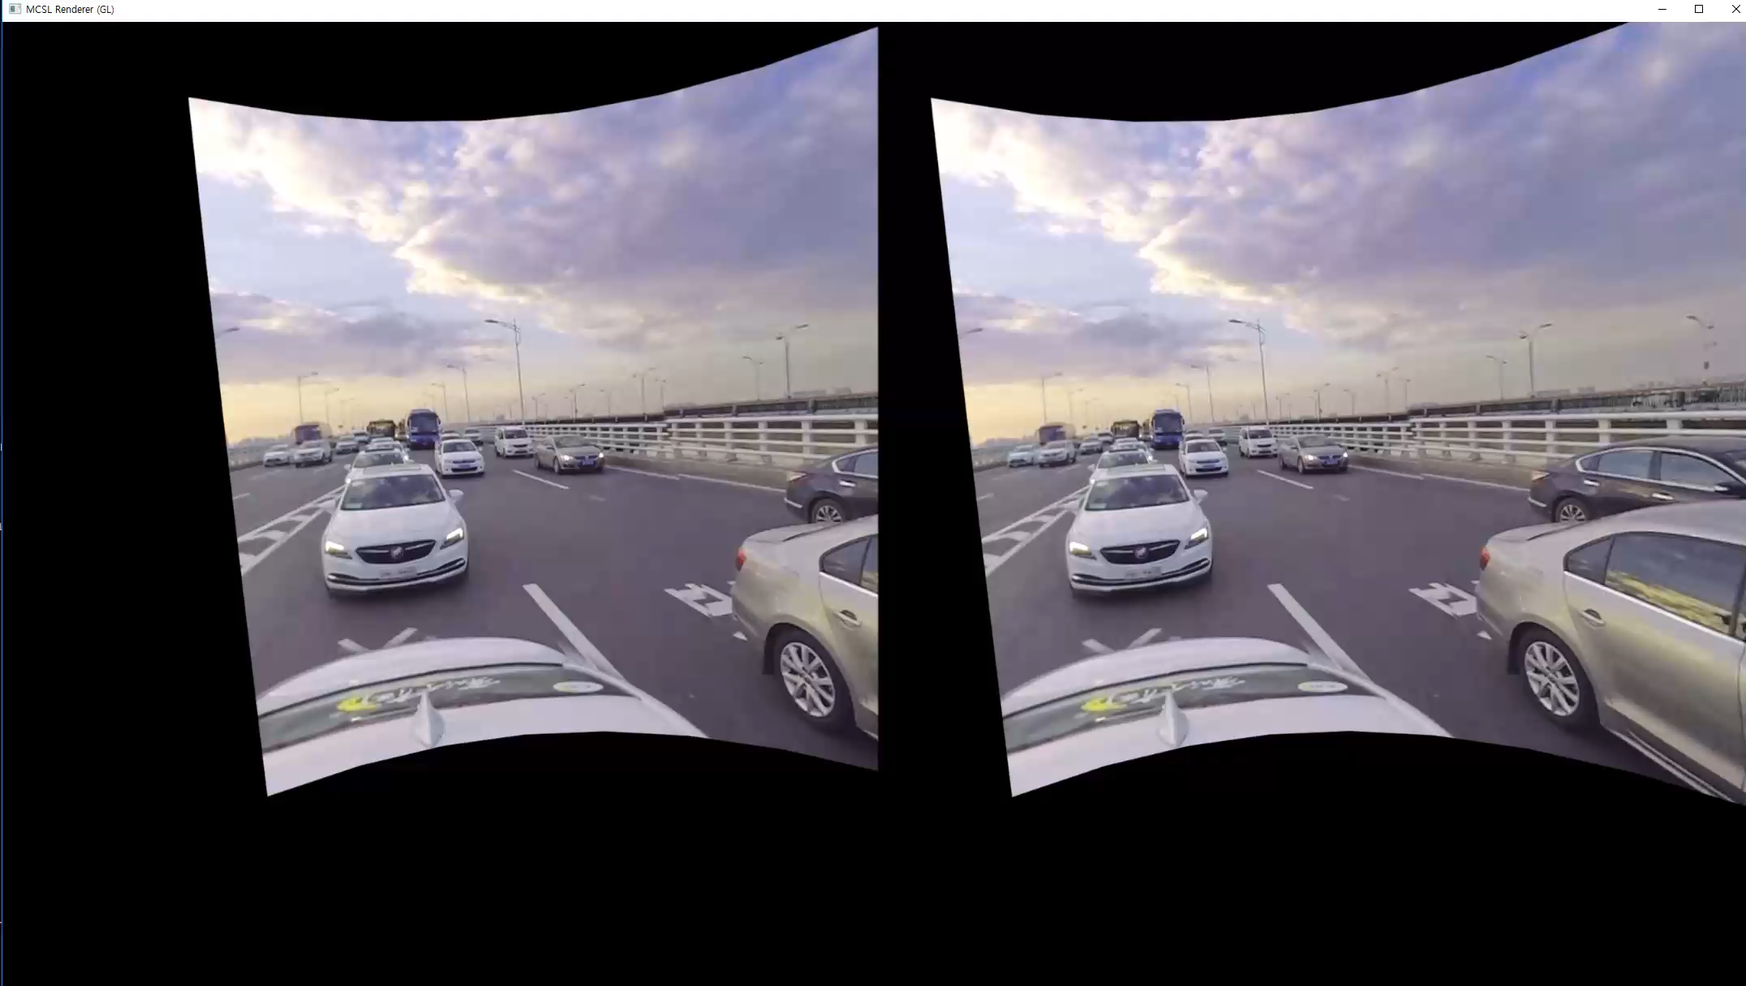
Implemented Renderer and Player

Slide 12
Experimental Results (1/2)
Experimental Setup
  8K test sequences defined in JVET CTC (common test condition)
  Random Access (RA) coding structure
  Uniform 3x3, 9 Tiles
  HM ver. 16.16 encoder / SHM ver. 12.3 encoder
Coding Option | SHM Parameter | HM parameter
Version | 12.3 | 16.16
CTU size | 64×64
Coding structure | RA
QP | -
Base Layer QP | 22
Enhancement Layer QP | 22
Tile | Uniformly 3x3 = 9 tiles
Slice mode | Disable all slice options
WPP mode | Disable all wpp options
Name | Resolution | Frame Length | Frame Rate
KiteFlite | 8192×4096 | 300 | 30 fps
Harbor | 8192×4096 | 300 | 30 fps
Trolley | 8192×4096 | 300 | 30 fps
GasLamp | 8192×4096 | 300 | 30 fps
8K Test sequences
Coding options

Slide 13
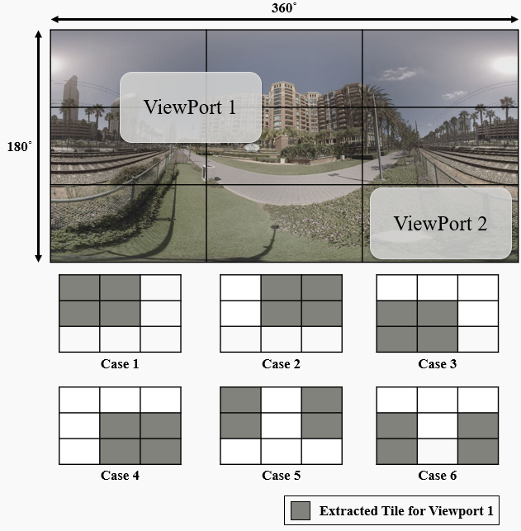
Experimental Results (2/2)
Bitrate savings in case of transmiting some Tiles only using proposed MCTS (among 9 Tiles)
Various number of Tiles and eye-tracking with DL are under researching now; expecting NOSSDAV 2019. : )
 | Proposed SHM |  | Proposed HM
Name | 4 tiles bitrate saving | 1 tile bitrate saving | 4 tiles bitrate saving | 1 tile bitrate saving
KiteFlite | 52% | 88% | 51% | 87%
Harbor | 53% | 88% | 51% | 87%
Trolley | 50% | 87% | 49% | 87%
GasLamp | 49% | 87% | 47% | 86%
Average bitrate saving | 51% | 87% | 49% | 86%

Slide 14
Conclusion
Motivation
  High Quality VR >= 12k resolution
  High BW, High computational complexity
  Viewport tile streaming for 360 VR
Proposed method
  Motion Constrained Tile Sets (MCTS)
  Extraction Information Set SEI Message (EIS SEI)
  NAL Packet Extractor for Selected (ROI) Tiles
Results
  Transmit Selected Tiles without Decoding Errors
  Save Bitrate, Reduce Computational Complexity at Decoder Side
Future work
  Eye tracking for Accurate Viewport Extraction
  Deep Learning for ROI Estimation and Prefetching

