Slide 1
Efficient Image Interpolation Using Deep Learning for Virtual Reality
Suk-Ju Kang, Sogang University

Slide 2
Compliance with IEEE Standards Policies and Procedures
Subclause 5.2.1 of the IEEE-SA Standards Board Bylaws states, "While participating in IEEE standards development activities, all participants...shall act in accordance with all applicable laws (nation-based and international), the IEEE Code of Ethics, and with IEEE Standards policies and procedures."
The contributor acknowledges and accepts that this contribution is subject to
The IEEE Standards copyright policy as stated in the IEEE-SA Standards Board Bylaws, section 7, http://standards.ieee.org/develop/policies/bylaws/sect6-7.html#7, and the IEEE-SA Standards Board Operations Manual, section 6.1, http://standards.ieee.org/develop/policies/opman/sect6.html
The IEEE Standards patent policy as stated in the IEEE-SA Standards Board Bylaws, section 6, http://standards.ieee.org/guides/bylaws/sect6-7.html#6, and the IEEE-SA Standards Board Operations Manual, section 6.3, http://standards.ieee.org/develop/policies/opman/sect6.html

Slide 3
IEEE 3079
Cybersickness Reduction Working Group
[Dong Il Seo and dillon@volercreative.com]
Efficient Image Interpolation for Virtual Reality Using Deep Learning
Date: 2018-10-06
Author(s): Suk-Ju Kang
Name | Affiliation | Phone [optional] | Email [optional]
Suk-Ju Kang | Sogang University | +82-10-7103-6520 | sjkang@sogang.ac.kr

Slide 4
Outline
Introduction
Motivation
Proposed Hardware Architecture
Experimental environments and results
Summary

Slide 5
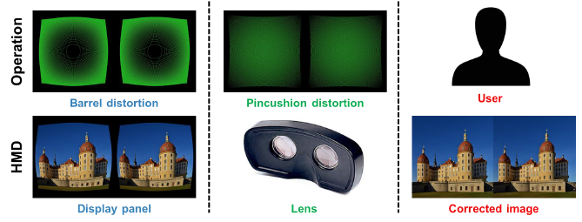
Introduction
The low-cost HMD systems with a novel optical structure have been presented by several companies

Slide 6


Motivation
Motion-to-Photon latency is the time needed for a user movement to be fully reflected on a display screen.
Low motion-to-photon (< 20ms) latency is a prerequisite to convince user’s mind that user is in another place.
A high motion-to-photon latency makes a poor virtual reality experience.
Tracker
CPU
GPU
Display
Photons
Optics
Head motion
Under 20 milliseconds of latency for comfortability
User’s retina

Slide 7

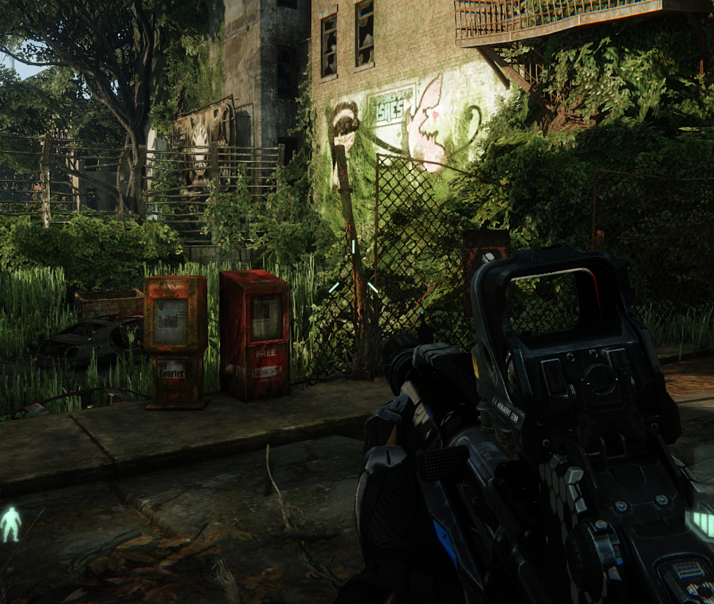
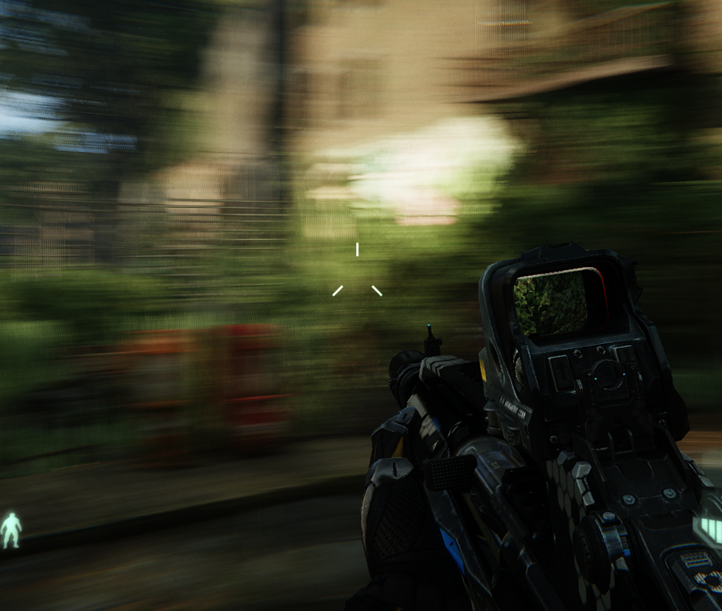
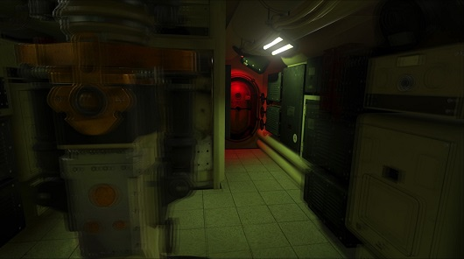
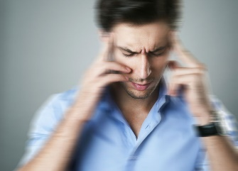
Motivation
A challenge of Virtual Reality
  Users feel gaps on their sense between the reality and virtual reality because of a motion-to-photon latency
  This causes dizziness and motion sickness to user
Motion-to-photon latency must be compensated!
Human perception
Problems from latency of HMD
Motion sickness
Blurring
Image judder
Dizziness

Slide 8
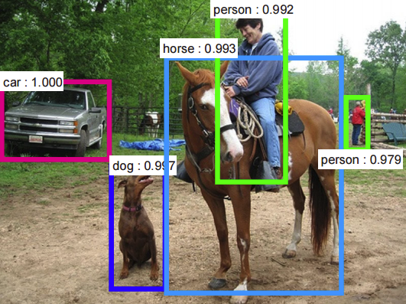
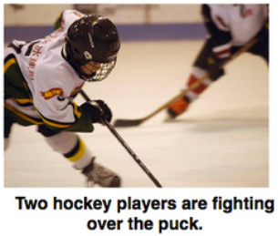
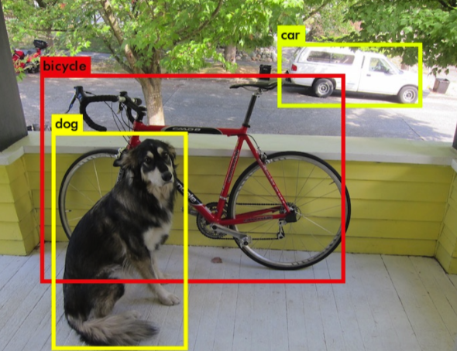
Motivation
Convolutional neural networks (CNN) can solve the problems faced by existing machine learning algorithms in such as object recognition and natural language processing, etc.

Slide 9
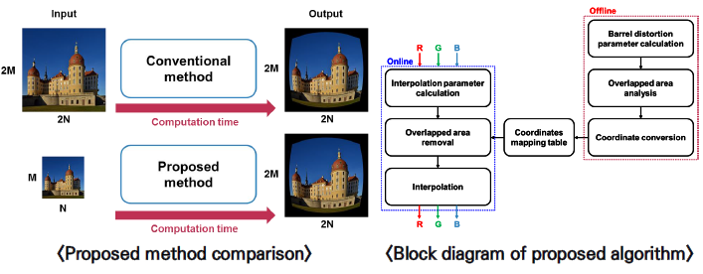
Proposed HMD System
Distorted Stereoscopic Image

Slide 10
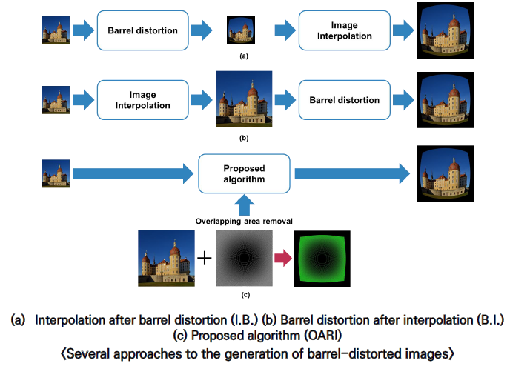
Proposed HMD System

Slide 11
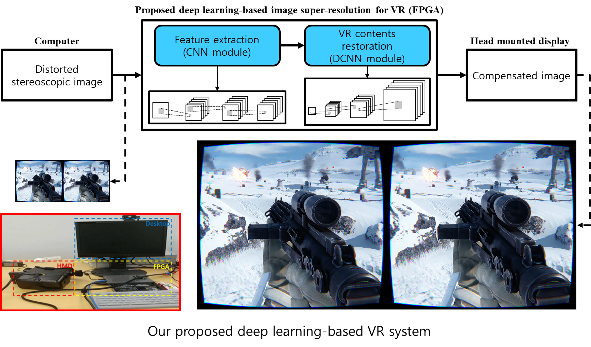
Proposed HMD System
Distorted Stereoscopic Image

Slide 12
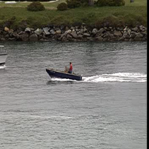

Proposed HMD System (Background)
Especially, deconvolutional neural networks (DCNN) are mainly used to reconstruct target images in image enhancement applications.
Convolution +
Activation
Convolution +
Activation
Deconvolution +
Activation

Slide 13
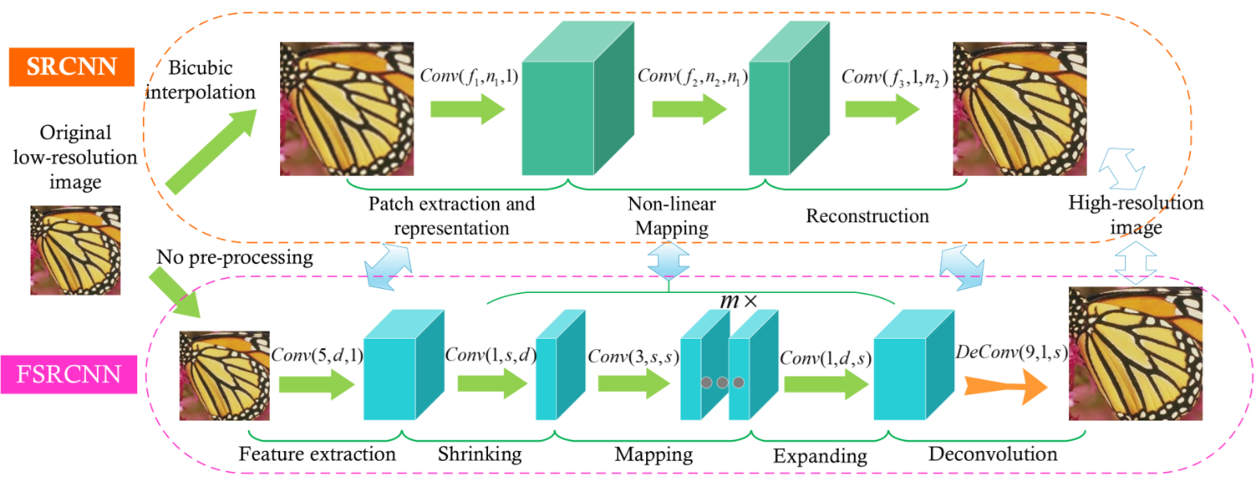
Proposed HMD System (Background)
*C. Dong, et al. Accelerating the super-resolution convolutional neural network. In Springer ECCV 2016.
FSRCNN*
  Deep networks (7 CNN + 1 DCNN)
  More cost effective than SRCNN, but it’s even better.

Slide 14










Proposed Hardware Architecture
Convolution in CNN
Input image
Filter
Output image
$$H_{out}$$
$$K_{C}$$
$$K_{C}$$
$$H_{in}$$
$$N$$
$$K_{C}$$
$$K_{C}$$
$$N$$
$$W_{out}$$
$$W_{in}$$

Slide 15













Proposed Hardware Architecture
Convolution in CNN
Input image
Filter
Output image
$$K_{C}$$
$$K_{C}$$
$$N$$
$$H_{in}$$
$$K_{C}$$
$$H_{out}$$
$$K_{C}$$
$$M$$
$$N$$
$$M$$
$$W_{in}$$
$$W_{out}$$

Slide 16




Proposed Hardware Architecture
Deconvolution in DCNN
Input image
Filter
Output image
$$K_{D}$$
$$H_{out}$$
$$K_{D}$$
$$K_{D}$$
$$H_{in}$$
$$N$$
$$K_{D}$$
$$N$$
$$W_{out}$$
$$W_{in}$$

Slide 17




Proposed Hardware Architecture
Deconvolution in DCNN
Input image
Filter
Output image
$$K_{D}$$
$$N$$
$$K_{D}$$
$$H_{in}$$
$$K_{D}$$
$$H_{out}$$
$$M$$
$$K_{D}$$
$$N$$
$$M$$
$$W_{in}$$
$$W_{out}$$

Slide 18




Proposed Hardware Architecture
Problems with DCNN
  Overlapping sum problem
  Loop dimensions
$$R_{H}$$
$$R_{L}$$
$$C_{L}$$
$$C_{H}$$
Need to sum these overlaps up

Slide 19
Proposed Hardware Architecture
Problems with DCNN
  Overlapping sum problem
  Loop dimensions
Pixels
Pixels
Pixels
Registers & Processing Engine Arrays
Off-chip
Memory
On-chip
Memory
Weights
Weights
Weights
PE
PE
PE
PE
Pixels
Pixels
Pixels
PE
PE
PE
PE
PE
PE
PE
PE
<General CNN Acceleration system>

Slide 20
Proposed Hardware Architecture
Problems with DCNN
  Overlapping sum problem
  Loop dimensions
Pixels
Pixels
Pixels
Registers & Processing Engine Arrays
Off-chip
Memory
On-chip
Memory
Weights
Weights
Weights
PE
PE
PE
PE
Pixels
Pixels
Pixels
PE
PE
PE
PE
PE
PE
PE
PE
<General DCNN Acceleration system>

Slide 21

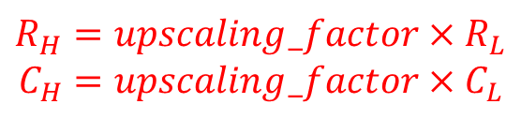



Proposed Hardware Architecture
Problems with DCNN
  Overlapping sum problem
  Loop dimensions
$$R_{H}$$
$$R_{L}$$
$$C_{L}$$
Deconvolution
$$C_{H}$$
$$R_{H}=upscaling_factor×R_{L}$$
$$C_{H}=upscaling_factor×C_{L}$$

Slide 22
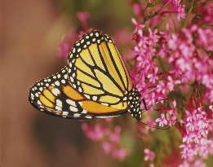






Proposed Hardware Architecture
*Chang, et al. Optimizing FPGA-based convolutional neural networks accelerator for image super-resolution. In IEEE/ACM ASP-DAC 2018.
Problems with DCNN
  We solve these problems using TDC method*.
$$1$$
$$K_{C}$$
$$S_{D}×S_{D}$$
$$K_{C}$$
$$1$$
Deconvolution→Convolution

Slide 23
Experimental Environments
Hardware Implementation Tool
  High-Level Synthesis
  Vivado HLS 2016. 4
  Xilinx Virtex-7 485T FPGA
  Single-precision floating point
CNN model
  FSRCNN
    7 convolution + 1 deconvolution

Slide 24
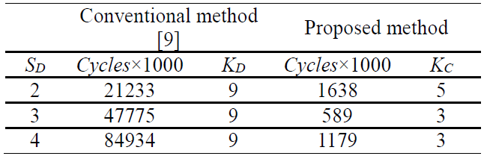



Experimental Results
[1]X. Zhang, et al. A design methodology for efficient implementation of deconvolutional neural networks on an FPGA. In arxiv: 1705.02583.
TDC Method
  Loop tiling factor (T_{n}, T_{m}) was set to (56, 9).
  Two reasons for the increase in the throughput
    Kernel size
    Resource underutilization problem is resolved
[1]
12.96 $×$
8$1.11×$
7$2.04×$

Slide 25
Experimental Results
Latency
Execution time
Conv1
Conv1
Conv1
Conv1
Conv1
QHD 21.27ms(×2)
9.45ms(×3)
5.34ms(×4)
Conv2
Conv2
Conv2
Conv2
Conv2
Conv3
Conv3
Conv3
Conv3
Conv4
Conv4
Conv4
Conv4
Conv5
Conv5
Conv5
Timeline
Conv1
Conv1
Conv1
Conv1
Conv1
QHD 7.09ms(×2)
3.15ms(×3)
1.78ms(×4)
Conv2
Conv2
Conv2
Conv2
Conv2
Conv3
Conv3
Conv3
Conv3
Conv4
Conv4
Conv4
Conv4
Conv5
Conv5
Conv5
Timeline

Slide 26
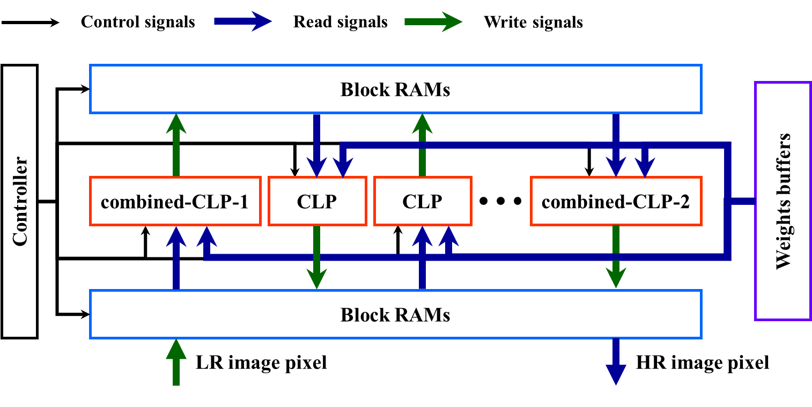
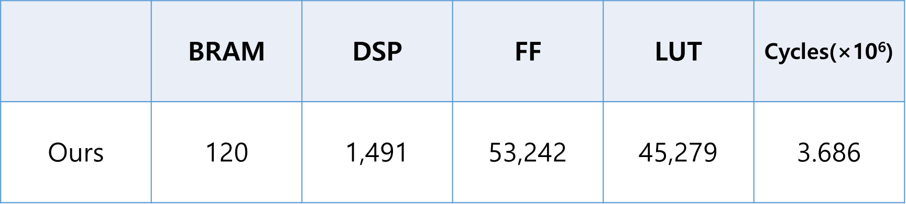
Experimental Results
FPGA Utilization (130MHz)
FPGA resources 사용량

Slide 27
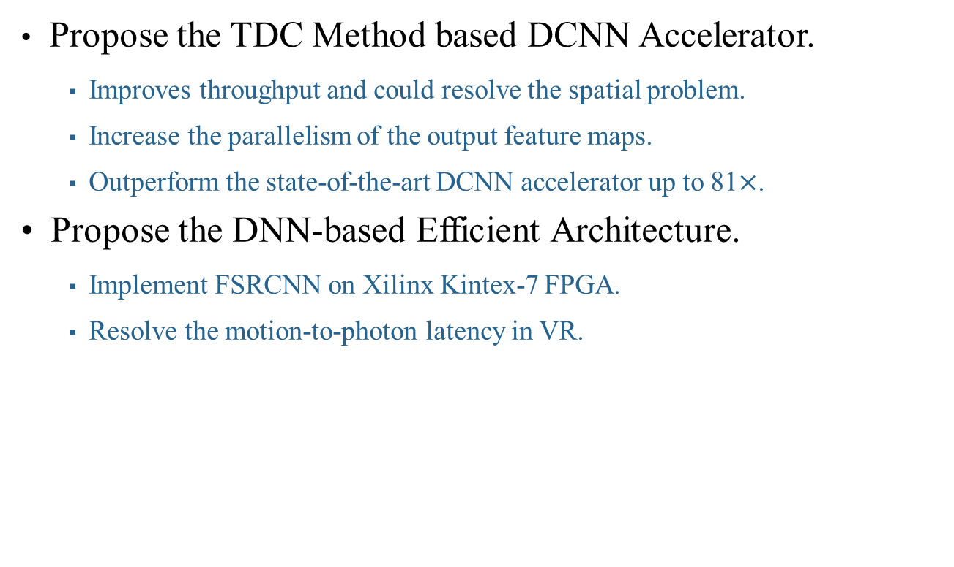
Summary
Propose the TDC Method based DCNN Accelerator.
  Improves throughput and could resolve the spatial problem.
  Increase the parallelism of the output feature maps.
  Outperform the state-of-the-art DCNN accelerator up to 81$×$.
Propose the DNN-based Efficient Architecture.
  Implement FSRCNN on Xilinx Kintex-7 FPGA.
  Resolve the motion-to-photon latency in VR.

