Slide 1
Terms for MPEG-Immersive 3DoF+ Standard Work
Presenter: Eun-Seok Ryu (esryu@gachon.ac.kr)
Ju-Hyeong Kim, Jong-Beom Jeong, Dongmin Jang, SoonBin Lee, Eun-Seok Ryu
Multimedia Communications and Systems Lab. (MCSL)
http://mcsl.gachon.ac.kr
Department of Computer Engineering
Gachon University

Slide 2
Contributions on 3DoF+
w17726 - Common Test Conditions (CTC) on 3DoF+
w17759 - Reference View Synthesizer (RVS) manual
w17760 - ERP WS-PSNR software manual
m43504 – Outperforming 3DoF+ anchors: first evidence
w17761 - 3DoF+ software platform description
w17724 - Draft call for proposals on 3DoF+

Slide 3
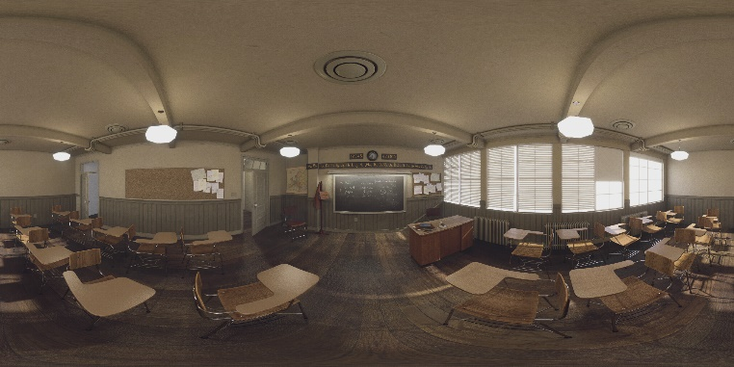
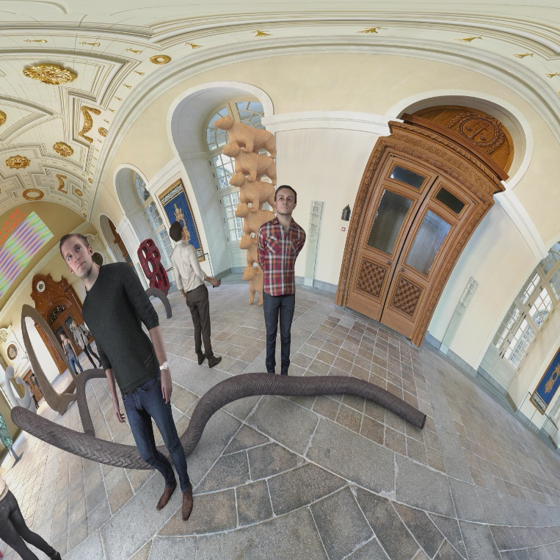
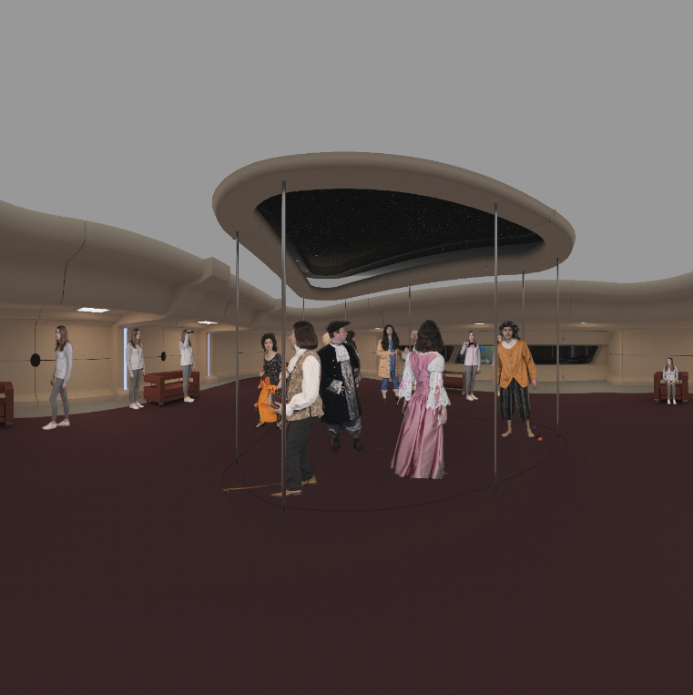
Common Test Conditions (CTC) on 3DoF+
Common Test Conditions (CTC)
Conditions for the experiment including parameters for the test sequence
Test sequence
Test materials used in the experiment
In 3DoF+, 3 test sequences are provided
Class A
ClassroomVideo (4096x2048), 360º x 180º FOV ERP,
30fps, 120frames, 15 source views
Class B
TechnicolorMuseum (2048x2048), 180º x 180º FOV ERP,
30fps, 300frames, 24 source views
Class C
TechnicolorHijack (4096x4096), 180º x 180º FOV ERP,
30fps, 300frames, 10 source views

Slide 4
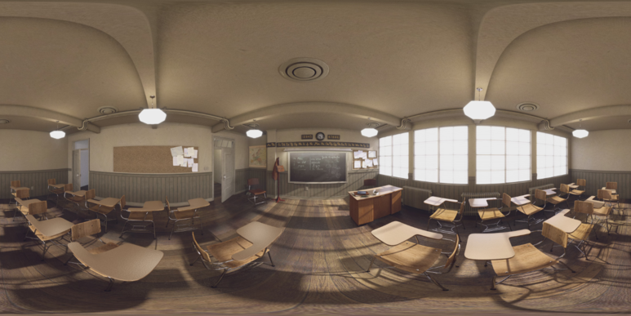
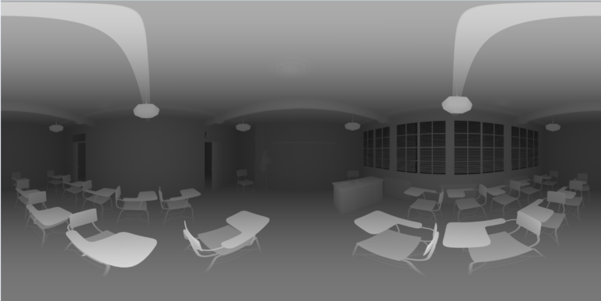
Common Test Conditions (CTC) on 3DoF+
Texture
Made of picture which contains the color information
Depth
Represents the distance between the camera and the objects shown in texture
Source view
Video provided by the test sequence, includes both texture and depth
Intermediate view
Video which is not provided by the test sequence
Virtually synthesized from source views
Texture of ClassroomVideo
Depth of ClassroomVideo

Slide 5
Common Test Conditions (CTC) on 3DoF+
Non-coded source view
A view generated from anchor view whose position is one of the source view
Anchor view
A subset of source views to be used in view synthesis
In 3DoF+, it is encoded and decoded with HEVC
Definition of the anchor

Slide 6
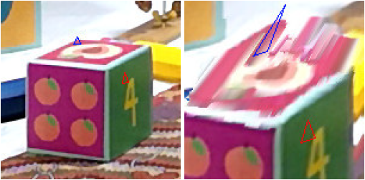
Reference View Synthesizer (RVS) manual
Reference View Synthesizer (RVS)
Software used to synthesize a view in 3DoF+
3D warping
Pixel movement between viewpoints of the same world coordinates
(a) Input view
(b) Obtained view after synthesizing view and depth

Slide 7
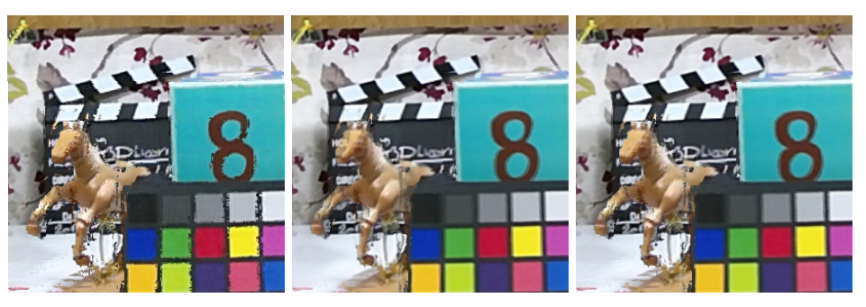
Reference View Synthesizer (RVS) manual
View blending
Blending all of the synthesized images
Hole
Area of the synthesized view which did not filled by the source views
Inpainting
Filling the hole with the nearest pixel
(a)
(b)
(c)
(a): Blending by argmax
(b): Weighted mean
(c): Multi-spectral blending: argmax - high frequencies weighted mean - low frequencies

Slide 8
ERP WS-PSNR software manual
WS-PSNR
Uniform weight in sphere PSNR
Designed to evaluate the coded omnidirectional video
Weight map of WS-PSNR

Slide 9
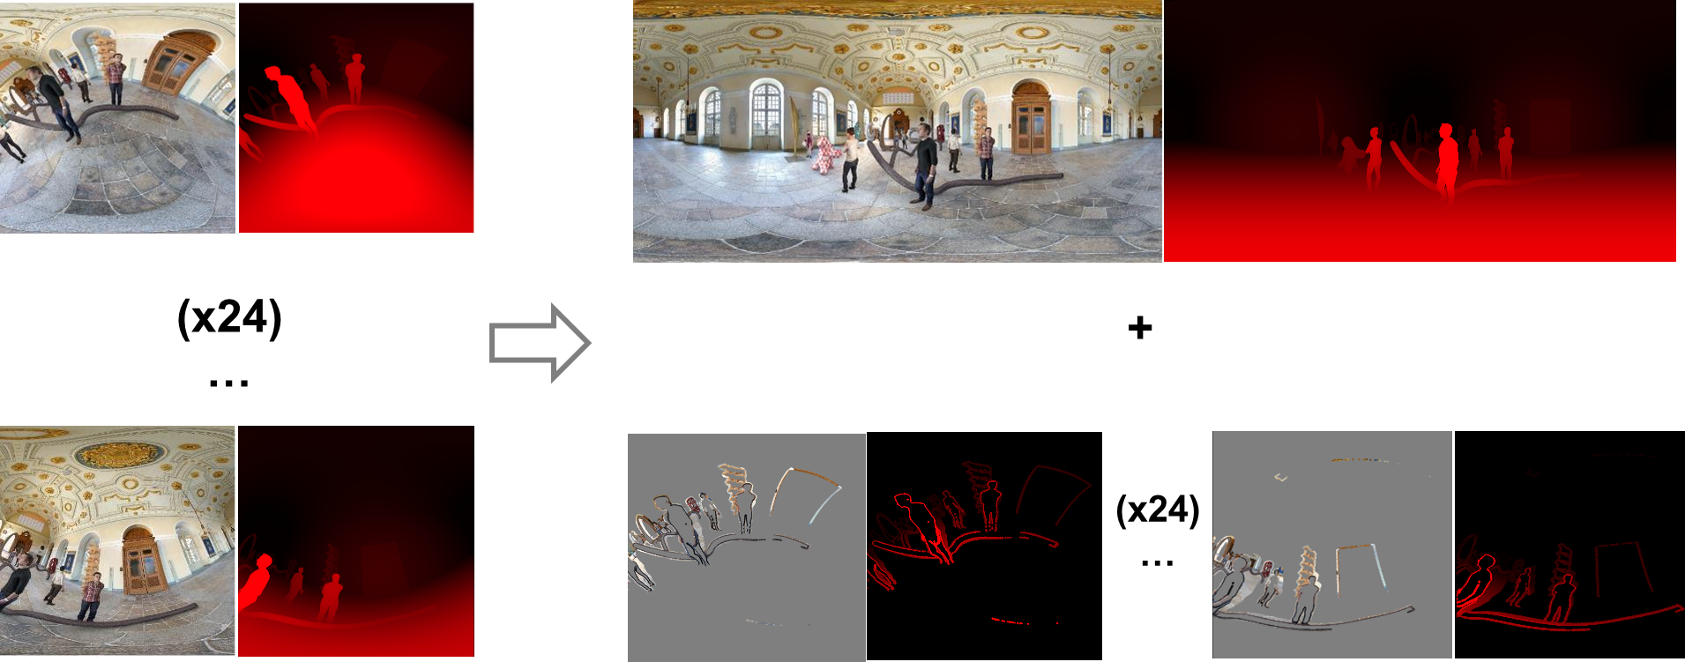
Outperforming 3DoF+ anchors: first evidence
Central view
A view which contains most of the information of the source views
The position of the central view is the most frequently used position
Sparse view
A view only carries a particular information of its own
Generated by removing redundancy between source views and central view
Visualization of the central view and the source views

Slide 10
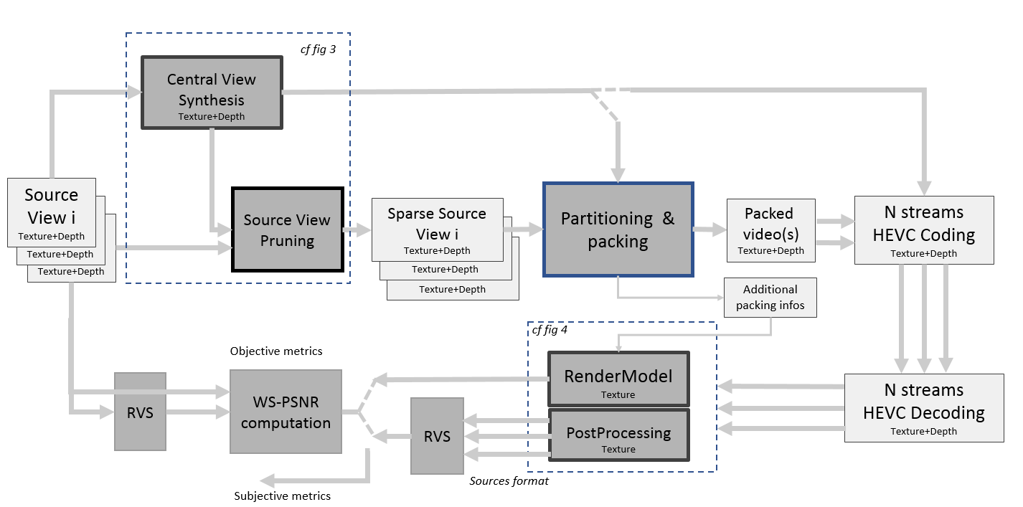
3DoF+ software platform description
Source view pruning
Generates the sparse view with the central view and the source views
Removes the pixels which the central view already contains
Partitioning & packing
Divides the sparse views and discard the empty spaces
Merges all of the partitions and generates additional information
3DoF+ software platform description

Slide 11
Draft call for proposals on 3DoF+
Viewport
A rectangular image which the user sees
Has a field of view of 90ºx90º, rectilinear projection format
Pose trace
Information about the user’s viewport

