Slide 1
[Framework of Evaluation and Assessment for the VR Sickness of VR Content]
[Beom-Ryeol Lee/ETRI]

Slide 2
Compliance with
IEEE Standards Policies and Procedures
Subclause 5.2.1 of the IEEE-SA Standards Board Bylaws states, "While participating in IEEE standards development activities, all participants...shall act in accordance with all applicable laws (nation-based and international), the IEEE Code of Ethics, and with IEEE Standards policies and procedures."
The contributor acknowledges and accepts that this contribution is subject to
The IEEE Standards copyright policy as stated in the IEEE-SA Standards Board Bylaws, section 7, http://standards.ieee.org/develop/policies/bylaws/sect6-7.html#7, and the IEEE-SA Standards Board Operations Manual, section 6.1, http://standards.ieee.org/develop/policies/opman/sect6.html
The IEEE Standards patent policy as stated in the IEEE-SA Standards Board Bylaws, section 6, http://standards.ieee.org/guides/bylaws/sect6-7.html#6, and the IEEE-SA Standards Board Operations Manual, section 6.3, http://standards.ieee.org/develop/policies/opman/sect6.html

Slide 3
IEEE 3079
HMD Based VR Sickness Reducing Technology
Dongil Dillon Seo, dillon@volercreative
Framework of Evaluation and Assessment for the VR Sickness of VR Content
Date: 2018-10-10
Author(s):
Name | Affiliation | Phone [optional] | Email [optional]
Beom-Ryeol Lee | ETRI | +82 10 8880 3347 | lbr@etri.re.kr

Slide 4
Contents
Framework for the analysis and evaluation of VR sickness
Reference content
Clinical trial
Survey subjects

Slide 5
Framework for the analysis and evaluation of VR sickness
Reference content
Clinical trial
Survey subjects

Slide 6
Framework of Evaluation and Assessment for the VR Sickness of VR Content
Purpose of standard
  To provide criteria for the analytical framework using objective and subjective evaluation measures for analyzing and evaluating the VR sickness for VR content
Scope of standard
  Framework to quantify the correlation between human factors parameters in VR content and symptoms of VR sickness.
    Implementation issues for referential VR content
    Protocol design for clinical trial
    Survey design for user’s response with SSQ, MSSQ

Slide 7
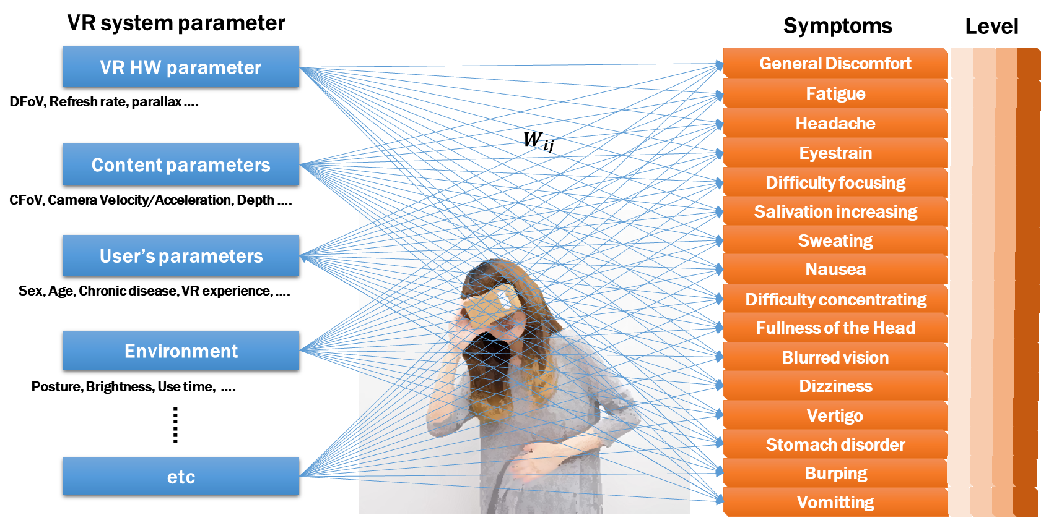
Relationship between human factor parameters and VR sickness symptoms for evaluation of VR sickness

Slide 8
Framework for the analysis and evaluation of VR sickness
Components of the framework
    Reference VR content
    Stimulus classification
    System parameters
    Subjective evaluation methods and procedures
    Objective evaluation methods and procedures
    Clinical trail database
    Correlation analysis methods and procedures for VR sickness
    Methods and standards for leveling VR sickness
    Clinical trial configuration and test methods for evaluating and analyzing VR sickness
    Configuration and measurement of a user's VR sickness survey

Slide 9
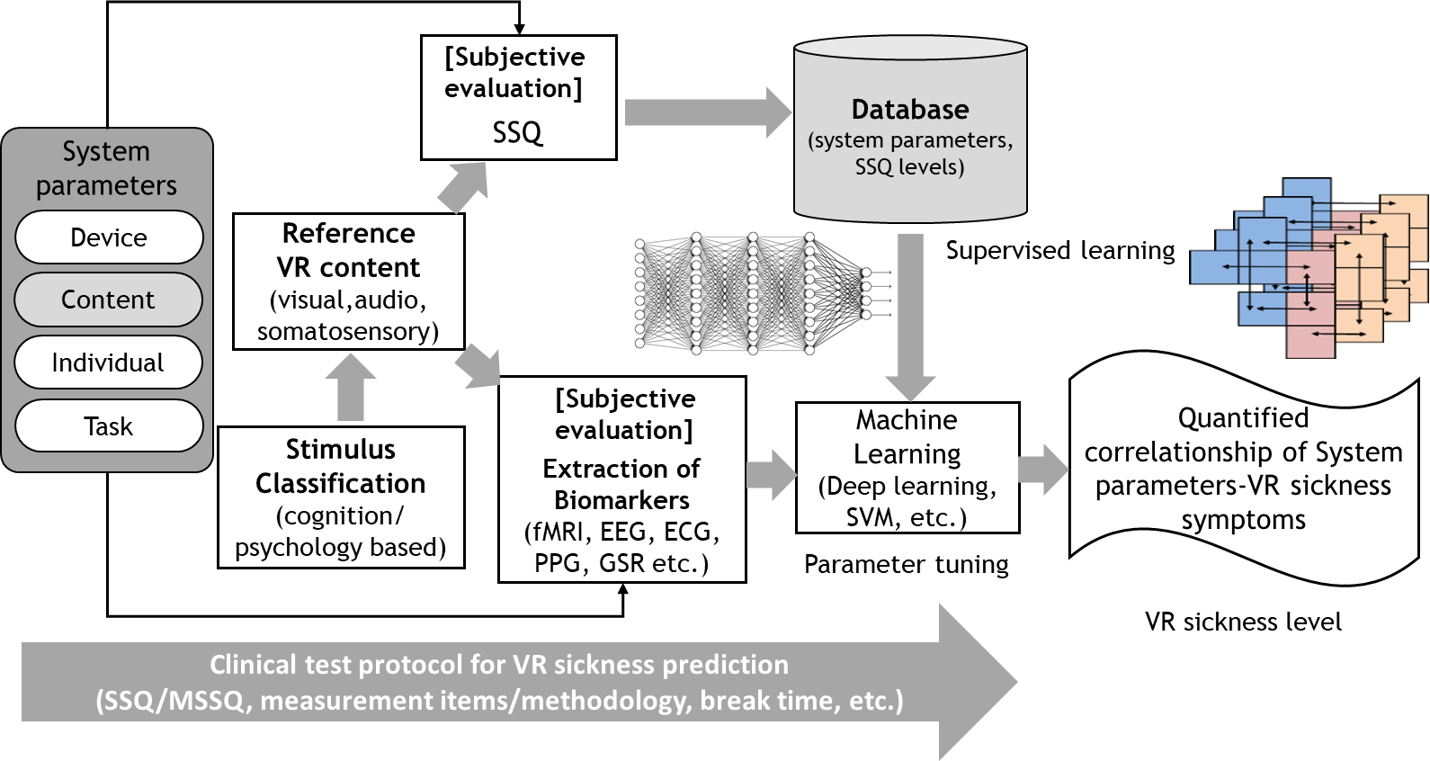
Framework for the analysis and evaluation of VR sickness

Slide 10
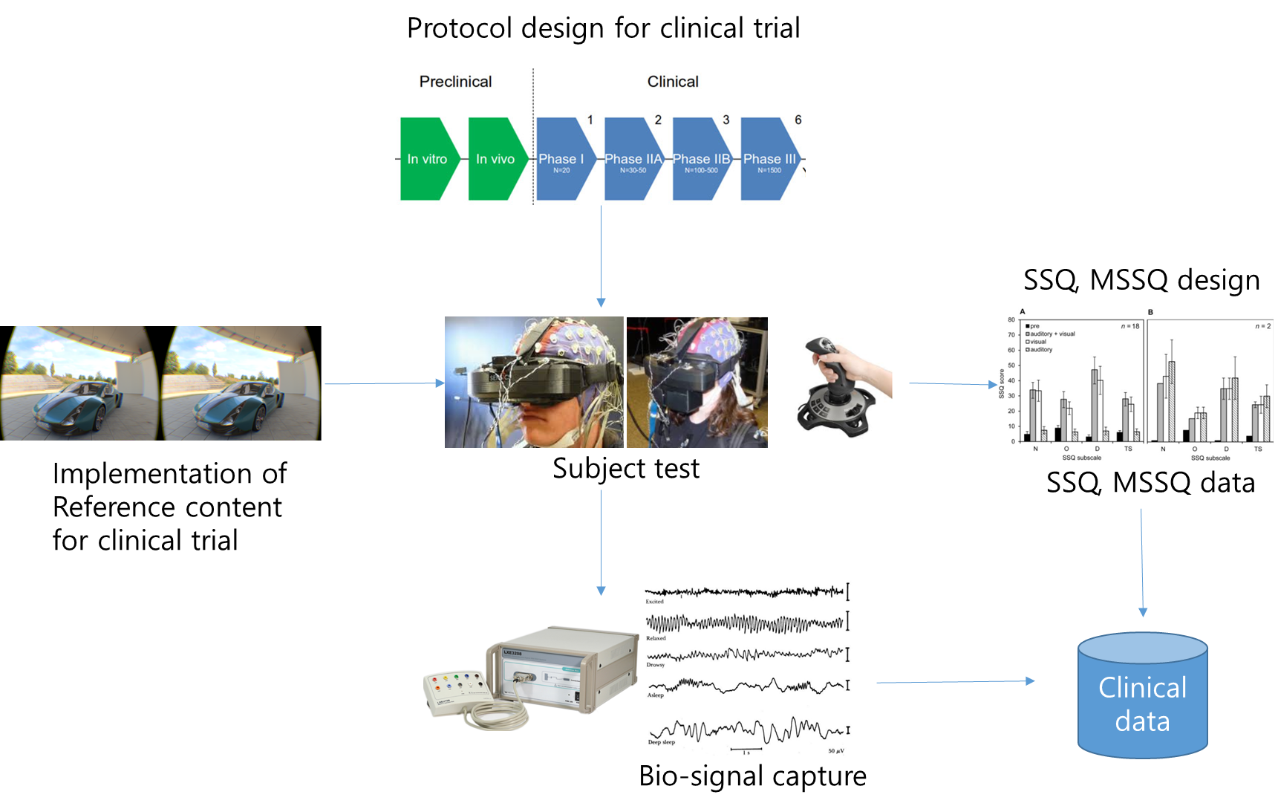
Measuring tools for analysis and evaluation of VR sickness

Slide 11
Framework for the analysis and evaluation of VR sickness
Reference content
Clinical trial
Survey subjects

Slide 12
Reference content
Primitive content
  Content for clinical evaluation that separates VR sickness by parameter adjustment of VR content
  Extract individual VR parameters in content that affect VR sickness
Scenario content
  Content for clinical evaluation by multiple coordination of VR parameters
  Testing and analyzing combinations of VR parameters in content that affect VR sickness

Slide 13
Primitive content
Parameters for primitive content:
  Moving direction/velocity/acceleration of virtual camera
  Moving direction/velocity/acceleration of objects
  # of objects
  FoV
  Visual guides
  etc

Slide 14
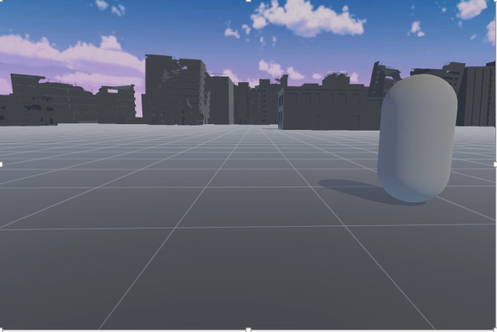
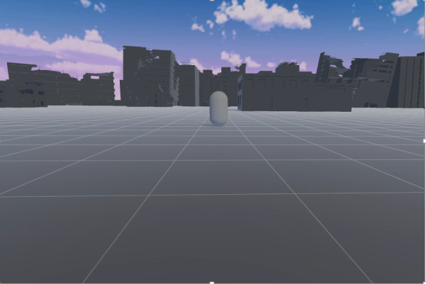
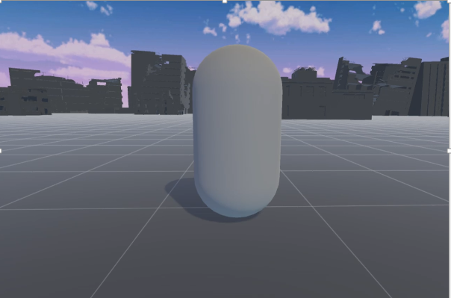
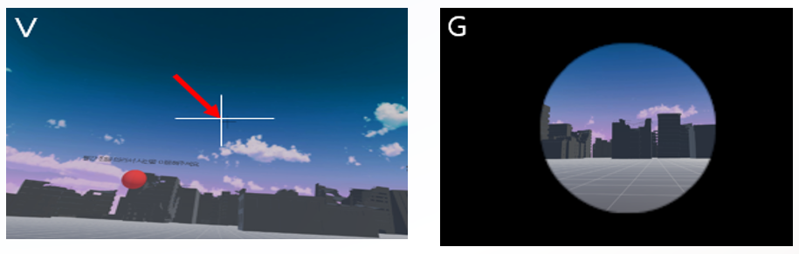
Primitive content
Object movement
(Left/Right)
Object movement
(Depth direction)
Object size
Visual Guide
FoV adjustment

Slide 15
Primitive content
Configuration of primitive content
i-th shot of primitive content
Pi
Bg1
Action
Bg2
2 sec
appx. 10 sec
5 sec
Bg1 : Show background and stop(prepare and pause)
Bg2 : Press button according to VR sickness level
Action : Play content for evaluate VR sickness level

Slide 16
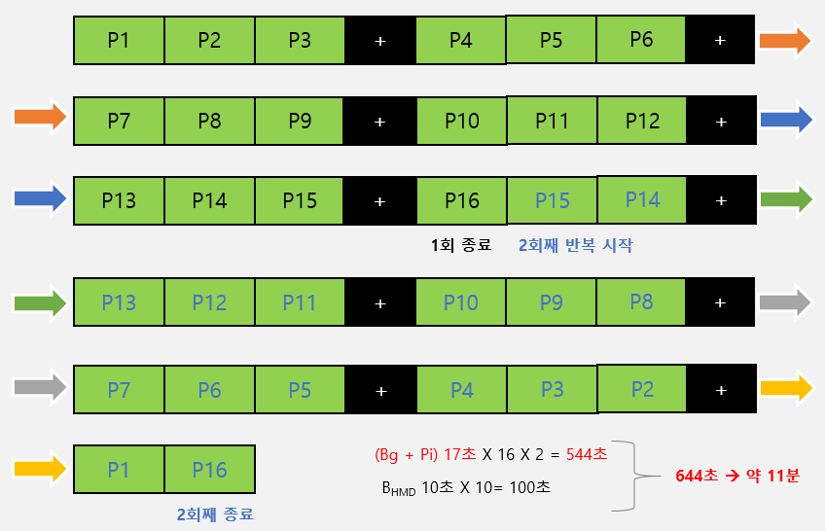
Primitive content
Clinical trial for primitive content
17sec(Bg+Pi) x 16 shots x 2 times = 544sec
10sec(B_{HMD}) x 10 = 100sec
644sec
(appx. 11 min.)
  P1~P16 repeat 2 times(appx. 11 min.)
  P17~P32
Primitive content(1)
Primitive content(2)

Slide 17
Primitive content
Naming of primitive content
Naming | Actions
OM | Object movement
CM | Virtual camera movement
H | Horizontal direction(left and right)
X | Diagonal direction
FB | Forward and backward movement
UD | Up and down movement
RR | Rotation of rolling direction
RP | Rotation of pitch direction
RY | Rotation of Yaw direction
Vz | Display visual guide
G | Adjust field of view(goggling effect)

Slide 18
Scenario content
Test for interagency between individual parameters identified in the primitive content
  Drone shooting VR game
  Car racing VR Game

Slide 19
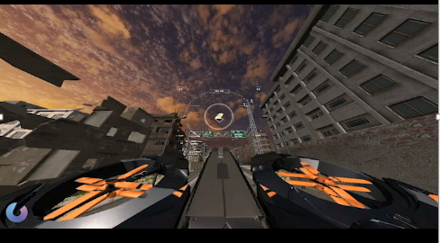
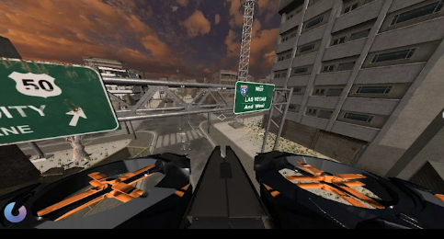
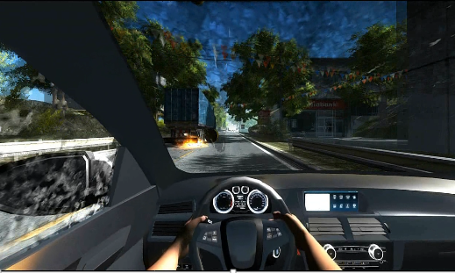
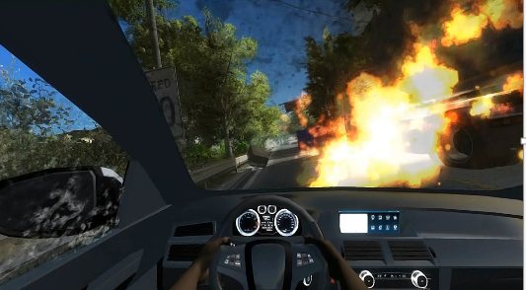
Scenario content
Image of drone game(height and depth changing)
Image of driving game(on and off visual effect)

Slide 20
Scenario content
Configuration of scenario content
i-th stage of scenario content
Si
+
Si
10 sec
appx. 60 sec
B_{HMD} : Blank and “+” (Wear HMD)
Si : Play scenario content for evaluate VR sickness level

Slide 21
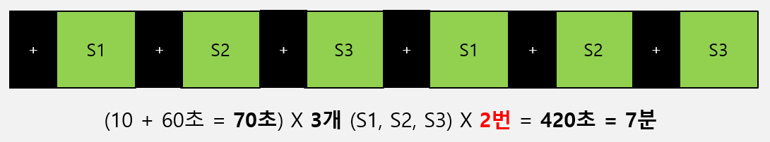
Scenario content
Clinical trial for scenario content
70sec(B_{HMD} +Si) x 3 stages(S1, S2, S3) x 2 times = 420sec
= 7 min.
Primitive content(1)
  Drone shooting
  Car driving
Primitive content(2)

Slide 22
Correlation between primitive content and scenario content
Primitive content
OM
CM
G
Vz
G
H
FB
X
UD
H
FB
UD
RR
RY
RP
RY
RP
RY
RP
RY
RP
V1
V2
V1
V2
V1
V2
V1
V2
V1
V2
V1
V2
V1
V2
V1
V2
V1
V2
V1
V2
V1
V2
V1
V2
V1
V2
V1
V2
V1
V2
V1
V2
P1
P2
…
P16
P17
…
P31
P32
S1
S2
S3
S1
S2
S3
Slight
Moderate
Severe
Slight
Moderate
Severe
Drone shooting
Car driving
Scenario content

Slide 23
Framework for the analysis and evaluation of VR sickness
Reference content
Clinical trial
Survey subjects

Slide 24
Protocol for clinical trial
Procedure of clinical trial
  Prepare reference VR content
  Choose VR hardware for application
  Set measuring tools for subject’s bio-signals
  Design protocol for clinical trial
  Design survey with SSQ, MSSQ

Slide 25
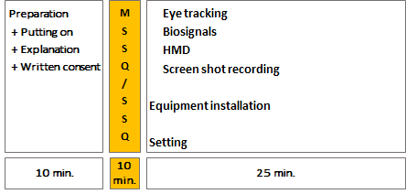
Protocol for clinical trial
Typical configuration of clinical trial

Slide 26
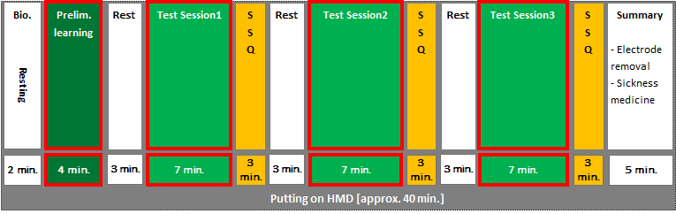
Protocol for clinical trial
Repeat intervals at clinical trial

Slide 27
Clinical trial with bio-signal measurement
With brain wave measurement = 130 min.
Prepare testing
+ explanation
+ agreements
Examine clicking controller +
Practice primitive focusing
(hand-out)
Brain wave/Bio-signal/
HMD
preparation
HMD on → attach bio-signal electrodes
Bio-signals
SSQ
Rest
HMD off
+ Survey (demographic, VR experience,
MSSQ)
Brain wave/Bio-signal/
HMD
preparation
HMD on → attach bio-signal electrodes
SSQ
SSQ
Wrap-up
- Detach bio-signal electrodes
- Dose drug for VR sickness
Primitive content(1)
Resting
Primitive content(2)
Scenario content(1)
Resting
Scenario content(2)
Resting
5min
3min
15min
5m
11m
5m
11m
2
15m
15min
7m
2
10m
7m
2
15min
HMD weared [47 min.]
HMD weared [41 min.]

Slide 28
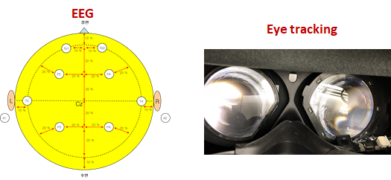
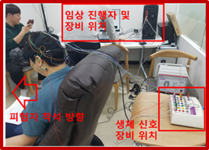
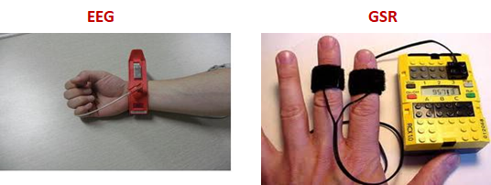
Protocol for clinical trial
Operational environments for clinical trial
Clinical presenter and tools
Subject seating
Bio-signal measuring

Slide 29
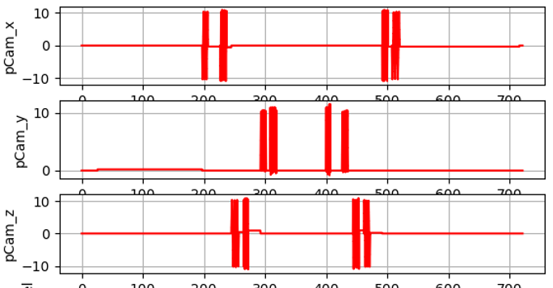
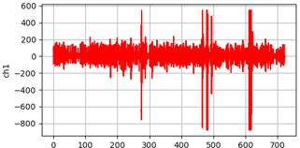
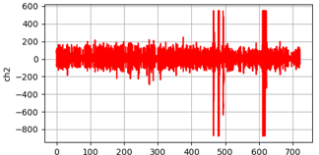
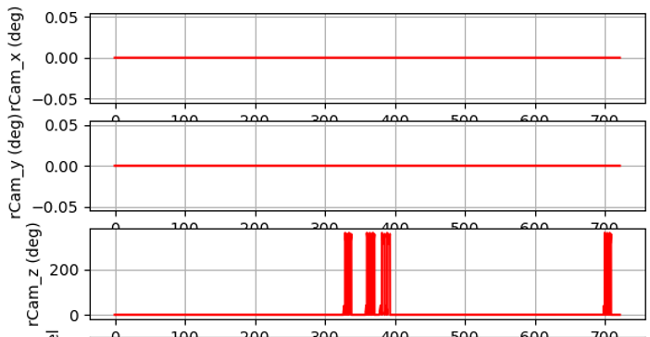
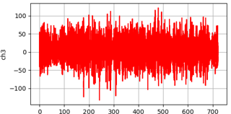
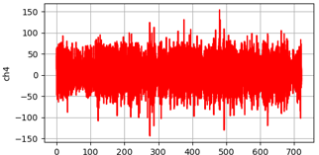
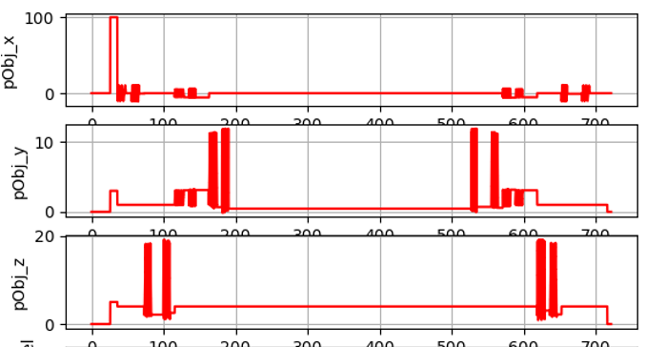
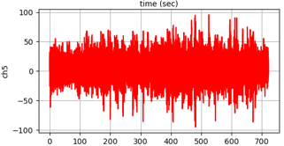
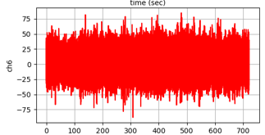
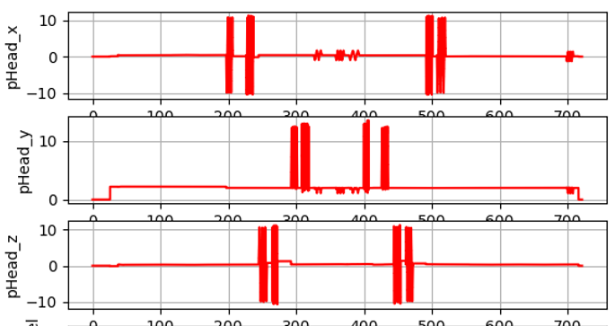
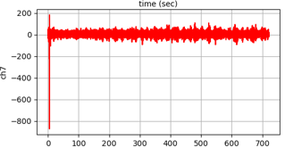
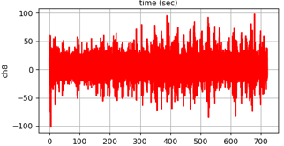
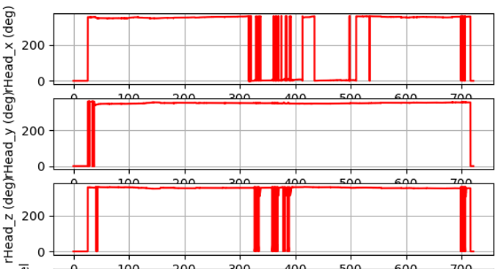
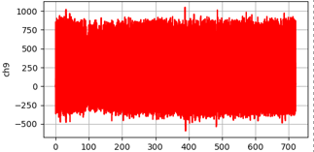
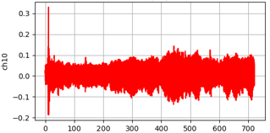
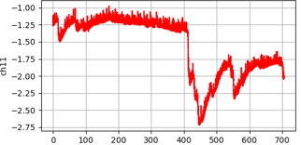
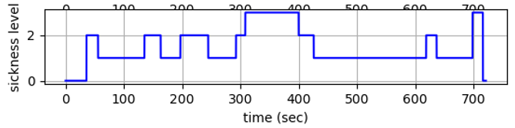
Visualization results of clinical trial
System parameters
Bio-signals
Camera position
Camera rotation
EEG
Object position
Head position
ECG
Head rotation
PPG
GSR
Sickness level
Sickness level
Visual Guide &
FOV adding

Slide 30
Framework for the analysis and evaluation of VR sickness
Reference content
Clinical trial
Survey subjects

Slide 31
Survey subjects
SSQ (Simulator Sickness Questionnaire)
  After experiencing VR content, the subject will conduct a scoring process that reflects scores on VR sickness through surveys of users about symptoms of VR sickness.
MSSQ (Motion Sickness Susceptibility Questionnaire)
  Before the clinical trial is screened, personalised information such as demographic information game content and VR experience and motion sickness sensitivity are conducted.

Slide 32
Survey subjects
IRB (Institutional Review Board)
  The subject must obtain approval from the IRB before conducting a clinical trial.
  IRB accreditation is valid for one year from the date of accreditation and is required to report the results of the clinical trial.

Slide 33
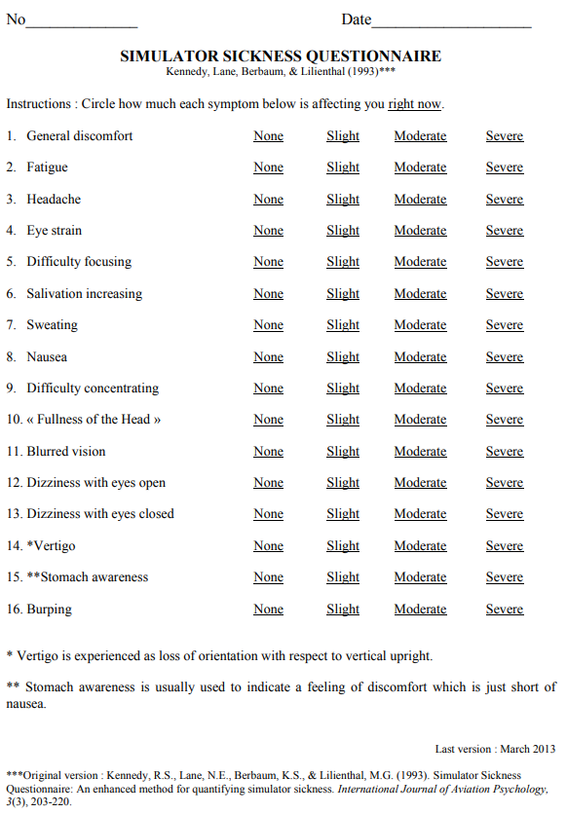
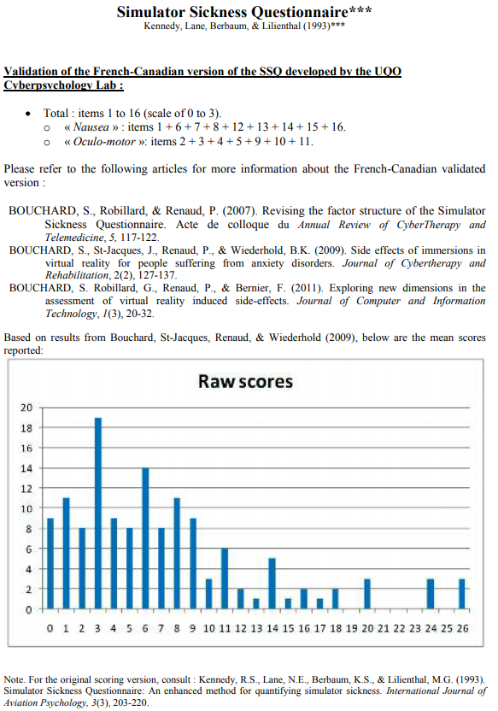
Examples of SSQ

Slide 34
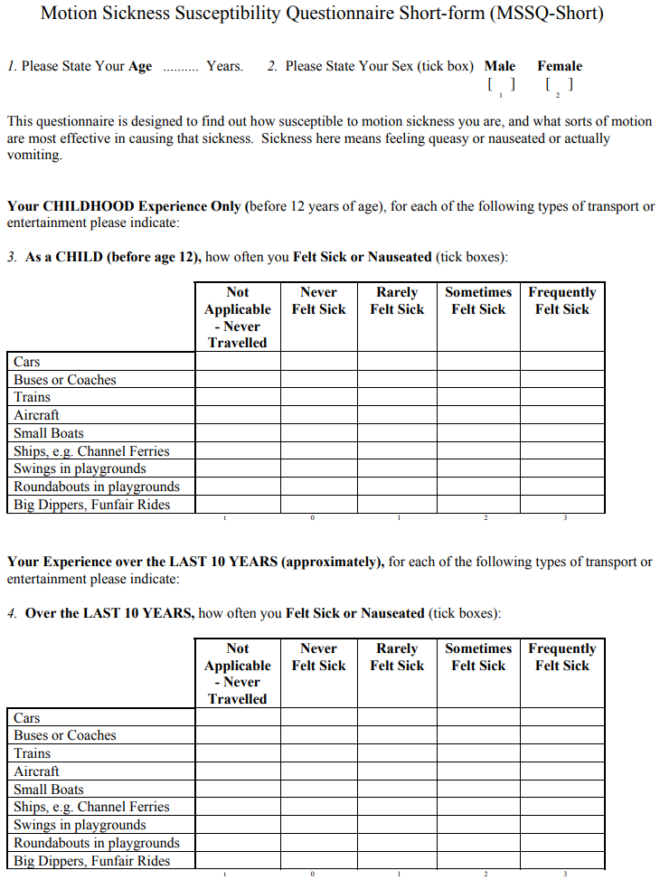
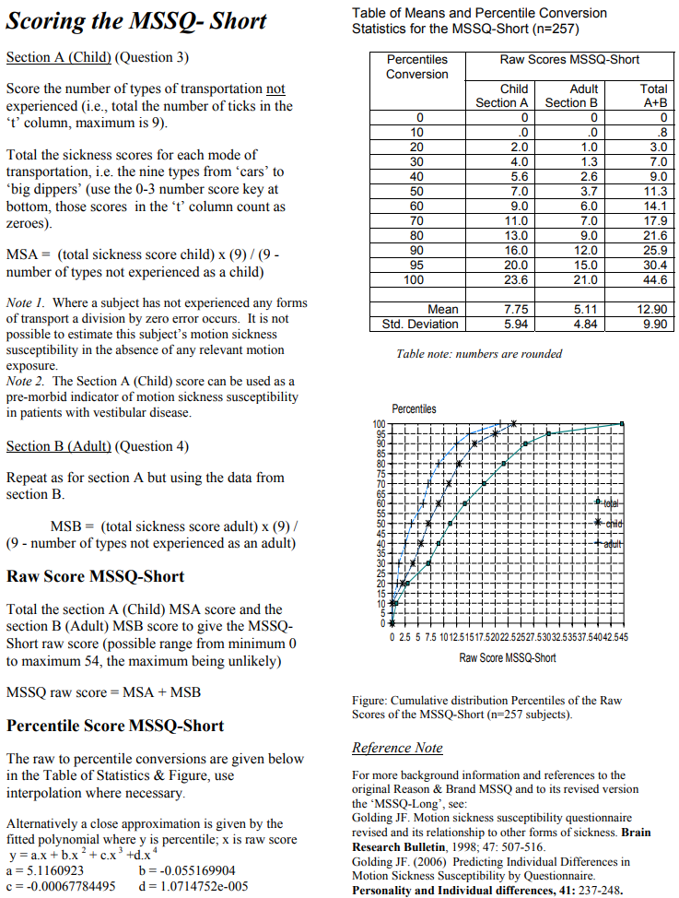
Examples of MSSQ

Slide 35
Conclusions
Propose a framework for the analysis and evaluation of VR sickness from the point of view of reference content, clinical trial, and survey subjects.
Enabling a database of VR sickness through clinical trials to be used as base data for reducing VR sickness is a very important issue for VR human factors research.

Slide 36
Thank You

