Slide 1
[Database Construction for Quantitative Analysis
of VR Sickness]
[Heeseok Oh, Beom-Ryeol Lee, Yongho Lee, Wookho Son / ETRI]

Slide 2
Compliance with
IEEE Standards Policies and Procedures
Subclause 5.2.1 of the IEEE-SA Standards Board Bylaws states, "While participating in IEEE standards development activities, all participants...shall act in accordance with all applicable laws (nation-based and international), the IEEE Code of Ethics, and with IEEE Standards policies and procedures."
The contributor acknowledges and accepts that this contribution is subject to
The IEEE Standards copyright policy as stated in the IEEE-SA Standards Board Bylaws, section 7, http://standards.ieee.org/develop/policies/bylaws/sect6-7.html#7, and the IEEE-SA Standards Board Operations Manual, section 6.1, http://standards.ieee.org/develop/policies/opman/sect6.html
The IEEE Standards patent policy as stated in the IEEE-SA Standards Board Bylaws, section 6, http://standards.ieee.org/guides/bylaws/sect6-7.html#6, and the IEEE-SA Standards Board Operations Manual, section 6.3, http://standards.ieee.org/develop/policies/opman/sect6.html

Slide 3
IEEE 3079
HMD Based VR Sickness Reducing Technology
Dongil Dillon Seo, dillon@joyfun.kr
Database Construction for Quantitative Analysis of VR Sickness
Date: 2019-7-10
Author(s):
Name | Affiliation | Phone [optional] | Email [optional]
Heeseok Oh | ETRI | +82 10 5264 1928 | ohhs@etri.re.kr
Beom-Ryeol Lee | ETRI | +82 10 8880 3347 | lbr@etri.re.kr
Youngho Lee | ETRI | +82 10 3008 5770 | jason0720@etri.re.kr
Wookho Son | ETRI | +82 10 8759 3602 | whson@etri.re.kr

Slide 4
CONTENTS
Overview
Background
Standardization Provisions
  Creation of reference content for VR sickness evaluation
  Design of protocol for a large-scale VR sickness clinical test
  Release of database for analysis of VR sickness
  Quantitative analysis of VR sickness
Expectations

Slide 5
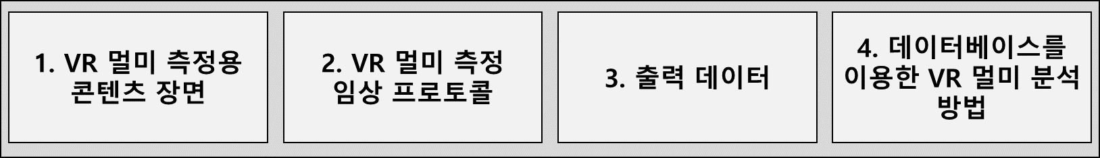
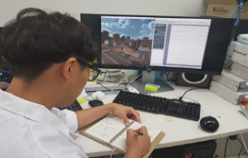
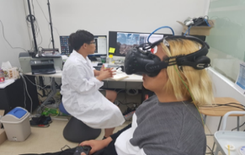
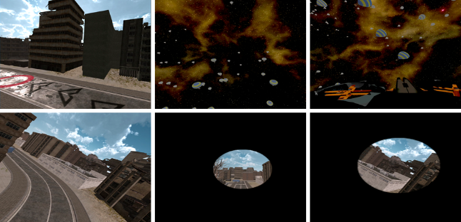
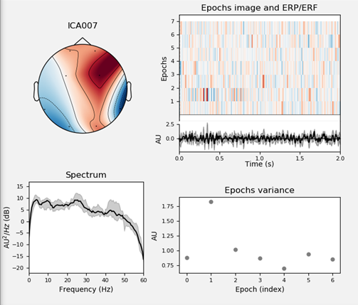
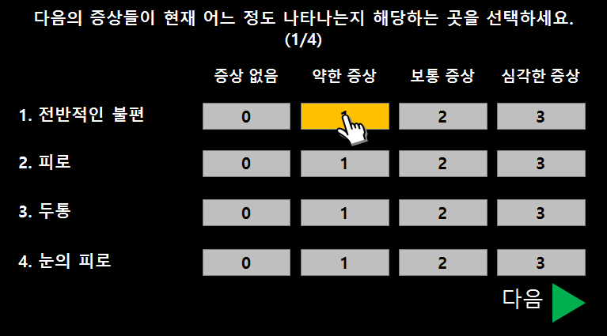
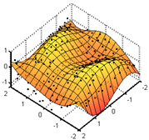

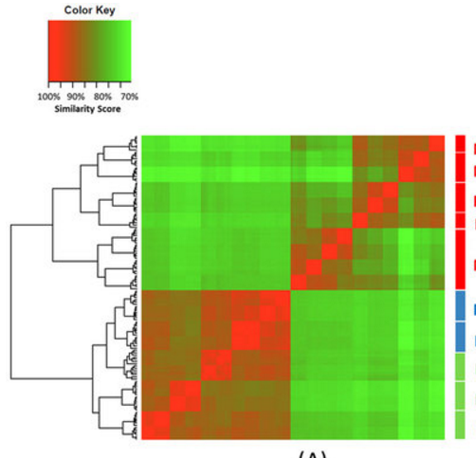
1. Overview
Title: The Guideline on Database Construction for Quantitative Analysis of VR Sickness
Contents: The methods on creating reference content and measuring VR sickness for objective/quantitative analysis of physiological symptoms arising from viewing VR content
Main Items
1. Producing reference content for VR sickness
2. Designing protocol for large-scale VR sickness evaluation
3. Releasing database for analysis of VR sickness
4. Quantitative analysis of VR sickness
VR sickness evaluation
VR Content parameters
v
카메라
위치
VR scenes having sickness level
Camera
Location
Head Movement
머리움직임
속도
Physiological measurement
FOV
Speed
Acceleration
VR 시청 영상
가속도
VR Scene
Quantitative analysis of VR sickness
Subject’s opinion

Slide 6
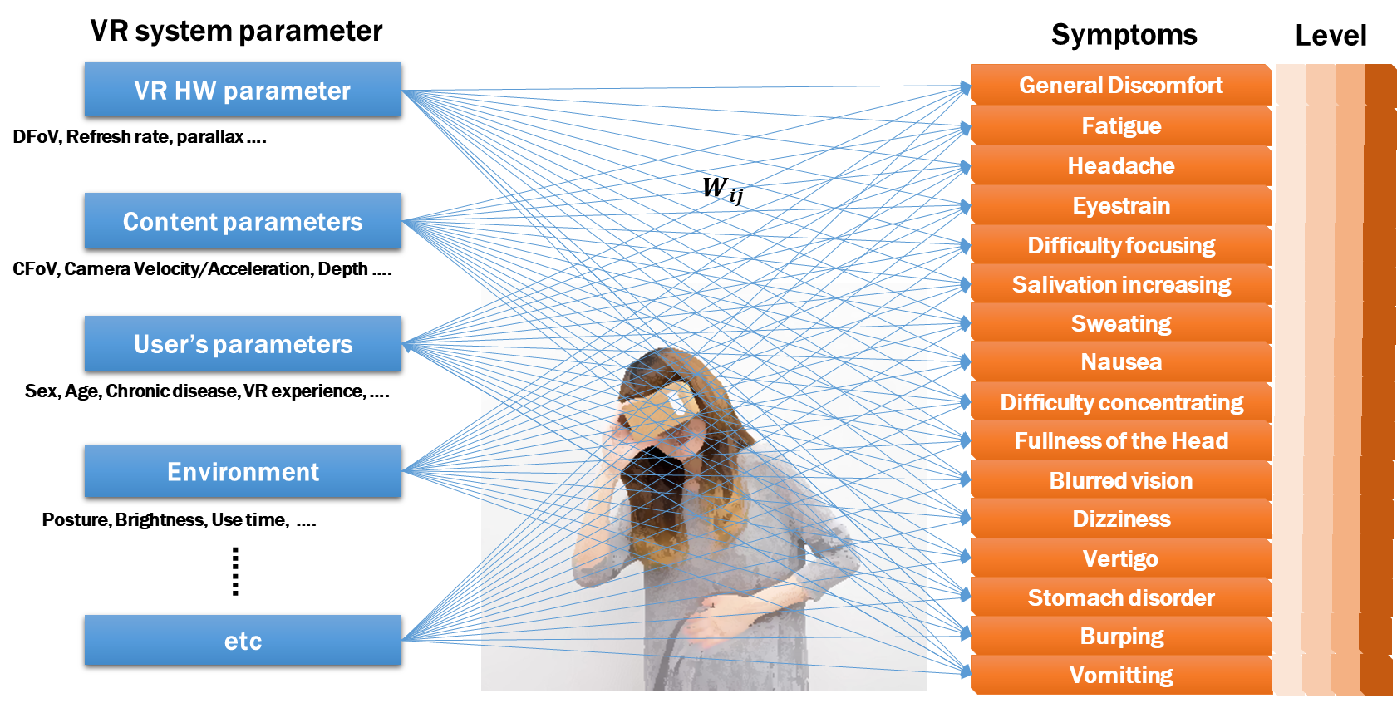
2. Background
Severe VR sickness is ensued when viewing VR content through HMD
Means of reducing VR sickness is necessary based on observable parameters
A lack of standard database for an analysis of VR sickness
A practical difficulty on subjective evaluation with participants

Slide 7
3. Standardization Provisions
Coverage
Main category | Subcategory | Note
1. Creating VR scenes for VR sickness measurement | 1.1. Categorizing scenes along VR sickness level | Grouping the VR scenes along the sickness level
 | 1.2. VR contents params. Inducing VR sickness | Factors on VR contents
2. Designing the protocol for subjective VR sickness evaluation | 2.1. VR sickness measuring protocol | Overall procedure of obtaining data
 | 2.2. Clustering of subjects | Age and sex
 | 2.3. Agreement format | Ethics and IRB on subjective test
 | 2.4. Obtaining personal VR sickness susceptibility | In order to reflect individual differences
 | 2.5. Measuring Physiological signals | Detailed measurements of biological signals
 | 2.6. Designing the tutorial session | Reflecting the demand characteristics of human
 | 2.7. Resting and assessing
3. Public database format for analysis on VR sickness | 3.1. Database for VR sickness | Data format of VR contents and scenes
 | 3.2. Objective measurement | Data format of objective measurements
 | 3.3. Subjective measurement | Data format of subjective measurements
4. The methods on quantitative analysis of VR sickness | 4.1. Analysis on system params – VR sickness | Statistical analysis
 | 4.2. Analysis on physiological signal – VR sickness | Statistical analysis
 | 4.3. Analysis on gaze – VR sickness | Statistical analysis
 | 4.4. Predictive model for the level of VR sickness via machine learning | Using supervised learning

Slide 8
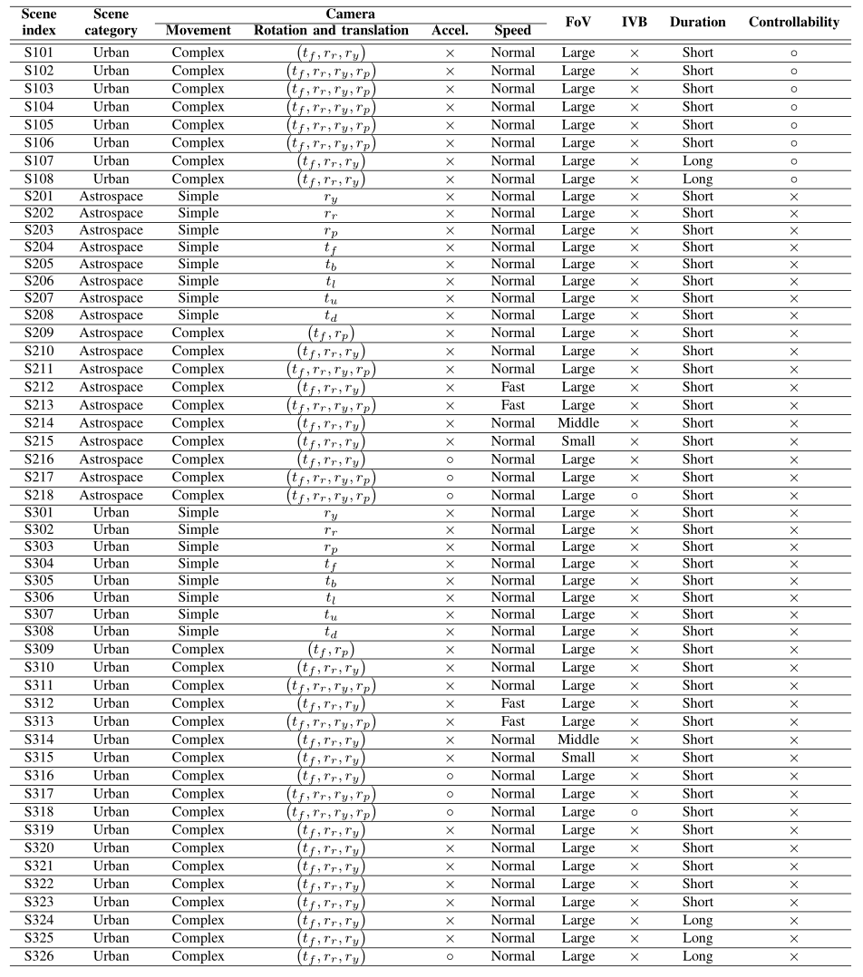
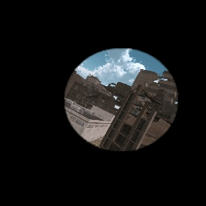
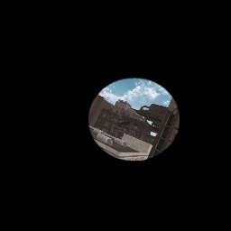
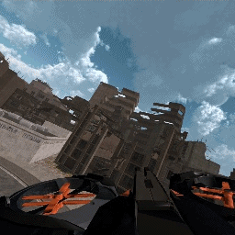
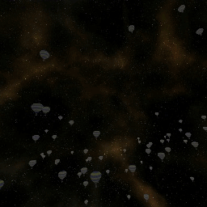
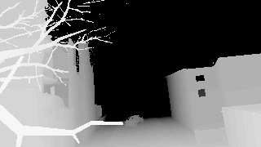
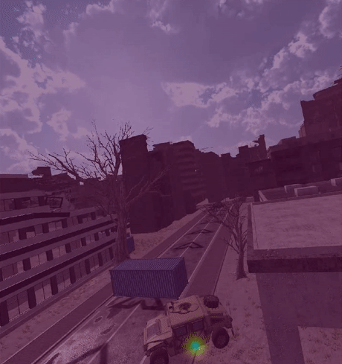
3. Standardization Provision #1
Creation of reference content for VR sickness evaluation
FOV (moderate)
FOV (small)
IVB
Acceleration
Depth
Saliency
52 reference VR scenes
→ Subjective evaluation
7

Slide 9
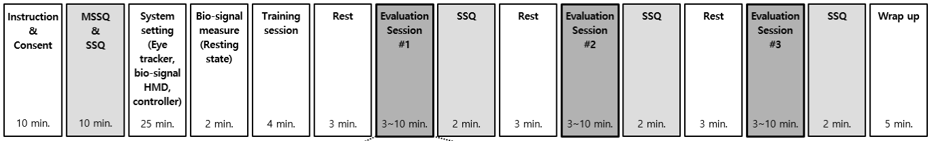


3. Standardization Provision #2
Design of protocol for a large-scale VR sickness clinical test
  Overall procedure
Designing the protocol for subjective VR sickness evaluation
Elaborated protocol based on neuropsychiatry, psychiatry, psychology consultation
Survey on VR sickness measurement and estimation
Dividing sessions and embedding rest for being avoid severe dizziness and VR sickness accumulation
Tutorial session is given to reflect Psychological demand characteristics
On-line monitoring of subject’s physical state and unusual response (vomit, cough, interruption, etc.)
Obtaining VR scene by deploying capture board
Operator:
Monitoring the participant’s physical state
Subjective evaluation

Slide 10
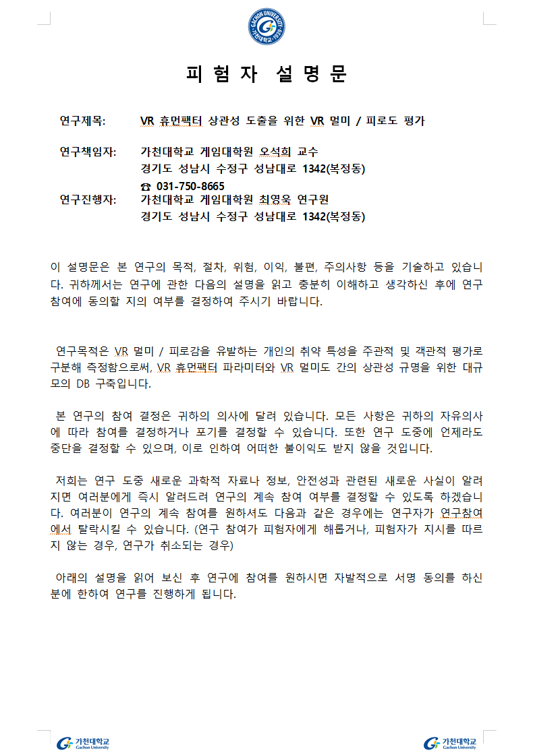
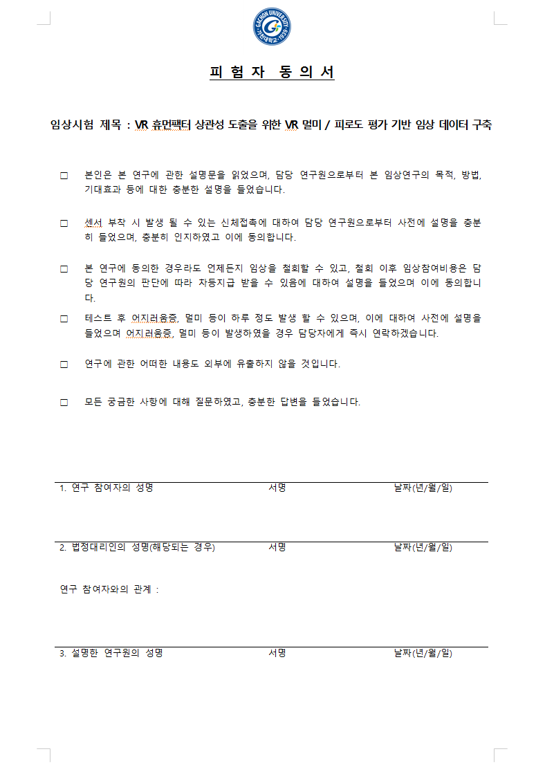
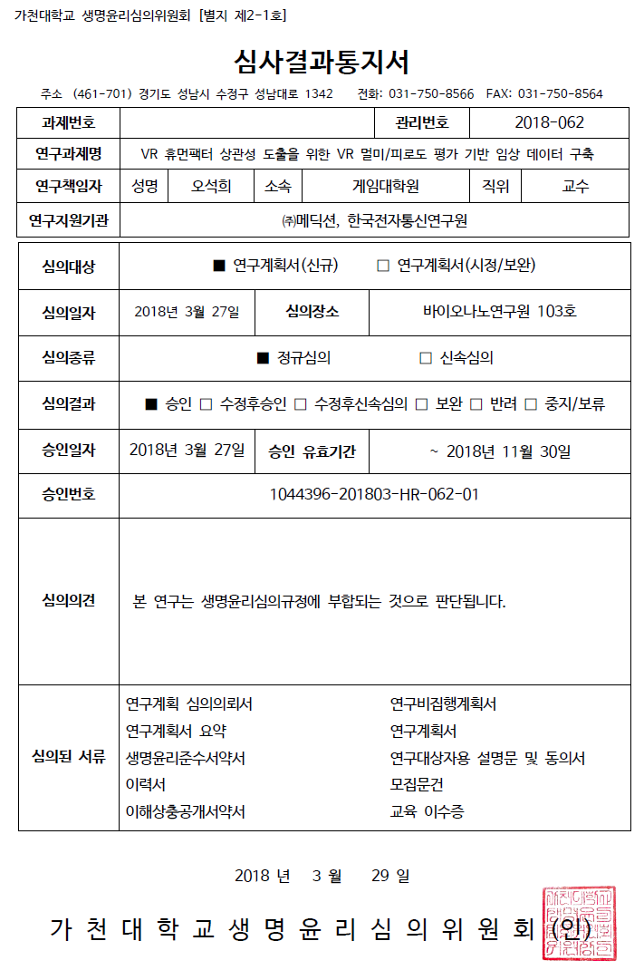
3. Standardization Provision #2
Design of protocol for a large-scale VR sickness clinical test
  Instruction
Instruction
Consent
IRB permission
IRB
IRB (Institutional Review Board)
All human subjects research conducted by researcher, faculty, or staff of research institute must receive approval from IRB
Permission: March 27th 2018
Instruction and Consent
Instructing the purpose of experiment
Obtain an agreements on unpleasant physical contact during attaching electrodes

Slide 11
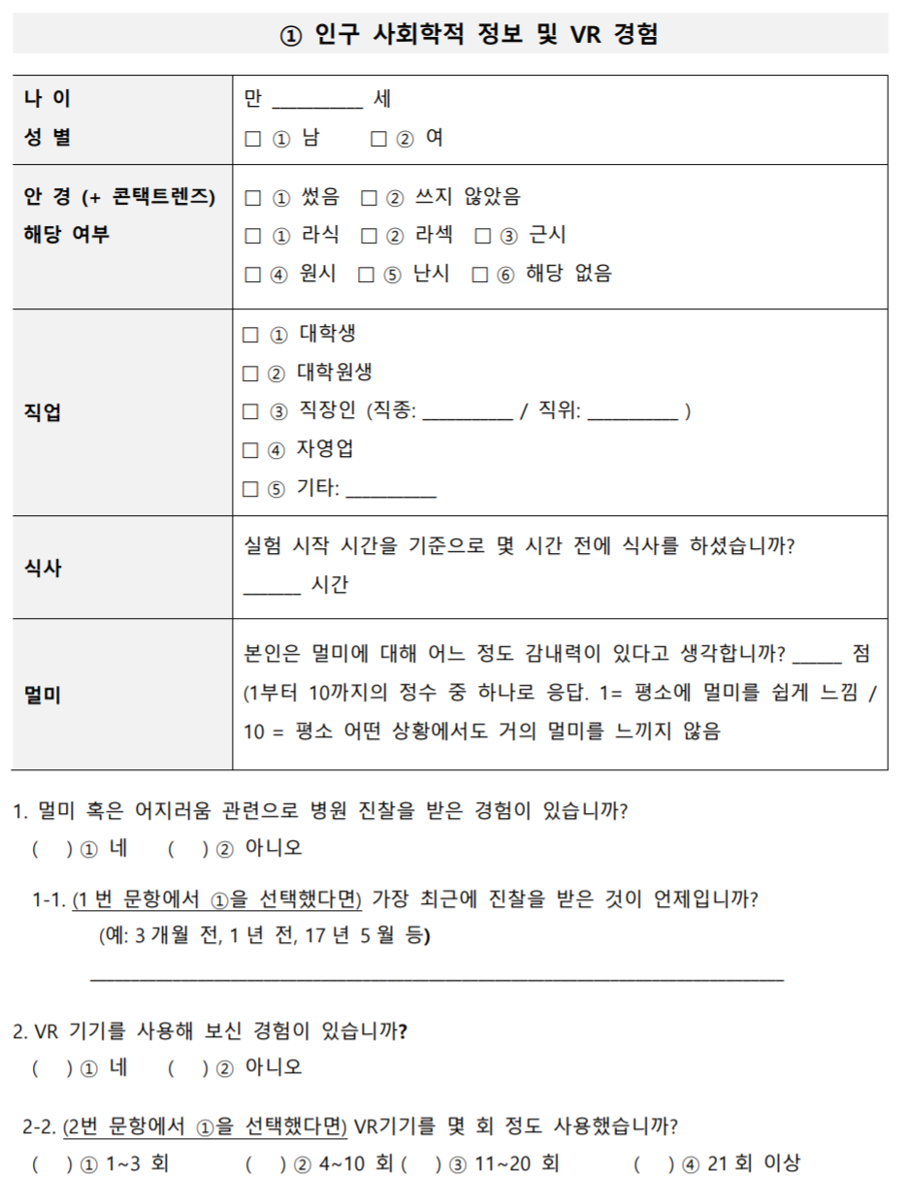
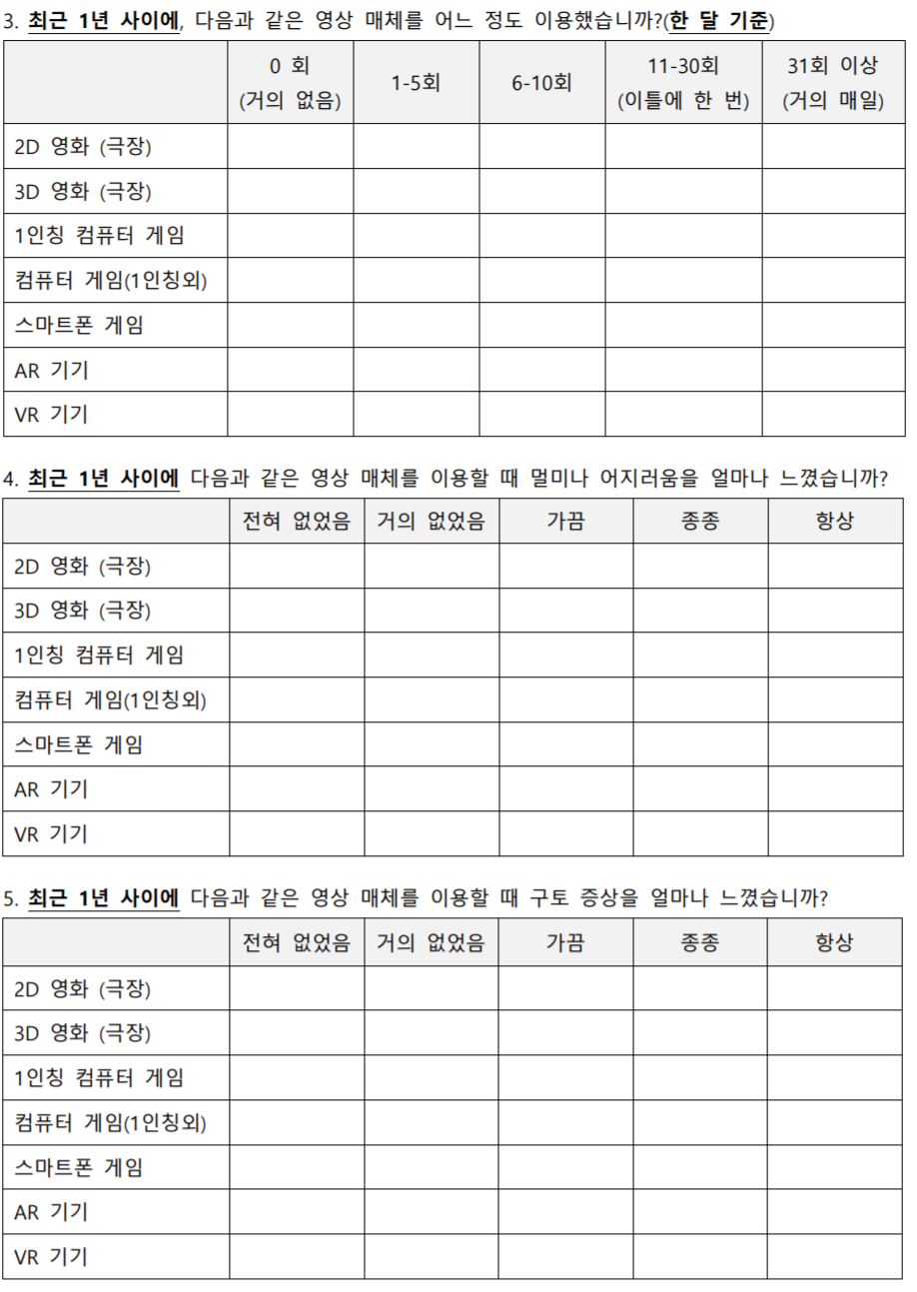
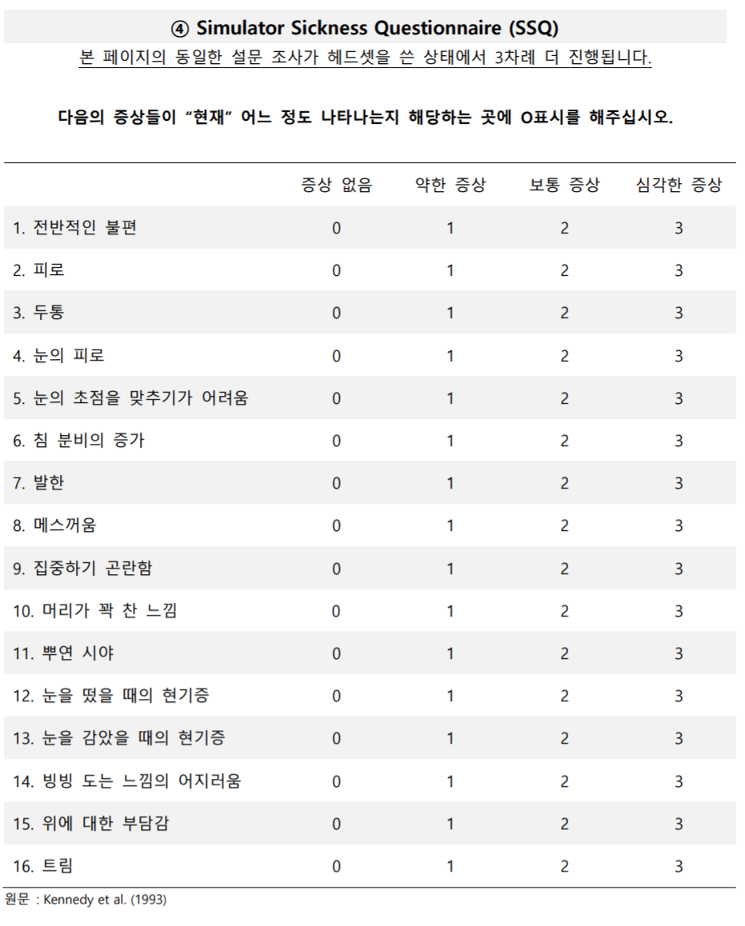
3. Standardization Provision #2
Design of protocol for a large-scale VR sickness clinical test
  Obtaining VR sickness susceptibility
MSSQ
(Motion Sickness Susceptibility Questionnaire)
Pre-questionnaire for motion sickness susceptibility
MSSQ A: under 12 (age)
MSSQ B: recent decade
* J. F. Golding, “Motion sickness susceptibility questionnaire revised and its relationship to other forms of sickness,” 1998
Sociological information and past experiences on game/VR
Adding a questions – medical history and favorite game genre
MSSQ
SSQ
SSQ
(Simulator Sickness Questionnaire)
4-level scoring on general 16 motion sickness symptoms
* Kennedy et al., “Simulator sickness questionnaire: an enhanced method for quantifying simulator sickness,” 1993
Measuring nausea, disorientation, dizziness, oculomotor fatigue by rating 16 symptoms,
Obtaining both pre- and post-evaluation

Slide 12
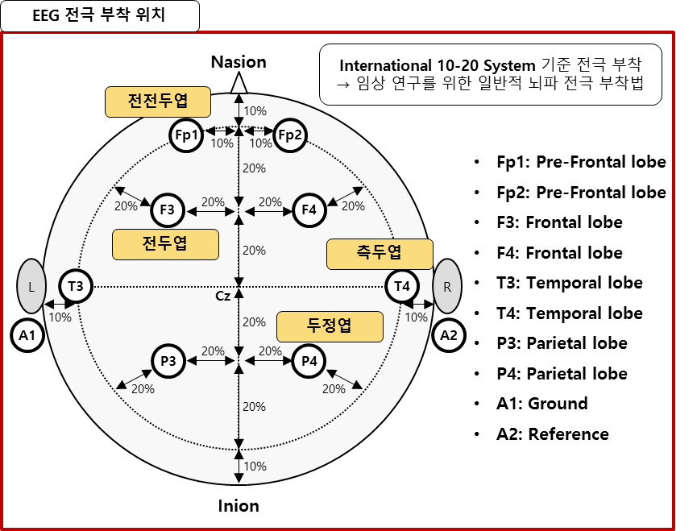
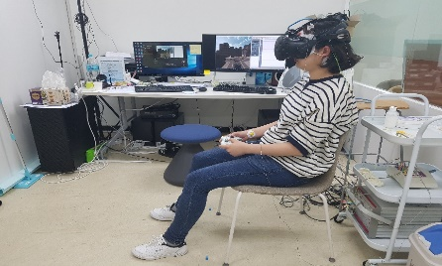
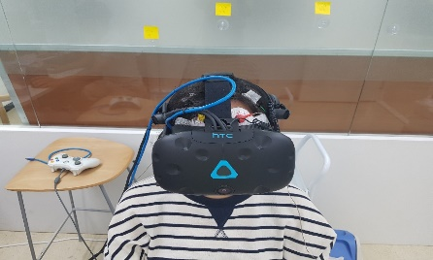
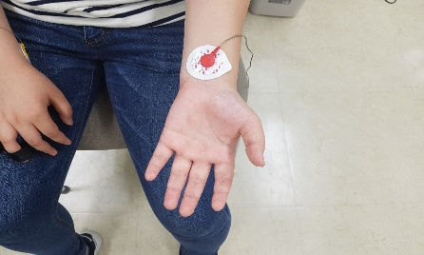
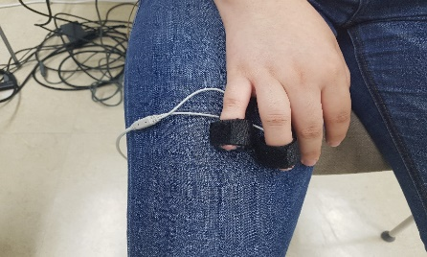
3. Standardization Provision #2
Design of protocol for a large-scale VR sickness clinical test
  Physiological measurements
Bio signals in resting state
Obtaining 2 min. epoch bio-signals in resting state
EEG (Electroencephalography)
: 8ch
ECG (Electrocardiogram)
: 1ch
GSR (Galvanic Skin Response)
: 1ch
EEG electrode position
International 10-20 System
Equipments
EEG
Pre-Frontal
Frontal
Temporal
Parietal
ECG
GSR

Slide 13
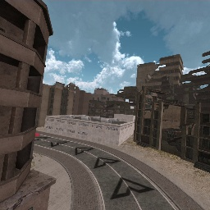
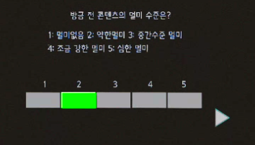
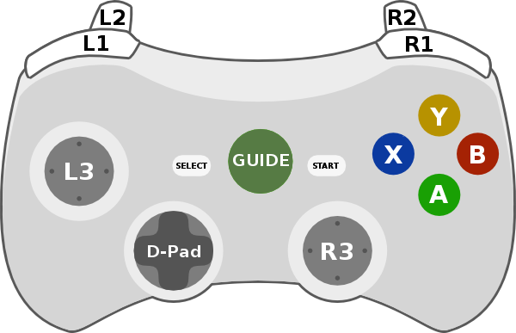
3. Standardization Provision #2
Design of protocol for a large-scale VR sickness clinical test
  Tutorial
Tutorial session
Pre-training of control and scoring by employing 6 scenes
Experiencing overall level of VR sickness which is mainly for normalized rating
Scoring: GUI
→ no need to take HMD off
Tutorial session (6 scenes, 4 min.)
15 sec
5 sec
사전
설명
1
평가
2
평가
3
평가
4
평가
5
평가
6
평가
SSQ
사후
설명
Pre
explain
Ev
Ev
Ev
Ev
Ev
Ev
Post
explain
2 sec
2분
Viewing VR contetent
Scoring (1-5)
Learning control
Select
VR Sickness Level?
1: No 2: Minor 3: Moderate
4: High 5: Severe
선택
이동
Move

Slide 14

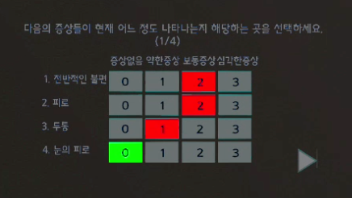
3. Standardization Provision #2
Design of protocol for a large-scale VR sickness clinical test
  Rest & subjects’ opinion
Rest
Scoring the level of VR sickness
Scoring 1-5 level of VR sickness
Each session contains different concept of VR scene
SSQ scoring and resting after each session
→ no need to take HMD off
SSQ (GUI)
Select one!
Session ①: Sickness level 1 (8 scenes, 3 min)
No Low Mid High
1. General uncomfort
2. Fatique
3. Headache
4. Eyestrain
1
평가
2
평가
3
평가
4
평가
5
Ev
평가
6
평가
7
평가
8
평가
Ev
Ev
Ev
Ev
Ev
Ev
Ev
3분
3 min
Session ②: Sickness level 2 (18 scenes, 7 min.)
15s 5s
15초
5초
1
Ev
Ev
Ev
Ev
Ev
Ev
Ev
Ev
Ev
Ev
평가
2
평가
3
평가
4
평가
5
평가
6
평가
7
평가
8
평가
9
평가
10
평가
11
평가
12
평가
13
평가
14
평가
15
평가
16
평가
17
평가
18
평가
Ev
Ev
Ev
Ev
Ev
Ev
Ev
Ev
7 min
7분
Session ③: Sickness level 3 (26 scenes, 9 min.)
15s 5s
15초
5초
1
Ev
Ev
Ev
Ev
Ev
Ev
Ev
평가
2
평가
3
평가
4
평가
5
평가
6
평가
7
평가
8
평가
9
평가
10
평가
11
평가
12
평가
13
평가
14
평가
15
평가
16
평가
25
평가
26
평가
Ev
Ev
Ev
Ev
Ev
Ev
Ev
Ev
Ev
Ev
Ev
9분
9 min

Slide 15
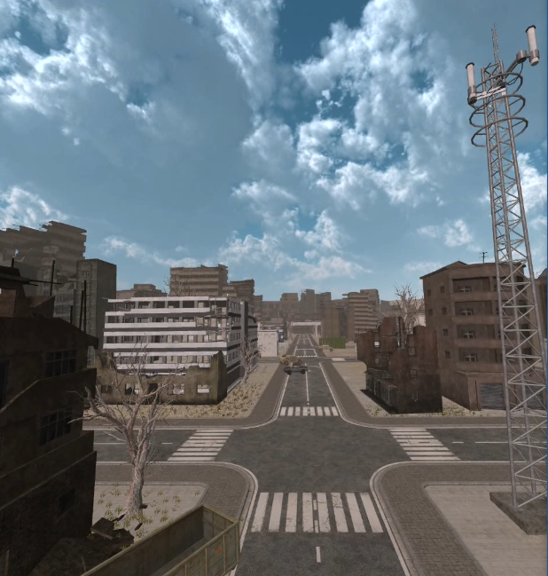
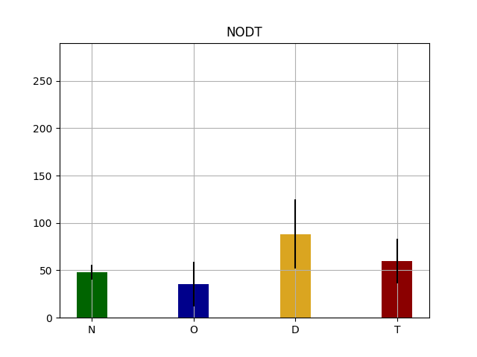
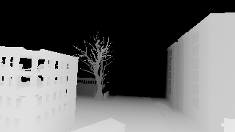
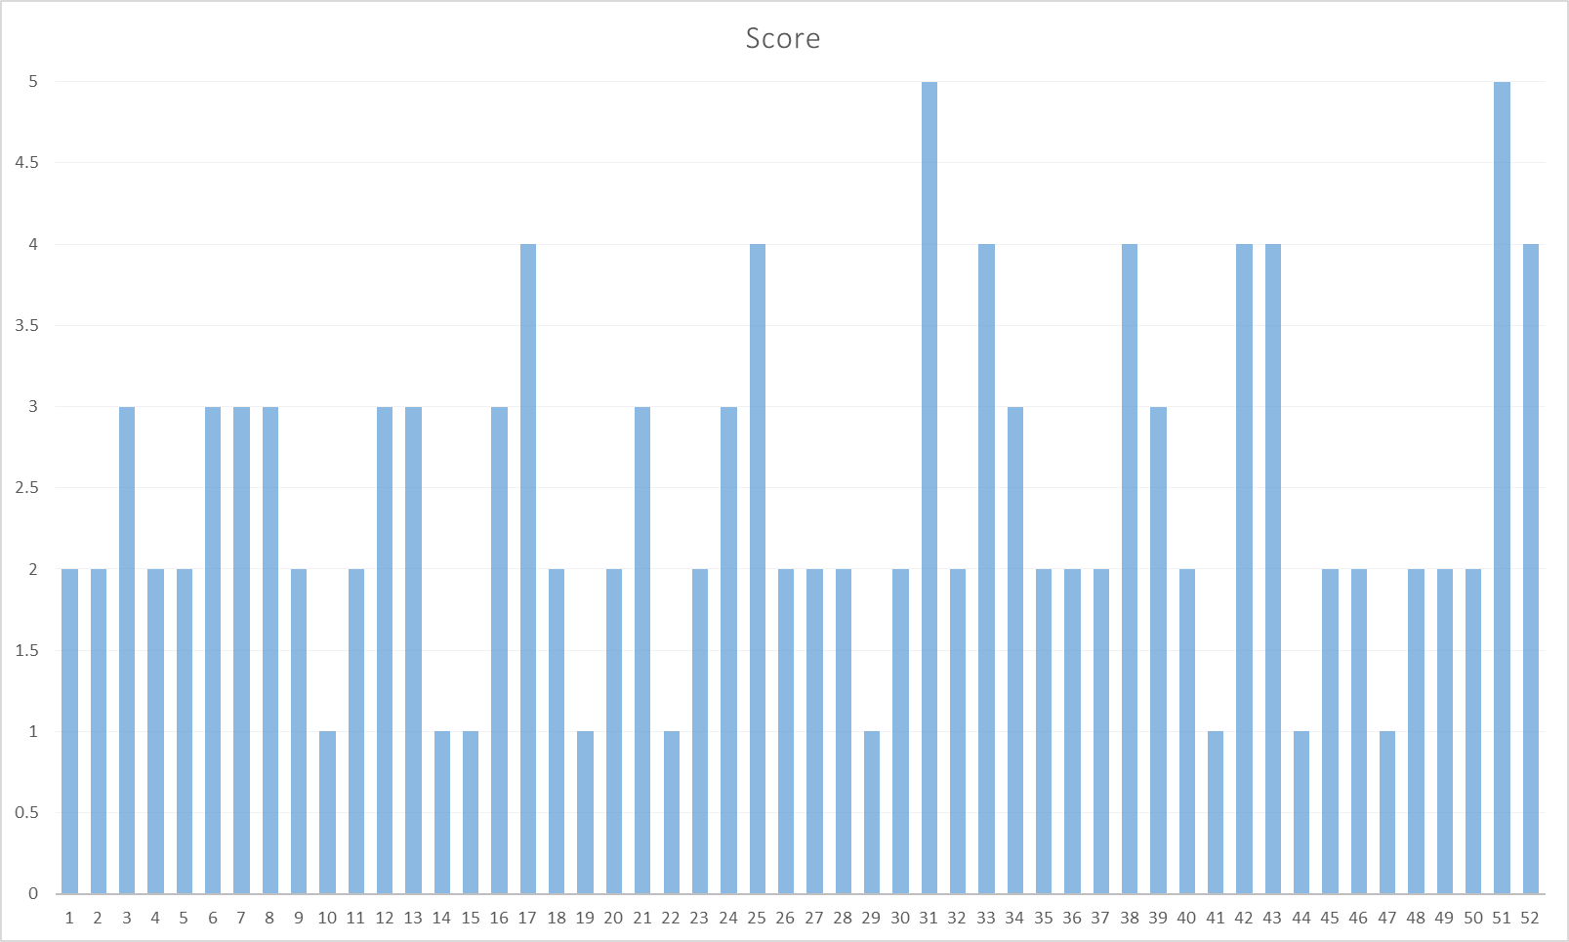
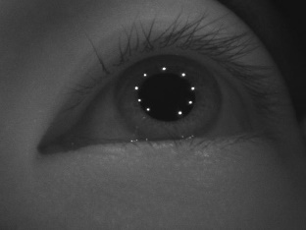
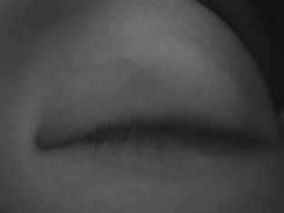
3. Standardization Provision #3
Release of database for VR sickness analysis
VR contents database
Objective measurements
Subjective score
System parameters
Bio-signals
VR content parameter | Camera movement | X position
 |  | y position
 |  | z position
 |  | X Speed
 |  | y Speed
 |  | z Speed
 |  | X Acceleration
 |  | y Acceleration
 |  | z Acceleration
 |  | X angle
 |  | Y angle
 |  | Z angle
 |  | X Angular Vel.
 |  | y Angular Vel.
 |  | z Angular Vel.
 |  | x Angular accel.
 |  | y Angular accel.
 |  | z Angular accel.
 | Head movement | X position
 |  | y position
 |  | z position
 |  | X Speed
 |  | y Speed
 |  | z Speed
 |  | X Acceleration
 |  | y Acceleration
 |  | z Acceleration
 |  | X angle
 |  | Y angle
 |  | Z angle
 |  | X Angular Vel.
 |  | y Angular Vel.
 |  | z Angular Vel.
 |  | x Angular accel.
 |  | y Angular accel.
 |  | z Angular accel.
 | Controller | Forward
 |  | Left
 |  | Right
 | Rendering | Frame/Sec
VR scene (RGB)
MSSQ
SSQ
Depthmap
Saliency info.
Eye-tracking Information | Gaze point x
 | Gaze point y
 | Pupil detection confidence
 | Pupil size x
 | Pupil size y
 | Pupil anlge
Sickness level
Metadata
Metadata for importing | Frame number
 | Date
 | Time stamp (ms)
 | Scene name
 | State
 | Sync. Info.
Eye blink

Slide 16
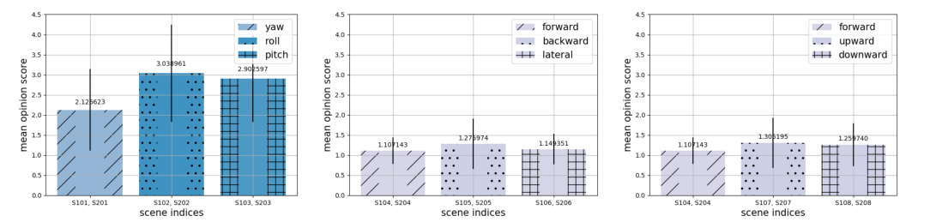
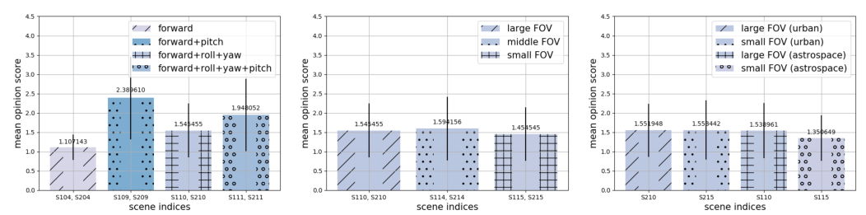
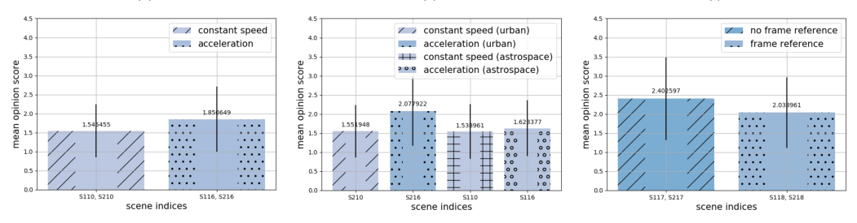
3. Standardization Provision #4
Quantitative analysis of VR sickness
  Analysis of system parameters – VR sickness

Slide 17
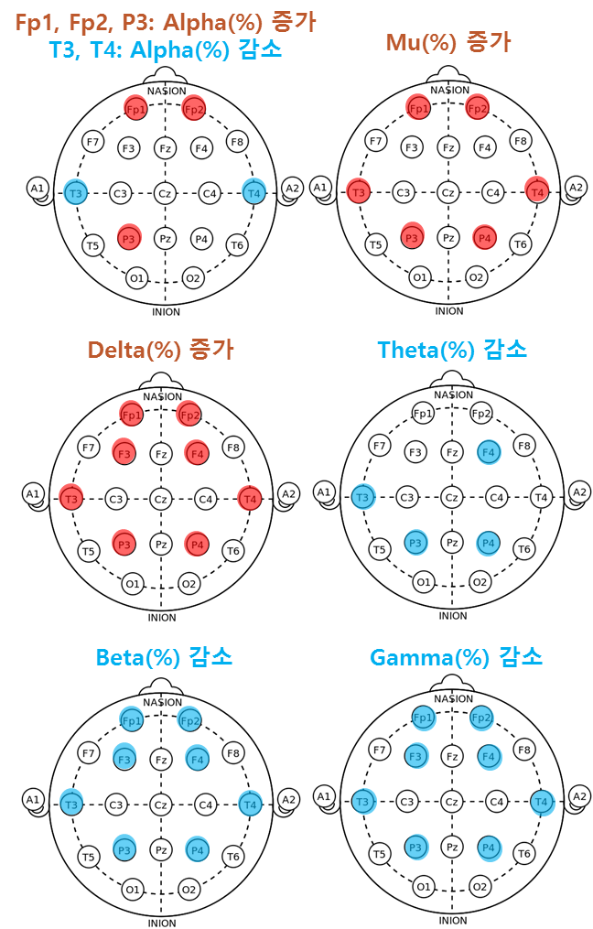
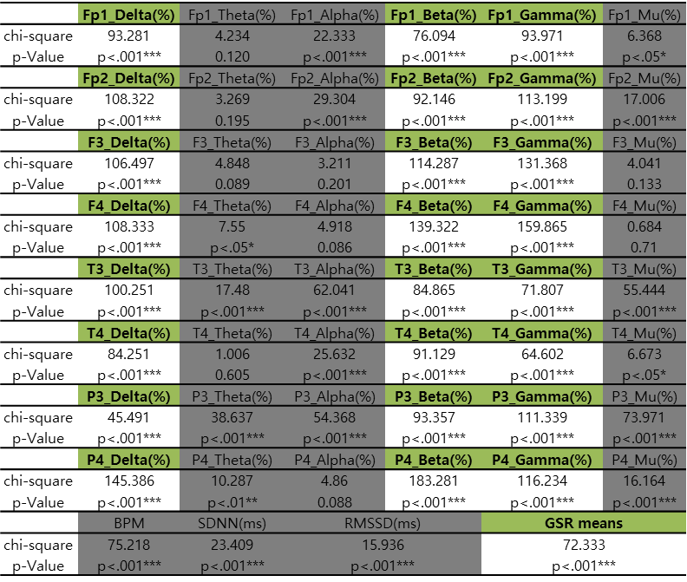
3. Standardization Provision #4
Quantitative analysis of VR sickness
  Analysis of physiological signals – VR sickness
Fp1, Fp2, P3: Alpha(%) Increasing
T3, T4: Alpha(%) Decreasing
Mu(%) Increasing
Delta(%) Increasing
Theta(%) decreasing
Beta(%) decreasing
Gamma(%) decreasing

Slide 18
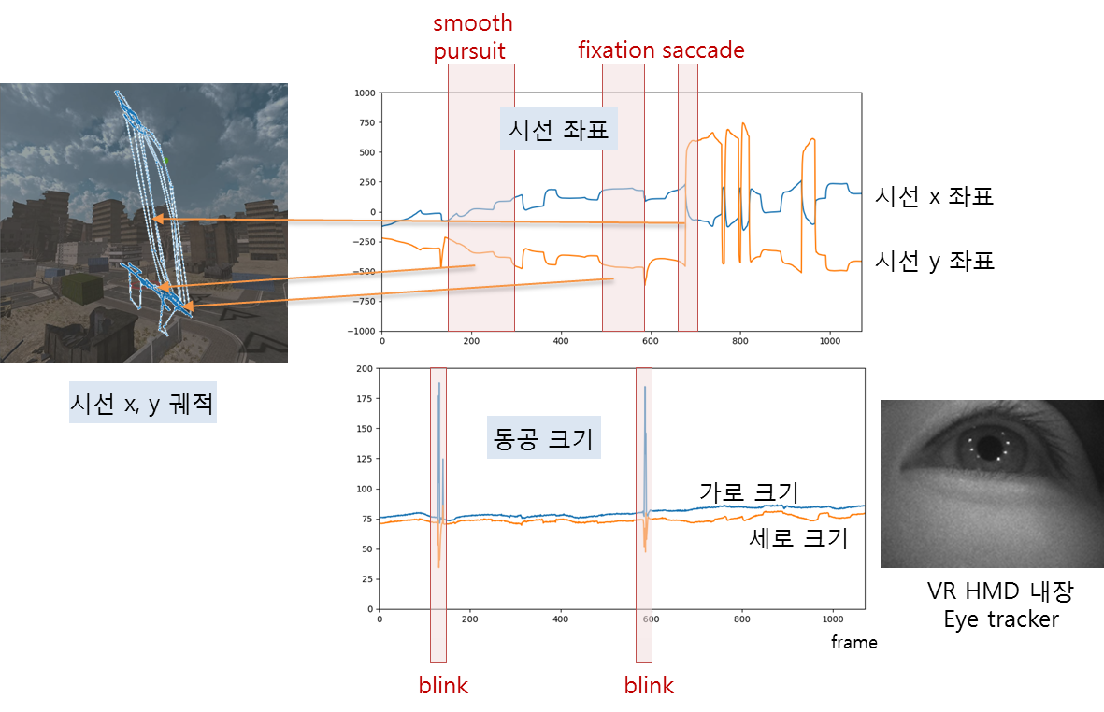
3. Standardization Provision #4
Quantitative analysis of VR sickness
  Analysis of gaze movements – VR sickness
Gaze point
Gaze point (x)
Gaze point (y)
Gaze
trajectory
Pupil size
Pupil size (x)
Pupil size (y)
VR HMD
Built-in
Eye tracker

Slide 19
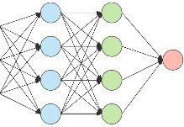
3. Standardization Provision #4
Quantitative analysis of VR sickness
  Prediction model for identifying the level of VR sickness via supervised learning
Training
80% of the total dataset (120 participants)
Subjective score
Extracting
spatial features
Extracting
Temporal features
Supervised
learning
(SVR)
VR sickness
Reference contents
$$T$$
$$T$$
Testing
20% of the total dataset (30 participants)
Predicted
VR sickness
score
Extracting
spatial features
Extracting
Temporal features
Supervised
learning
(SVR)
VR sickness
Reference contents
Predictive
model
$$T$$
$$T$$

Slide 20
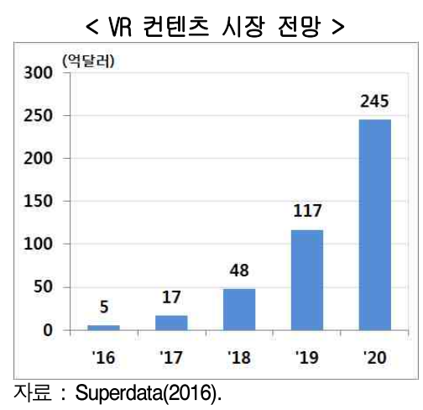
4. Expectations
<VR Content Market Forecast>
2016-2020 global AR∙VR market prospect
  Goldman Sachs: 2.2 billion USD → 80 USD
  Digi-Capital: 3.9 billion USD → 150 billion USD
  VR content-related market 24.5 billion USD
    Hyundai Research Institute,
    “Domestic and Foreign AR∙VR Industry Trends
    and its Implication,” 2017
Expanded VR content market via guaranteed human’s physical safety
Triggering further in-depth R&D for reducing VR sickness
Revenue in terms of royalties or the authorization fee for the proprietary standard related to the large-scale clinical test dataset
(0.1 billion Dollars)
Data : Superdata(2016)

Slide 21
Thank You

