Slide 1
[Deep Learning-based VR Sickness Assessment Considering Content Quality Factor]
[Sangmin Lee, Kihyun Kim, Hak Gu Kim, Minho Park, Yong Man Ro / KAIST]

Slide 2
Compliance with IEEE Standards Policies and Procedures
Subclause 5.2.1 of the IEEE-SA Standards Board Bylaws states, "While participating in IEEE standards development activities, all participants...shall act in accordance with all applicable laws (nation-based and international), the IEEE Code of Ethics, and with IEEE Standards policies and procedures."
The contributor acknowledges and accepts that this contribution is subject to
The IEEE Standards copyright policy as stated in the IEEE-SA Standards Board Bylaws, section 7, http://standards.ieee.org/develop/policies/bylaws/sect6-7.html#7, and the IEEE-SA Standards Board Operations Manual, section 6.1, http://standards.ieee.org/develop/policies/opman/sect6.html
The IEEE Standards patent policy as stated in the IEEE-SA Standards Board Bylaws, section 6, http://standards.ieee.org/guides/bylaws/sect6-7.html#6, and the IEEE-SA Standards Board Operations Manual, section 6.3, http://standards.ieee.org/develop/policies/opman/sect6.html

Slide 3
IEEE 3079 HMD Based VR Sickness Reducing Technology Dongil Dillon Seo, dillon@joyfun.kr
Deep Learning-based VR Sickness Assessment Considering Content Quality Factor
Date: 2019-7-8
Author(s):
Name | Affiliation | Phone [optional] | Email [optional]
Sangmin Lee | KAIST | +82 10 5611 6617 | sangmin.lee@kaist.ac.kr
Kihyun Kim | KAIST | +82 10 4408 8264 | noddown@kaist.ac.kr
Hak Gu Kim | KAIST | +82 10 5137 3551 | hgkim0331@kaist.ac.kr
Minho Park | KAIST | +82 10 8539 5033 | roger618@kaist.ac.kr
Yong Man Ro | KAIST | +82 10 3896 1429 | ymro@kaist.ac.kr

Slide 4
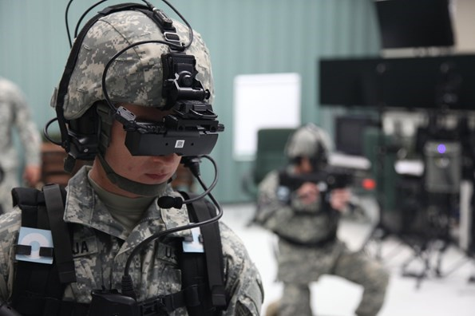
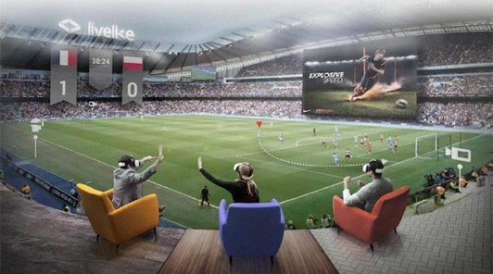
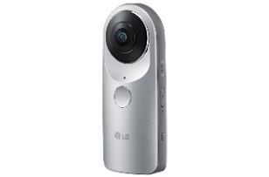
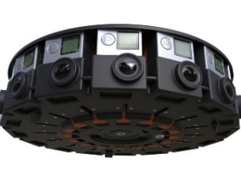
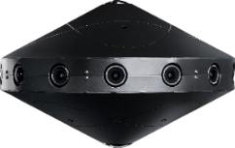
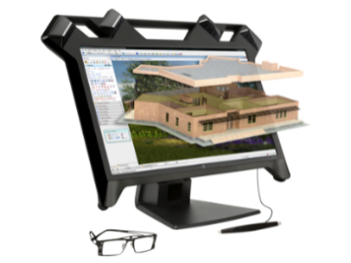
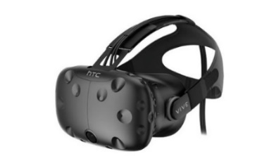
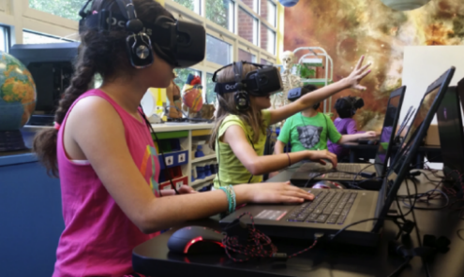
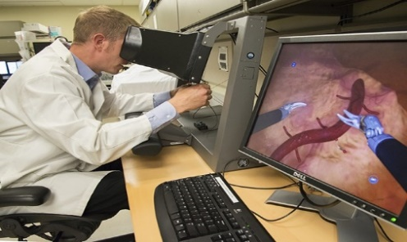
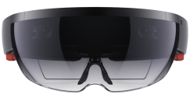
Virtual Reality
VR contents such as 360-degree video can provide realistic and immersive viewing experience for viewers.
The development of the 360-degree cameras and VR displays has increased the interest and popularity of the VR contents for various applications.
360-degree cameras
Training
Entertainment
VR displays
Education
Healthcare

Slide 5
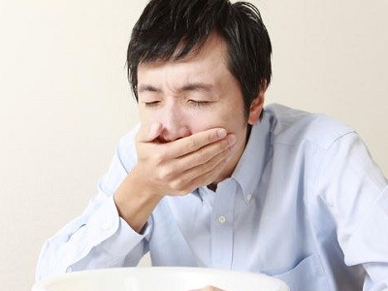
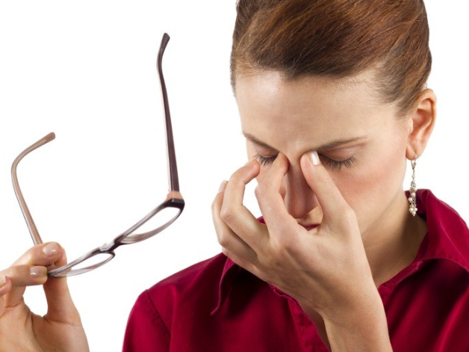
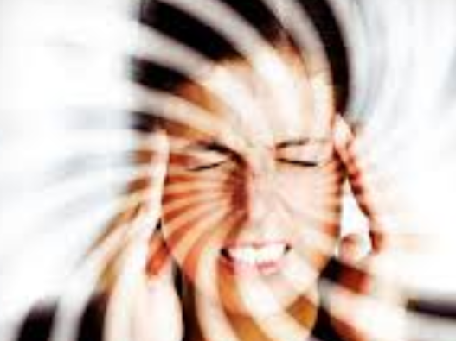
VR Sickness
VR sickness, which is one of motion sickness, could cause three major physical symptoms [1]
Nausea symptom : Salivation, sweating, burping, …
Oculomotor symptom : Visual fatigue, headache, …
Disorientation symptom : Dizziness, fullness of head, …
1) Nausea symptoms
2) Oculomotor symptoms
3) Disorientation symptoms
[1] R. S. Kennedy, N. E. Lane, K. S. Berbaum, and M. G. Lilienthal, “Simulator sickness questionnaire: An enhanced method for quantifying simulator sickness,” Int. J. Aviat. Psychol., vol. 3, no. 3, pp. 203–220, 1993.

Slide 6
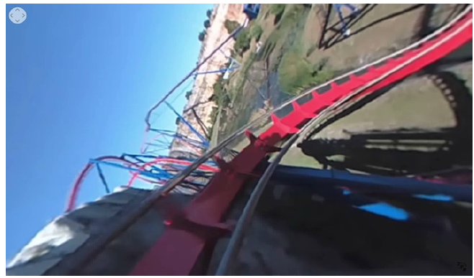
Triggers of VR Sickness
Exceptional motion
Exceptional motion patterns of VR contents such as acceleration and rapid rotation could lead to excessive motion mismatch between the simulation motion of the content and the physical motion of the user [2].
Acceleration and rapid rotation
[2] H.G. Kim, H. Lim, S. Lee, and Y.M. Ro, “Vrsa net: Vr sickness assessment considering exceptional motion for 360 vr video,” IEEE Transactions on Image Processing, vol. 28, no. 4, pp. 1646–1660, 2019.

Slide 7
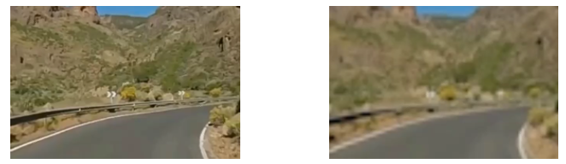
Triggers of VR Sickness
Resolution
Low resolution has higher simulator sickness than the contents of high resolution with respect to spatial and temporal inconsistency [3].
Spatial inconsistency : low quality video has a loss of spatial information.
Temporal inconsistency : low quality video frames also lose temporal information from the spatial inconsistency.
High resolution
low resolution
[3] R. Barrette, K. Dunkley, R. Kruk, D. Kurts, S. Marshall, T. Williams, P. Weissman, and S. Antos, “Flight simulator: Advanced wide field-of-view, helmet-mounted, infinity display system,” Technical Report AFHRLTR- 89–36, Air Force Human Resources Laboratory, Williams Air Force Base, 1990.

Slide 8
Contribution of the Proposed Work
Propose a novel deep learning-based objective assessment framework for predicting VR sickness caused by quality degradation considering spatio-temporal perceptual characteristics of VR contents. It is the first work that quantifies VR sickness caused by quality-degradation.
To evaluate the effectiveness of the proposed method, we built a new benchmark dataset that consists of 360-degree videos with 4 resolution types, physiological signals, and the corresponding SSQ scores.

Slide 9
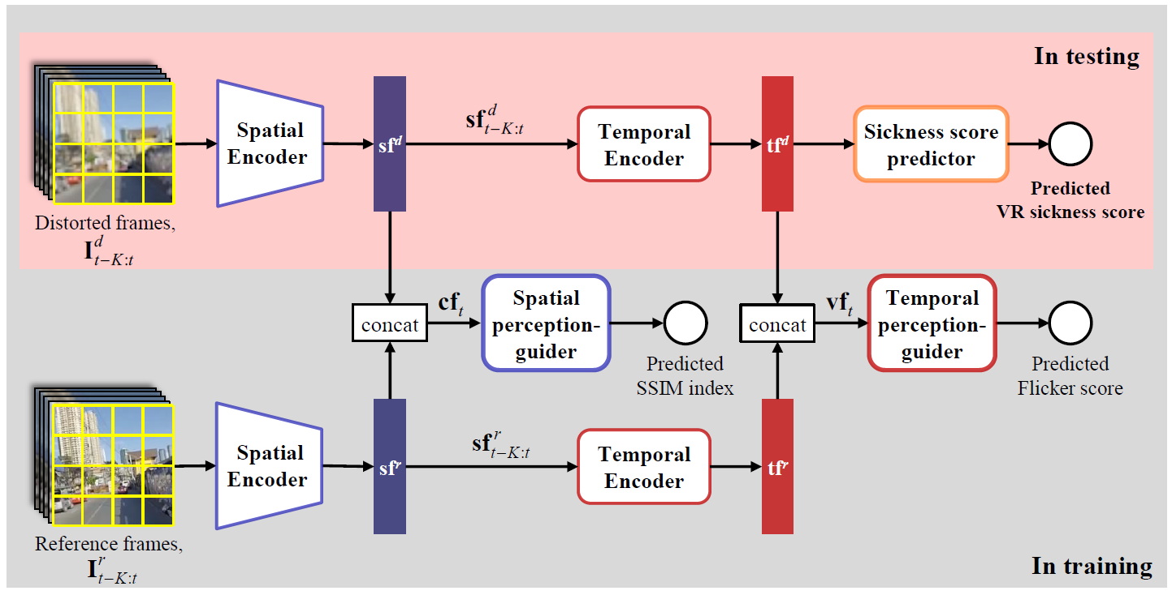
Proposed Method
Overall framework
Spatial perception-guider helps spatial encoder reliably extract the spatial perception considering spatial inconsistency.
Temporal perception-guider helps temporal encoder reliably extract the temporal perception considering temporal inconsistency

Slide 10
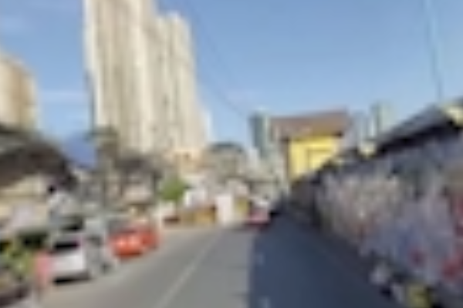
Proposed Method
Spatial inconsistency
The Structural Similarity (SSIM) is a perceptual metric that quantifies image quality degradation.
SSIM is used for measuring structural similarity (0 ~ 1) between two images.
SSIM ↓, Spatial inconsistency ↑.
Input frame
Reference frame
SSIM = 0.72

Slide 11
Proposed Method
Temporal inconsistency
Flicker amount is defined as an average of difference at pixel level between adjacent two frames as follows, ${F.A}_{t}= \frac{1}{x ×y}\sum_{x∈X,y∈Y}{ \left|I_{t}(X,Y) −I_{t−1}(X,Y)\right|}$.
Flicker score is also computed as ${F.S}_{t}=\left|F.A_{t}^{GT}−F.A_{t}^{input}\right|$.
Flicker score ↑, Temporal inconsistency ↑.
Input frame
Reference frame
$${F.A}_{t}^{input}=0.5$$
$${F.A}_{t}^{GT}=0.3$$
$${F.S}_{t}=\left|0.2−0.4\right|=0.2$$

Slide 12
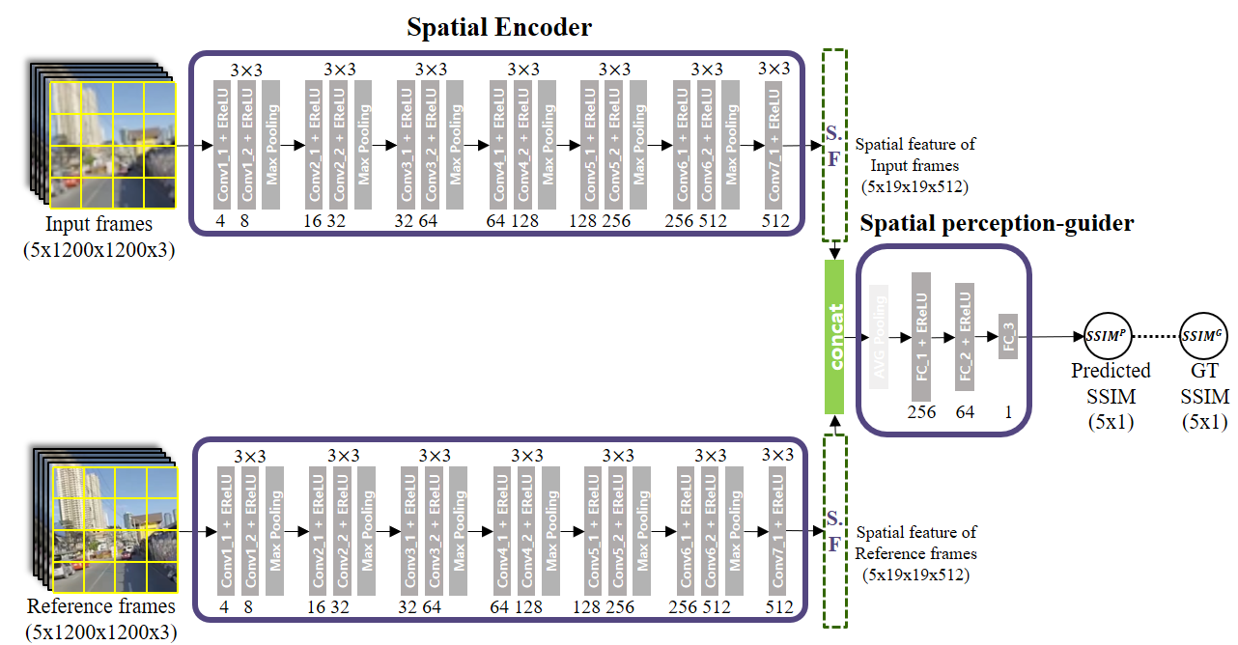
Proposed Method
Spatial encoder and spatial perception-guider
Spatial encoder and spatial perception-guider are trained with minimizing SSIM prediction loss, $L_{S}={\left| SSIM^{G}−SSIM^{P}\right|}_{2}^{2}$

Slide 13
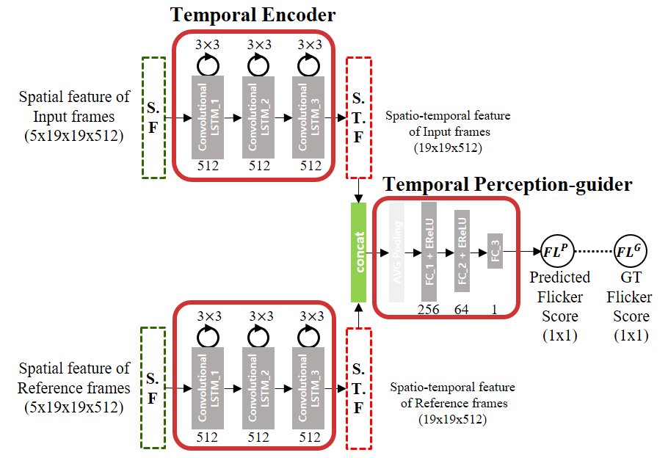
Proposed Method
Temporal encoder and temporal perception-guider
Temporal encoder and Flicker predictor are trained with minimizing Flicker prediction loss, $L_{T}={\left| {FL}^{G}−{FL}^{P}\right|}_{2}^{2}.$

Slide 14
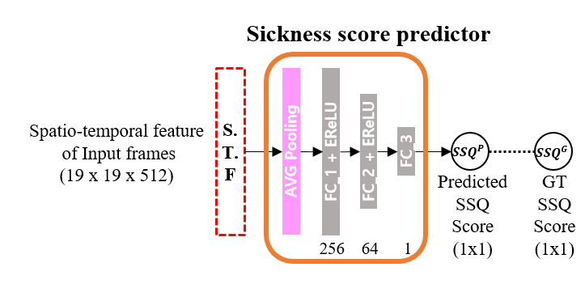
Proposed Method
Sickness score predictor
Takes spatio-temporal feature of input frames and output predicted SSQ score passing through three FC layers.
Sickness score predictor is trained with minimizing SSQ prediction loss, $L_{SSQ,STD}={\left| {(SSQ}^{G}+λn_{σ_k})−{SSQ}^{P}\right|}_{2}^{2},$ where $n_{σ_k}$denotes gaussian noise with standard deviation $σ_k$ of content $k$SSQ scores. Weight parameter $λ$ is set as 0.2.

Slide 15
Proposed Method
Training scheme
First, Spatial encoder and Temporal encoder are jointly trained with SSIM and Flicker prediction loss, $L_{S}+L_{T}={\left| SSIM^{G}−SSIM^{P}\right|}_{2}^{2}+{\left| {FL}^{G}−{FL}^{P}\right|}_{2}^{2}$
After converging SSIM and Flicker prediction network, SSQ predictor is trained with SSQ loss, $L_{SSQ,STD}={\left|{(SSQ}^{G}+λn_{σ_k})−{SSQ}^{P}\right|}_{2}^{2}.$

Slide 16
Benchmark Database
Subjective assessment experiments
17 subjects (ranging between 20 to 31 years old / normal or corrected-to-normal vision)
20 types x 4 resolutions (SD, HD, FHD, UHD) = 80 360-degree contents
For every contents, watching (1min) / SSQ marking and resting (2min)
Subjective score: SSQ score
Physiological signal: EKG, GSR
Equipment
Oculus Rift CV1 for displaying 360-degree videos.
NeuLog NUL-208 and NUL-207 for measuring EKG and GSR.

Slide 17
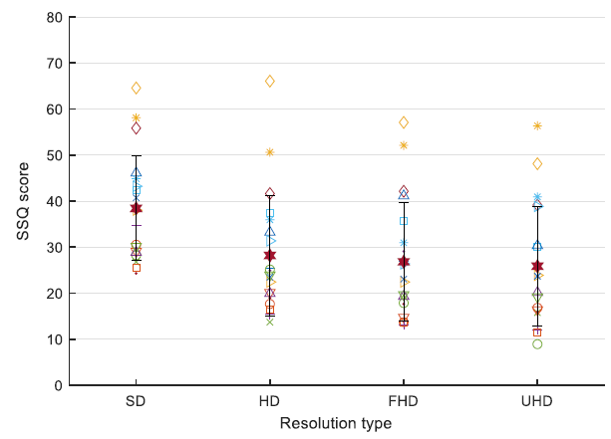
Benchmark Database
Subjective experiment results
VR sickness tends to increase as spatial resolution decreases. Especially, VR sickness in SD is severe.
Average SSQ score:
UHD : 25.855
FHD : 26.822
HD : 28.191
SD : 38.434

Slide 18
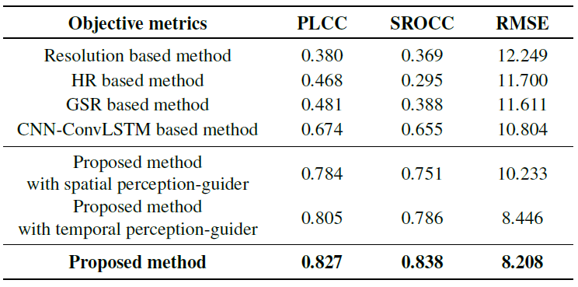
Experiments
Sickness score prediction performance
Measures : evaluated performance with 5-fold cross validation
Pearson linear correlation coefficient (PLCC)
Spearman rank order correlation coefficient (SROCC)
Root mean square error (RMSE)

Slide 19
Thank You

