Slide 1
[Deep Learning-based VR Sickness Assessment with Content Stimulus and Physiological Response]
[Sangmin Lee, Seongyeop Kim, Hak Gu Kim, Yong Man Ro / KAIST]

Slide 2
Compliance with IEEE Standards Policies and Procedures
Subclause 5.2.1 of the IEEE-SA Standards Board Bylaws states, "While participating in IEEE standards development activities, all participants...shall act in accordance with all applicable laws (nation-based and international), the IEEE Code of Ethics, and with IEEE Standards policies and procedures."
The contributor acknowledges and accepts that this contribution is subject to
The IEEE Standards copyright policy as stated in the IEEE-SA Standards Board Bylaws, section 7, http://standards.ieee.org/develop/policies/bylaws/sect6-7.html#7, and the IEEE-SA Standards Board Operations Manual, section 6.1, http://standards.ieee.org/develop/policies/opman/sect6.html
The IEEE Standards patent policy as stated in the IEEE-SA Standards Board Bylaws, section 6, http://standards.ieee.org/guides/bylaws/sect6-7.html#6, and the IEEE-SA Standards Board Operations Manual, section 6.3, http://standards.ieee.org/develop/policies/opman/sect6.html

Slide 3
IEEE 3079 HMD Based VR Sickness Reducing Technology Dongil Dillon Seo, dillon@joyfun.kr
Deep Learning-based VR Sickness Assessment with Content Stimulus and Physiological Response
Date: 2019-7-8
Author(s):
Name | Affiliation | Phone [optional] | Email [optional]
Sangmin Lee | KAIST | +82 10 5611 6617 | sangmin.lee@kaist.ac.kr
Seongyeop Kim | KAIST | +82 10 6758 1052 | seongyeop@kaist.ac.k
Hak Gu Kim | KAIST | +82 10 5137 3551 | hgkim0331@kaist.ac.kr
Yong Man Ro | KAIST | +82 10 3896 1429 | ymro@kaist.ac.kr

Slide 4
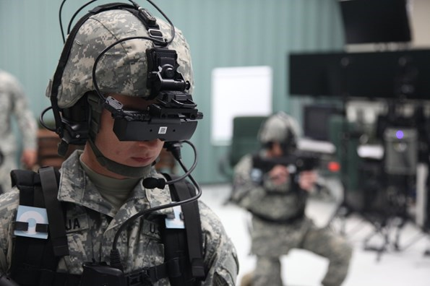
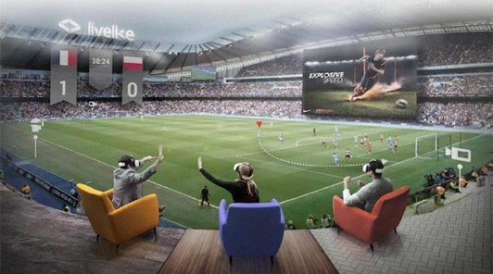
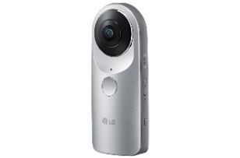
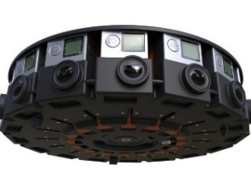
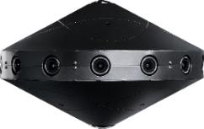
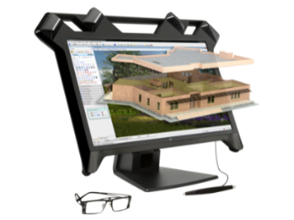
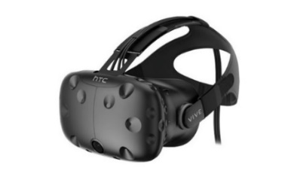
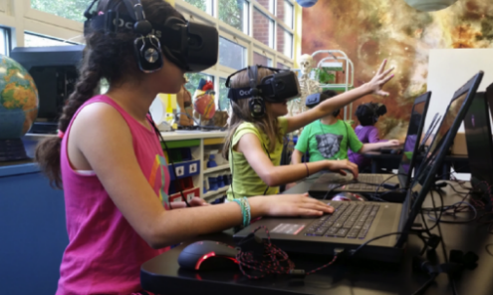
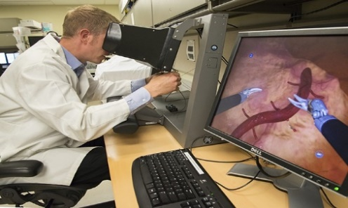
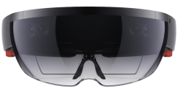
Virtual Reality
VR contents such as 360-degree video can provide realistic and immersive viewing experience for viewers.
The development of the 360-degree cameras and VR displays has increased the interest and popularity of the VR contents for various applications.
360-degree cameras
Training
Entertainment
VR displays
Education
Healthcare

Slide 5
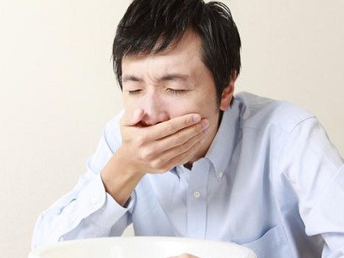
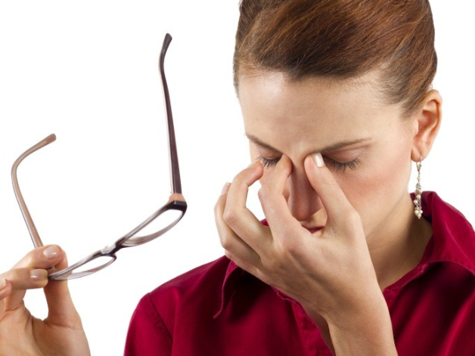
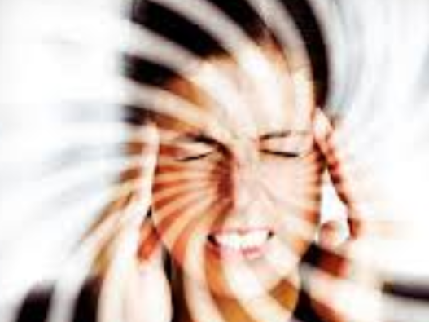
VR Sickness
VR sickness, which is one of motion sickness, could cause three major physical symptoms [1]
Nausea symptom : Salivation, sweating, burping, …
Oculomotor symptom : Visual fatigue, headache, …
Disorientation symptom : Dizziness, fullness of head, …
1) Nausea symptoms
2) Oculomotor symptoms
3) Disorientation symptoms
[1] R. S. Kennedy, N. E. Lane, K. S. Berbaum, and M. G. Lilienthal, “Simulator sickness questionnaire: An enhanced method for quantifying simulator sickness,” Int. J. Aviat. Psychol., vol. 3, no. 3, pp. 203–220, 1993.

Slide 6
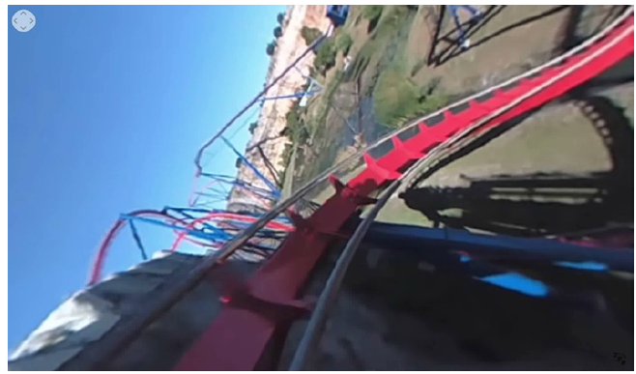
Triggers of VR Sickness
Exceptional motion
Exceptional motion patterns of VR contents such as acceleration and rapid rotation could lead to excessive motion mismatch between the simulation motion of the content and the physical motion of the user [2].
Acceleration and rapid rotation
[2] H.G. Kim, H. Lim, S. Lee, and Y.M. Ro, “Vrsa net: Vr sickness assessment considering exceptional motion for 360 vr video,” IEEE Transactions on Image Processing, vol. 28, no. 4, pp. 1646–1660, 2019.

Slide 7
Triggers of VR Sickness
Visual-vestibular conflict
Caused by exceptional motion
Induce VR sickness
The degree of the VR sickness felt by each person may differs.

Slide 8
Contribution of the Proposed Work
Propose a novel deep learning framework that predicts individual VR sickness with content stimulus and physiological response. To the best of our knowledge, this is the first work that quantifies individual VR sickness considering individual subject with stimulus.
For evaluation of the proposed model, we built newly collected real-world 360-degree video dataset with corresponding physiological signals (EEG, EKG, and GSR) and SSQ scores.

Slide 9
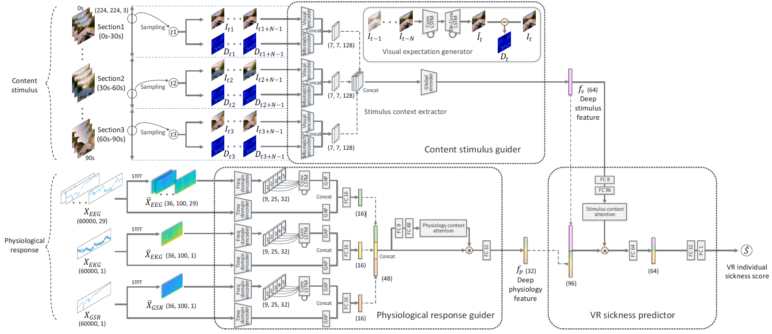
Proposed Method
Overall framework

Slide 10
Proposed Method
Content stimulus guider
Contains visual expectation generator and stimulus context extractor.
Visual expectation generator extracts exceptional motion patterns.
Stimulus context extractor outputs deep stimulus feature which represents tendency of sickness-inducing stimulus about the content

Slide 11
Proposed Method
Physiological response guider
Combines time domain analysis and frequency domain analysis
Extracts deep physiology feature which reflects the physiological characteristics related with individual VR sickness from 3 physiological signals

Slide 12
Proposed Method
VR sickness predictor
Fuses the deep stimulus feature and the deep physiology feature to predict individual VR sickness score.

Slide 13
Proposed Method
Training scheme
First, Visual expectation generator is pre-trained with frame generation loss, $L_{gen}=\frac{1}{K}\sum_{t∈batch}{{\left\|G\left(I_{t−N}, …,I_{t−1}\right)−I_{t}\right\|}_{2}^{2}}$. Dataset for pre-training generator is from [2]
With the pre-trained visual expectation generator, other networks are trained with sickness score loss, $L_{SSQ}=\frac{1}{K}\sum_{t∈batch}{{\left\|P\left(f_{s}, f_{p}\right)−{SSQ}_{indiv}\right\|}_{2}^{2}}$.
[2] H.G. Kim, H. Lim, S. Lee, and Y.M. Ro, “Vrsa net: Vr sickness assessment considering exceptional motion for 360 vr video,” IEEE Transactions on Image Processing, vol. 28, no. 4, pp. 1646–1660, 2019.

Slide 14
Benchmark Database
Subjective assessment experiments
17 subjects (ranging between 20 to 31 years old / normal or corrected-to-normal vision)
10 types x 2 resolutions (10hz, 60hz) = 20 360-degree VR contents
For every contents, watching (1min) / SSQ marking and resting (2min)
Subjective score: SSQ score
Physiological signal: EEG, EKG, GSR
Equipment
LG 34UC98 ultra-wide curved monitor for displaying 360-degree videos.
Cognionics Quick-30 and AIM for measuring EEG, EKG, GSR

Slide 15
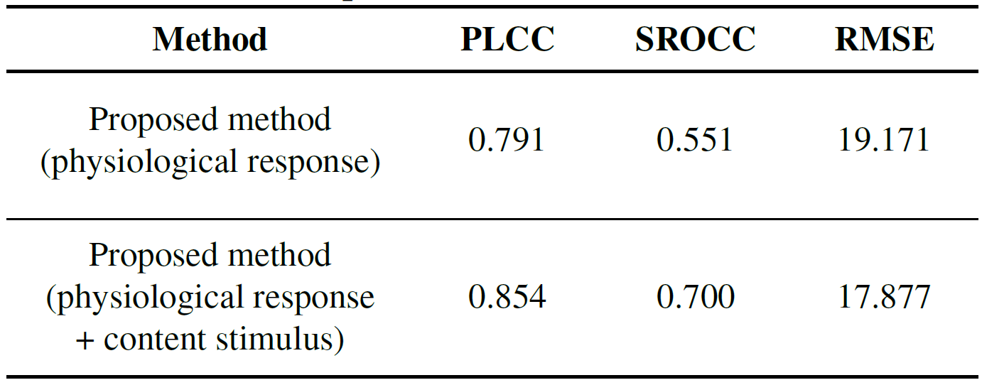
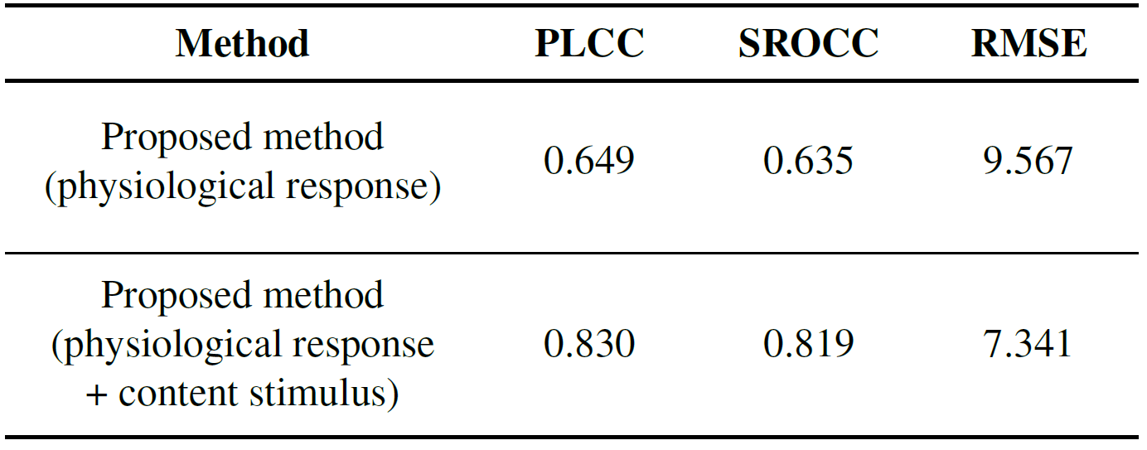
Experimental Results
Sickness score prediction performance
Measures : evaluated performance with 5-fold cross validation
Pearson linear correlation coefficient (PLCC)
Spearman rank order correlation coefficient (SROCC)
Root mean square error (RMSE)
Prediction performance for individual SSQ score
Prediction performance for mean SSQ score

Slide 16
Experimental Results
Visual expectation generator visualization
Difference frames between generated frames and original frames

Slide 17
Experimental Results
In this work, we proposed a novel deep learning framework for predicting the individual VR sickness.
To represent the sickness related features, we devised content stimulus guider and physiological response guide which encodes stimulus sickness tendency and individual sickness characteristics.
The experimental results showed that our proposed network had a meaningful correlation between predicted individual SSQ score and human subjective SSQ score.

Slide 18
Thank You

