Slide 1
Status of the Immersive Media Standard:
Related to Test Model for Immersive Video (TMIV) for 3DoF+
Presenter: Jong-Beom Jeong (uof4949@skku.edu)
Jong-Beom Jeong, SoonBin Lee, Il-Woong Ryu, Dongmin Jang, Eun-Seok Ryu
Multimedia Computing Systems Lab. (MCSL)
http://mcsl.skku.edu
Department of Computer Education
Sungkyunkwan University

Slide 2
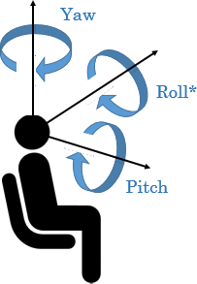
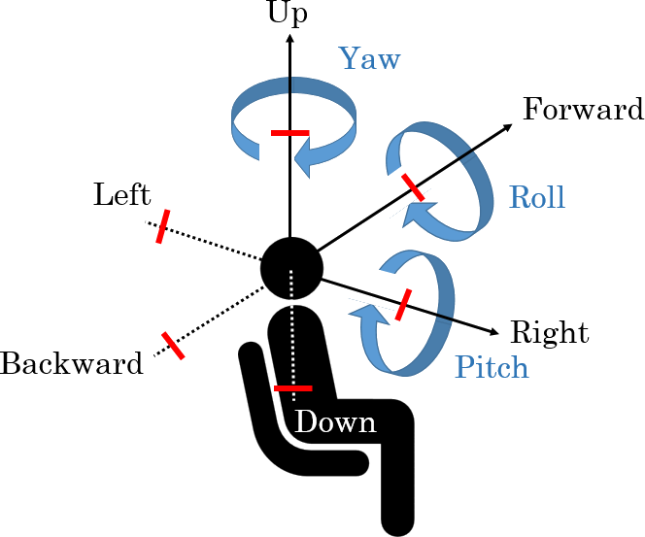
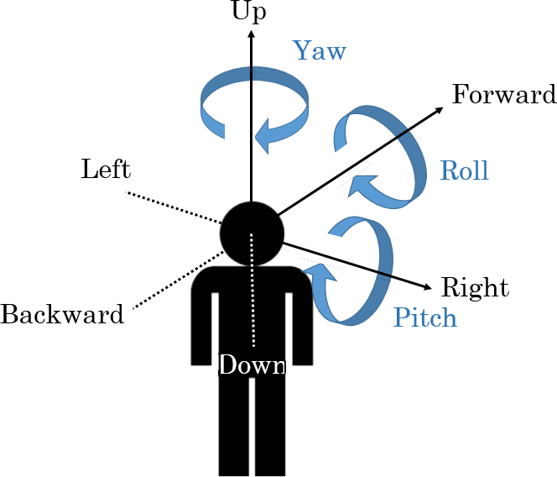
Immersive Media Standard
Step-by-step objective of ISO/IEC MPEG Immersive Video
  MPEG-I is responsible for standardizing immersive media in MPEG and specifies the goals of step 3.
  Goal of Revitalizing VR Commercial Service by 2020
  Goal of 6DoF media support by 2022 after completing 3DoF standard by 2017
Step 1
Step 2
Step 3
Yaw
Up
Up
Yaw
Forward
Yaw
Forward
Roll
Left
Roll
Roll
Left
Pitch
Backward
Right
Backward
Right
Pitch
Pitch
Down
Down
Complete 3DoF standard by 2017
Rotate head in a fixed state
360 video full streaming by default
Tiled streaming if possible
Enable VR commercial servicers by 2020
Allow head rotation and movement within a restricted area
User-to-user conversations and projection optimization
Support 6DoF by 2022
6DoF video will reflect user’s walking motion
Support interaction with virtual environments
3079-19-0036-00-0002

Slide 3
Immersive Media Standard Roadmap
2018
2019
Now
2020
2021
2022
2023
2024
Beyond
Media
Genome Compression
Genome Compression Extensions
Descriptors for Video Analysis (CDVA)
Neural Network Compression for Multimedia
Color Support in Open Font Format
Essential Video Coding
Low Complexity Enhancement Video Coding
Media
Coding
Versatile Video Coding
6 DoF Audio
Immersive Media Standards
Dense Representation of Light Field Video
3DoF+ Video
Video with 6 DoF
Video Point Cloud Compression
Point Cloud Compression v.2
Geometry Point Cloud Compression
PCC Systems Support
Immersive Media Scene Description Interface
VR 360
OMAF v.2
Systems
and Tools
Network-Based Media Processing
Media Orchestration
CMAF v.2
Multi-Image Application Format
Partial File Format
Web Resource Tracks
Internet of Media Things
3079-19-0036-00-0002

Slide 4
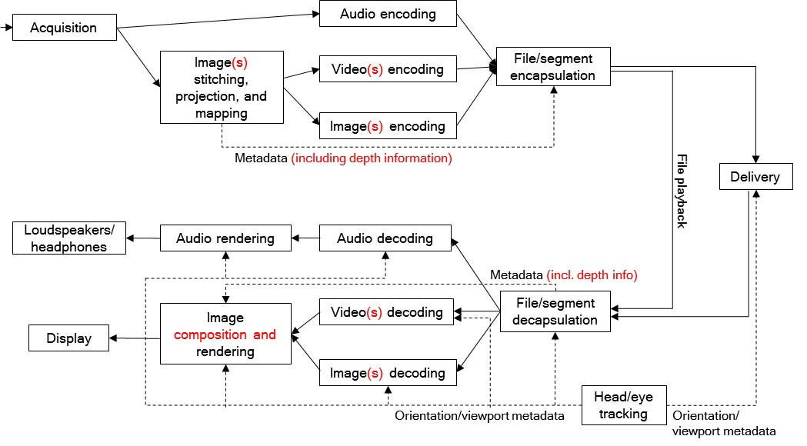
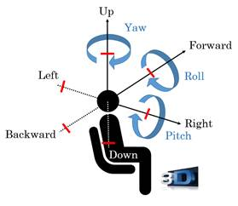
3DoF+ CfP (w18097)
Background
  MPEG defined degree of freedom of VR as 3DoF, 3DoF+, and 6DoF
  Limited movements for user sitting in a chair is available for 3DoF+
Requirements
  Solution will be built on HEVC with 3DoF+ metadata(included in MPEG-I part 7)
  Both objective and subjective quality evaluation will be performed
Use case for 3DoF+
Architecture for 3DoF+ media
3079-19-0036-00-0002

Slide 5
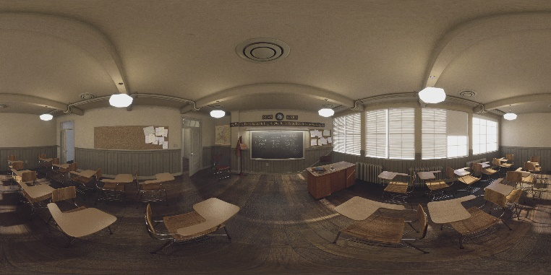
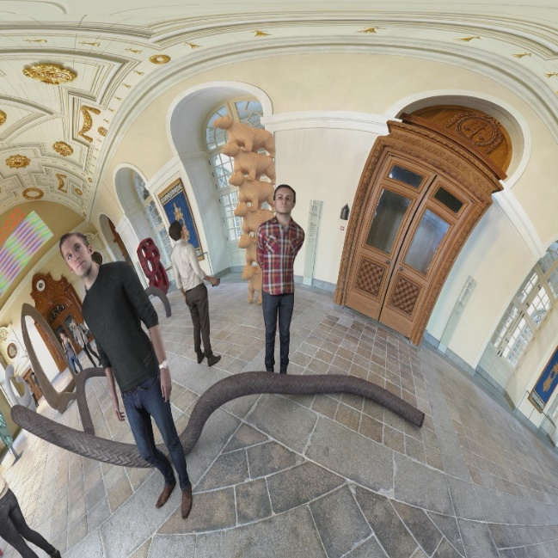
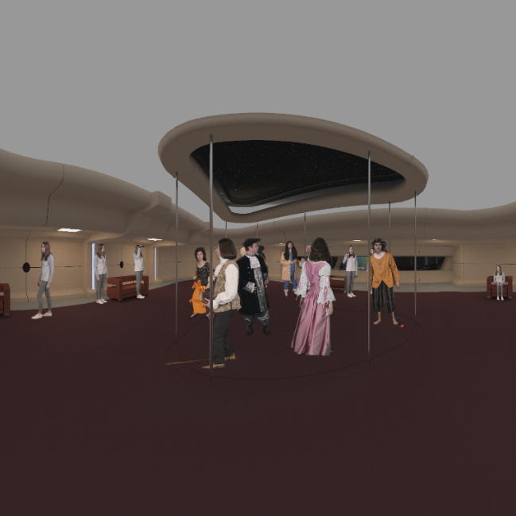
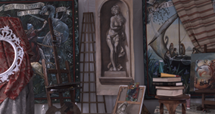
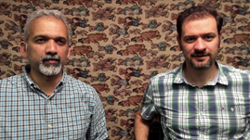
3DoF+ CfP (w18097) (-Cont’d)
Test Sequences
ClassroomVideo
TechnicolorMuseum
TechnicolorHijack
TechnicolorPainter
IntelKermit
Sequence | Class | Resolution | No. of views | Frame count | Frame rate | Source FoV
ClassroomVideo | A | 4096x2048 | 15 | 120 | 30 | 360º x 180º
TechnicolorMuseum | B | 2048x2048 | 24 | 300 | 30 | 180º x 180º
TechnicolorHijack | C | 4096x4096 | 10 | 300 | 30 | 180º x 180º
TechnicolorPainter | D | 2048x1088 | 16 | 300 | 30 | 46º x 25º
IntelKermit | E | 1920x1080 | 13 | 300 | 30 | 77.8º x 77.8º
3079-19-0036-00-0002

Slide 6
3DoF+ CfP (w18097) (-Cont’d)
Software
Software name | Location | Tag/branch
RVS | http://mpegx.int-evry.fr/software/MPEG/Explorations/3DoFplus/RVS | v3.1
WS-PSNR | http://mpegx.int-evry.fr/software/MPEG/Explorations/3DoFplus/WS-PSNR | v2.0
HDRTools | https://gitlab.com/standards/HDRTools | v0.18
360Lib | https://jvet.hhi.fraunhofer.de/svn/svn_360Lib | 360Lib-5.1-dev
HM | https://hevc.hhi.fraunhofer.de/svn/svn_HEVCSoftware | HM-16.16
Target Bitrate
 | Target bitrates [Mbit/s]
Sequence | Rate 1 | Rate 2 | Rate 3 | Rate 4 | Rate 5 | Rate 6
ClassroomVideo | 6.5 | 10 | 15 | 25 | 40 | 65
TechnicolorMuseum | 10 | 15 | 25 | 40 | 65 | 100
TechnicolorHijack | 6.5 | 10 | 15 | 25 | 40 | 65
TechnicolorPainter | 6.5 | 10 | 15 | 25 | 40 | 65
IntelKermit | 4 | 6.5 | 10 | 15 | 25 | 40
3079-19-0036-00-0002

Slide 7
Response on 3DoF+ CfP
For response of 3DoF+ CfP, 5 input documents are proposed
All of proposals introduce pruning and packing architecture
These technologies are included in test model for 3DoF+
Number | Title
m47179 | Philips response to 3DoF+ Visual CfP
m42372 | Description of Nokia’s response to CFP for 3DOF+ visual
m47407 | Technical description of proposal for Call for Proposals on 3DoF+ Visual prepared by Poznan University of Technology (PUT) and Electronics and Telecommunications Research Institute (ETRI)
m47445 | Technicolor-Intel Response to 3DoF+ CfP
m47684 | Description of Zhejiang University’s response to 3DoF+ Visual CfP
3079-19-0036-00-0002

Slide 8
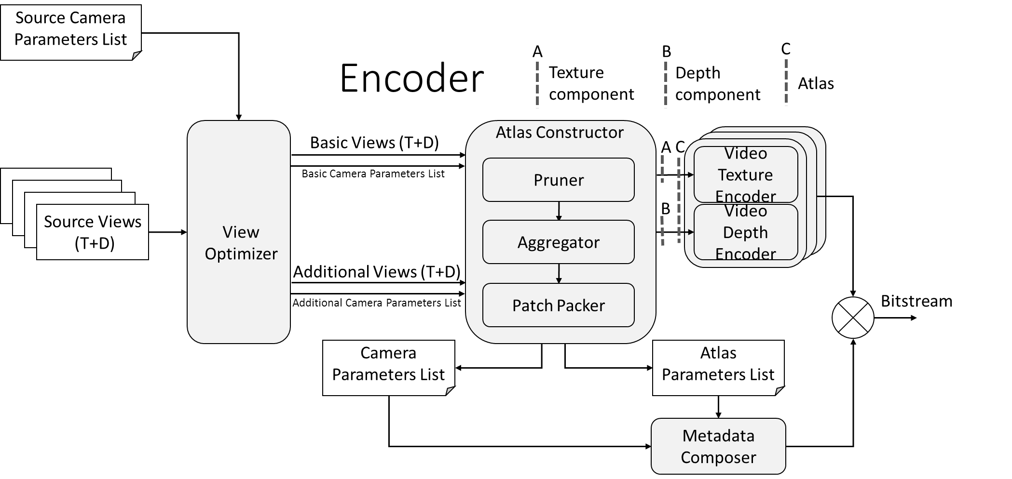
Test Model for Immersive Video (TMIV)
Encoder
  TMIV encoder consists of three main steps:
  (1) View optimizer
  (2) Atlas constructor
  (3) Video encoder & Metadata composer
Architecture for TMIV encoder[1]
[1] Basel Salahieh, et al. Test Model for Immersive Video. 126th MPEG meeting of ISO/IEC JTC1/SC29/ WG11, w18470.
3079-19-0036-00-0002

Slide 9
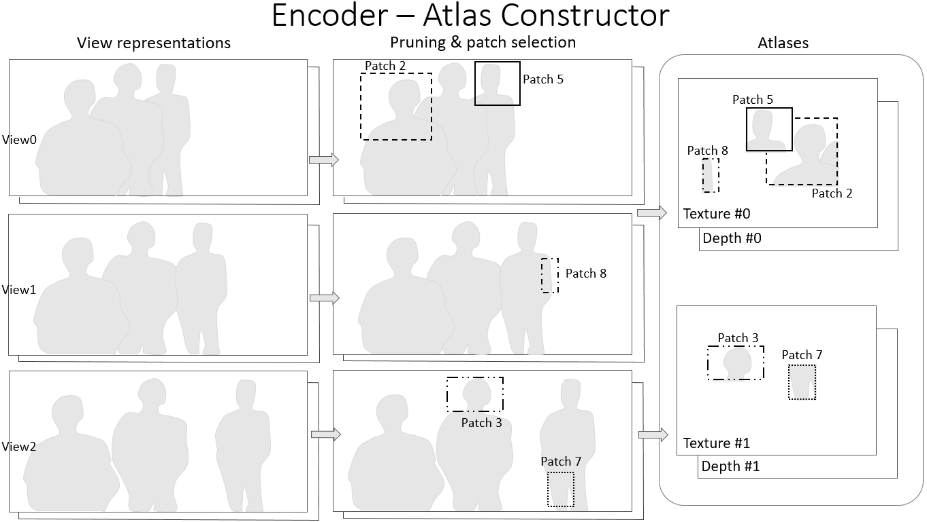
Test Model for Immersive Video (TMIV) (-Cont’d)
Encoder
  Atlas constructor references the occupancy map of each views
  Minimizes the atlas size by overlapping the patches
Example of TMIV encoder process[1]
[1] Basel Salahieh, et al. Test Model for Immersive Video. 126th MPEG meeting of ISO/IEC JTC1/SC29/ WG11, w18470.
3079-19-0036-00-0002

Slide 10
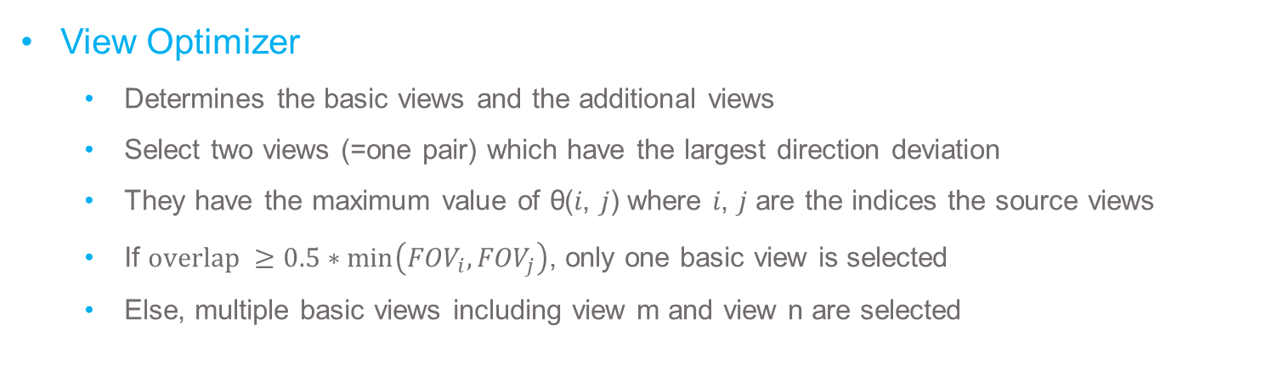
Test Model for Immersive Video (TMIV) (-Cont’d)
View Optimizer
  Determines the basic views and the additional views
  Select two views (=one pair) which have the largest direction deviation
  They have the maximum value of θ(𝑖, 𝑗) where 𝑖, 𝑗 are the indices the source views
  If $overlap ≥0.5∗\min\left({FOV}_{i},{FOV}_{j}\right)$, only one basic view is selected
  Else, multiple basic views including view m and view n are selected
Example of the directions deviations[1]
Illustration of the overlap and its calculation[1]
[1] Basel Salahieh, et al. Test Model for Immersive Video. 126th MPEG meeting of ISO/IEC JTC1/SC29/ WG11, w18470.
3079-19-0036-00-0002

Slide 11
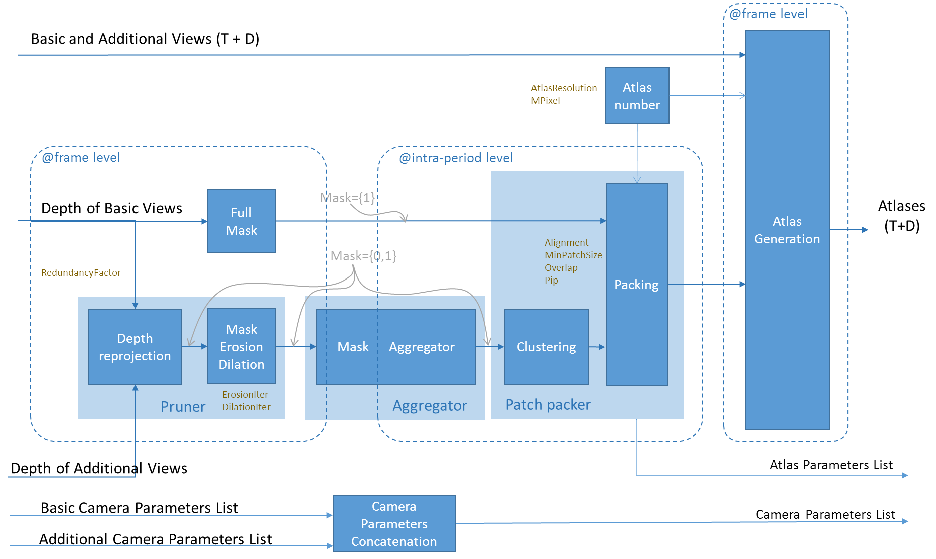
Test Model for Immersive Video (TMIV) (-Cont’d)
Atlas Constructor
  Atlas : aggregation of patches after packing process
  The atlas constructor is composed of three parts:
  (1) Pruner, (2) Aggregator, and (3) Patch packer
Block diagram of the Atlas Constructor[1]
[1] Basel Salahieh, et al. Test Model for Immersive Video. 126th MPEG meeting of ISO/IEC JTC1/SC29/ WG11, w18470.
3079-19-0036-00-0002

Slide 12
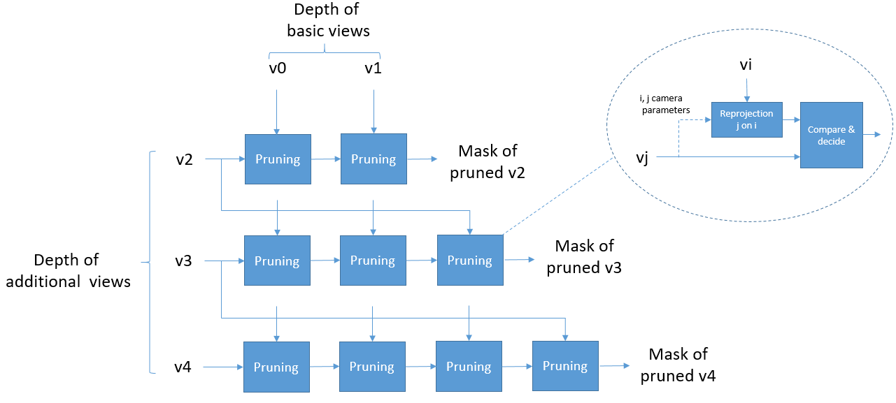
Test Model for Immersive Video (TMIV) (-Cont’d)
Pruner
  De-project depth from view j to 3D space and project them to the reference view I
  A sample is pruned if it is already covered by the previous view, determined by :
  Default value of RedundancyFactor is 0.02
$\left|z−z_{p}\right|<RedundancyFactor∗min⁡(z,$ $z_{p}$)
Example of pruning with 2 basic views and 3 additional views[1]
[1] Basel Salahieh, et al. Test Model for Immersive Video. 126th MPEG meeting of ISO/IEC JTC1/SC29/ WG11, w18470.
3079-19-0036-00-0002

Slide 13
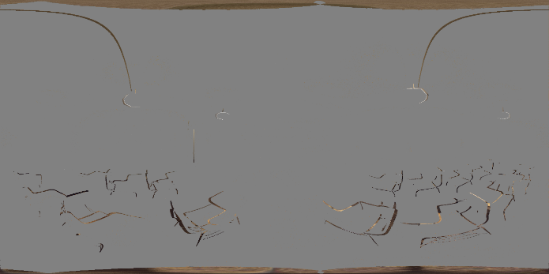
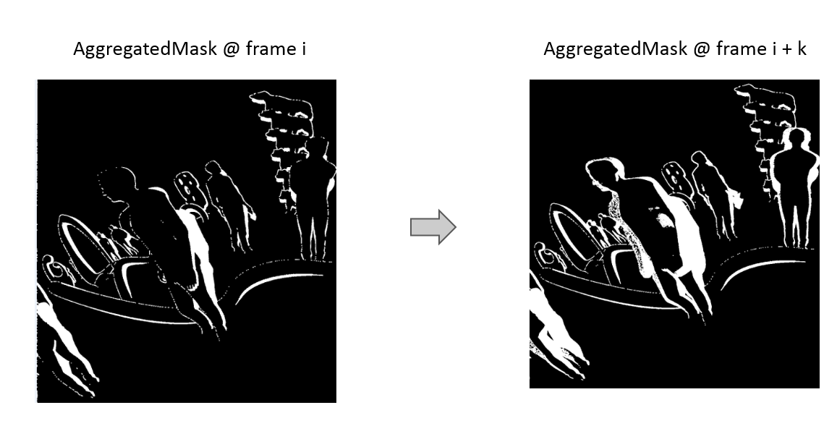
Test Model for Immersive Video (TMIV) (-Cont’d)
Aggregator
  Accumulation for each intra period
  Implemented by logical operation OR
…
Aggregated Mask
(Merge)
t frame
t+31 frame
[1] Basel Salahieh, et al. Test Model for Immersive Video. 126th MPEG meeting of ISO/IEC JTC1/SC29/ WG11, w18470.
3079-19-0036-00-0002

Slide 14
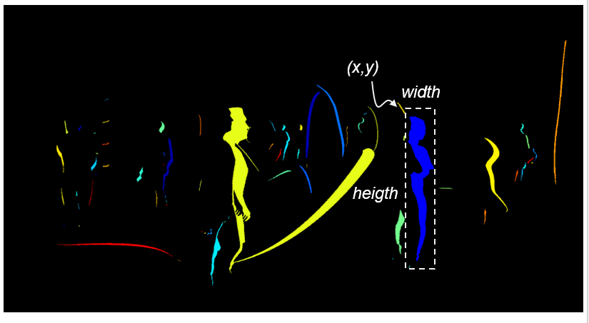

Test Model for Immersive Video (TMIV) (-Cont’d)
Patch Packer
  8-pixel neighborhood region growing is conducted to generate a cluster
  Then, the clusters are sorted by a decreasing size order
  The number of atlases is determined by :
  where maximum size of all atlases is expressed in Mpixels (default value : 20)
$$N_{Atlas}=ceil(\frac{MPixel∗{1024}^{2}}{AtlasWidth∗AtlasHeight})$$
Example of 8-pixel neighborhood region growing
Example of clusters represented in false color on a pruned view
3079-19-0036-00-0002

Slide 15
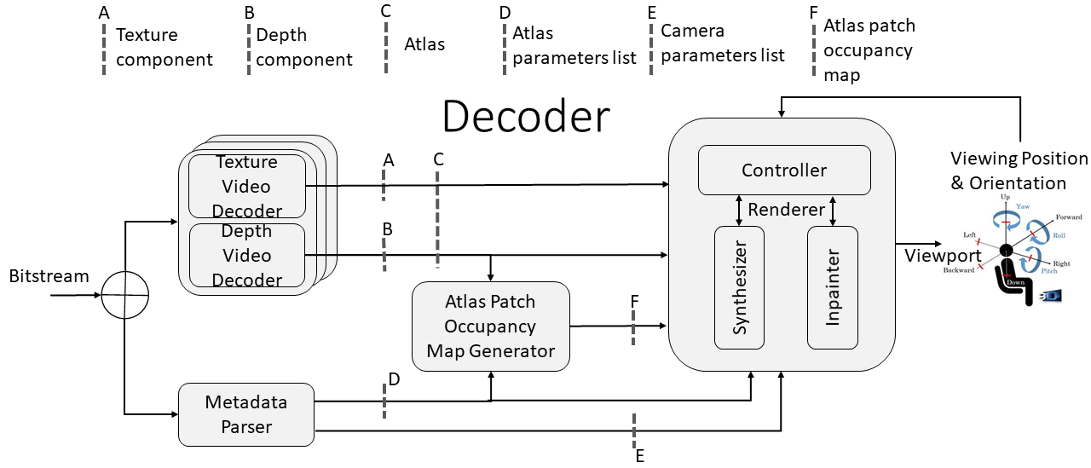
Test Model for Immersive Video (TMIV) (-Cont’d)
Decoder
  Decoder receives HEVC decoded atlases and the following metadata
  TMIV decoder consists of three main steps:
  (1) Video decoder and metadata parser
  (2) Atlas patch occupancy map generator
  (3) Renderer
Architecture for TMIV decoder[1]
[1] Basel Salahieh, et al. Test Model for Immersive Video. 126th MPEG meeting of ISO/IEC JTC1/SC29/ WG11, w18470.
3079-19-0036-00-0002

Slide 16
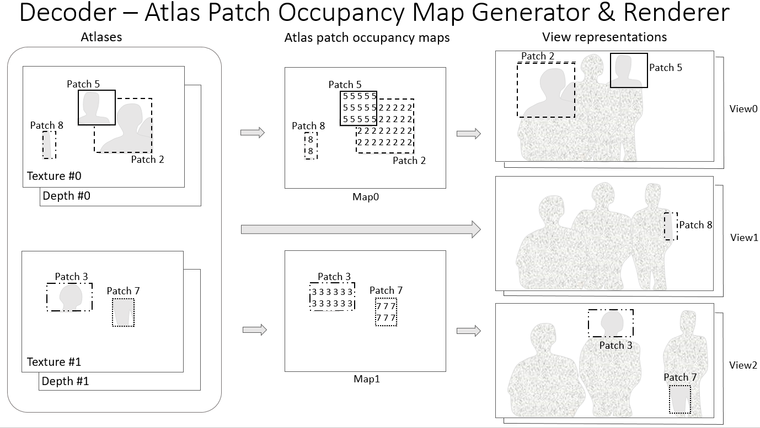
Test Model for Immersive Video (TMIV) (-Cont’d)
Atlas Patch Occupancy Map Generator
  An occupancy map is generated for each atlas
  Occupancy map contains the locations of the patches
  Based on the occupancy map, the source views are reconstructed
Data flow of TMIV decoder[1]
[1] Basel Salahieh, et al. Test Model for Immersive Video. 126th MPEG meeting of ISO/IEC JTC1/SC29/ WG11, w18470.
3079-19-0036-00-0002

Slide 17
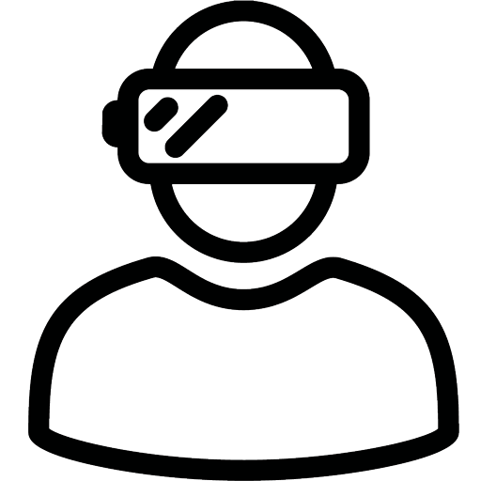


Experimental Results
HEVC anchor, TMIV anchor, and MCSL’s method are evaluated
MCSL’s method represents TMIV-like encoder and decoder
BD-rate, required number of decoders, encoding time are measured
Viewport
Rendering
Central View Synthesis
Central view
2D texture
2D depth
HEVC Encoder
Virtual View Synthesis
…
Central view
2D texture
2D depth
HEVC Decoder
Reconstruction
Pruning
HEVC Decoder
Packing
Packed view
2D texture
2D depth
HEVC Encoder
Network
Packed view
2D texture
2D depth
HEVC Decoder
Unpacking
360 cameras array
Pre-processing
Metadata
Metadata
Post-processing
Video Server
Video Client
Block diagram for MCSL 3DoF+ S/W platform[1]
[1] Jong-Beom Jeong, et al. Towards 3DoF+ 360 Video Streaming System for Immersive Media. IEEE Access, vol. 7, pp. 136399-136408, 2019.
3079-19-0036-00-0002

Slide 18
Experimental Results (-Cont’d)
Server
  2 linux servers (ubuntu 16.04) were used in experiment
  One has 2 intel xeon E5-2687w (12 cores, 24 threads) CPUs and 128GB memory
  Another has 2 intel xeon E5-2620 (6 cores, 12 threads) CPUs and 128GB memory
Software
  Versions of softwares meet the requirements of CfP
  OpenCV 3.4.2 was used in source view pruning, reconstruction, and RVS
  OpenGL was not used because of the building issue in linux
3079-19-0036-00-0002

Slide 19
Experimental Results (-Cont’d)
Experimental results for ClassroomVideo and TechnicolorMuseum
  For the objective evaluation, WS-PSNR[1] is used
  TMIV showed the best results on BD-rate and encoding time saving
  MCSL’s method requires the least number of decoders among the introduced methods
Sequence | Method | BD-rate | No.of decoders required | Encoding time saving
ClassroomVideo | HEVC-anchor | 0.00% | 30 | 0.00%
 | TMIV-anchor | -80.59% | 4 | -86.28%
 | MCSL | -37.14% | 4 | -81.68%
TechnicolorMuesum | HEVC-anchor | 0.00% | 48 | 0.00%
 | TMIV-anchor | -68.26% | 8 | -86.72%
 | MCSL | -18.90% | 4 | -95.21%
Results of HEVC anchor, TMIV anchor, and MCSL’s method
[1] Yule Sun, et al. Weighted-to-spherically-uniform quality evaluation for omnidirectional video. IEEE signal processing letters, 24(9), 1408-1412. 2018.
3079-19-0036-00-0002

Slide 20
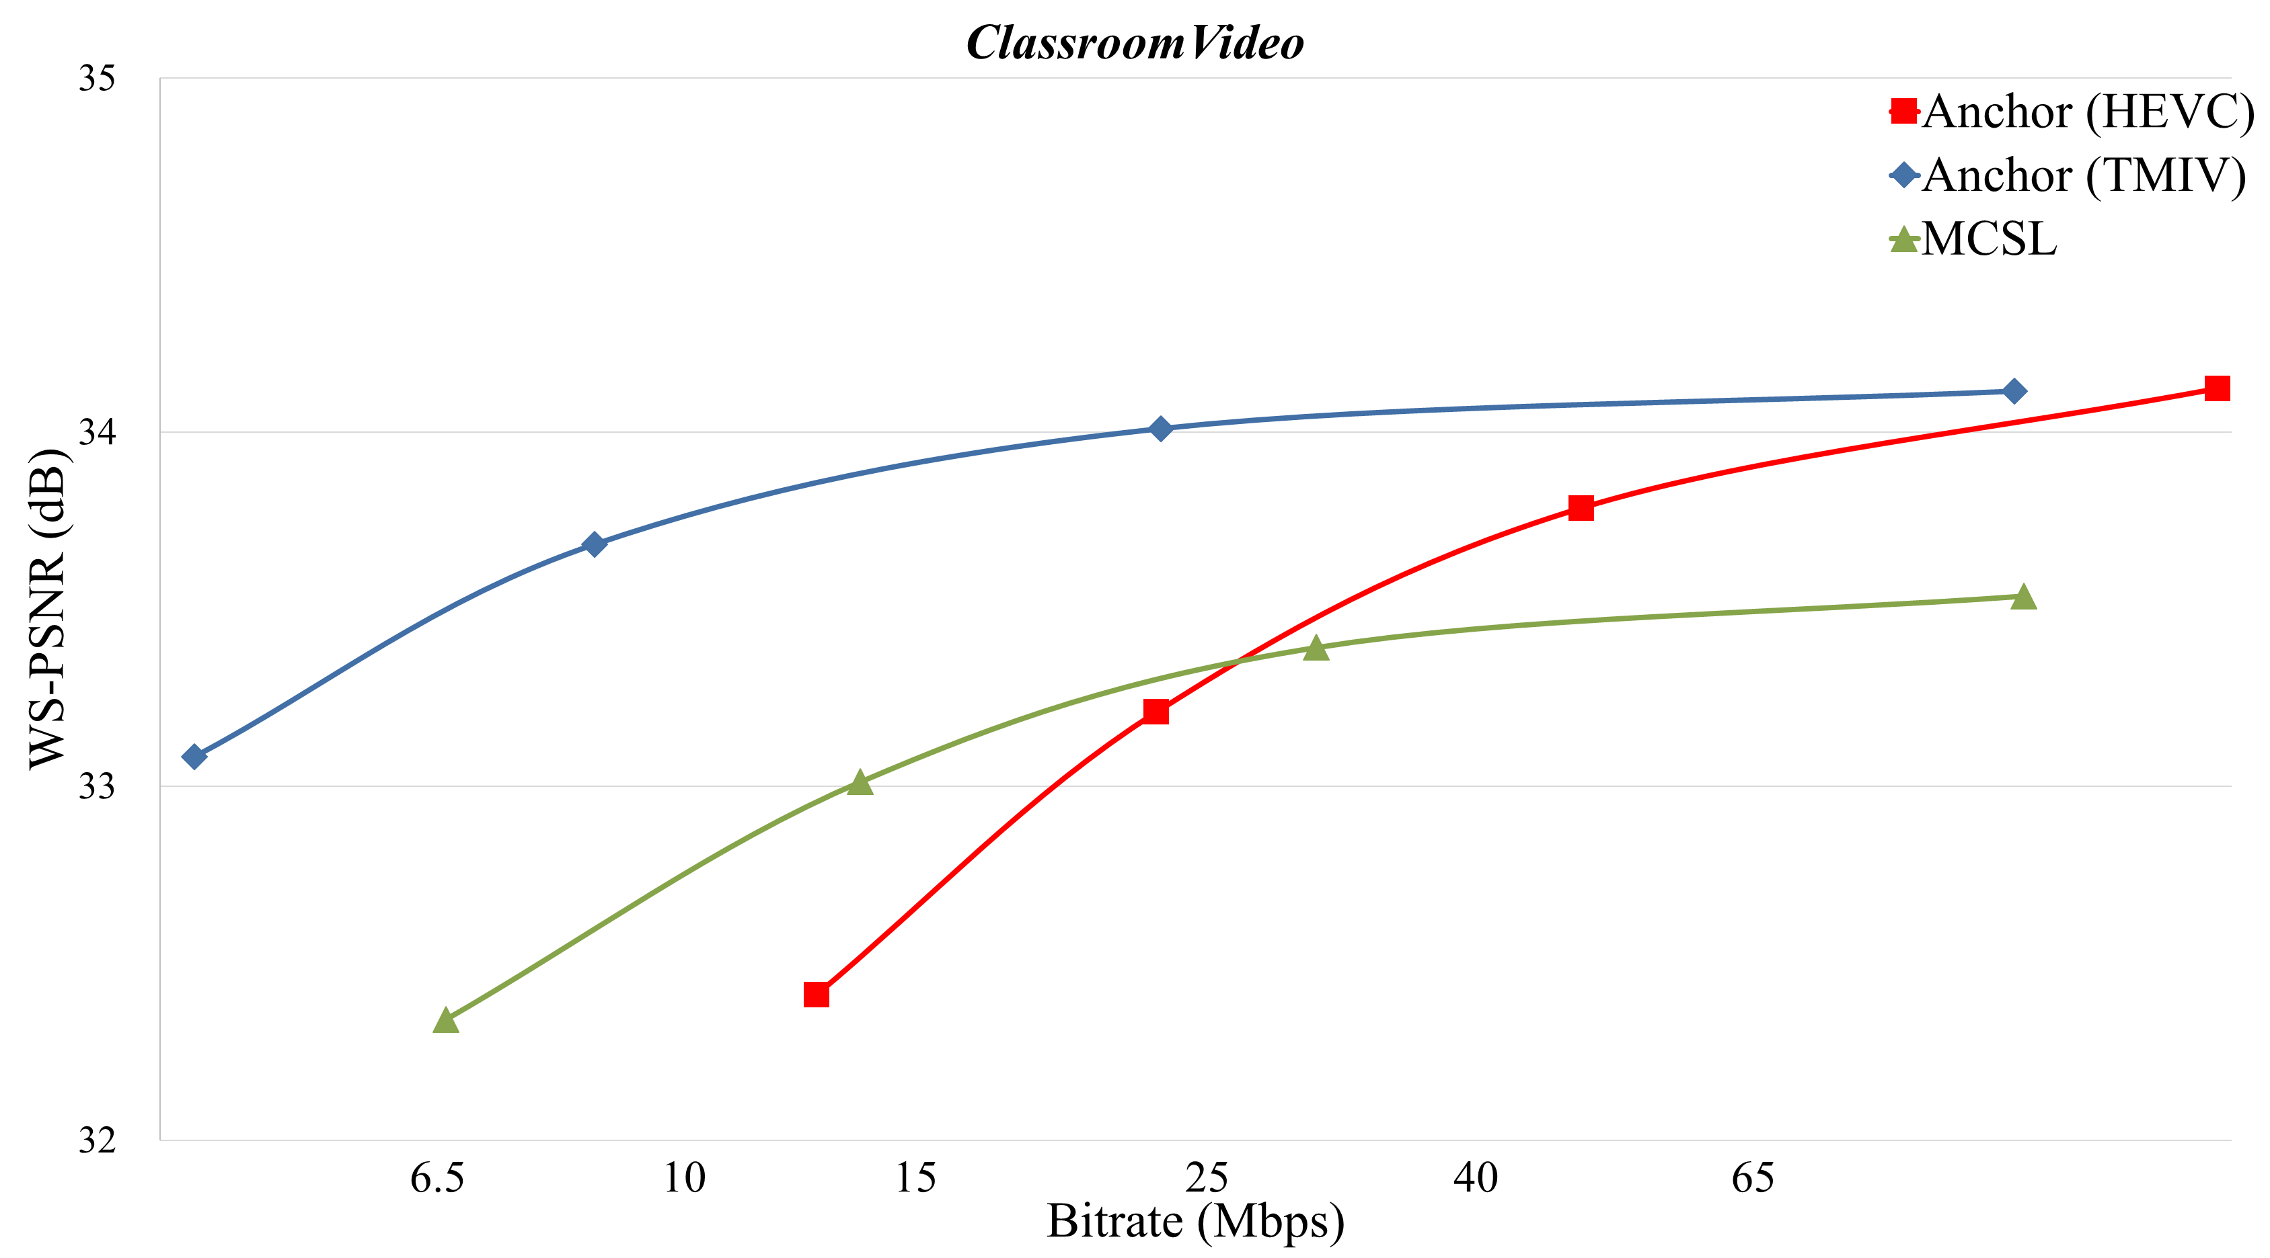
Experimental Results (-Cont’d)
RD-curve of ClassroomVideo
3079-19-0036-00-0002

Slide 21
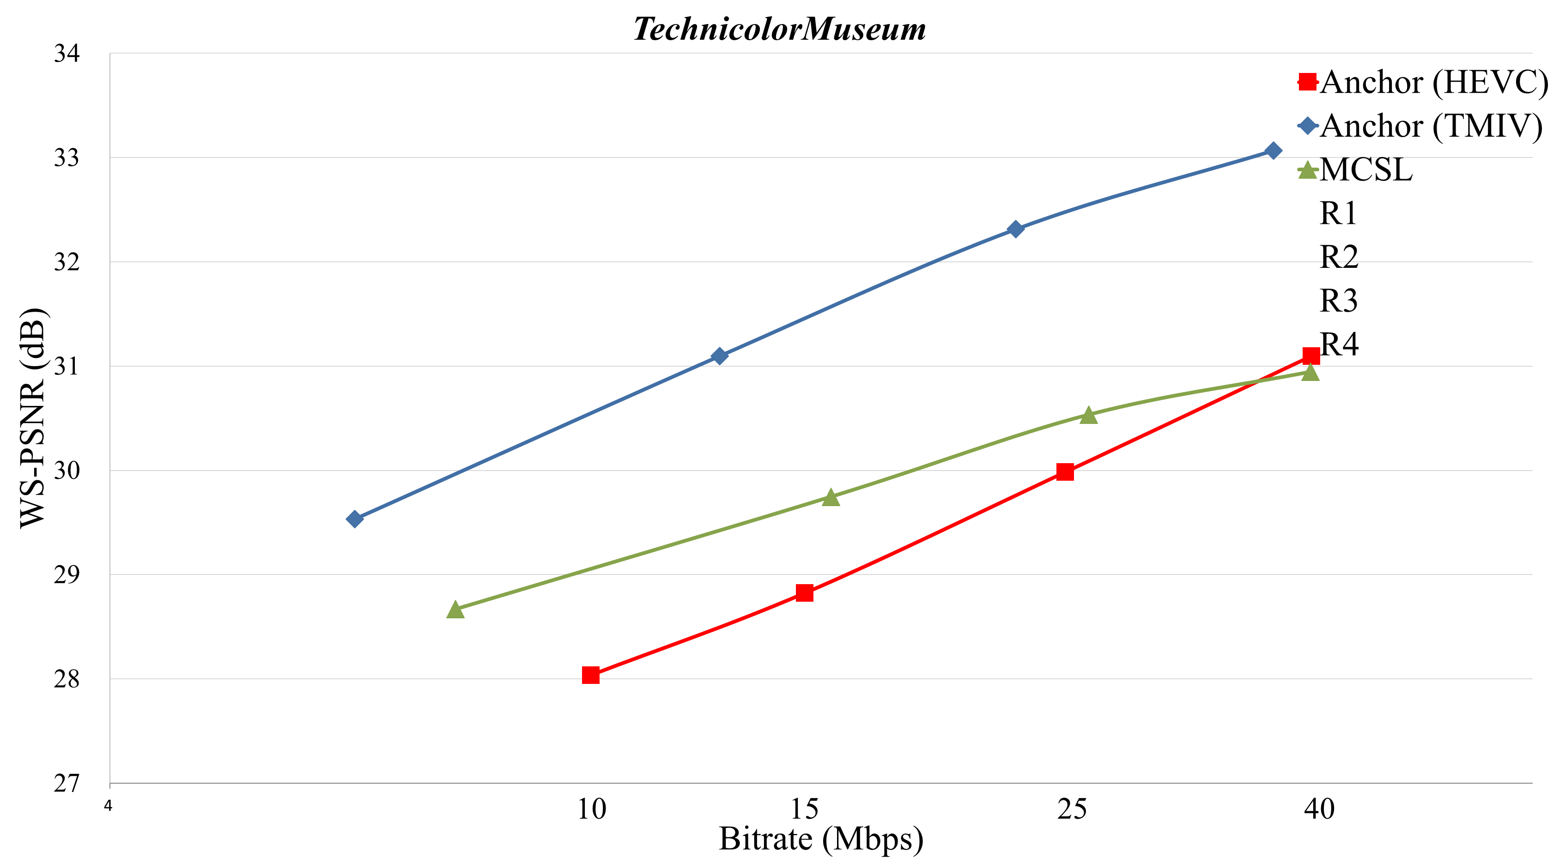
Experimental Results (-Cont’d)
RD-curve of TechnicolorMuseum
3079-19-0036-00-0002

Slide 22
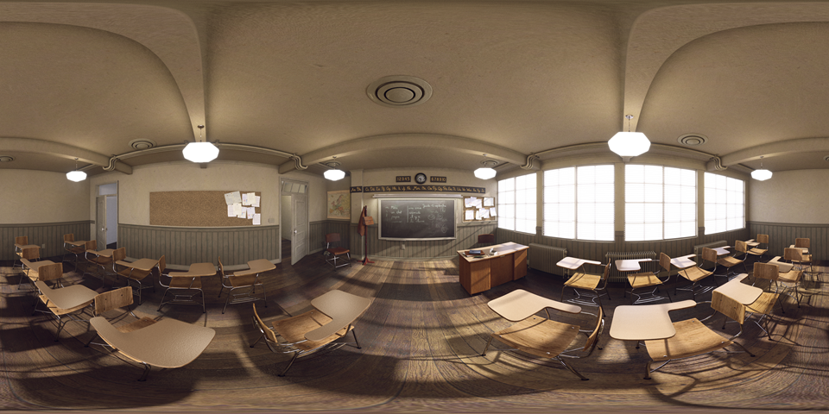
Appendix : Atlas generated by TMIV
Class A1(ClassroomVideo), atlas 0 (basic view), texture
Resolution = 4096x2048
3079-19-0036-00-0002

Slide 23
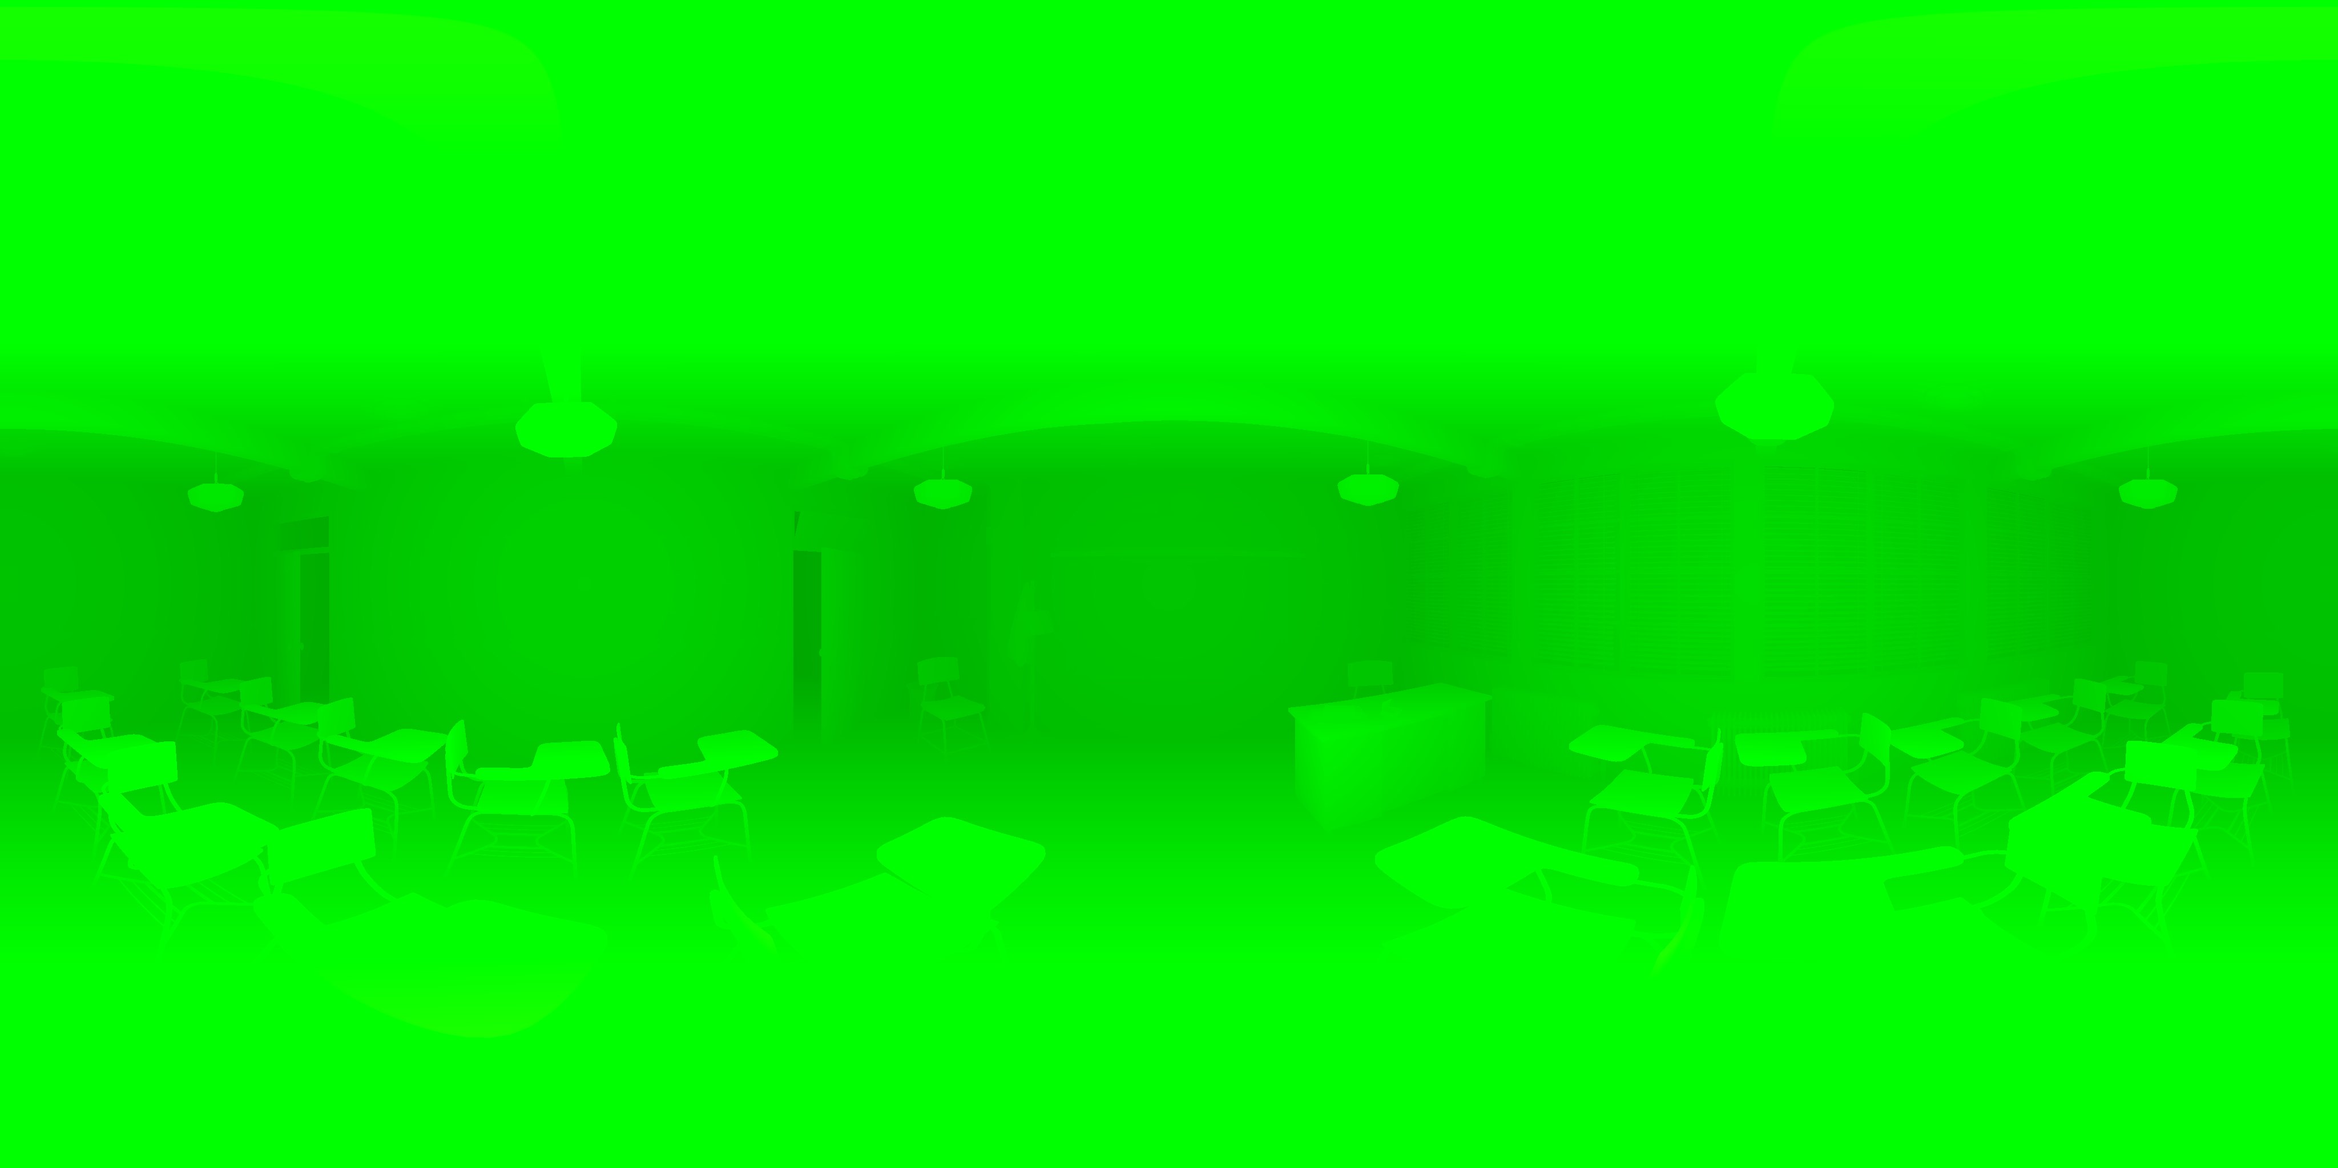
Appendix : Atlas generated by TMIV
Class A1(ClassroomVideo), atlas 0 (basic view), depth
Resolution = 4096x2048
3079-19-0036-00-0002

Slide 24

Appendix : Atlas generated by TMIV
Class A1(ClassroomVideo), atlas 1 (additional view), texture
Resolution = 4096x2048
3079-19-0036-00-0002

Slide 25

Appendix : Atlas generated by TMIV
Class A1(ClassroomVideo), atlas 1 (additional view), depth
Resolution = 4096x2048
3079-19-0036-00-0002

Slide 26
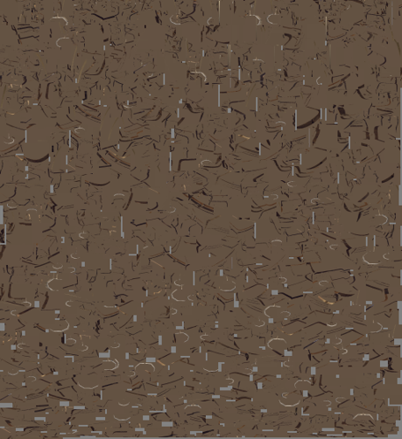
Appendix : Packed View generated by MCSL
Class A1(ClassroomVideo), texture
Resolution = 4096x4480
3079-19-0036-00-0002

