Slide 1
Latency Compensation Technique
Suk-Ju Kang, Sogang University

Slide 2
Compliance with IEEE Standards Policies and Procedures
Subclause 5.2.1 of the IEEE-SA Standards Board Bylaws states, "While participating in IEEE standards development activities, all participants...shall act in accordance with all applicable laws (nation-based and international), the IEEE Code of Ethics, and with IEEE Standards policies and procedures."
The contributor acknowledges and accepts that this contribution is subject to
The IEEE Standards copyright policy as stated in the IEEE-SA Standards Board Bylaws, section 7, http://standards.ieee.org/develop/policies/bylaws/sect6-7.html#7, and the IEEE-SA Standards Board Operations Manual, section 6.1, http://standards.ieee.org/develop/policies/opman/sect6.html
The IEEE Standards patent policy as stated in the IEEE-SA Standards Board Bylaws, section 6, http://standards.ieee.org/guides/bylaws/sect6-7.html#6, and the IEEE-SA Standards Board Operations Manual, section 6.3, http://standards.ieee.org/develop/policies/opman/sect6.html

Slide 3
IEEE 3079
HMD Based 3D Content Motion Sickness Reducing Technology
[Dong Il Seo and dillon@volercreative.com]
Latency Compensation Technique
Date: 2019-10-7
Author(s): Suk-Ju Kang
Name | Affiliation | Phone [optional] | Email [optional]
Suk-Ju Kang | Sogang University | +82-10-7103-6520 | sjkang@sogang.ac.kr

Slide 4
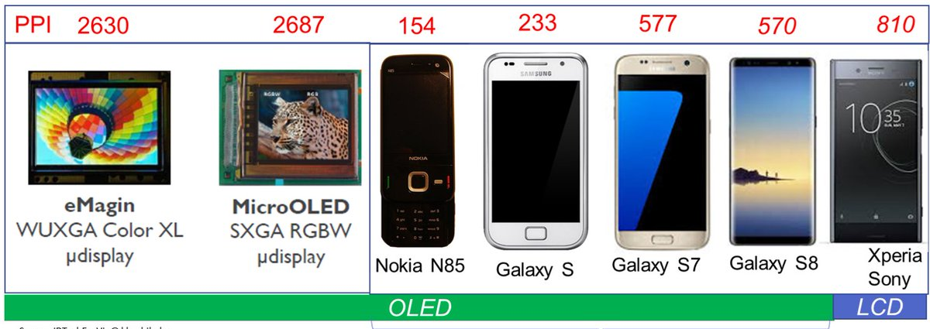
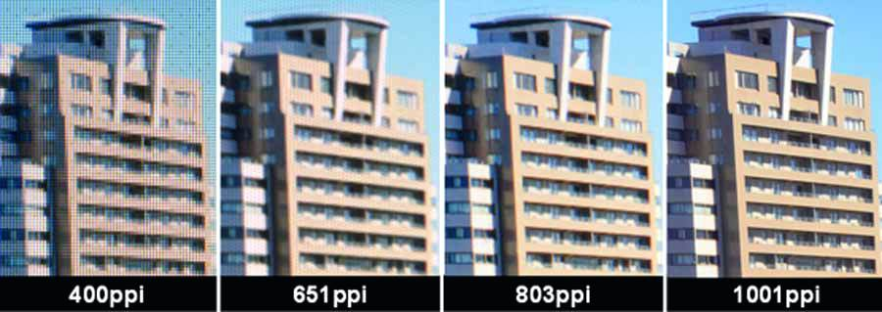
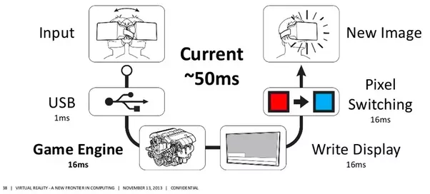
Background
Resolution and Latency
Resolution
Latency

Slide 5
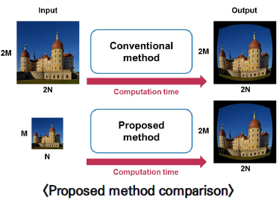
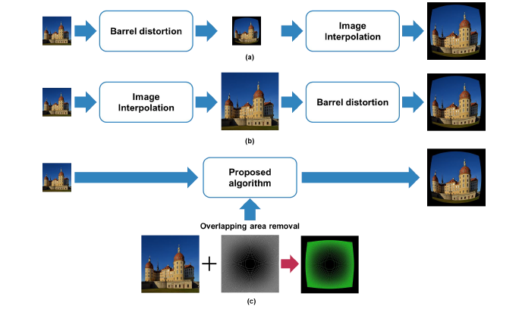
Background
Computational Cost Reduction

Slide 6
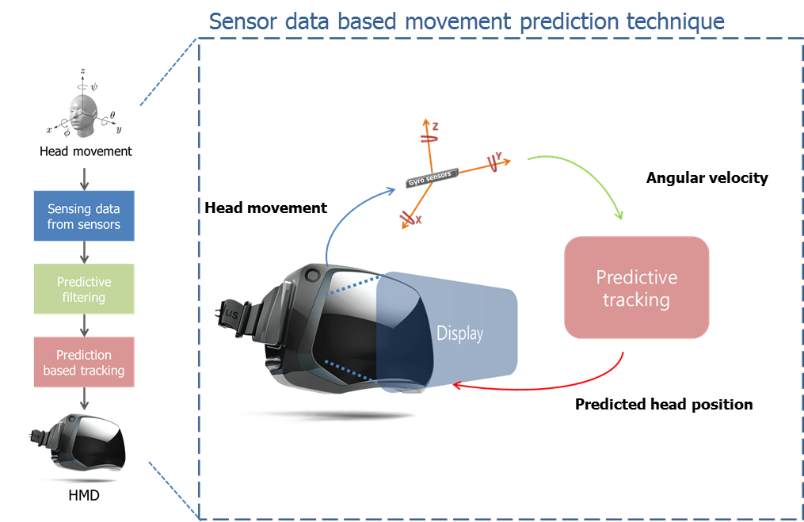
System Overview

Slide 7

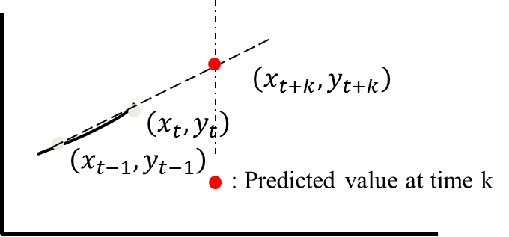

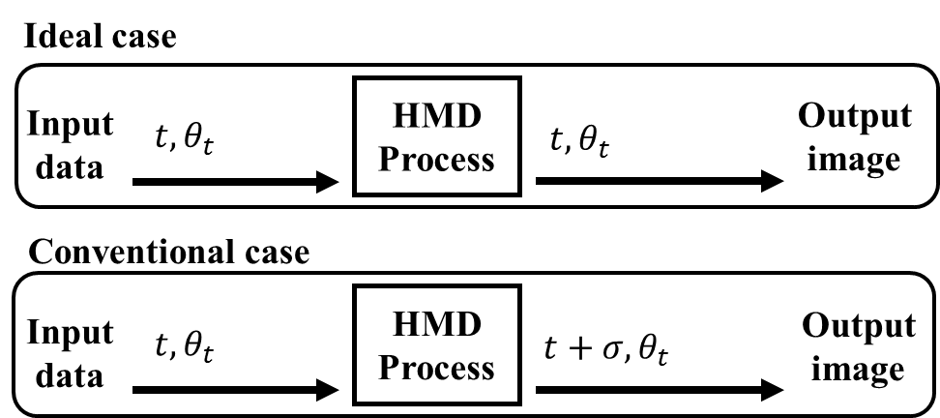
System Overview
Motion prediction process
Head motion
Prediction
Prediction based warping
Reference
(a)
(b)
degree
(a)
Delayed output
(b)
time
$θ_{t}:$Angle at time t , $σ:$ Latency

Slide 8
Proposed Method
Overall architecture
Head motion
Prediction
Prediction based warping
Prediction method
HMD device
yaw
Curve fitting
K-step ahead prediction
yaw
Warping
pitch
pitch
roll
roll
Orientation
Rendering system
VRAM
Pixel values

Slide 9




Proposed Method
Linear extrapolation
  Our goal is to develop a processor-based predictive tracking method
  For a real-time implementation, a linear extrapolation is used
    Over 75Hz refresh rate of HMD display -> One prediction step ≈ 13.3 ms
    Considering the quality preservation and low complexity
3rd order polynomial curve (high complexity)
Lagrange polynomials
$$\left(x_{t+k},y_{t+k}\right)$$
Linear extrapolated
$$\left(x_{t},y_{t}\right)$$
$$\left(x_{t−1},y_{t−1}\right)$$
: Predicted value at time k

Slide 10
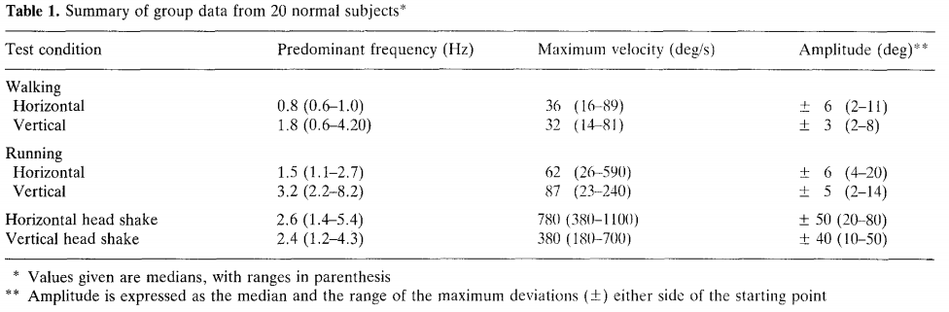
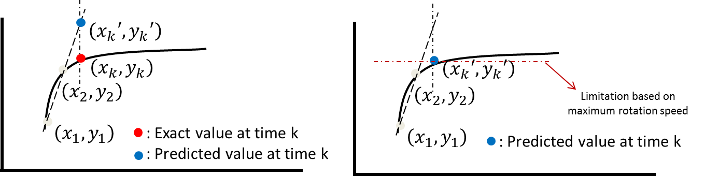
Proposed Method
Limitation
  Position error caused by the maximum head rotation speed
  In order to compensate the error, we evaluate maximum rotation speeds based on the biological data and generate the mapping table
*G.E. Grossman et. al “Frequency and velocity of rotational head perturbations during locomotion”

Slide 11
Experimental Results
Predicted angles
  Prediction steps (1, 2)
    Prediction step 1: 13.3 milliseconds
    Prediction step 2: 26.6 milliseconds
Sensor data
Proposed system
Sensor data
Proposed system

Slide 12
Experimental Results
Predicted angles
  Prediction steps (3, 4)
    Prediction step 3: 39.9 milliseconds
    Prediction step 4: 53.2 milliseconds
Sensor data
Proposed system
Sensor data
Proposed system

