Slide 1
Viewport Tile Selection Experiment:
Using Test Model for Immersive Video (TMIV)
Presenter: Soonbin Lee (soonbinlee@skku.edu)
Jong-Beom Jeong, Soonbin Lee, Sungbin Kim, Il-Woong Ryu, Dongmin Jang, Eun-Seok Ryu
Multimedia Computing Systems Lab. (MCSL)
http://mcsl.skku.edu
Department of Computer Education
Sungkyunkwan University

Slide 2
Compliance with IEEE Standards Policies and Procedures
Subclause 5.2.1 of the IEEE-SA Standards Board Bylaws states, "While participating in IEEE standards development activities, all participants...shall act in accordance with all applicable laws (nation-based and international), the IEEE Code of Ethics, and with IEEE Standards policies and procedures."
The contributor acknowledges and accepts that this contribution is subject to
The IEEE Standards copyright policy as stated in the IEEE-SA Standards Board Bylaws, section 7, http://standards.ieee.org/develop/policies/bylaws/sect6-7.html#7, and the IEEE-SA Standards Board Operations Manual, section 6.1, http://standards.ieee.org/develop/policies/opman/sect6.html
The IEEE Standards patent policy as stated in the IEEE-SA Standards Board Bylaws, section 6, http://standards.ieee.org/guides/bylaws/sect6-7.html#6, and the IEEE-SA Standards Board Operations Manual, section 6.3, http://standards.ieee.org/develop/policies/opman/sect6.html

Slide 3
IEEE 3079 HMD Based VR Sickness Reducing Technology Dongil Dillon Seo, dillon@volercreative
Using Test Model for Immersive Video (TMIV)
Date: 2020-02-03
Author(s): Jong-Beom Jeong, Soonbin Lee, Sungbin Kim, Il-Woong Ryu, Dongmin Jang, Eun-Seok Ryu
Name | Affiliation | Phone [optional] | Email [optional]
Soonbin Lee | Sungkyunkwan Univ. |  | soon0698@gmail.com
Jong-Beom Jeong | Sungkyunkwan Univ.
Sungbin Kim | Sungkyunkwan Univ.
Il-Woong Ryu | Sungkyunkwan Univ.
Dongmin Jang | Sungkyunkwan Univ.
Eun-Seok Ryu | Sungkyunkwan Univ. |  | esryu@skku.edu

Slide 4
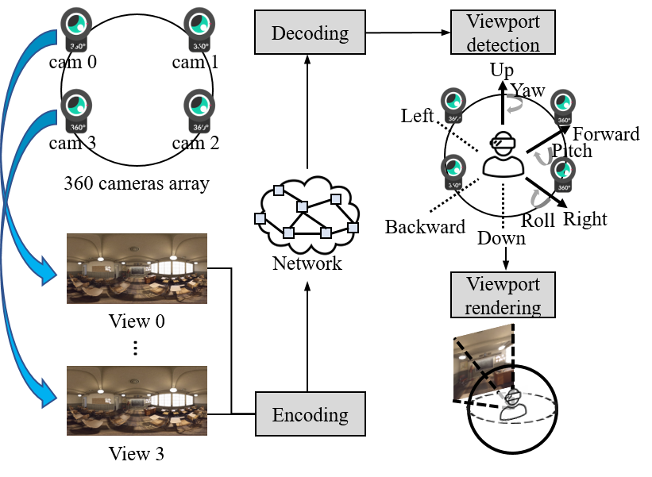
3DoF+ Overview
3DoF+ Overview System
the MPEG defined 3DoF+ to support the user’s head movements.
requires a high computing power and bandwidth

Slide 5
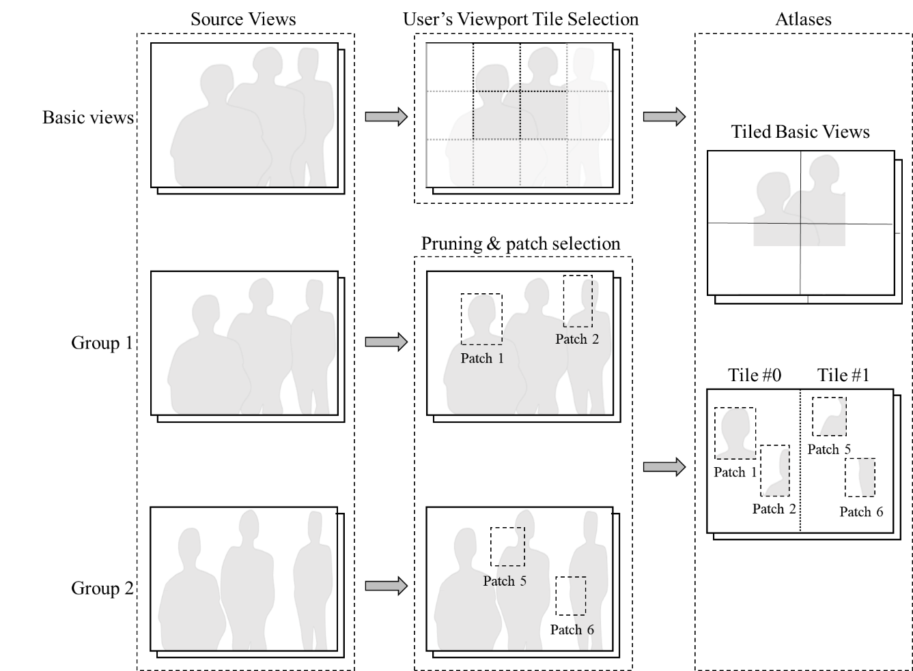
Viewport Streaming for 3DoF+
Viewport Streaming for 3DoF+
When a user’s head movement are transferred from the client, selects the tile sets that belong to the user’s viewport and their bitstreams.

Slide 6
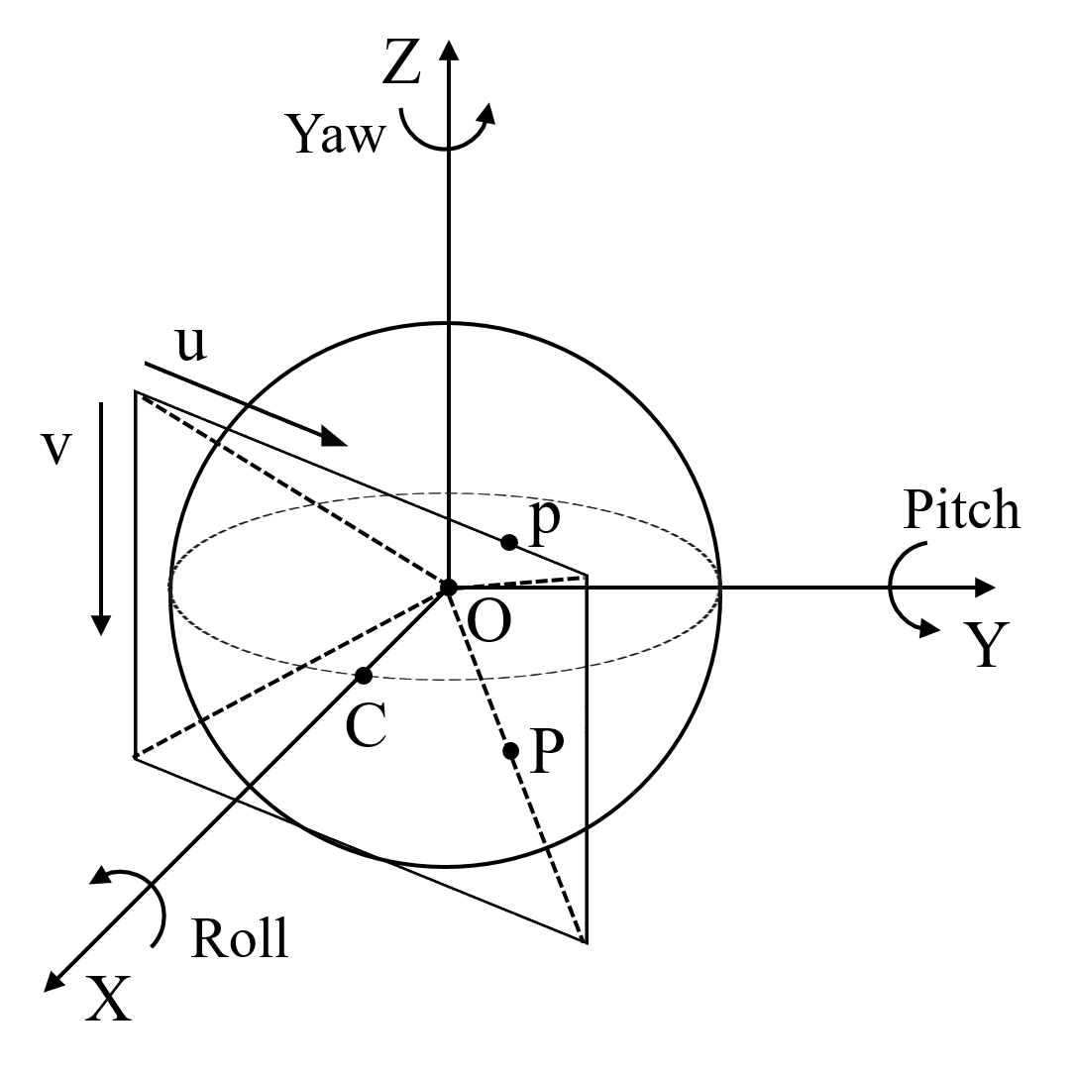
OMAF(Omnidirectional MediA Format)
OMAF Coordinate System
Global coordinate system is defined in OMAF, OMAF is part 2 of MPEG-I
Viewport tile decision method for a single 360 video, which is compatible with OMAF

Slide 7
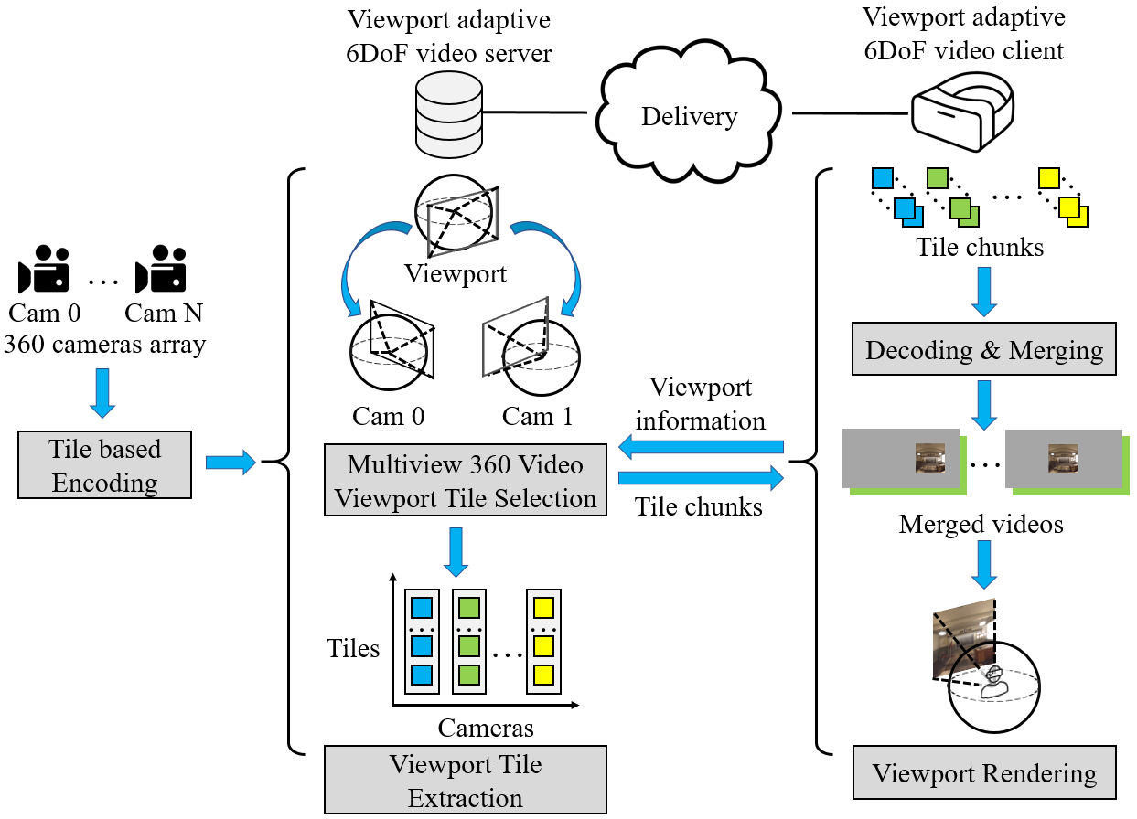
Viewport Tile Selection (VTS)
Viewport Tile Selection (VTS)
Single-pass encoding/rendering with MCTS-encoder and modified TMIV
Saving bandwidth with selective tile-based streaming
Fewer decoder instance

Slide 8
Experimental Results
Experimental results for CTC
We conducted experiment with CTC defined in MPEG
Every evaluation frames is 97
Sequence | Class | Resolution | View FoV | Global FoV | No. of views | Evaluation frames
 |  |  |  |  |  | Start frame | No. of frames
ClassroomVideo | CG1-A | 4096×2048 | 360×180 | 360×180 | 15 | 23 | 97
TechnicolorMuesum | CG1-B | 2048×2048 | 180×180 | 360×180 | 24 | 100 | 97
TechnicolorHijack | CG1-C | 4096×4096 | 180×180 | 180×180 | 10 | 0 | 97
NokaChess | CG1-N | 2048×2048 | 180×180 | 360×180 | 10 | 60 | 97

Slide 9
Experimental Results
Experimental results for CTC
For the objective evaluation, PSNR and IV-PSNR* is used.
VTS method showed the better results on BD-rate and number of decoders.
Sequence | Class | No. of decoders required | High BD-rate Y-PSNR(%) | Low BD-rate Y-PSNR(%) | High BD-rate IV-PSNR(%) | Low BD-rate IV-PSNR(%)
ClassroomVideo | CG1-A | 4 | -23.5 | -21.3 | -31.1 | -24.8
TechnicolorMuesum | CG1-B | 8 | -24.9 | -24.1 | -24.1 | -23.5
TechnicolorHijack | CG1-C | 6 | 2.8 | 3.5 | 2.8 | 2.7
NokaChess | CG1-N | 8 | -7.3 | -4.4 | -8.1 | -5.0
Average | - | 6.5 | -13.2 | -11.6 | -15.1 | -12.7

Slide 10
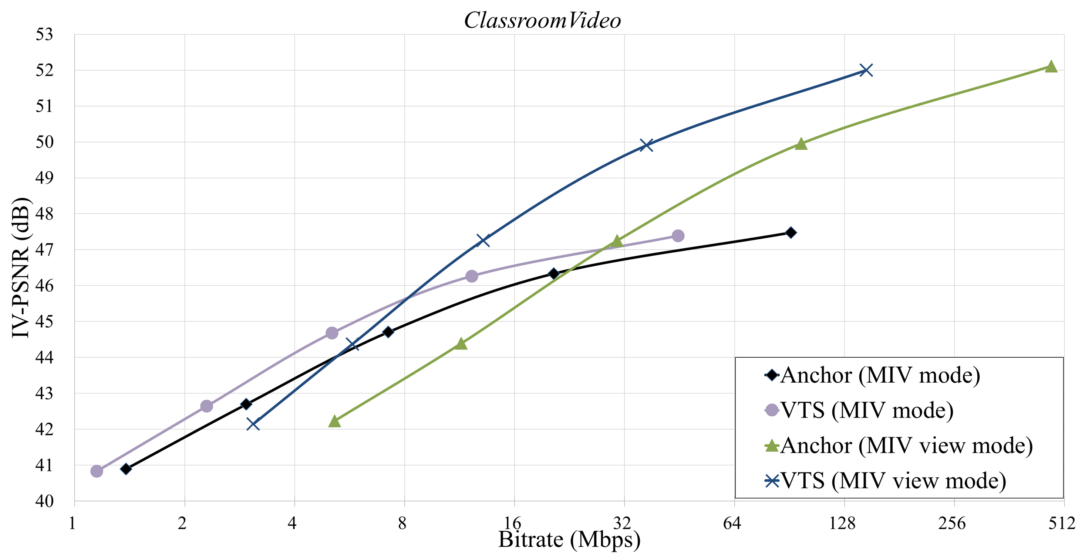
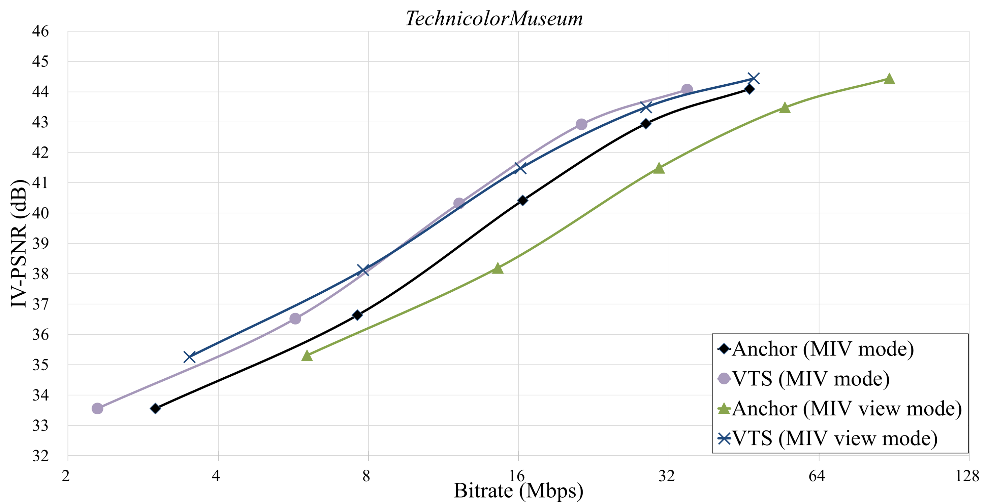
Experimental Results (-Cont’d)
RD-curve of TechnicolorMuseum

Slide 11
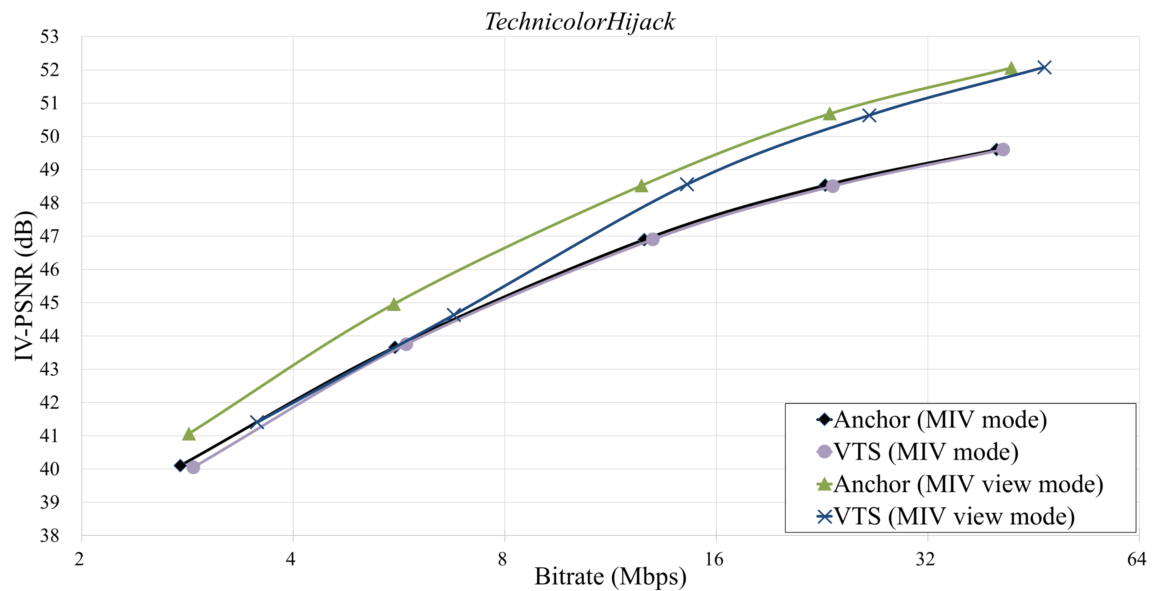
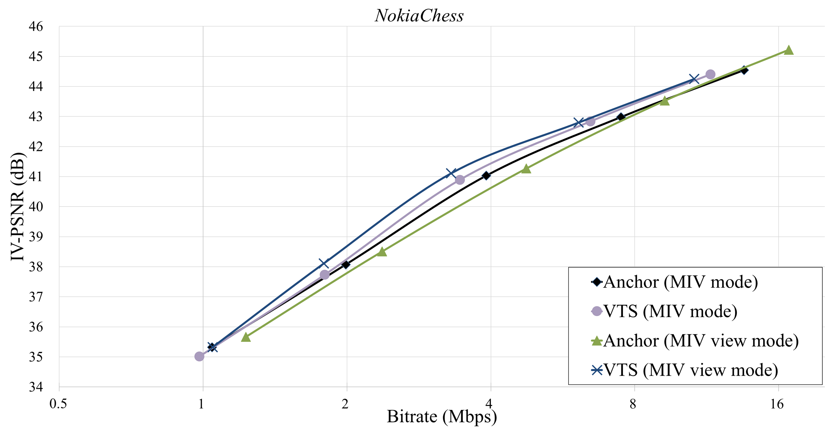
Experimental Results (-Cont’d)
RD-curve of TechnicolorMuseum

Slide 12
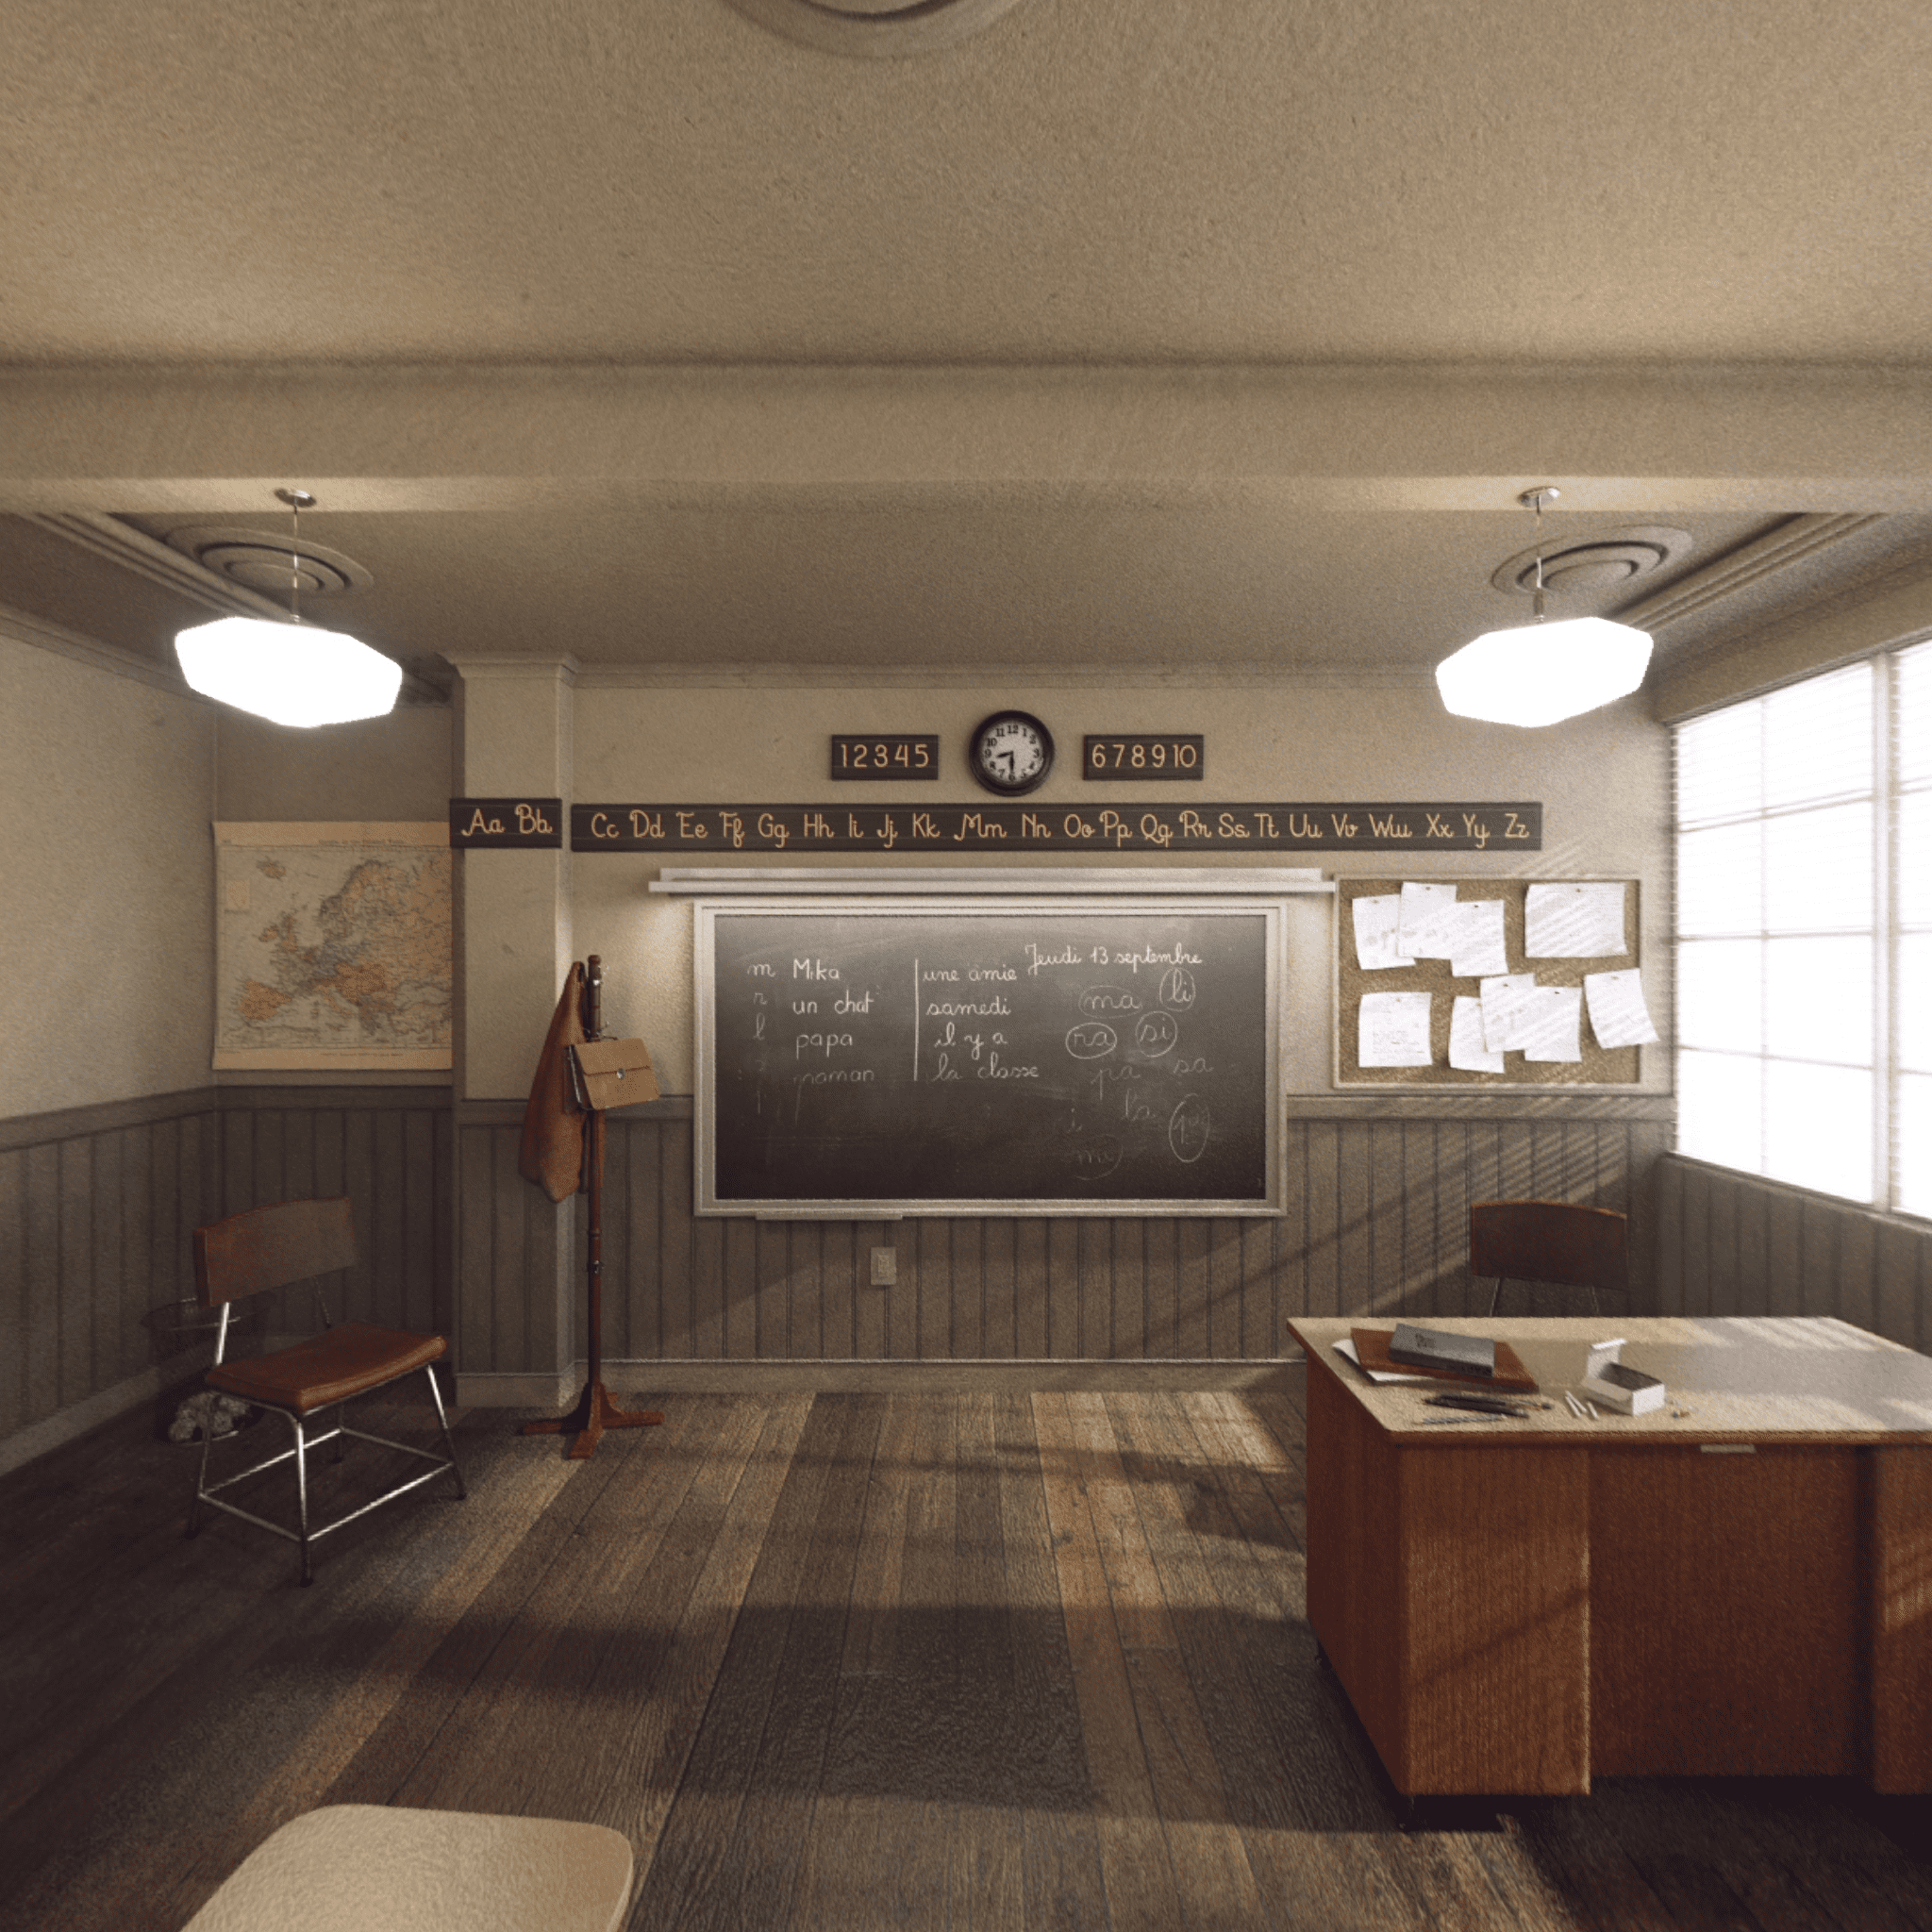
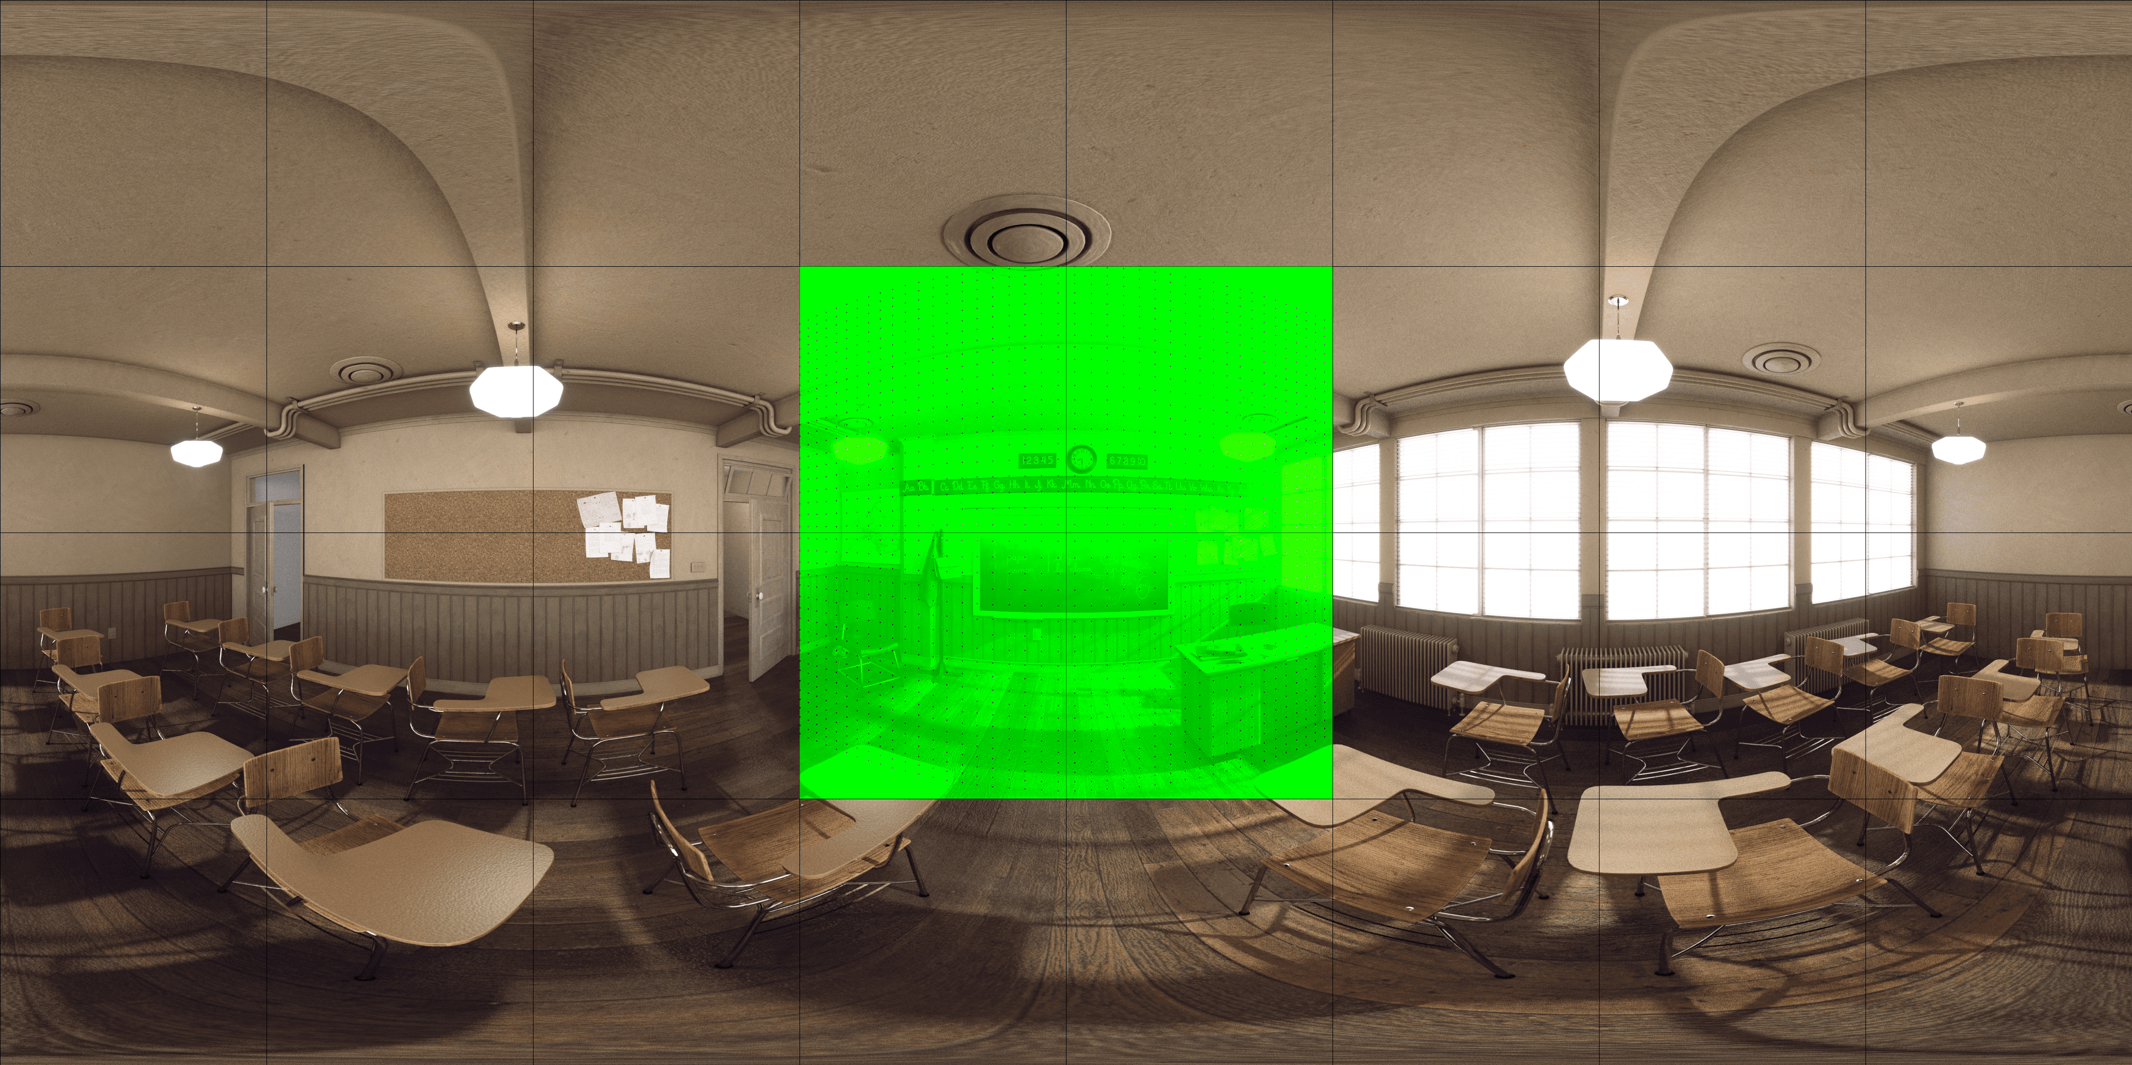
Appendix (-Cont’d)
CG1-A, position at v0, (x, y, z, yaw, pitch, roll) = (0, 0, 0, 0, 0, 0)
Pose trace Ap02, (x, y, z, yaw, pitch, roll) = (0,0,0,1.85E-05,-2.99E-06,3.20E-05)
viewport
v0

Slide 13
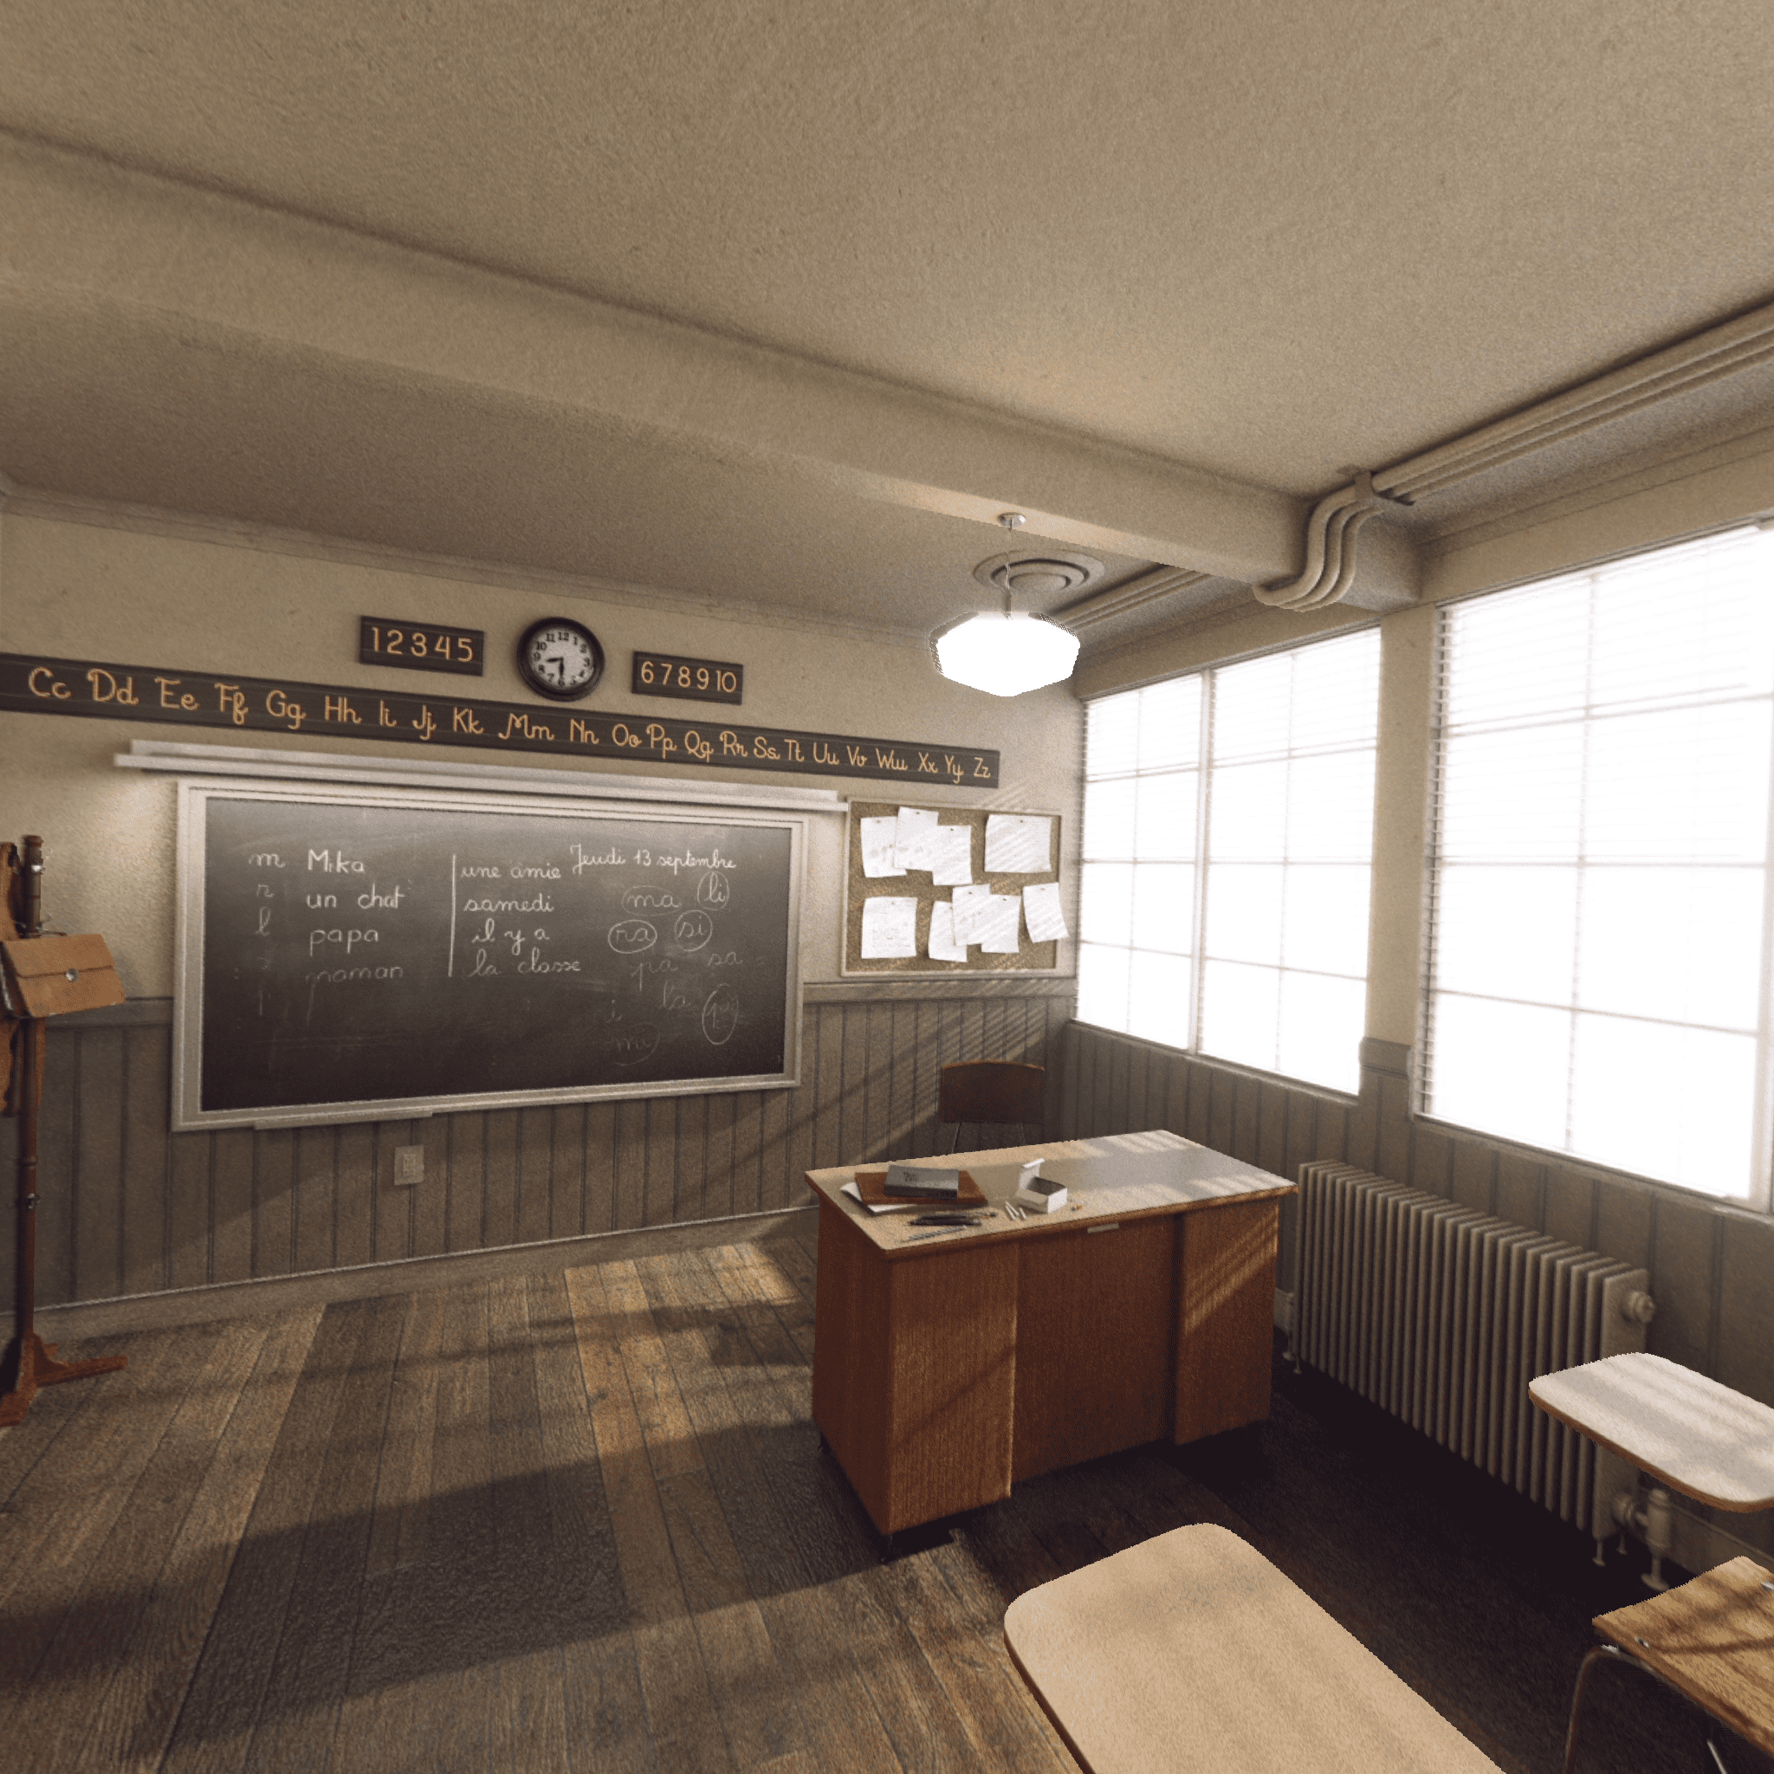
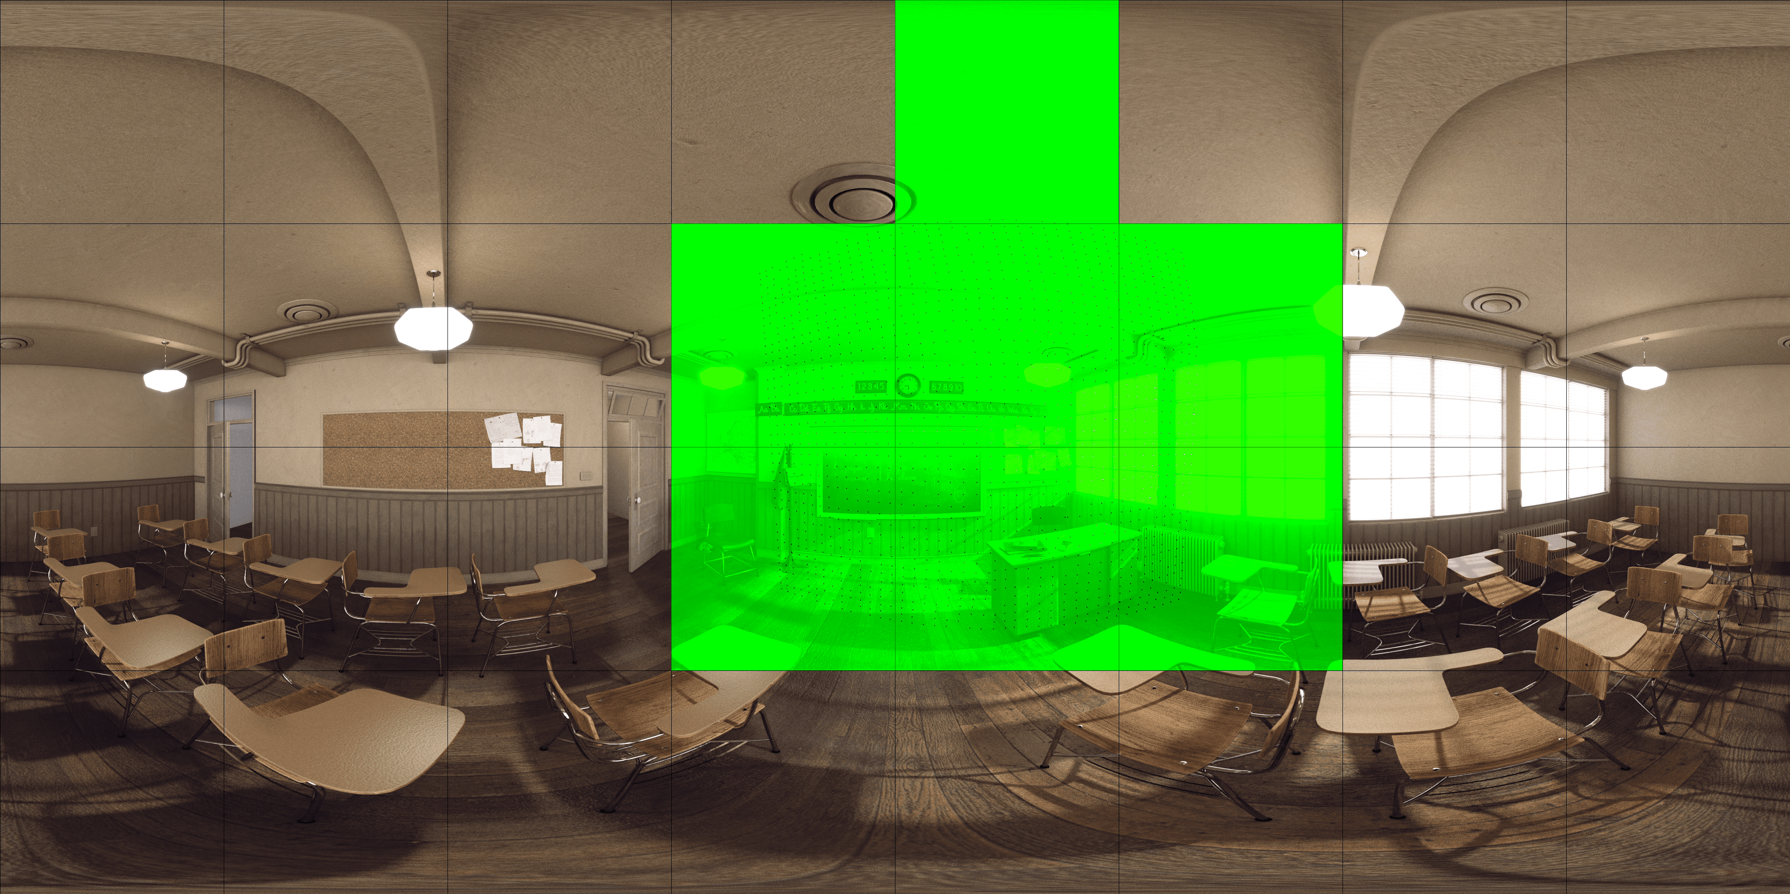
Appendix (-Cont’d)
CG1-A, position at v0, (x, y, z, yaw, pitch, roll) = (0, 0, 0, 0, 0, 0)
Pose trace Ap01, (x, y, z, yaw, pitch, roll) = (0.205,0.09,0,-20,-5,0)
viewport
v0

Slide 14
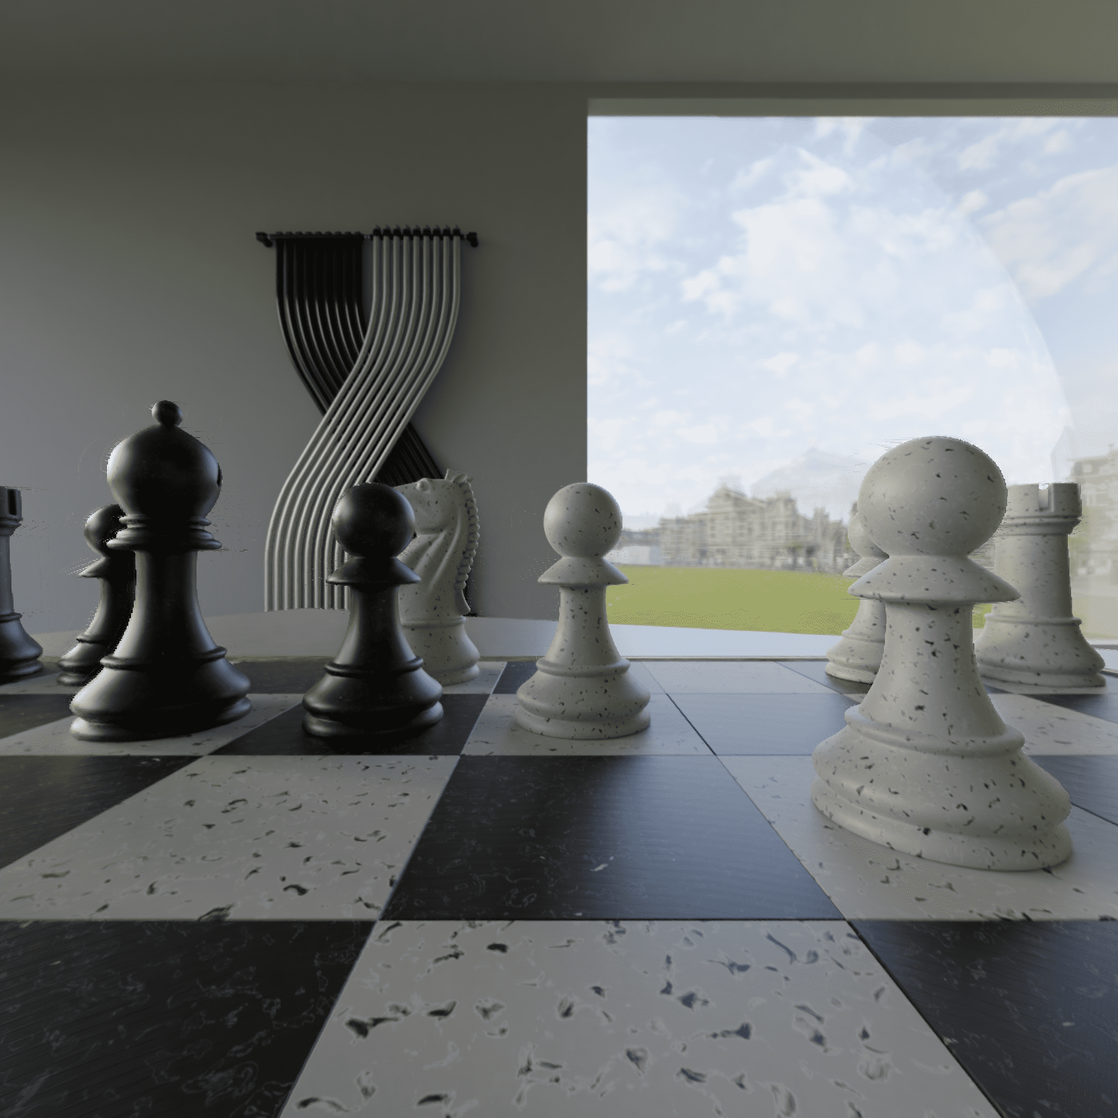
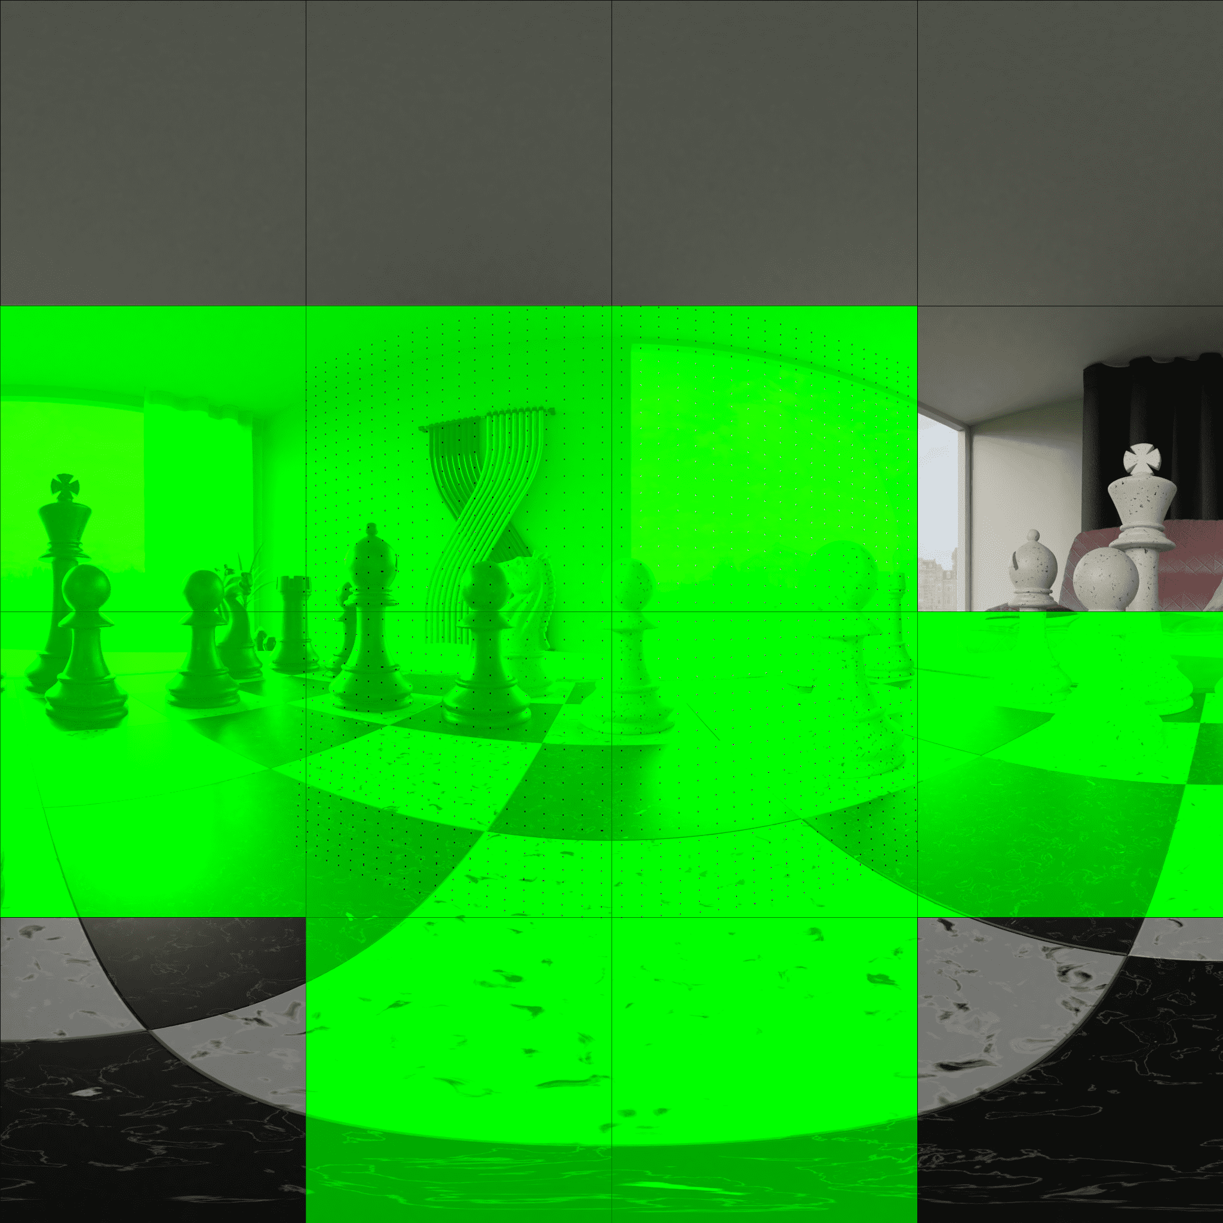
Appendix (-Cont’d)
CG1-N, position at v1, (x, y, z, yaw, pitch, roll) = (-0.20000000298023224, -0.5, 1.0, -0.0, -0.0, 0.0)
Pose trace Np01, (x, y, z, yaw, pitch, roll) = (0.25,0.0,0.0,5.08888476044965E-14,-2.4148358874568E-06,2.4148358874568E-06)
viewport
v1

Slide 15
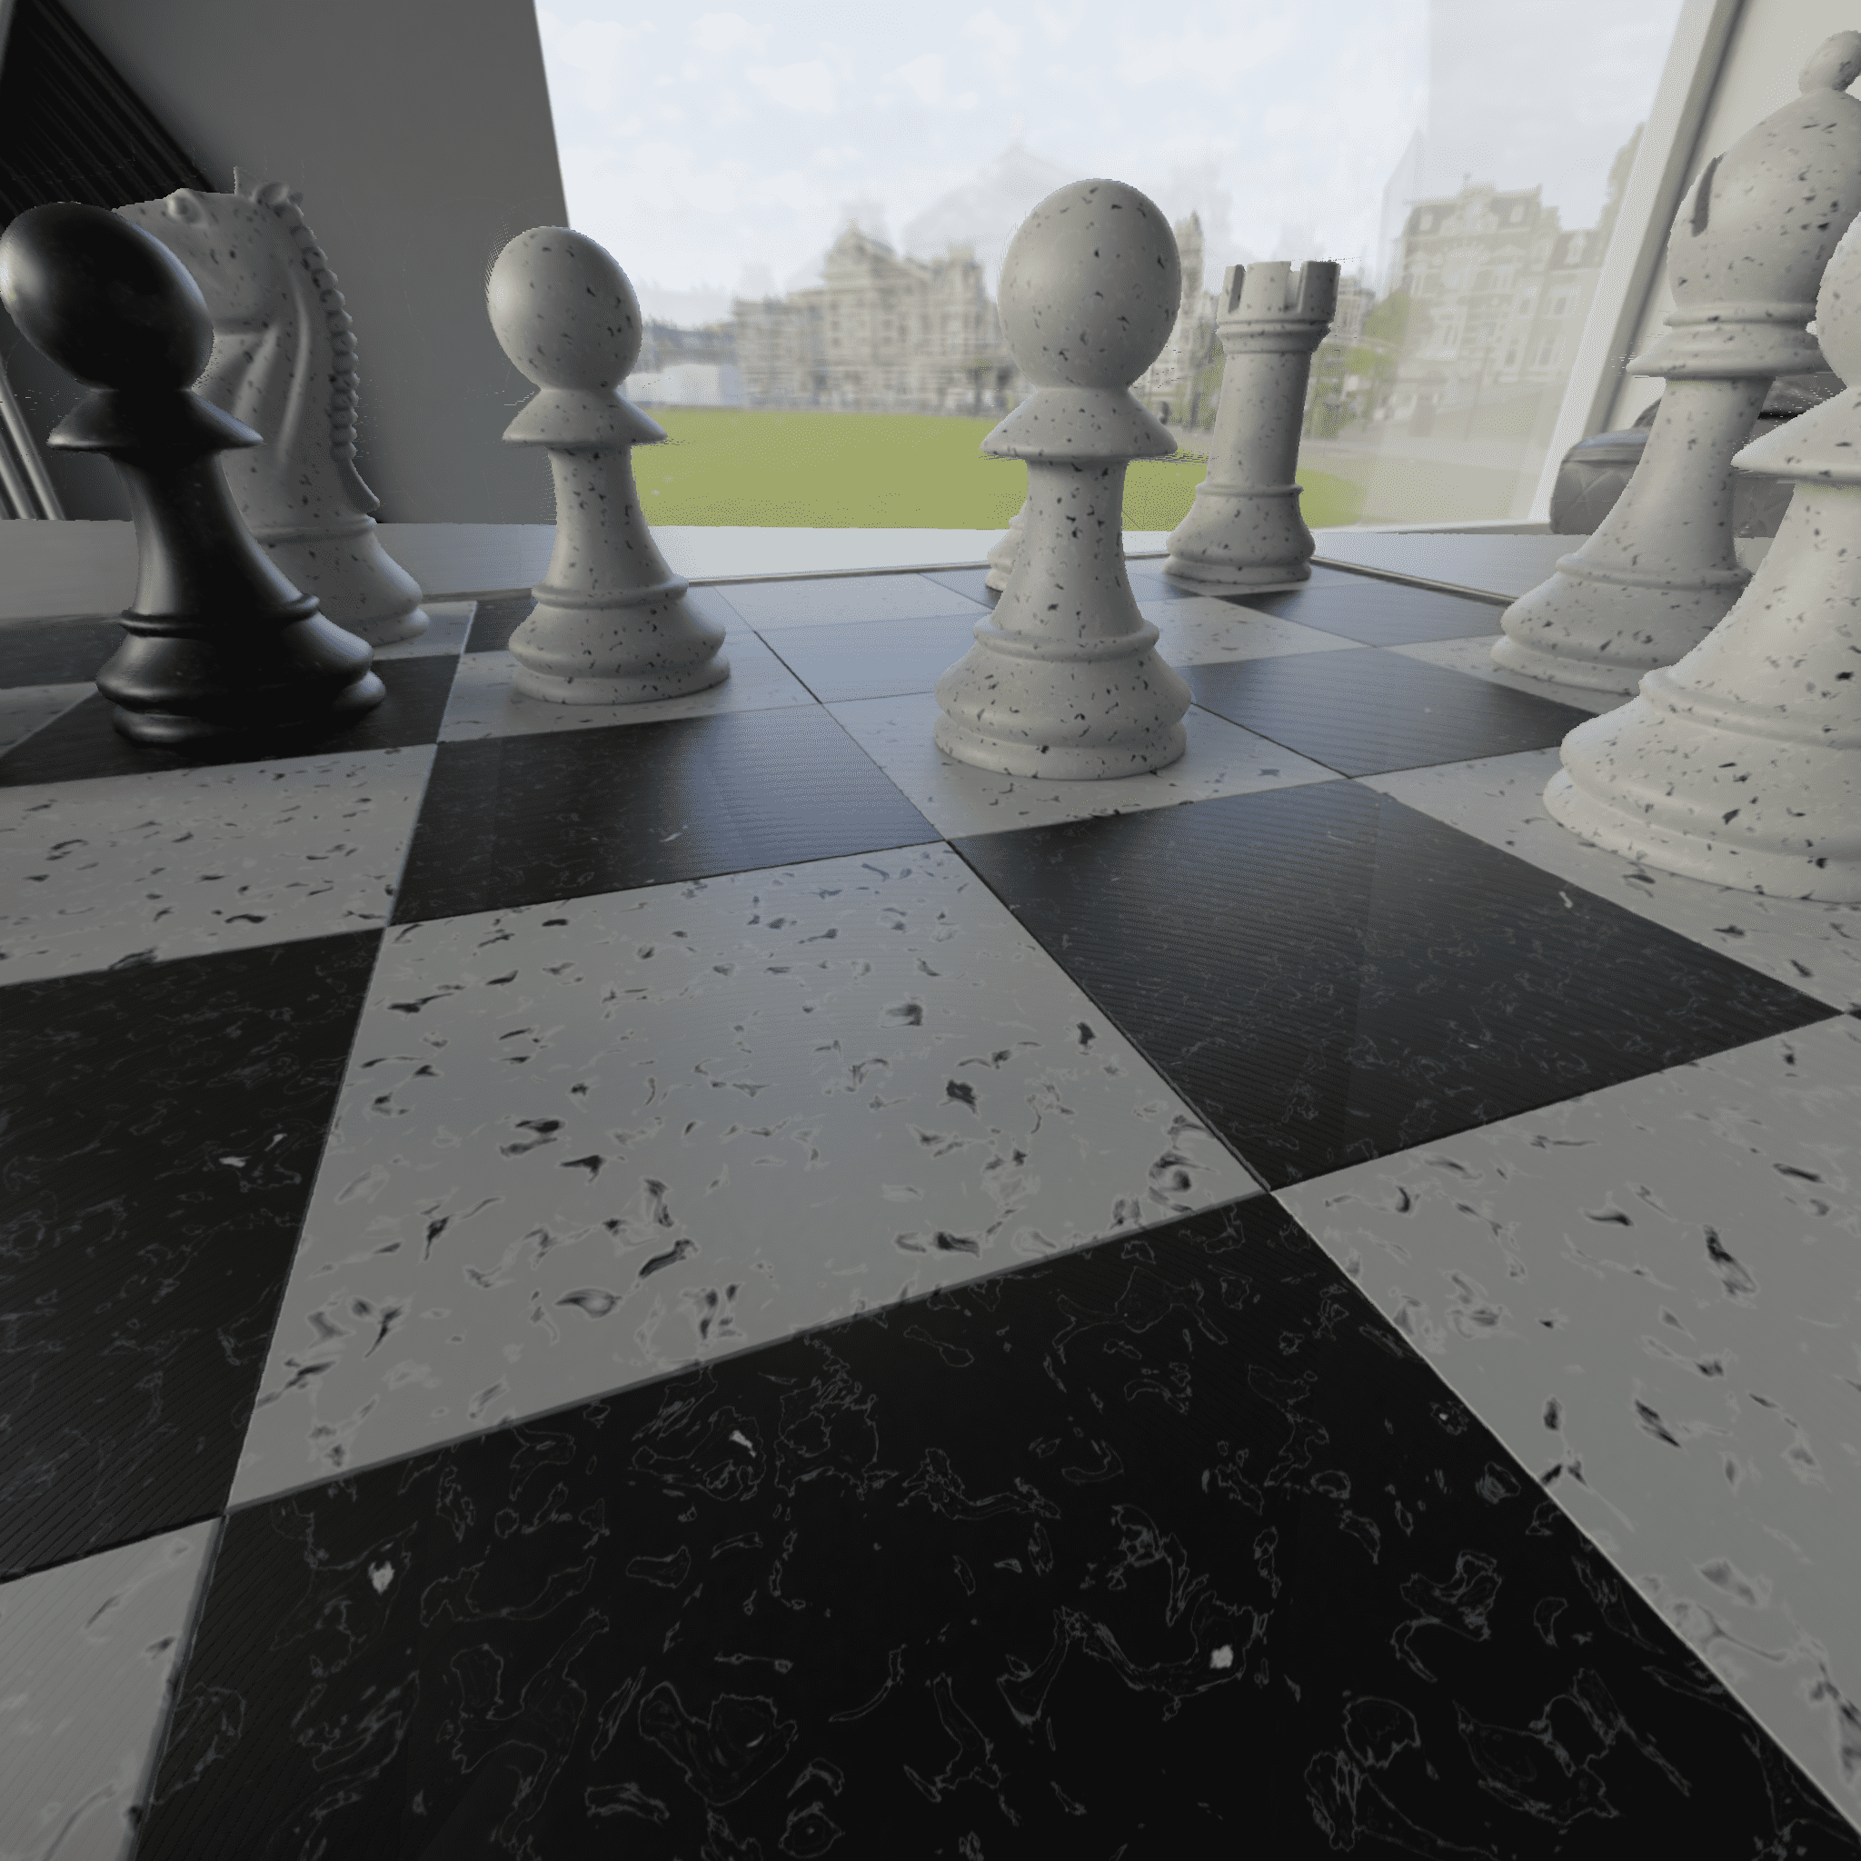
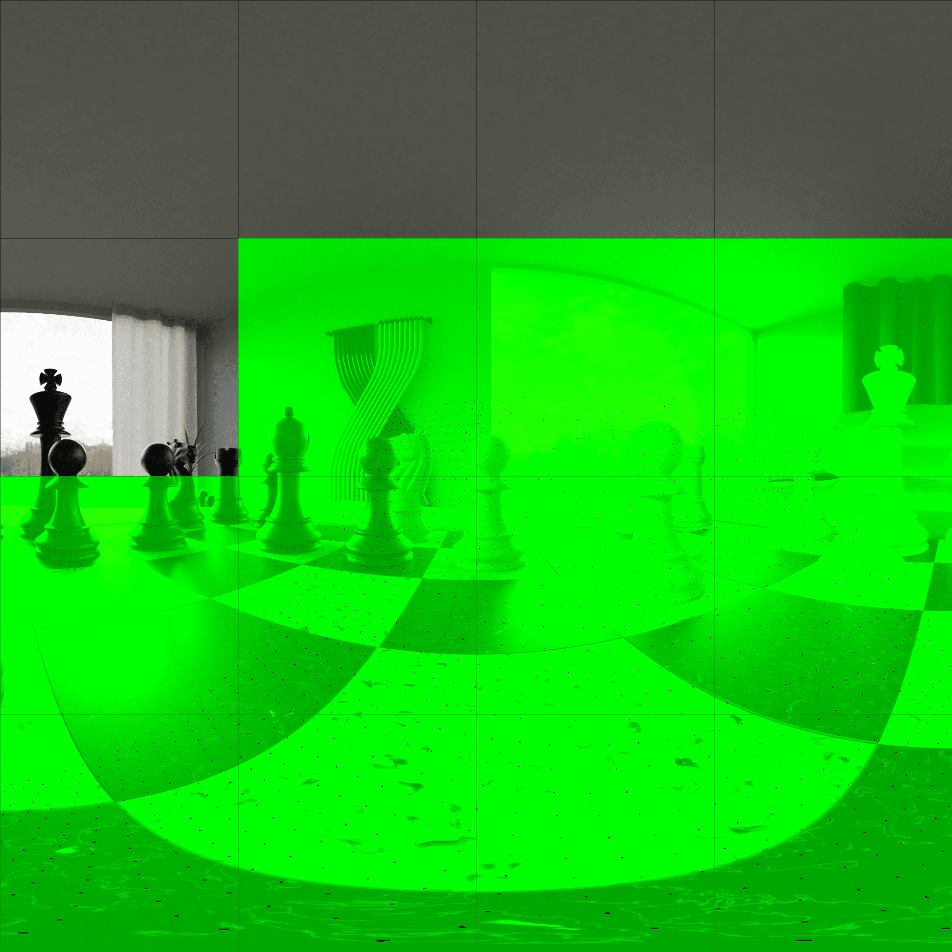
Appendix (-Cont’d)
CG1-N, position at v1, (x, y, z, yaw, pitch, roll) = (-0.20000000298023224, -0.5, 1.0, -0.0, -0.0, 0.0)
Pose trace Np02, (x, y, z, yaw, pitch, roll) = (-0.25,0.0,0.0,-20.200002725009400, 29.99999741973150, -8.79232615657642E-09)
viewport
v1

