Slide 2

Motion to Photon Latency
2020. 04. 20. ~ 04. 24.
Hyun Kyoon Lim, PhD,
Principal Research Scientist/Professor
Center for Medical Metrology /
Korea Research Institute of Standards and Science
Department of Medical Physics/
University of Science and Technology
IEEE p3079

Slide 3
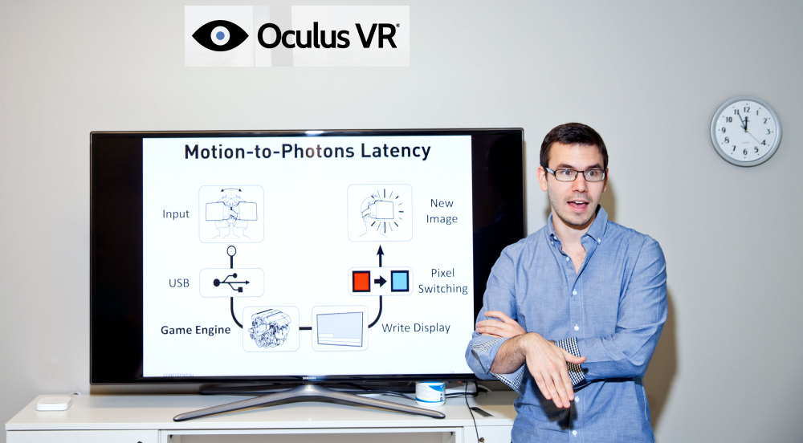

Slide 4

Head Rotation →
Sensing (degree) →
Computer →
Calculation →
Display →
Eyes
0-90 degrees

Slide 5
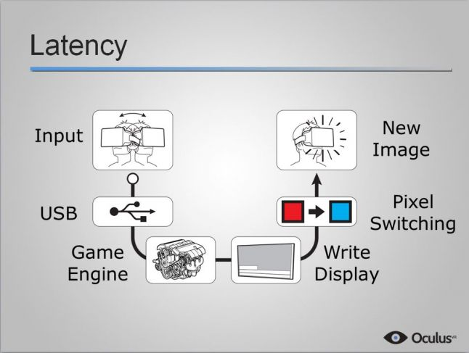

Slide 6
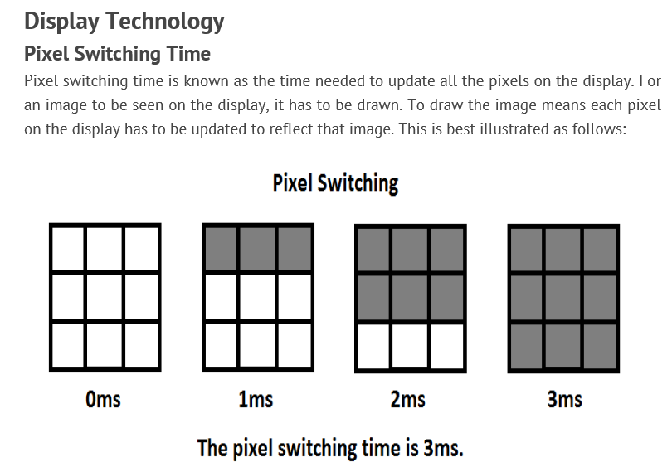
http://www.chioka.in/what-is-motion-to-photon-latency/

Slide 7
What is Motion to Photon(MTP) Latency?
VR System
Total Motion-to-Photon Latency = ① + ② + ③ + ④ + ⑤ + ⑥ + ⑦
≤ 20ms (if more than 20ms it can make VR sickness)
HMD
Motion
Input
New Image
Output
①
1ms
⑦
Pixel
Switching
1ms
IMU
90Hz OLED Display 11ms
⑥
②
Write Display
⑤
Local Content Server
Data Processing Unit
2ms
Remote Content Server
③
④
Data Processing Unit
2ms

Slide 8
How about Refresh Rate?
The refresh rate is the frequency the display fetches a new image to be drawn from the graphics card, which determines how long the latency to wait between each image.
The latency of 60 Hz display:
1000 / 60 = 16.67 ms.
This means even if the image takes zero latency to be drawn at the graphics card, and have zero pixel switching time, the image can only be updated as fast as 1 image every 16.67 ms.
The latency of 120 Hz will be 8.33 ms.
http://www.chioka.in/what-is-motion-to-photon-latency/

Slide 9
For example, an HMD with the display rate (=refresh rate) of 90 Hz:
1000/90 = 11.11 ms
11.11 ms
1000 ms

Slide 10
Quiz: If a man rotated his head for a certain angle taking 10 ms, then how long does the man wait for the next scene? If the innate MTP latency of the system is 20 ms.
What would be the “Total MTP latency” of this case?
10.0 ms
(1) 10 + 20 = 30 ms
(2) 10 + 10 + 20 = 40 ms
(3) Nobody knows
When and where CPU stops and calculate?

Slide 11
Previous studies | Measurement Equipment | Results
Choi et al., 2016 | Photosensor Oculus Rift DK2 | Rotation angle에 따라 latency에 차이(예 90도: 51.83 ms) 확인 및 측정 시스템 제안
Zhao et al., 2017 | Photosensor Rotary potentiometer Oculus Rift DK2 | rotational and translational Motion-to-Photon latencies 모두를 측정하는 방법 제시
Seo et al., 2017 | Photosensor Rotary encoder Oculus Rift DK2 | average latency 47.05 ms 381.17ms (increasing the rendering workload in the HMD) Photosensor-based latency measurement system 제안
Choi et al., 2018 | Photosensor Rotary encoder Oculus Rift DK2 | Minimum of 46.55 ms to a maximum of 154.63 ms according to the workload levels This paper proposes a novel system to measure and visualize the time sequential motion-to-photon latency in real time for HMDs
Xun et al., 2019 | Photosensor HTC VIVE | We propose an automated and universal HMD latency measurement system average latency 22.58 ms

Slide 12
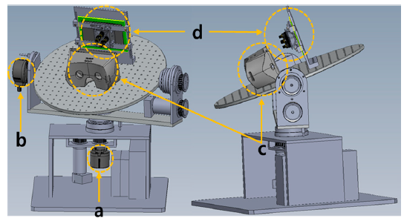
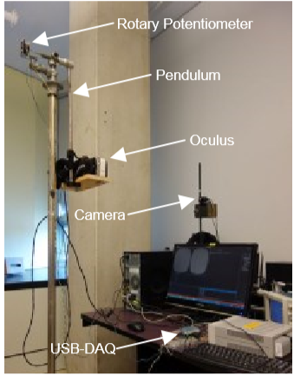
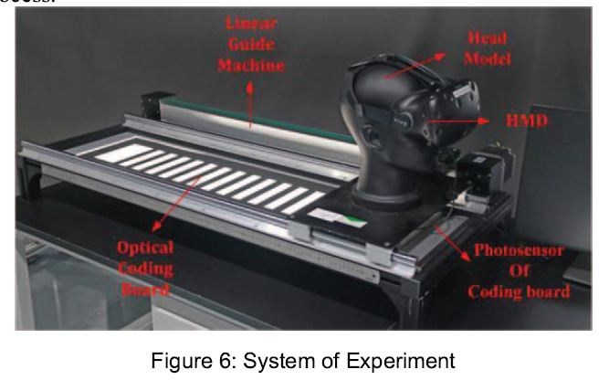
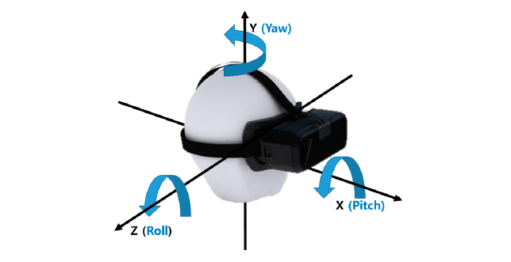
Proposed MTP measurement systems
Xun et al., 2019
Seo et al., 2017
Zhao et al., 2017

Slide 13
Choi, S.; Seo, M.; Lee, S.; Park, J.; Oh, E.; Baek, J.; Kang, S. Head position model-based Latency Measurement System for Virtual Reality Head Mounted Display. SID 2016, 47, 1381–1384
Zhao, J.; Allison, R.S.; Vinnikov, M.; Jennings, S. Estimating the motion-to-photon latency in head mounted displays. In Proceedings of the 2017 IEEE Virtual Reality (VR), Los Angeles, CA, USA, 18–22 March 2017; pp. 313–314.
Nin-Woo Seo.; Song-Woo Choi.; Sang-Lyn Lee.; Eui-Yeol Oh.; Jong-sang Baek. Photosensor-Based Latency Measurement System for Head-Mounted Displays. Sensor 2017, 17(5), 1112
Choi, Song-Woo & Lee, Siyeong & Seo, Min-Woo & Kang, Suk-Ju. (2018). Time Sequential Motion-to-Photon Latency Measurement System for Virtual Reality Head-Mounted Displays. Electronics. 7. 171. 10.3390/electronics7090171.
Xun, Hang & Wang, Yongtian & Weng, Dongdong. (2019). New System to Measure Motion Motion-to-Photon Latency of Virtual Reality Head Mounted Display. 58-62. 10.1109/ISMAR-Adjunct.2019.00029.

Slide 14
Standardization of MTP Latency, What we need?
Reference Measurement #!:
Motion Input (IMU sensor) to New Image Output time measure (Prof. SJ Kang? Anyone?)
Decision #1: Contents Complexity Level
Decision #2: Display Type HMD type (Vive Pro, Oculus R)
Decision #3: Target MTP Latency Range
Decision #4: Human brain response (EEG), How many?
(MSSQ sensitive 20, Non-sensitive 20, male), Female?
Decision #5: What would be the criteria of the cyber sickness level? And the evidence?

Slide 15


Let’s see in detail !

Slide 16
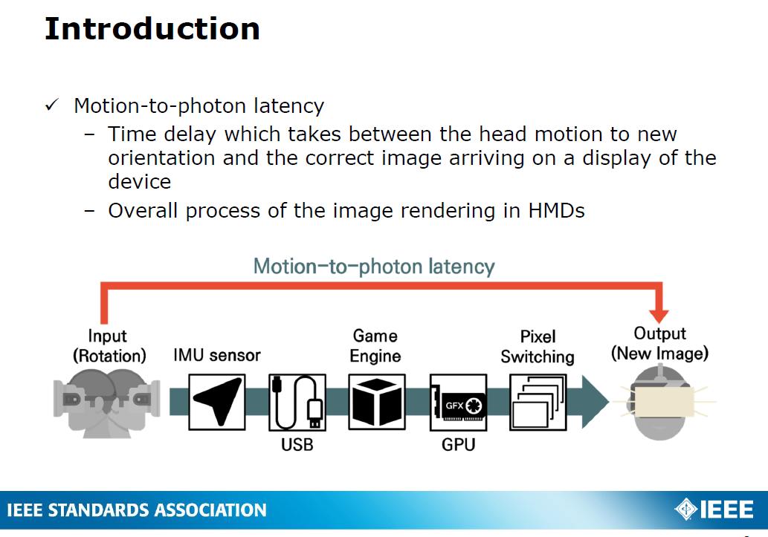
Reference Measurement #!:
Motion Input (IMU sensor) to New Image Output time measure (Prof. SJ Kang? Anyone?)
From Prof. Suk-JuKang’s Presentation (2017)

Slide 17
Can we trust the uncertainty of the IMU sensor ?
Do we have (get) a calibration report of the system?
Do we need to check the system?
(Any idea? Prof. Kang?)

Slide 18
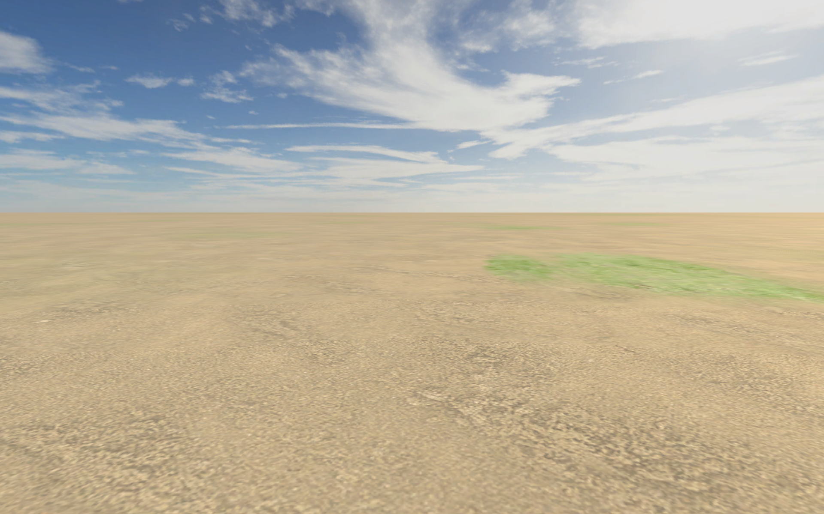
Decision #1: Contents Complexity Level
Field of view
Total Area: Horizontal vs. Vertical area
Pitch, Yaw, Roll, Zoom in & Out combination
Speed, Color, background,
Do we need to ask a participant to focus on an object?

Slide 19
Decision #2: Display Type HMD type (Vive Pro, Oculus R)
Now we have two system in KRISS lab. Do we need more?
Any idea?
Resolution: | 1440 x 1600 pixels per eye (2880 x 1600 pixels combined)
Field of view: | 110 degrees
Screen: | Dual AMOLED 3.5" diagonal
Refresh rate: | 90 Hz
Audio: | Hi-Res certificate headset Hi-Res certificate headphones (removable) High impedance headphones support

Slide 20
 | Oculus Rift S | Oculus Rift
Resolution | 2560×1440 (1280×1440 per eye) | 2160×1200 (1080×1200 per eye)
Field of view: | 115 degrees | 110 degrees
Pixel Density | Approx. 600ppi | 456ppi
Screen Type | LCD | Pentile AMOLED
Refresh Rate | 80Hz | 90Hz

Slide 21
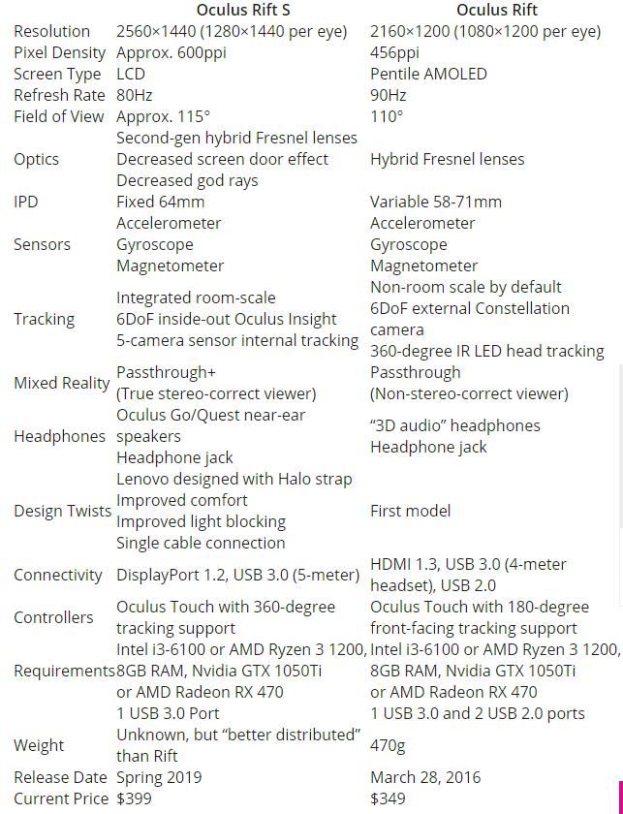

Slide 22
Decision #3: Target MTP Latency Range
John insisted that MTP latency is less than 20ms to apply to the HMD product.
5
ms
10 ms
15 ms
20 ms
30 ms

Slide 23
Decision #4: Human brain response (EEG), How many?
(MSSQ sensitive 20, Non-sensitive 20, male), Female?
How many do we need to prove the significant difference?
Male vs. female?
Young and old?
Sensitive vs. non-sensitive?
Experienced vs. novice?

Slide 24
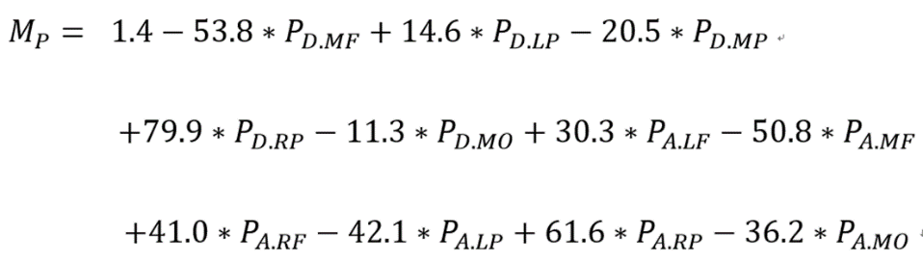
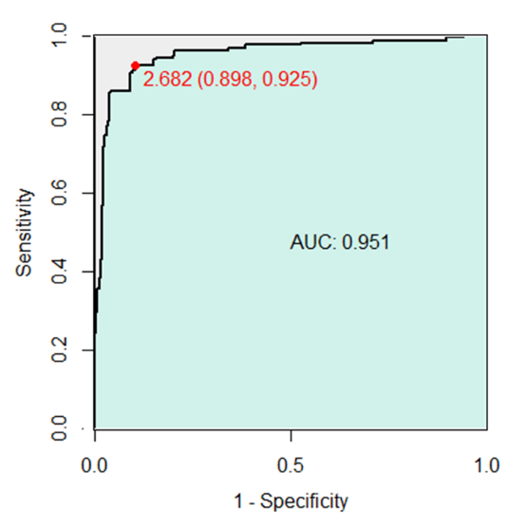
Decision #5: What would be the criteria of the cyber sickness level? And the evidence?
P_{D.MF} , Delta power in the middle frontal lobe;
P_{D.LP} , Delta power in the left parietal lobe;
P_{D.MP} , Delta power in the middle parietal lobe;
P_{D.RP} , Delta power in the right parietal lobe;
P_{D.MO} , Delta power in the middle occipital lobe;
P_{A.LF} , Alpha power in left frontal lobe;
P_{A.MF} , Alpha power in the middle frontal lobe;
P_{A.RF} , Alpha power in the right frontal lobe;
P_{A.LP} , Alpha power in the left parietal lobe;
P_{A.RP} , Alpha power in the right parietal lobe;
P_{A.MO} , Alpha power in the middle occipital lobe

Slide 25
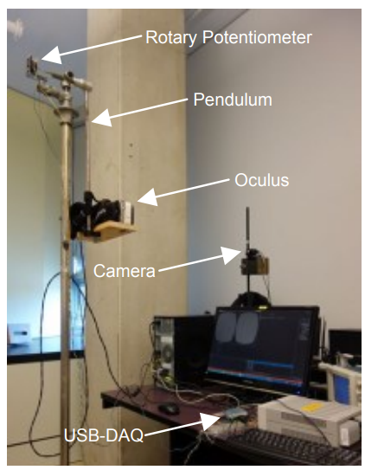
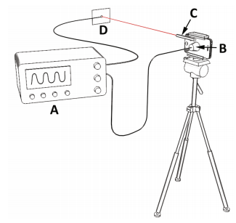
How to measure MTP Latency?
MTP can be measured by using Pendulum, Osilloscope

Slide 26
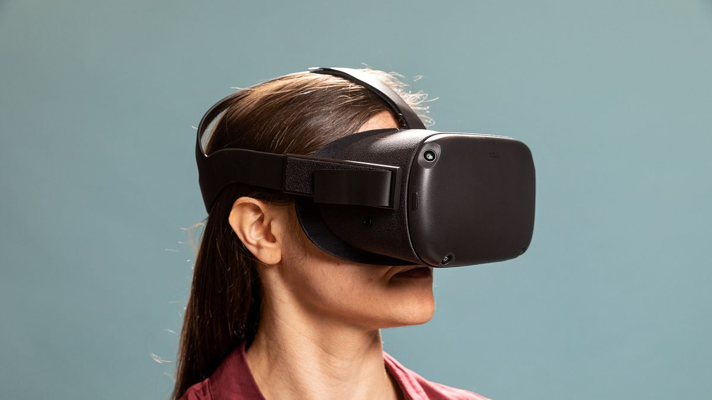
Latency Control system using Unity 3D
매 프레임마다 현재 Head Position을 저장한다.
현재 시점보다 이전에 저장된 Head Position에서 보여지는 View를 사용자에게 보여준다. 즉, 피험자가 고개를 움직여 이동된 지점을 바라보려 하여도 이는 약간의 Delay를 가지고 피험자에게 Display 된다.
위와 같은 Delay를 조절하여 피험자에게 MTP Latency에 변화를 주며, 이는 VR Sickness를 유도할 것으로 예상된다.

Slide 27
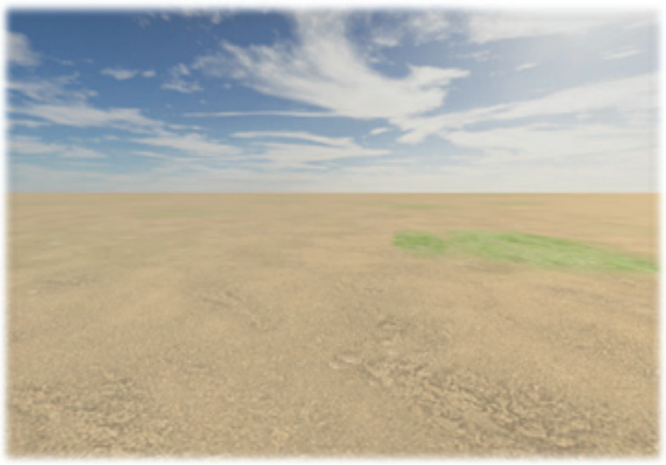


Task for MTP Latency based VR Sickness
피험자는 가능한 일정한 속도로 VR 환경에서 양쪽에 있는 마커를 반복해서 바라본다.
이동 속도를 조절하기 위해 매트로놈과 같은 소리 큐 또는 시간 표시 등과 같은 알림이 표시된다.
피험자는 앞서 설명한 Delay가 서로 다른 5개의 세션에 참여하여 각 세션당 200회의 마커 응시하기 과제를 수행한다.
피험자는 과제의 수행 도중 뇌파 Recording을 진행하며, 각 세션마다 멀미 측정 설문을 진행한다.

Slide 28
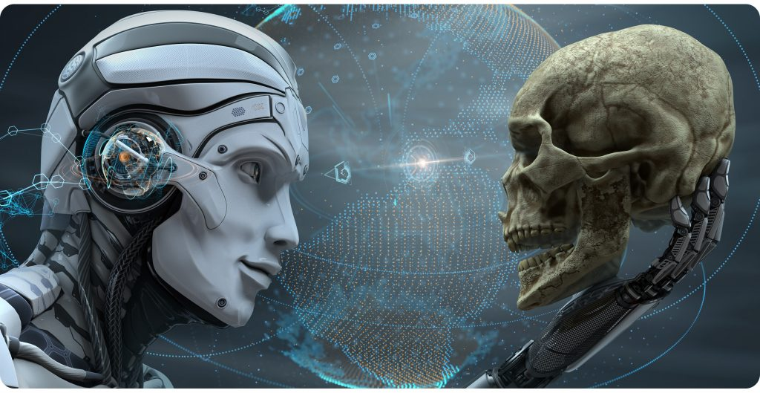
Thank you for your attention
hlim@kriss.re.kr / 010-4741-7343

