Slide 1
[IEEE P3079 Session #14 WG Closing Plenary]
[Sangkwon Peter Jeong / JoyFun]

Slide 2
Compliance with IEEE Standards Policies and Procedures
Subclause 5.2.1 of the IEEE-SA Standards Board Bylaws states, "While participating in IEEE standards development activities, all participants...shall act in accordance with all applicable laws (nation-based and international), the IEEE Code of Ethics, and with IEEE Standards policies and procedures."
The contributor acknowledges and accepts that this contribution is subject to
The IEEE Standards copyright policy as stated in the IEEE-SA Standards Board Bylaws, section 7, http://standards.ieee.org/develop/policies/bylaws/sect6-7.html#7, and the IEEE-SA Standards Board Operations Manual, section 6.1, http://standards.ieee.org/develop/policies/opman/sect6.html
The IEEE Standards patent policy as stated in the IEEE-SA Standards Board Bylaws, section 6, http://standards.ieee.org/guides/bylaws/sect6-7.html#6, and the IEEE-SA Standards Board Operations Manual, section 6.3, http://standards.ieee.org/develop/policies/opman/sect6.html

Slide 3
IEEE 3079 HMD Based VR Sickness Reducing Technology Dongil Dillon Seo, dillon@volercreative
IEEE 3079 Session #14 WG Closing Plenary
Date: 2020-04-23
Author(s):
Name | Affiliation | Phone [optional] | Email [optional]
Jeong, Sangkwon Peter | JoyFun | +82 10 8667 7329 | ceo@joyfun.kr

Slide 4
Session Time and Location
 | Monday (April 20, 2020) | Tuesday (April 21, 2020) | Wednesday (April 22, 2020) | Thursday (April 23, 2020) | Friday (April 24, 2020)
AM 1 9:00-10:30a
AM 2 11:00-12:30 | Open Plenary Roll Call Reviewing last meeting minutes (Introducing participants) | WG Meeting (Topic: edit to MEC) | MTP Latency IG Meeting (Context & Scope for Draft document) | MTP Latency IG Meeting (Context & Scope for Draft document) | WG Closing Plenary
PM 1 1:30 – 3:00p | WG Meeting (Topic: 3079.1 PAR submit 3079.2 PAR submit ) | WG Meeting (Topic: Status for Sponsor Ballot) | MR Standard Framework for Motion Learning (Context & Scope for Draft document) | MR Standard Framework for Motion Learning (Standardization Schedule for 3079.2)
PM 2 3:30 – 5:00p
※ Location
Video Conference by Zoom (Operate by Dillon)

Slide 5
WG Motions

Slide 6
WG Motion #1
Move to approve the document ‘3079-20-0019-00-0000-Session-14-Agenda’
Move: Sangkwon Peter Jeong
Second: Beom-Ryeol Lee
For Agree: 04
Against: 00
Abstain: 00
Motion Passes

Slide 7
WG Motion #2
Move to approve the Meeting minutes ‘3079-20-0009-00-0000-Session-13-WG-Meetingminutes’
Move: Sangkwon Peter Jeong
Second: Hyun Kyoon Lim
For Agree: 04
Against: 00
Abstain: 00
Motion Passes

Slide 8
WG Motion #3
Move to approve the document ‘Human Factor for Immersive Content WG P&P’
Move: Sangkwon Peter Jeong
Second: Suk-Ju Kang
For Agree: 08
Against: 00
Abstain: 00
Motion Passes

Slide 9
WG Motion #4
Move to approve the ‘3079-20-0020-00-0000-IEEE-P3079-2020-04-20-kriss-ver20’’
Move: Hyun Kyoon Lim
Second: Dong Soo Choi
For Agree: 08
Against: 00
Abstain: 00
Motion Passes

Slide 10
WG Motion #5
Move to approve the ‘3079-20-0023-00-0000-Introduction to the Mixed Reality Standard Framework’
Move: Sangkwon Peter Jeong
Second: Suk-Ju Kang
For Agree: 08
Against: 00
Abstain: 00
Motion Passes

Slide 11
WG Motion #6
Move to approve the ‘3079-20-0024-00-0000-Introduction-to-the-motion-to-photon-latency-study-design’
Move: Hyun Kyoon Lim
Second: Dong Soo Choi
For Agree: 06
Against: 00
Abstain: 00
Motion Passes

Slide 12
WG Motion #7
Move to approve the ‘3079-20-0025-02-1000-Standardization schedule for P3079.2’
Move: Sangkwon Peter Jeong
Second: Hyun Kyoon Lim
For Agree: 06
Against: 00
Abstain: 00
Motion Passes

Slide 13
WG Motion #8
Move to approve the ‘3079-20-0018-01-0000-IEEE 3079.2_Mixed Reality Standard Framework for Motion Learning_CSABSCcomments’
Move: Sangkwon Peter Jeong
Second: Hyun Kyoon Lim
For Agree: 06
Against: 00
Abstain: 00
Motion Passes

Slide 14
WG Motion #9
Move to approve the ‘IEEE-P3079-D01-STD-R08’
Move: Beom-Ryeol Lee
Second: Sangkwon Peter Jeong
For Agree: 05
Against: 00
Abstain: 00
Motion Passes

Slide 15
Attendees
Seo, Dong Il Dillon | DTCP
Sangkwon Peter Jeong | JoyFun Inc.,
Beom-Ryeol Lee | ETRI
Hyun Kyoon Lim | KRISS
Dong Soo Choi | Dong-A University
Choi, Changjoon | Tiny Powers
Choi, Jae Boo | Tiny Powers
Kang SukJu | Sogang University
Hyunwoo Nam | Dongduk Women’s University
Ye-Shin Woo | Korea Research Institute of Standards and Science/Yonsei University
Sungu Nam | KAIST

Slide 16
Future Sessions – 2020
July 6-10, 2020, KRISS Office, 267 Gajeong-ro, Yuseong-gu, Daejeon, Republic of Korea
October 19-23, 2020, ETRI Office, Busan Cultural Content Complex, Busan, Republic of Korea

Slide 17
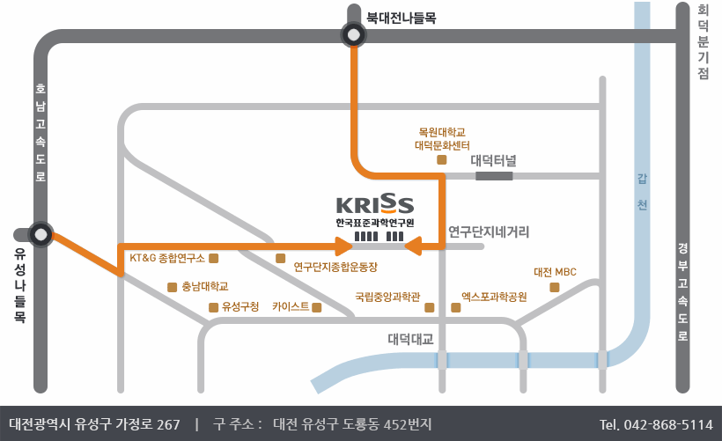
Information of next meeting
WG Documents:
https://mentor.ieee.org/3079/documents
Food and Beverages:
Morning Coffee break: 10:30AM-11:00AM
Lunch Time: 12:30PM –1:30PM
Afternoon Coffee break: 3:00PM-3:30PM
Registration:
Location: 267 Gajeong-ro, Yuseong-gu, Daejeon

Slide 18
Work item for next meeting
Comment received and Resolution by result of the 1st Sponsor Ballot of the P3079 draft document
Restructuring the IEEE 3079 WG
7 TGs -> 2 TGs
Standardization for IEEE 3079.1
Standardization for IEEE 3079.2

Slide 19
Session Time and Location
 | Monday (July 06, 2020) | Tuesday (July 07, 2020) | Wednesday (July 08, 2020) | Thursday (July 09, 2020) | Friday (July 10, 2020)
AM-1 9:00-10:30a
AM-2 11:00a-12:30p | Open Plenary Roll Call Reviewing last meeting minutes (Introducing participants) | WG Meeting | 3079.1 TG | 3079.1 TG | WG Closing Plenary
PM-1 1:30 – 3:00p | WG Meeting | WG Meeting | 3079.2 TG | 3079.2 TG
PM-2 3:30 – 5:00p
※ Location
KRISS Office, 267 Gajeong-ro, Yuseong-gu, Daejeon, Republic of Korea

Slide 20
Thank You

