Slide 1
[Introduction to the Mixed Reality Standard Framework]
[Sangkwon Peter Jeong / JoyFun]

Slide 2
Compliance with
IEEE Standards Policies and Procedures
Subclause 5.2.1 of the IEEE-SA Standards Board Bylaws states, "While participating in IEEE standards development activities, all participants...shall act in accordance with all applicable laws (nation-based and international), the IEEE Code of Ethics, and with IEEE Standards policies and procedures."
The contributor acknowledges and accepts that this contribution is subject to
The IEEE Standards copyright policy as stated in the IEEE-SA Standards Board Bylaws, section 7, http://standards.ieee.org/develop/policies/bylaws/sect6-7.html#7, and the IEEE-SA Standards Board Operations Manual, section 6.1, http://standards.ieee.org/develop/policies/opman/sect6.html
The IEEE Standards patent policy as stated in the IEEE-SA Standards Board Bylaws, section 6, http://standards.ieee.org/guides/bylaws/sect6-7.html#6, and the IEEE-SA Standards Board Operations Manual, section 6.3, http://standards.ieee.org/develop/policies/opman/sect6.html

Slide 3
IEEE 3079
HMD Based VR Sickness Reducing Technology
Dongil Dillon Seo, dillon.seo@telekom-capital.com
Introduction to the Mixed Reality Standard Framework
Date: 2020-04-21
Author(s): Jeong, Sangkwon Peter
Name | Affiliation | Phone | Email
Jeong, Sangkwon Peter | JoyFun | +82 10 8667 7329 | ceo@joyfun.kr

Slide 4
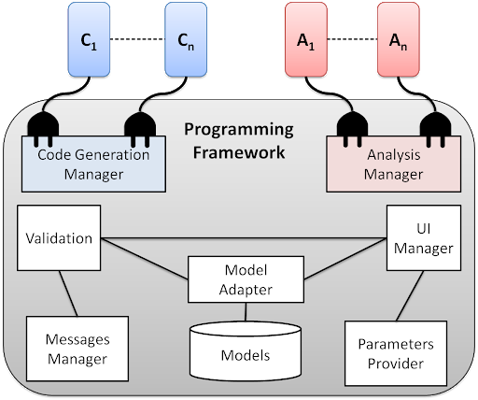
Concept of Framework
The definition of a ‘framework’ is to provide elements and rules to make a program easy.
<Programming Framework>
※ source: Department of Engineering and Computer Science and Mathematics
URL: http://a4wsn.di.univaq.it/programming.html

Slide 5
Mixed Reality Standard Framework for Motion Learning
Reference’s Motion
Verification System
User’s Motion
Motion Data Input
Analysis Manager
Motion Data Input
Terms & Definition
Generation of Skeleton Info.
Compare & Judgment
Generation of Skeleton Info.
Unity 3D or Unreal
Generation of Reference Character
Validation
UI Manager
Model Adopter
Projection Controller
Messages Manager
: Framework

Slide 6
Conclusion
Scope of the proposed standard:
This standard defines a framework for mixed reality content aimed at effectively motion learning . This standard includes definition for motion sensing and guiding for reference motion learning. Definitions of terms, requirements and data formats for input and output processes and application programming interfaces used for implementation of the content.
Notes:
이 표준은 동작의 학습 효과를 높이기 위한 목적으로 혼합현실 콘텐츠의 표준 프레임워크를 제공하기 위한 것이다. 이 표준의 범위는 동작인식 센서가 사람의 동작을 추적하기 위해 사용하는 좌표계와 동작을 가이드하기 위해 표현되는 좌표계의 동기화를 포함한다. 또한, 콘텐츠의 원활한 구현을 위하여 사용되는 입출력 프로세스와 응용 프로그래밍 인터페이스뿐만 아니라 어휘, 요구 사항, 데이터 형식을 포함한다.

Slide 7
Thank You

