Slide 1
Video Quality Assessment Methods Performance Comparison for 3DoF+
Presenter: Jong-Beom Jeong (uof4949@skku.edu)
Jong-Beom Jeong, Soonbin Lee, Inae Kim, Il-Woong Ryu, Sungbin Kim, Eun-Seok Ryu
Multimedia Computing Systems Lab. (MCSL)
http://mcsl.skku.edu
Department of Computer Education
Sungkyunkwan University

Slide 2
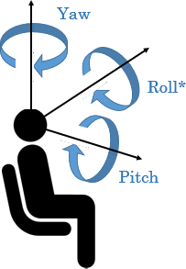
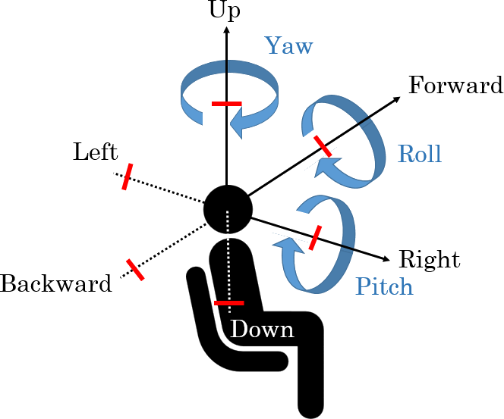
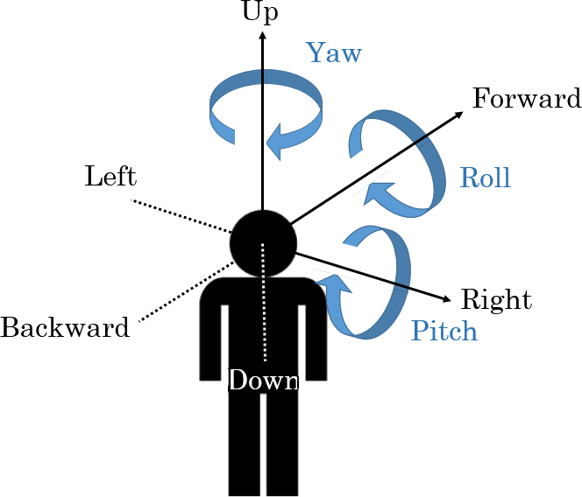
Virtual Reality in MPEG-I
Three phases of ISO/IEC MPEG-Immersive VR standardization
  To support the entire movement in VR, 6DoF is required
  6DoF media support will be completed by 2022
  3DoF+ standard will be established by 2020 to support the limited 6DoF
Step 1
Step 2
Step 3
Yaw
Up
Up
Yaw
Forward
Yaw
Forward
Roll
Left
Roll
Roll
Left
Pitch
Backward
Right
Backward
Right
Pitch
Pitch
Down
Down
Complete 3DoF standard by 2017
Rotate head in a fixed state
360 video full streaming by default
Tiled streaming if possible
Enable VR commercial servicers by 2020
Allow head rotation and movement within a restricted area
User-to-user conversations and projection optimization
Support 6DoF by 2022
6DoF video will reflect user’s walking motion
Support interaction with virtual environments
3079-20-0027-00-0002

Slide 3
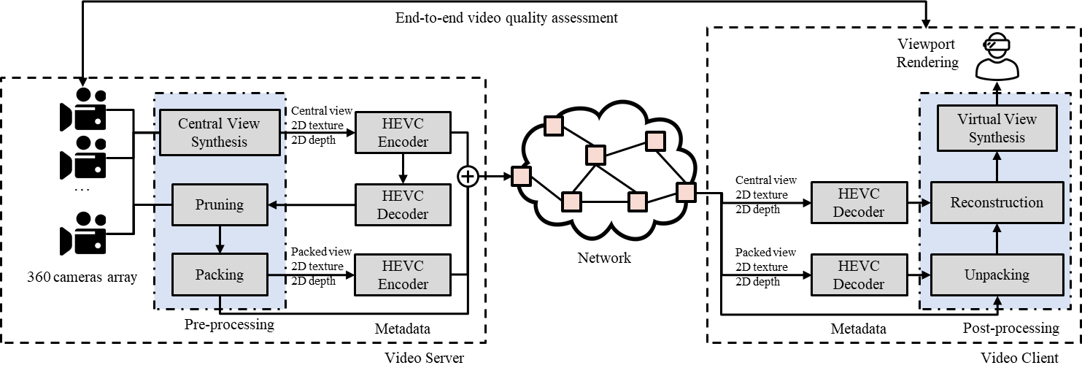
Virtual Reality in MPEG-I (Cont’d)
Background
  General framework for 3DoF+ S/W
  Uses HEVC (not MV-HEVC) and additional metadata
  End-to-end video quality assessment is conducted
Block diagram for 3DoF+ S/W platform
Source: Jong-Beom Jeong, Soonbin Lee, Dongmin Jang, Eun-Seok Ryu. “Towards 3DoF+ 360 Video Streaming System for Immersive Media” IEEE Access, vol. 7, pp. 136399-136408, 2019
3079-20-0027-00-0002

Slide 4
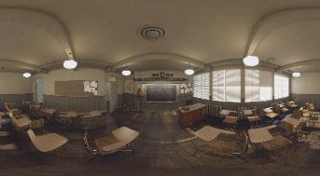
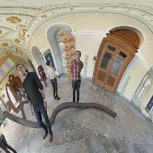
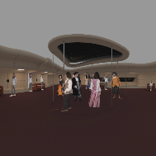

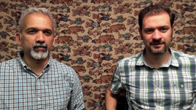
Virtual Reality in MPEG-I (Cont’d)
Background
  3DoF+ video has multiple views, including texture + depth
  Based on the views, viewport of an user is generated
ClassroomVideo
TechnicolorMuseum
TechnicolorHijack
TechnicolorPainter
IntelKermit
Sequence | Class | Resolution | No. of views | Frame count | Frame rate | Source FoV
ClassroomVideo | A | 4096x2048 | 15 | 120 | 30 | 360º x 180º
TechnicolorMuseum | B | 2048x2048 | 24 | 300 | 30 | 180º x 180º
TechnicolorHijack | C | 4096x4096 | 10 | 300 | 30 | 180º x 180º
TechnicolorPainter | D | 2048x1088 | 16 | 300 | 30 | 46º x 25º
IntelKermit | E | 1920x1080 | 13 | 300 | 30 | 77.8º x 77.8º
3079-20-0027-00-0002

Slide 5
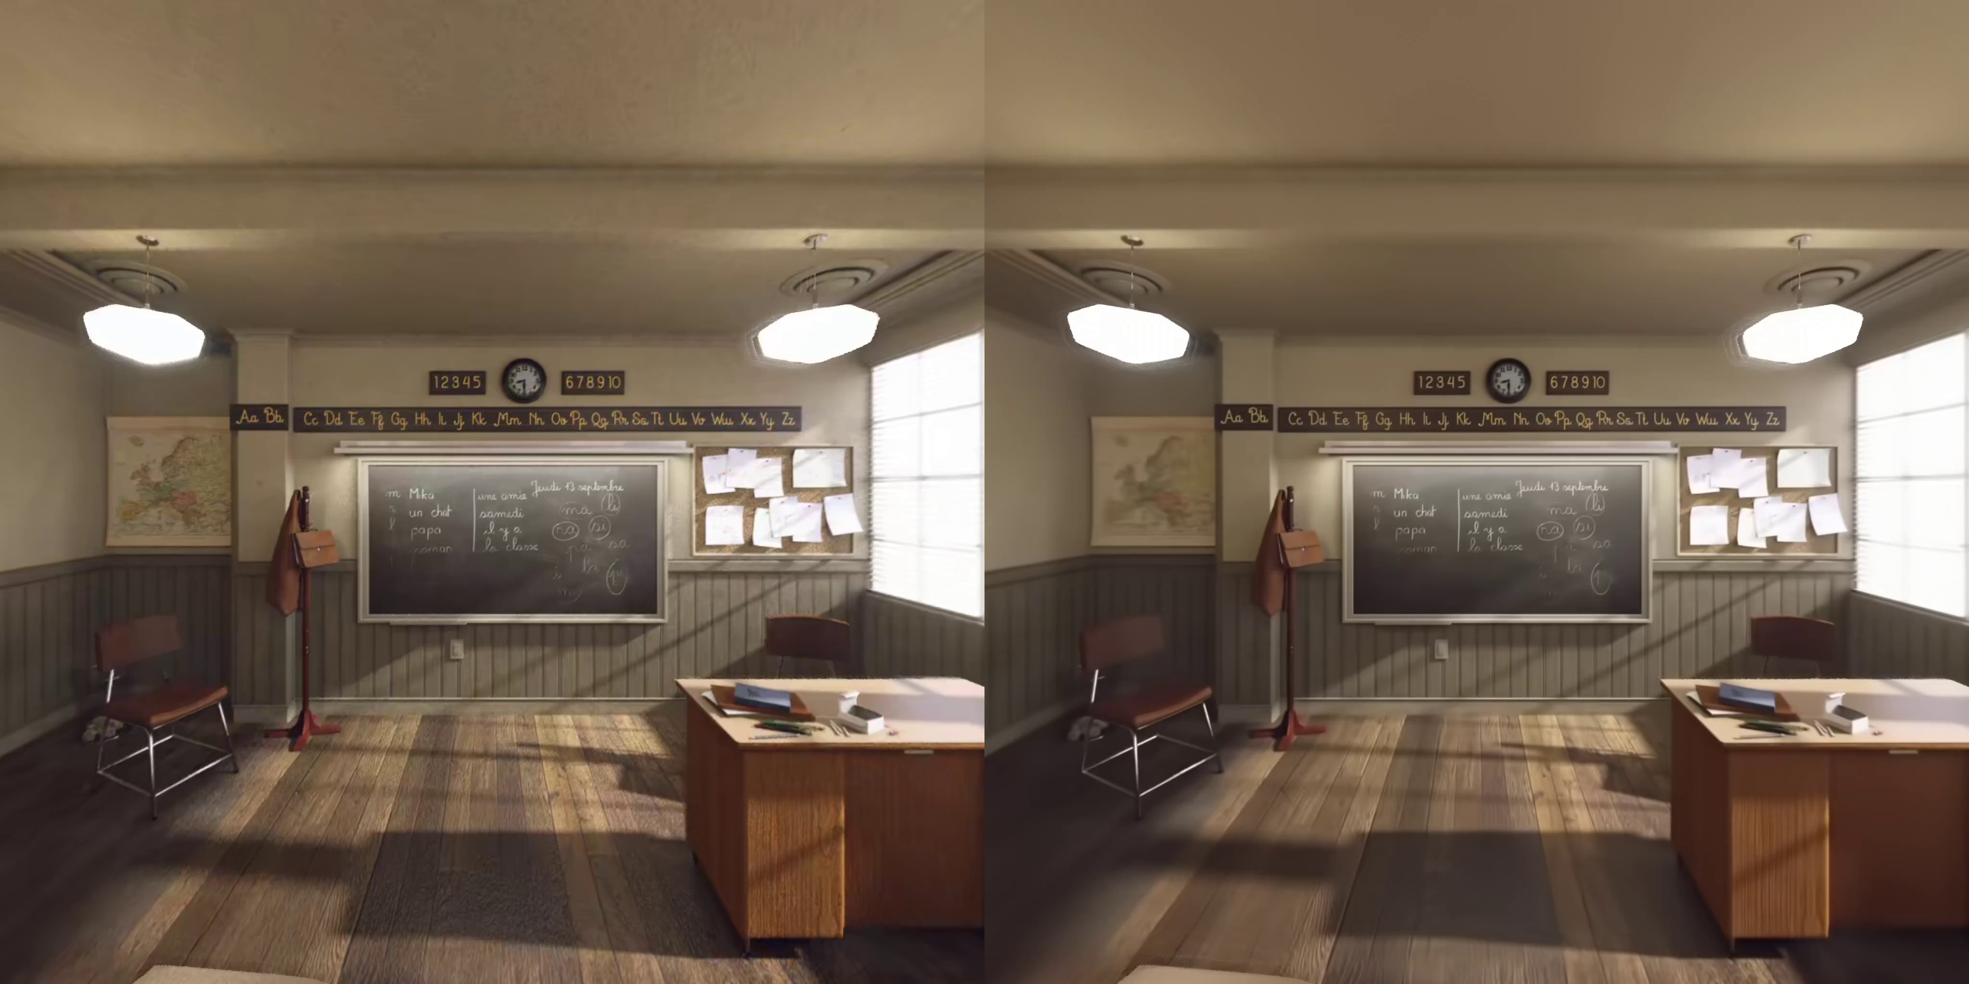
Virtual Reality in MPEG-I (Cont’d)
Limitation
  In some cases, PSNR (traditional quality metric) does not reflect the user’s QoE
  Unlike traditional codec, 3DoF+ shows different types of artifacts
  -> Need to find a better quality metric
MCSL (proposed)
PSNR: 39.46 dB
HEVC (anchor)
PSNR: 40.18 dB
Difference between objective and subjective quality in 3DoF+ 360 video viewport rendering
3079-20-0027-00-0002

Slide 6
Objective Quality Metrics for Immersive Video
Background
  Immersive video shows different types of artifacts
  For evaluation, common test conditions for immersive video defines the quality metrics
Purpose
  Evaluate the 3DoF+ system SW (test model for immersive video (TMIV)) to:
    Provide the viewport which satisfies the user’s quality of experience (QoE)
Metric name | Document No. | Location | Tag/branch
WS-PSNR | w18069 | https://gitlab.com/mpeg-i-visual/wspsnr | v2.0.1
VMAF | - | https://github.com/Netflix/vmaf | v1.3.14
MS-SSIM | - | https://github.com/Netflix/vmaf | v1.3.14
VIF | - | https://github.com/Netflix/vmaf | v1.3.14
IV-PSNR | w18709 | https://gitlab.com/mpeg-i-visual/ivpsnr | v1.0
Objective quality metrics for immersive video
3079-20-0027-00-0002

Slide 7
Test Conditions
Test Materials
  Followed common test conditions (CTC) of MPEG-I
  5 test sequences(class A, B, C, D, E) were encoded
  For subjective data, used 3DoF+ CfR results including mean opinion score (MOS)
Environment
  Versions of softwares meet the requirements of 3DoF+ CfP
  OpenCV 3.4.2 was used to build reference view synthesizer (RVS) v3.1
3079-20-0027-00-0002

Slide 8
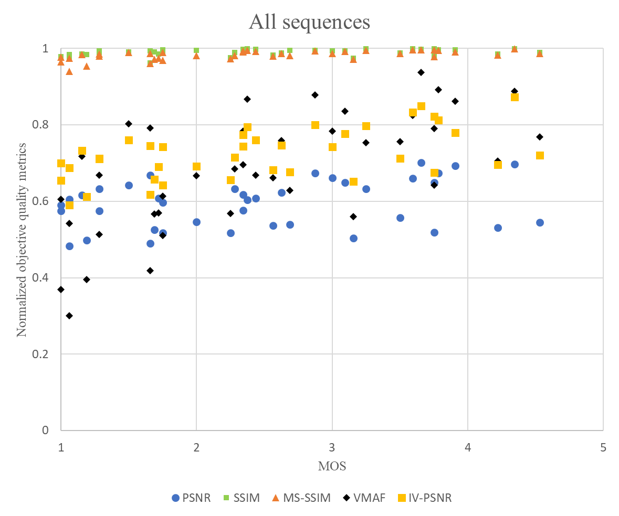
Experimental Results
VMAF showed the best correlation coefficient with MOS
PSNR showed the worst results among the metrics
Metric name | Correlation coefficient with MOS
PSNR | 0.3012
SSIM | 0.3932
MS-SSIM | 0.5694
VMAF | 0.6601
IV-PSNR | 0.5539
Correlation coefficient
between MOS and objective quality metrics
Correlation between MOS and objective quality metrics
3079-20-0027-00-0002

Slide 9
Conclusion
Problem
  For state-of-the-art virtual reality system, quality metric is really important
  Subjective quality and traditional metric (e.g. PSNR) shows low correlation
Proposed Methods and Insights
  Quality metrics of MPEG-I were analyzed with 3DoF+ subjective quality data
  Traditional metric (e.g. PSNR) is not appropriate for 3DoF+
Future Work
  Human-familiar quality metric should be developed
3079-20-0027-00-0002

