Slide 1
Video Quality Assessment Methods Performance Comparison for 3DoF+
Presenter: Jong-Beom Jeong (uof4949@skku.edu)
Jong-Beom Jeong, Soonbin Lee, Inae Kim, Il-Woong Ryu, Sungbin Kim, Eun-Seok Ryu
Multimedia Computing Systems Lab. (MCSL)
http://mcsl.skku.edu
Department of Computer Education
Sungkyunkwan University

Slide 2
Compliance with
IEEE Standards Policies and Procedures
Subclause 5.2.1 of the IEEE-SA Standards Board Bylaws states, "While participating in IEEE standards development activities, all participants...shall act in accordance with all applicable laws (nation-based and international), the IEEE Code of Ethics, and with IEEE Standards policies and procedures."
The contributor acknowledges and accepts that this contribution is subject to
The IEEE Standards copyright policy as stated in the IEEE-SA Standards Board Bylaws, section 7, http://standards.ieee.org/develop/policies/bylaws/sect6-7.html#7, and the IEEE-SA Standards Board Operations Manual, section 6.1, http://standards.ieee.org/develop/policies/opman/sect6.html
The IEEE Standards patent policy as stated in the IEEE-SA Standards Board Bylaws, section 6, http://standards.ieee.org/guides/bylaws/sect6-7.html#6, and the IEEE-SA Standards Board Operations Manual, section 6.3, http://standards.ieee.org/develop/policies/opman/sect6.html
3079-20-0027-02-0002 Video Quality Assessment Methods Performance Comparison for 3DoF+

Slide 3
IEEE 3079
HMD Based VR Sickness Reducing Technology
Dongil Dillon Seo, dillon.seo@telekom-capital.com
Video Quality Assessment Methods Performance Comparison for 3DoF+
Date: 2020-07-09
Author(s): Jong-Beom Jeong, Soonbin Lee, Inae Kim, Il-Woong Ryu, Sungbin Kim, Eun-Seok Ryu
Name | Affiliation | Phone [optional] | Email [optional]
Jong-Beom Jeong | Sungkyunkwan Univ. |  | uof4949@skku.edu
Soonbin Lee | Sungkyunkwan Univ.
Inae Kim | Sungkyunkwan Univ.
Il-Woong Ryu | Gachon Univ.
Sungbin Kim | Sungkyunkwan Univ.
Eun-Seok Ryu | Sungkyunkwan Univ. |  | esryu@skku.edu
3079-20-0027-02-0002 Video Quality Assessment Methods Performance Comparison for 3DoF+

Slide 4
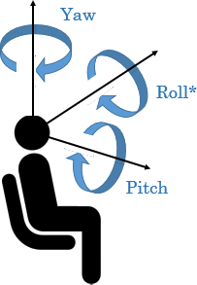
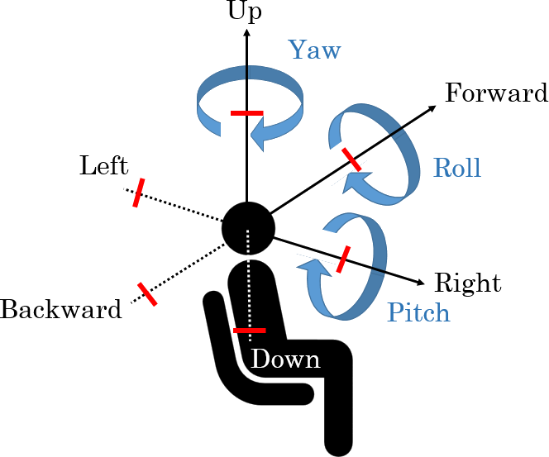
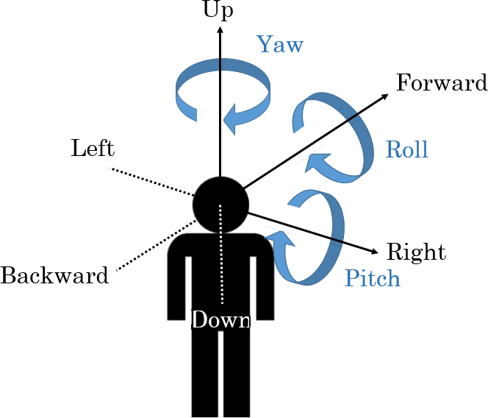
Virtual Reality in MPEG-I
Three phases of ISO/IEC MPEG-Immersive VR standardization
  To support the entire movement in VR, 6DoF is required
  6DoF media support will be completed by 2022
  3DoF+ standard will be established by 2020 to support the limited 6DoF
Step 1
Step 2
Step 3
Yaw
Up
Up
Yaw
Forward
Yaw
Forward
Roll
Left
Roll
Roll
Left
Pitch
Backward
Right
Backward
Right
Pitch
Pitch
Down
Down
Complete 3DoF standard by 2017
Rotate head in a fixed state
360 video full streaming by default
Tiled streaming if possible
Enable VR commercial servicers by 2020
Allow head rotation and movement within a restricted area
User-to-user conversations and projection optimization
Support 6DoF by 2022
6DoF video will reflect user’s walking motion
Support interaction with virtual environments
3079-20-0027-02-0002 Video Quality Assessment Methods Performance Comparison for 3DoF+

Slide 5
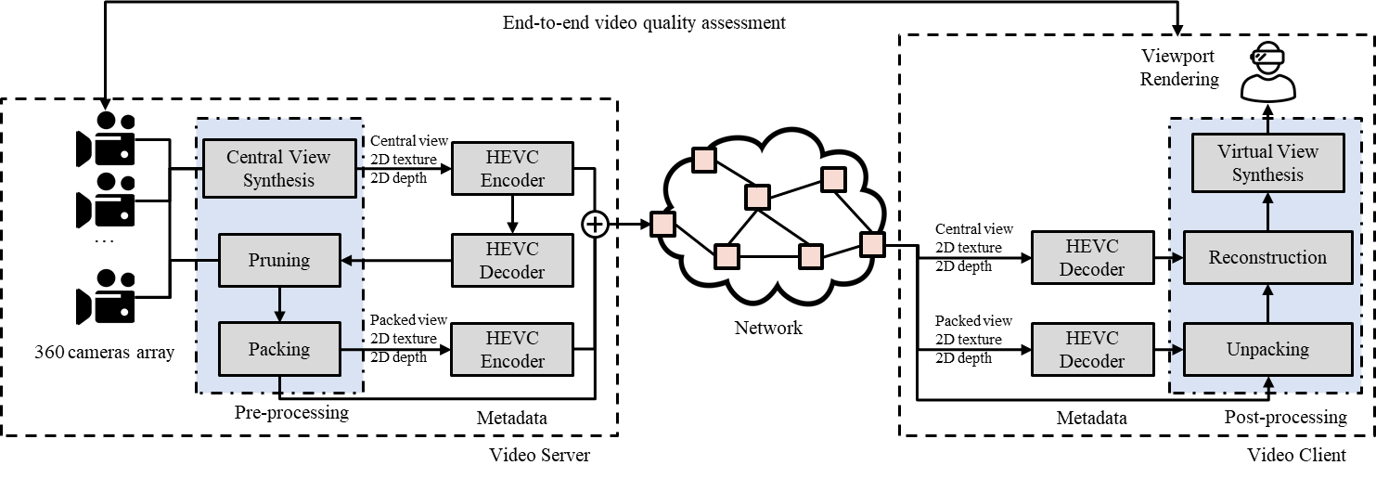
Virtual Reality in MPEG-I (Cont’d)
Background
  General framework for 3DoF+ S/W
  Uses HEVC (not MV-HEVC) and additional metadata
  End-to-end video quality assessment is conducted
Block diagram for 3DoF+ S/W platform
Source: Jong-Beom Jeong, Soonbin Lee, Dongmin Jang, Eun-Seok Ryu. “Towards 3DoF+ 360 Video Streaming System for Immersive Media” IEEE Access, vol. 7, pp. 136399-136408, 2019
3079-20-0027-02-0002 Video Quality Assessment Methods Performance Comparison for 3DoF+

Slide 6
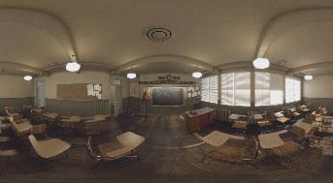
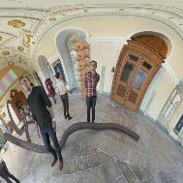
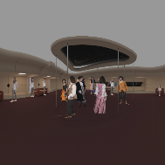

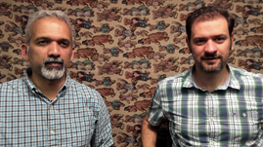
Virtual Reality in MPEG-I (Cont’d)
Background
  3DoF+ video has multiple views, including texture + depth
  Based on the views, viewport of an user is generated
ClassroomVideo
TechnicolorMuseum
TechnicolorHijack
TechnicolorPainter
IntelKermit
Sequence | Class | Resolution | No. of views | Frame count | Frame rate | Source FoV
ClassroomVideo | A | 4096x2048 | 15 | 120 | 30 | 360º x 180º
TechnicolorMuseum | B | 2048x2048 | 24 | 300 | 30 | 180º x 180º
TechnicolorHijack | C | 4096x4096 | 10 | 300 | 30 | 180º x 180º
TechnicolorPainter | D | 2048x1088 | 16 | 300 | 30 | 46º x 25º
IntelKermit | E | 1920x1080 | 13 | 300 | 30 | 77.8º x 77.8º
3079-20-0027-02-0002 Video Quality Assessment Methods Performance Comparison for 3DoF+

Slide 7
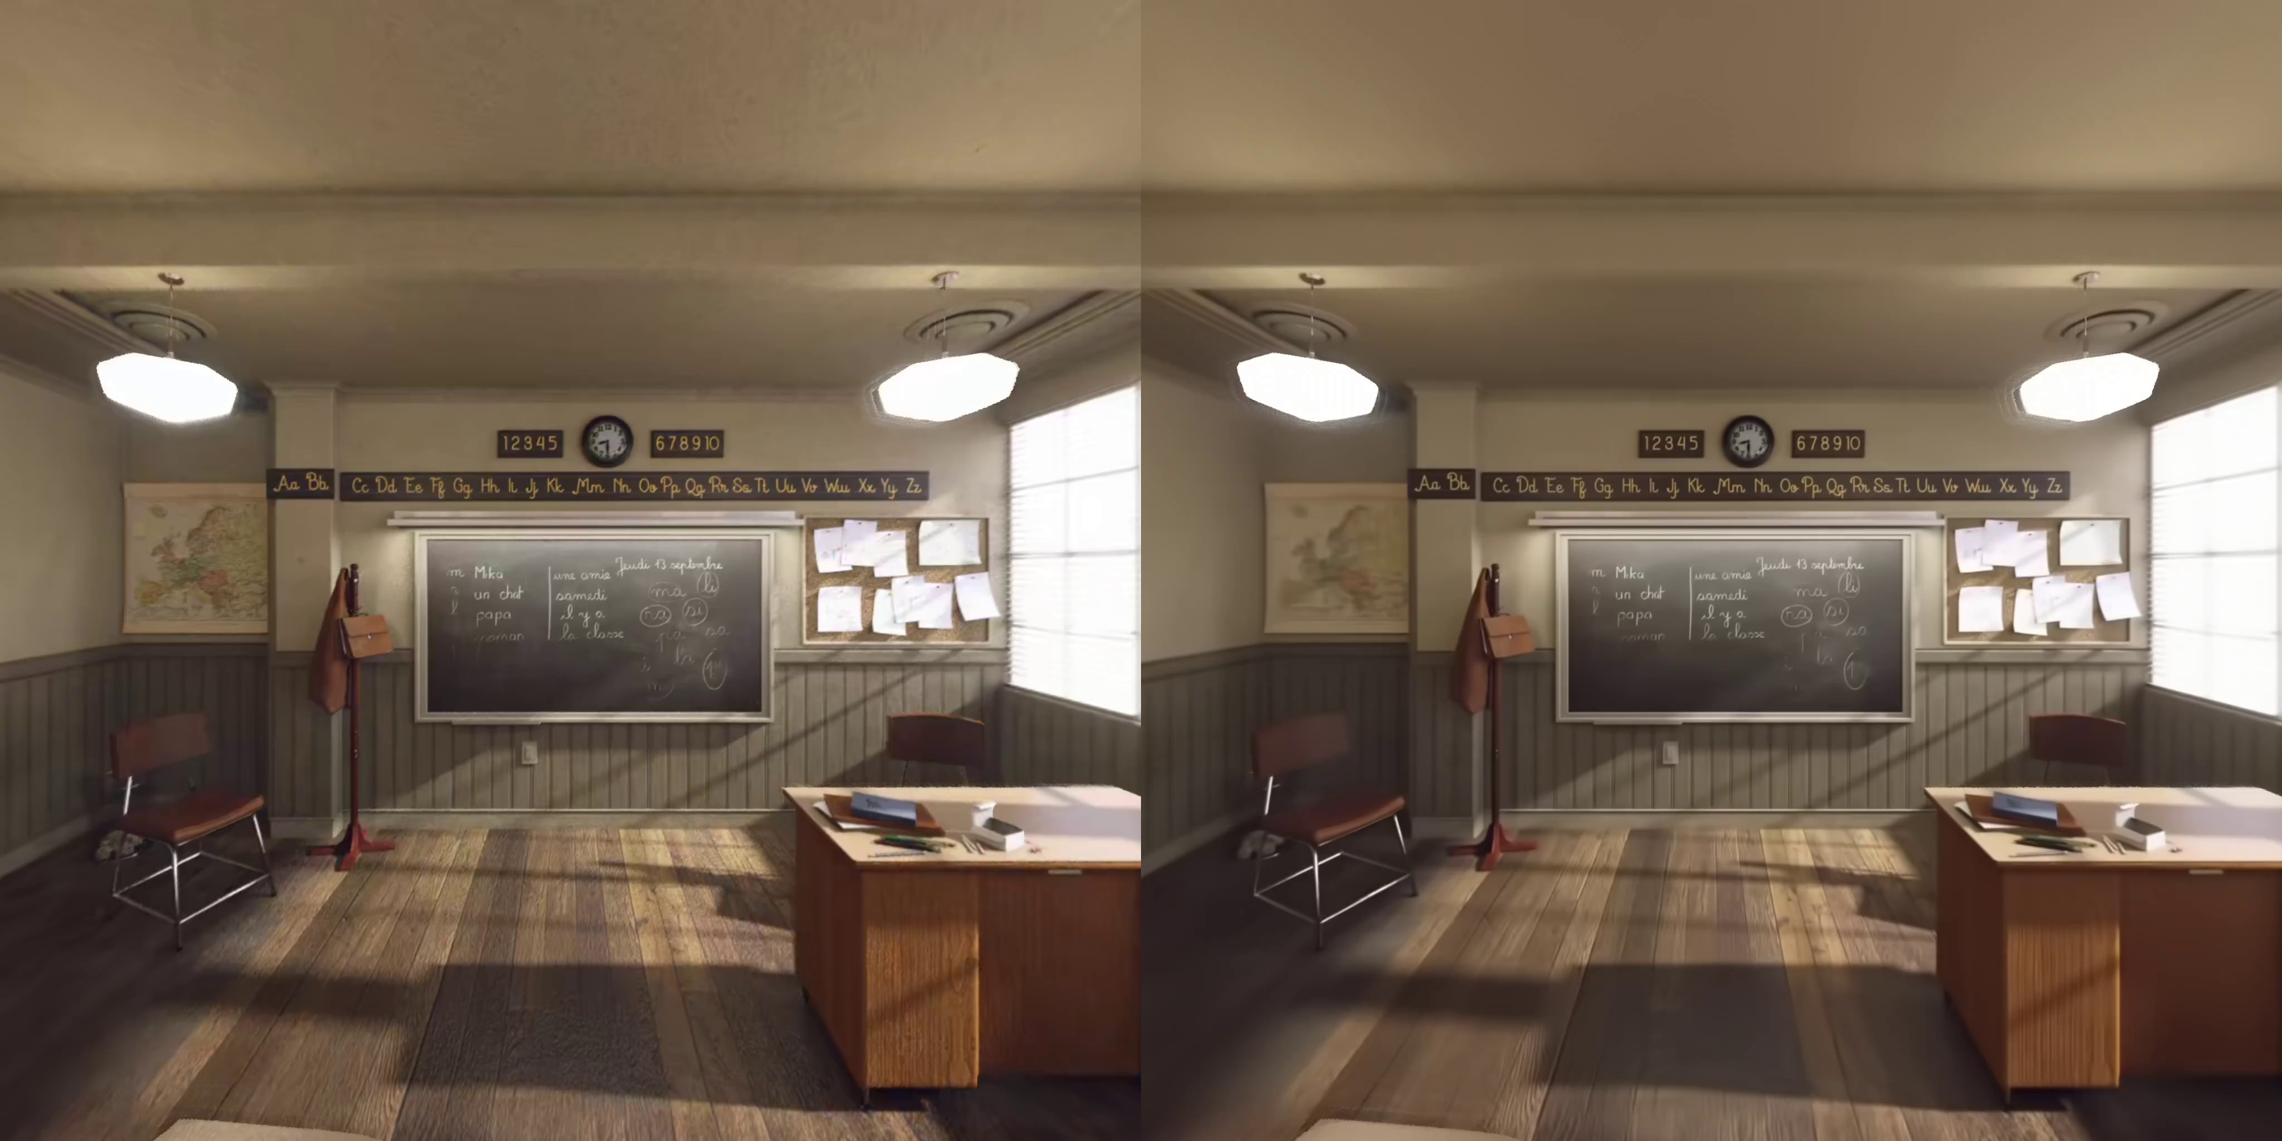
Virtual Reality in MPEG-I (Cont’d)
Limitation
  In some cases, PSNR (traditional quality metric) does not reflect the user’s QoE
  Unlike traditional codec, 3DoF+ shows different types of artifacts
  -> Need to find a better quality metric
MCSL (proposed)
PSNR: 39.46 dB
HEVC (anchor)
PSNR: 40.18 dB
Difference between objective and subjective quality in 3DoF+ 360 video viewport rendering
3079-20-0027-02-0002 Video Quality Assessment Methods Performance Comparison for 3DoF+

Slide 8
Objective Quality Metrics for Immersive Video
Background
  Immersive video shows different types of artifacts
  For evaluation, common test conditions for immersive video defines the quality metrics
Purpose
  Evaluate the 3DoF+ system SW (test model for immersive video (TMIV)) to:
    Provide the viewport which satisfies the user’s quality of experience (QoE)
Metric name | Document No. | Location | Tag/branch
WS-PSNR | w18069 | https://gitlab.com/mpeg-i-visual/wspsnr | v2.0.1
VMAF | - | https://github.com/Netflix/vmaf | v1.3.14
MS-SSIM | - | https://github.com/Netflix/vmaf | v1.3.14
VIF | - | https://github.com/Netflix/vmaf | v1.3.14
IV-PSNR | w18709 | https://gitlab.com/mpeg-i-visual/ivpsnr | v1.0
Objective quality metrics for immersive video
3079-20-0027-02-0002 Video Quality Assessment Methods Performance Comparison for 3DoF+

Slide 9
Test Conditions
Test Materials
  Followed common test conditions (CTC) of MPEG-I
  5 test sequences(class A, B, C, D, E) were encoded
  For subjective data, used 3DoF+ CfR results including mean opinion score (MOS)
Environment
  Versions of softwares meet the requirements of 3DoF+ CfP
  OpenCV 3.4.2 was used to build reference view synthesizer (RVS) v3.1
3079-20-0027-02-0002 Video Quality Assessment Methods Performance Comparison for 3DoF+

Slide 10
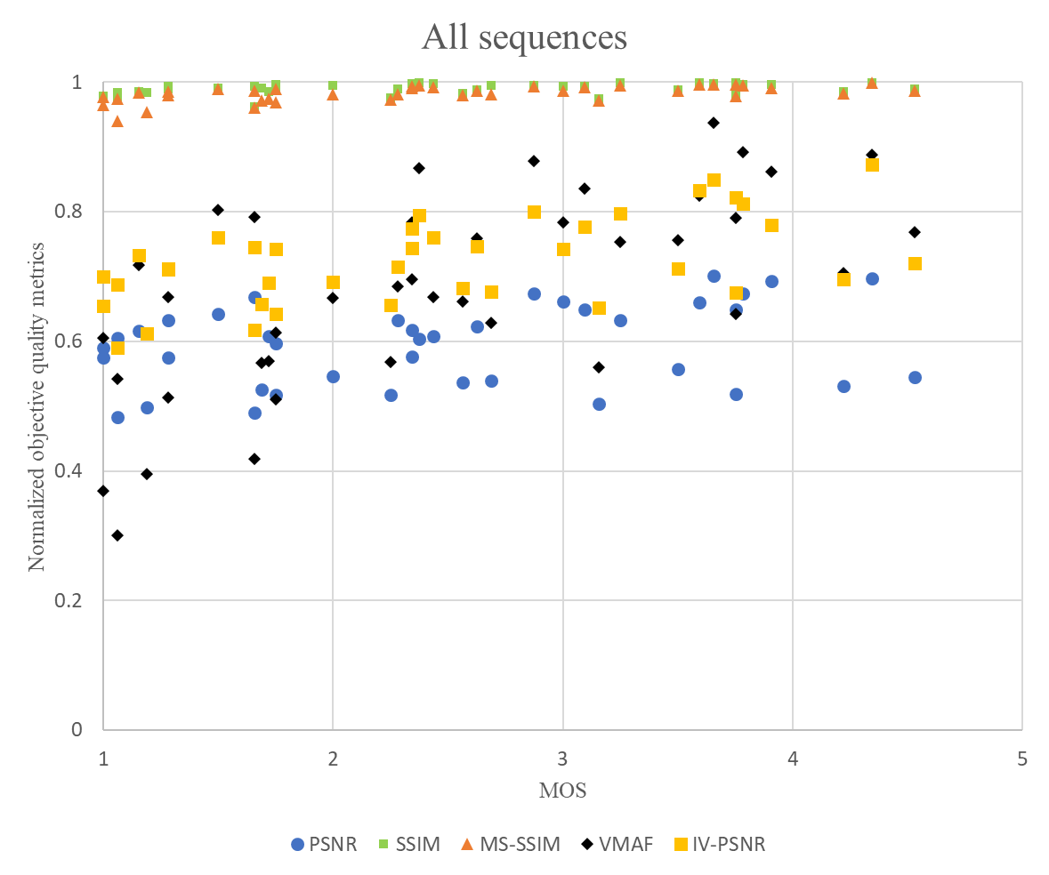
Experimental Results
VMAF showed the best correlation coefficient with MOS
PSNR showed the worst results among the metrics
Metric name | Correlation coefficient with MOS
PSNR | 0.3012
SSIM | 0.3932
MS-SSIM | 0.5694
VMAF | 0.6601
IV-PSNR | 0.5539
Correlation coefficient
between MOS and objective quality metrics
Correlation between MOS and objective quality metrics
3079-20-0027-02-0002 Video Quality Assessment Methods Performance Comparison for 3DoF+

Slide 11
Conclusion
Problem
  For state-of-the-art virtual reality system, quality metric is really important
  Subjective quality and traditional metric (e.g. PSNR) shows low correlation
Proposed Methods and Insights
  Quality metrics of MPEG-I were analyzed with 3DoF+ subjective quality data
  Traditional metric (e.g. PSNR) is not appropriate for 3DoF+
Future Work
  Human-familiar quality metric should be developed
3079-20-0027-02-0002 Video Quality Assessment Methods Performance Comparison for 3DoF+

