Slide 1
Viewport-adaptive 6DoF 360-degree Video Tiled Streaming for Immersive Media
Presenter: Jong-Beom Jeong (uof4949@skku.edu)
Jong-Beom Jeong, Soonbin Lee, Il-Woong Ryu, Sungbin Kim, Inae Kim, Eun-Seok Ryu
Multimedia Computing Systems Lab. (MCSL)
http://mcsl.skku.edu
Department of Computer Education
Sungkyunkwan University

Slide 2
Compliance with IEEE Standards Policies and Procedures
Subclause 5.2.1 of the IEEE-SA Standards Board Bylaws states, "While participating in IEEE standards development activities, all participants...shall act in accordance with all applicable laws (nation-based and international), the IEEE Code of Ethics, and with IEEE Standards policies and procedures."
The contributor acknowledges and accepts that this contribution is subject to
The IEEE Standards copyright policy as stated in the IEEE-SA Standards Board Bylaws, section 7, http://standards.ieee.org/develop/policies/bylaws/sect6-7.html#7, and the IEEE-SA Standards Board Operations Manual, section 6.1, http://standards.ieee.org/develop/policies/opman/sect6.html
The IEEE Standards patent policy as stated in the IEEE-SA Standards Board Bylaws, section 6, http://standards.ieee.org/guides/bylaws/sect6-7.html#6, and the IEEE-SA Standards Board Operations Manual, section 6.3, http://standards.ieee.org/develop/policies/opman/sect6.html
3079-20-0028-02-0002 Viewport-adaptive 6DoF 360-degree Video Tiled Streaming for Immersive Media

Slide 3
IEEE 3079 HMD Based VR Sickness Reducing Technology Dongil Dillon Seo, dillon.seo@telekom-capital.com
Viewport-adaptive 6DoF 360-degree Video Tiled Streaming for Immersive Media
Date: 2020-07-09
Author(s): Jong-Beom Jeong, Soonbin Lee, Il-Woong Ryu, Sungbin Kim, Inae Kim, Eun-Seok Ryu
Name | Affiliation | Phone [optional] | Email [optional]
Jong-Beom Jeong | Sungkyunkwan Univ. |  | uof4949@skku.edu
Soonbin Lee | Sungkyunkwan Univ.
Il-Woong Ryu | Gachon Univ.
Sungbin Kim | Sungkyunkwan Univ.
Inae Kim | Sungkyunkwan Univ.
Eun-Seok Ryu | Sungkyunkwan Univ. |  | esryu@skku.edu
3079-20-0028-02-0002 Viewport-adaptive 6DoF 360-degree Video Tiled Streaming for Immersive Media

Slide 4
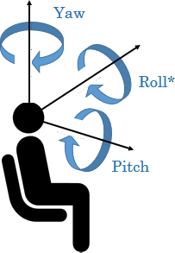
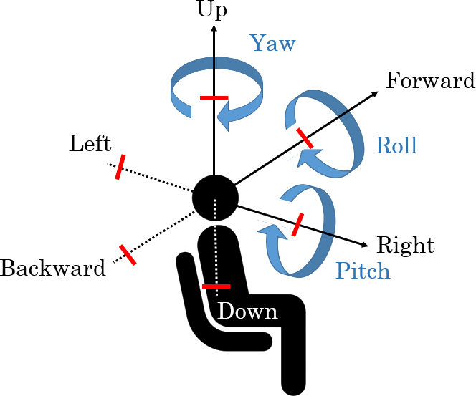
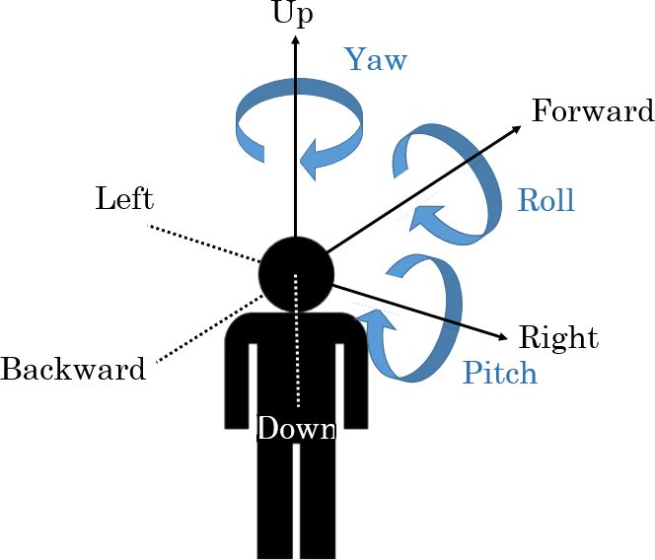
Virtual Reality in MPEG-I
Three phases of ISO/IEC MPEG-Immersive VR standardization
To support the entire movement in VR, 6DoF is required
6DoF media support will be completed by 2022
3DoF+ standard will be established by 2020 to support the limited 6DoF
Step 1
Step 2
Step 3
Yaw
Up
Up
Yaw
Forward
Yaw
Forward
Roll
Left
Roll
Roll
Left
Pitch
Backward
Right
Backward
Right
Pitch
Pitch
Down
Down
Complete 3DoF standard by 2017
Rotate head in a fixed state
360 video full streaming by default
Tiled streaming if possible
Enable VR commercial servicers by 2020
Allow head rotation and movement within a restricted area
User-to-user conversations and projection optimization
Support 6DoF by 2022
6DoF video will reflect user’s walking motion
Support interaction with virtual environments
3079-20-0028-02-0002 Viewport-adaptive 6DoF 360-degree Video Tiled Streaming for Immersive Media

Slide 5
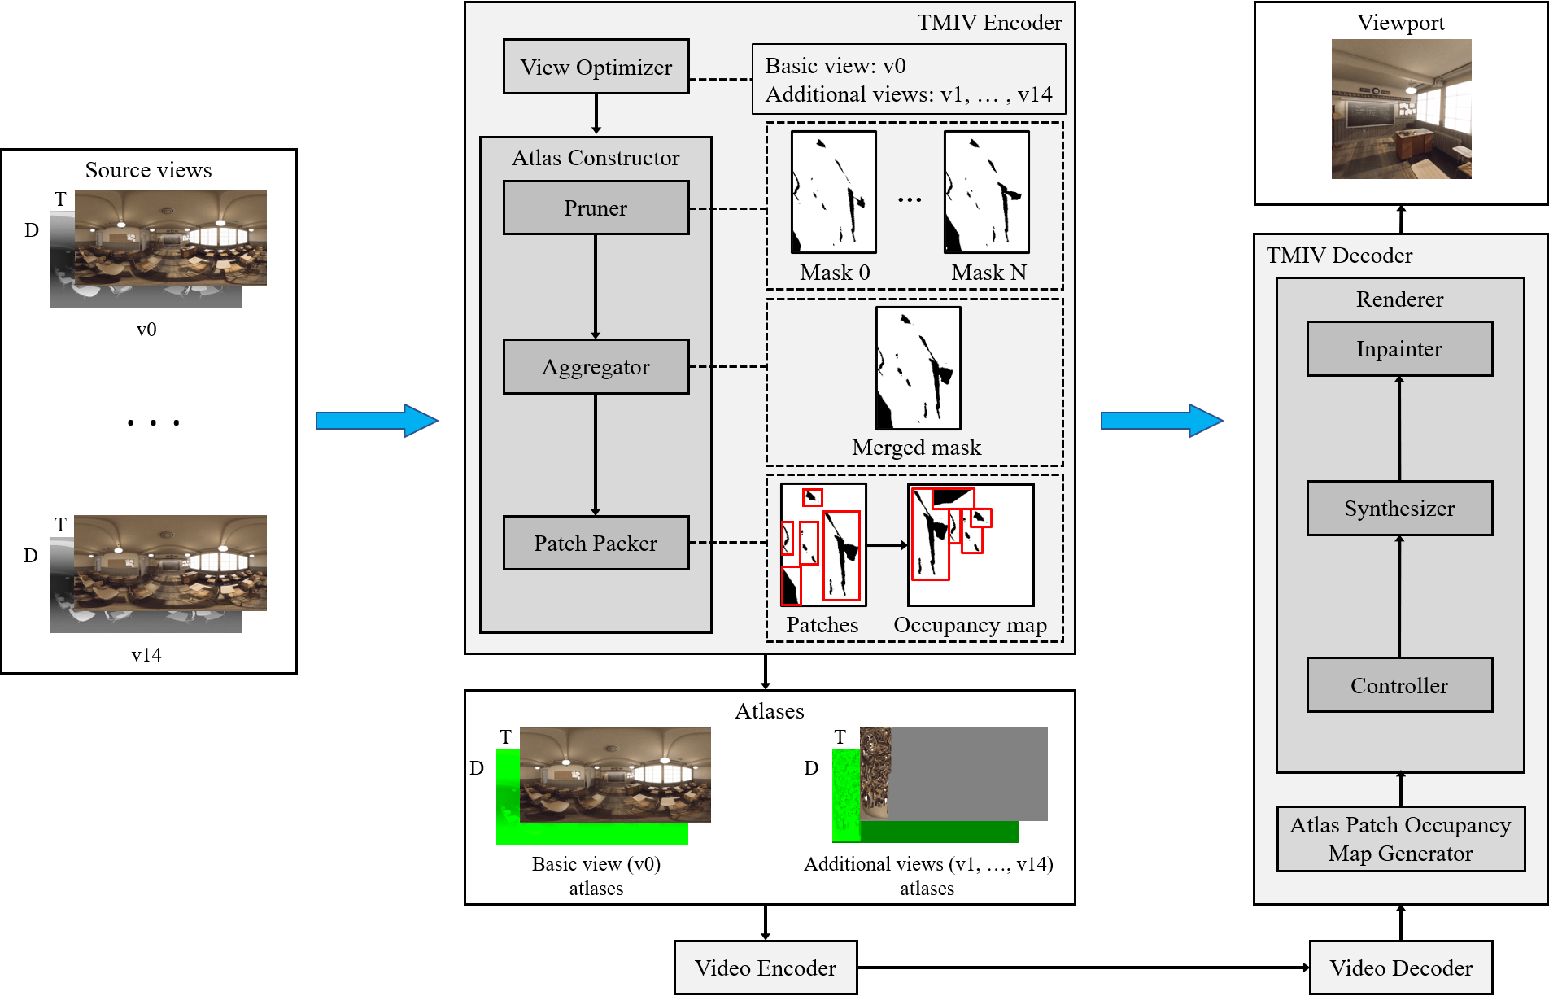
Virtual Reality in MPEG-I (Cont’d)
3DoF+ and 6DoF
MPEG-I requested call for proposals (CfP) on 3DoF+
Philips, Intel & Technicolor, Nokia, PUT & ETRI, ZJU submitted responses -> based on them, test model for immersive video (TMIV) was established
TMIV will be improved to compress 6DoF videos
Block diagram of TMIV architecture
3079-20-0028-02-0002 Viewport-adaptive 6DoF 360-degree Video Tiled Streaming for Immersive Media

Slide 6
Virtual Reality in MPEG-I (Cont’d)
Test sequences of immersive video
11 test sequences are provided (5 computer graphics, 6 natural contents)
Among them, 4 sequences are 360 videos
Class (M/O) | Sequence name Resolution | Thumbnail | Type | No. of views | Depth range | Frame count | Frame rate | Bit depth
CG1-A (M) | ClassroomVideo 4096x2048 |  | ERP | 15 | [0.8m, inf] | 120 | 30fps | Texture: 10, Geometry: 16
CG1-B (M) | TechnicolorMuseum 2048x2048 |  | ERP | 24 | [0.5m, 25m] | 300 | 30fps | Texture: 10, Geometry: 16
CG1-C (M) | InterdigitalHijack 4096x4096 |  | ERP | 10 | [0.5m, 25m] | 300 | 30fps | Texture: 10, Geometry: 16
CG1-N (O) | NokiaChess 2048x2048 |  | ERP | 10 | [0.1m, 500m] | 300 | 30fps | Texture: 10, Geometry: 16
CG2-J (M) | OrangeKitchen 1920x1080 |  | Perspective | 25 (5x5) | [2.2, 7.2] | 97 | 30fps | Texture: 10, Geometry: 10
NC1-D (M) | TechnicolorPainter 2048x1088 |  | Perspective | 16 (4x4) | - | 300 | 30fps | Texture: 10, Geometry: 16
NC1-E (M) | IntelFrog 1920x1080 |  | Perspective | 13 (13x1) | [0.3, 1.62] | 300 | 30fps | Texture: 10, Geometry: 16
NC2-L (M) | PoznanFencing 1920x1080 |  | Perspective | 10 | [3.5, 7.0] | 250 | 25fps | Texture: 10, Geometry: 16
MPEG-I immersive video test sequences
3079-20-0028-02-0002 Viewport-adaptive 6DoF 360-degree Video Tiled Streaming for Immersive Media

Slide 7
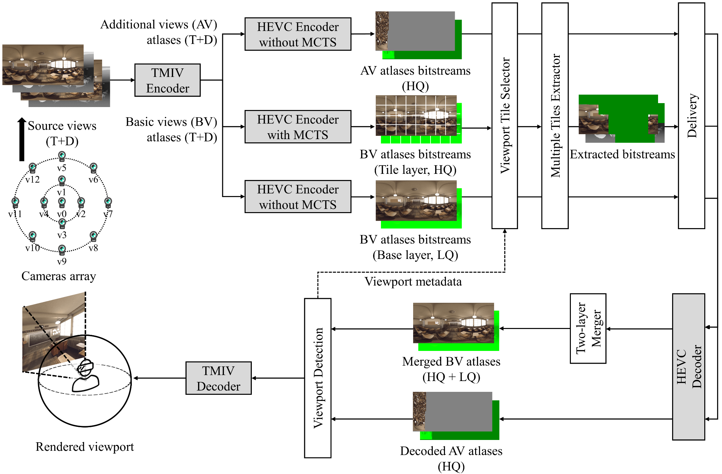
Tiled Streaming on 6DoF 360-degree Video
Developed viewport tile selector (VTS) on 6DoF
Compatible with TMIV and HEVC (or any other codecs, e.g. VVC)
User’s viewport tiles (HQ) + entire videos (LQ) simulcast streaming -> low delay and bandwidth adaptive streaming
Viewport tile selector based tiled streaming
3079-20-0028-02-0002 Viewport-adaptive 6DoF 360-degree Video Tiled Streaming for Immersive Media

Slide 8
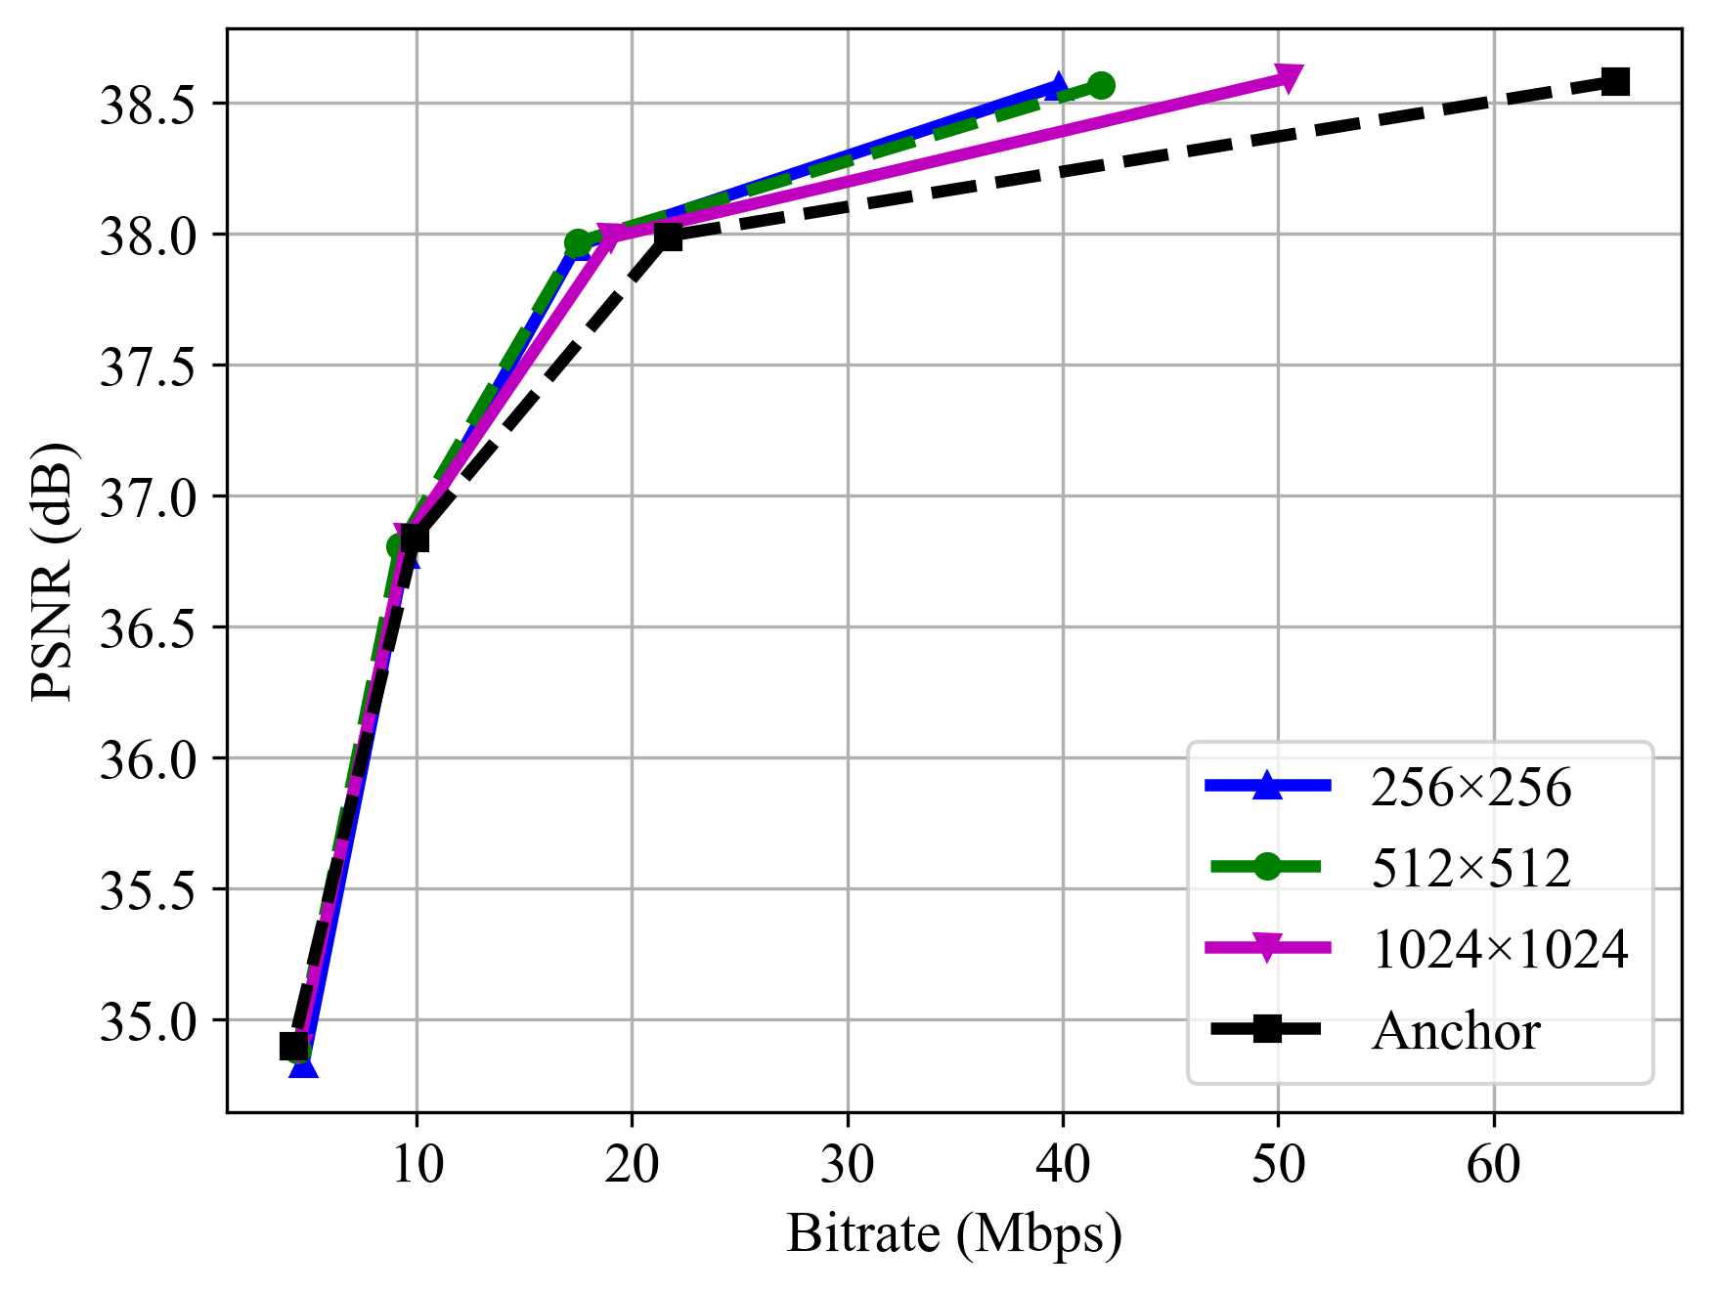
Tiled Streaming on 6DoF 360-degree Video (Cont’d)
Tiled streaming shows BD-rate gain compared to the non-tiled streaming
512×512 tile shows the best result
5.69% of BD-rate saving for Y-PSNR was shown -> For realistic sequence, ClassroomVideo, 19.40% gain was shown
Better results on VMAF and IV-PSNR -> Efficient on subjective quality
Sequence | Y-PSNR | VMAF | VIF | MS-SSIM | IV-PSNR
ClassroomVideo | -19.40% | -27.78% | -29.10% | -21.82% | -29.95%
TechnicolorMuseum | -4.65% | -4.31% | -6.30% | -2.05% | -3.40%
InterdigitalHijack | 5.40% | 6.10% | 5.30% | 6.80% | 5.40%
NokiaChess | -4.14% | -7.94% | -9.20% | -3.88% | -6.23%
Average | -5.69% | -8.47% | -9.82% | -5.23% | -8.55%
BD-rate savings of the VTS based tiled streaming method
RD-curve of the tiled streaming
3079-20-0028-02-0002 Viewport-adaptive 6DoF 360-degree Video Tiled Streaming for Immersive Media

Slide 9
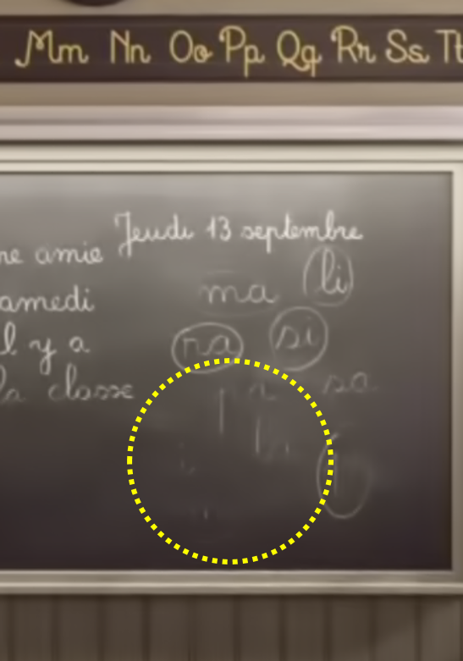
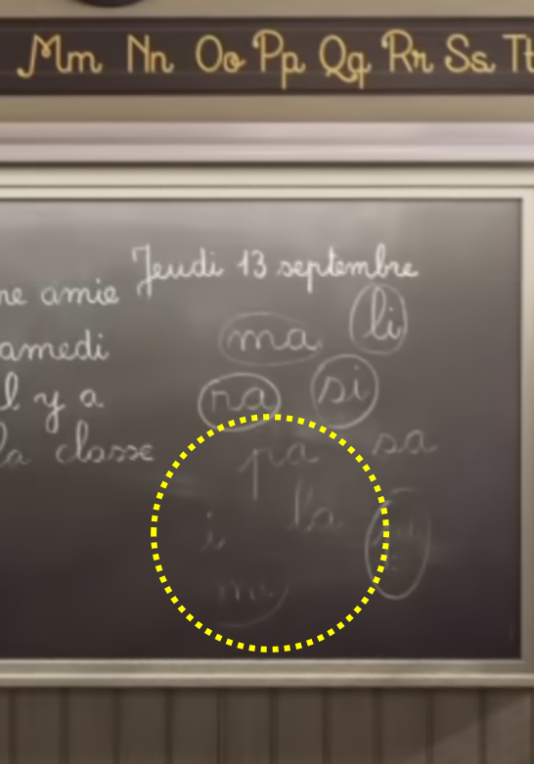
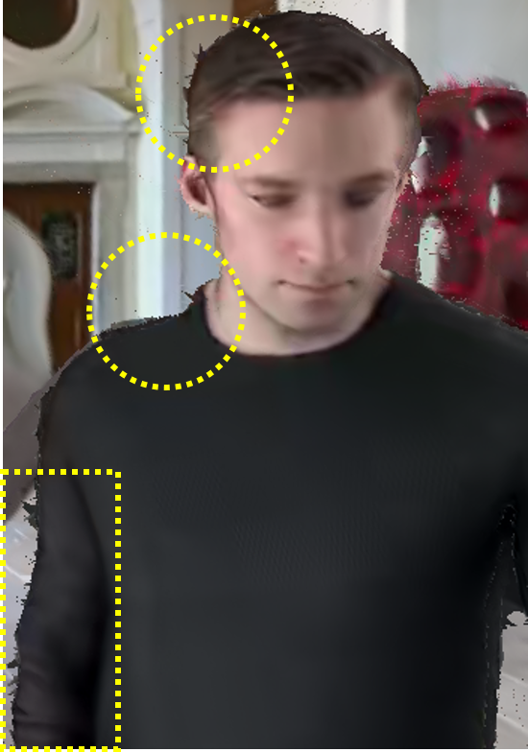
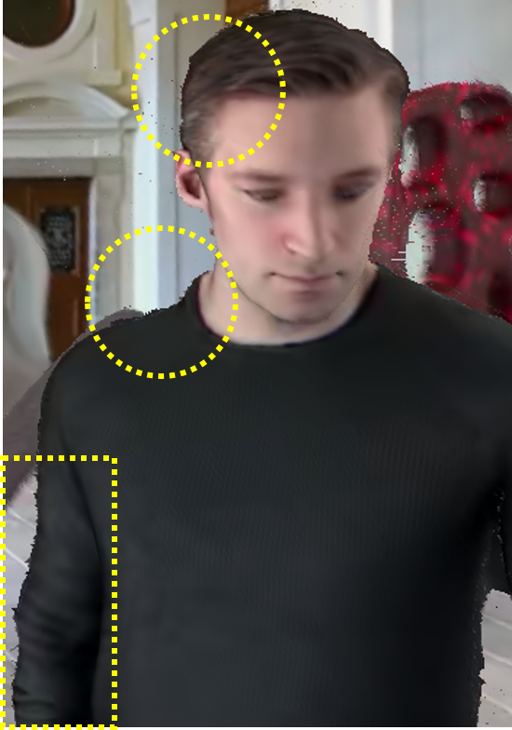
Tiled Streaming on 6DoF 360-degree Video (Cont’d)
At the same bandwidth, tiled streaming preserves more details (Traditional video artifacts)
Especially on edge, there are less artifacts when using tiled streaming (6DoF view synthesis artifacts)
(a)
(b)
(c)
(d)
Quality difference of tiled streaming and the TMIV anchor (a, c: TMIV anchor; b, d: tiled streaming)
3079-20-0028-02-0002 Viewport-adaptive 6DoF 360-degree Video Tiled Streaming for Immersive Media

Slide 10
Conclusion
Motivation
6DoF 360-degree video streaming requires high bandwidth
Reducing the bitrate can reduce the latency, which influences quality of experience (QoE)
Proposed Methods and Insights
Viewport-adaptive tiled streaming for 6DoF 360-degree video
Showed BD-rate gain compared to the non-tiled streaming
Future Work
Experiment of mixed quality tiled streaming will be conducted
3079-20-0028-02-0002 Viewport-adaptive 6DoF 360-degree Video Tiled Streaming for Immersive Media

