Slide 1
Latency for Viewport-adaptive 360-degree Video Streaming Toward Immersive Experience
Presenter: Jong-Beom Jeong (uof4949@skku.edu)
Tuan Thanh Le, Jong-Beom Jeong, Soonbin Lee, Il-Woong Ryu, Sungbin Kim, Eun-Seok Ryu
Multimedia Computing Systems Lab. (MCSL)
http://mcsl.skku.edu
Department of Computer Education
Sungkyunkwan University

Slide 2
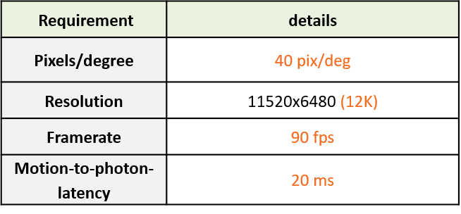
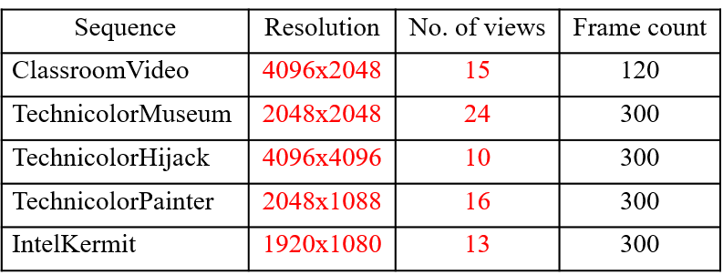
Challenges
High Bandwidth Requirement of VR
  Requires 40 pix/deg, 12K resolution for High quality VR
  To avoid the sickness, 90 fps and 20 ms MTP are required
  Immersive video contains texture (color) and depth (geometry) -> (×2)
  Also, immersive video has high quality (nearly 4K) multiple views -> (×N)
  -> Requires high bandwidth
Requirements for high quality VR
Characteristics of immersive video
Source: Mary-Luc Champel, Thomas Stockhammer, Thierry Fautier, Emmanuel Thomas,
and Rob Koenen. “Quality Requirements for VR”, document MPEG116/m39532,
116th MPEG meeting of ISO/IEC JTC1/SC29/WG11.
3079-20-0029-00-0003

Slide 3


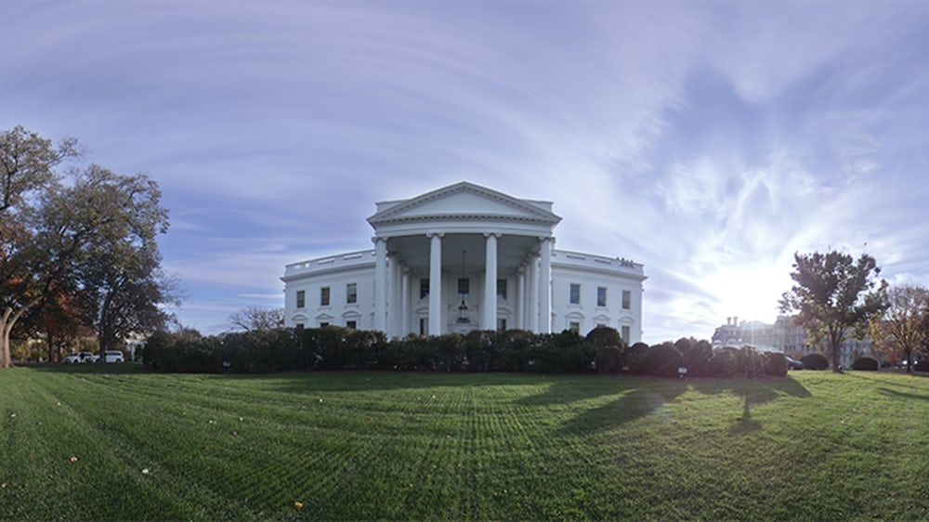








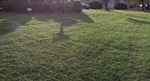



Virtual Reality Streaming Technologies
Viewport Adaptive Streaming
Motion Constrained Tile Sets (MCTS) refer to the encoder for time and space movement reference for independent tile transfer within the current location tile
Extract and composite specific tiles from the bitstream with MCTS to form an adaptive environment at the time of the user
Reduce bandwidth when sending only tiles that correspond to a user’s area of interest
$$t_{0}$$
$$t_{1}$$
$$t_{2}$$
Tile/ Slice | Tile/ Slice | Tile/ Slice
Tile/ Slice | Tile/ Slice | Tile/ Slice
Tile/ Slice | Tile/ Slice | Tile/ Slice
viewport
viewport
Ensure independence between tiles
Viewport
…
Tiles
Motion Constrained Tile Sets
Viewport-adaptive decoding and rendering
Viewport-driven tiled streaming system based on MCTS
3079-20-0029-00-0003

Slide 4







VR Tiled Streaming Latency
We define latency as the total time between movement of the user’s head and the updated image being displayed on the screen
It includes the times for sensor response, fusion, rendering, image transmission, and display response
Head’s movement
$$∆t_{1}$$
Client request
$$∆t_{2}$$
Server Listen
Processing latency
Request Latency
($∆t_{2}$ is quite small)
$$∆t_{3}$$
Processing latency
Decoding & Rendering VR-HMD
$$∆t_{5}$$
Client received tiled bitstream
$$∆t_{4}$$
Output Tiled Bitstream
Processing latency
Transmission Latency
$Total_latency=∆t_{1}$+ $∆t_{2}$+ $∆t_{3}$+ $∆t_{4}$+ $∆t_{5}$
3079-20-0029-00-0003

Slide 5
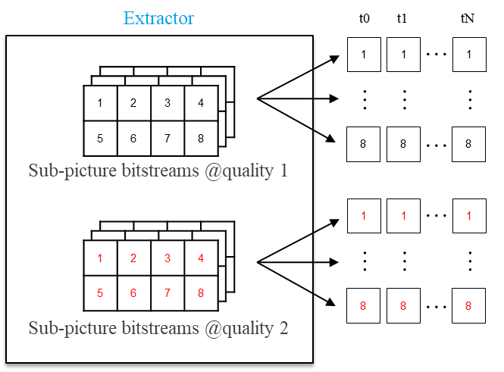







VR Tiled Streaming System Architecture
Streaming Server
File encapsulation
Delivery (MPEG DASH/ RTSP/RTP)
$$∆t_{4}$$
$$∆t_{3}$$
Server Listen
Selected Tiles
$$∆t_{2}$$
viewport
File
decapsulation
Decoding,
mapping
$$∆t_{5}$$
$$∆t_{4}$$
VR rendering
DASH/RTSP/RTP
Client
Tile Priority Generator
Tile selection,
chunk request
Client Request
$$∆t_{2}$$
Prediction Model
Adaptive Network Bandwidth Model
$$∆t_{1}$$
Head’s movement
PC - Client
3079-20-0029-00-0003

Slide 6
Opportunities for Research
Optimizing size of tiles
  Adaptive Bandwidth
  Reduce latency (∆𝑡_3, ∆𝑡_4 and ∆𝑡_5)
Head’s movement prediction
  According to eyes-coordinates function and a prediction model
  Decide the next tiles of new tiled stream
  Reduce latency (∆𝑡_1)
High quality and low-quality streams
  Instead of requesting a new chunk, client uses low-quality tiles at exact same location
  Reduce latency (∆𝑡_1, ∆𝑡_3,∆𝑡_4, and ∆𝑡_5)
viewport
viewport
Head’s movement
3079-20-0029-00-0003

