Slide 1
[User requirement analysis for QoI measurement on XR content ]
[Beom-Ryeol Lee, Younho Lee, Wookho Son/ETRI]

Slide 2
Compliance with
IEEE Standards Policies and Procedures
Subclause 5.2.1 of the IEEE-SA Standards Board Bylaws states, "While participating in IEEE standards development activities, all participants...shall act in accordance with all applicable laws (nation-based and international), the IEEE Code of Ethics, and with IEEE Standards policies and procedures."
The contributor acknowledges and accepts that this contribution is subject to
The IEEE Standards copyright policy as stated in the IEEE-SA Standards Board Bylaws, section 7, http://standards.ieee.org/develop/policies/bylaws/sect6-7.html#7, and the IEEE-SA Standards Board Operations Manual, section 6.1, http://standards.ieee.org/develop/policies/opman/sect6.html
The IEEE Standards patent policy as stated in the IEEE-SA Standards Board Bylaws, section 6, http://standards.ieee.org/guides/bylaws/sect6-7.html#6, and the IEEE-SA Standards Board Operations Manual, section 6.3, http://standards.ieee.org/develop/policies/opman/sect6.html

Slide 3
IEEE 3079
HMD Based VR Sickness Reducing Technology
Dong Il Dillon Seo, dillon.seo@telekom-capital.com
User requirement analysis for QoI measurement on XR content
Date: 2020-10-15
Author(s): Beom-Ryeol Lee, Yongho Lee, Wookho Son
Name | Affiliation | Phone | Email
Beom-Ryeol Lee | ETRI | +82 10 8880 3347 | Lbr@etri.re.kr
Yongho Lee | ETRI | +82 10 3008 5770 | jason0720@etri.re.kr
Wookho Son | ETRI | +82 10 8759 3602 | whson@etri.re.kr

Slide 4
Contents
Definition of QoI
Needs for standard
Content operational environment
Scope of the standards
Discussion

Slide 5
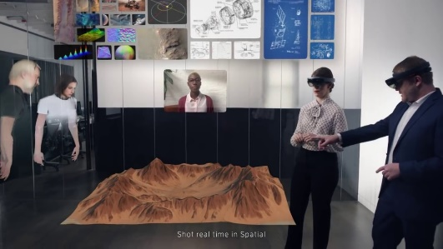
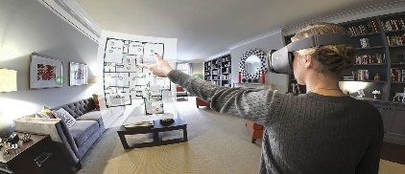
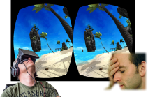
Definition of QoI
QoI(Quality of Interaction): The level of satisfaction that reflects the user’s interaction results as they experience realistic content such as XR content including VR, AR, and XR.
QoE(Quality of Experience)
Scenario
QoI(Quality of Interaction)
VR Sickness
Immersiveness
Emotion
Delay
Camera Movement
Eye Tracking
Object Movement
Precision
Image Complexity
User Movement
Depth
FoV
Frame Rate
Resolution

Slide 6
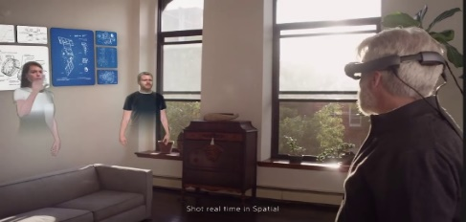


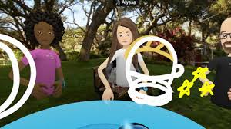



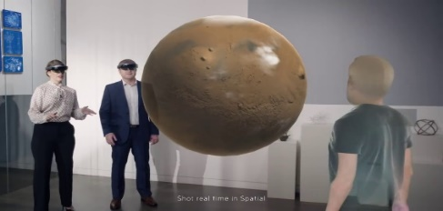

Needs for standards
Light-weight, Low-latency, Interaction Sync., User Experience
eXtended Reality
AR (Remote Space)
Mixed Reality
VR (Virtual Collaborating Space)
5G Multi-access Edge Computing
AR (Real Space)
AR (Wide-area Remote Space)

Slide 7












Content operational environment
XR content operation on the MEC(Mobile Edge Computing)
Sensing data
5G Edge Cloud
Light-weight display
devices
Internet
Cloud
Datacenter
5G Edge Cloud
…
Low Latency
Sync
Rendering
result
5G MEC Servers
3D hand tracking
3D map reconstruction
Interaction engine
Rendering engine
…

Slide 8
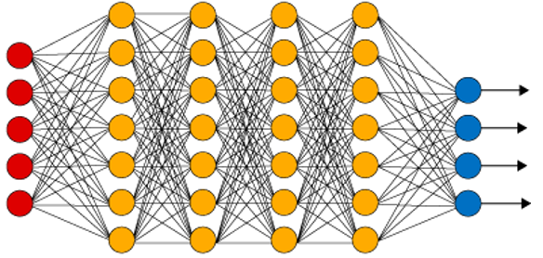

Scope of the standards
Stepwise procedures for analyzing and measuring QoI
Reference
Content
Extract
Features
Visual Features
Face and Eye Tracking Features
User’s Emotion Features
User’s Evaluation
QoI Metric
사용자 평가 점수
사용자 평가 점수
Visual Modeling
Bio-metric Modeling
QoI Scores
QoI Score
Measured Data
QoI Score
Env. Info
Content Info
Interaction Info
User Info
환경/콘텐츠 정보
환경/콘텐츠 정보
Predicted
QoI
Score
Integrated QoI
Cognitive Modeling
Correlation Assessment
Measuring
Data Info
Analyzing and Modeling
Features
Mapping
Quantified QoI
Scoring
QoI Level

Slide 9
Discussion
Development procedures of the standards in IEEE 3079.2
Documentation level of the standards in IEEE 3079.2
Standardization issues for requirement spec of QoI.
  QoI Measuring Features
  QoI Measuring methods
  QoI Measuring process
  Multi-participant space information
Standard Tools
  Reference content
  Interoperability & conformance testing tool

Slide 10
Thank You

