Slide 1
Super Metric for Immersive Video
Presenter: Eun-Seok Ryu (hope.ryu@gmail.com‎)
SeungHwan Kim, Jong-Beom Jeong, Soonbin Lee, Inae Kim, Sungbin Kim, Eun-Seok Ryu
Multimedia Computing Systems Lab. (MCSL)
http://mcsl.skku.edu
Department of Computer Education
Sungkyunkwan University

Slide 2
Compliance with IEEE Standards Policies and Procedures
Subclause 5.2.1 of the IEEE-SA Standards Board Bylaws states, "While participating in IEEE standards development activities, all participants...shall act in accordance with all applicable laws (nation-based and international), the IEEE Code of Ethics, and with IEEE Standards policies and procedures."
The contributor acknowledges and accepts that this contribution is subject to
The IEEE Standards copyright policy as stated in the IEEE-SA Standards Board Bylaws, section 7, http://standards.ieee.org/develop/policies/bylaws/sect6-7.html#7, and the IEEE-SA Standards Board Operations Manual, section 6.1, http://standards.ieee.org/develop/policies/opman/sect6.html
The IEEE Standards patent policy as stated in the IEEE-SA Standards Board Bylaws, section 6, http://standards.ieee.org/guides/bylaws/sect6-7.html#6, and the IEEE-SA Standards Board Operations Manual, section 6.3, http://standards.ieee.org/develop/policies/opman/sect6.html
3079-20-0056-01-0001 Super Metric for Immersive Video

Slide 3
IEEE 3079.1 HMD Based VR Sickness Reducing Technology Dongil Dillon Seo, dillon.seo@telekom-capital.com
Super Metric for Immersive Video
Date: 2020-10-19
Author(s): SeungHwan Kim, Jong-Beom Jeong, Soonbin Lee, Inae Kim, Sungbin Kim, Eun-Seok Ryu
Name | Affiliation | Phone [optional] | Email [optional]
SeungHwan Kim | Sungkyunkwan Univ. |  | whitekomani@skku.edu
Jong-Beom Jeong | Sungkyunkwan Univ. |  | uof4949@skku.edu
Soonbin Lee | Sungkyunkwan Univ. |  | soonbinlee@skku.edu
Inae Kim | Sungkyunkwan Univ. |  | inaelk@skku.edu
Sungbin Kim | Sungkyunkwan Univ. |  | beencooke@skku.edu
Eun-Seok Ryu | Sungkyunkwan Univ. |  | esryu@skku.edu
3079-20-0056-01-0001 Super Metric for Immersive Video

Slide 4
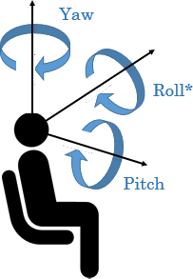
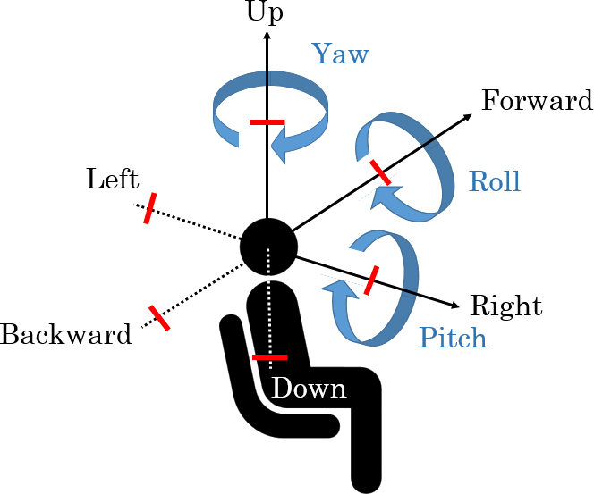
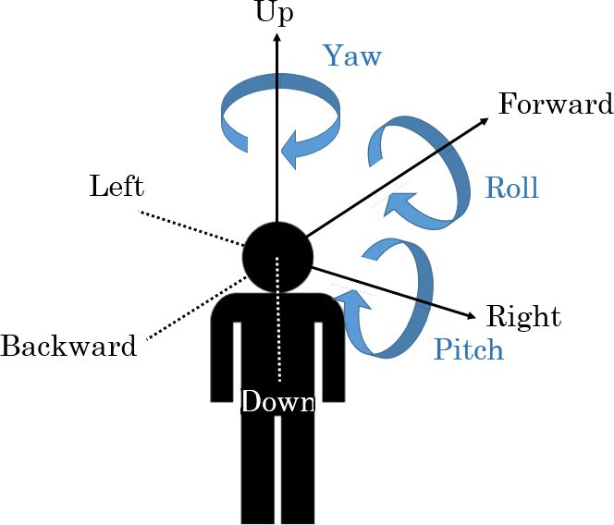
Virtual Reality in MPEG-I
Three phases of ISO/IEC MPEG-Immersive VR standardization
To support the entire movement in VR, 6DoF is required
6DoF media support will be completed by 2022
3DoF+ standard will be established by 2020 to support the limited 6DoF
Step 1
Step 2
Step 3
Yaw
Up
Up
Yaw
Forward
Yaw
Forward
Roll
Left
Roll
Roll
Left
Pitch
Backward
Right
Backward
Right
Pitch
Pitch
Down
Down
Complete 3DoF standard by 2017
Rotate head in a fixed state
360 video full streaming by default
Tiled streaming if possible
Enable VR commercial servicers by 2020
Allow head rotation and movement within a restricted area
User-to-user conversations and projection optimization
Support 6DoF by 2022
6DoF video will reflect user’s walking motion
Support interaction with virtual environments
3079-20-0056-01-0001 Super Metric for Immersive Video

Slide 5
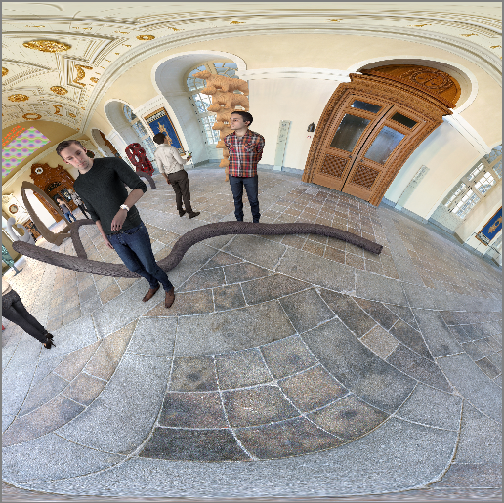
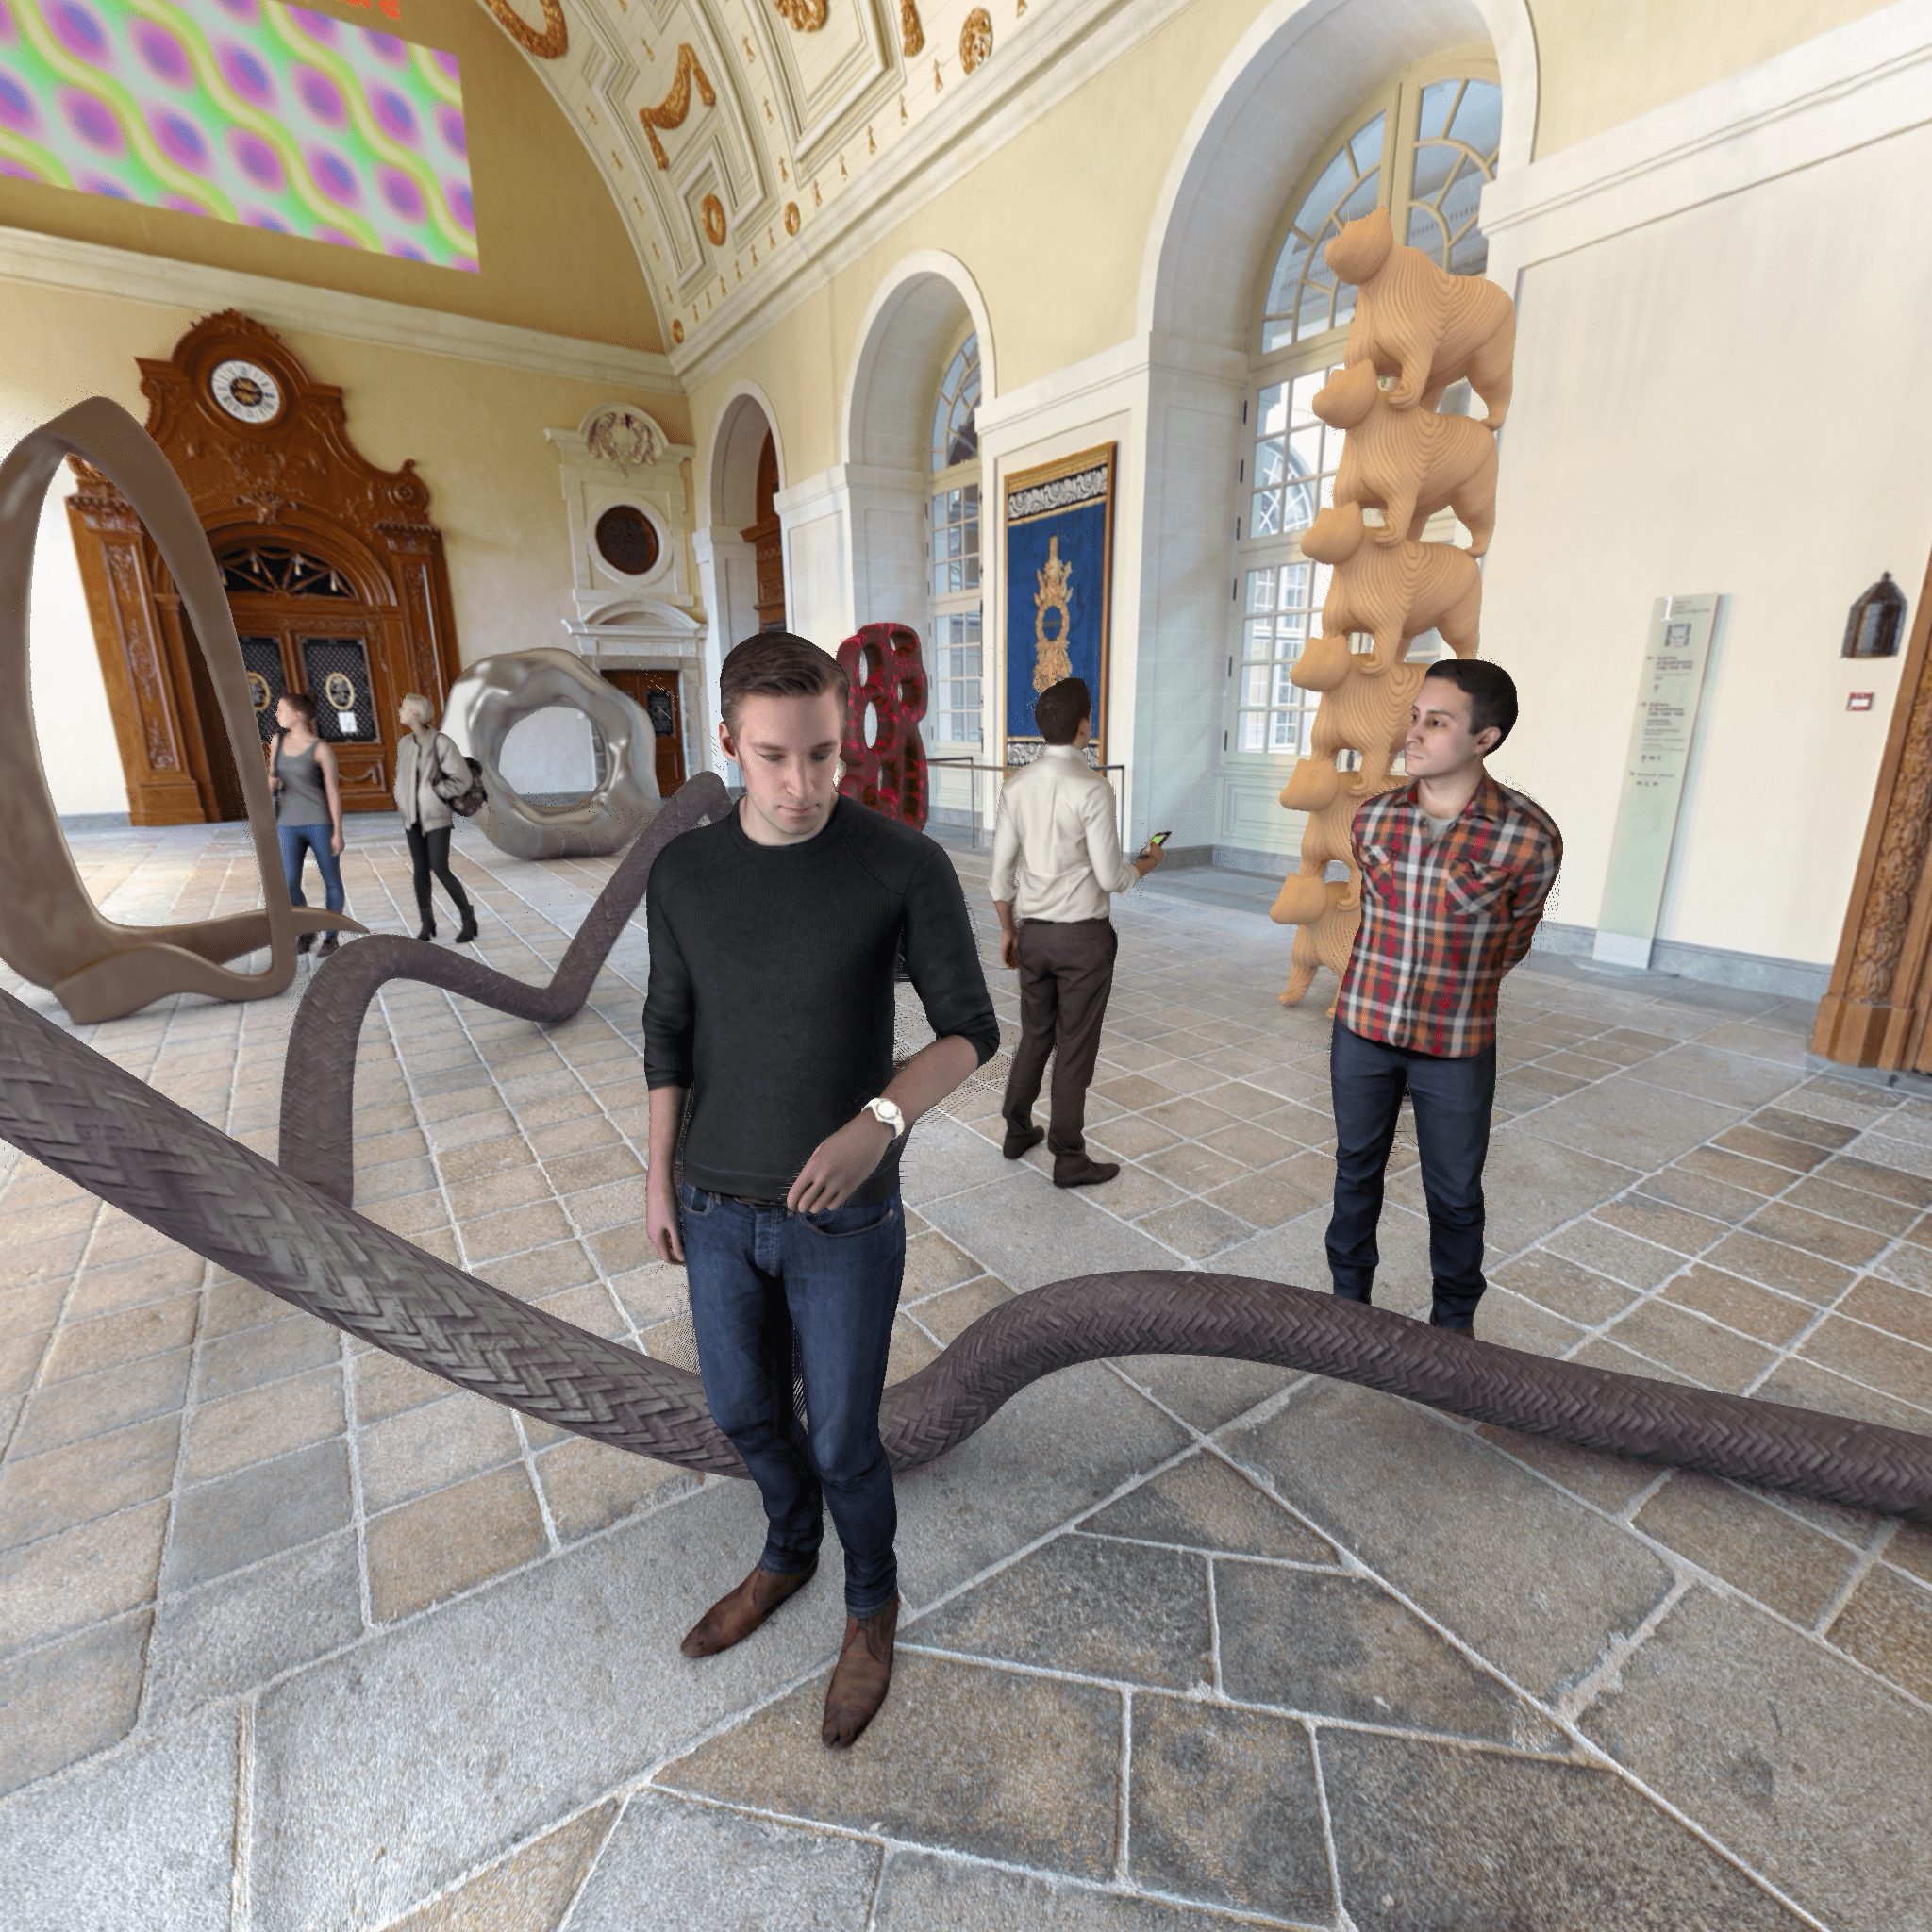
Super Metric for Immersive Video
Server
Source views
TMIV
Encoder
HEVC/VVC
Encoder
Atlases
$$α$$
PSNR
TMIV
Renderer
$$ρ$$
$$β$$
SSIM
Delivery
$$γ$$
MS-SSIM
Client
$$δ$$
VMAF
$$ε$$
IV-PSNR
TMIV
Renderer
HEVC/VVC
Decoder
Super
Metric
Reconstructed
Atlases
$$\text{Super} \text{Metric}=α\left[PSNR\right]+β\left[SSIM\right]+γ\left[MS SSIM\right]+δ\left[VMAF\right]+ε\left[IV PSNR\right]+ρ$$
3079-20-0056-01-0001 Super Metric for Immersive Video

Slide 6
Immersive Video PSNR (IV-PSNR)
Proposed to increase the correlation between: objective and subjective quality
PSNR is calculated in block units
Considers pixel movement
Edge artifacts shown in 3DoF+ view synthesis
Equations of IV-PSNR
Source: Adrian Dziembowski. 2019. Software manual of IV-PSNR for Immersive Video.
128th MPEG meeting of ISO/IEC JTC1/SC29/ WG11, MPEG127/n18709.
3079-20-0056-01-0001 Super Metric for Immersive Video

Slide 7
Video Multimethod Assessment Fusion (VMAF)
Proposed by Netflix
Combination of several elementary metrics
Visual quality fidelity (VIF) and detail loss measure (DLM): spatial domain
Temporal information (TI): temporal domain
Considers the subjective quality
Training Prediction
Opinion scores
SVM
training
Model
SVM
prediction
VMAF score
Training
Ref./Dis.
video pairs
Elementary metrics
Testing
Ref./Dis.
video pairs
Elementary metrics
VIF_scale0
VIF_scale0
…
…
VIF_scale3
VIF_scale3
DLM
DLM
Internal process of VMAF
3079-20-0056-01-0001 Super Metric for Immersive Video

Slide 8
Super Metric for Immersive Video
Background
Each quality metric evaluates different factors
For evaluation, common test conditions for immersive video defines the enhanced quality metric
Purpose
Evaluate the 3DoF+ system SW (test model for immersive video (TMIV)) to:
Provide the viewport which satisfies the user’s quality of experience (QoE)
Metric name | Document No. | Location | Tag/branch
WS-PSNR | w18069 | https://gitlab.com/mpeg-i-visual/wspsnr | v2.0.1
VMAF | - | https://github.com/Netflix/vmaf | v1.3.14
MS-SSIM | - | https://github.com/Netflix/vmaf | v1.3.14
VIF | - | https://github.com/Netflix/vmaf | v1.3.14
IV-PSNR | w18709 | https://gitlab.com/mpeg-i-visual/ivpsnr | v1.0
Objective quality metrics for immersive video
3079-20-0056-01-0001 Super Metric for Immersive Video

Slide 9
Test Conditions
Test Materials
Followed common test conditions (CTC) of MPEG-I
5 test sequences(class A, B, C, D, E) were encoded
For subjective data, used 3DoF+ CfR results including mean opinion score (MOS) [1]
Environment
Versions of softwares meet the requirements of 3DoF+ CfP
OpenCV 3.4.2 was used to build reference view synthesizer (RVS) v3.1
[1] document m47979
3079-20-0056-01-0001 Super Metric for Immersive Video

Slide 10
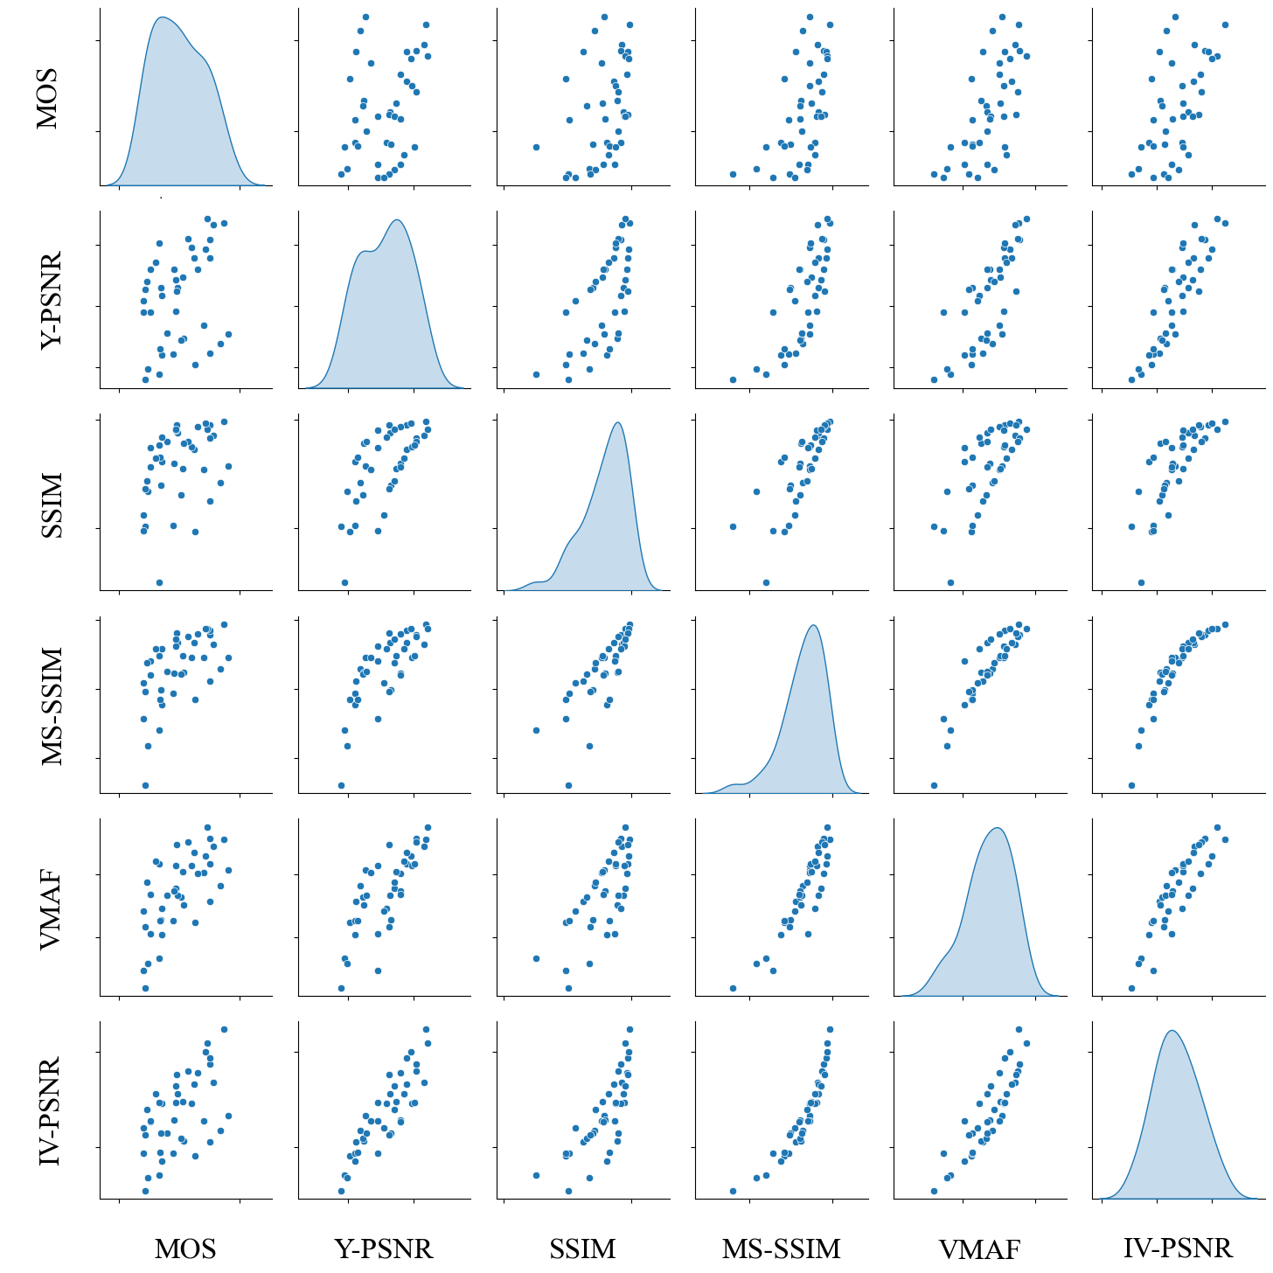
Experimental Results
In scatter plot matrix, linear representation with MOS means high correlation
PSNR showed the worst correlation with MOS among the metrics
Scatter plot matrix of metrics
3079-20-0056-01-0001 Super Metric for Immersive Video

Slide 11
Experimental Results
Super Metric is weighted sum of metrics
$$α=\text{−0.212892} β=−0.414345 γ=−0.610262 δ=0.031026 ϵ=0.226949 ρ=−0.66383$$
Super Metric has higher correlation coefficient with MOS than any other single metric
Metric name | Correlation coefficient with MOS
PSNR | 0.3012
SSIM | 0.3932
MS-SSIM | 0.5694
VMAF | 0.6601
IV-PSNR | 0.5539
Super Metric | 0.7525
Correlation coefficient
between MOS and objective quality metrics
Correlation between MOS and objective quality metrics
3079-20-0056-01-0001 Super Metric for Immersive Video

Slide 12
Conclusion
Problem
For state-of-the-art virtual reality system, quality metric is very important
Subjective quality and traditional metric (e.g. PSNR) show low correlation with MOS
Proposed Methods and Insights
Weighted sum of traditional metrics can achieve high correlation with MOS
A single traditional metric (e.g. PSNR) is not appropriate for 3DoF+
Future Work
Mathematical analysis of each metric and simplify process
Combining the metrics according to their characteristics (e.g. IV-PSNR and WS-PSNR)
3079-20-0056-01-0001 Super Metric for Immersive Video

