Slide 1
Tile Extractor Optimization for Low-latency
Viewport-dependent 360 Video Tiled Streaming
Presenter: Eun-Seok Ryu (esryu@skku.edu)
Jong-Beom Jeong, Soonbin Lee, Inae Kim, Eun-Seok Ryu
Multimedia Computing Systems Lab. (MCSL)
http://mcsl.skku.edu
Department of Computer Education
Sungkyunkwan University

Slide 2
Compliance with
IEEE Standards Policies and Procedures
Subclause 5.2.1 of the IEEE-SA Standards Board Bylaws states, "While participating in IEEE standards development activities, all participants...shall act in accordance with all applicable laws (nation-based and international), the IEEE Code of Ethics, and with IEEE Standards policies and procedures."
The contributor acknowledges and accepts that this contribution is subject to
The IEEE Standards copyright policy as stated in the IEEE-SA Standards Board Bylaws, section 7, http://standards.ieee.org/develop/policies/bylaws/sect6-7.html#7, and the IEEE-SA Standards Board Operations Manual, section 6.1, http://standards.ieee.org/develop/policies/opman/sect6.html
The IEEE Standards patent policy as stated in the IEEE-SA Standards Board Bylaws, section 6, http://standards.ieee.org/guides/bylaws/sect6-7.html#6, and the IEEE-SA Standards Board Operations Manual, section 6.3, http://standards.ieee.org/develop/policies/opman/sect6.html
3079-20-0057-02-0001 Tile Extractor Optimization for Low-latency Viewport-dependent 360 Video Tiled Streaming

Slide 3
IEEE 3079
HMD Based VR Sickness Reducing Technology
Dongil Dillon Seo, dillon.seo@telekom-capital.com
Tile Extractor Optimization for Low-latency Viewport-dependent 360 Video Tiled Streaming
Date: 2020-10-19
Author(s): Jong-Beom Jeong, Soonbin Lee, Il-Woong Ryu, Sungbin Kim, Inae Kim, Eun-Seok Ryu
Name | Affiliation | Phone [optional] | Email [optional]
Jong-Beom Jeong | Sungkyunkwan Univ. |  | uof4949@skku.edu
Soonbin Lee | Sungkyunkwan Univ. |  | soonbinlee@skku.edu
Inae Kim | Sungkyunkwan Univ. |  | inaelk@skku.edu
Eun-Seok Ryu | Sungkyunkwan Univ. |  | esryu@skku.edu
3079-20-0057-02-0001 Tile Extractor Optimization for Low-latency Viewport-dependent 360 Video Tiled Streaming

Slide 4
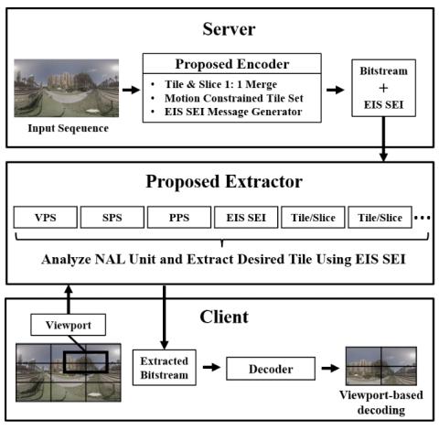
360-degree Video Tiled Streaming
High resolution and framerate for high-quality 360-degree video streaming
  high bandwidth
Tiled streaming based on MCTS for viewport-dependent streaming
  well-known selective streaming method
Requirement | details
pixels/degree | 40 pix/deg
video resolution | 11520x6480
framerate | 90 fps
Requirements for high quality VR
Source:Technicolor, Oct. 2016 (m39532, MPEG 116th Meeting)
360-degree video tiled streaming system
Source: Jangwoo Son, Dongmin Jang, and Eun-Seok Ryu. 2018. Implementing 360 video tiled streaming system.
In Proceedings of the 9th ACM Multimedia Systems Conference. ACM, 521–524.
3079-20-0057-02-0001 Tile Extractor Optimization for Low-latency Viewport-dependent 360 Video Tiled Streaming

Slide 5
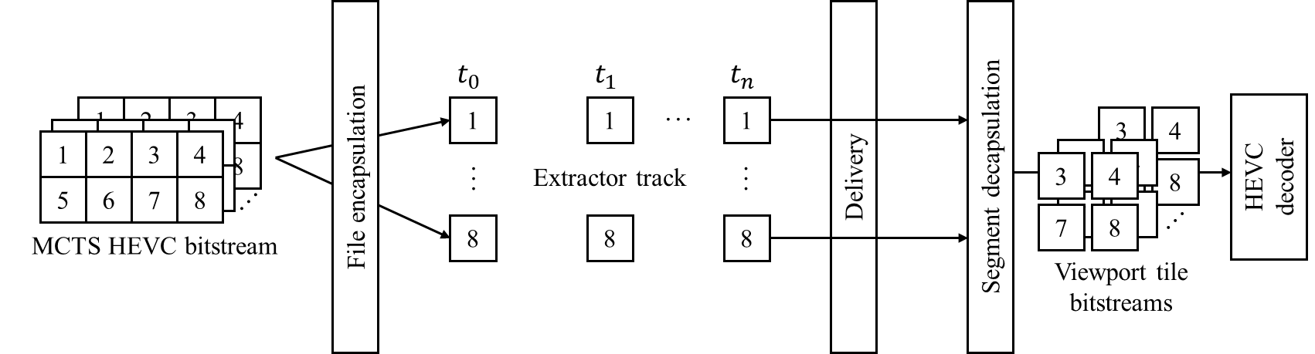
360-degree Video Tiled Streaming: Challenges
In HEVC test model (HM) 16.20, a tile extraction SW is included
  single tile extraction is available
Based on HM 16.20, number of tile bitstreams are generated
Generally, a VR player has one or few number of decoders
  single tile extraction causes decoding resource issues
Example of viewport-dependent 360-degree video streaming
3079-20-0057-02-0001 Tile Extractor Optimization for Low-latency Viewport-dependent 360 Video Tiled Streaming

Slide 6
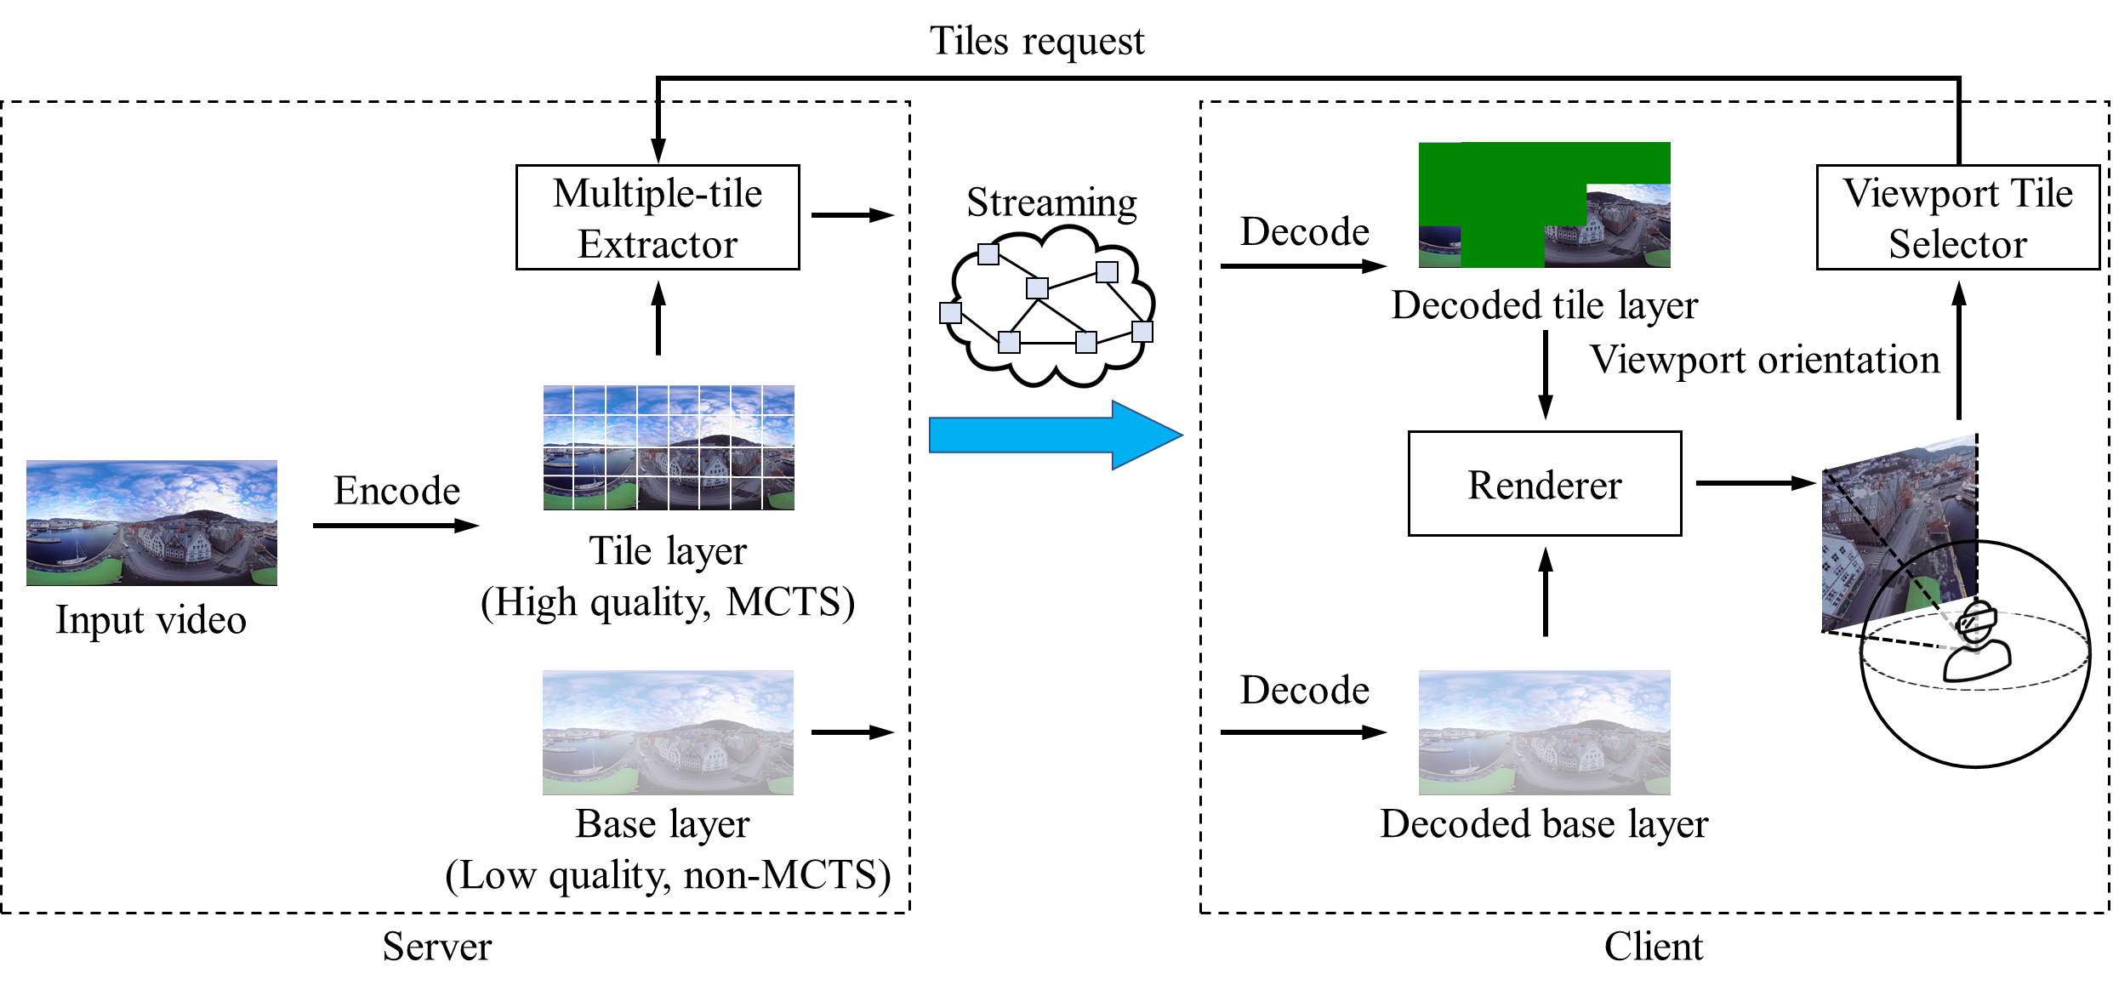
Multiple-tile Extraction for Low-latency Streaming
Server-driven approach to reduce the latency:
multiple-tile extraction, base layer simulcasting
Extracts multiple tiles and generates single bitstream
  two decoders for high-quality low-latency tiled streaming
Low-latency 360-degree video streaming using multiple-tile extraction
3079-20-0057-02-0001 Tile Extractor Optimization for Low-latency Viewport-dependent 360 Video Tiled Streaming

Slide 7
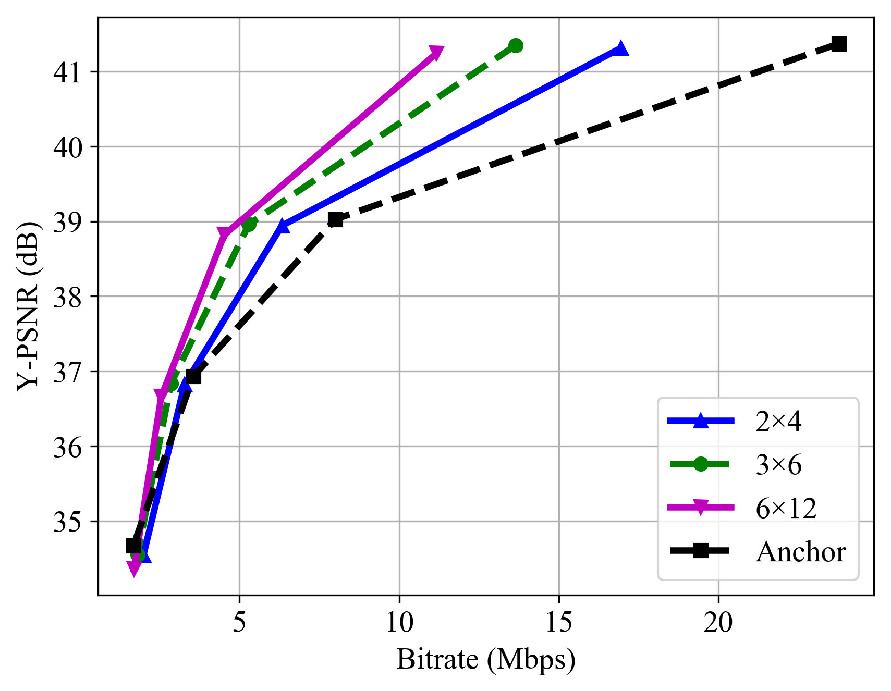
Experimental Results: BD-rate Saving
Used four 4K 360-degree test sequences
Three tiling scenarios (2×4, 3×6, 6×12) were used
In tiled streaming, low-quality base layer (e.g. QP=42) was transmitted
16.98% of BD-rate saving for Y-PSNR was shown
6×12 tiling showed the best BD-rate
  in traditional tiled streaming, generates many bitstreams
Tiling | Y-PSNR | VMAF | MS-SSIM | IV-PSNR
2×4 | -6.05% | 2.95% | -1.73% | -5.14%
3×6 | -19.93% | -8.36% | -12.90% | -17.86%
6×12 | -24.97% | -13.96% | 18.77% | 24.32%
Average | -16.98% | -6.45% | -11.13% | -15.77%
BD-rate savings of the tiled streaming
compared to non-tiled streaming
RD-curve of the tiled streaming,
non-tiled streaming
3079-20-0057-02-0001 Tile Extractor Optimization for Low-latency Viewport-dependent 360 Video Tiled Streaming

Slide 8
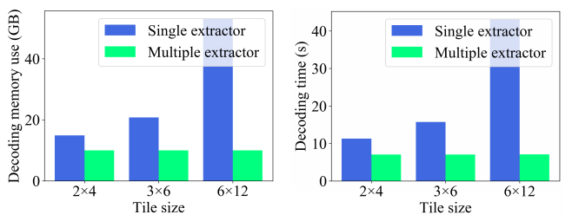
Experimental Results: Decoding Resource Saving
Compared single-tile extractor (STE) and multiple-tile extractor (MTE)
in terms of: decoding memory use and delay
The client has a Intel i7-7700k CPU (4 cores, 8 threads), 16 GB memory, GTX 1080 Ti
6×12 tiling consumed 52.99 GB of memory and 43.04 seconds using STE
  MTE required 10.00 GB and 7.08 seconds
(a)
(b)
Performance comparison between a single tile extractor and multiple tile extractor
in terms of (a) decoding memory use, (b) decoding delay
3079-20-0057-02-0001 Tile Extractor Optimization for Low-latency Viewport-dependent 360 Video Tiled Streaming

Slide 9
Conclusion
Motivation
  360-degree video streaming requires high bandwidth: tiled streaming can be used
  Single tile extraction requires number of decoders
    increases latency which influences quality of experience (QoE)
Proposed Methods and Insights
  Multiple-tile extraction for generating single bitstream
  Showed decoding resource savings compared to the single tile extraction
    66.16%, 69.79% decoding memory and decoding delay savings
Future Work
  Experiments on high-resolution video (e.g. 8K / 16K) will be conducted
3079-20-0057-02-0001 Tile Extractor Optimization for Low-latency Viewport-dependent 360 Video Tiled Streaming

