Slide 1
IEEE 3079 WG Introduction
to IEEE TAB-CoS & SPS Webinar
[Dong Il Dillon Seo / DTCP]
[Sangkwon Peter Jeong / JoyFun]

Slide 2
Compliance with IEEE Standards Policies and Procedures
Subclause 5.2.1 of the IEEE-SA Standards Board Bylaws states, "While participating in IEEE standards development activities, all participants...shall act in accordance with all applicable laws (nation-based and international), the IEEE Code of Ethics, and with IEEE Standards policies and procedures."
The contributor acknowledges and accepts that this contribution is subject to
The IEEE Standards copyright policy as stated in the IEEE-SA Standards Board Bylaws, section 7, http://standards.ieee.org/develop/policies/bylaws/sect6-7.html#7, and the IEEE-SA Standards Board Operations Manual, section 6.1, http://standards.ieee.org/develop/policies/opman/sect6.html
The IEEE Standards patent policy as stated in the IEEE-SA Standards Board Bylaws, section 6, http://standards.ieee.org/guides/bylaws/sect6-7.html#6, and the IEEE-SA Standards Board Operations Manual, section 6.3, http://standards.ieee.org/develop/policies/opman/sect6.html

Slide 3
IEEE 3079 Human Factor for Immersive Content Working Group Seo, Dong Il Dillon, dillon.seo@dtcp.capital
IEEE 3079 WG Introduction to IEEE TAB-CoS & SPS Webinar
Date: 2020-10-20
Author(s): Seo, Dong Il Dillon
Name | Affiliation | Phone | Email
Jeong, Sangkwon Peter | JoyFun | +82 10 8667 7329 | ceo@joyfun.kr
Seo, Dong Il | DTCP | +82 10 3135 3194 | dillon.seo@dtcp.capital

Slide 4
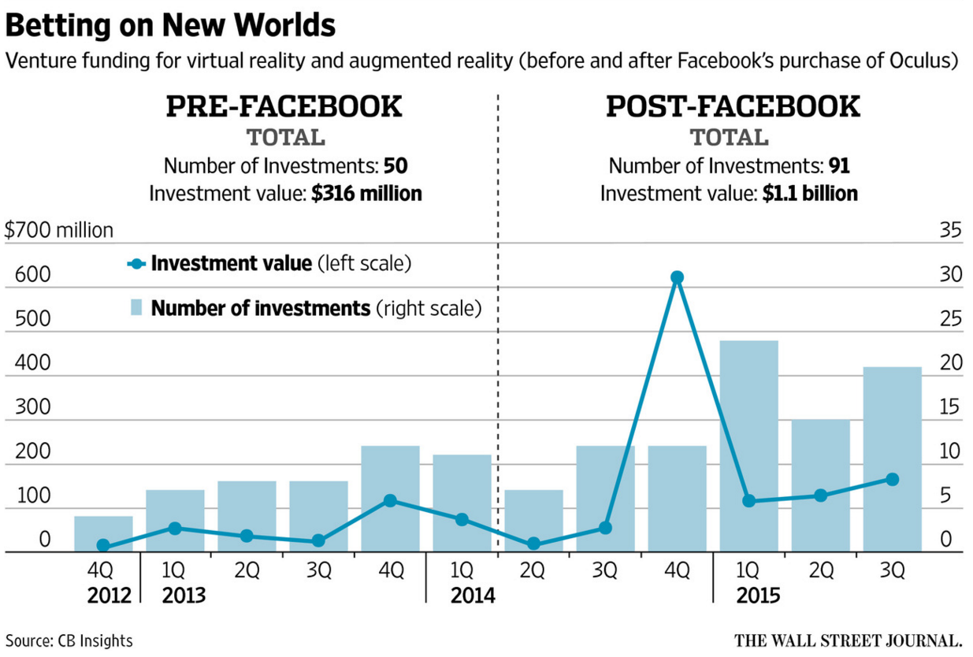
Background

Slide 5
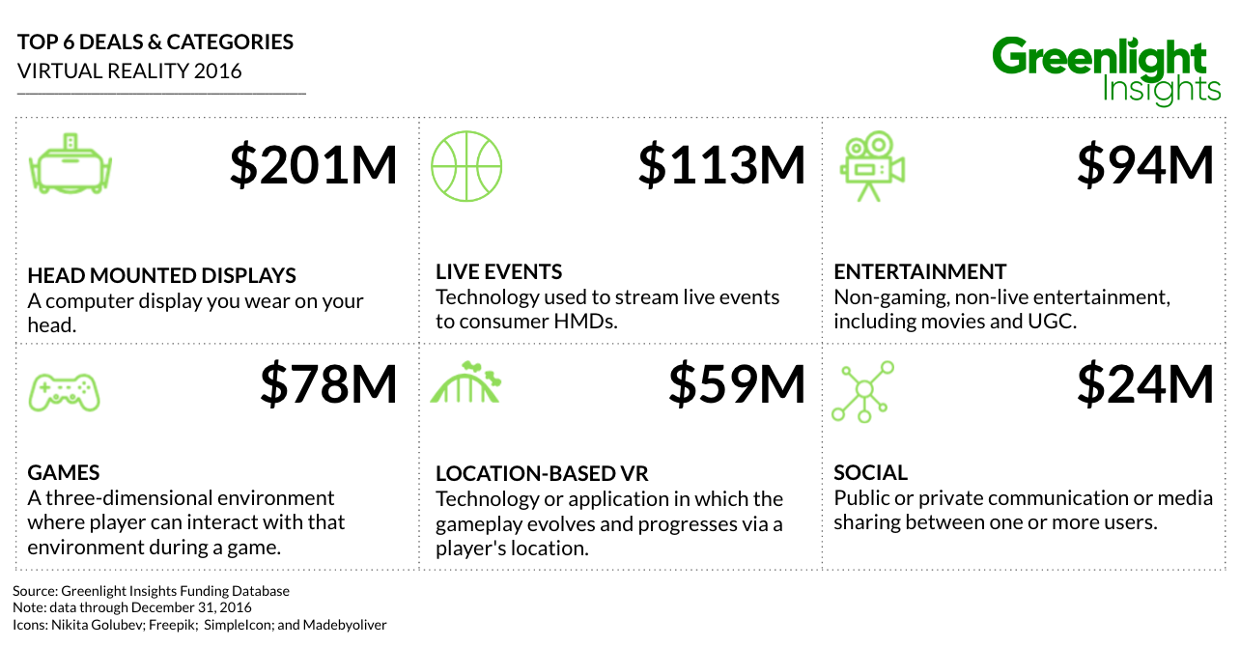
Background

Slide 6
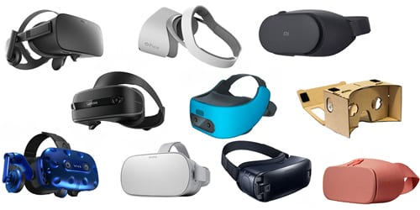
Background

Slide 7
Background

Slide 8
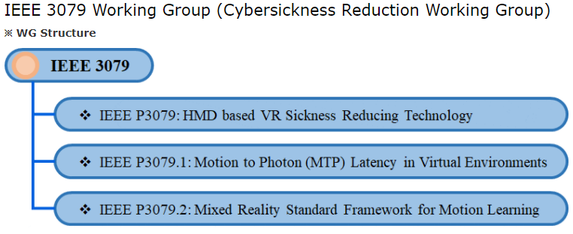
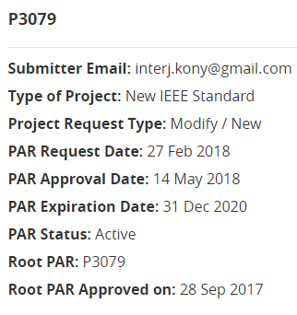
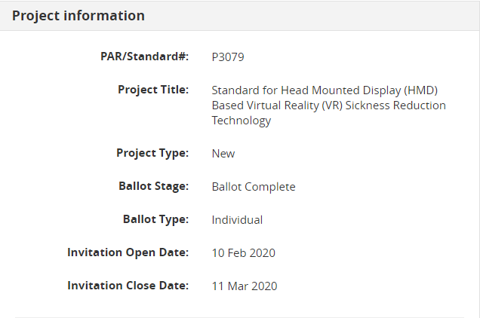
Introduction

Slide 9
Scope (Original)

Slide 10
Scope (Modified)
VR Content Design
VR Sickness Assessment
Motion to Photon Latency (Measurement & Network)

Slide 11
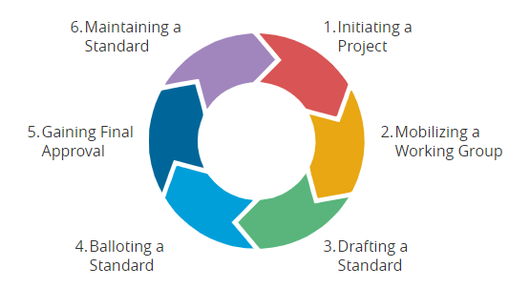
Results
IEEE Standard Development Procedures

Slide 12
Discussion
What would be the ideal frame rate for VR content to minimize the VR sickness?
What would be the ideal resolution for VR content to minimize the VR sickness?
How do we properly measure the motion to photon latency?
……
Many questions are still needed to be answered!

Slide 13
Thank You

