Slide 1
[User’s content operational issues on MTP latency ]
[Beom-Ryeol Lee, Younho Lee, Wookho Son/ETRI]

Slide 2
Compliance with IEEE Standards Policies and Procedures
Subclause 5.2.1 of the IEEE-SA Standards Board Bylaws states, "While participating in IEEE standards development activities, all participants...shall act in accordance with all applicable laws (nation-based and international), the IEEE Code of Ethics, and with IEEE Standards policies and procedures."
The contributor acknowledges and accepts that this contribution is subject to
The IEEE Standards copyright policy as stated in the IEEE-SA Standards Board Bylaws, section 7, http://standards.ieee.org/develop/policies/bylaws/sect6-7.html#7, and the IEEE-SA Standards Board Operations Manual, section 6.1, http://standards.ieee.org/develop/policies/opman/sect6.html
The IEEE Standards patent policy as stated in the IEEE-SA Standards Board Bylaws, section 6, http://standards.ieee.org/guides/bylaws/sect6-7.html#6, and the IEEE-SA Standards Board Operations Manual, section 6.3, http://standards.ieee.org/develop/policies/opman/sect6.html
33

Slide 3
IEEE 3079 HMD Based VR Sickness Reducing Technology Dong Il Dillon Seo, dillon.seo@telekom-capital.com
User’s content operational issues on MTP latency
Date: 2020-10-21
Author(s): Beom-Ryeol Lee, Yongho Lee, Wookho Son
Name | Affiliation | Phone | Email
Beom-Ryeol Lee | ETRI | +82 10 8880 3347 | Lbr@etri.re.kr
Yongho Lee | ETRI | +82 10 3008 5770 | jason0720@etri.re.kr
Wookho Son | ETRI | +82 10 8759 3602 | whson@etri.re.kr

Slide 4
Contents
MTP latency
Standards developing guidelines
Related paras on MTP latency
User related paras on MTP latency
Content delivery paras on MTP latency
Network configuration paras on MTP latency
Discussion

Slide 5
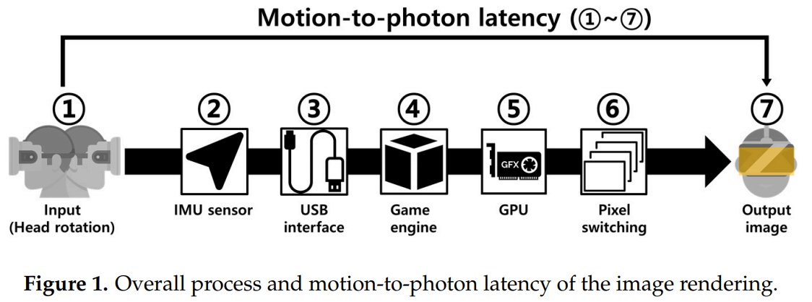
MTP Latency
What is MTP latency?
https://medium.com/@DAQRI/motion-to-photon-latency-in-mobile-ar-and-vr-99f82c480926
Motion to Photon Latency in Mobile AR and VR
https://www.ncbi.nlm.nih.gov/pmc/articles/PMC5470788/pdf/sensors-17-01112.pdf
Photosensor-Based Latency Measurement System for Head-Mounted Displays
Interaction-to-photon latency
Mouth-to-ear latency

Slide 6
MTP Latency
Why MTP latency?
Content Immersion
Quality of Experience
Device Manufacturer
Why MTP latency standards?
Measuring Methods and Procedure
User’s Perceptual Tolerance
Content Preference
Device Manufacturing reference

Slide 7
Standards developing guidelines in 3079
What is the standard?
Definition of Standard in 3079 ?
Standard
Guideline
Reference
Architecture
Specification
Functionality
Platform
Framework
Middleware
Dataset
Model
Format, Metadata

Slide 8
Standards developing guidelines in 3079
IEEE-SASB: NesCom/RevCom/ProCom/PatCom/AudCom/AdCom
3079 Standards Developing Process
Par → cFp / Market Request and Customer Request
Technical Seminar / Cases of Products
Developing Participants
Developing Projects for Standardization Supporting and Funding
Exit Plan of Standards
Marketing Plan
Scope of the Standard
Classify user
Use cases & Scenarios
User Requirement(functional/non-functional)
System Requirement
System Spec.
Reference Content
API Spec.
Reference Implementation
Testing Tools
Configuration Management

Slide 9
Related paras on MTP latency
User/Content/Display devices/Network/Content delivery
Reference content/user test/baseline of user’s response
Personalized features
Requirement on MTP latency
MTP latency: 10~20msec
Resolution full-view sphere video: 12K~24K
Resolution on FOV: 4K ~
FOV: 120 degree ~
Frame rate: 60~120fps
Refresh rate: 90Hz
Device cost: low
Battery consumption: minimum
Tethered or standalone devices
Content downloading or streaming
Operator’s traffic: minimum
…

Slide 10
User related paras on MTP latency
User’s cognitive latency ¹⁾
cf) device/network latency
Perceptual tolerance ranges
with content
User experience
Three phases: Fair/Comfortable/Ideal-experience
Service experience indicators
https://www.microsoft.com/en-us/research/publication/measuring-system-visual-latency-through-cognitive-latency-on-video-see-through-ar-devices/
Measuring System Visual Latency through Cognitive Latency on Video See-Through AR devices

Slide 11
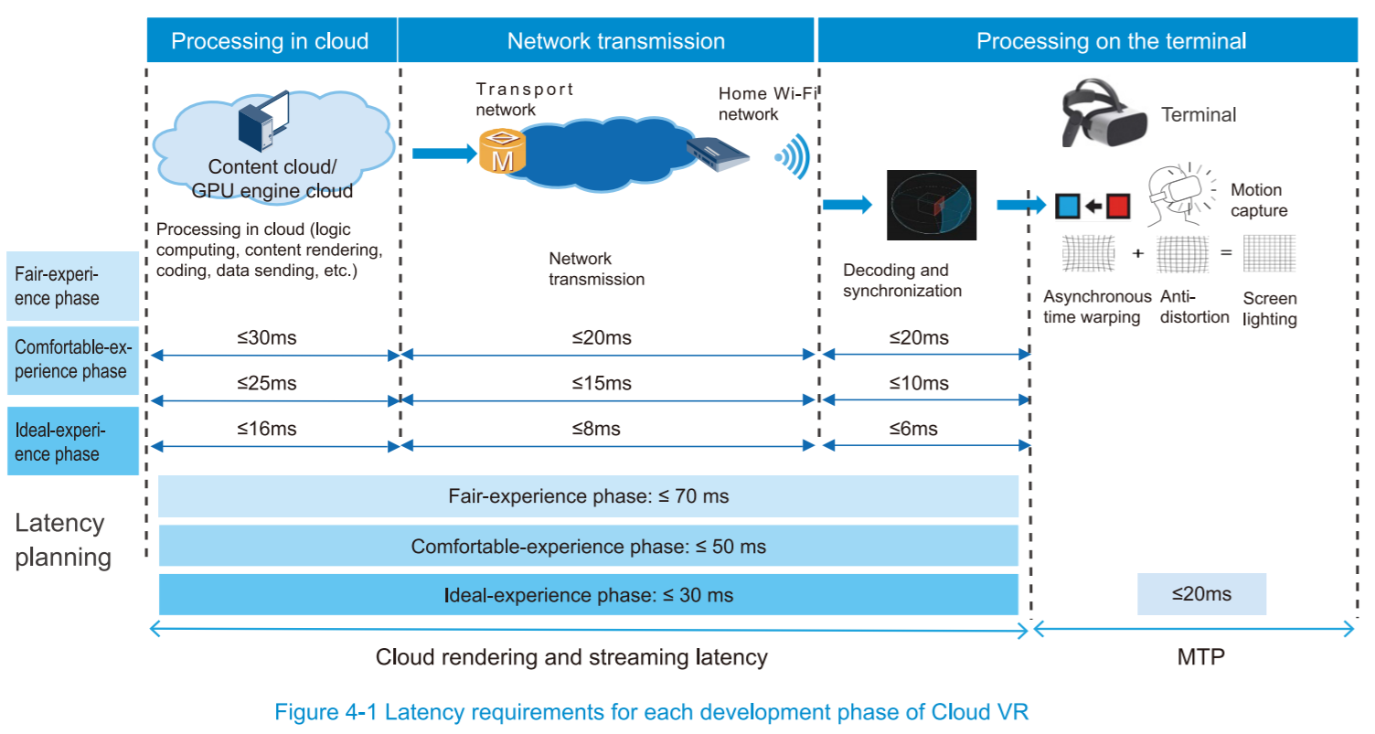
Expected Latency Requirements
※ https://www.huawei.com/minisite/pdf/ilab/cloud_vr_solutions_wp_en.pdf
Cloud VR Solution White Paper - Huawei

Slide 12
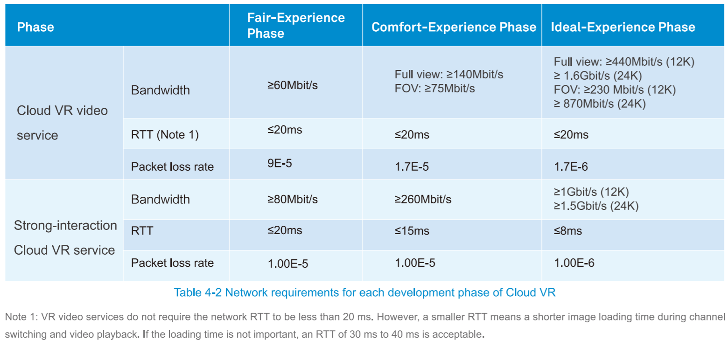
Expected Network Requirements
※ https://www.huawei.com/minisite/pdf/ilab/cloud_vr_solutions_wp_en.pdf
Cloud VR Solution White Paper - Huawei

Slide 13
Content delivery paras on MTP latency
 | Content Delivery | Computing | Computation | Network Latency
1. | Downloading | Device | Standalone | No
2. | Streaming | Edge | On-premise | 수ms
3. | Streaming | Edge | Operator Edge | 수ms~수십ms
4. | Streaming | Cloud | ISP | 수십ms~수백ms

Slide 14
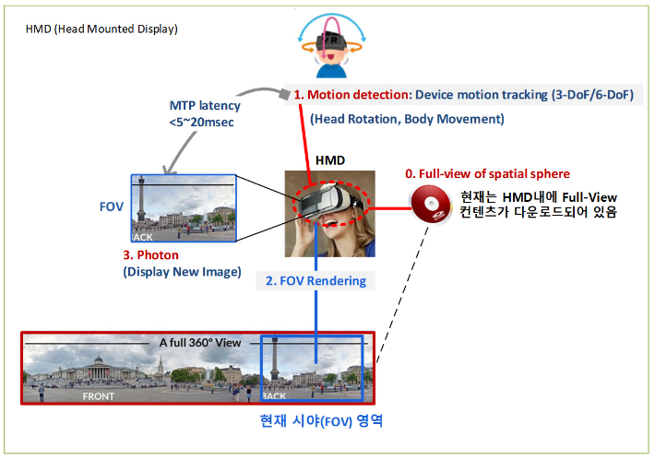
Content delivery paras on MTP latency
1. Downloading - Standalone, FOV Rendering
Full-view content downloaded
Current FOV region
※ https://netmanias.com/ko/?m=view&id=blog&no=13939
VR and Edge Computing, Dec 12, 2018

Slide 15
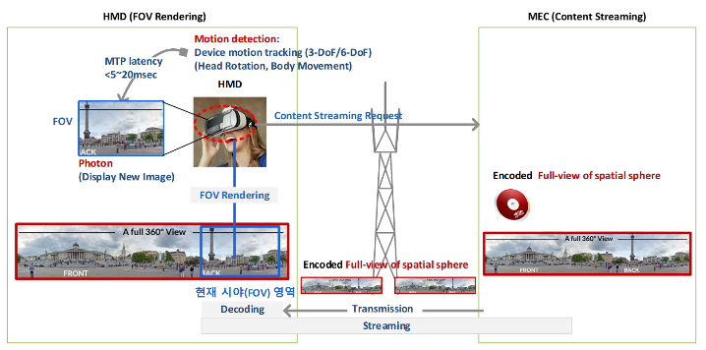
Content delivery paras on MTP latency
2. Streaming – Full view streaming/transmission
Current FOV region
※ https://netmanias.com/ko/?m=view&id=blog&no=13939
VR and Edge Computing, Dec 12, 2018

Slide 16
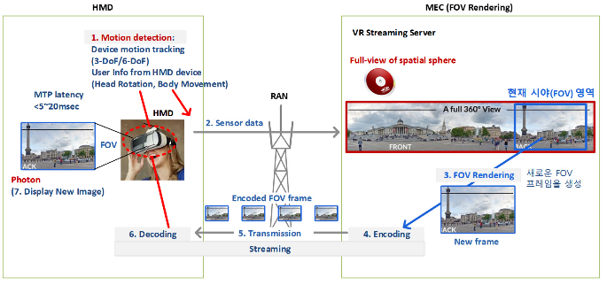
Content delivery paras on MTP latency
3. Streaming – FOV streaming/transmission
Current FOV region
Create new FOV frame
※ https://netmanias.com/ko/?m=view&id=blog&no=13939
VR and Edge Computing, Dec 12, 2018

Slide 17
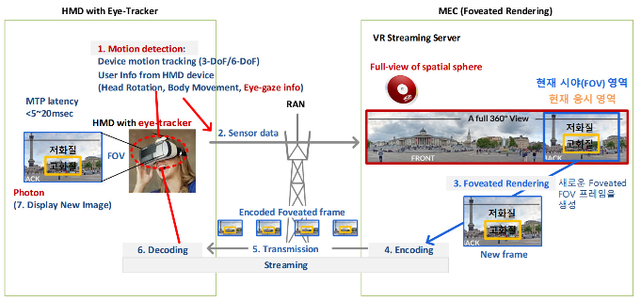
Content delivery paras on MTP latency
4. Streaming – FOV + Foveated Rendering transmission
Current FOV region
Current viewing area
Create new Foveated FOV frame
Low Quality
High Quality
※ https://netmanias.com/ko/?m=view&id=blog&no=13939
VR and Edge Computing, Dec 12, 2018

Slide 18
Network configuration paras on MTP latency
VR System
Total Motion-to-Photon Latency ≤20ms
HMD
Motion
Input
New Image
Output
①
1ms
⑦
Pixel
Switching
1ms
IMU
90Hz OLED Display 11ms
⑥
②
Write Display
Local Content Server
⑤
Data Processing Unit
2ms
Remote Content Server
③
④
Data Processing Unit
2ms
※ 3079-18-0035-00-0003 Network Diagrams for HMD based VR Service

Slide 19
Network configuration paras on MTP latency
Case | Status of each node |  |  |  |  |  |  | Remarks
 | ① | ② | ③ | ④ | ⑤ | ⑥ | ⑦
1 | direct | Wired connection (e.g. HDMI) | Wired WAN | Wired WAN | Wired connection (e.g. HDMI) | chip | display Panel | Wired Network | VIVE / Oculus / PS VR
2 | direct | on Board | Wireless WLAN | Wireless WAN | on Board | chip | display Panel | Wireless Network | Gear VR or Oculus GO
3 | direct | on Board | Cellular network | Cellular network | on Board | chip | display Panel | Mobile Network | Gear VR or Oculus GO
4 | direct | LAN / Wireless connection | n/a | n/a | LAN / Wireless connection | chip | display Panel | Local Network | VIVE / Oculus / PS VR
5 | Sensor Network | Wired connection (e.g. HDMI) | n/a | n/a | Wired connection (e.g. HDMI) | chip | display Panel | Motion Sensing | Whole kinds HMD
6 | direct | on Board | Cellular network / Wireless LAN | Cellular network / Wireless LAN | on Board | chip | display Panel | Network Handover | Gear VR or Oculus GO
※ 802.21-18-0039-02-0000 New Diagram for Network Enablers
for seamless HMD based VR Content Service

Slide 20
Discussion
Standardization Process in 3079
Scope of the Standard
Extract Parameters on MTP Latency
User Perception and Immersion → Quality of Experience → Quality of Immersion → Quality of Interaction
Motion to Photon Latency → Interaction to Photon Latency, Mouth to Ear Latency

Slide 21
Thank You

