Slide 1
Experiment for VR Sickness
by Motion-to-Photon (MTP) Latency
Lim, Hyun Kyoon, Ph.D. (contact: hlim@kriss.re.kr)
Moonyoung Kwon, Kyoung-Mi Jang , Sun Gu Nam, Da Mee Kim
Korea Research Institute of Standards and Science (KRISS)

Slide 2
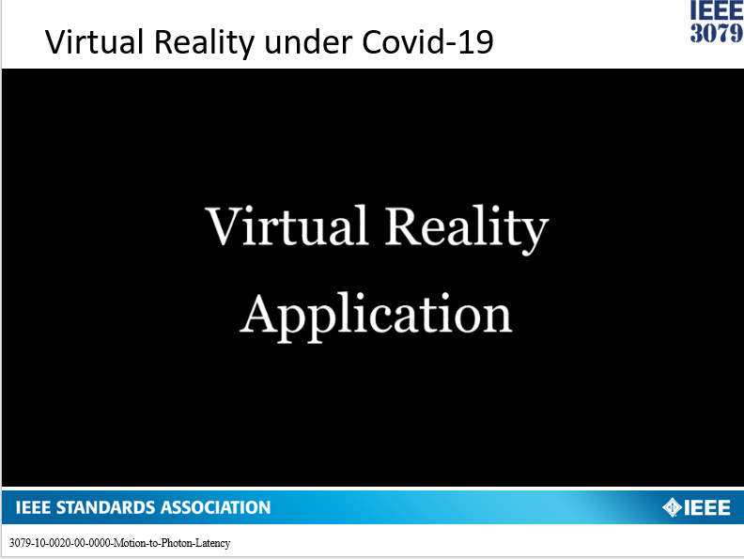

Slide 3
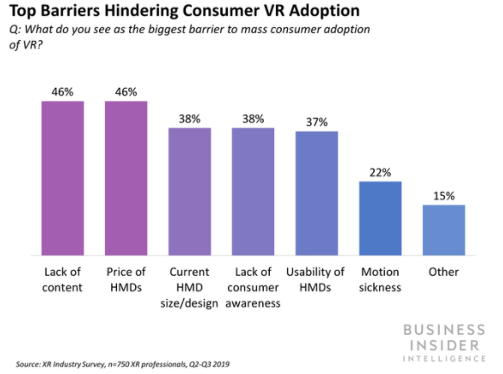
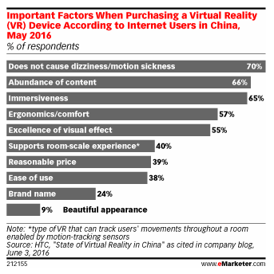
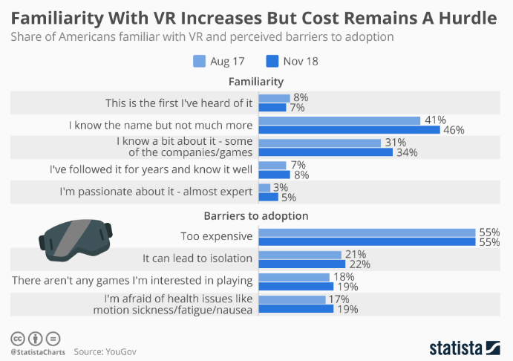
Hurdles for Adoption of VR

Slide 4
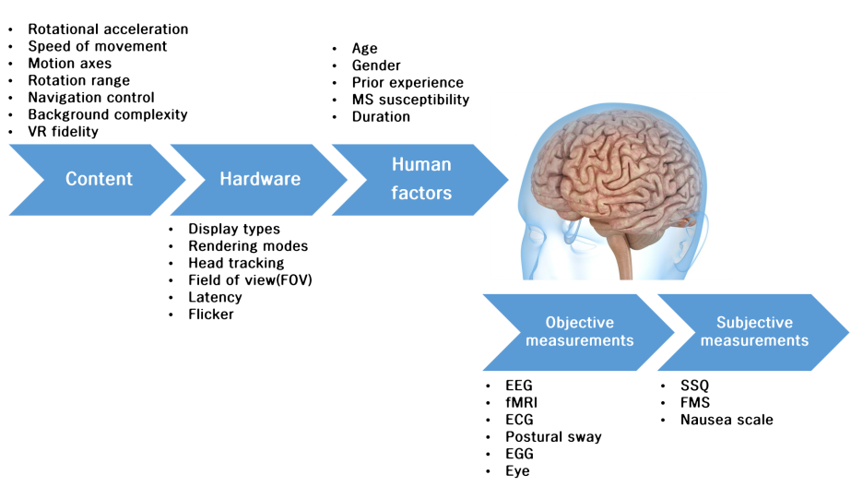
VR Sickness from

Slide 5
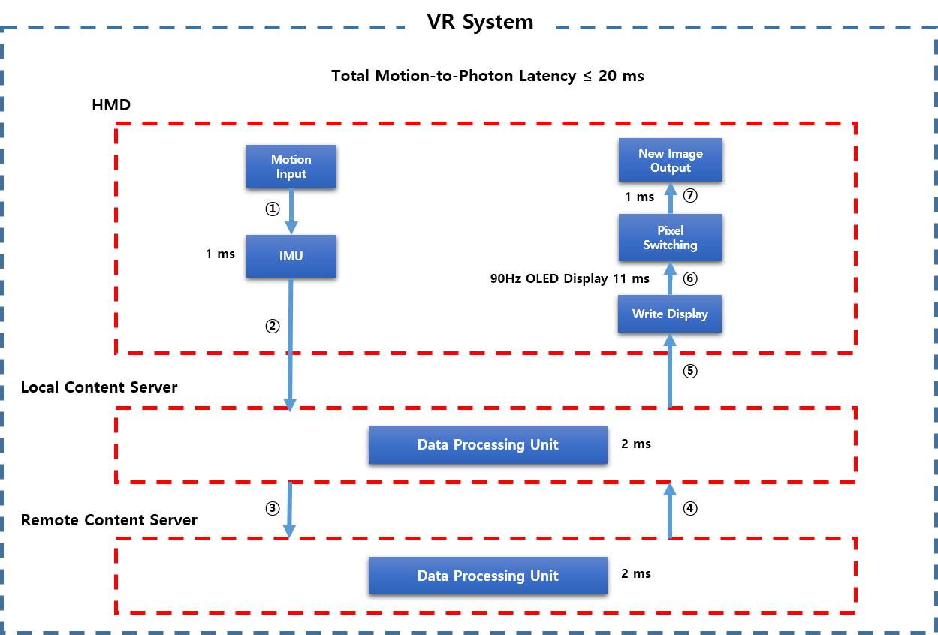
Latency in HMD

Slide 6
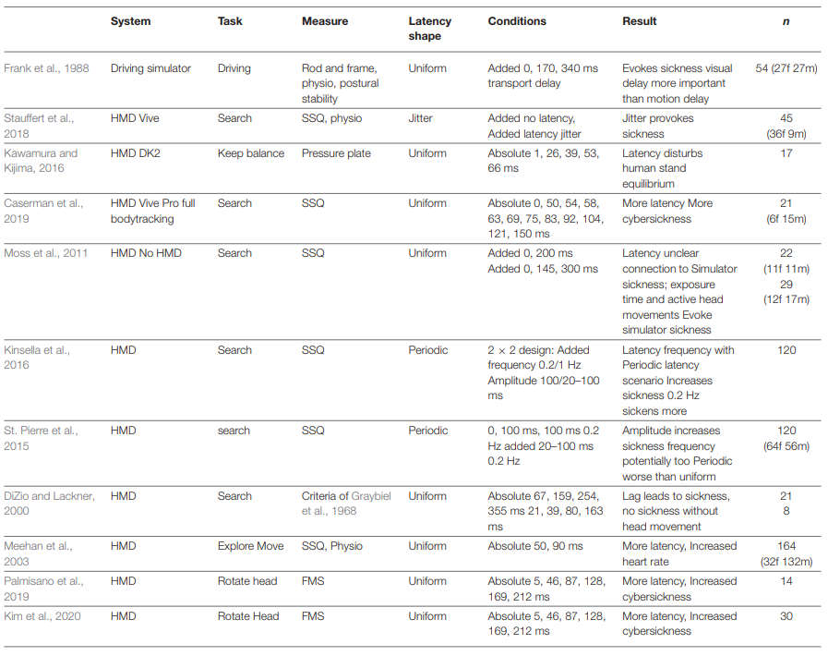
Related Works (Latency and VR sickness)
Stauffert et al., 2020
Previous studies of VR sickness by latency investigated
using subjective measurements (SSQ, FMS)
Our lab studies the impact by using objective information (EEG)

Slide 7
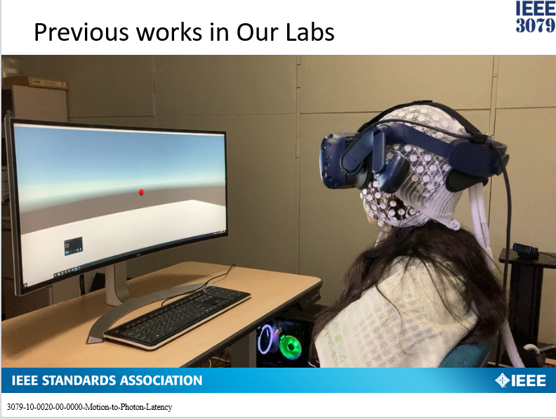
Previous works in Our Labs

Slide 8
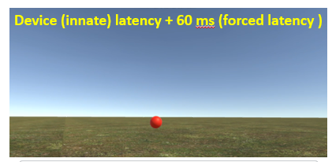
Previous works
Move head left and right following visual cue (red ball)
Field of view (FOV): 80°
Head movement speed: 80 °/s.
Forced latency: 0, 15, 30, 45, and 60 ms
Each trial lasts 2 min
Device (innate) latency + 60 ms (forced latency )

Slide 9
Modified Task
Problem
  Aim: movement → video delay
  Previous task: video → movement
  → Less VR sickness by focusing red ball
Correction
  Visual stimulus (FOV)
    Moving red ball → Fixed bars
  Neck movement (Speed)
    Following visual cue → matched to auditory cue
  → Evoked VR sickness by MTP latency

Slide 10
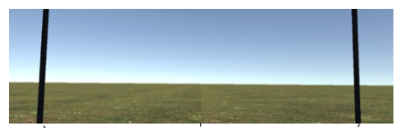

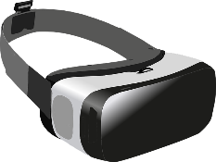
Modified Task
Neck movement
  80°/sec
Beep sound
  Every second
  To limit
  movement speed
Added latency
  0 (only innate), 30, 60 ms
Beep
Beep
40°
40°

Slide 11
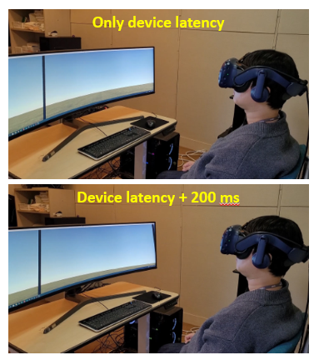
Experiment Videos
Only device latency
Device latency + 200 ms
To help your understand, the latency (200 ms) was used for video recording
We do not conduct experiment using additional latency of 200 ms

Slide 12

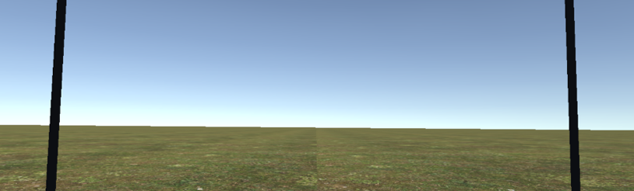
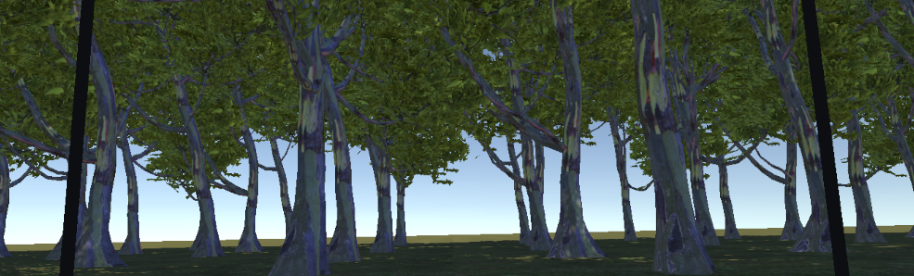
Composition of Video
Stage 1
Stage 1
  Black background
  Effect of head movement
Stage 2
  Sky, ground
  Low complexity
Stage 3
  Sky, ground, trees
  High complexity
Stage 2
Stage 3

Slide 13
In the Next Meeting,
Current
Steps
Modify VR Videos
Fix Experimental Procedure
Conduct Experiment with EEG
Analysis of EEG Changes by MTP Latency
VR Video Evaluation
Please give any comments for the videos to us

Slide 14
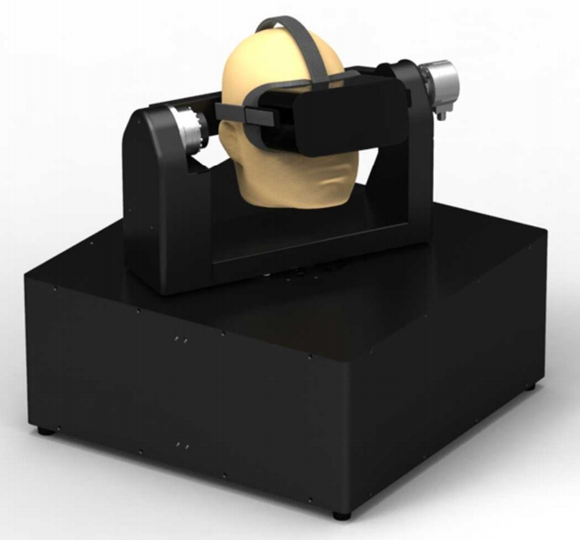
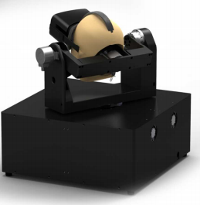
Upgrade MTP Latency Measurement System
(3 Degree of Freedom)
<Drawing of Design>
Head mounted display (HMD)

Slide 15
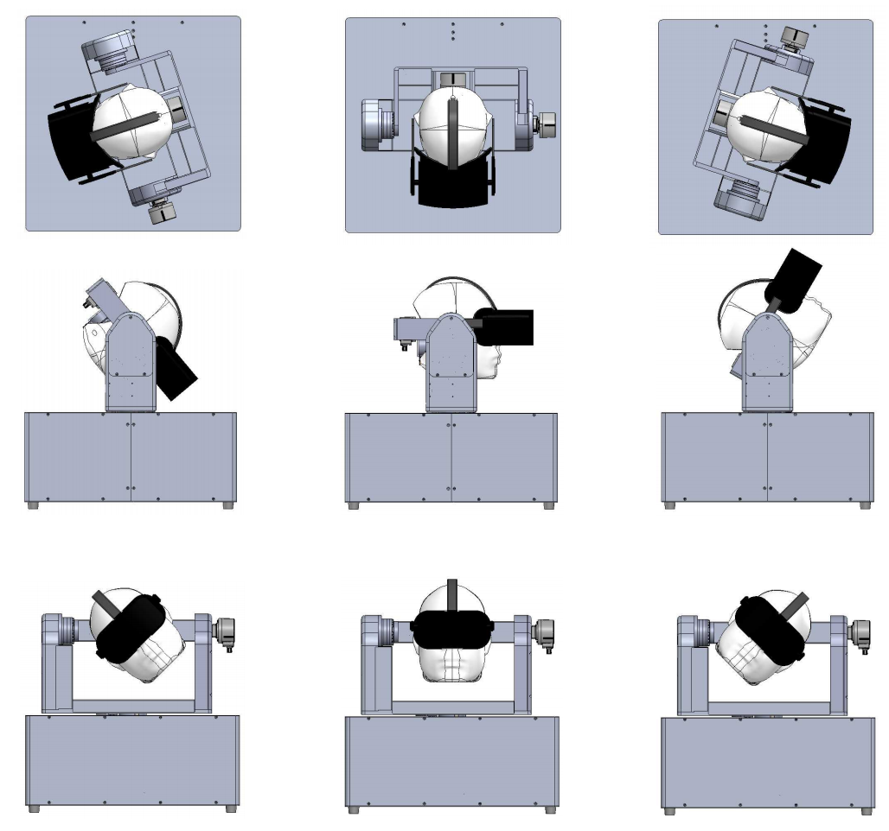
Normal Range of Neck Motion
Yaw
(-72° to +72 °)
Pitch
(-50° to +60 °)
Roll
(-45° to +45 °)

Slide 16
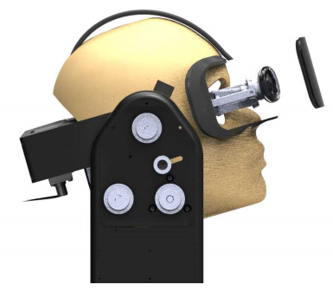
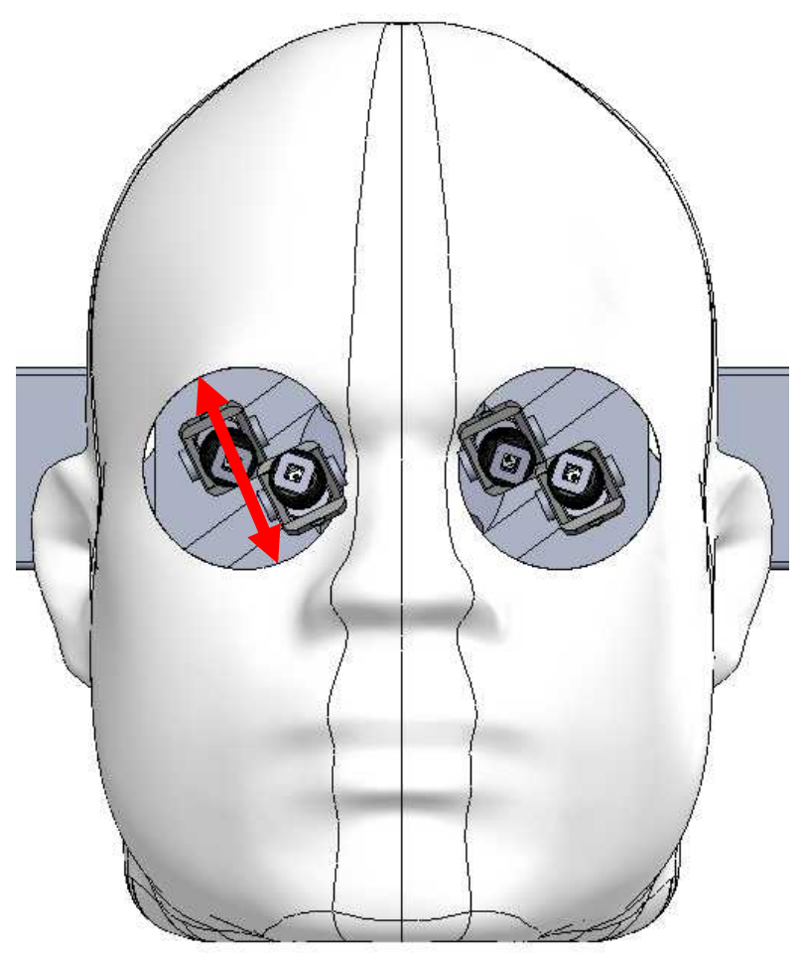
Photosensor in the Measurement System
Photosensor

Slide 17
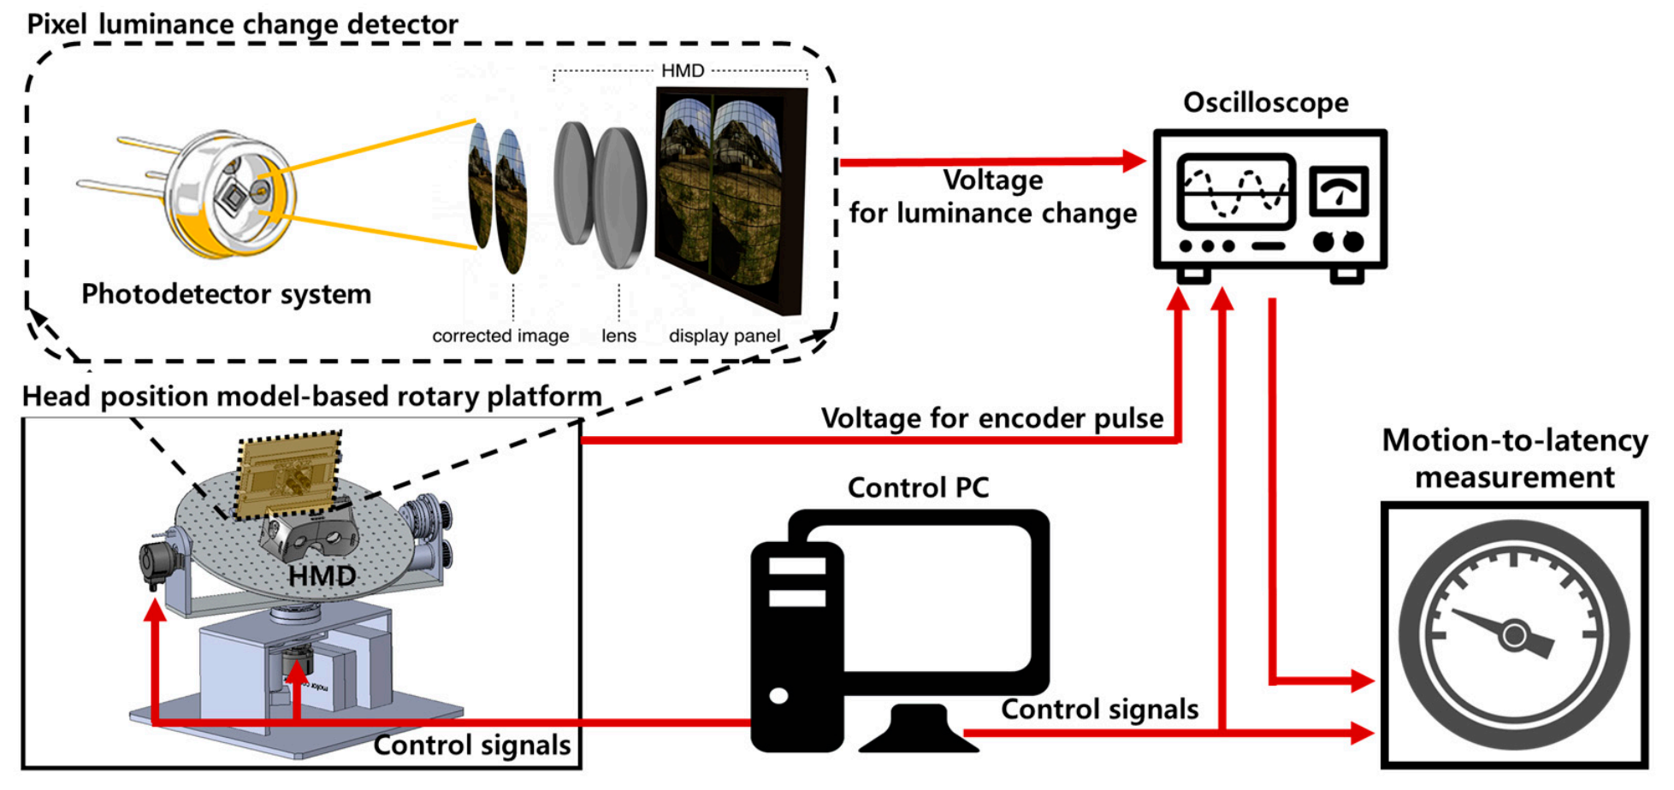
Diagram of Device MTP Latency Measurement
Seo et al., Sensors 2017

Slide 18
Thank You

