Slide 1
VR Sickness Parameter - Discussion on a FOV Study
[Lim, Hyun Kyoon, PhD
Korea Research Institute of Standards and Science]

Slide 2
Compliance with IEEE Standards Policies and Procedures
Subclause 5.2.1 of the IEEE-SA Standards Board Bylaws states, "While participating in IEEE standards development activities, all participants...shall act in accordance with all applicable laws (nation-based and international), the IEEE Code of Ethics, and with IEEE Standards policies and procedures."
The contributor acknowledges and accepts that this contribution is subject to
The IEEE Standards copyright policy as stated in the IEEE-SA Standards Board Bylaws, section 7, http://standards.ieee.org/develop/policies/bylaws/sect6-7.html#7, and the IEEE-SA Standards Board Operations Manual, section 6.1, http://standards.ieee.org/develop/policies/opman/sect6.html
The IEEE Standards patent policy as stated in the IEEE-SA Standards Board Bylaws, section 6, http://standards.ieee.org/guides/bylaws/sect6-7.html#6, and the IEEE-SA Standards Board Operations Manual, section 6.3, http://standards.ieee.org/develop/policies/opman/sect6.html

Slide 3
IEEE 3079 Human Factor for Immersive Content Working Group Seo, Dong Il Dillon, dillon.seo@dtcp.capital
Experiment for VR Sickness by Motion-to-Photon (MTP) Latency
Date: 2021-01-31
Author(s): Lim, Hyun Kyoon
Name | Affiliation | Phone | Email
Lim, Hyun Kyoon | KRISS |  | hlim@kriss.re.kr
Kwon, Moonyoung | KRISS |  | mykwon@kriss.re.kr
Jang, Kyoung-Mi | KRISS |  | cest20@hanmail.net
Nam, Sun Gu | KAIST |  | naisz@kaist.ac.kr
Kim, Da Mee | KRISS |  | dameeing@kriss.re.kr

Slide 4
한국컴퓨터 그래픽스학회 Vol 24/No 3, 2018

Slide 5
FOV Restrictor를 활용한 가상 멀미 저감 요소 기술연구
No FOV Restrictor – 제한 없음, 일반적, 110°
Center-fixed FOV Restrictor
Eye-tracking FOV Restrictor

Slide 6
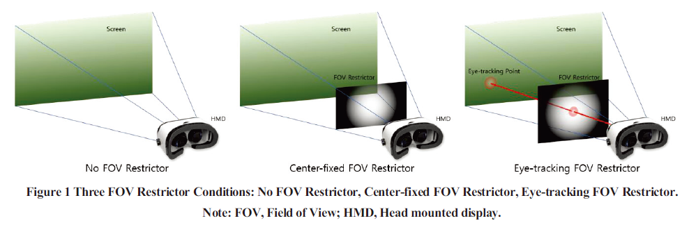

Slide 7
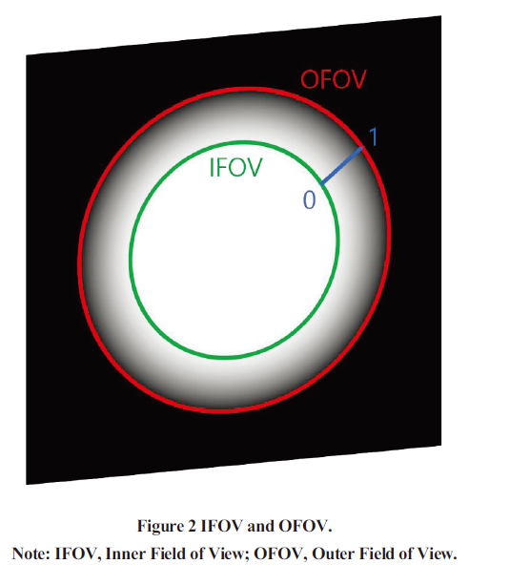

Slide 8
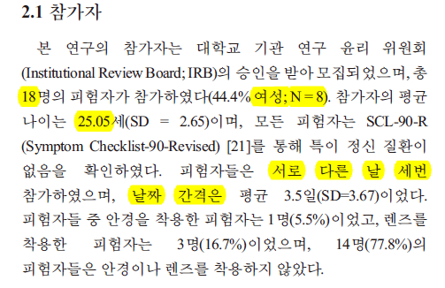

Slide 9
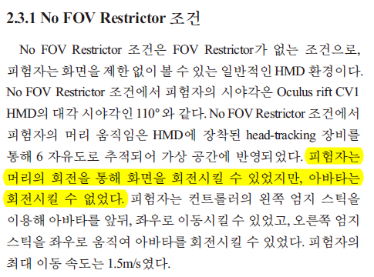

Slide 10
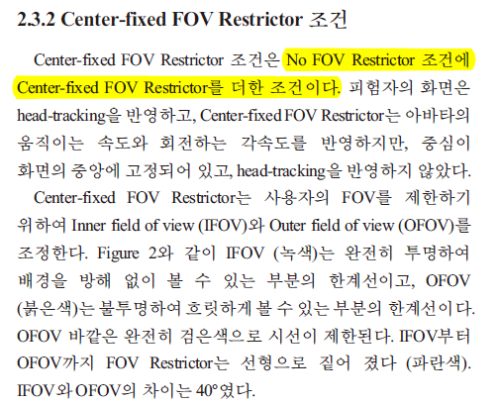

Slide 13
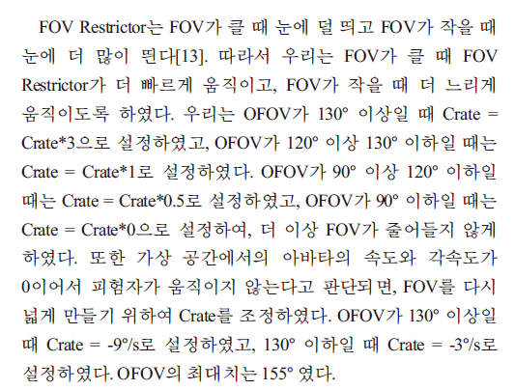

Slide 14
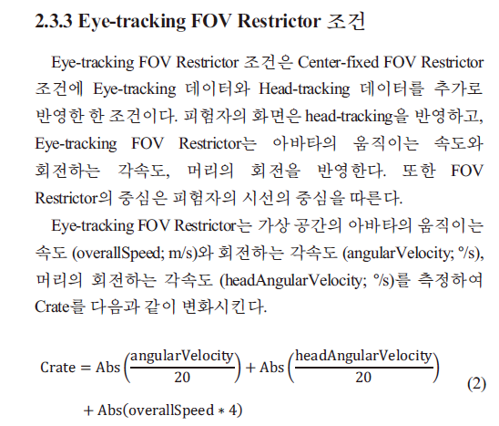

Slide 15
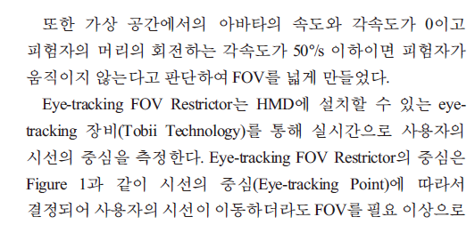
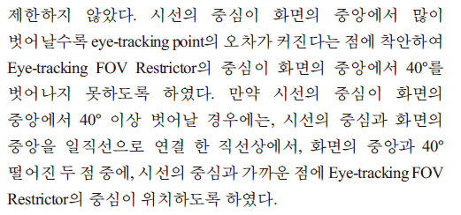

Slide 16
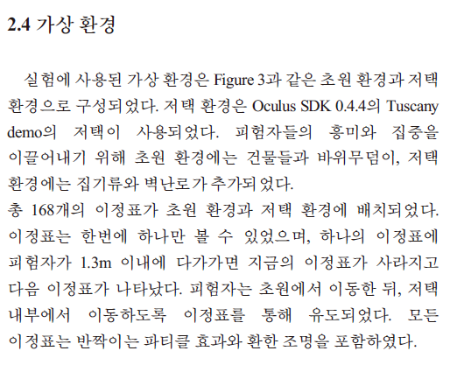

Slide 17
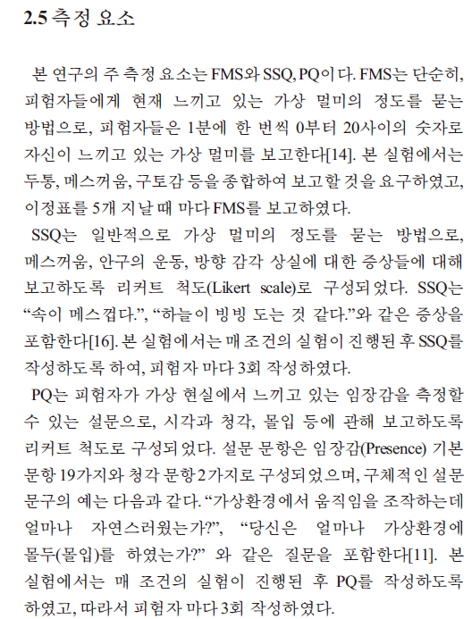

Slide 18
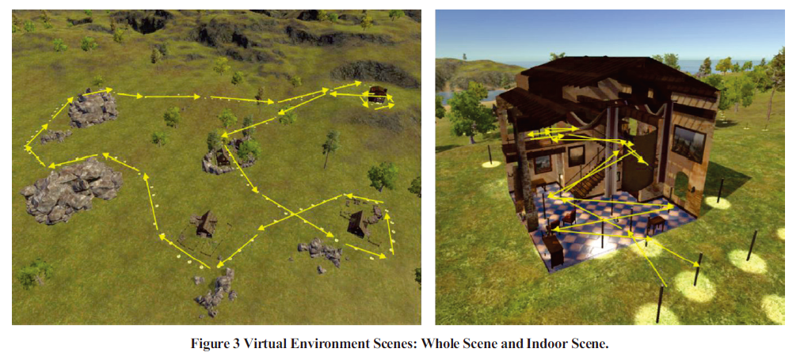

Slide 19
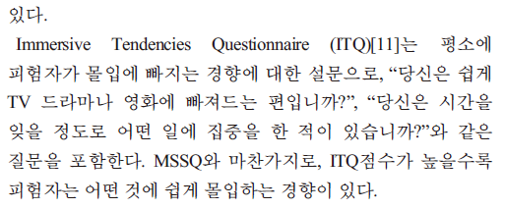

Slide 20
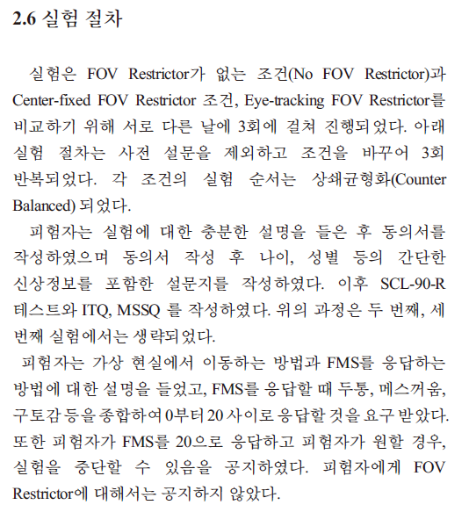

Slide 21
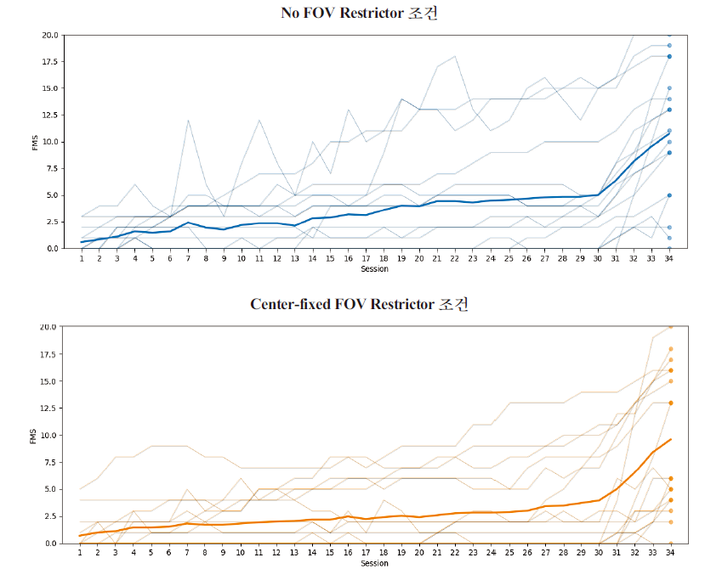

Slide 22
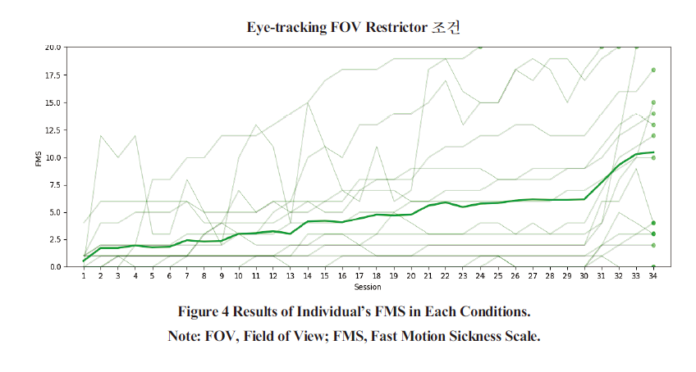

Slide 23
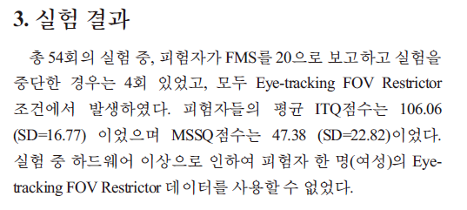

Slide 24
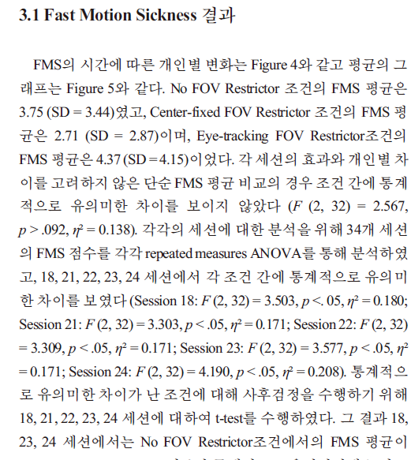
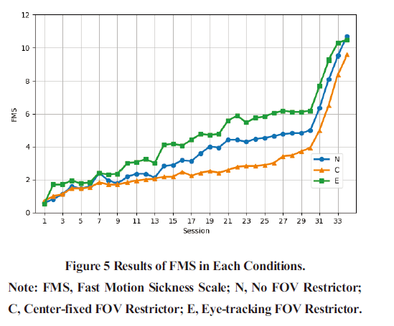

Slide 26
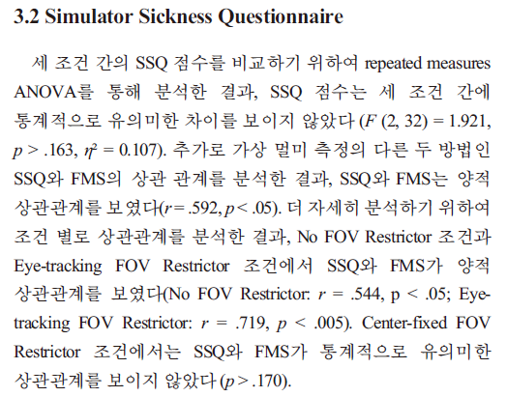

Slide 27
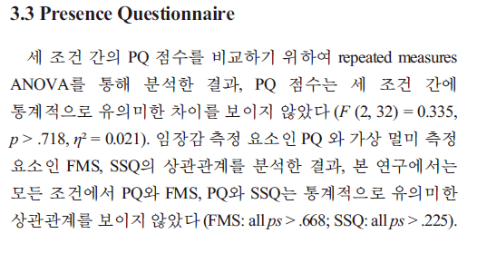

Slide 28
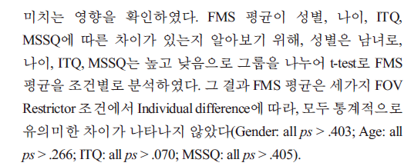

Slide 29
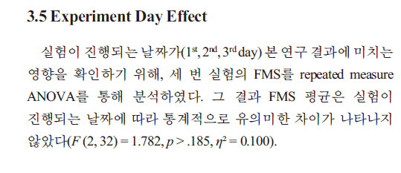

Slide 30
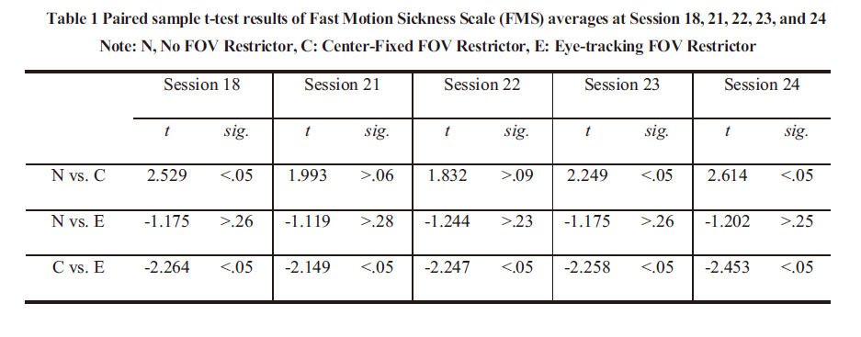

Slide 31
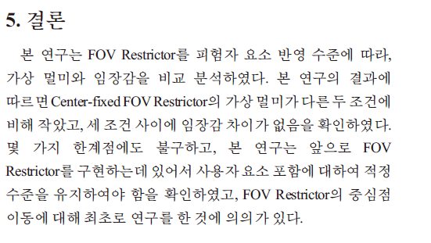

Slide 32
Thank You

