Slide 1
[ Monitoring and Measuring Procedures of the Quality of User Interaction on the Extended Reality Content ]
[Beom-Ryeol Lee, Younho Lee, Jung-Chul Park, Wookho Son/ETRI]

Slide 2
Compliance with
IEEE Standards Policies and Procedures
Subclause 5.2.1 of the IEEE-SA Standards Board Bylaws states, "While participating in IEEE standards development activities, all participants...shall act in accordance with all applicable laws (nation-based and international), the IEEE Code of Ethics, and with IEEE Standards policies and procedures."
The contributor acknowledges and accepts that this contribution is subject to
The IEEE Standards copyright policy as stated in the IEEE-SA Standards Board Bylaws, section 7, http://standards.ieee.org/develop/policies/bylaws/sect6-7.html#7, and the IEEE-SA Standards Board Operations Manual, section 6.1, http://standards.ieee.org/develop/policies/opman/sect6.html
The IEEE Standards patent policy as stated in the IEEE-SA Standards Board Bylaws, section 6, http://standards.ieee.org/guides/bylaws/sect6-7.html#6, and the IEEE-SA Standards Board Operations Manual, section 6.3, http://standards.ieee.org/develop/policies/opman/sect6.html

Slide 3
IEEE 3079
HMD Based VR Sickness Reducing Technology
Dong Il Dillon Seo, dillon.seo@telekom-capital.com
Monitoring and Measuring Procedures of the Quality of User Interaction on the Extended Reality Content
Date: 2021-04-12
Author(s): Beom-Ryeol Lee, Yongho Lee, Jung-Chul Park, Wookho Son
Name | Affiliation | Phone | Email
Beom-Ryeol Lee | ETRI | +82 10 8880 3347 | Lbr@etri.re.kr
Yongho Lee | ETRI | +82 10 3008 5770 | jason0720@etri.re.kr
Jung-Chul Park | ETRI | +82 10 6565 7297 | jucpark@etri.re.kr
Wookho Son | ETRI | +82 10 8759 3602 | whson@etri.re.kr

Slide 4
Contents
Quality of User Interaction(QoI)
Standardization of QoI
Procedure of monitoring and measuring QoI
Conclusion and Discussion

Slide 5
Background
User satisfaction rating issue for the extended reality content from the perspective of users and developers
Need for evaluation criteria for user interaction satisfaction considering the correlation of characteristic parameters that can affect the user’s realism and immersion on the extended reality content
Need to present quantitative comparison criteria for user interaction satisfaction by the extended reality content

Slide 6
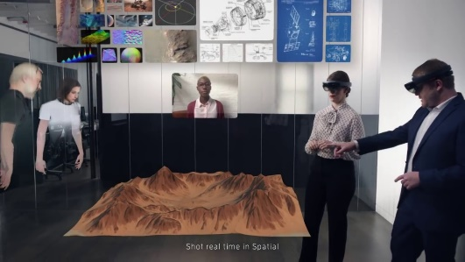
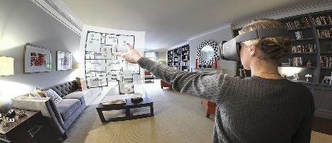
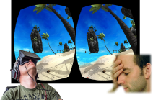
Quality of User Interaction
Quality of User Interaction: The level of satisfaction that reflects the user’s interaction results as they experience realistic content such as extended reality content.
QoE(Quality of Experience)
Scenario
Quality of User Interaction)
VR Sickness
Immersiveness
Emotion
Delay
Camera Movement
Eye Tracking
Object Movement
Precision
Image Complexity
User Movement
Depth
FoV
Frame Rate
Resolution

Slide 7
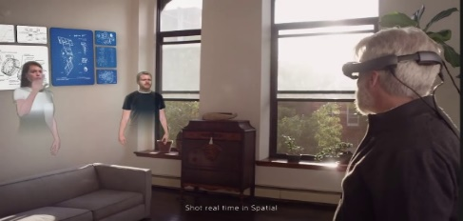


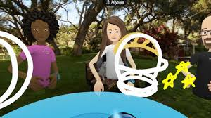



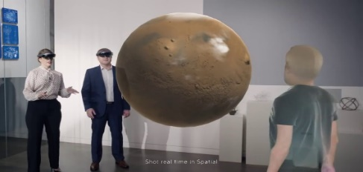

Immersive content for users
Light-weight devices, Low-latency, Interaction synchronization, Extended user experience
eXtended Reality
AR - Remote Space
Mixed Reality
VR - Virtual Collaborating Space
5G Multi-access Edge Computing
AR - Real Space
AR - Wide-area Remote Space

Slide 8













Immersive content operation
XR content operation on the MEC(Mobile Edge Computing)
Sensing data
5G Edge Cloud
Light-weight display
devices
Internet
Cloud
Datacenter
5G Edge Cloud
…
Low Latency
Sync
Rendering
result
5G MEC Servers
3D hand tracking
3D map reconstruction
Interaction engine
Rendering engine
…

Slide 9
Standardization of QoI
User requirement specification for the standard of QoI
Extracted features characterized User Interaction on the immersive content
Procedures for monitoring and measuring QoI on the content operational environment
QoI monitoring and measuring architecture and method
Reference model for QoI monitoring and measuring

Slide 10
Procedures of monitoring and measuring QoI
Application services of the extended content
for satisfaction of user’s interaction
1)
2)
3)
4)
Extract features
for satisfaction
of the user’s interaction
Analysis and modeling
for satisfaction
of the user’s interaction
Quantify and mapping
for satisfaction
of the user’s interaction
Calculate and Rating
for satisfaction
of the user’s interaction

Slide 11
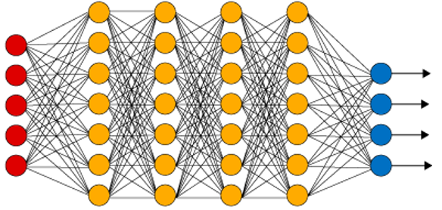

Arch. of monitoring and measuring QoI
Stepwise procedure for quality of user interaction
Reference
Content
Extract
Features
Visual Features
Face and Eye Tracking Features
User’s Emotion Features
User’s Evaluation
QoI Metric
사용자 평가 점수
사용자 평가 점수
Visual Modeling
Bio-metric Modeling
QoI Scores
QoI Score
Measured Data
QoI Score
Env. Info
Content Info
Interaction Info
User Info
환경/콘텐츠 정보
환경/콘텐츠 정보
Predicted
QoI
Score
Integrated QoI
Cognitive Modeling
Correlation Assessment
Measuring
Data Info
Analyzing and Modeling
Features
Mapping
Quantified QoI
Scoring
QoI Level

Slide 12

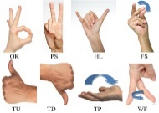
Step 1) Extract features for QoI
Reference extended reality content
Features of QoI
Feature parameters for QoI
- Operational env. info..
- Content info.
- Composing interaction info.
- User info.
QoI 별 파라미터
환경/콘텐츠 정보
QoI 별 파라미터
환경/콘텐츠 정보
Evaluate QoI
사용자 평가 점수
사용자 평가 점수

Slide 13
Step 2) Analysis and modeling for QoI
Analysis and modeling of QoI
Extract image characteristics
Extract eye-tracking info.
Extract user’s emotion info. continually
Analysis image characteristics
Analaysis eye-tracking info.
Analysis user’s emotion info. continually
- Modeling visual recognition
- Modeling user’s emotion

Slide 14
Step 3) Quantifying and mapping for QoI
Quantified mapping of QoI
Referenced evaluation value of QoI
Execution of quantified mapping algorithm for QoI
Estimated value for QoI
Feature parameters for QoI
Featuring model for QoI

Slide 15
Step 4) Calculate and rating for QoI
Calculation of QoI rating
Execution of rating algorithm for QoI
Criterion for QoI
Rating of QoI
Quantification model for QoI

Slide 16
Conclusion and Discussion
Standard of the monitoring and measuring procedures for QoI
  Features extract for QoI
  Analysis and modeling for QoI
  Model mapping and quantifying QoI
  Calculate and rating QoI
Issues for implementation and standardization tools
  Reference content
  Conformance test

Slide 17
Thank You

