Slide 1
Brain Activity Changes by MTP Latency
[Lim, Hyun Kyoon, PhD
Korea Research Institute of Standards and Science]

Slide 2
Compliance with
IEEE Standards Policies and Procedures
Subclause 5.2.1 of the IEEE-SA Standards Board Bylaws states, "While participating in IEEE standards development activities, all participants...shall act in accordance with all applicable laws (nation-based and international), the IEEE Code of Ethics, and with IEEE Standards policies and procedures."
The contributor acknowledges and accepts that this contribution is subject to
The IEEE Standards copyright policy as stated in the IEEE-SA Standards Board Bylaws, section 7, http://standards.ieee.org/develop/policies/bylaws/sect6-7.html#7, and the IEEE-SA Standards Board Operations Manual, section 6.1, http://standards.ieee.org/develop/policies/opman/sect6.html
The IEEE Standards patent policy as stated in the IEEE-SA Standards Board Bylaws, section 6, http://standards.ieee.org/guides/bylaws/sect6-7.html#6, and the IEEE-SA Standards Board Operations Manual, section 6.3, http://standards.ieee.org/develop/policies/opman/sect6.html

Slide 3
IEEE 3079.1
HMD Based VR Sickness Reducing Technology
Seo, Dong Il Dillon, dillon.seo@dtcp.capital
Brain Activity Changes by MTP Latency
Date: 2021-04-19
Author(s): Lim, Hyun Kyoon
Name | Affiliation | Phone | Email
Lim, Hyun Kyoon | KRISS |  | hlim@kriss.re.kr
Kwon, Moonyoung | KRISS |  | mykwon@kriss.re.kr
Jang, Kyoung-Mi | KRISS |  | km_jang@kriss.re.kr
Nam, Sun Gu | KAIST |  | naisz@kaist.ac.kr
Kim, Da Mee | KRISS |  | dameeing@kriss.re.kr

Slide 4
Aim of Study
VR sickness from
  Rotation, speed of movement, field of view, display type, motion-to-photon (MTP) latency, age, experience, …
Previous study
  Evaluate VR sickness using subjective measurement such as simulator sickness questionnaire (SSQ), fast motion sickness scale (FMS) scores
Goal
1. Find objective indicator of VR sickness by MTP latency
2. Propose safety guideline of MTP latency

Slide 5
Progress of the Study
Create VR(with MTP latency) Videos
Fix Experimental Procedure
Conduct Experiment with EEG
Analysis of EEG Changes by MTP Latency
VR Video Evaluation
Find Indicator and propose safety guideline of latency
Conduct experiment
(ongoing)
  Goal: 30 subjects
  Performance
  : 15 subjects
EEG analysis (ongoing)
  Frequency power of
  0 ms vs. 60 ms

Slide 6
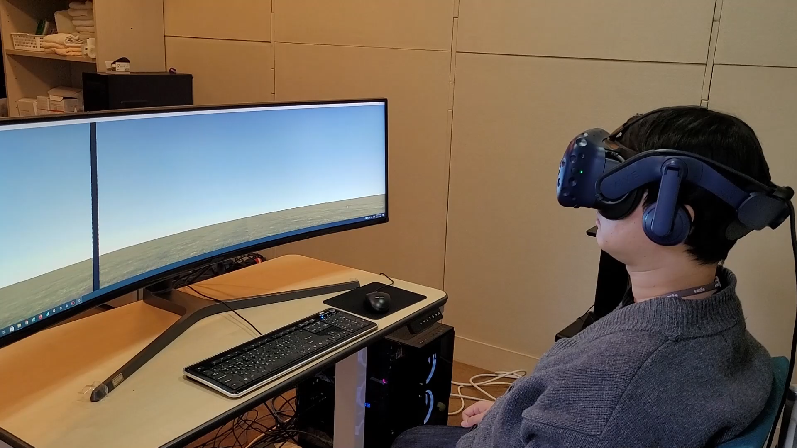
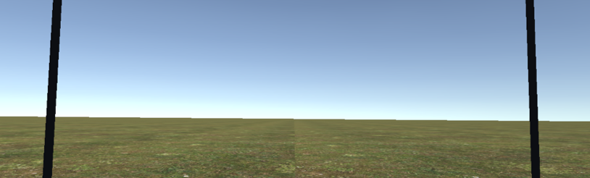

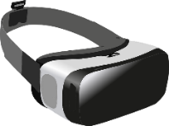
Experimental Design
Beep
Beep
Neck movement
  80°/sec
Beep sound
  Every second
  To limit movement speed
40°
40°

Slide 7
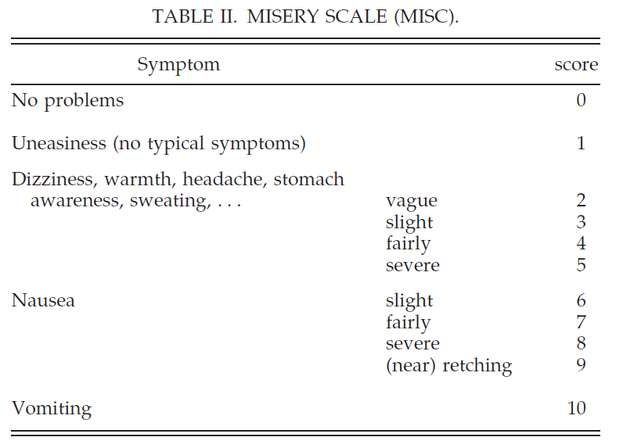
Subjective Measurement: Misery Scale
Bos et al., 2005

Slide 8
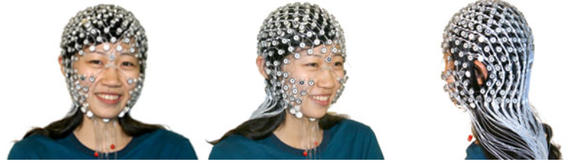
Objective Measurement: EEG
Device
  GSN-HydroCel 256-channel (EGI, www.egi.com)
Analysis
  Spectral density changes between ‘before’ and ‘after’ conditions
    Delta(1 – 4 Hz), theta (4 – 8 Hz), alpha (8 – 13 Hz), beta (13 – 30 Hz), gamma (30 – 50 Hz)

Slide 9



Experimental Procedure
Additional latency
  0 ms (only device latency), 30 ms, 60 ms
2 trials/condition
Before: 30 s
Task: 60 s
After: 30 s

Slide 10
Results – Subjective Measurement
13 subjects
*
2.23 ± 1.42
1.46 ± 1.17

Slide 11
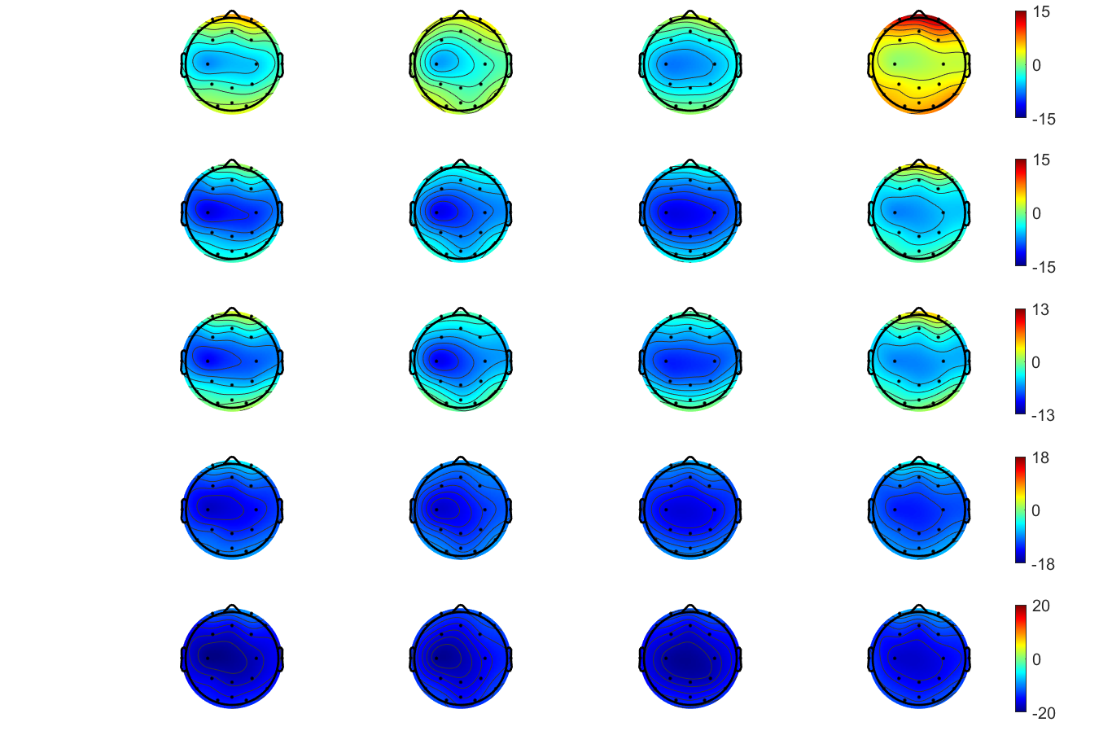
Results – Objective(EEG) Measurement
13 subjects
only device latency
device latency + 60 ms
Before
After
Before
After
Delta (1 – 4 Hz)
*
Theta (4 – 8 Hz)
Alpha (8 – 13 Hz)
Beta (13 – 30 Hz)
Gamma (30 – 50 Hz)

Slide 12
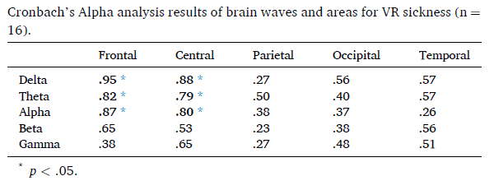
Tentative Conclusion
VR sickness by MTP latency
  Delta, theta, alpha powers may be indicators
  Increase powers on most of regions
  Especially, delta power on frontal area
  Similar results with previous work (Lim et al., 2021)
Lim et al., 2021

Slide 13
Future Work
Create VR(with MTP latency) Videos
Fix Experimental Procedure
Conduct Experiment with EEG
Analysis of EEG Changes by MTP Latency
VR Video Evaluation
Find Indicator and propose safety guideline of latency
Current
Steps
Future
Work

Slide 14
Thank You

