Slide 1
[Session #18 3079.1 TG Meeting Summary]
[Yoon, Sangcheol / Daejeon University]

Slide 2
Compliance with
IEEE Standards Policies and Procedures
Subclause 5.2.1 of the IEEE-SA Standards Board Bylaws states, "While participating in IEEE standards development activities, all participants...shall act in accordance with all applicable laws (nation-based and international), the IEEE Code of Ethics, and with IEEE Standards policies and procedures."
The contributor acknowledges and accepts that this contribution is subject to
The IEEE Standards copyright policy as stated in the IEEE-SA Standards Board Bylaws, section 7, http://standards.ieee.org/develop/policies/bylaws/sect6-7.html#7, and the IEEE-SA Standards Board Operations Manual, section 6.1, http://standards.ieee.org/develop/policies/opman/sect6.html
The IEEE Standards patent policy as stated in the IEEE-SA Standards Board Bylaws, section 6, http://standards.ieee.org/guides/bylaws/sect6-7.html#6, and the IEEE-SA Standards Board Operations Manual, section 6.3, http://standards.ieee.org/develop/policies/opman/sect6.html

Slide 3
IEEE 3079
Human Factor for Immersive Content Working Group
Seo, Dong Il Dillon, dillon.seo@dtcp.capital
Session #18-3079.1 TG Meeting Summary
Date: 2021-04-22
Author(s):
Name | Affiliation | Phone | Email
Lim, Hyun Kyoon | KRISS | +82 10 4741 7343 | hlim@kriss.re.kr
Yoon, Sangcheol | Daejeon Univ. | +82 10 2502 6915 | yoonsangcheol@gmail.com

Slide 4
Session Time and Location
 | Monday (April 19, 2021) | Tuesday (April 20, 2021) | Wednesday (February 03, 2021) | Thursday (February 04, 2021) | Friday (February 05, 2021)
AM 1 9:00-10:30a |  | IEEE 3079.2 TG | IEEE 3079.2 TG
AM 2 11:00-12:30 | Open Plenary Roll Call Reviewing last meeting minutes (Introducing participants) | IEEE 3079.1 TG |  | WG Closing Plenary
PM 1 1:30 – 3:00p | WG Meeting
PM 2 3:30 – 5:00p
※ Location
Contact to Video Conference: https://us02web.zoom.us/j/83808221695?pwd=eERXZDVCYkJMWXI3VHdQdFdvaWl5dz09

Slide 5
2nd Day
Tuesday, April 20th, 2021 11:00am~12:30pm
  3079-21-0032-00-0001-(MTP) Brain Activity Changes by MTP Latency
  Presented by Lim, Hyun Kyoon, Ph.D.

Slide 6
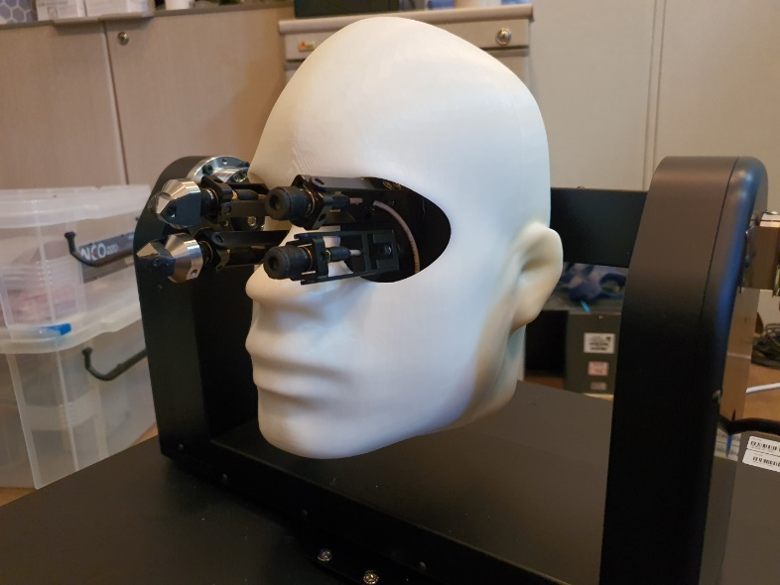
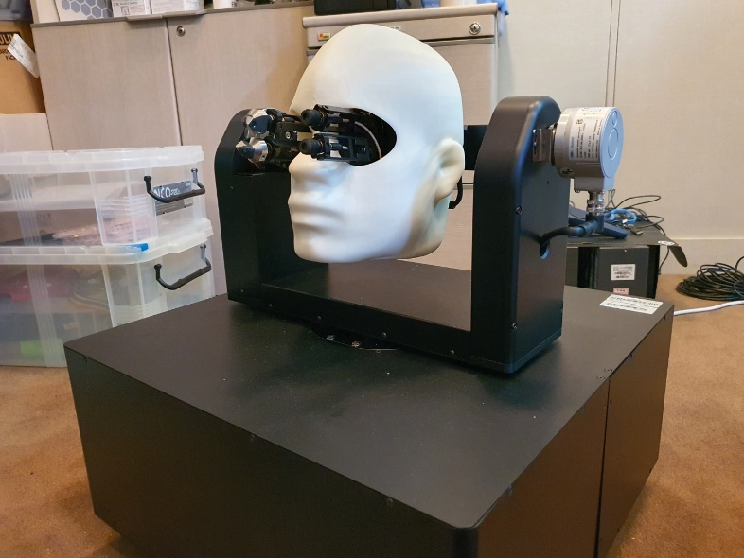
Next Agenda
Continue discussion on the terms & definitions of P3079.1 standard
Draft of 3079.1 will be made for new PAR including specification of followings;
  Measurement MTP Latency using following device

Slide 7
Thank You

