Slide 1
[IEEE 3079 Session #19 WG Opening Plenary]
[Sangkwon Peter Jeong / JoyFun]

Slide 2
Compliance with
IEEE Standards Policies and Procedures
Subclause 5.2.1 of the IEEE-SA Standards Board Bylaws states, "While participating in IEEE standards development activities, all participants...shall act in accordance with all applicable laws (nation-based and international), the IEEE Code of Ethics, and with IEEE Standards policies and procedures."
The contributor acknowledges and accepts that this contribution is subject to
The IEEE Standards copyright policy as stated in the IEEE-SA Standards Board Bylaws, section 7, http://standards.ieee.org/develop/policies/bylaws/sect6-7.html#7, and the IEEE-SA Standards Board Operations Manual, section 6.1, http://standards.ieee.org/develop/policies/opman/sect6.html
The IEEE Standards patent policy as stated in the IEEE-SA Standards Board Bylaws, section 6, http://standards.ieee.org/guides/bylaws/sect6-7.html#6, and the IEEE-SA Standards Board Operations Manual, section 6.3, http://standards.ieee.org/develop/policies/opman/sect6.html

Slide 3
IEEE 3079
Human Factor for Immersive Content Working Group
Beom-Ryeol Lee, lbr@etri.re.kr
Opening Plenary
Date: 2021-07-10
Author(s): Jeong, Sangkwon Peter
Name | Affiliation | Phone | Email
Jeong, Sangkwon Peter | JoyFun | +82 10 8667 7329 | ceo@joyfun.kr
Beom-Ryeol Lee | ETRI | +82 10 8880 3347 | lbr@etri.re.kr

Slide 4
Session Time and Location
 | Monday (July 19, 2021) | Tuesday (July 20, 2021) | Wednesday (July 21, 2021) | Thursday (July 22, 2021) | Friday (July 23, 2021)
AM 1 9:00a-10:30a |  | IEEE 3079.1 TG | IEEE 3079.1 TG | IEEE 3079.1 TG | WG Meeting
AM 2 11:00a-12:30p | Open Plenary Roll Call Reviewing last meeting minutes (Introducing participants) | IEEE 3079.1 TG | IEEE 3079.1 TG | IEEE 3079.1 TG | WG Meeting Closing Plenary
PM 1 1:30p – 3:00p | WG Meeting | IEEE 3079.2 TG | IEEE 3079.2 TG | IEEE 3079.2 TG
PM 2 3:30p – 5:00p |  | IEEE 3079.2 TG | IEEE 3079.2 TG | IEEE 3079.2 TG
※ Location
Contact to Video Conference: https://us02web.zoom.us/j/83808221695?pwd=eERXZDVCYkJMWXI3VHdQdFdvaWl5dz09

Slide 5
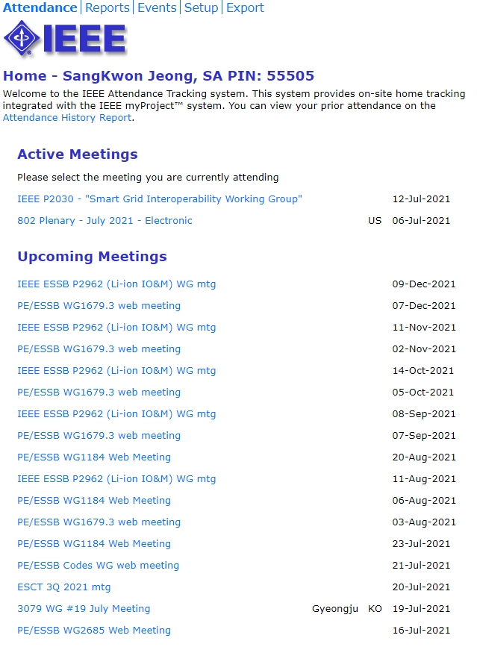
Attendance
Electronic Attendance ONLY
Electronic Attendance
  IMAT System
    https://imat.ieee.org/attendance
  Mark attendance during every session

Slide 6
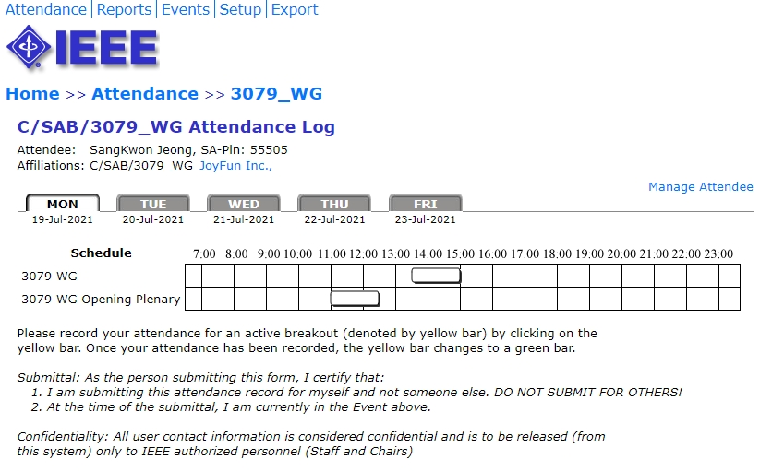
Attendance
Total number of IEEE 3079 WG timeslots: 16
8 timeslots for 50% attendance to be counted towards WG voting membership
All attendance records are reported on the meeting minutes
  Please check the attendance records for any errors

Slide 7
Voting Membership
3079 Voting Membership described in
  DCN#: 3079-20-0043-00-0000 (https://mentor.ieee.org/3079/dcn/20/3079-20-0043-00-0000-ieee-3079-wg-p-p.pdf)
Maintenance of Voting Membership
  Two Plenary sessions out of four consecutive Plenary sessions on a moving window basis
WG Letter Ballots
  WG members are expected to vote on WG LBs
  Failure to vote on 2 out of last 3 WG LBs could result
  in loss of voting rights

Slide 8
Miscellaneous Meeting Logistics
WG Documents: https://mentor.ieee.org/3079/documents
Standard Draft Documents: https://ieee-sa.imeetcentral.com/3079/
Food and Beverages:
  Breakfast:
  Morning Coffee Break: 10:30a ~ 11:00a
  Lunch Time: 12:30p ~ 1:30p
  Afternoon Coffee Break: 3:00p ~ 3:30p
  Dinner: From 5:00 pm

Slide 9
Registration and Media Recording
Each Attendee must provide contact information and pay conference fee
Conference fee has to be paid through the registration desk
Failure to pay conference fee results in loss of credit for voting rights
Photography not permitted unless approved by WG Chair
Audio taping of IEEE 3079 meetings is NOT allowed
Media – Press and Analyst briefings
  Only the 3079 WG Chair is allowed to give verbal statements/interviews to the media on behalf of the IEEE 3079 working group

Slide 10
Membership & Anti-Trust
Individual membership
  In all IEEE standards meetings, membership is by individual, hence you do not represent a company or organization.
Anti-Trust laws
  The Anti-Trust laws forbid the discussion of prices within our meetings.

Slide 11
Participants have a duty to inform the IEEE
  Participants shall inform the IEEE (or cause the IEEE to be informed) of the identity of each holder of any potential Essential Patent Claims of which they are personally aware if the claims are owned or controlled by the participant or the entity the participant is from, employed by, or otherwise represents
  Participants should inform the IEEE (or cause the IEEE to be informed) of the identity of any other holders of potential Essential Patent Claims
  Early identification of holders of potential Essential Patent Claims is encouraged

Slide 12
Ways to inform IEEE
Cause an LOA to be submitted to the IEEE-SA (patcom@ieee.org); or
Provide the chair of this group with the identity of the holder(s) of any and all such claims as soon as possible; or
Speak up now and respond to this Call for Potentially Essential Patents
If anyone in this meeting is personally aware of the holder of any patent claims that are potentially essential to implementation of the proposed standard(s) under consideration by this group and that are not already the subject of an Accepted Letter of Assurance, please respond at this time by providing relevant information to the WG Chair

Slide 13
Other guidelines for IEEE WG meetings
All IEEE-SA standards meetings shall be conducted in compliance with all applicable laws, including antitrust and competition laws.
  Don’t discuss the interpretation, validity, or essentiality of patents/patent claims.
  Don’t discuss specific license rates, terms, or conditions.
    Relative costs of different technical approaches that include relative costs of patent licensing terms may be discussed in standards development meetings.
      Technical considerations remain the primary focus
  Don’t discuss or engage in the fixing of product prices, allocation of customers, or division of sales markets.
  Don’t discuss the status or substance of ongoing or threatened litigation.
  Don’t be silent if inappropriate topics are discussed … do formally object.
---------------------------------------------------------------
For more details, see IEEE-SA Standards Board Operations Manual, clause 5.3.10 and
Antitrust and Competition Policy: What You Need to Know at http://standards.ieee.org/develop/policies/antitrust.pdf

Slide 14
Patent-related information
  The patent policy and the procedures used to execute that policy are documented in the:
    IEEE-SA Standards Board Bylaws (http://standards.ieee.org/develop/policies/bylaws/sect6-7.html#6)
    IEEE-SA Standards Board Operations Manual (http://standards.ieee.org/develop/policies/opman/sect6.html#6.3)
  Material about the patent policy is available at
  http://standards.ieee.org/about/sasb/patcom/materials.html
  If you have questions, contact the IEEE-SA Standards Board Patent Committee Administrator at patcom@ieee.org

Slide 15
Participation in IEEE 3079 Meetings
All participation in IEEE 3079 Working Group meetings is on an individual basis
• Participants in the IEEE standards development individual process shall act based on their qualifications and experience. (https://standards.ieee.org/develop/policies/bylaws/sb_bylaws.pdfsection 5.2.1)
• IEEE 3079 Working Group membership is by individual; “Working Group members shall participate in the consensus process in a manner consistent with their professional expert opinion as individuals, and not as organizational representatives”. (subclause 4.2.1 “Establishment”, of the IEEE 3079 Working Group Policies and Procedures)
Participants have an obligation to act and vote as an individual and not under the direction of any other individual or group. A Participant’s obligation to act and vote as an individual applies in all cases, regardless of any external commitments, agreements, contracts, or orders.
Participants shall not direct the actions or votes of any other member of an IEEE 3079 Working Group or retaliate against any other member for their actions or votes within IEEE 3079 Working Group meetings, see https://standards.ieee.org/develop/policies/bylaws/sb_bylaws.pdf section 5.2.1.3 and the IEEE 3079 Working Group Policies and Procedures, subclause 3.4.1 “Chair”, list item x.
By participating in IEEE 3079 meetings, you accept these requirements. If you do not agree to these policies then you shall not participate.

Slide 16
IEEE SA COPYRIGHT POLICY
By participating in this activity, you agree to comply with the IEEE Code of Ethics, all applicable laws, and all IEEE policies and procedures including, but not limited to, the IEEE SA Copyright Policy.
Previously Published material (copyright assertion indicated) shall not be presented/submitted to the Working Group nor incorporated into a Working Group draft unless permission is granted.
Prior to presentation or submission, you shall notify the Working Group Chair of previously Published material and should assist the Chair in obtaining copyright permission acceptable to IEEE SA.
For material that is not previously Published, IEEE is automatically granted a license to use any material that is presented or submitted.

Slide 17
IEEE SA COPYRIGHT POLICY
The IEEE SA Copyright Policy is described in the IEEE SA Standards Board Bylaws and IEEE SA Standards Board Operations Manual
IEEE SA Copyright Policy, see
Clause 7 of the IEEE SA Standards Board Bylaws
https://standards.ieee.org/about/policies/bylaws/sect6‐7.html#7
Clause 6.1 of the IEEE SA Standards Board Operations Manual
https://standards.ieee.org/about/policies/opman/sect6.html
IEEE SA Copyright Permission
https://standards.ieee.org/content/dam/ieee‐standards/standards/web/documents/other/permissionltrs.zip
IEEE SA Copyright FAQs
http://standards.ieee.org/faqs/copyrights.html/
IEEE SA Best Practices for IEEE Standards Development
http://standards.ieee.org/develop/policies/best_practices_for_ieee_standards_development_051215.pdf
Distribution of Draft Standards (see 6.1.3 of the SASB Operations Manual)
https://standards.ieee.org/about/policies/opman/sect6.html

Slide 18
Copyright
Under the current US copyright law — the author of information is deemed to own the copyright from the moment of creation
The IEEE Bylaws require copyright of all material to be held by the IEEE
  Must consult with IEEE for re-use of copyright material
The IEEE Standards accomplishes transfer of copyright ownership through the Project Authorization Request (PAR) process

Slide 19
Work Items for This Meeting
  Development to the IEEE 3079.1 draft document for standard
  Review input contributions
  Discussion of IEEE 3079.1
  Development to the IEEE 3079.2 draft document for standard
  Review input contributions
  Discussion of IEEE 3079.2
  Discussion of the NEW ‘PAR’

Slide 20
Future Sessions – 2021
If the COVID-19 situation does not get better and the travel restrictions are lifted, the following meetings will be changed to on-line meeting only.
For those who have difficulties in traveling due to various reasons, on-line meeting support will be always provided.
October 04-08 2021, Toshkent, Republic of Uzbekistan (TBD)

Slide 21
Future Sessions – 2022
February 07-11 2022, KRISS Office, 267 Gajeong-ro, Yuseong-gu, Daejeon, Republic of Korea
April 25-29 2021, 3 Park Avenue, (​IEEE-SA Office), New York City, New York 10016
July 25-29 2022, Barcelona, Spain (Air B&B)
October 24-28 2022, E-1904 Aoyama-Twin Tower Bldg.,
1-1-1 Minami-aoyama, Minato-ku, Tokyo 107-0062, Japan Tokyo, Japan

Slide 22
Thank You

