Slide 1
[Introduction of IEEE 2888 WG]
[Sangkwon Peter Jeong / JoyFun]

Slide 2
Compliance with
IEEE Standards Policies and Procedures
Subclause 5.2.1 of the IEEE-SA Standards Board Bylaws states, "While participating in IEEE standards development activities, all participants...shall act in accordance with all applicable laws (nation-based and international), the IEEE Code of Ethics, and with IEEE Standards policies and procedures."
The contributor acknowledges and accepts that this contribution is subject to
The IEEE Standards copyright policy as stated in the IEEE-SA Standards Board Bylaws, section 7, http://standards.ieee.org/develop/policies/bylaws/sect6-7.html#7, and the IEEE-SA Standards Board Operations Manual, section 6.1, http://standards.ieee.org/develop/policies/opman/sect6.html
The IEEE Standards patent policy as stated in the IEEE-SA Standards Board Bylaws, section 6, http://standards.ieee.org/guides/bylaws/sect6-7.html#6, and the IEEE-SA Standards Board Operations Manual, section 6.3, http://standards.ieee.org/develop/policies/opman/sect6.html

Slide 3
IEEE 3079
Human Factor for Immersive Content Working Group
Beom-Ryeol Lee, lbr@etri.re.kr
Introduction of IEEE 2888 WG
Date: 2021-07-12
Author(s): Jeong, Sangkwon Peter
Name | Affiliation | Phone | Email
Sangkwon Peter Jeong | JoyFun | +82 10 8667 7329 | ceo@joyfun.kr
HyeonWoo Nam | Dongduk Women’s Univ. | +82 10 5313 1197 | hwnam@dongduk.ac.kr

Slide 4
Contents
Background
Organization of IEEE 2888 WG
IEEE 2888 Overall Architecture
Each Part of IEEE 2888
Application Support of IEEE 2888
Base Architecture of IEEE 2888.4
Conclusion

Slide 5
1. Background: MPEG-V
ISO/IEC 23005 MPEG-V (Media context and control)
A Standard providing standardized interfaces bridging (1st Edition released in 2011)
  Virtual worlds
  Real world and Virtual world
Based on two main proposals dealing (2007)
  Avatar description for Metaverse interoperability (by Metaverse 1)
  Representation of Sensory Effects (by ETRI)
Developed 4 main parts of technical specification (Total of 7 parts)
  Part 2: Control Information
  Part 3: Sensory Information
  Part 4: Virtual World Object Characteristics
  Part 5: Data Formats for Interaction Devices
Limitations
  The scope is limited to the representation of virtual world, and representation of sensory effects with data formats related to activation of sensory effects

Slide 6
1. Background: IEEE 2888 WG
Objective
Development of “Standardized Interface” for Cyber world and Physical world to enable or help enable “Smart-X” and “Digital Twin” like applications
Scope
This WG aims to develop industry standards for
interfacing cyber world and physical world such as:
  Vocabulary, Requirements, Rubric, Data formats, and APIs for acquiring information from sensors;
  Vocabulary, Requirements, Rubric, Data Formats, and APIs for control of actuators.
  These standards will provide compatibility between devices and systems in implementing various ICT-based systems such as smart cities, smart farms, smart transportation, as well as digital twins.

Slide 7





2. Organization of IEEE 2888 WG
Organization (Since Sept. 2019 and Dec. 2020)
Interfacing Cyber and Physical World
Specification of Sensor Interface for Cyber and Physical World
Standard for Actuator Interface for Cyber and Physical World
Standard on Orchestration of Digital Synchronization between Cyber and Physical World
Standard on Architecture for Virtual Reality Disaster Response Training System with Six degrees of Freedom (6 DoF)

Slide 8
3. IEEE 2888 Overall Architecture
Cyber World 1 (Metaverse, Simulation, VR, Games etc.)
Cyber World 2 (Metaverse, Simulation, VR, Games etc.)
Digital Thing Definition
Digital Thing Synchronization
Sensor Data
Actuator Commands
Digital Thing
Mission Control
Sensor Capability
Actuator Capability
Sensor APIs
Actuator APIs
Physical World (Sensors)
Physical World (Actuators)
IoT

Slide 9
4. Each Part of IEEE 2888
Cyber World 1 (Metaverse, Simulation, VR, Games etc.)
Cyber World 2 (Metaverse, Simulation, VR, Games etc.)
Digital Thing Definition
Digital Thing Synchronization
Sensor Data
Actuator Commands
Digital Thing
Mission Control
Sensor Capability
Actuator Capability
Sensor APIs
Actuator APIs
Physical World (Sensors)
Physical World (Actuators)
IoT

Slide 10
4. Each Part of IEEE 2888
Cyber World 1 (Metaverse, Simulation, VR, Games etc.)
Cyber World 2 (Metaverse, Simulation, VR, Games etc.)
Digital Thing Definition
Digital Thing Synchronization
Sensor Data
Actuator Commands
Digital Thing
Mission Control
Sensor Capability
Actuator Capability
Sensor APIs
Actuator APIs
Physical World (Sensors)
Physical World (Actuators)
IoT

Slide 11
4. Each Part of IEEE 2888
Cyber World 1 (Metaverse, Simulation, VR, Games etc.)
Cyber World 2 (Metaverse, Simulation, VR, Games etc.)
Digital Thing Definition
Digital Thing Synchronization
Sensor Data
Actuator Commands
Digital Thing
Mission Control
Sensor Capability
Actuator Capability
Sensor APIs
Actuator APIs
Physical World (Sensors)
Physical World (Actuators)
IoT

Slide 12
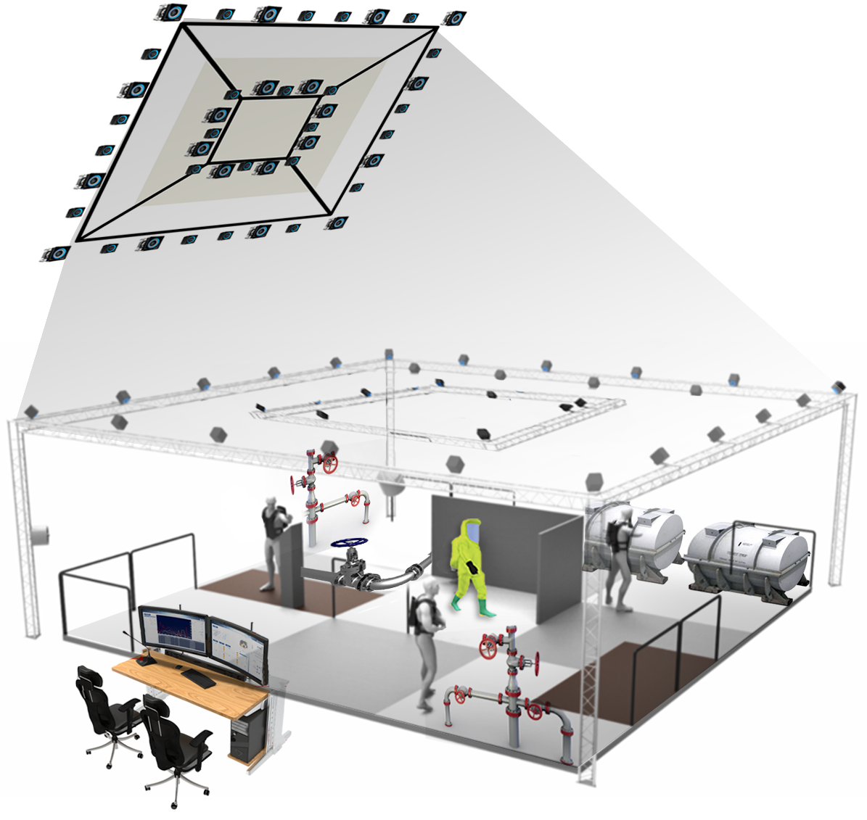
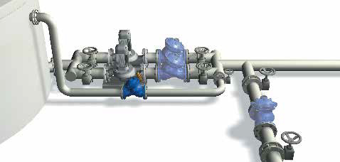
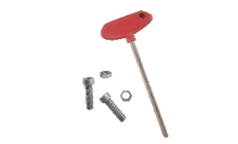
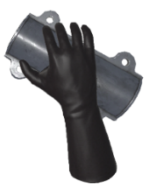
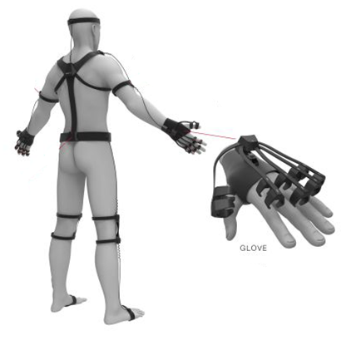
5. Application support of IEEE 2888
Virtual Objects with
Physical/Virtual Sensors
Physical Sensors

Slide 13
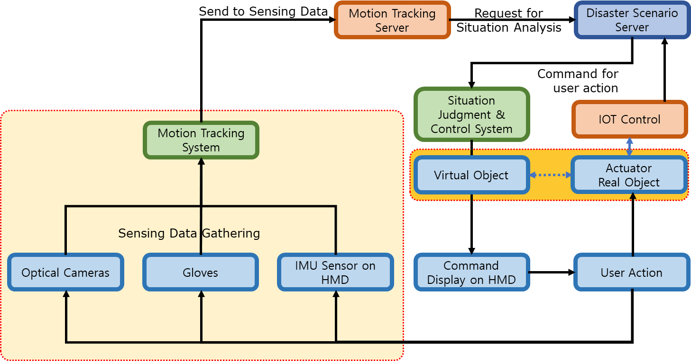
6. Base Architecture of IEEE 2888.4

Slide 14
7. Conclusion
Summary
First three parts are intended to provide common technology for digital twin space or metaverse plus
Interacting with real world and virtual world affects each other and the states of both worlds are somehow synchronized.
The fourth standard is designed to provide specific application of others.
IEEE 2888 WG just took a first step in the development of standard supporting interfacing cyber and physical worlds or building synchronized metaverse.
We hope to let the world know what we are trying to do and attract more people interested in this subject.

Slide 15
Thank You

