Slide 1
[Introduction of IEEE 3079]
[Sangkwon Peter Jeong / JoyFun]

Slide 2
Compliance with
IEEE Standards Policies and Procedures
Subclause 5.2.1 of the IEEE-SA Standards Board Bylaws states, "While participating in IEEE standards development activities, all participants...shall act in accordance with all applicable laws (nation-based and international), the IEEE Code of Ethics, and with IEEE Standards policies and procedures."
The contributor acknowledges and accepts that this contribution is subject to
The IEEE Standards copyright policy as stated in the IEEE-SA Standards Board Bylaws, section 7, http://standards.ieee.org/develop/policies/bylaws/sect6-7.html#7, and the IEEE-SA Standards Board Operations Manual, section 6.1, http://standards.ieee.org/develop/policies/opman/sect6.html
The IEEE Standards patent policy as stated in the IEEE-SA Standards Board Bylaws, section 6, http://standards.ieee.org/guides/bylaws/sect6-7.html#6, and the IEEE-SA Standards Board Operations Manual, section 6.3, http://standards.ieee.org/develop/policies/opman/sect6.html

Slide 3
IEEE 3079
Human Factor for Immersive Content Working Group
Beom-Ryeol Lee, lbr@etri.re.kr
Introduction of IEEE 3079
Date: 2021-07-13
Author(s): Jeong, Sangkwon Peter
Name | Affiliation | Phone | Email
Jeong, Sangkwon Peter | JoyFun | +82 10 8667 7329 | ceo@joyfun.kr
Beom-Ryeol Lee | ETRI | +82 10 8880 3347 | lbr@etri.re.kr
Jimmy Jaeyoung Jang | JoyFun | +82 10 8261 9539 | jimmyjanggg@joyfun.kr

Slide 4
General of IEEE 3079 WG
WG Title: Cybersickness Reduction Working Group (C/SAB/3079_WG)
Standard Title: Standard for Head Mounted Display (HMD) Based Virtual Reality (VR) Sickness Reduction Technology

Slide 5
Scope of IEEE P3079
This standard provides technical guidance in respect to the reduction of Virtual Reality (VR) sickness, caused by the visual response to HMD based 3D content motion, through the study of:
visual response to the focal distortion
visual response to the lens materials
visual response to the lens refraction ratio

Slide 6
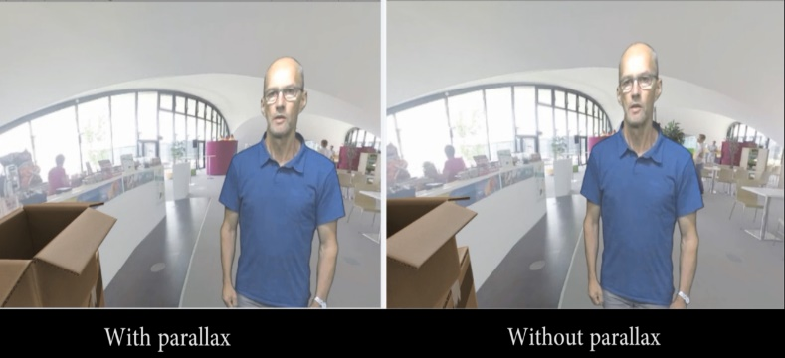
Quality Requirements for VR
Requirement | details
pixels/degree | - 40 pix/deg - no HMD is capable of displaying 40pix/deg today
video resolution | - 3 times 4K(3840x1920) vertical resolution = 11520x6480
framerate | - 90 fps - a 90fps framerate offers a latency low enough to prevent nausea
3D Audio | - support of scene-based and/or environmental audio - 360 surround sound, object-based audio, Ambisonics
motion-to-photon latency & motion-to-audio latency | - how much time there is between the user interacts and an image / audio - maximum 20ms
foreground & parallax | - objects in the foreground shall be far enough to prevent nausea - if objects are too close it is likely they can become an important cause of nausea - interactive parallax with background shall be present for such objects - pic1 shows how it is possible to look behind the figure in the foreground
Fig. 1. Importance of parallax.

Slide 7


IEEE 3079.1 for MTP Latency
Motion-to-Photon Latency
  Motion-to-Photon latency is the time needed for a user movement to be fully reflected on a display screen
  Low motion-to-photon (< 20 ms) latency is a prerequisite to convince user’s mind that user is in another place
  A high motion-to-photon latency makes a poor virtual reality experience
Tracker
CPU
GPU
Display
Photons
Optics
Head motion
Under 20 milliseconds of latency for comfortability
User’s retina

Slide 8
IEEE 3079.1 for MTP Latency

Slide 9
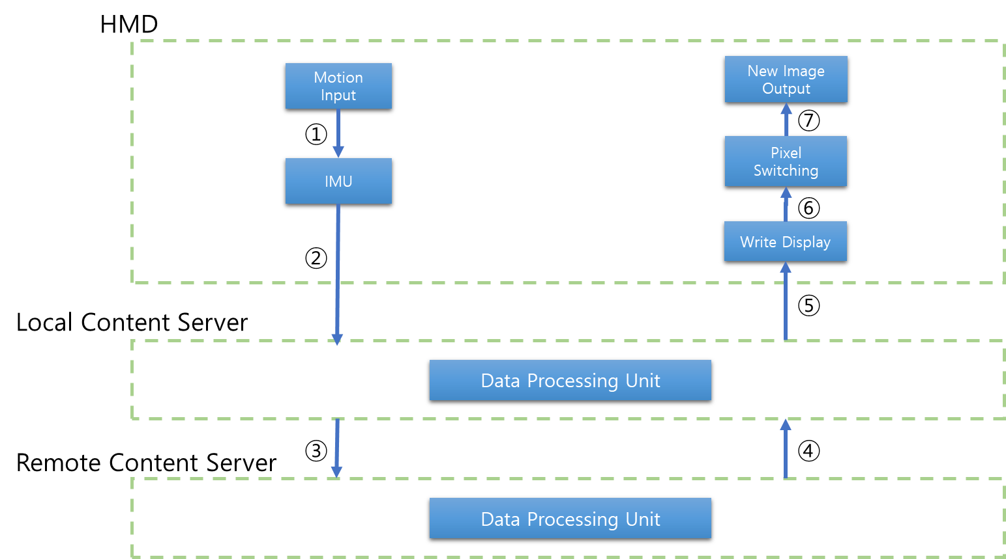
IEEE 3079.1 for MTP Latency
Case | Status of each node |  |  |  |  |  |  | Remarks
 | ① | ② | ③ | ④ | ⑤ | ⑥ | ⑦
1 | direct | Wired connection (e.g. HDMI) | Wired LAN | Wired LAN | Wired connection (e.g. HDMI) | chip | display Panel | Wired Network | VIVE / Oculus / PS VR
2 | direct | on Board | Wireless LAN | Wireless LAN | on Board | chip | display Panel | Wireless Network | Gear VR or Oculus GO
3 | direct | on Board | Cellular network | Cellular network | on Board | chip | display Panel | Mobile Network | Gear VR or Oculus GO
4 | direct | LAN / Wireless connection | n/a | n/a | LAN / Wireless connection | chip | display Panel | Local Network | VIVE / Oculus / PS VR
5 | Sensor Network | Wired connection (e.g. HDMI) | n/a | n/a | Wired connection (e.g. HDMI) | chip | display Panel | Motion Sensing | Whole kinds HMD
6 | direct | on Board | Cellular network / Wireless LAN | Cellular network / Wireless LAN | on Board | chip | display Panel | Network Handover | Gear VR or Oculus GO

Slide 10

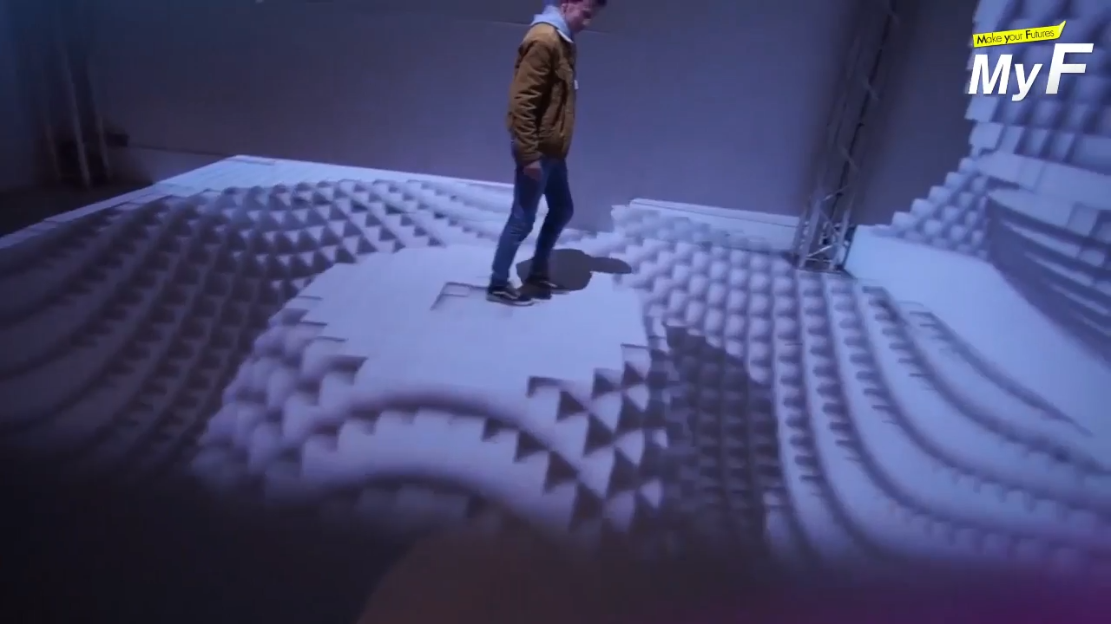
Introducing of IEEE 3079.2 TG

Slide 11
Framework of IEEE P3079.2
Reference’s Motion
Verification System
User’s Motion
Motion Data Input
Analysis Manager
Motion Data Input
Terms & Definition
Generation of Skeleton Info.
Compare & Judgment
Generation of Skeleton Info.
Unity 3D or Unreal
Generation of Reference Character
Validation
UI Manager
Model Adopter
Projection Controller
Messages Manager
: Framework
<Mixed Reality Standard Framework for Motion Learning>

Slide 12
Standardization schedule for IEEE P3079.2
Open SA Ballot Invitation
Mandatory Editorial Coordination submission
2nd Draft for Letter Ballot
Terms & Definition
Character Generation
Verification Module
1st Draft for Letter Ballot
3rd Draft for SA Ballot
4th Draft for SA Ballot
Final
Approve
&
Published
WG 1st
letter Ballot
Start
1st SA
Ballot
Start
2nd SA
Ballot
PAR
Approve
UI Manager
Character Generation
Draft Writing
WG 2nd
Letter Ballot
09/2020
07/2021
02/2022
07/2022
11/2022
04/2023
09/2023
01/2024
06/2024
02/2021
10/2021
04/2022
10/2022
02/2023
08/2023
10/2023
03/2024

Slide 13
Thank You

