Slide 1
On MCTS Tile Merger for CDN-based Viewport-dependent 360 Video Tiled Streaming
Presenter: Eun-Seok Ryu (esryu@skku.edu)
Jong-Beom Jeong, Soonbin Lee, Eun-Seok Ryu
Multimedia Computing Systems Lab. (MCSL)
http://mcsl.skku.edu
Department of Computer Education
Sungkyunkwan University

Slide 2
Compliance with IEEE Standards Policies and Procedures
Subclause 5.2.1 of the IEEE-SA Standards Board Bylaws states, "While participating in IEEE standards development activities, all participants...shall act in accordance with all applicable laws (nation-based and international), the IEEE Code of Ethics, and with IEEE Standards policies and procedures."
The contributor acknowledges and accepts that this contribution is subject to
The IEEE Standards copyright policy as stated in the IEEE-SA Standards Board Bylaws, section 7, http://standards.ieee.org/develop/policies/bylaws/sect6-7.html#7, and the IEEE-SA Standards Board Operations Manual, section 6.1, http://standards.ieee.org/develop/policies/opman/sect6.html
The IEEE Standards patent policy as stated in the IEEE-SA Standards Board Bylaws, section 6, http://standards.ieee.org/guides/bylaws/sect6-7.html#6, and the IEEE-SA Standards Board Operations Manual, section 6.3, http://standards.ieee.org/develop/policies/opman/sect6.html
3079-21-0055-00-0001 On MCTS Tile Merger for CDN-based Viewport-dependent 360 Video Tiled Streaming

Slide 3
IEEE 3079.1 Motion to Photon (MTP) Latency in Virtual Environments Dongil Dillon Seo, dillon.seo@telekom-capital.com
On MCTS Tile Merger for CDN-based Viewport-dependent 360 Video Tiled Streaming
Date: 2021-07-19
Author(s): Jong-Beom Jeong, Soonbin Lee, Eun-Seok Ryu
Name | Affiliation | Phone [optional] | Email [optional]
Jong-Beom Jeong | Sungkyunkwan Univ. |  | uof4949@skku.edu
Soonbin Lee | Sungkyunkwan Univ. |  | soonbinlee@skku.edu
Eun-Seok Ryu | Sungkyunkwan Univ. |  | esryu@skku.edu
3079-21-0055-00-0001 On MCTS Tile Merger for CDN-based Viewport-dependent 360 Video Tiled Streaming

Slide 4
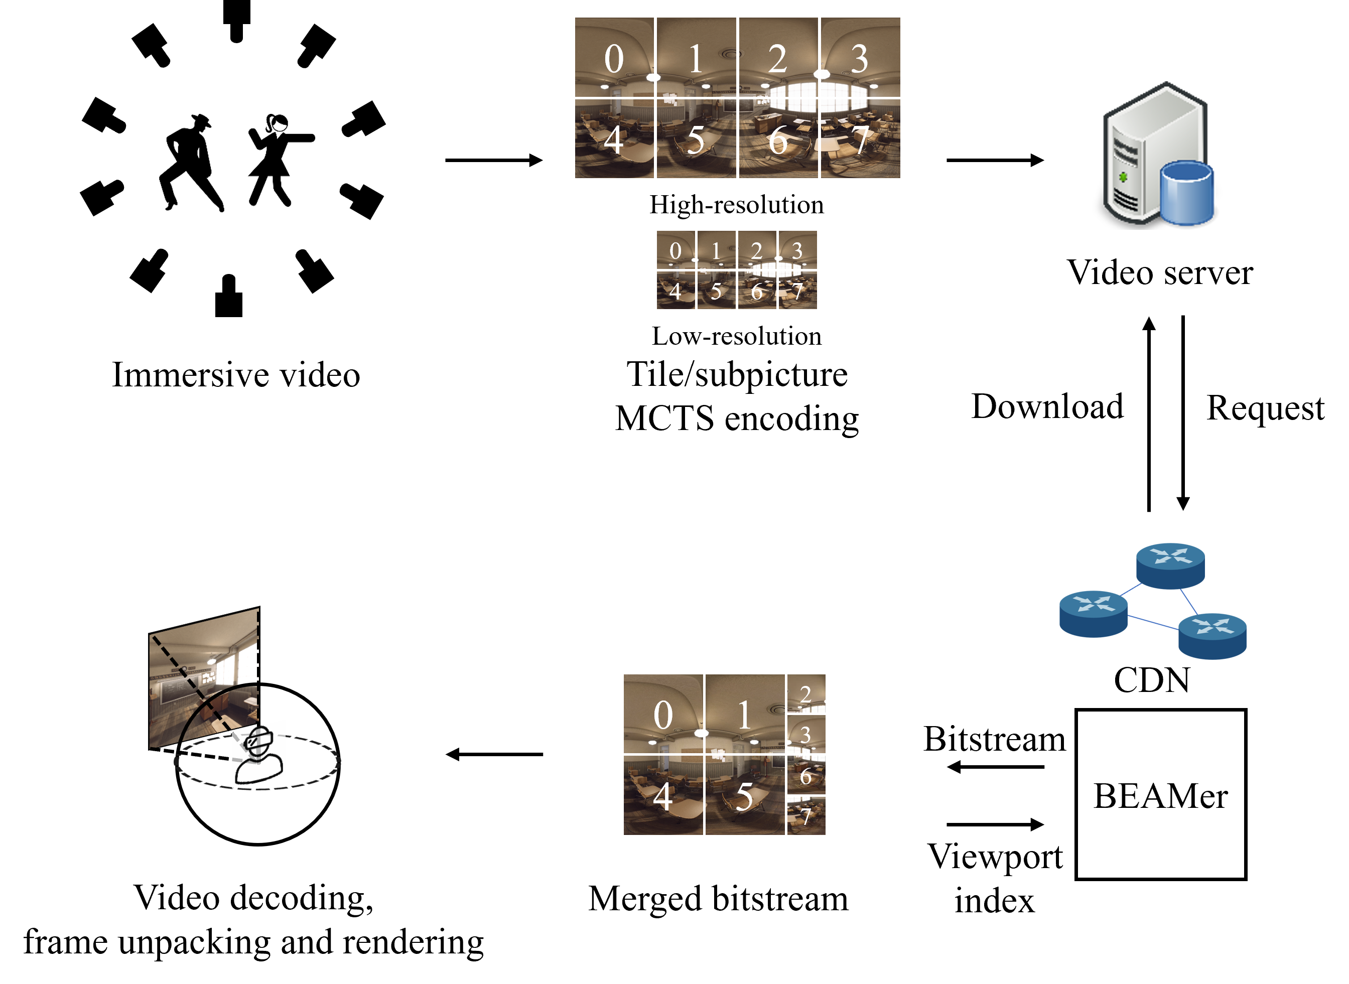
360 Video Tiled Streaming
High resolution and framerate for high-quality 360 video streaming
high bandwidth, high computational complexity
Tiled streaming based on MCTS for viewport-dependent streaming
Bitstream extractor and merger (BEAMer) in CDN
Distributed computing for flexible device-adaptive streaming
Requirement | details
pixels/degree | 40 pix/deg
video resolution | 11520×6480
framerate | 90 fps
Requirements for high quality VR
Source:Technicolor, Oct. 2016 (m39532, MPEG 116th Meeting)
Immersive 360 video tiled streaming system
3079-21-0055-00-0001 On MCTS Tile Merger for CDN-based Viewport-dependent 360 Video Tiled Streaming

Slide 5
Background
MPEG System group proposed BEAMer to:
Prevent waste of decoding resources (low-quality pictures which are not rendered)
Time consumption because of several bitstreams
Legacy decoder model
PTL: Profile/Tier/Level
BEAMer-based decoder model
Source: ISO/IEC SC29 WG11, Thoughts on Immersive Media Decoding Interface for VVC,
126th meeting of ISO/IEC SC29 WG11, n18438, 2019.
3079-21-0055-00-0001 On MCTS Tile Merger for CDN-based Viewport-dependent 360 Video Tiled Streaming

Slide 6
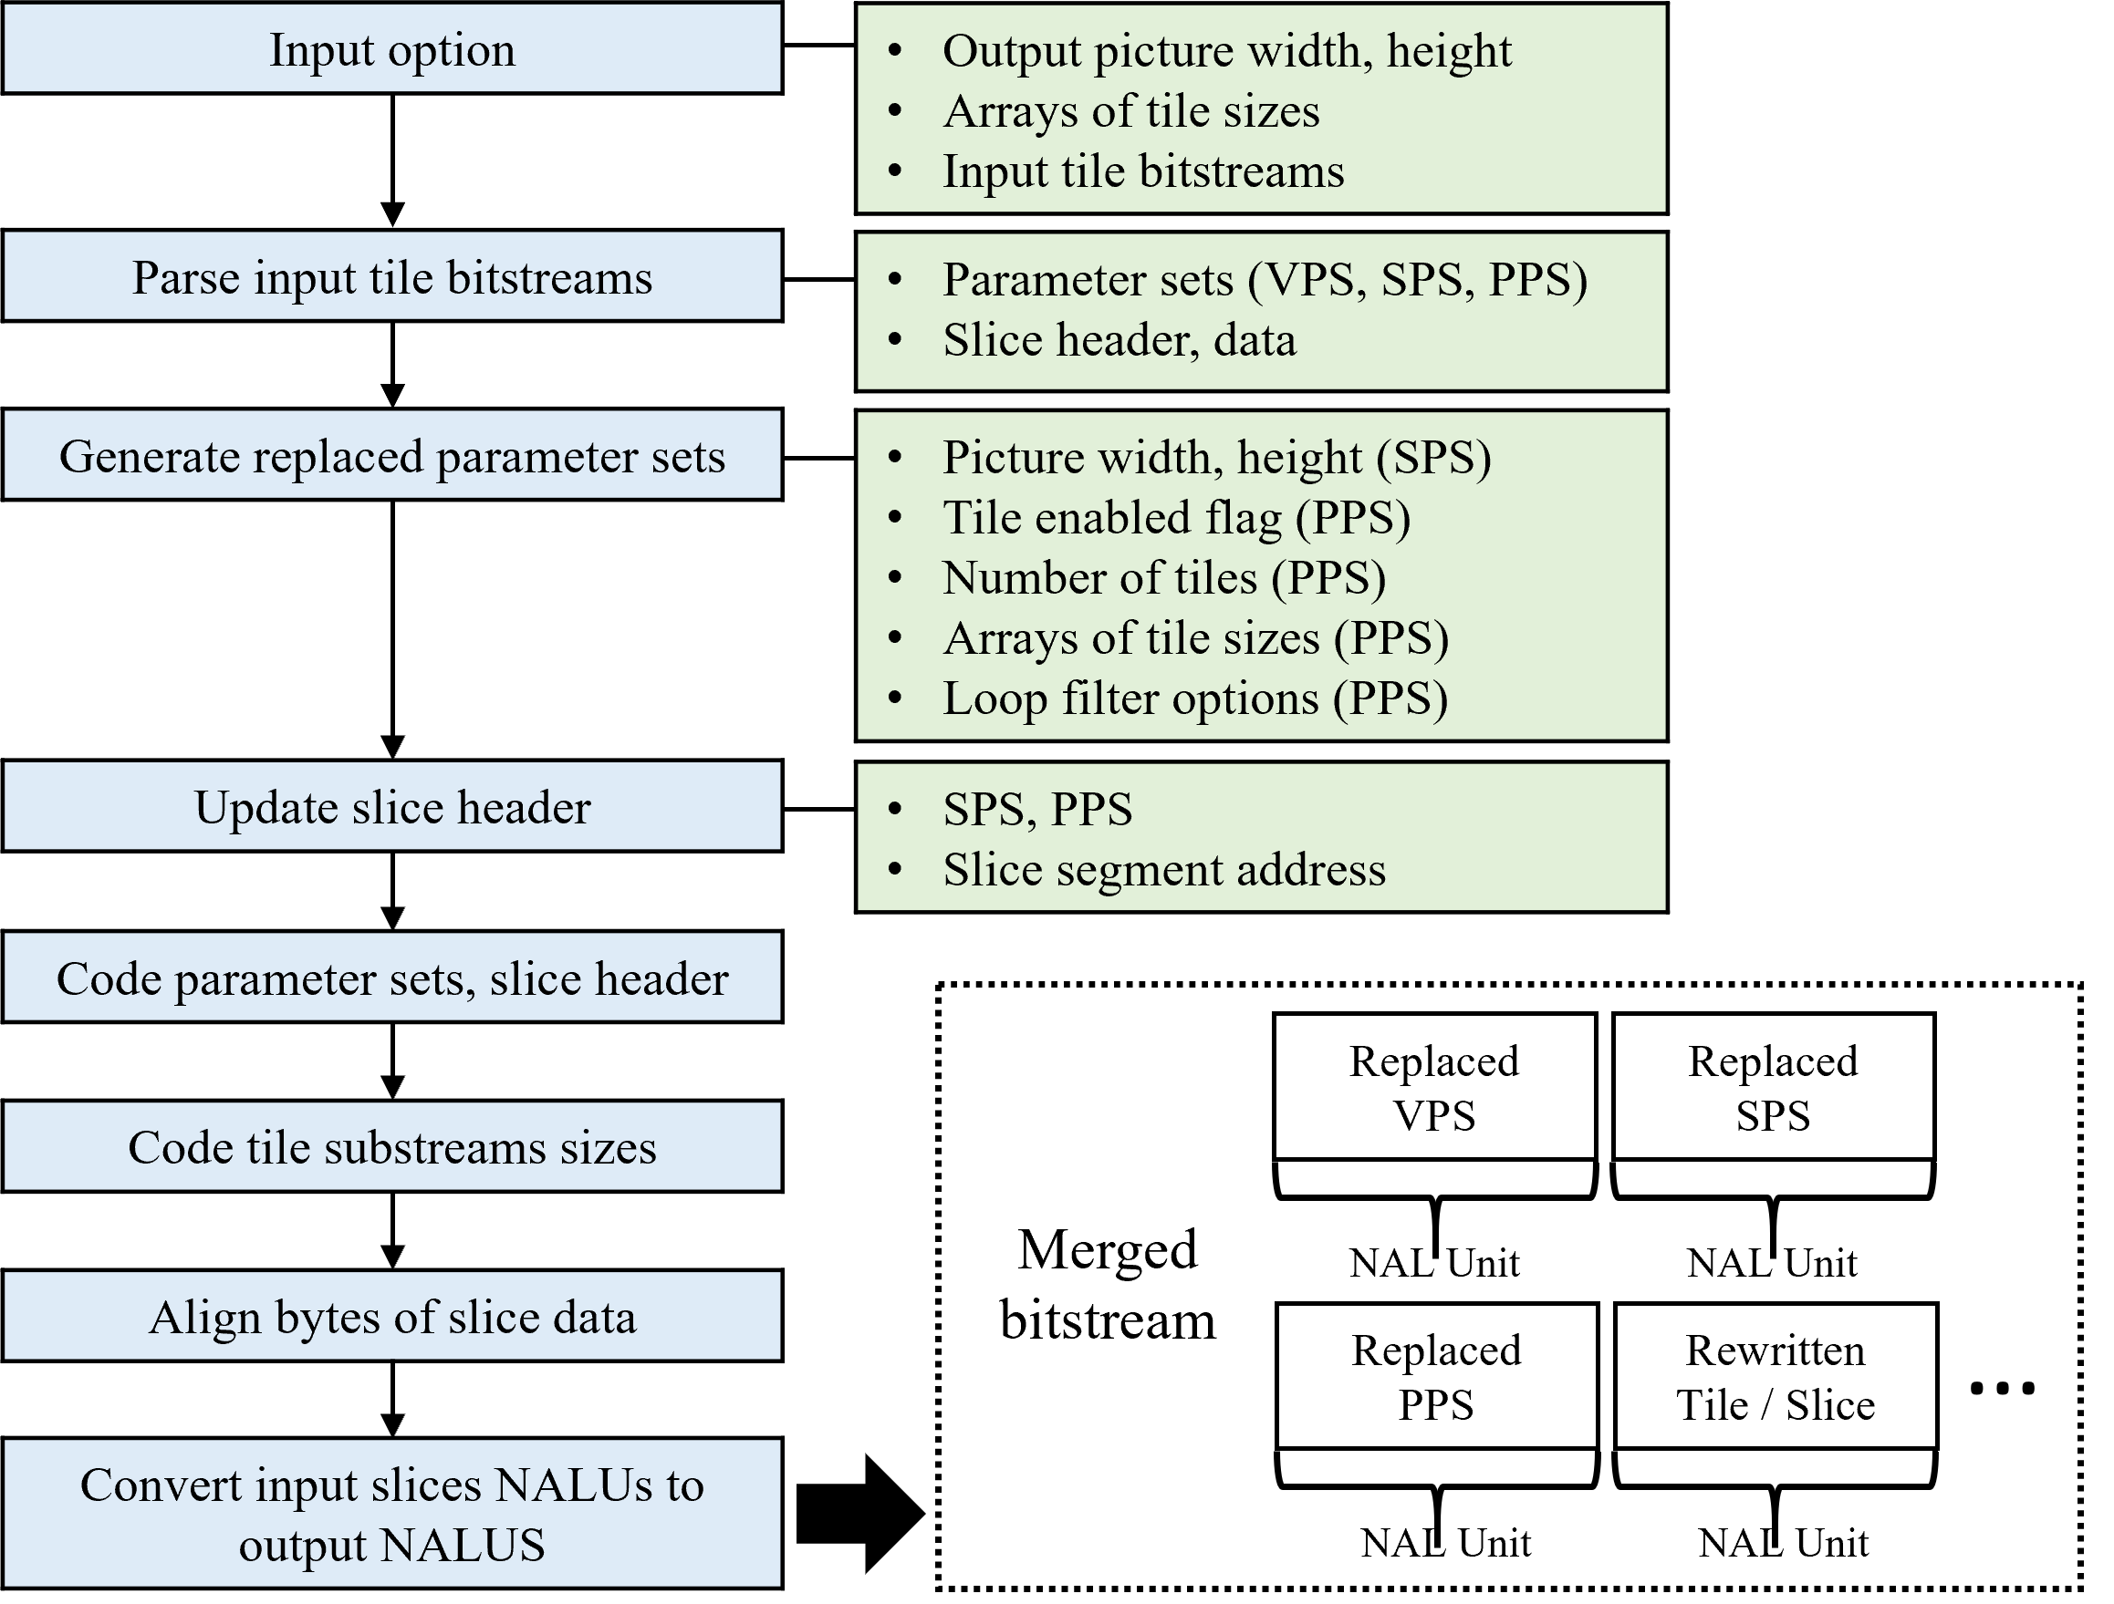
Implementation of Tile Merger
In HEVC test model (HM) 16.20, a tile extraction SW is included
Tile merging SW is not included
Used low-level entropy coding objects to implement fast merging
HM extractor uses high-level objects -> slower
HEVC and VVC-compliant versatile MCTS merging
Mixed quality, mixed resolution tile/subpicture merging is available
System architecture of tile merger
3079-21-0055-00-0001 On MCTS Tile Merger for CDN-based Viewport-dependent 360 Video Tiled Streaming

Slide 7
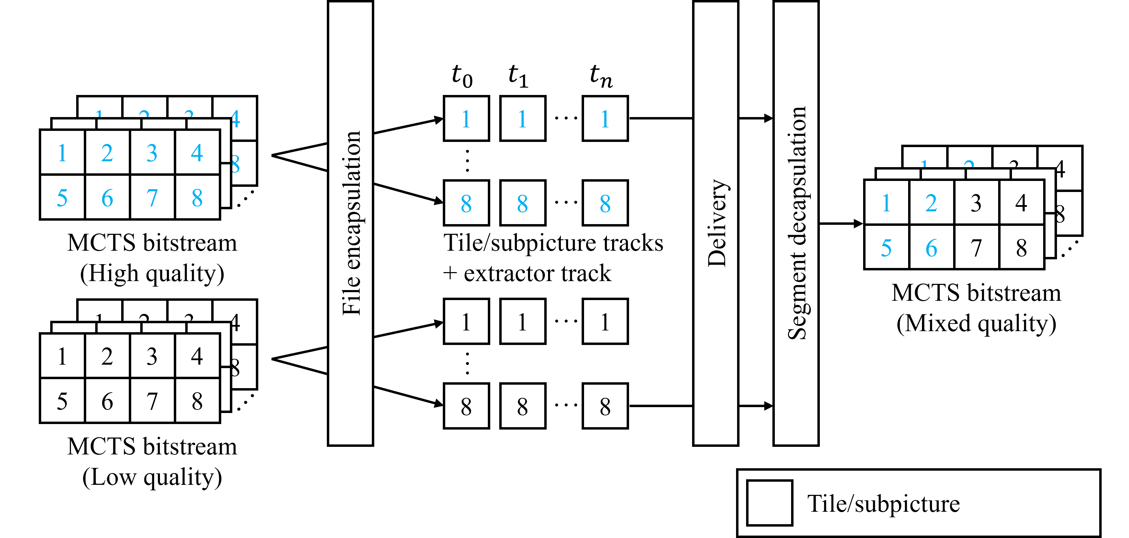
Mixed Quality Tiled Streaming
Tiles/subpictures are divided in compressed domain using MCTS
High- and low-quality MCTS bitstreams at the server-side
Tile/subpicture QP modification for mixed quality merging
$$SliceQPDelta=PPS→QP()−initQPMinus26+26$$
$$SliceQP=SliceQPDelta+26$$
Example of mixed-quality viewport-dependent 360-degree video tiled streaming
3079-21-0055-00-0001 On MCTS Tile Merger for CDN-based Viewport-dependent 360 Video Tiled Streaming

Slide 8
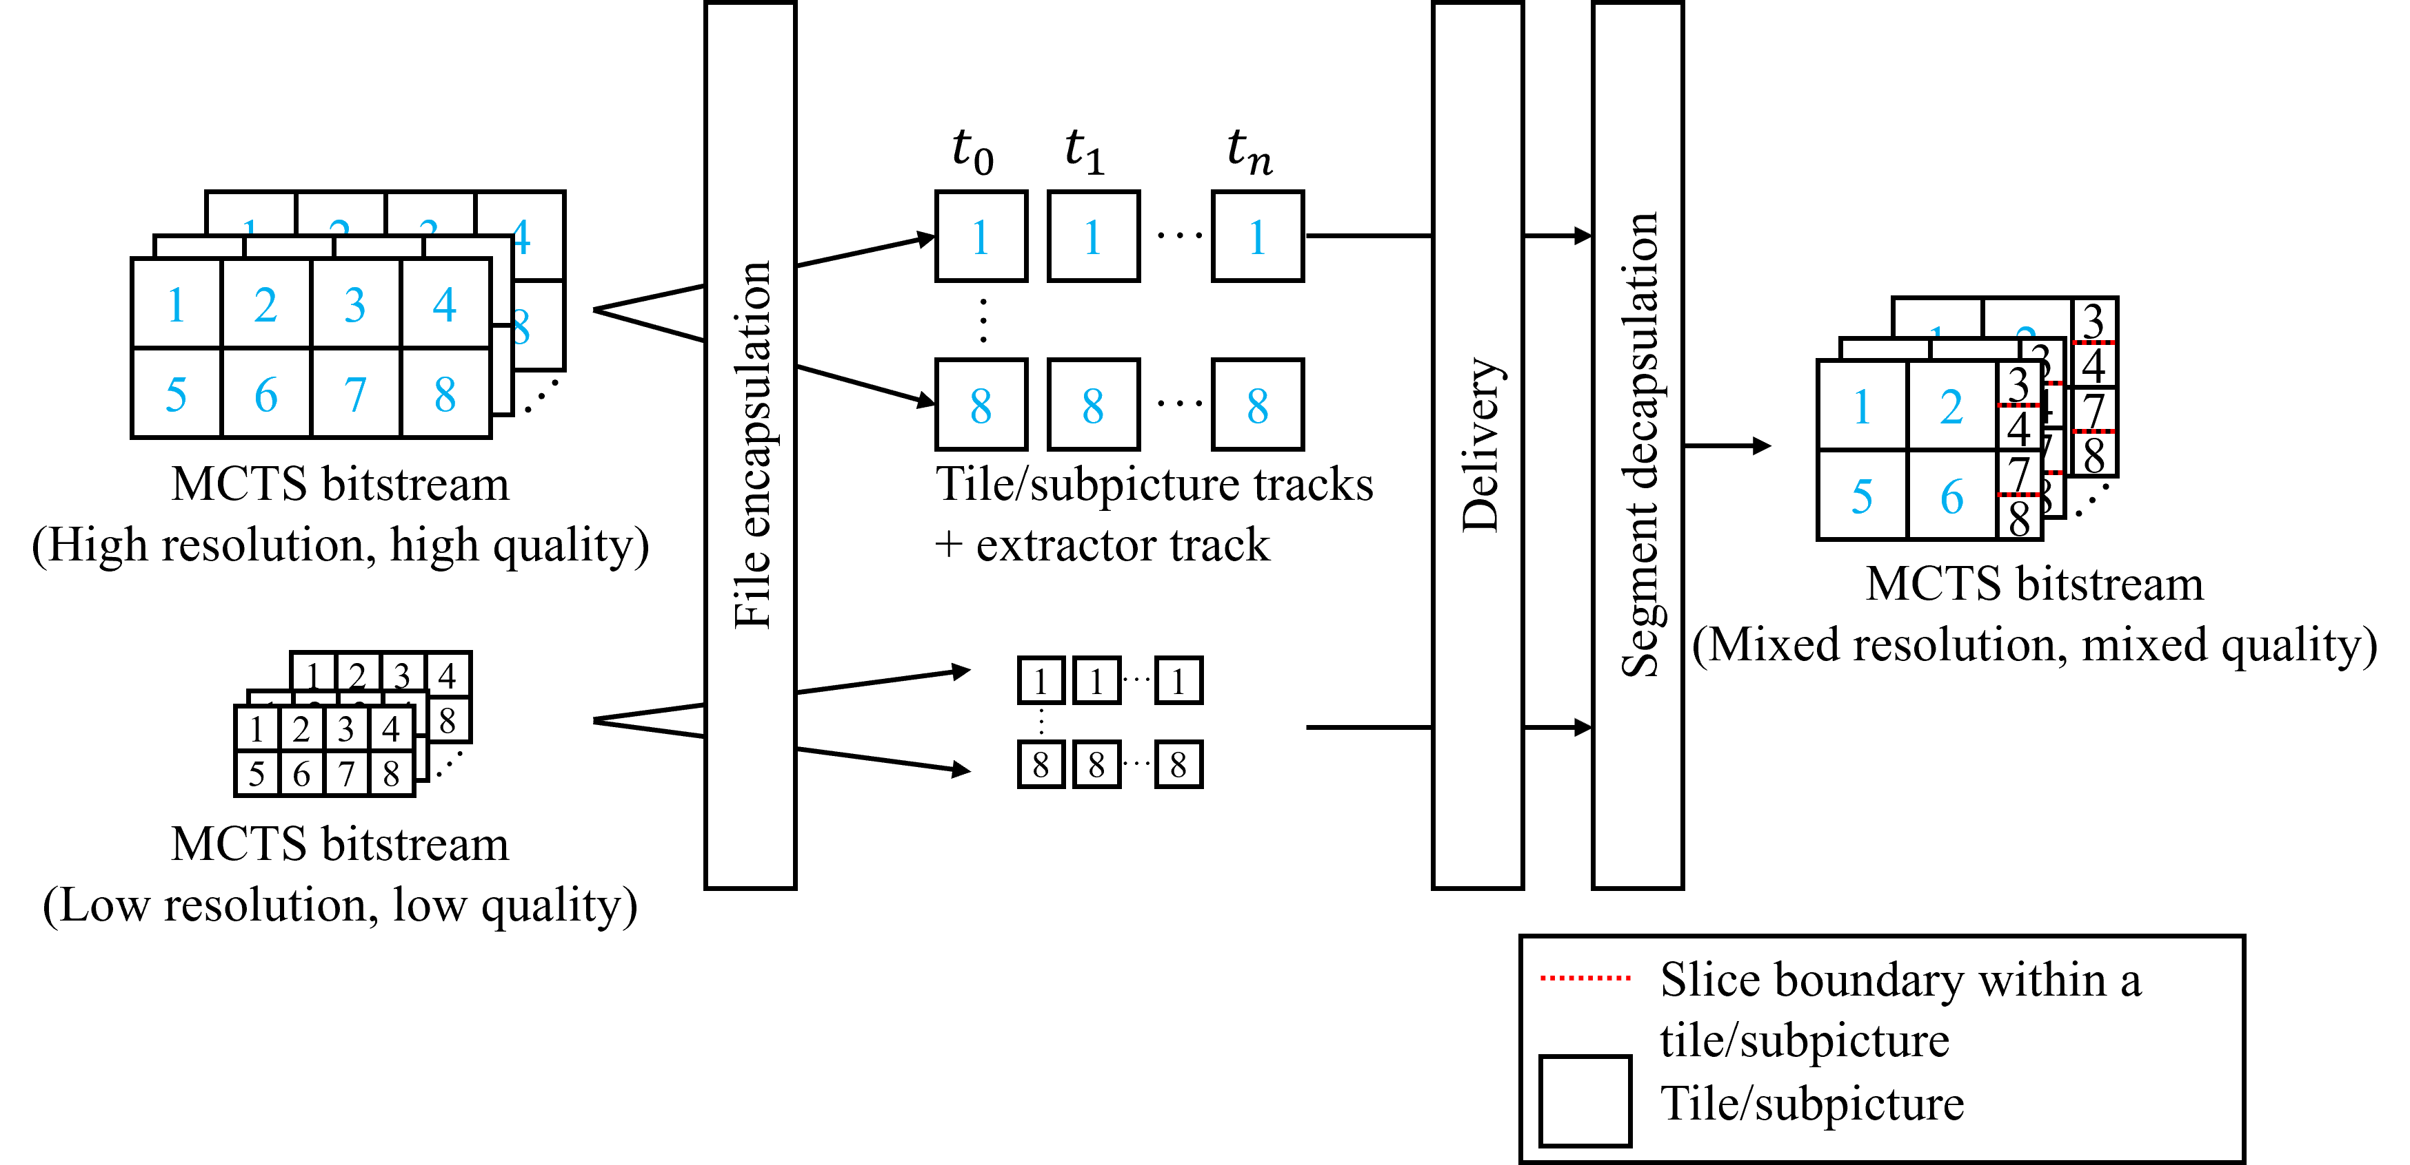
Mixed Quality & Resolution Tiled Streaming
Tiles/subpictures are divided in compressed domain using MCTS
Mixed-quality and mixed-resolution MCTS bitstreams at the server-side
HEVC and VVC-compliant versatile MCTS merging
Multiple slices aligned vertically in one tile/subpicture
Mixed quality, mixed resolution tile/subpicture merging is available
Example of mixed-quality and mixed-resolution viewport-dependent 360-degree video tiled streaming
3079-21-0055-00-0001 On MCTS Tile Merger for CDN-based Viewport-dependent 360 Video Tiled Streaming

Slide 9
Experimental Results
HM 16.20 for encoding, ffmpeg git-2020-03-28-3362330 for decoding
Intel i5-8250U (4 cores) and 8GB memory on the experimental device
In merging, half of the tiles were HQ, the others were LQ
Quantization parameter (QP) 22 for HQ, 37 for LQ
Resolution 4096×2048 for HQ, 2048×1024 (down-sampled) for LQ
Mixed quality & resolution saved 37.12% pixel rate and merging/decoding time
Method | Tiling | Resolution | No. of merged tiles | QP | Merging time (s) | Decoding time (s)
Anchor | - | 4096×2048 | - | 22 | - | 3.014
Anchor | - | 4096×2048 | - | 37 | - | 2.543
Mixed quality | 2×4 | 4096×2048 | 8 | 22, 37 | 0.388 | 2.743
Mixed quality | 4×8 | 4096×2048 | 32 | 22, 37 | 0.392 | 2.926
Mixed quality, mixed resolution | 2×4 | 2560×2048 | 8 | 22, 37 | 0.386 | 2.048
Merging, decoding performances of mixed quality, mixed quality & resolution tiled streaming
3079-21-0055-00-0001 On MCTS Tile Merger for CDN-based Viewport-dependent 360 Video Tiled Streaming

Slide 10
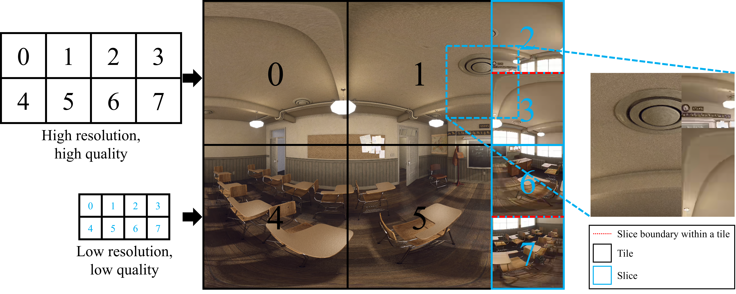
Experimental Results (-Cont’d)
Decoding by HM and ffmpeg without any problems
At the tile boundaries, no visual errors were observed (successful merging)
Decoding example of mixed quality & resolution tiled streaming
3079-21-0055-00-0001 On MCTS Tile Merger for CDN-based Viewport-dependent 360 Video Tiled Streaming

Slide 11
Conclusion
Motivation
High BW & computing time for 360-degree video streaming: tiled streaming can be used
Bitstream extractor and merger (BEAMer) in MPEG for:
Preventing the waste of decoding resources including time consumption
Proposed Methods and Insights
HEVC bitstream merger for mixed quality & resolution tiled streaming
Pixel rate, merging time, decoding time savings compared to the anchor
CDN-based system architecture for flexible client-adaptive streaming
Future Work
Experiments on several tiling scenarios will be conducted
3079-21-0055-00-0001 On MCTS Tile Merger for CDN-based Viewport-dependent 360 Video Tiled Streaming

