Slide 1
MPEG-Immersive 6DoF Standard Work: Related to MPEG Immersive Video
Presenter: Eun-Seok Ryu (esryu@skku.edu)
Jong-Beom Jeong, Soonbin Lee, Eun-Seok Ryu
Multimedia Computing Systems Lab. (MCSL)
http://mcsl.skku.edu
Department of Computer Education
Sungkyunkwan University

Slide 2
Compliance with IEEE Standards Policies and Procedures
Subclause 5.2.1 of the IEEE-SA Standards Board Bylaws states, "While participating in IEEE standards development activities, all participants...shall act in accordance with all applicable laws (nation-based and international), the IEEE Code of Ethics, and with IEEE Standards policies and procedures."
The contributor acknowledges and accepts that this contribution is subject to
The IEEE Standards copyright policy as stated in the IEEE-SA Standards Board Bylaws, section 7, http://standards.ieee.org/develop/policies/bylaws/sect6-7.html#7, and the IEEE-SA Standards Board Operations Manual, section 6.1, http://standards.ieee.org/develop/policies/opman/sect6.html
The IEEE Standards patent policy as stated in the IEEE-SA Standards Board Bylaws, section 6, http://standards.ieee.org/guides/bylaws/sect6-7.html#6, and the IEEE-SA Standards Board Operations Manual, section 6.3, http://standards.ieee.org/develop/policies/opman/sect6.html
3079-21-0056-00-0001 MPEG-Immersive 6DoF Standard Work: Related to MPEG Immersive Video

Slide 3
IEEE 3079.1 Motion to Photon (MTP) Latency in Virtual Environments Dongil Dillon Seo, dillon.seo@telekom-capital.com
MPEG-Immersive 6DoF Standard Work: Related to MPEG Immersive Video
Date: 2021-07-19
Author(s): Jong-Beom Jeong, Soonbin Lee, Eun-Seok Ryu
Name | Affiliation | Phone [optional] | Email [optional]
Jong-Beom Jeong | Sungkyunkwan Univ. |  | uof4949@skku.edu
Soonbin Lee | Sungkyunkwan Univ. |  | soonbinlee@skku.edu
Eun-Seok Ryu | Sungkyunkwan Univ. |  | esryu@skku.edu
3079-21-0056-00-0001 MPEG-Immersive 6DoF Standard Work: Related to MPEG Immersive Video

Slide 4
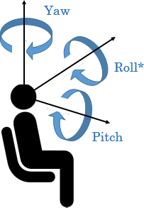
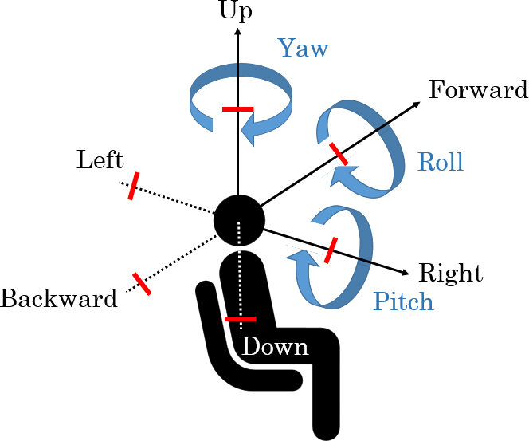
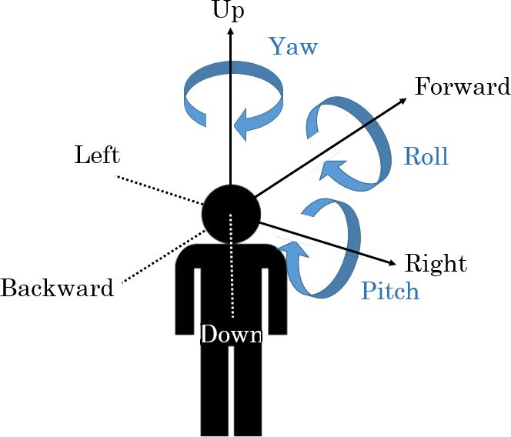
MPEG Immersive Video (MIV) Overview
Step-by-step objective of ISO/IEC MPEG immersive video
MPEG-I is responsible for standardizing immersive media in MPEG and specifies the goals of step 3
Goal of Revitalizing VR Commercial Service by 2020
Goal of 6DoF media support by 2022 after completing 3DoF standard by 2017
Step 1
Step 2
Step 3
Yaw
Up
Up
Yaw
Forward
Yaw
Forward
Roll
Left
Roll
Roll
Left
Pitch
Backward
Right
Backward
Right
Pitch
Pitch
Down
Down
Complete 3DoF standard by 2017
Rotate head in a fixed state
360 video full streaming by default
Tiled streaming if possible
Enable VR commercial servicers by 2020
Allow head rotation and movement within a restricted area
User-to-user conversations and projection optimization
Support 6DoF by 2022
6DoF video will reflect user’s walking motion
Support interaction with virtual environments
Definitions of 3DoF, 3DoF+, and 6DoF
3079-21-0056-00-0001 MPEG-Immersive 6DoF Standard Work: Related to MPEG Immersive Video

Slide 5
MPEG Immersive Video (MIV) Overview (-Cont’d)
MPEG-I requested call for proposals (CfP) on 3DoF+
Philips, Intel & Technicolor, Nokia, PUT & ETRI, ZJU submitted responses > test model for immersive video (TMIV)
Removes correlation between multi-view
VR streaming on 6DoF natural-content
Viewport generated by TMIV
Block diagram of TMIV architecture
3079-21-0056-00-0001 MPEG-Immersive 6DoF Standard Work: Related to MPEG Immersive Video

Slide 6
MPEG Immersive Video (MIV)-related Activities (-Cont’d)
Mandates and Input Contributions in MPEG134 MPEG-I Visual
1. Prepare draft international standard of MPEG Immersive Video 2
2. Study profiles, tiers, and levels for MPEG Immersive Video 1
3. Carry on core experiments of MPEG Immersive Video 3
4. Update test model and reference software for MPEG Immersive Video 3
5. Define CTC for MPEG Immersive Video 8
6. Carry out exploration experiments on MPEG Immersive Video 10
7. Investigate dense light field content in immersive video applications 10
8. Study performance improvements under CTC conditions 2
9. Promote MPEG Immersive Video outside MPEG 0
Total 39 doc.
3079-21-0056-00-0001 MPEG-Immersive 6DoF Standard Work: Related to MPEG Immersive Video

Slide 7
MIV Common Test Conditions
Reference softwares
Software name | Location | Tag/branch
TMIV | https://gitlab.com/mpeg-i-visual/tmiv | v8.0
VVenC | https://github.com/fraunhoferhhi/vvenc | v0.2.0.0
VVdeC | https://github.com/fraunhoferhhi/vvdec | v0.2.0.0
VMAF | https://github.com/Netflix/vmaf | v1.3.14
IV-PSNR | https://gitlab.com/mpeg-i-visual/ivpsnr | v3.0
IVDE | https://gitlab.com/mpeg-i-visual/ivde | v3.0
3079-21-0056-00-0001 MPEG-Immersive 6DoF Standard Work: Related to MPEG Immersive Video

Slide 8
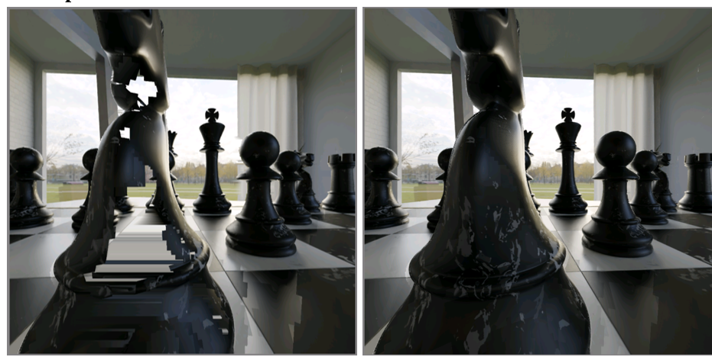
[MIV] ZJU response to CE2 viewport culling (m56415)
Previous culler removed some patches from the viewport
This is because of the patches which has FoV >= 180°
Divided such large patches into sub-blocks
AhG recommendations:
Integrate into TMIV
Enable in the CTC anchors
Frame in SQ P01 anchor (left) and modified subblock culler (right)
3079-21-0056-00-0001 MPEG-Immersive 6DoF Standard Work: Related to MPEG Immersive Video

Slide 9
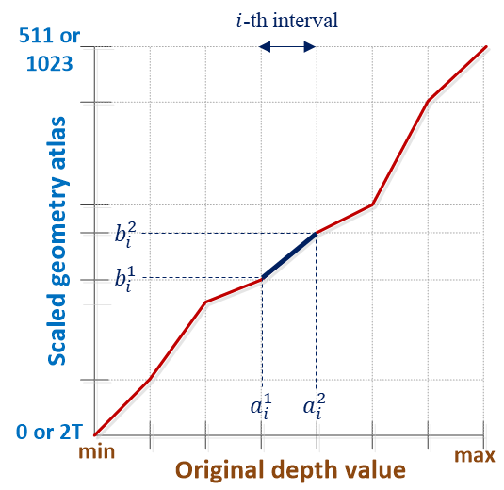
[MIV] CE3.2 Piecewise Linear Scaling of Geometry Atlas (m56481)
Current TMIV normalizes depth values into 10-bits
Proposed method conducts:
Divide depth into predefined number of intervals (proposed: 16)
Adaptively scale depth values
Important close depth - disparity is large
$$d^{′}=\frac{(b_{i}^{2}−b_{i}^{1})∗(d−a_{i}^{1})}{a_{i}^{2}−a_{i}^{1}}+b1_{i}$$
more accurate
less accurate
Example of piecewise linear scaling
3079-21-0056-00-0001 MPEG-Immersive 6DoF Standard Work: Related to MPEG Immersive Video

Slide 10
[MIV] CE3.2 Piecewise Linear Scaling of Geometry Atlas (m56481) (-Cont’d)
3.4% BD-rate gain compared to the anchor
Subjective quality advantages at the edges
Proposed new syntax for depth quantization
Left: anchor viewport, right: proposed viewport
3079-21-0056-00-0001 MPEG-Immersive 6DoF Standard Work: Related to MPEG Immersive Video

Slide 11
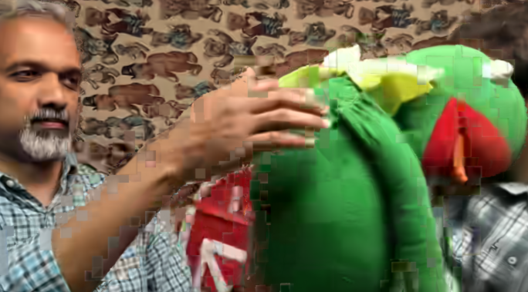
Pose trace issues with TMIV8 (m56774)
Block artifacts are generated when using TMIV8 anchor (VVenC) Maybe because of optimization in VVenC..? Blocky artifacts in high QP
AhG recommendations:
1. Better crosschecking: Evaluate the pose traces, study the code, apply a strict expert viewing process
2. Focus more on the pose trace generation: Viewing pose traces when releasing TMIV9, objective result is less important
3. Tool evaluation: Decision with only subjective results, encode 17 frames and render 97
Frog pose trace P01 in QP5
3079-21-0056-00-0001 MPEG-Immersive 6DoF Standard Work: Related to MPEG Immersive Video

Slide 12
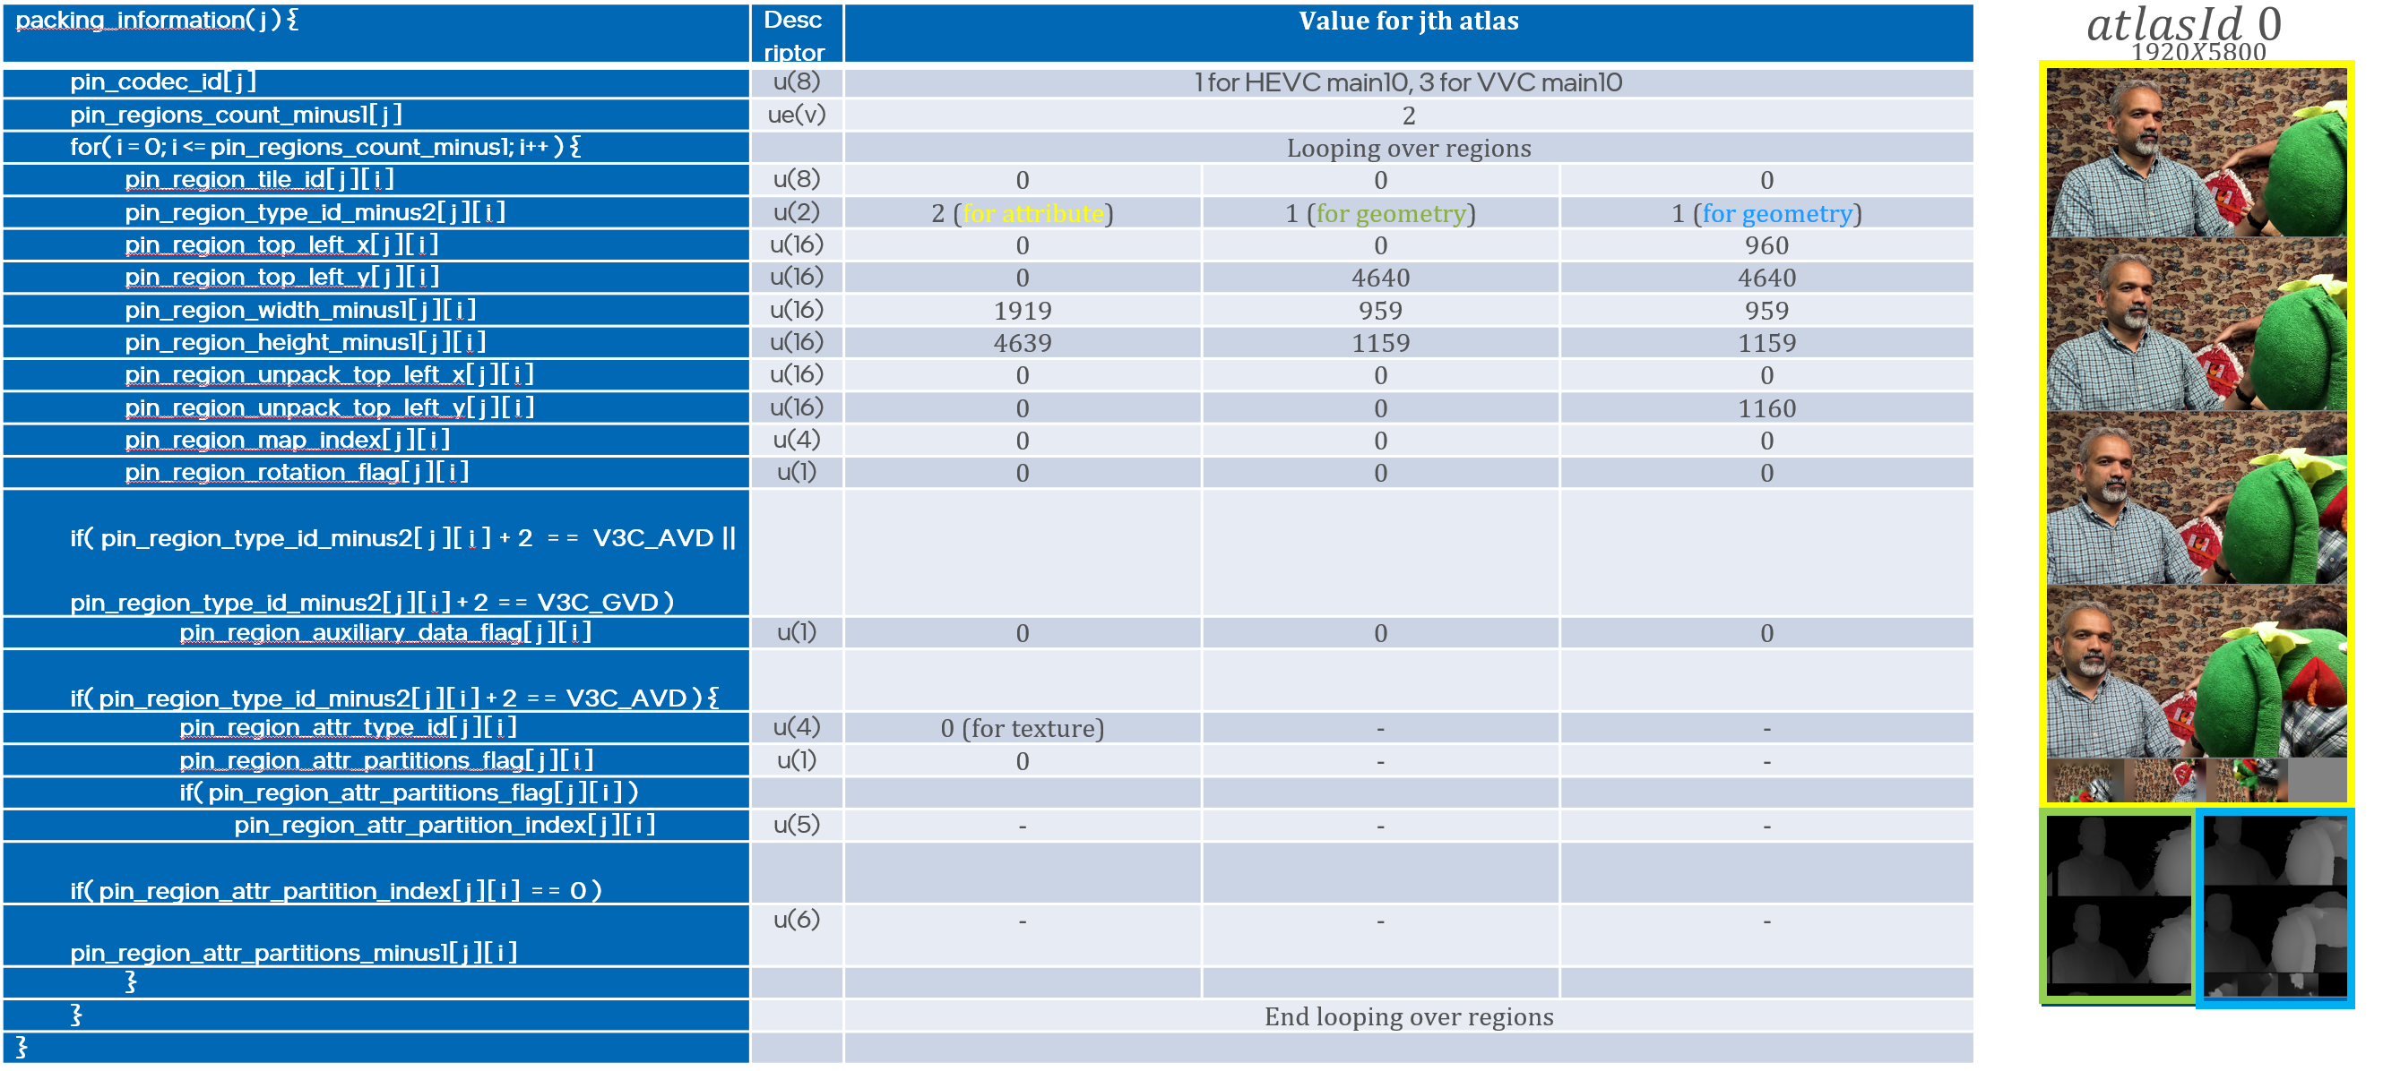
Frame Packing Implementation in TMIV (m56827)
Frame packing implementation in TMIV to:
No empty spaces in the packed video
Not restricted to VVC (sub-pictures) or HEVC-specific (MCTS) solutions
Frame packing across different atlas indices is not available
current syntax does not allow it
Packing information for V17 with 1 tile
3079-21-0056-00-0001 MPEG-Immersive 6DoF Standard Work: Related to MPEG Immersive Video

Slide 13
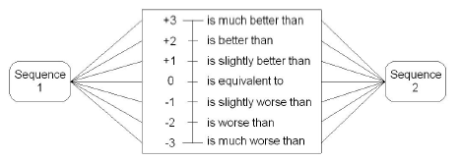
Recommendations for MIV expert viewing sessions (m56321)
Guidelines for expert viewing session
Watching anchor/proposed video (10s) two times is enough Typical option: A/B/A/B, P.800 for instance Lowering frame rate is not acceptable
Because matching the bitrate is hard, some flexibility is allowed Proponents can adjust texture and depth QP
PVS.i
Grey
PVS.j
Grey
PVS.k
voting
voting
voting
Example of viewing session
Sequence rating
3079-21-0056-00-0001 MPEG-Immersive 6DoF Standard Work: Related to MPEG Immersive Video

Slide 14
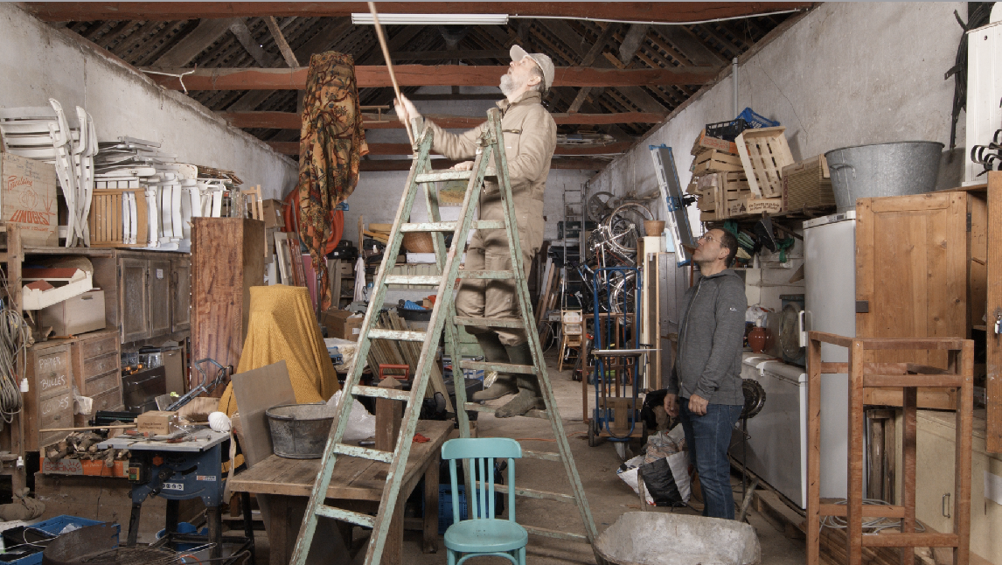
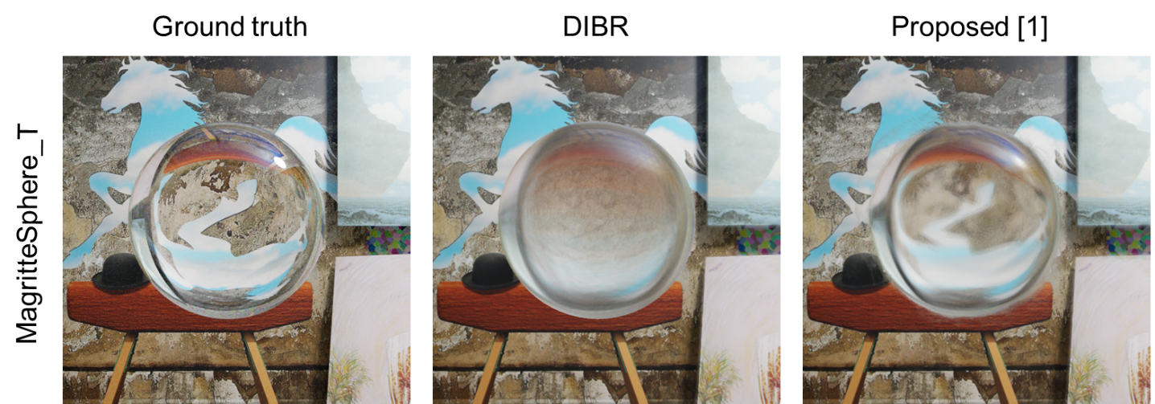
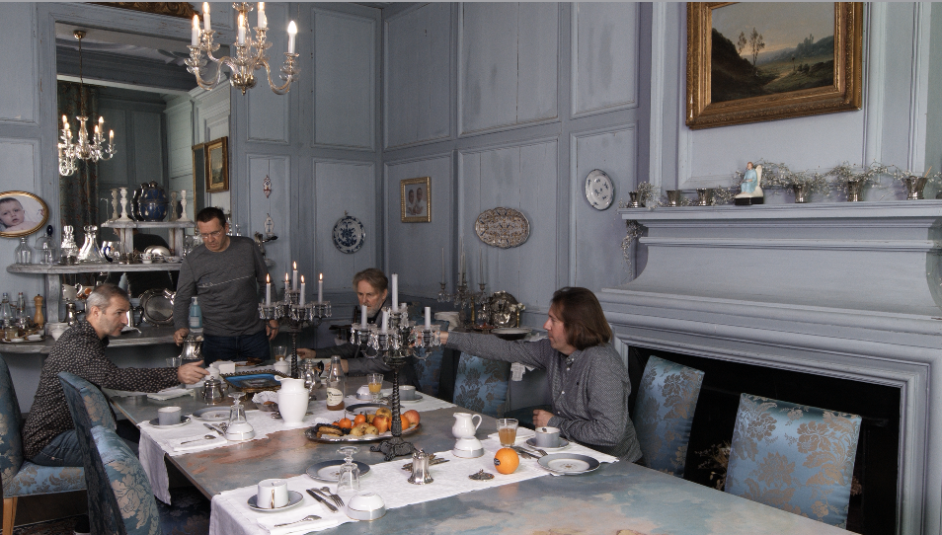
Test Materials (m56450, 56632, 56730)
Non-Lambertian CG content “MagritteSphere” by m56450
Rendered with Blender, two versions (transparent and mirror)
1 frame, 21×21 views, 2000×2000 size
NC content “Barn” by m56632
97 frames, 5×3 perspective views, 1920×1080 size
Some holes exist (invalid depth)
Estimated depth by proprietary tool
NC content “Breakfast” by m56730
Spec. is same as “Barn”
Captured in the dining room of Chateau de la Ballue
Barn sequence
MagritteSphere sequence
Breakfast sequence
3079-21-0056-00-0001 MPEG-Immersive 6DoF Standard Work: Related to MPEG Immersive Video

Slide 15
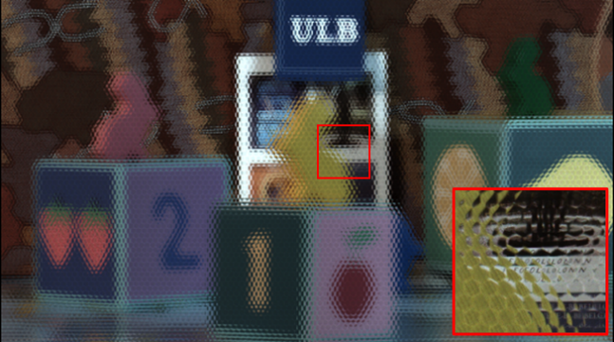
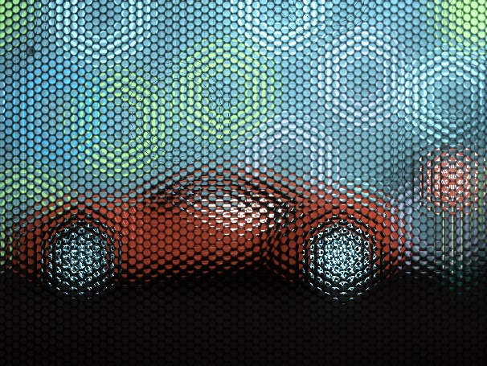
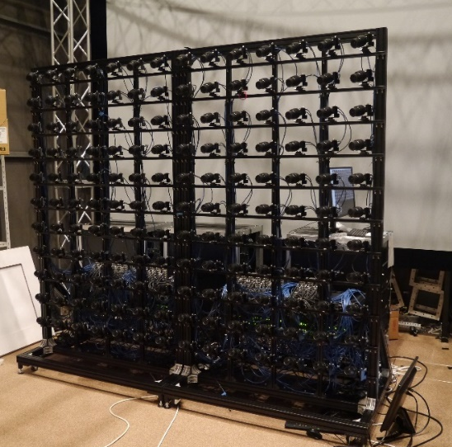
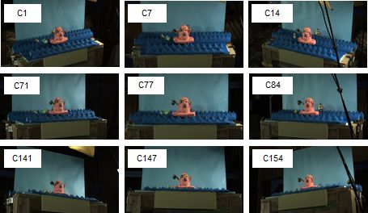
Test Materials (m56429, m56652, m56787)
Natural content “RabbitStamp” by m56429
Captured by RayTrix R8 Plenoptic 2.0
1 frame, 7×3 views, 2K×2K size
Natural content “Clay magic” by m56429
Captured by RayTrix R8 Plenoptic 2.0
193-318 frames, 14×11 views, 1920×1080 size
Not parallel cameras -> good for testing MIV..?
Natural content “Sports Car” by m56787
Captured by two plenoptic cameras
Recitification (rotate, crop, color matching)
RabbitStamp sequence
2600 mm
2000 mm
Clay magic sequence and capturing system
Left view of Sports Car sequence
3079-21-0056-00-0001 MPEG-Immersive 6DoF Standard Work: Related to MPEG Immersive Video

Slide 16
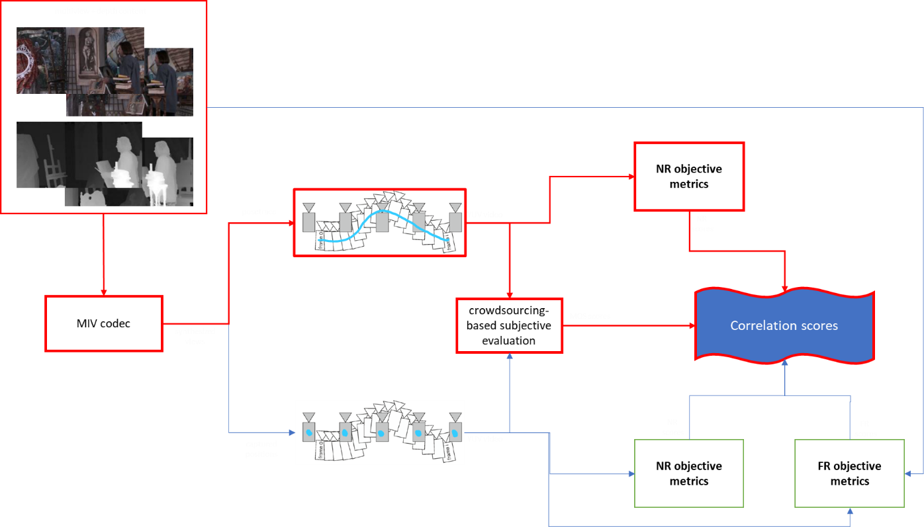
Evaluation of objective quality metrics in MIV context (m56411)
Current objective metrics are not suitable for MIV
Compression, synthesis artifacts
Evaluation on source views because GT is not enough (pose trace is needed)
Large differences between anchor and proposal
Crowdsourcing-like subjective evaluation
No-reference (NR) based on DL, but not re-trained for MIV
Correlation with MOS: 0.76 RMSE, 0.75 PLCC, 0.73 SRCC
ACR scale score
System overview of quality evaluation
3079-21-0056-00-0001 MPEG-Immersive 6DoF Standard Work: Related to MPEG Immersive Video

Slide 17
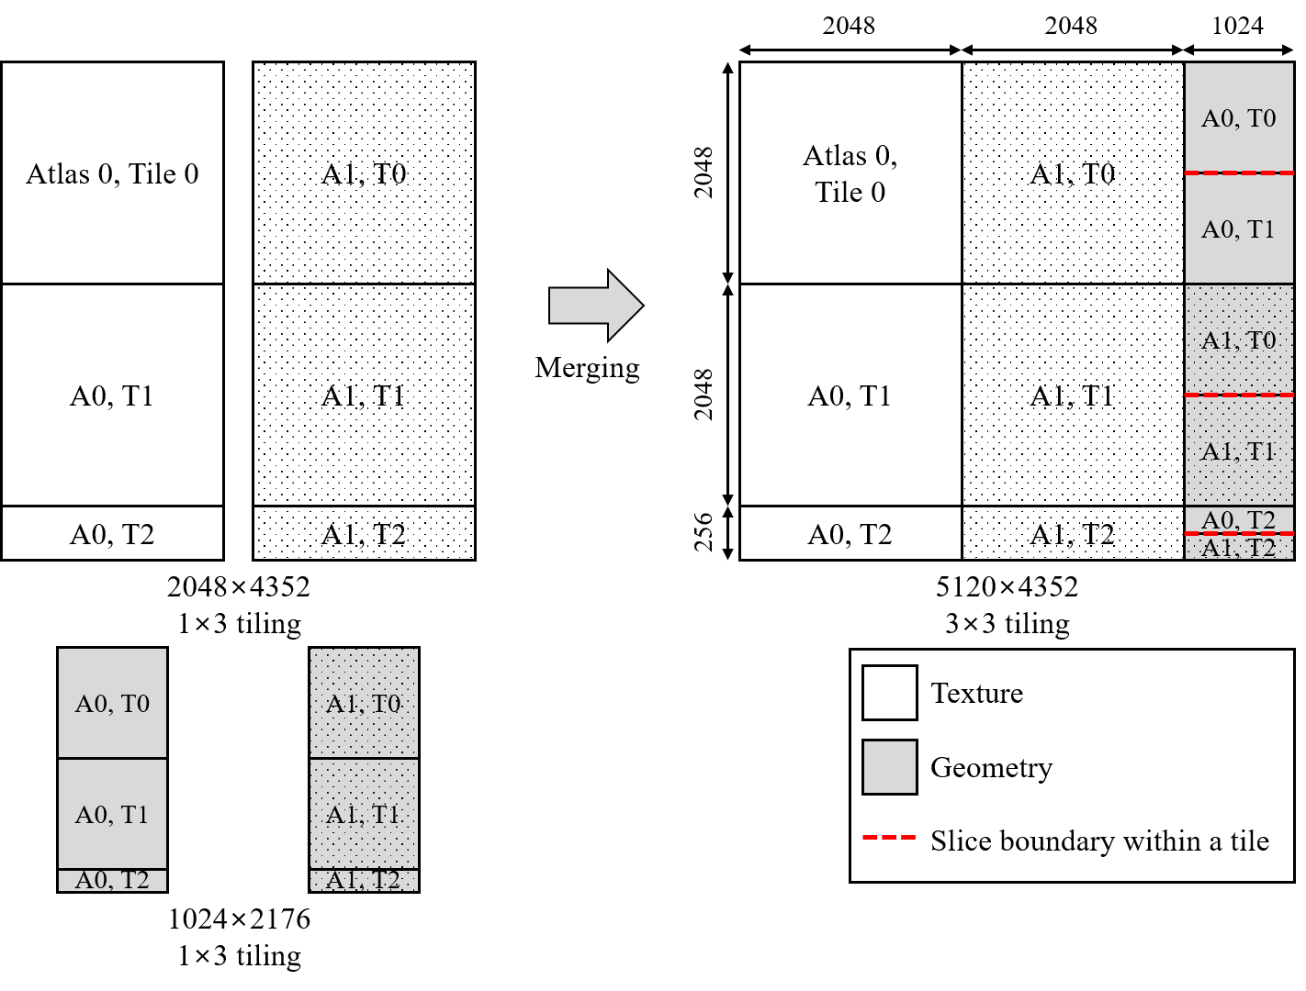
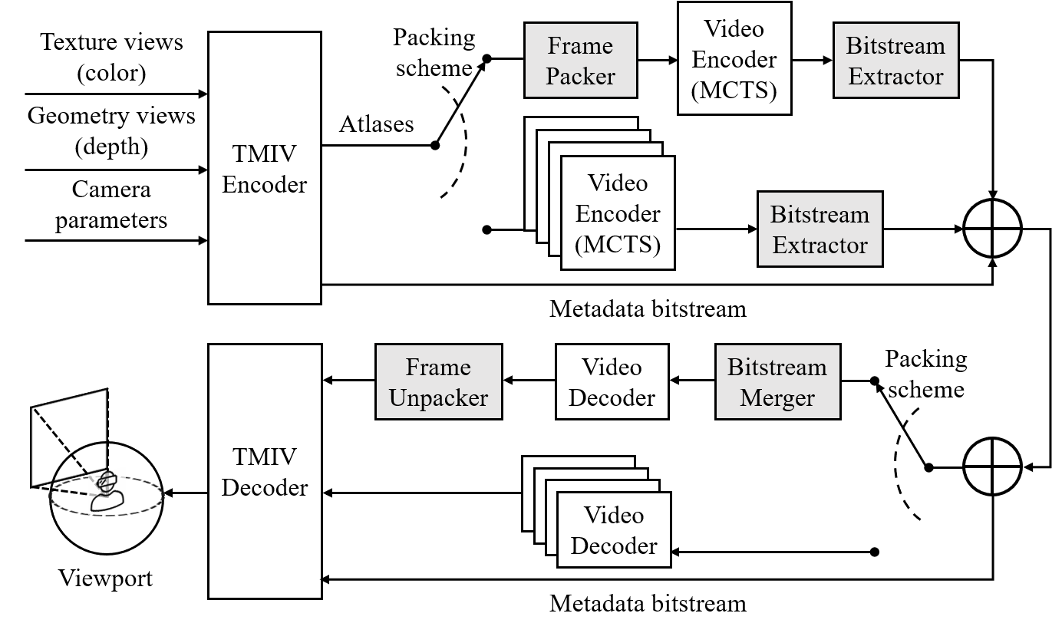
Extraction and Merging on Frame Packed Video (m56591)
SKKU MCSL proposed bitstream-level packing
Fine-grained system in terms of the number of decoder instances
Current TMIV supports pixel-level frame packing -> provides high level two bitstreams
Proposed method can provide low level four or high level two bitstreams
0.7%, 3.93% BD-rate saving because of deblocking filter deactivation
Developed tile bitstream extracting/merging software on HEVC test model
AhG recommendations
Tiling is needed for TMIV
Implementation of HLS to enable tiling on TMIV is more than welcome
System overview of packing method by MCSL
Example of bitstream-level packing
3079-21-0056-00-0001 MPEG-Immersive 6DoF Standard Work: Related to MPEG Immersive Video

Slide 18
Thank You ! http://mcsl.skku.edu/ Questions > esryu@skku.edu
3079-20-0057-02-0001 On MCTS Tile Merger for CDN-based Viewport-dependent 360 Video Tiled Streaming

