Slide 1
IEEE 3079 Working Group Human Factor for Immersive Content
Alexander Stickel, P.Eng.
Serious Labs

Slide 2
IEEE 3079
Human Factor for Immersive Content Working Group
Beom-Ryeol Lee, lbr@etri.re.kr
Proposal for vestibular parameters to be adopted under IEEE 3079
Date: 2021-07-00
Author(s):
Name | Affiliation | Phone | Email
Alexander Stickel | Serious Labs | 780-440-1128 | Alex.Stickel@SeriousLabs.com

Slide 3
Sensory Conflict Theory
Mismatch between visual and vestibular systems leading to discomfort¹

Slide 4
Human Vestibular System
Primary sense of motion
Otolith organs
Semicircular Canals
Figure 1: Placement of the human vestibular system²
Figure 2: The Human Vestibular System³

Slide 5
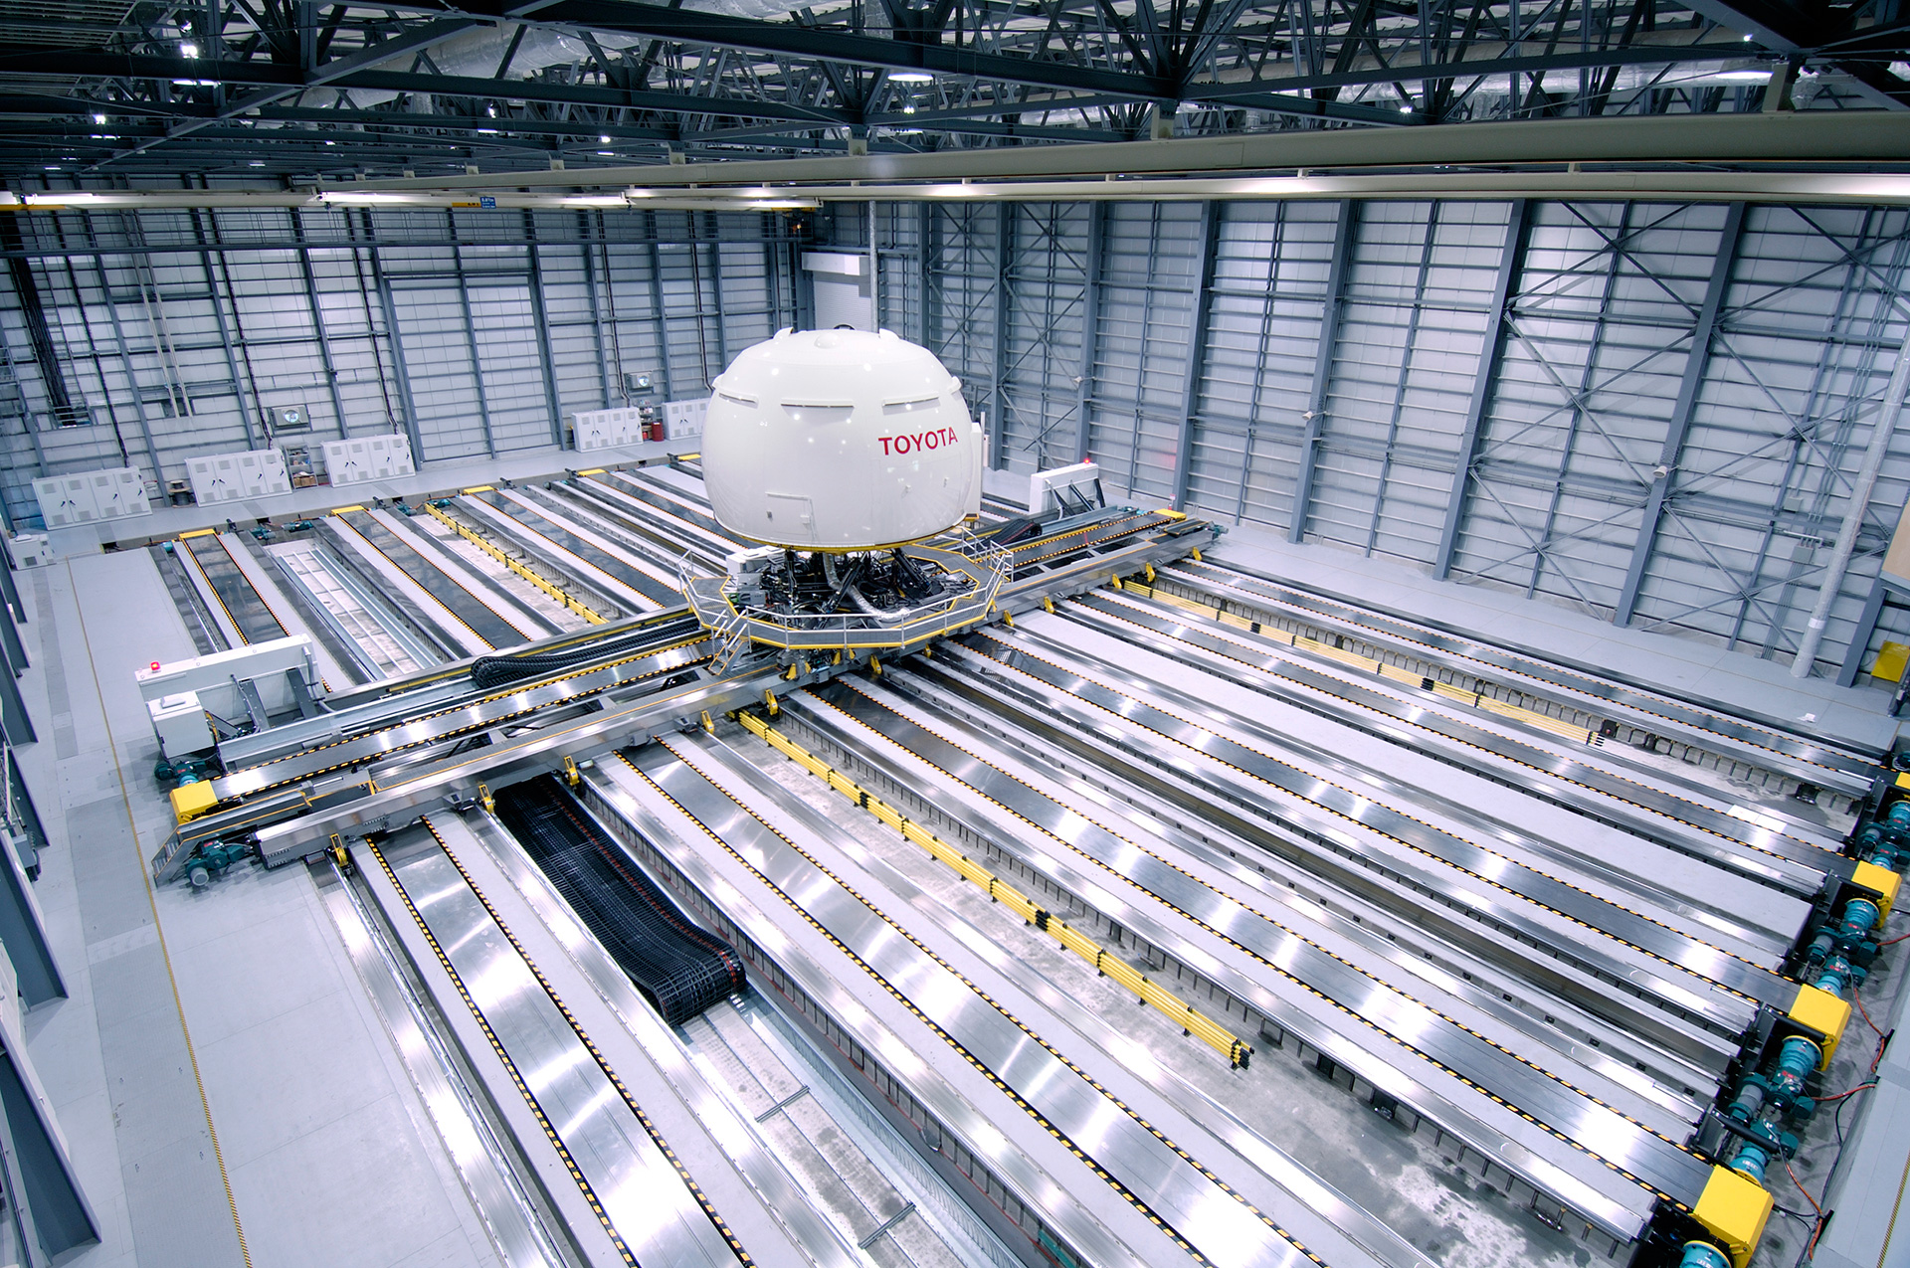
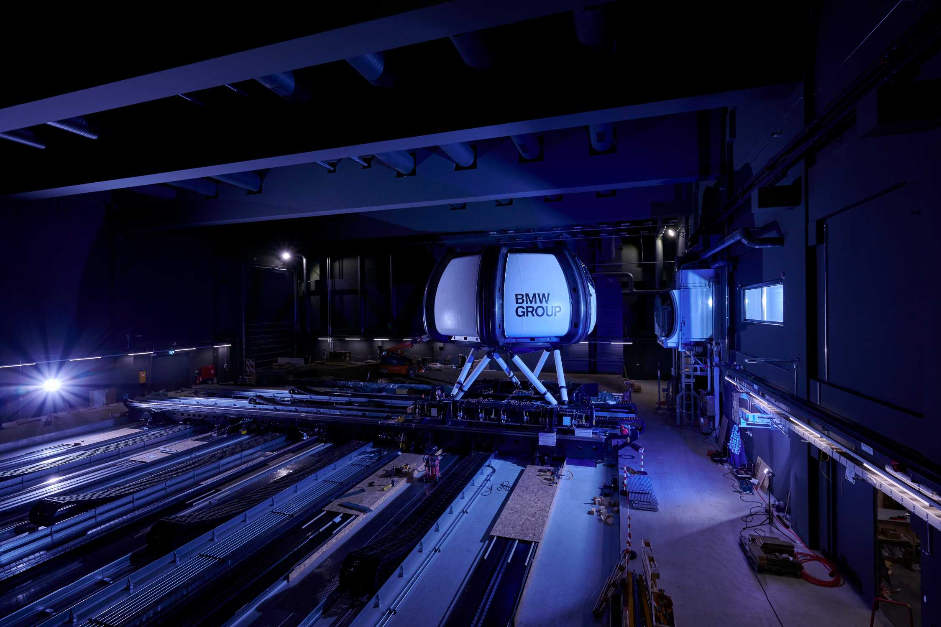
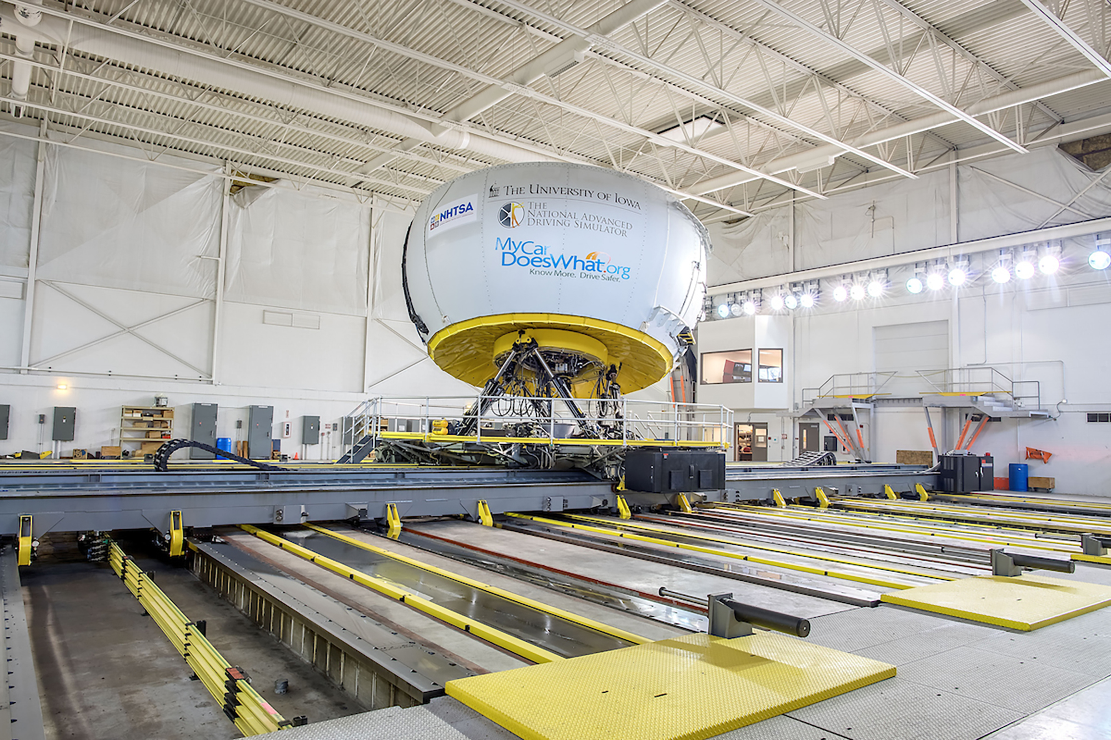
Sensory Conflict Mitigations
Motion Systems
  Stewart Table
  Carousel
  XY Track
  6+ Degrees of Freedom
Provide perceptible motion while washing out to the original position.
Toyota Driving Simulator⁴
BMW High Fidelity Simulator⁵
NADS-1 Driving Simulator⁶

Slide 6
Vestibular Thresholds of Perception
Otolith limits of detection
Otolith transfer function model example⁹
Reference | SURGE | SWAY | HEAVE
Reid and Nahon⁷ | 1.7 | 0.17 | 0.28
Benson, et al.⁸ | 0.0625 | 0.0569 | 0.154

Slide 7

Vestibular Thresholds of Perception
Semicircular canal limits of detection
Semicircular canal transfer function model example¹⁰
Reference | ROLL | PITCH | YAW
Reid and Nahon⁷ | 3.0 | 3.6 | 2.6
Benson, et al.⁸ | 2.0 | 2.0 | 1.6

Slide 8
Question to group:
Does the IEEE 3079 Workgroup believe there would be value in compiling models and characteristics of the human vestibular system as a reference and best practice for the community as part of the 3079 standard?
Tasks
  Compile models
  Exclude or affirm models as possible
  Provide conclusions and recommendations to this group

Slide 9
References:
Charles M. Oman. Motion sickness: a synthesis and evaluation of the sensory conflict theory. Canadian Journal of Physiology and Pharmacology. 68(2): 294-303. https://doi.org/10.1139/y90-044
Purves D, Augustine GJ, Fitzpatrick D, et al., editors. Neuroscience. 2nd edition. Sunderland (MA): Sinauer Associates; 2001. Available from: https://www.ncbi.nlm.nih.gov/books/NBK10799/
C. Stangor, Introduction to Psychology, Flatworld Knowledge, 2010
Image taken from global Toyota website (https://global.toyota/en/download/14221274/), Accessed July 18th, 2021
Image taken from global BMW website (https://www.bmw.com/en/events/nextgen/driving-simulator.html), accessed July 18^{th,} 2021
Image taken from the University of Iowa website (https://nads.uiowa.edu/nads-1-simulator), Accessed July 18th, 2021
Reid, L.D., and Nahon, M. A, Flight Simulation Motion-Base Drive Algorithms: Part 1 - Developing and Testing the Equations. 1985, UTIAS Report No. 296, CN ISSN 0082-5255, Institute for Aerospace Studies, University of Toronto, Toronto, Canada.
Benson, A.J., Hutt, E. C. B., and Brown, S. F., Thresholds for the Perception of Whole Body Angular Movement About a Vertical Axis. Aviation, Space, and Environmental Medicine, 1989. 60: p. 205-213.
Asadi, Houshyar & Mohamed, Shady & Lim, Chee & Nahavandi, Saeid. (2016). A Review on Otolith Models in Human Perception. Behavioural Brain Research. 309. 10.1016/j.bbr.2016.03.043.
Capustiac, Alina & Hesse, Benjamin & Schramm, Dieter & Banabic, D.. (2011). A Human Centered Control Strategy for a Driving Simulator. International Journal of Mechanical & Mechatronics Engineering IJMME-IJENS. 11. 45-52.

Slide 10
Thank You

