Slide 1
AR Glasses for See-Direct Communication
RYU Cheol / ETRI

Slide 2
Compliance with IEEE Standards Policies and Procedures
Subclause 5.2.1 of the IEEE-SA Standards Board Bylaws states, "While participating in IEEE standards development activities, all participants...shall act in accordance with all applicable laws (nation-based and international), the IEEE Code of Ethics, and with IEEE Standards policies and procedures."
The contributor acknowledges and accepts that this contribution is subject to
The IEEE Standards copyright policy as stated in the IEEE-SA Standards Board Bylaws, section 7, http://standards.ieee.org/develop/policies/bylaws/sect6-7.html#7, and the IEEE-SA Standards Board Operations Manual, section 6.1, http://standards.ieee.org/develop/policies/opman/sect6.html
The IEEE Standards patent policy as stated in the IEEE-SA Standards Board Bylaws, section 6, http://standards.ieee.org/guides/bylaws/sect6-7.html#6, and the IEEE-SA Standards Board Operations Manual, section 6.3, http://standards.ieee.org/develop/policies/opman/sect6.html

Slide 3
IEEE 3079 Human Factor for Immersive Content Working Group
AR glasses for See-Direct Communication
Date: 2021-07-19
Author(s):
Name | Affiliation | Phone | Email
RYU Cheol | ETRI
LEE Jaeho | ETRI

Slide 4
Introduction of See-Direct Communication

Slide 5
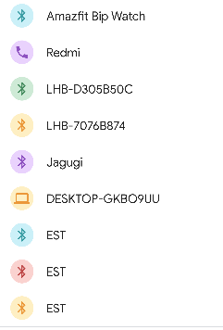
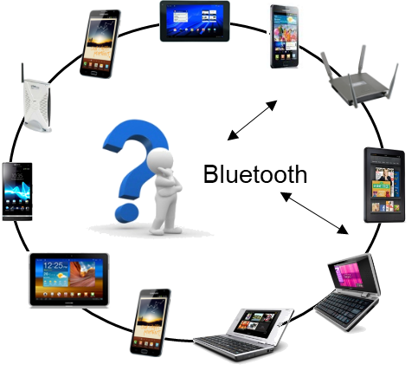
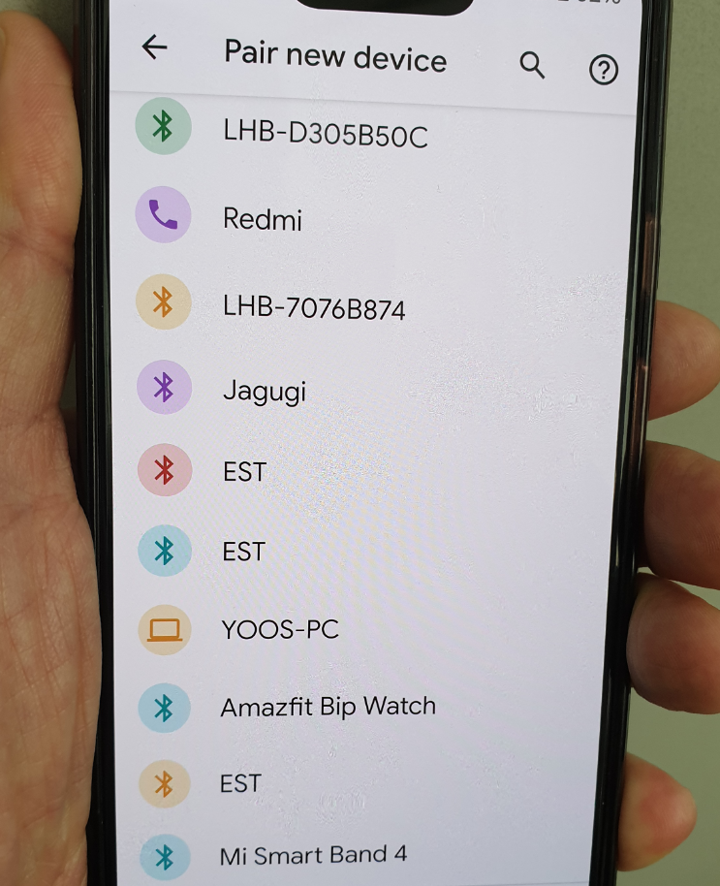
Background
Increases in IoT devices with various services require more instinctive ways to discover and connect to them
Scan-and-Select needs several steps of user intervention such as identifying targets and selecting the right target
Too many devices and services slow down the discovery of them
Scan-and-Select
Far from user-friendly interface
for smart glasses

Slide 6
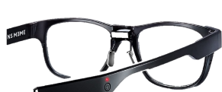
Bluetooth AoA
User-friendly, intuitive connection interface via ‘Look-and-Connect’
Just looking at the target device through smart glasses leads to automatic connection
More use cases beyond asset tracking(AoA) and indoor positioning(AoD)
Angle estimation can significantly reduce connection time by minimizing user intervention to identify a target device
LE Transmitter
IoT device
AoA
LE Receiver
See-Direct
Profiles and Services
Smart glasses

Slide 7
Device Image Recognition
Vision-based device selection
Selecting a device among the candidate devices by classifying device into categories
Incremental learning with pre-trained Convolutional Neural Network model

Slide 8
Use Cases of See-Direct Communication

Slide 9
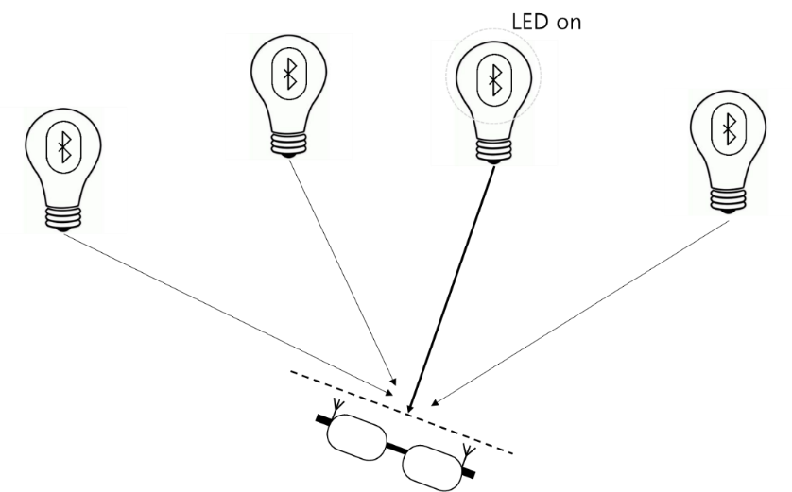
User Scenario A : Selecting a lamp
Smart glasses connect to and control the LED lamp in the line of sight

Slide 10
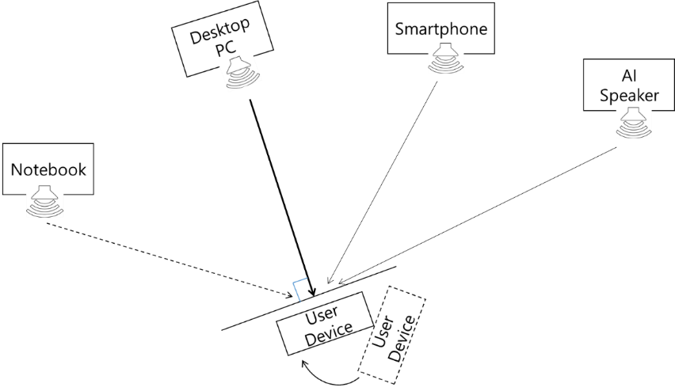
User Scenario B : Listening to a specific audio device
Smart glasses connect to and control a specific audio device, selecting among multiple nearby devices

Slide 11
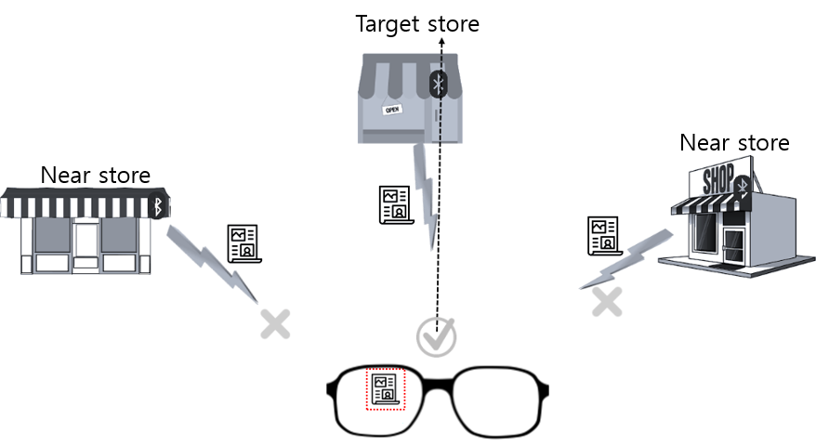
User Scenario C : Filtering broadcast from multiple beacons
See-Direct Communication can filter out broadcast data from beacons outside the user's line of sight

Slide 12
Demonstration

Slide 13
Thank You

