Slide 1
[Human Factor Related to Cybersickness in HMD VR]
[Yoon, Sangcheol / Daejeon University]

Slide 2
Compliance with
IEEE Standards Policies and Procedures
Subclause 5.2.1 of the IEEE-SA Standards Board Bylaws states, "While participating in IEEE standards development activities, all participants...shall act in accordance with all applicable laws (nation-based and international), the IEEE Code of Ethics, and with IEEE Standards policies and procedures."
The contributor acknowledges and accepts that this contribution is subject to
The IEEE Standards copyright policy as stated in the IEEE-SA Standards Board Bylaws, section 7, http://standards.ieee.org/develop/policies/bylaws/sect6-7.html#7, and the IEEE-SA Standards Board Operations Manual, section 6.1, http://standards.ieee.org/develop/policies/opman/sect6.html
The IEEE Standards patent policy as stated in the IEEE-SA Standards Board Bylaws, section 6, http://standards.ieee.org/guides/bylaws/sect6-7.html#6, and the IEEE-SA Standards Board Operations Manual, section 6.3, http://standards.ieee.org/develop/policies/opman/sect6.html

Slide 3
IEEE 3079
Human Factor for Immersive Content Working Group
Beom-Ryeol Lee, lbr@etri.re.kr
Human Factor Related to Cybersickness in HMD based VR
Date: 2021-07-21
Author(s):
Name | Affiliation | Phone | Email
Yoon, Sangcheol | Daejeon Univ. | +82 10 2502 6915 | yoonsangcheol@gmail.com
- | - | - | -

Slide 4
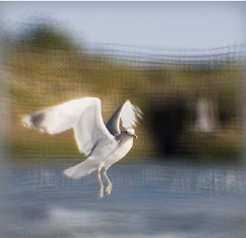
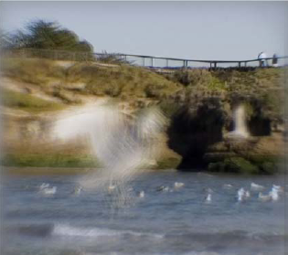
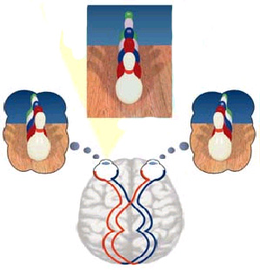

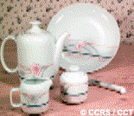
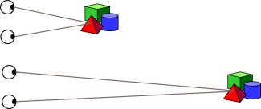

Physiological Cues
Accommodation
Binocular disparity
Vergence
Motion parallax

Slide 5
Psychological Cues
Linear perspective
Overlapping
Shading and Shadow
Texture Gradient

Slide 6
Classification of 3D Displays
3D Display which gives image including depth information by using physiological depth cue
Classification |  |  | Depth cues | Key component
Stereoscopic | Glasses type |  | Binocular disparity | Polarizing glasses
 |  |  |  | LC shutter glasses
 | Autostereoscopic (Non-glasses type) | Multi-view display | Binocular disparity, Vergence, Motion parallax (Horizontal only, limited range, discrete) | Parallax barrier
 |  |  |  | Lenticular lens
 |  |  |  | HOE (Holographic Optical Element)
 |  |  |  | Directional BLU
 |  | Super multi-view | Binocular disparity, Vergence, Motion parallax (H only, continuous), Accommodation | Lenticular lens
 |  |  |  | Multiple projection
 |  | Integral imaging | Binocular disparity, Vergence, Motion parallax (H&V, continuous), Accommodation | Lens array
Volumetric display |  |  | Binocular disparity, Vergence, Motion parallax, Accommodation | Stacked screens
 |  |  |  | Spinning screen/mirror
 |  |  |  | Crossed-beam (Two-photon absorption)
Holographic display |  |  | Binocular disparity, Vergence, Motion parallax, Accommodation | Electro-holography (Coherent optics)

Slide 7

Accommodation
The process by the vertebrate eye changes optical power to maintain a clear image or focus on an object as its distance varies
Accommodation distance

Slide 8
Vergence [Convergence]
The simultaneous movement of both eyes in opposite direction to obtain or maintain single binocular vision

Slide 9
Sight in real world
Observer
Object
Accommodation distance $≅$ Convergence distance

Slide 10
Sight in Stereoscopic 3D Display
3D Object
Observer
Accommodation distance
Convergence distance

Slide 11
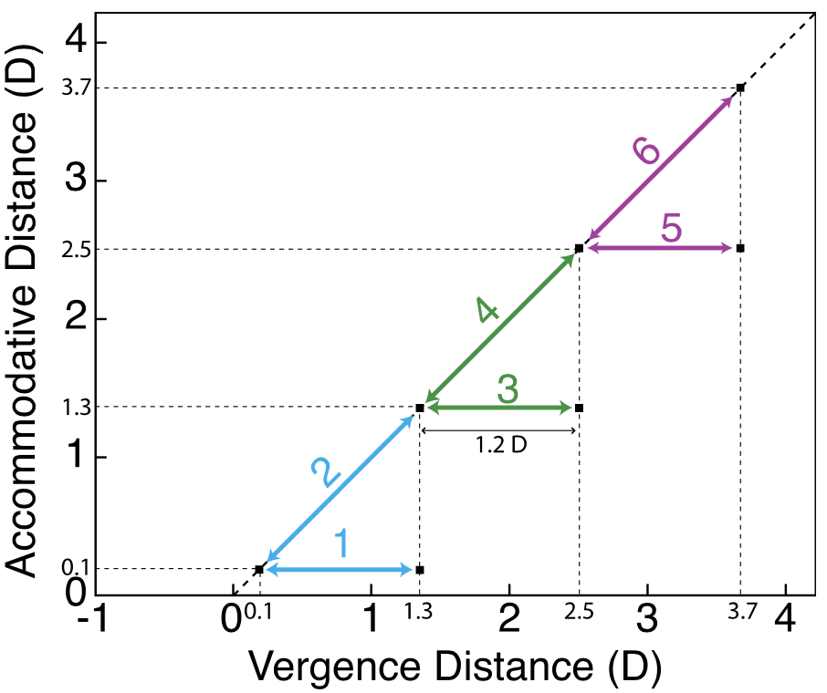
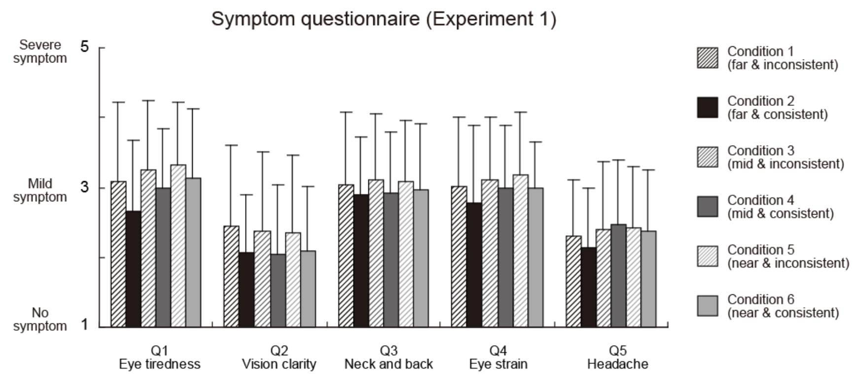
Insight into Vergence-Accommodation Mismatch
Vergence-Accommodation mismatch is possible to causing cybersickness
24 peoples in 19-33 years old.
‘Insight into Vergence-Accommodation Mismatch’, Martin S, Banks, Joohwan Kim, and Takashi Shibata (2013)

Slide 12
Conclusion
Observer
Accommodation rotation distance $≠$ Convergence rotation distance

Slide 13
Thank You

