Slide 1
[IEEE P3079 Session #19 WG Closing Plenary]
[Sangkwon Peter Jeong / JoyFun]

Slide 2
Compliance with
IEEE Standards Policies and Procedures
Subclause 5.2.1 of the IEEE-SA Standards Board Bylaws states, "While participating in IEEE standards development activities, all participants...shall act in accordance with all applicable laws (nation-based and international), the IEEE Code of Ethics, and with IEEE Standards policies and procedures."
The contributor acknowledges and accepts that this contribution is subject to
The IEEE Standards copyright policy as stated in the IEEE-SA Standards Board Bylaws, section 7, http://standards.ieee.org/develop/policies/bylaws/sect6-7.html#7, and the IEEE-SA Standards Board Operations Manual, section 6.1, http://standards.ieee.org/develop/policies/opman/sect6.html
The IEEE Standards patent policy as stated in the IEEE-SA Standards Board Bylaws, section 6, http://standards.ieee.org/guides/bylaws/sect6-7.html#6, and the IEEE-SA Standards Board Operations Manual, section 6.3, http://standards.ieee.org/develop/policies/opman/sect6.html

Slide 3
IEEE 3079
Human Factor for Immersive Content Working Group
Beom-Ryeol Lee, lbr@etri.re.kr
IEEE 3079 Session #19 WG Closing Plenary
Date: 2021-07-22
Author(s):
Name | Affiliation | Phone [optional] | Email [optional]
Jeong, Sangkwon Peter | JoyFun | +82 10 8667 7329 | ceo@joyfun.kr
Son Wookho | ETRI | +82 10 8759 3602 | whson@etri.re.kr

Slide 4
Session Time and Location
 | Monday (July 19, 2021) | Tuesday (July 20, 2021) | Wednesday (July 21, 2021) | Thursday (July 22, 2021) | Friday (July 23, 2021)
AM 1 9:00a-10:30a |  | WG Meeting | IEEE 3079.1 TG
AM 2 11:00a-12:30p | Open Plenary Roll Call Reviewing last meeting minutes (Introducing participants) | IEEE 3079.1 TG |  |  | WG Meeting Closing Plenary
PM 1 1:30p – 3:00p | WG Meeting | IEEE 3079.2 TG | IEEE 3079.2 TG | IEEE 3079.2 TG
PM 2 3:30p – 5:00p |  | IEEE 3079.2 TG | IEEE 3079.2 TG | IEEE 3079.2 TG
※ Location
CAPELLA Hall in LAHAN Select Hotel at Gyeongju, Korea
Contact to Video Conference: https://us02web.zoom.us/j/83808221695?pwd=eERXZDVCYkJMWXI3VHdQdFdvaWl5dz09

Slide 5
WG Motions

Slide 6
WG Motion #1
Move to approve the document ‘3079-21-0041-00-0000-Session #19 WG Opening Plenary’
Move: Sangkwon Peter Jeong
Second: HyeonWoo Nam
For Agree: 07
Against: 00
Abstain: 00
Motion Passes

Slide 7
WG Motion #2
Move to approve the document ‘3079-21-0046-01-0000-Session #19 WG Agenda’
Move: Sangkwon Peter Jeong
Second: HyeonWoo Nam
For Agree: 07
Against: 00
Abstain: 00
Motion Passes

Slide 8
WG Motion #3
Move to approve the document ‘3079-21-0045-00-0000-PAR Modification for the IEEE 3079.2’
Move: Sangkwon Peter Jeong
Second: HyeonWoo Nam
For Agree: 02
Against: 06
Abstain: 00
Motion Fail

Slide 9
WG Motion #4
Move to approve the document ‘3079-21-0044-00-0000-Proposal of New PAR for 'Motion Recognition-based Unattended Motion Learning Standard Framework’
Move: Sangkwon Peter Jeong
Second: HyeonWoo Nam
For Agree: 02
Against: 06
Abstain: 00
Motion Fail

Slide 10
WG Motion #5
Move to approve the document ‘3079-21-0048-00-0000-Orientation of IEEE 3079 WG for New Comers’
Move: Sangkwon Peter Jeong
Second: HyeonWoo Nam
For Agree: 08
Against: 00
Abstain: 00
Motion Passes

Slide 11
WG Motion #6
Move to approve the document ‘3079-21-0047-00-0000-Introduction of IEEE 3079’
Move: HyeonWoo Nam
Second: Sangcheol Yoon
For Agree: 08
Against: 00
Abstain: 00
Motion Passes

Slide 12
WG Motion #7
Move to approve the document ‘3079-21-0050-00-0000-Introduction of Digital Human and its Evaluation’
Move: Sangcheol Yoon
Second: Hyun Kyoon Lim
For Agree: 08
Against: 00
Abstain: 00
Motion Passes

Slide 13
WG Motion #8
Move to approve the document ‘3079-21-0052-01-0000-Proposal of New PAR for Framework for Evaluating the Quality of Digital Human’
Move: Sangcheol Yoon
Second: HyeonWoo Nam
For Agree: 08
Against: 00
Abstain: 00
Motion Passes

Slide 14
WG Motion #9
Move to approve the document ‘3079-21-0054-00-0002-Adding-Definitions-acronyms-and-abbreviations’
Move: Sangkwon Peter Jeong
Second: Sangcheol Yoon
For Agree: 02
Against: 00
Abstain: 06
Motion Fails

Slide 15
WG Motion #10
Move to approve the document ‘3079-21-0059-00-0000-AR Glasses for See-Direct Communication’
Move: Sangkwon Peter Jeong
Second: Sangcheol Yoon
For Agree: 08
Against: 00
Abstain: 00
Motion Passes

Slide 16
WG Motion #11
Move to approve the document ‘3079-21-0042-00-0001-Introduction of IEEE 2888 WG’
Move: Seung Wook Lee
Second: Sangcheol Yoon
For Agree: 08
Against: 00
Abstain: 00
Motion Passes

Slide 17
WG Motion #12
Move to approve the document ‘3079-21-0049-00-0001-Progress on Human Factor and Measurement System for MTP Latency’
Move: Sangcheol Yoon
Second: HyeonWoo Nam
For Agree: 08
Against: 00
Abstain: 00
Motion Passes

Slide 18
WG Motion #13
Move to approve the document ‘3079-21-0058-00-0001-Proposal for Vestibular Parameters Under IEEE 3079’
Move: Peter Sangkwon Jeong
Second: Sangcheol Yoon
For Agree: 08
Against: 00
Abstain: 00
Motion Passes

Slide 19
WG Motion #14
Move to approve the document ‘3079-21-0039-00-0002-RGB User Image-based User Motion Correction Instruction Providing System’
Move: HyeonWoo Nam
Second: Hyun Kyoon Lim
For Agree: 08
Against: 00
Abstain: 00
Motion Passes

Slide 20
WG Motion #15
Move to approve the document ‘3079-21-0040-00-0002-WebRTC Connection through QR code and JWT’
Move: HyeonWoo Nam
Second: Hyun Kyoon Lim
For Agree: 08
Against: 00
Abstain: 00
Motion Passes

Slide 21
WG Motion #16
Move to approve the document ‘3079-21-0043-00-0002-Real-time User Tracking System Using Depth Camera’
Move: HyeonWoo Nam
Second: Hyun Kyoon Lim
For Agree: 08
Against: 00
Abstain: 00
Motion Passes

Slide 22
WG Motion #17
Move to approve the document ‘3079-21-0008-01-0002-Human body key point data format for Mixed Reality Motion Recognition’
Move: Peter Sangkwon Jeong
Second: Hyun Kyoon Lim
For Agree: 08
Against: 00
Abstain: 00
Motion Passes

Slide 23
WG Motion #18
Move to approve the document ‘3079-21-0053-00-0002-Description Scheme of Facial image for personal recognition of Mixed Reality’
Move: Peter Sangkwon Jeong
Second: Hyun Kyoon Lim
For Agree: 08
Against: 00
Abstain: 00
Motion Passes

Slide 24
WG Motion #19
Move to approve the document ‘3079-21-0055-00-0001-On MCTS Tile Merger for CDN-based Viewport-dependent 360 Video Tiled Streaming’
Move: Seung Wook Lee
Second: Sangkwon Peter Jeong
For Agree: 08
Against: 00
Abstain: 00
Motion Passes

Slide 25
WG Motion #20
Move to approve the document ‘3079-21-0056-00-0001-MPEG-Immersive 6DoF Standard Work Related to MPEG Immersive Video’
Move: Seung Wook Lee
Second: Sangkwon Peter Jeong
For Agree: 08
Against: 00
Abstain: 00
Motion Passes

Slide 26
WG Motion #21
Move to approve the document ‘3079-21-0057-00-0001-On OpenGL-based View Synthesizer Optimization for Real-time 6DoF Immersive Video Streaming’
Move: Seung Wook Lee
Second: Sangkwon Peter Jeong
For Agree: 08
Against: 00
Abstain: 00
Motion Passes

Slide 27
WG Motion #22
Move to approve the document ‘3079-21-0060-03-0001-Human Factor related to cybersickness in HMD based VR’
Move: Seung Wook Lee
Second: Sangkwon Peter Jeong
For Agree: 08
Against: 00
Abstain: 00
Motion Passes

Slide 28
WG Motion #23
Move to approve the document ‘3079-21-0061-01-0002-Hierarchy for IEEE P3079.2’
Move: Hyo Chul Bae
Second: HyeonWoo Nam
For Agree: 08
Against: 00
Abstain: 00
Motion Passes

Slide 29
WG Motion #24
Move to approve the document ‘3079-21-0065-00-0002-STD-D01-Frameowk for Motion Training’
Move: HyeonWoo Nam
Second: Hyo Chul Bae
For Agree: 08
Against: 00
Abstain: 00
Motion Passes

Slide 30
WG Motion #25
Move to approve the document ‘3079-21-0064-00-0002-PAR Modification for the IEEE 3079.2’
Move: Hyo Chul Bae
Second: HyeonWoo Nam
For Agree: 08
Against: 00
Abstain: 00
Motion Passes

Slide 31
WG Motion #26
Move to approve the document ‘3079-21-0044-01-0000-Proposal of New PAR for ‘Basic Framework for Motion Training’
Move: Seung Wook Lee
Second: HyeonWoo Nam
For Agree: 07
Against: 01
Abstain: 00
Motion Passes

Slide 32
WG Motion #27
Move to approve the document ‘3079-21-0045-01-0000-PAR Modification for the IEEE 3079.2’
Move: Seung Wook Lee
Second: HyeonWoo Nam
For Agree: 08
Against: 00
Abstain: 00
Motion Passes

Slide 33
WG Motion #28
Move to approve the document ‘3079-21-0067-00-0001-Session 19 3079.1 TG Meeting Summary’
Move: Seung Wook Lee
Second: HyeonWoo Nam
For Agree: 08
Against: 00
Abstain: 00
Motion Passes

Slide 34
WG Motion #29
Move to approve the document ‘3079-21-0062-00-0002-Session 19 3079.2 TG Meeting Summary’
Move: Sangkwon Peter Jeong
Second: Seung Wook Lee
For Agree: 08
Against: 00
Abstain: 00
Motion Passes

Slide 35
WG Motion #30
Move to approve the document ‘3079-21-0066-00-0000-Session #19 WG Closing Plenary’
Move: Seung Wook Lee
Second: HyeonWoo Nam
For Agree: 08
Against: 00
Abstain: 00
Motion Passes

Slide 36
Action Item

Slide 37
WG Action Item
New PARs Proposal to Standard Committee (C/SAB)
Modification proposal for expansion of P3079.2
WG title change proposal to Standard Committee (C/SAB)

Slide 38
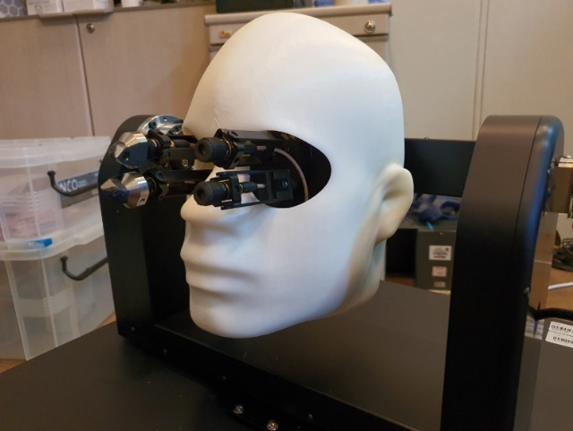
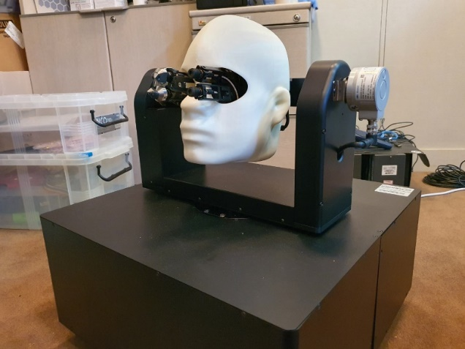
Next Agenda for P3079.1
Continue discussion on the terms & definitions of P3079.1 standard
MTP Latency measurement of VR devices in market
  MTP Latency measurement using following devices:
  - Various company products (Oculus, Vive, Pico, etc.)

Slide 39
Next Agenda for P3079.2
Standard draft writing for P3079.2
Reviewing contribution documents
Continue discussion on the character generation for P3079.2 standard

Slide 40
Attendees
Name | Affiliation
Wookho Son | ETRI
Sangkwon Peter Jeong | JoyFun Inc.
Hyun Kyoon Lim | KRISS
HyeonWoo Nam | Dongduk Women’s University
Andrew Min-gyu Han | Hansung University
Sangcheol Yoon | Daejeon University
Da Mee Kim | KRISS
Alexander Stickel | Serious Labs
Daejung Kim | TTA
GookHwan Lee | JoyFun Inc.
Cheol Ryu | ETRI
Jaeho Lee | ETRI
SeungWook Lee | ETRI
Eun-Seok Ryu | Sungkunkwan University
Hyo Chul Bae | KonKuk University
Beom-Ryeol Lee | ETRI

Slide 41
Future Sessions – 2021
October 04-08 2021, TTA, Sungnam, Korea (TBD)

Slide 42
Future Sessions – 2022
February 07-11 2022, KRISS Office, 267 Gajeong-ro, Yuseong-gu, Daejeon, Republic of Korea
April 25-29 2022, 3 Park Avenue, (​IEEE-SA Office), New York City, New York 10016
July 25-29 2022, Barcelona, Spain (Air B&B)
October 24-28 2022, E-1904 Aoyama-Twin Tower Bldg.,
1-1-1 Minami-aoyama, Minato-ku, Tokyo 107-0062, Japan Tokyo, Japan

Slide 43
Thank You

