Slide 1
[Session #19 3079.1 TG Meeting Summary]
[Yoon, Sangcheol / Daejeon University]

Slide 2
Compliance with
IEEE Standards Policies and Procedures
Subclause 5.2.1 of the IEEE-SA Standards Board Bylaws states, "While participating in IEEE standards development activities, all participants...shall act in accordance with all applicable laws (nation-based and international), the IEEE Code of Ethics, and with IEEE Standards policies and procedures."
The contributor acknowledges and accepts that this contribution is subject to
The IEEE Standards copyright policy as stated in the IEEE-SA Standards Board Bylaws, section 7, http://standards.ieee.org/develop/policies/bylaws/sect6-7.html#7, and the IEEE-SA Standards Board Operations Manual, section 6.1, http://standards.ieee.org/develop/policies/opman/sect6.html
The IEEE Standards patent policy as stated in the IEEE-SA Standards Board Bylaws, section 6, http://standards.ieee.org/guides/bylaws/sect6-7.html#6, and the IEEE-SA Standards Board Operations Manual, section 6.3, http://standards.ieee.org/develop/policies/opman/sect6.html

Slide 3
IEEE 3079
Human Factor for Immersive Content Working Group
Beom-Ryeol Lee, lbr@etri.re.kr
Session #19-3079.1 TG Meeting Summary
Date: 2021-07-23
Author(s):
Name | Affiliation | Phone | Email
Lim, Hyun Kyoon | KRISS | +82 10 4741 7343 | hlim@kriss.re.kr
Yoon, Sangcheol | Daejeon Univ. | +82 10 2502 6915 | yoonsangcheol@gmail.com

Slide 4
Session Time and Location
 | Monday (July 19, 2021) | Tuesday (July 20, 2021) | Wednesday (July 21, 2021) | Thursday (July 22, 2021) | Friday (July 23, 2021)
AM 1 9:00-10:30a |  | IEEE 3079 WG | IEEE 3079.1 TG |  | WG Meeting
AM 2 11:00-12:30 | Open Plenary Roll Call Reviewing last meeting minutes (Introducing participants) | IEEE 3079.1 TG |  |  | WG Closing Plenary
PM 1 1:30 – 3:00p | WG Meeting | IEEE 3079.2 TG | IEEE 3079.2 TG | IEEE 3079.2 TG
PM 2 3:30 – 5:00p |  | IEEE 3079.2 TG | IEEE 3079.2 TG | IEEE 3079.2 TG
※ Location
Capella Hall, B1, Lahan Select Hotel, Kyeong Ju, Korea
Contact to Video Conference: https://us02web.zoom.us/j/83808221695?pwd=eERXZDVCYkJMWXI3VHdQdFdvaWl5dz09

Slide 5
2nd Day
Tuesday, July 20th, 2021 11:00am~12:30pm
  3079-21-0042-00-0001-Introduction of IEEE2888 WG
  Presented by Sngkwon Peter Jeong
  3079-21-0049-00-0001-Progress on Human Factor and Measurement System for MTP Latency
  Presented by Lim, Hyun Kyoon, Ph.D.
  3079-21-0058-00-0001-Proposal for Vertibular Parameters Under IEEE3079
  Presented by Alexender Stickel

Slide 6
3rd Day
Wednesday, July 21th, 2021 AM1 09:00am~10:30pm
  3079-21-0055-00-0001-On MCTS Tile Manager for CDN-based Viewport-dependent 360 Video Tiled Streaming
  Presented by Eun-Seok Ryu
  3079-21-0056-00-0001-MPEG-Immersive 6DoF Standard Work Related to MPEG Immersive Video
  Presented by Eun-Seok Ryu
  3079-21-0057-00-0001-On OpenGL-Based View Synthesizer Optimization for Real-Time 6DoF Immersive Video Streaming
  Presented by Eun-Seok Ryu
  3079-21-0060-03-0001-Human Factor Related to Cybersickness in HMD Based VR
  Presented by Sangcheol Yoon

Slide 7
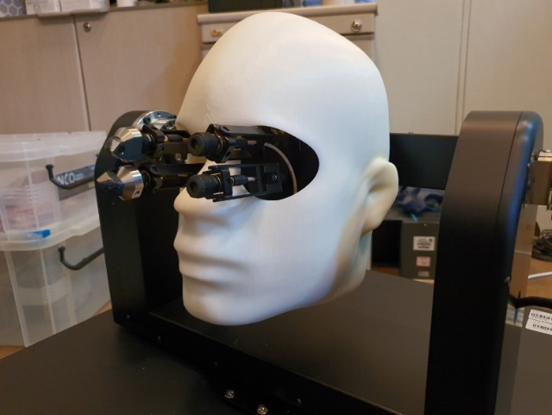
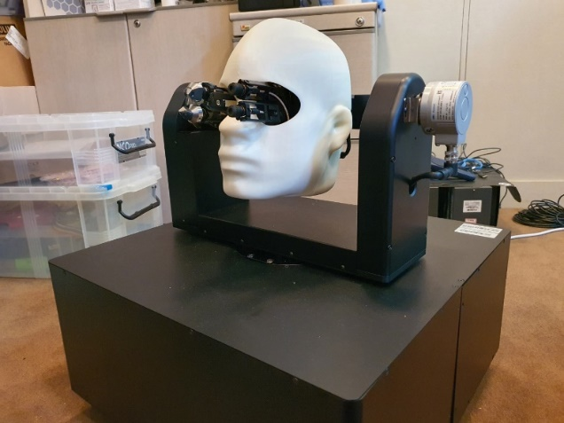
Next Agenda
Continue discussion on the terms & definitions of P3079.1 standard
Measurement MTP Latency of VR devices in market
  Measurement MTP Latency using following device
  Various companys products (Oculus, Vive, Pico, etc.)

Slide 8
Thank You

