Slide 1
[Session #20 3079.2 Deep Learning-based Pose Estimation on Real Time Embedded Systems]
[Suk-Ju Kang / Sogang University]

Slide 2
Compliance with
IEEE Standards Policies and Procedures
Subclause 5.2.1 of the IEEE-SA Standards Board Bylaws states, "While participating in IEEE standards development activities, all participants...shall act in accordance with all applicable laws (nation-based and international), the IEEE Code of Ethics, and with IEEE Standards policies and procedures."
The contributor acknowledges and accepts that this contribution is subject to
The IEEE Standards copyright policy as stated in the IEEE-SA Standards Board Bylaws, section 7, http://standards.ieee.org/develop/policies/bylaws/sect6-7.html#7, and the IEEE-SA Standards Board Operations Manual, section 6.1, http://standards.ieee.org/develop/policies/opman/sect6.html
The IEEE Standards patent policy as stated in the IEEE-SA Standards Board Bylaws, section 6, http://standards.ieee.org/guides/bylaws/sect6-7.html#6, and the IEEE-SA Standards Board Operations Manual, section 6.3, http://standards.ieee.org/develop/policies/opman/sect6.html

Slide 3
IEEE 3079
Human Factor for Immersive Content Working Group
Session #20 3079.2 Deep Learning-based Pose Estimation on Real Time Embedded Systems
Date: 2021-10-01
Author(s):
Name | Affiliation | Phone | Email
Suk-Ju Kang | Sogang University | +82 10 7103 6520 | sjkang@sogang.ac.kr
Kyoungro Yoon | Konkuk University | +82 10 5177 3768 | yoonk@konkuk.ac.kr

Slide 4
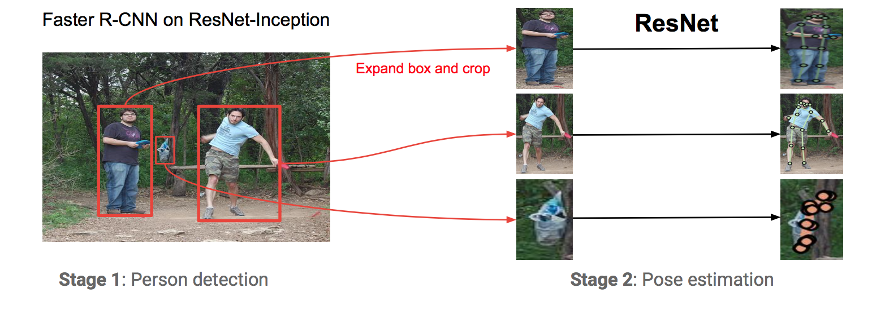
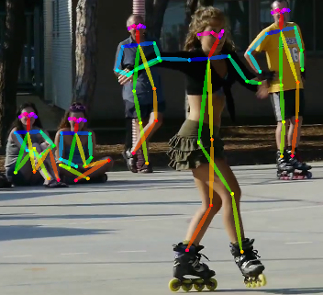
Introduction
Keypoint estimator
  Human pose skeleton
    A set of coordinates that can be connected to describe the pose of the person
    Main key points : head, neck, sholder, elbow, wrist, hip, knee, ankle
  Human pose estimation 2D Pose Estimation, 3D Pose Estimation
    Multi-person and single-person estimation

Slide 5
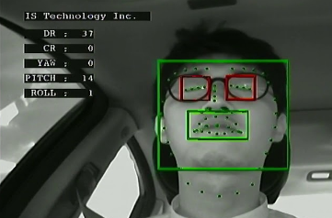
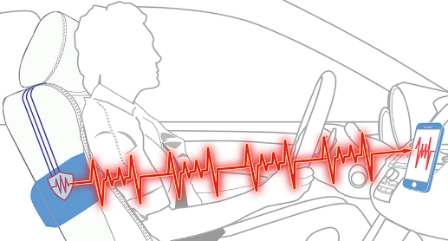
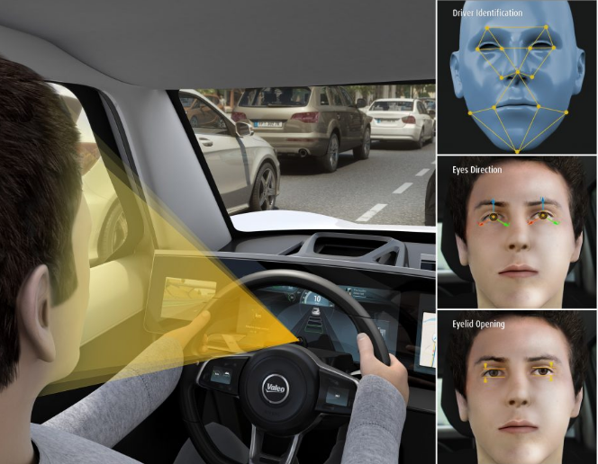
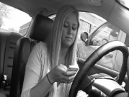
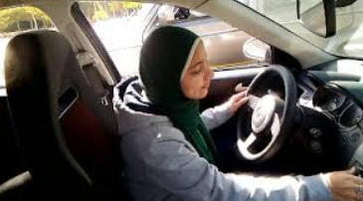
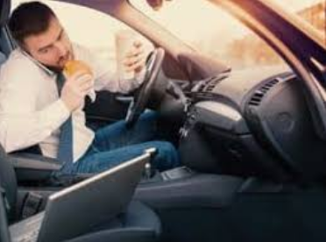
Introduction
Understanding driver’s status
  Previous
  Why pose information of drivers is important?

Slide 6
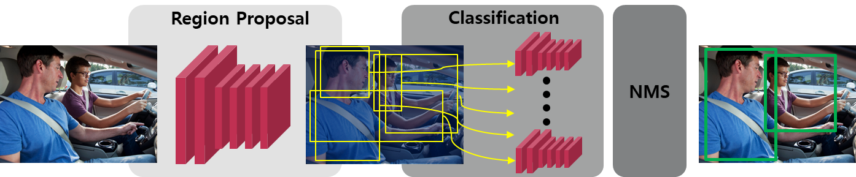
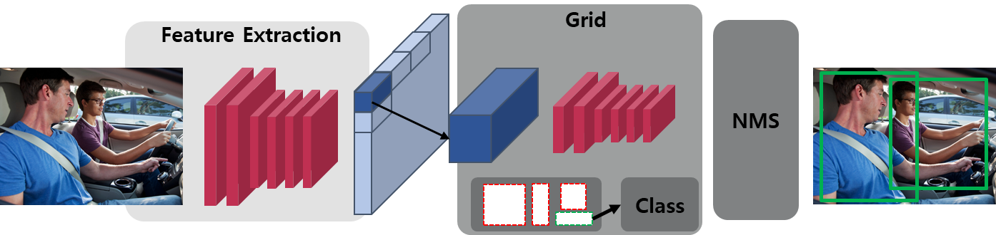
Related Work
Object detection
  2-stage object detection
  1-stage object detection

Slide 7
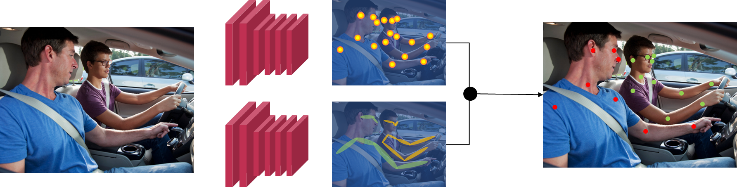
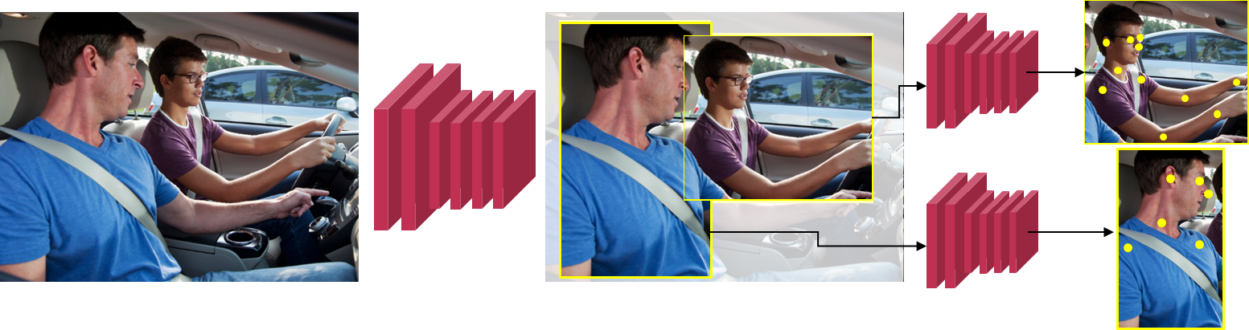
Related Work
Human pose estimation
  Bottom-up approach
  Top-down approach

Slide 8
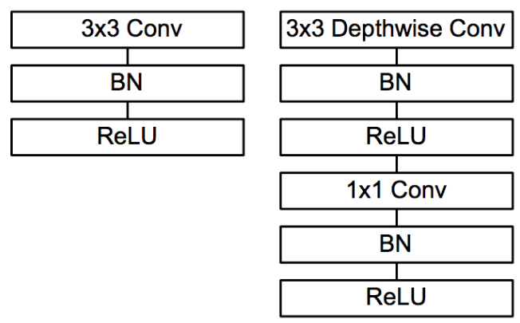
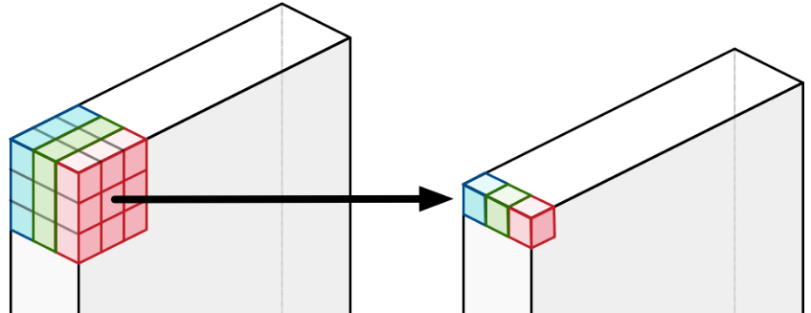
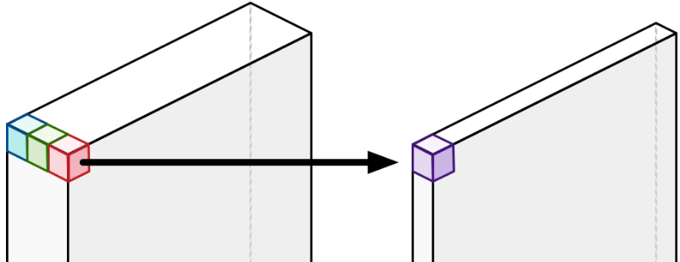
Related Work
Lightweight deep learning model
  Depthwise-separable convolution*
  Considerations when porting a model into NVIDIA Jetson TX2(TensorRT)
    Model optimization engine to accelerate the inference
      Quantization and precision calibration
      Graph Optimization
    Latency and throughput improvements with optimized resource usage
Depthwise-separable convolution
Depthwise convolution
Pointwise convolution

Slide 9
Proposed Method
The entire system flow
  Top-down pose estimation system
    Passenger detection module + single person pose estimation(SPPE) module
    Effective when upgrading each module
  Bounding box refinement to complement the limitation of lightweight detection model
    To reduce poor detections that cause degradation of the overall system
  Lightweight model-based pose estimation
    DenseNet-structured lightweight single person pose estimation
    Performance enhancement using Knowledge Distillation

Slide 10
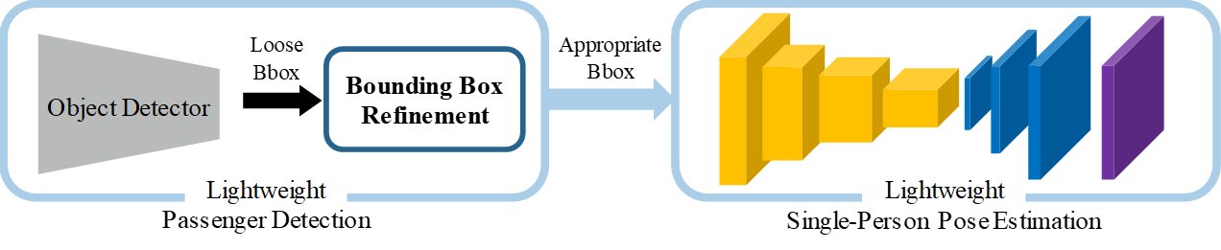
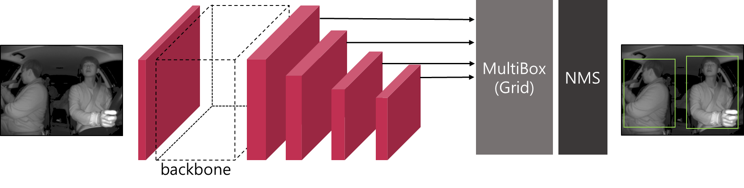
Proposed Method
Passengers detection module – object detection and refinement
  Pelee*
    SSD** object detection model using lightweight backbone
    Features of the applied backbone
      Optimized model structure without modifying convolution operations
      State-of-the-art classification performance among lightweight models

Slide 11
Proposed Method
Single person pose estimation module – model composition (overview)
  Blocks of the model
    Backbone: feature extraction, feature generation(12 x 9 x 704)
    Upscaling: resolution upscaling and channel compression of generated features (96 x 72 x 128)
    Final layer: channel compression for the output heatmap
      Final layer’s channel is equal to the number of keypoint(=17)
    Pixel coordinate estimation: peak finding from the final layer’s heatmap

Slide 12
Proposed Method
Single person pose estimation – model training (Knowledge Distillation; KD)
  KD at Backbone
    Location where resolutions are the same
      Teacher: ResBlock output feature
      Student: DenseBlock output feature
    Averaging features in channel-wise
      To solve different number of channel
      To avoid MSE between 3D features
  KD at Upscaling layers
    Averaging features in channel-wise
  KD at Final layer
    No averaging features in channel-wise
    Using reduced resolution of features instead

Slide 13
Proposed Method
Single person pose estimation – model training (loss function)
  Total loss
    Combining two different loss using the hyper parameter α
  Keypoint distance minimization
  Knowledge Distillation feature distance minimization

Slide 14
Experimental Results
Training of each module
  Passenger detection module
    Pretraining: ImageNet dataset
    Fine-tuning: MS COCO 2017 (bounding box)
  Single person pose estimation
    Pretraining: ImageNet dataset
    KD: MS COCO 2017 dataset
Pretraining
Fine-tuning
ImageNet
dataset
Object detection
backbone
MS COCO
dataset
Object detection
Knowledge
Distillation
Pretraining
MS COCO dataset
ImageNet
dataset
Student’s
backbone
Teacher
Student

Slide 15
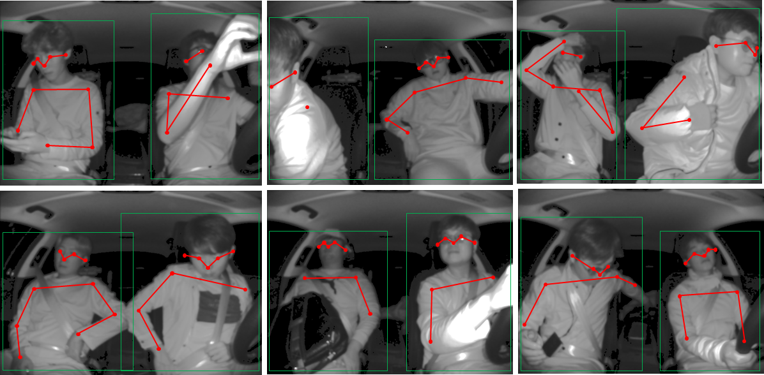
Experimental Results

Slide 16
Experimental Results
Evaluation 1: single person pose estimation model (without KD)
  Comparisons to the previous methods(average precision in OKS* score)
Method | Networks | Average Precision | GFLOPs
Bottom-up | Lightweight OpenPose | 39.6 | 27.2
 | OpenPose | 43.4 | 43.1
Top-down (SPPE) | 8-stage Hourglass | 66.9 | 14.3
 | SimplePose (ResNet-152 based) | 72.0 | 15.7
Top-down (SPPE) | Our method (deconv 256 / 256 / 256) | 66.5 | 3.5
 | Our method (deconv 128 / 128 / 128) | 65.7 | 1.6
 | Our method (deconv 32 / 64 / 128) | 62.7 | 0.9
1/10 of computation

Slide 17
Experimental Results
Evaluation 2: the operation time of the overall system
  Operation time comparison
    The same conditions from related work
      Time cost of image resizing has been excluded
    Input resolution
      Object detection: 304 x 304 x 3 as input resolution
      SPPE: 256 x 192 x 3 as input resolution
Component | Average Precision (GTX Titan XP) | FPS (Jetson TX2) (FP16)
Object Detection [19] | Over 200 | 125
Bounding box Refinement | Over 500 | 142
Single-Person Pose Estimation (1 operation a single passenger) | Over 200 | 195
Entire system | 189 | 80

Slide 18
Summary
Performance enhancement of single person pose estimation model
  Lightweight structure considering the embedded board porting
  Accuracy improvement using Knowledge Distillation between different model structure
Stabilizing the entire system by reducing degradation factors
  Refining redundant detection results not to multiply operate
  Refining poor detection results not to miss the keypoints

Slide 19
Thank You

