Slide 1
Self-reported Measures for VR Sickness by MTP Latency
[Lim, Hyun Kyoon, PhD
Korea Research Institute of Standards and Science]

Slide 2
Compliance with
IEEE Standards Policies and Procedures
Subclause 5.2.1 of the IEEE-SA Standards Board Bylaws states, "While participating in IEEE standards development activities, all participants...shall act in accordance with all applicable laws (nation-based and international), the IEEE Code of Ethics, and with IEEE Standards policies and procedures."
The contributor acknowledges and accepts that this contribution is subject to
The IEEE Standards copyright policy as stated in the IEEE-SA Standards Board Bylaws, section 7, http://standards.ieee.org/develop/policies/bylaws/sect6-7.html#7, and the IEEE-SA Standards Board Operations Manual, section 6.1, http://standards.ieee.org/develop/policies/opman/sect6.html
The IEEE Standards patent policy as stated in the IEEE-SA Standards Board Bylaws, section 6, http://standards.ieee.org/guides/bylaws/sect6-7.html#6, and the IEEE-SA Standards Board Operations Manual, section 6.3, http://standards.ieee.org/develop/policies/opman/sect6.html

Slide 3
IEEE 3079.1
HMD Based VR Sickness Reducing Technology
Seo, Dong Il Dillon, dillon.seo@dtcp.capital
Self-reported Measures for VR Sickness by MTP Latency
Date: 2021-10-04
Author(s): Lim, Hyun Kyoon
Name | Affiliation | Phone | Email
Lim, Hyun Kyoon | KRISS |  | hlim@kriss.re.kr
Kwon, Moonyoung | KRISS |  | mykwon@kriss.re.kr
Jang, Kyoung-Mi | KAIST |  | km_jang@kriss.re.kr
Nam, Sun Gu | KRISS |  | naisz@kaist.ac.kr
Kim, Da Mee | KRISS |  | dameeing@kriss.re.kr

Slide 4
VR Sickness by MTP Latency
Motion-to-photon (MTP) latency is known as one of the factors causing VR sickness.
However, the correlation between delay and VR sickness has not yet been established.
Previous studies are generally considered to be self-reported measures.
We would like to summarize the previous studies on the correlation between MTP latency and VR sickness based on self-reported measures.

Slide 5
Self-reported Measures for VR Sickness
Simulator sickness questionnaire (SSQ)
Fast motion sickness scale (FMS)
Misery scale (MISC)
Visually induced motion sickness susceptibility questionnaire (VIMSSQ)
Motion sickness assessment questionnaire (MSAQ)
Virtual reality sickness questionnaire (VRSQ)
Cybersickness questionnaire (CSQ)
Kennedy (1993)
Keshavarz (2001)
Bos (2005)
Keshavarz (2019)
Gianaros (2001)
Kim (2018)
Stone III (2017)

Slide 6
Simulator Sickness Questionnaire (SSQ)
Suggested by Kennedy (1993)
  Kennedy, R. S., Lane, N. E., Berbaum, K. S., & Lilienthal, M. G. (1993). Simulator Sickness Questionnaire: An enhanced method for quantifying simulator sickness. The International Journal of Aviation Psychology, 3(3), 203–220. https://doi.org/10.1207/s15327108ijap0303_3
Proposed to evaluate simulator sickness from flight simulators, 3D games
Widely used questionnaire for HMDs and VR devices/contents with symptoms due to the sensory mismatch
May not be idle tool because simulator and VR system yield different sickness symptoms
  Virtual reality sickness questionnaire (VRSQ): modified questionnaire for VR system
    Kim et al., (2018) Applied ergonomics

Slide 7
SSQ (Kennedy 1993)
Symptom | Weight |  |  | Score
 | Nausea | Oculomotor | Disorientation
General discomfort | 1 | 1 |  | 0 / 1 / 2 / 3 0: none 1: slight 2: moderate 3: severe
Fatigue |  | 1
Headache |  | 1
Eyestrain |  | 1
Difficulty focusing |  | 1 | 1
Increased salivation | 1
Sweating | 1
Nausea | 1 |  | 1
Difficulty concentrating | 1 | 1
Fullness of head |  |  | 1
Blurred vision |  | 1 | 1
Dizzy (eyes open) |  |  | 1
Dizzy (eyes closed) |  |  | 1
Vertigo |  |  | 1
Stomach awareness | 1
Burping | 1
Symptom score | A | B | C
Subtotal score | N = A*9.54 | O = B*7.58 | D = C*13.92
Total score | (N+O+D)*3.72

Slide 8
Fast motion sickness scale (FMS)
Suggested by Keshavarz (2011)
  Keshavarz, B., and Hecht, H. (2011) Validating an efficient method to quantify motion sickness. Human Factors, 53(4), 415–426. https://doi.org/10.1177/0018720811403736
Proposed simple verbal judgements
  20-point scale (0: no sickness at all, 20: frank sickness)
  Can be collected responses even during tasks without distracting
A Genuinely subjective phenomenon that has no perfect physiological correlate

Slide 9
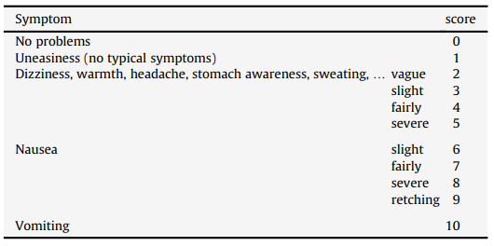
Misery scale (MISC)
Suggested by Bos (2005)
  Bos, J.E., MacKinnon, S.N., Patterson, A. (2005) Motion sickness symptoms in a ship motion simulator: effects of inside, outside, and no view. Aviat. Space Environ. Med. 76, 1111–1118.
Need a single question
  10-point scale (0: no problem, 10: vomiting)
  Fast response
A more sensitive number of sickness than just the number of vomiting incidences

Slide 10
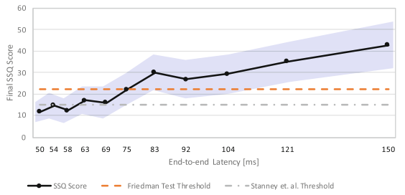
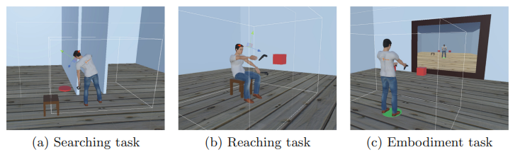
Previous Study – Delay ↑, VR sickness ↑ (1)
Paper | # of Participants | Task | Self-reported | Latency | Results
Jennings et al., 2004 | 3 | Flight simulator | Symptom | 67, 134, 184, 334 ms | Latency ↑ → Motion sickness symptom ↑
Stauffert et al., 2018 | 45 | Search | SSQ | Jitter (base : 35.67 ms, mean : 46.67 ms) | Disorientation ↑ Nausea, oculomotor x
Caserman et al., 2019 | 21 | Search, reach, embodiment | SSQ | 0-100 ms for search, reach, 0-200 ms for embodiment | Latency ↑ → SSQ ↑ End-to-end latency < 58 ms is required (< 15 SSQ)
Caserman (2019)

Slide 11
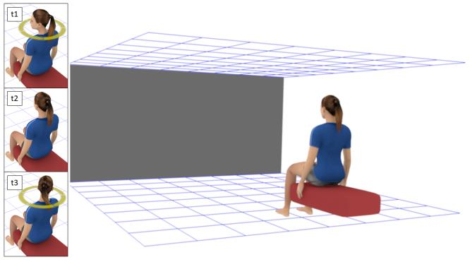
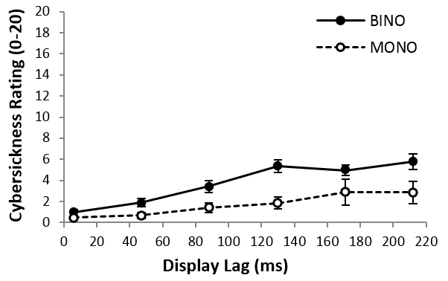
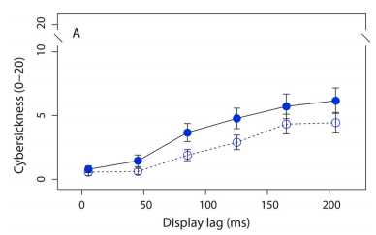
Previous Study – Delay ↑, VR sickness ↑ (2)
Paper | # of Participants | Task | Self-reported | Latency | Results
Palmisano et al., 2019 | 14 | Head rotation (yaw) | FMS | 5 – 212 ms | Latency ↑ → SSQ ↑
Kim et al., 2020 | 13 | Head rotation (pitch) | FMS | 5 – 212 ms | Latency ↑ → SSQ ↑
Palmisano (2019)
Kim (2020)

Slide 12
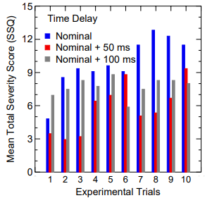
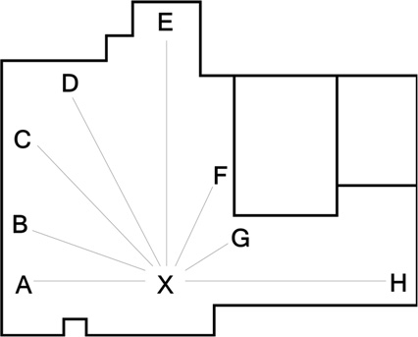
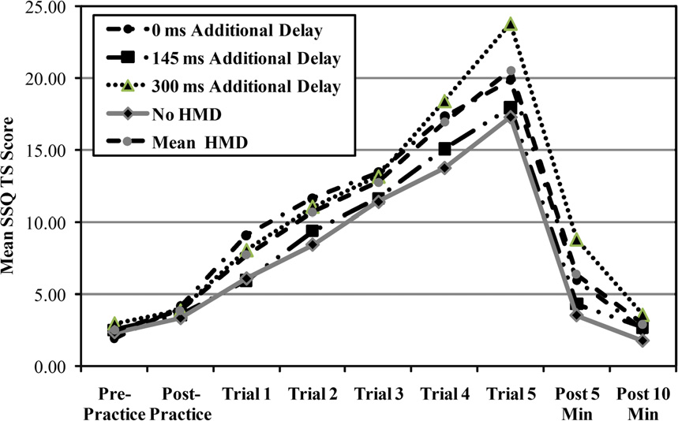
Previous Study – Delay ↑, VR sickness ↑
Paper | # of Participants | Task | Self-reported | Latency | Results
Nelson et al., 2000 | 7 | Head-slaved tracking | SSQ | 50, 100 ms | not sufficient for the onset of simulator sickness
Draper et al., 2001 | 11 | Search | SSQ | 125, 250 ms | No significant influence
Moss et al., 2011 | 29 | Search | SSQ | Exp1: 0, 200 ms Exp2: 0, 145, 300 ms | No effect of delay, but, exposure duration ↑ → SSQ ↑
Nelson (2000)
Moss (2011)

Slide 13
Summary
Self-reported measure for VR sickness
  Generally used SSQ for measuring VR sickness
  Need to develop a measurement method more suitable for VR contents due to difference between VR and simulator
MTP latency and VR sickness
  VR sickness is evoked by MTP latency
  The correlation between delay and VR sickness is inconsistent
    Different results depending on task, exposure time, or complexity of contents
    Need more controlled experiments
It is necessary to derive objective results using physiological data instead of self-reported measures that are subjective results.

Slide 14
Thank You

