Slide 1
On Inter-view Redundancy-aware Cluster Based Coding Structure Decision on MV-HEVC for MPEG Immersive Video
Presenter: Eun-Seok Ryu (esryu@skku.edu)
Jong-Beom Jeong, Changhee Han, Soonbin Lee, Inae Kim, Junho Park, Eun-Seok Ryu
Multimedia Computing Systems Lab. (MCSL)
http://mcsl.skku.edu
Department of Computer Education
Sungkyunkwan University

Slide 2
Compliance with
IEEE Standards Policies and Procedures
Subclause 5.2.1 of the IEEE-SA Standards Board Bylaws states, "While participating in IEEE standards development activities, all participants...shall act in accordance with all applicable laws (nation-based and international), the IEEE Code of Ethics, and with IEEE Standards policies and procedures."
The contributor acknowledges and accepts that this contribution is subject to
The IEEE Standards copyright policy as stated in the IEEE-SA Standards Board Bylaws, section 7, http://standards.ieee.org/develop/policies/bylaws/sect6-7.html#7, and the IEEE-SA Standards Board Operations Manual, section 6.1, http://standards.ieee.org/develop/policies/opman/sect6.html
The IEEE Standards patent policy as stated in the IEEE-SA Standards Board Bylaws, section 6, http://standards.ieee.org/guides/bylaws/sect6-7.html#6, and the IEEE-SA Standards Board Operations Manual, section 6.3, http://standards.ieee.org/develop/policies/opman/sect6.html
3079-21-0085-00-0001 On Inter-view Redundancy-aware Cluster Based Coding Structure Decision on MV-HEVC for MPEG Immersive Video

Slide 3
IEEE 3079.1
Motion to Photon (MTP) Latency in Virtual Environments
Hyun Kyun Lim, hlim@kriss.re.kr
On Inter-view Redundancy-aware Cluster Based Coding Structure Decision on MV-HEVC for MPEG Immersive Video
Date: 2021-10-04
Author(s): Jong-Beom Jeong, Changhee Han, Soonbin Lee, Inae Kim, Junho Park, Eun-Seok Ryu
Name | Affiliation | Phone [optional] | Email [optional]
Jong-Beom Jeong | Sungkyunkwan Univ. |  | uof4949@skku.edu
Changhee Han | Sungkyunkwan Univ. |  | chillycorn@skku.edu
Soonbin Lee | Sungkyunkwan Univ. |  | soonbinlee@skku.edu
Inae Kim | Sungkyunkwan Univ. |  | inaelk@skku.edu
Junho Park | Sungkyunkwan Univ. |  | wnsgh2933@skku.edu
Eun-Seok Ryu | Sungkyunkwan Univ. |  | esryu@skku.edu
3079-21-0085-00-0001 On Inter-view Redundancy-aware Cluster Based Coding Structure Decision on MV-HEVC for MPEG Immersive Video

Slide 4
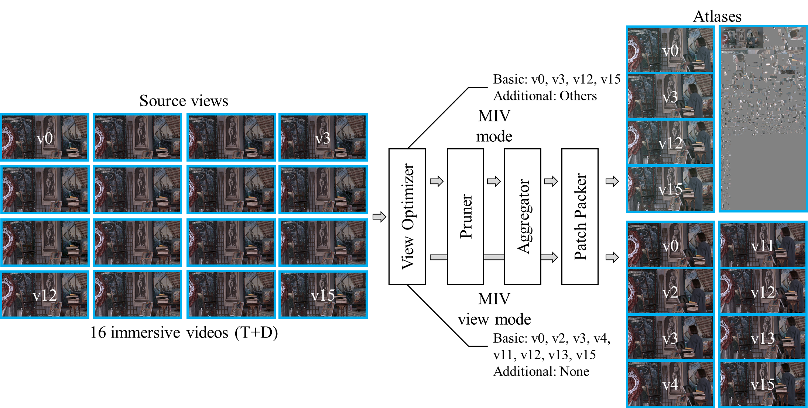
MPEG Immersive Video (MIV)
Challenges of multi-view videos processing to provide immersion:
  high bandwidth, high computational complexity, high latency
MIV for immersive video pre- and post-processing
  Test model for immersive video (TMIV) as a reference software
  MIV mode: removes redundancy from the source views (+HEVC, VVC)
  → efficient on low bandwidth
  MIV view mode: selects subset of views (+MV-HEVC)
  → efficient on high bandwidth, advantageous for multi-view color consistency
  (low sickness)
MIV pre-processing for immersive video (version 8.0)
3079-21-0085-00-0001 On Inter-view Redundancy-aware Cluster Based Coding Structure Decision on MV-HEVC for MPEG Immersive Video

Slide 5
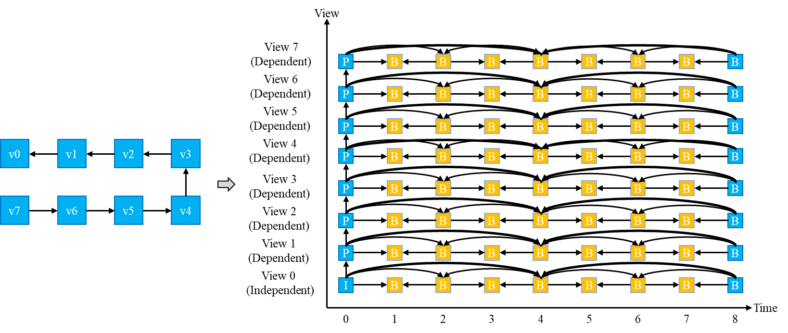
Background
MV-HEVC as an extension of HEVC to:
  Efficient compression of multi-view videos by exploiting inter-view redundancy
  Highly efficient for structured (rectangular) camera coordination
  Inter-view coding structure needs to be defined
  How to decide the optimal coding structure?
Example of MV-HEVC coding structure
3079-21-0085-00-0001 On Inter-view Redundancy-aware Cluster Based Coding Structure Decision on MV-HEVC for MPEG Immersive Video

Slide 6
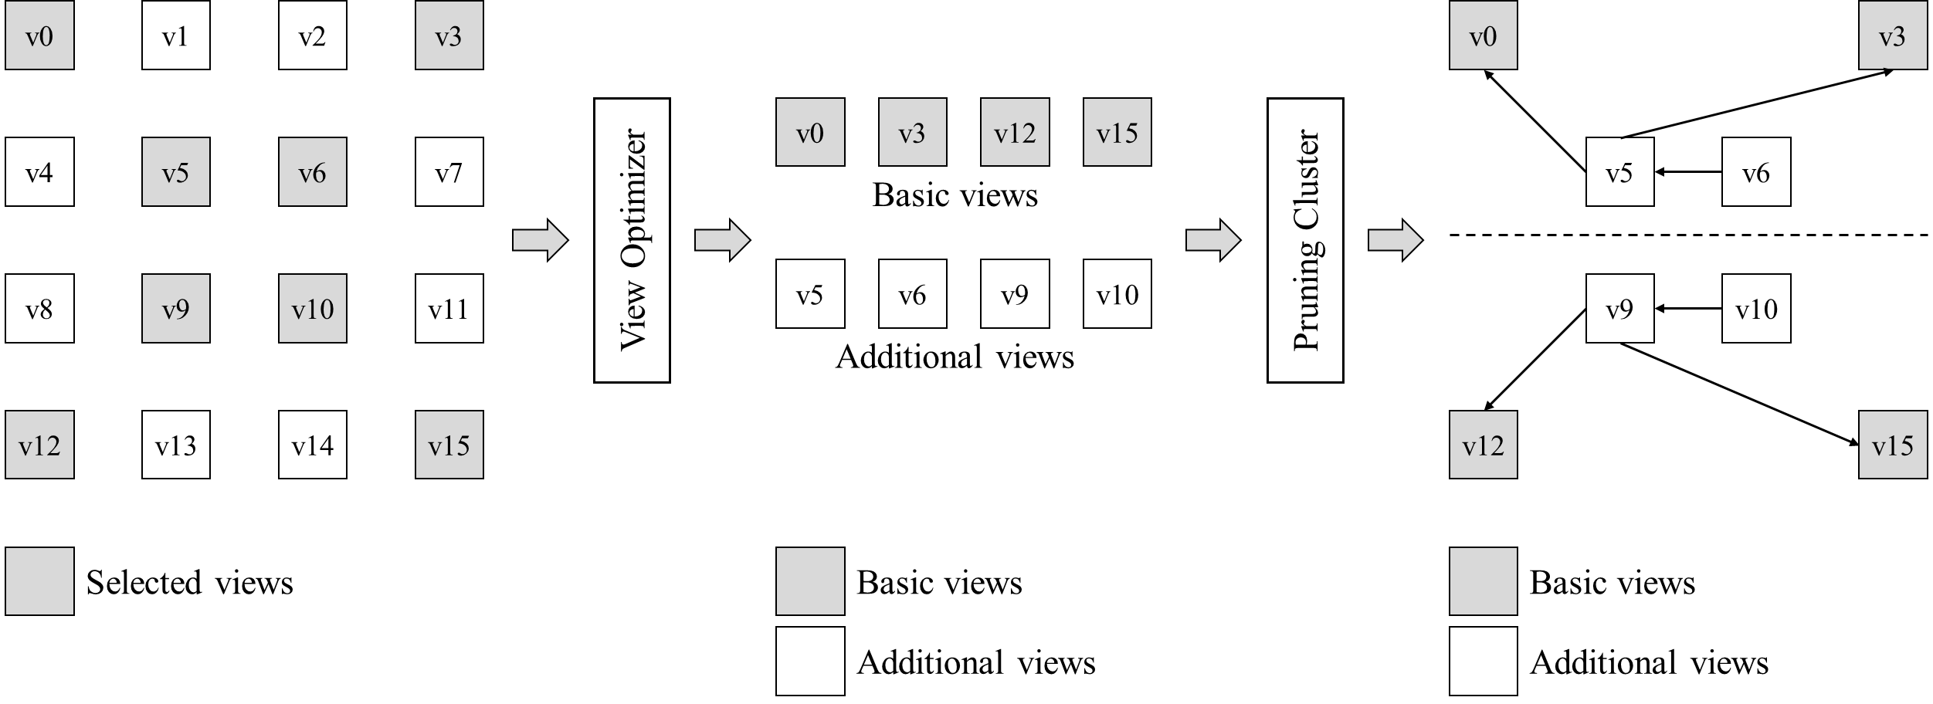
Cluster-based Pruning in MIV
Redundancies are removed by pruning process
View optimizer: divides basic views (BVs) and additional views (AVs)
  Redundancies are removed from AVs
Pruning cluster generates cluster graph to:
  Reduce the computational complexity
  Remove the redundancies more efficiently
Example of pruning cluster generation by TMIV (version 8.0)
3079-21-0085-00-0001 On Inter-view Redundancy-aware Cluster Based Coding Structure Decision on MV-HEVC for MPEG Immersive Video

Slide 7
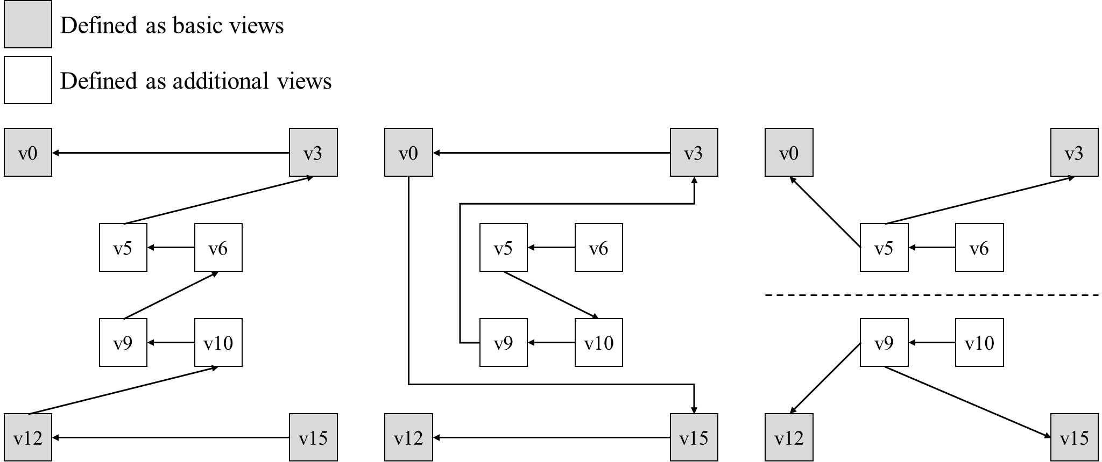
Redundancy-aware Coding Structure Decision
Method 1: view index based ordering
  Decides coding structure by view index (ascending order)
Method 2: pruning based ordering
  Coding structure mode decision by pruning order (no group)
Method 3: cluster based ordering
  Uses cluster-based approach for 1) increased coding efficiency,
  2) parallel decoding → low sickness and low latency
(a)
(b)
(c)
Coding structure decision modes.
(a) view index based ordering, (b) pruning based ordering, (c) cluster based ordering
3079-21-0085-00-0001 On Inter-view Redundancy-aware Cluster Based Coding Structure Decision on MV-HEVC for MPEG Immersive Video

Slide 8

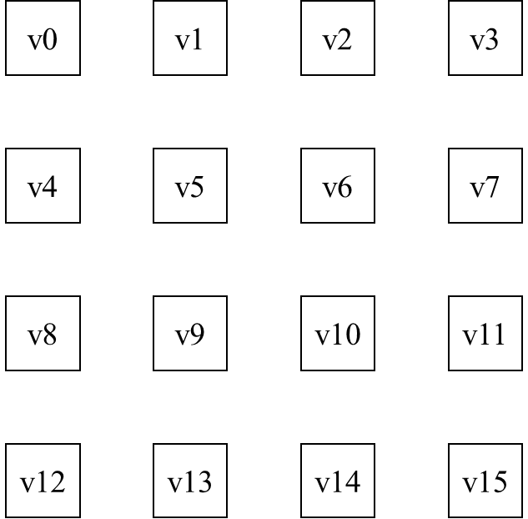
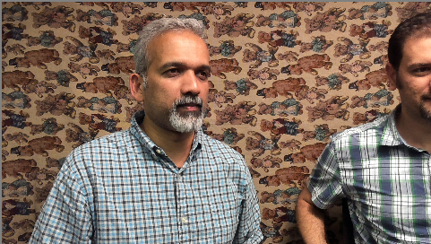
Experimental Setup
MV-HEVC test model (HTM) v13.0, TMIV v3.0
  TMIV v8.0 was used to decide the pruning graph
  TMIV v3.0 is better when using MV-HEVC
Two MIV test sequences were used
  Painter(2048×1088) – 16 views, Frog(1920×1080) – 13 views
View representations and camera coordinations.
Upper: Painter, Lower: Frog.
3079-21-0085-00-0001 On Inter-view Redundancy-aware Cluster Based Coding Structure Decision on MV-HEVC for MPEG Immersive Video

Slide 9
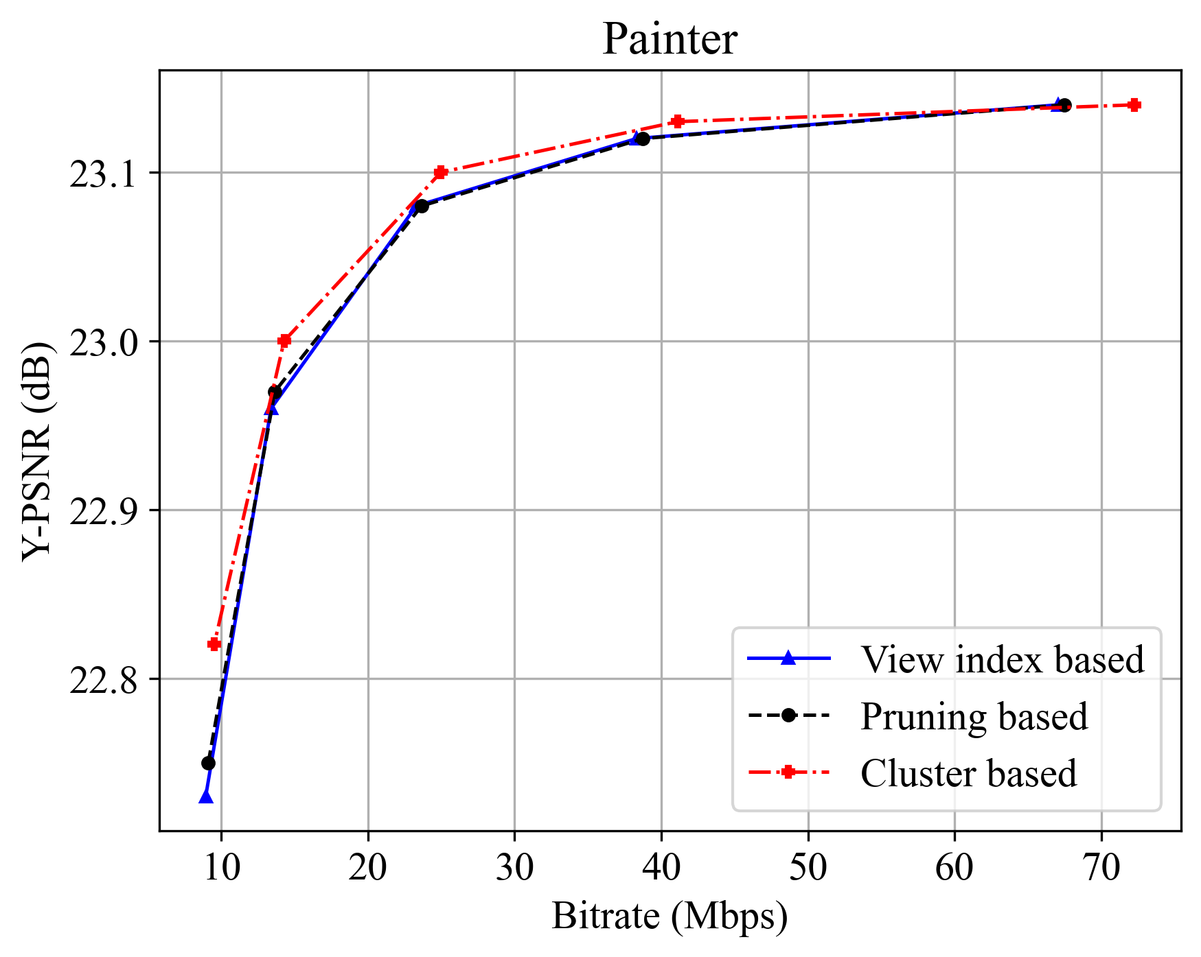
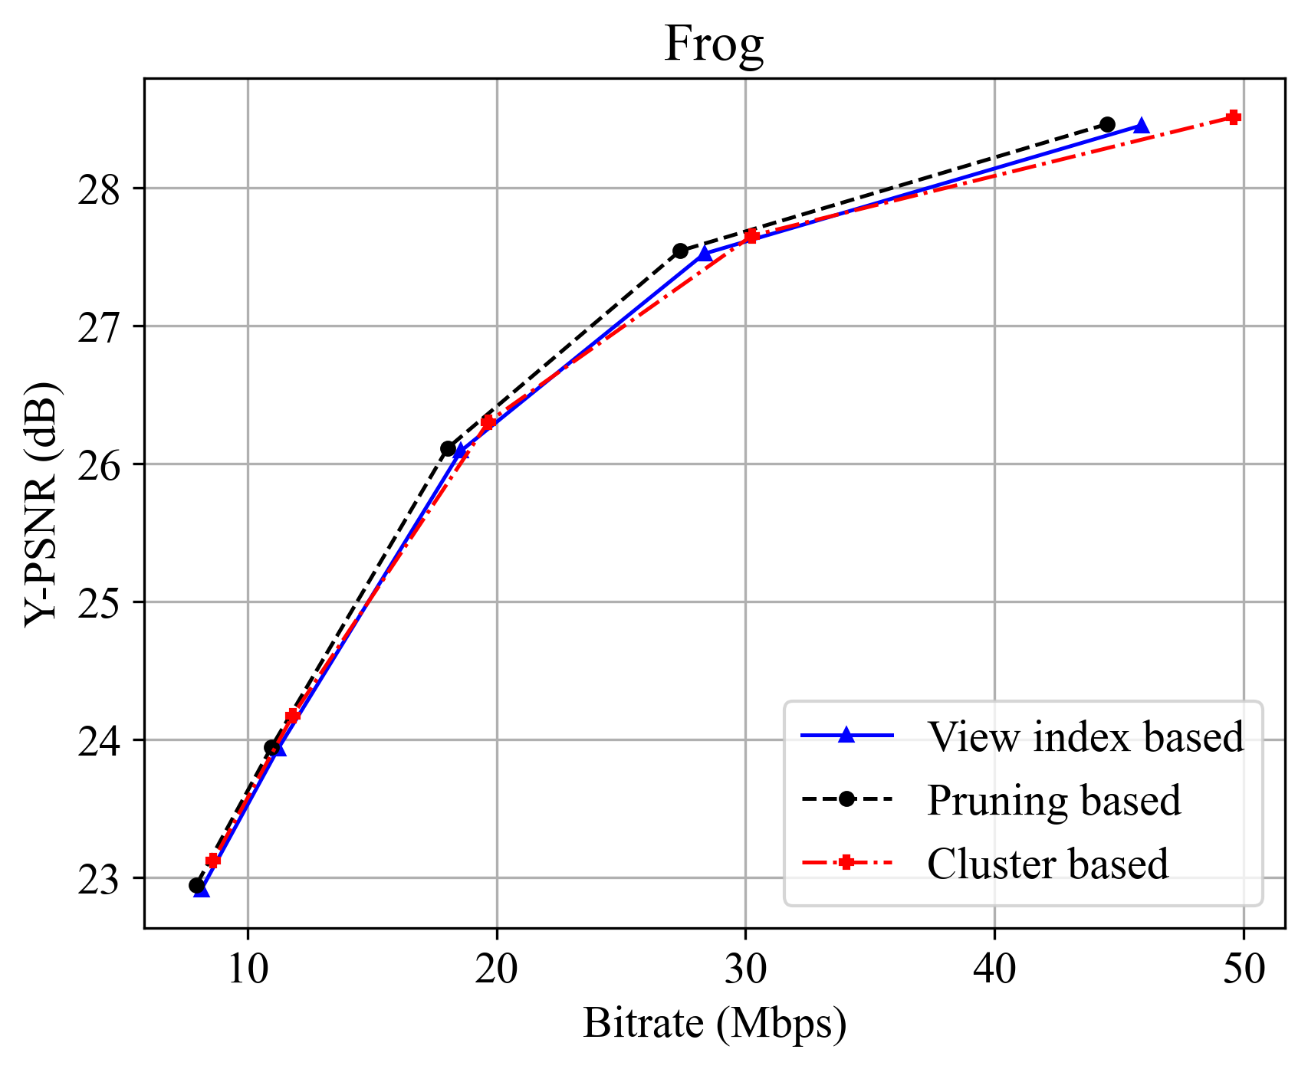
Experimental Results: Coding Efficiency
Y-PSNR BD-rate gains compared to the anchor (view index based)
In average, the cluster-based method showed the best bandwidth saving
Sequences | View index based | Pruning based | Cluster based
Painter | 0.00% | -0.78% | -8.33%
Frog | 0.00% | -3.36% | 0.56%
Average | 0.00% | -2.07% | -3.88%
Y-PSNR BD-rates
Rate-distortion curves of Painter (left), Frog (right)
3079-21-0085-00-0001 On Inter-view Redundancy-aware Cluster Based Coding Structure Decision on MV-HEVC for MPEG Immersive Video

Slide 10
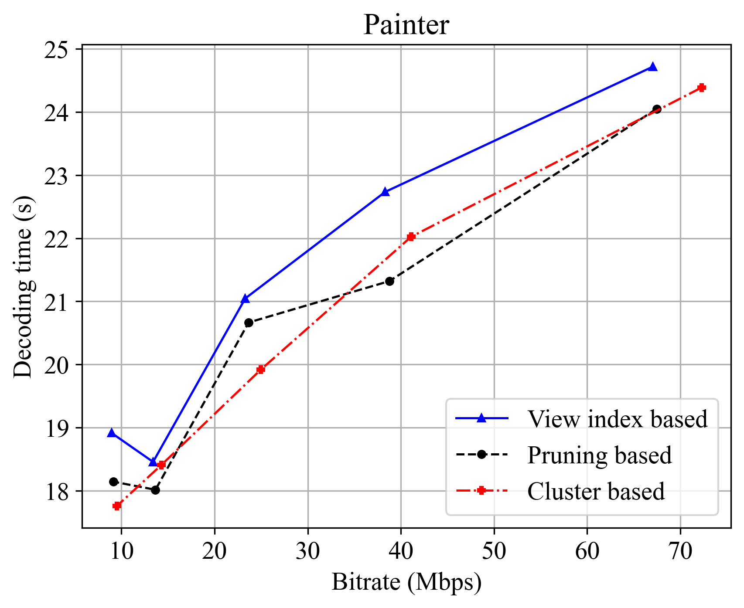
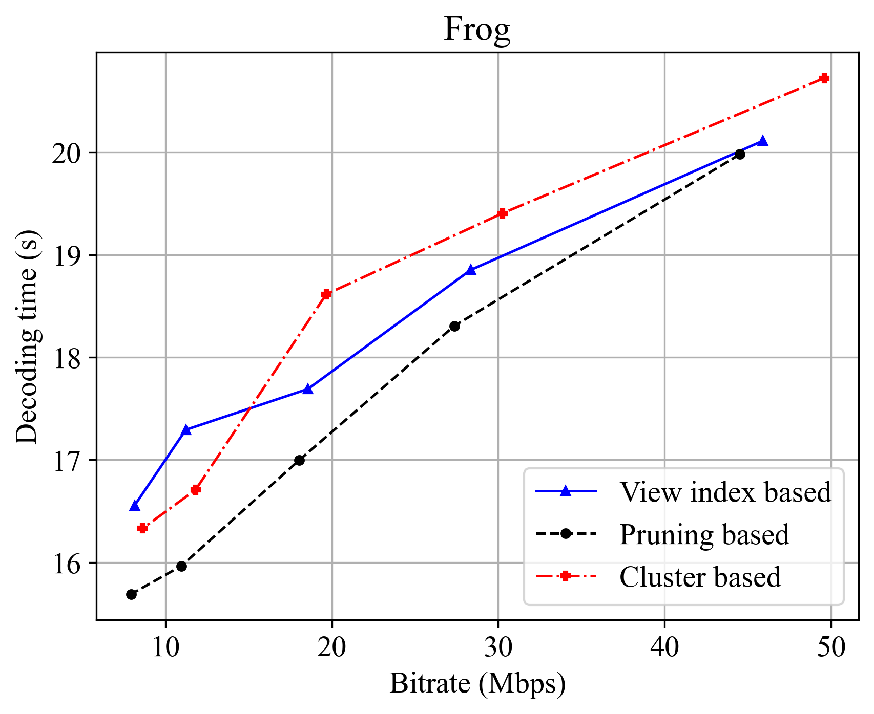
Experimental Results: Decoding runtime
Decoding runtime savings compared to the anchor (view index based)
If parallel decoding is available, cluster-based method can halve the runtime
Sequences | View index based | Pruning based | Cluster based
Painter | 100.00% | 96.53% | 96.81%
Frog | 100.00% | 96.06% | 101.41%
Average | 100.00% | 96.30% | 99.11%
Decoding runtime ratio
Decoding runtime curves
3079-21-0085-00-0001 On Inter-view Redundancy-aware Cluster Based Coding Structure Decision on MV-HEVC for MPEG Immersive Video

Slide 11
Conclusion
Motivation
  High BW & computing time for multi-view videos streaming: MIV & MV-HEVC can be used
  View clustering and ordering is needed to:
    Increased coding efficiency (better quality) and decreased latency
Proposed Methods and Insights
  Coding structure decision considering: 1) pruning order and 2) clustering by MIV
  BD-rate, decoding time savings compared to the anchor
  2× faster decoding runtime when using parallel processing to the cluster-based method
Conclusion and Future Work
  Inter-view redundancy-aware cluster based coding structure decision for immersive video leads to the decreases of bitrate and latency
  Experiments on parallel processing / selective group streaming needs to be conducted
3079-21-0085-00-0001 On Inter-view Redundancy-aware Cluster Based Coding Structure Decision on MV-HEVC for MPEG Immersive Video

