Slide 1
Motion to Photon Latency (MTP)
: Recent studies review
[Lim, Hyun Kyoon, PhD
Korea Research Institute of Standards and Science]

Slide 2
Compliance with IEEE Standards Policies and Procedures
Subclause 5.2.1 of the IEEE-SA Standards Board Bylaws states, "While participating in IEEE standards development activities, all participants...shall act in accordance with all applicable laws (nation-based and international), the IEEE Code of Ethics, and with IEEE Standards policies and procedures."
The contributor acknowledges and accepts that this contribution is subject to
The IEEE Standards copyright policy as stated in the IEEE-SA Standards Board Bylaws, section 7, http://standards.ieee.org/develop/policies/bylaws/sect6-7.html#7, and the IEEE-SA Standards Board Operations Manual, section 6.1, http://standards.ieee.org/develop/policies/opman/sect6.html
The IEEE Standards patent policy as stated in the IEEE-SA Standards Board Bylaws, section 6, http://standards.ieee.org/guides/bylaws/sect6-7.html#6, and the IEEE-SA Standards Board Operations Manual, section 6.3, http://standards.ieee.org/develop/policies/opman/sect6.html

Slide 3
IEEE 3079 HMD Based VR Sickness Reducing Technology Chair Beom-Ryeol Lee, lbr@etri.re.kr
IEEE 3079.1 Motion to Photon (MTP) Latency in Virtual Environments Chair Hyun Kyoon Lim, hlim@kriss.re.kr
Date: 2022-02-07
Author(s): Lim, Hyun Kyoon
Name | Affiliation | Phone | Email
Lim, Hyun Kyoon | KRISS |  | hlim@kriss.re.kr
Kwon, Moonyoung | KRISS & KCL |  | mykwon@ktl.re.kr
Jang, Kyoung-Mi | KRISS |  | km_jang@kriss.re.kr
Nam, Sun Gu | KRISS & KAIST |  | naisz@kaist.ac.kr

Slide 4
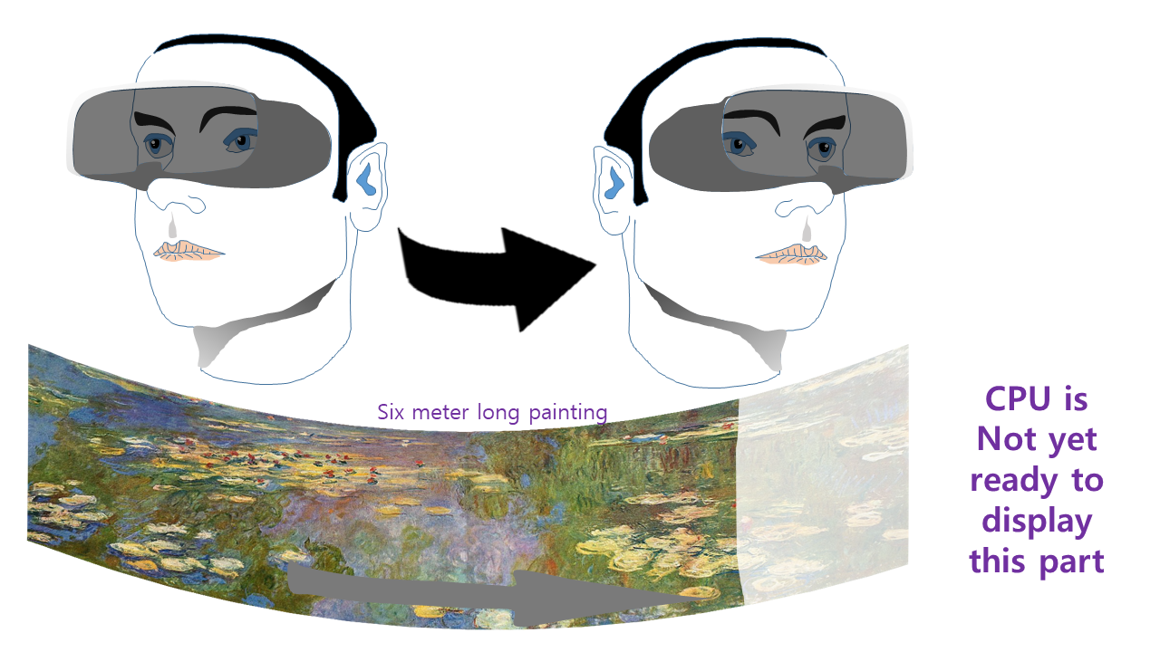
VR Sickness by MTP Latency
Motion-to-photon (MTP) latency is known as one of the factors causing VR sickness.

Slide 5
VR Sickness by MTP Latency
The correlation and the severity level between MTP latency and VR sickness have not yet been established.
Many studies considered self-reported measures (subjective evaluation method).
The relation between MTP latency and VR sickness should be studied in detail with various conditions.
In this document, we summarize recent 2 studies with respect to MTP latency.

Slide 6
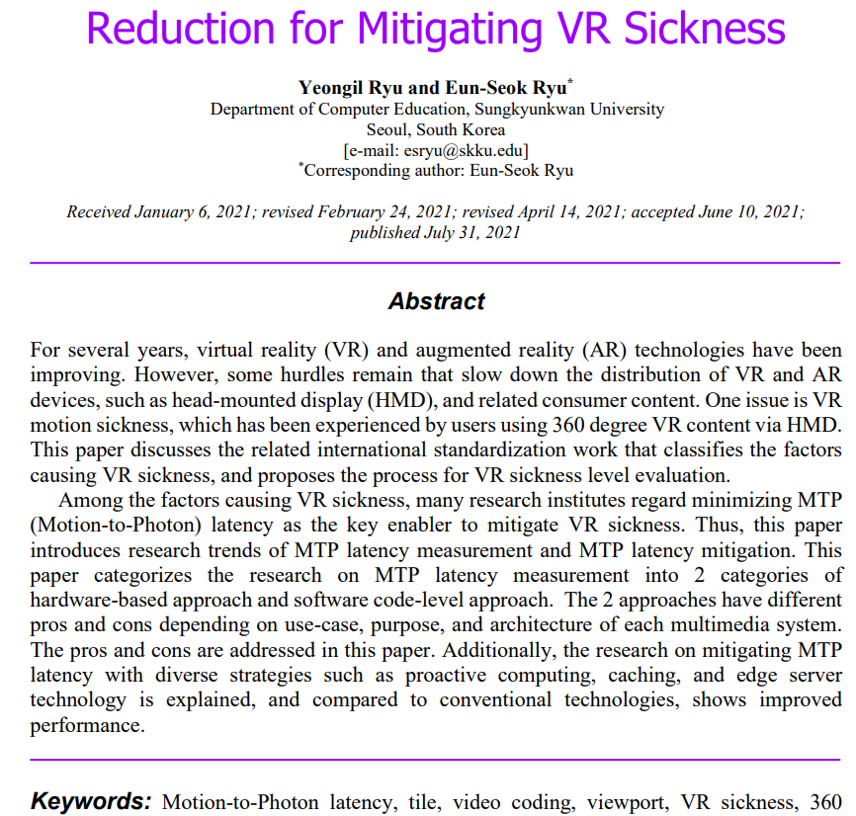

Slide 7
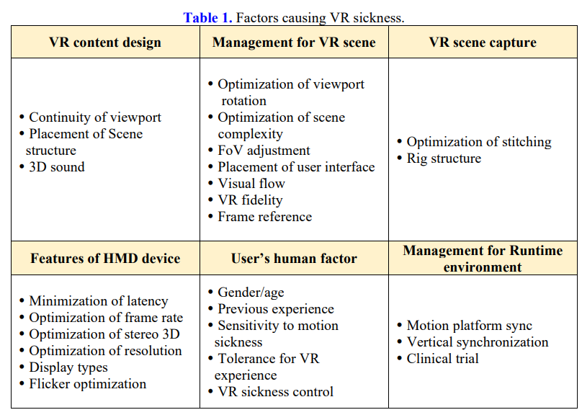

Slide 8
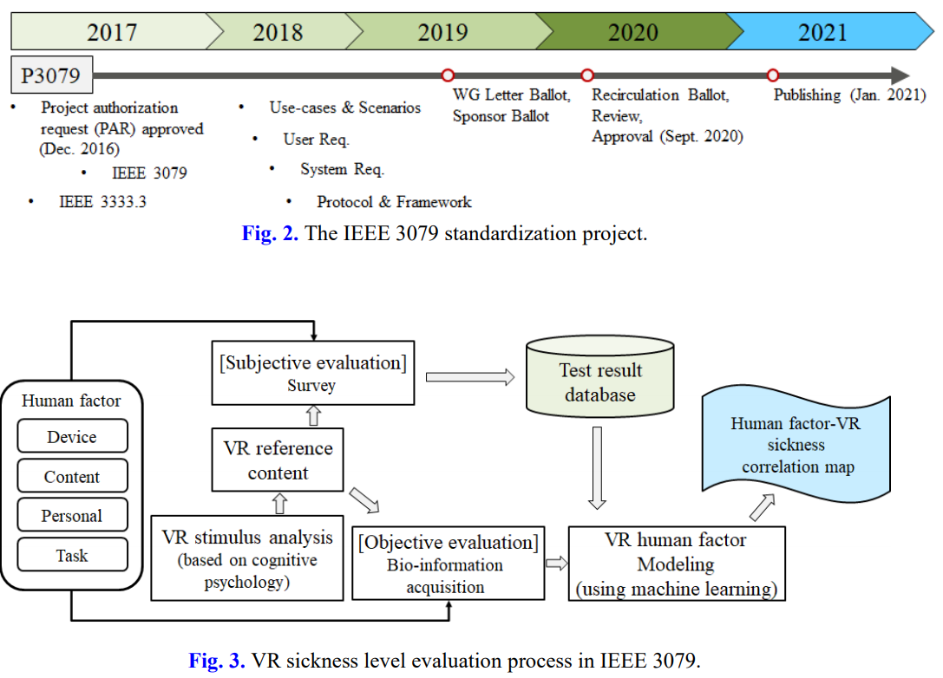

Slide 9
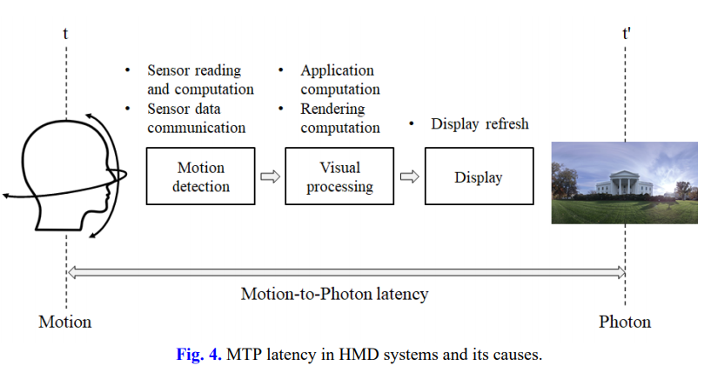

Slide 10
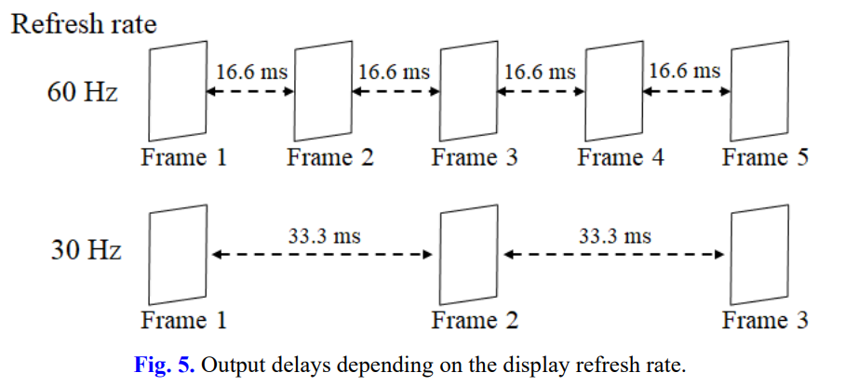

Slide 11
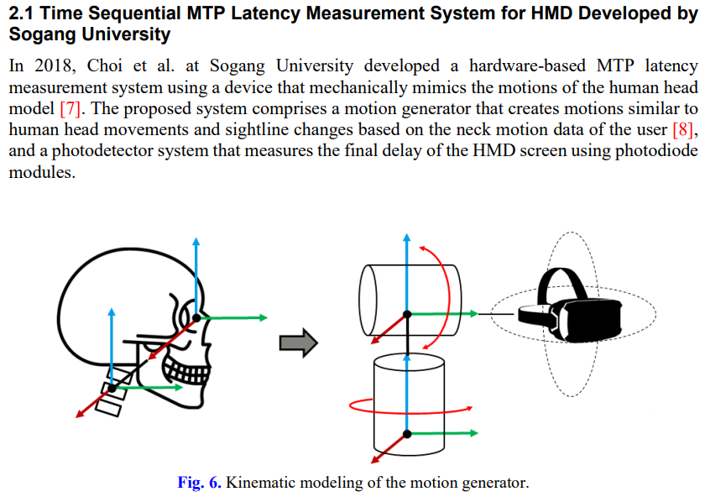

Slide 12
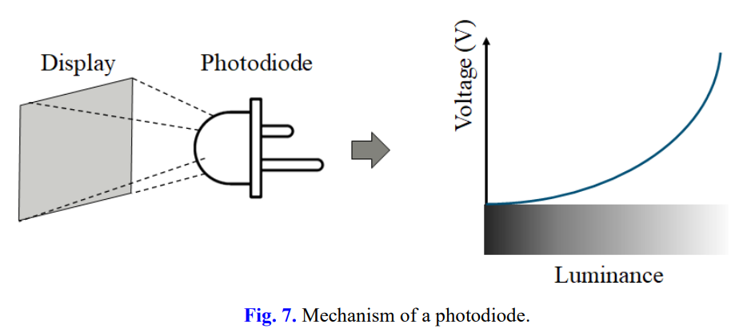
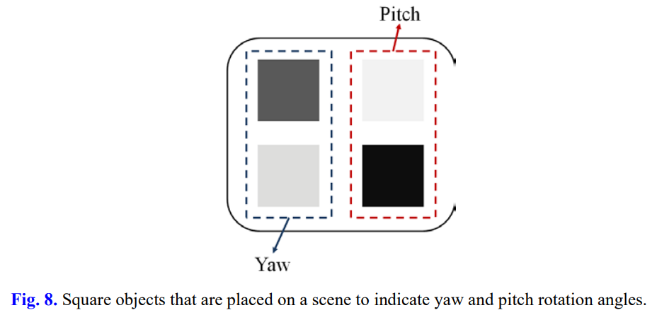

Slide 13
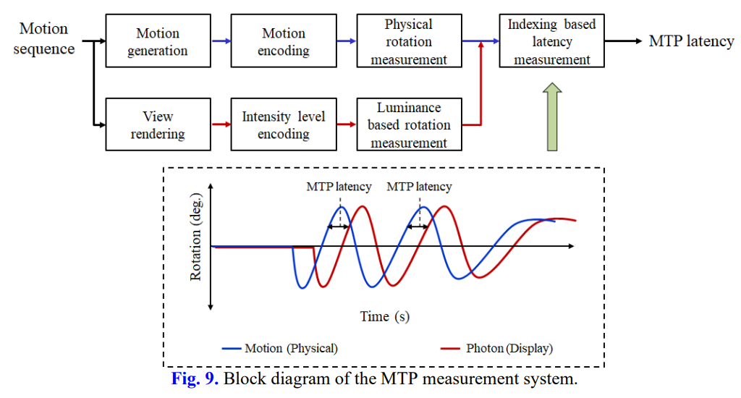

Slide 14
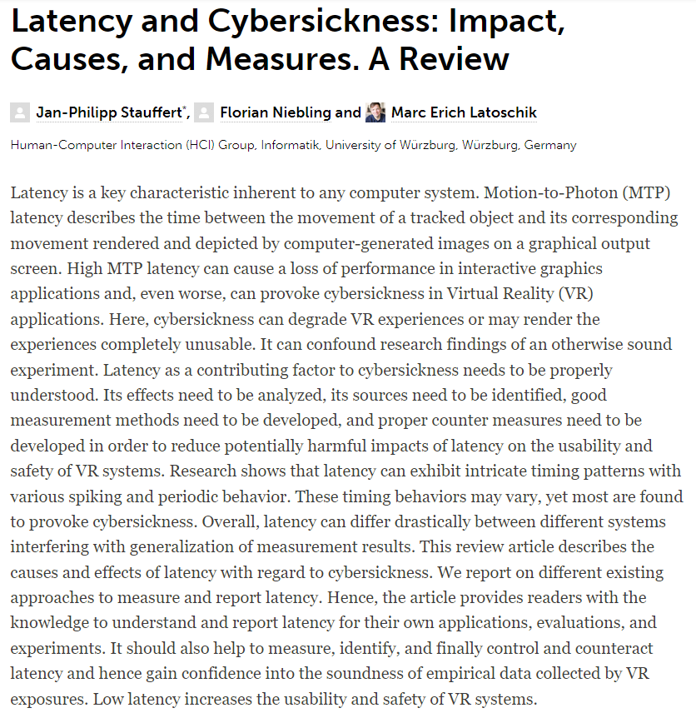
Notes:
https://www.frontiersin.org/articles/10.3389/frvir.2020.582204/full

Slide 15
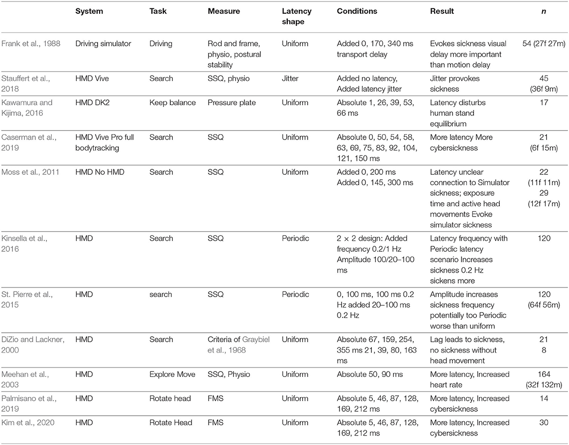
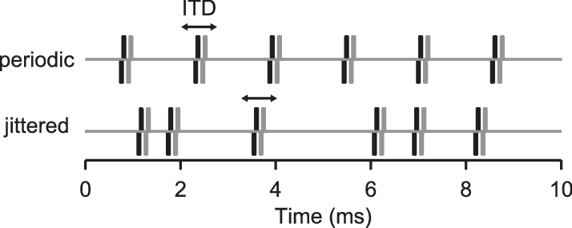
Research simulating latency that tested for a connection to cybersickness.

Slide 16
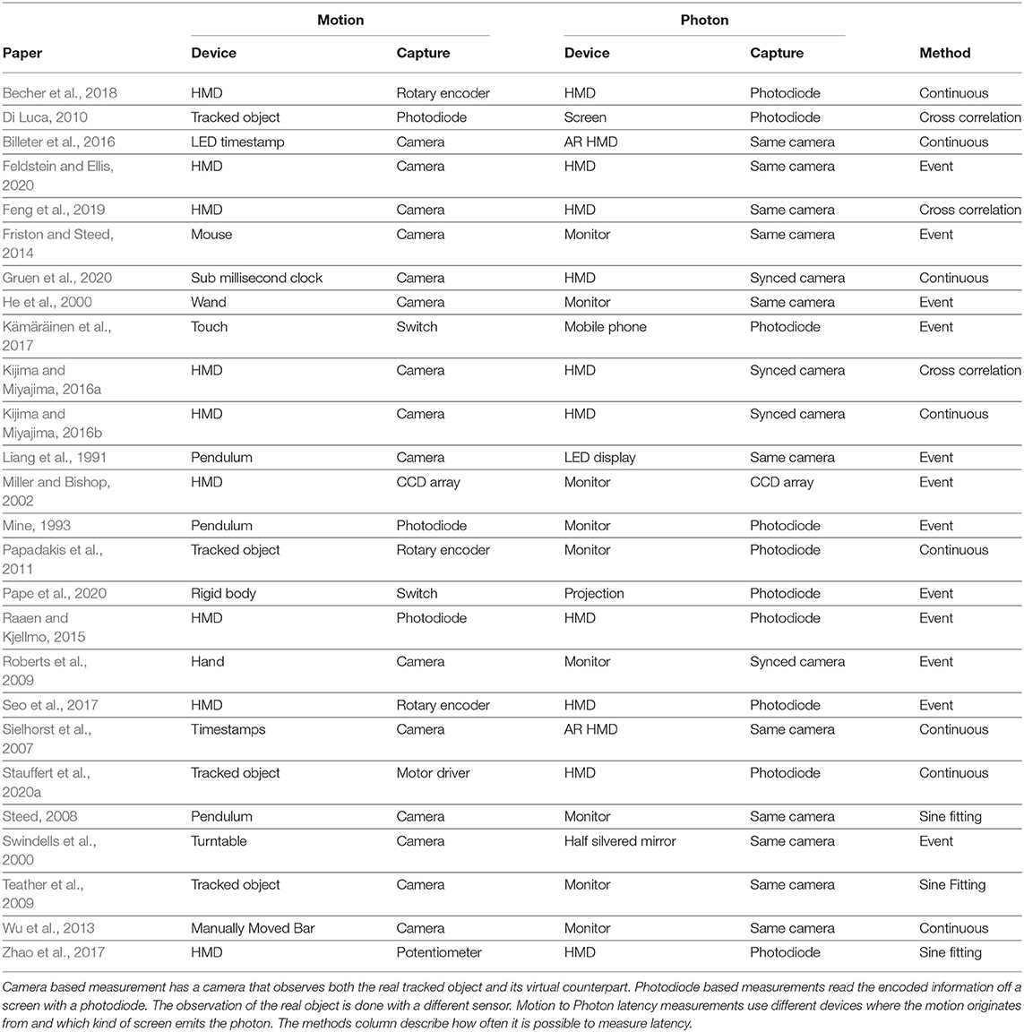

Slide 17
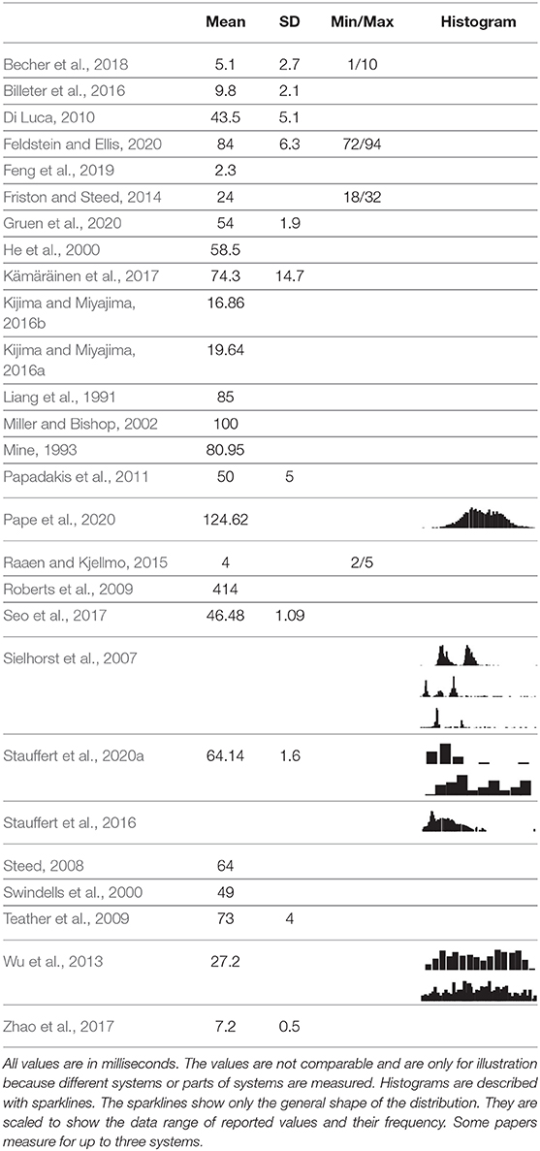
Table 3. Table summarizing how latency is reported in papers that propose latency measurement approaches.

Slide 18
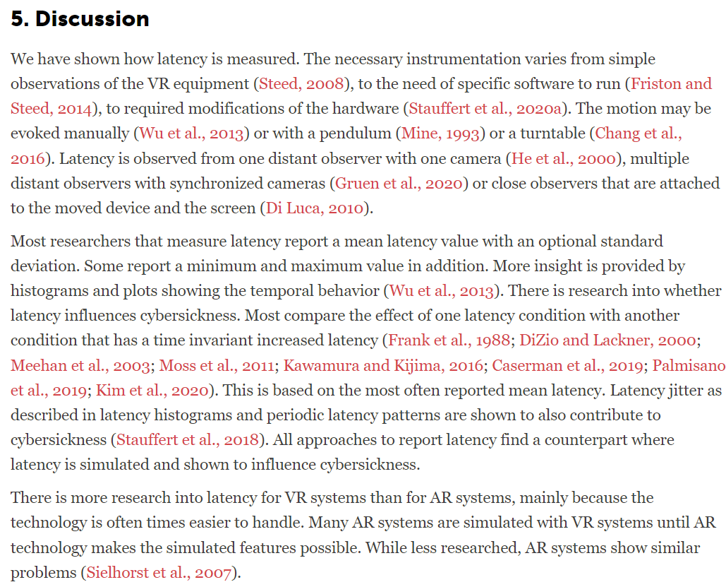

Slide 19
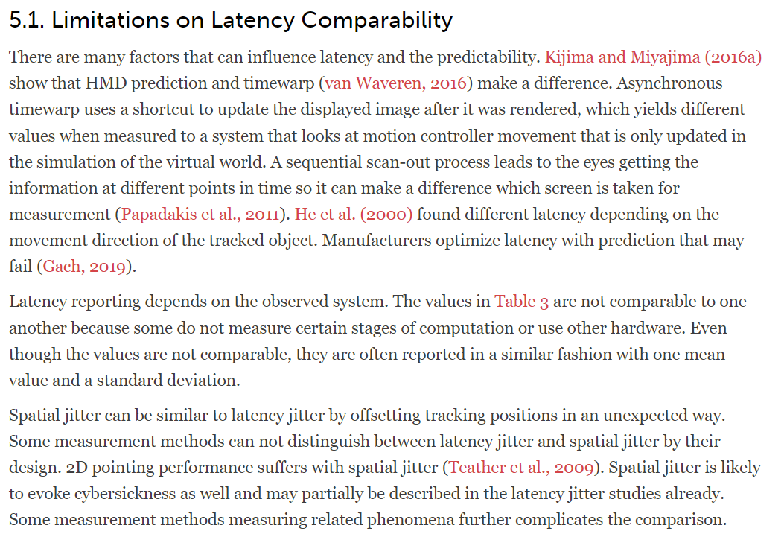

Slide 20
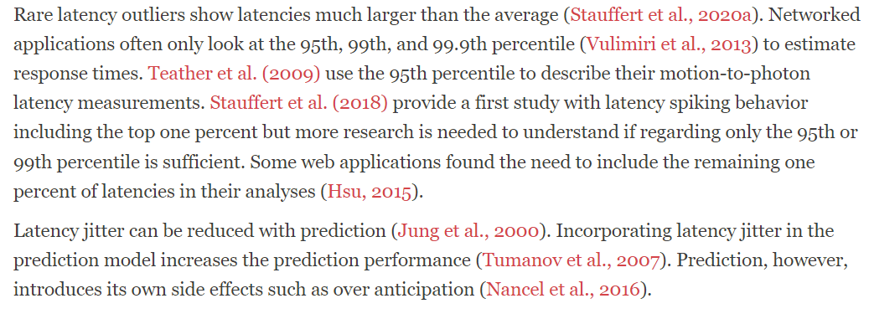

Slide 22
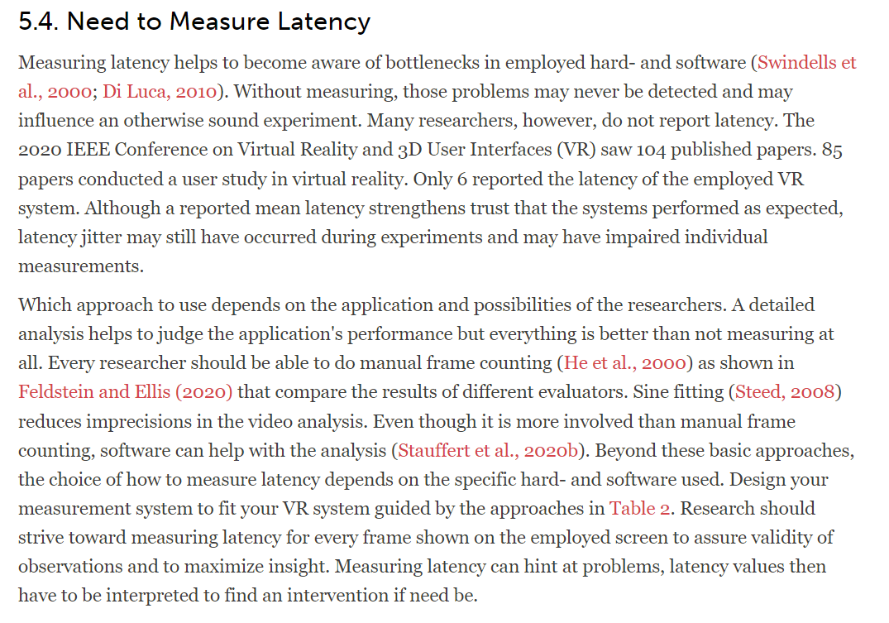

Slide 23
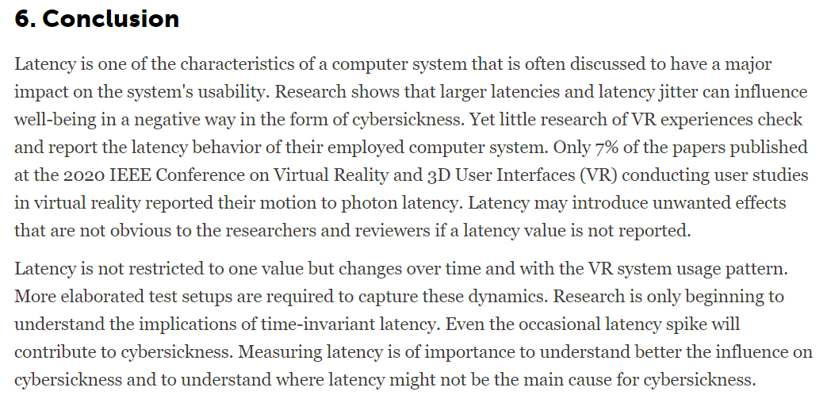

Slide 24
Thank You

